Slide 1
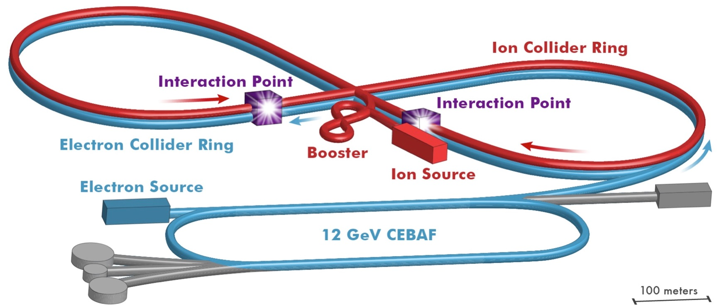
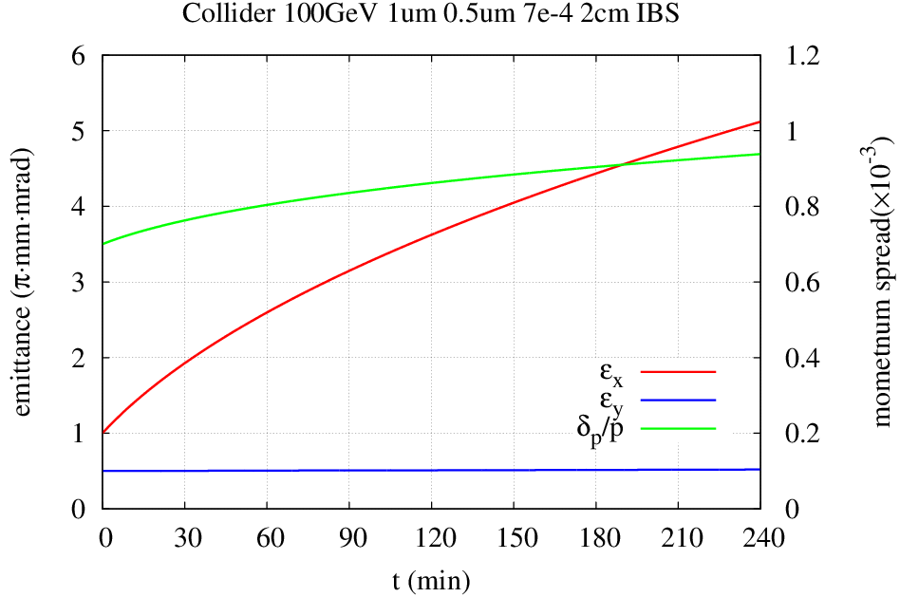
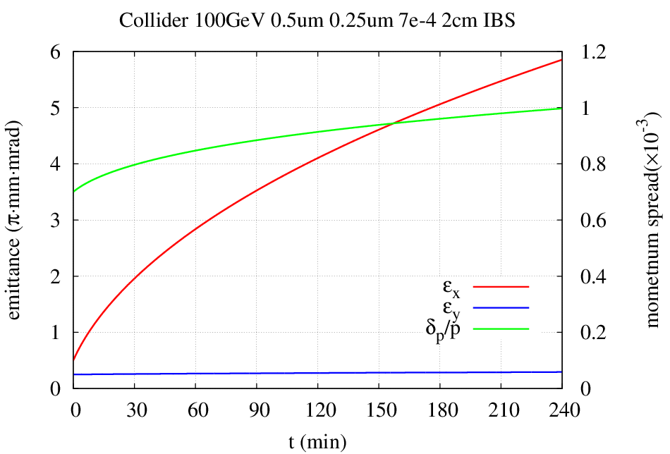
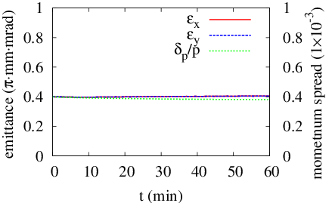
JLEIC Luminosity Without Cooling During Collision*
Yuhong Zhang and He Zhang, Jefferson Lab, Newport News, VA 23606, USA
Thomas Jefferson National Accelerator Facility, Newport News, Virginia, USA, Managed by the Jefferson Science Associates, LLC for the U.S. Department of Energy, Office of Science
Abstract The design strategy of Jefferson Lab electron-Ion Collider (JLEIC) for reaching high luminosities (>10³⁴ /cm²/s) is based on application of cooling of ion beams during collisions. This demands challenging R&D for development of advanced cooling technologies. Here we present an analysis of the JLEIC luminosity performance under the condition of no cooling of ion beams during collisions. We show the JLEIC integrated luminosity under this condition should exceed requirement of the EIC science program.
JLEIC for QCD Frontier
No Cooling During Collision
Adjusting IR Optics (β*) Dynamically for
Satisfying Beam-Beam and Aperture
Evolution of Instance Luminosity
Optimization without Cooling
Very Small Emittance Achieved By DC Cooling
Evolution of Instance Luminosity
8-100 GeV
Longitudinal IBS effect is modest ~20% growth in 2 h
240 min
240 min
3-10 GeV
120 min
150 min
180 min
210 min
Longitudinal IBS effect is modest
150 min
180 min
210 min
Linac
30 min
60 min
90 min
60 min
90 min
120 min
8 GeV
Vertical emittance has no growth
30 min
Vertical emittance has no growth
High Lumi.: High Bunch Repetition
If we start with 1 mm mrad (prepared by DC cooling)
IBS calculation by He Zhang’s code
If start with 0.5 / 0.25 µm (prepared by DC cooling)
Beam Design
High repetition rate
Low bunch intensity
Short bunch length
Small emittance
IBS calculation by He Zhang’s codes
IR Design
Very small β*
Crab crossing
Damping
Synchrotron radiation
Electron cooling
Initial emittance 1 and 0.5 µm
High contribution
8.8
8.4
6.2
Staged Electron Cooling
4.8
4.0
3.5
2.9
3.0
Ring | Functions | Kinetic energy (GeV / MeV) |  |  | Cooler type
 |  | Proton | Lead ion | Electron
booster ring | Accumulation of positive ions |  | 0.1 (injection) | 0.054 | DC
collider ring | Maintain emitt. during stacking | 7.9 (injection) | 2 (injection) | 4.3 (proton) 1.1 (lead) | DC
 | Pre-cooling for emitt. reduction | 7.9 (injection) | 7.9 (ramp to) | 4.3 | DC
 | Maintain emitt. during collision | Up to 100 | Up to 40 | Up to 54.5 | ERL
2.6
3.1
3.2
3.0
2.8
2.8
35 fb⁻¹
2.7
Beam Formation w/ Cooling
Ring refill time: 30 min
Baseline store time: 5 hrs
2.5
2.4
2.3
booster
collider Ring
Bunch splitting
BB cooling
Up to 100 GeV
Multi-turn injection accumulation
Stacking/Pre-cool
ERL cooler
Optimization: Frequent Dump/Refill Ion Collider Ring
7.9 GeV
285 MeV
DC cooler
proton
booster
collider Ring
Bunch splitting
BB cooling
4.6
2.8
Stacking, emittance preservation
Up to 40 GeV/u
3.8
Multi-turn injection accumulation
Pre-cool
ERL cooler
3.3
7.9 GeV
2.9
3.0
100 MeV/u
2 GeV
DC cooler
Lead ion
2.6
DC cooler
DC cooler
2.2
2.0
ERL-Circulator Cooler
Beam Reconditioning
Reconditioning time: should be 5 min or less
Ideally, ramp down/up ~ 1 minute
top-off << 1 seconds
DC cooling ~ a couple of mins,
Collision Energy
Ring refill time: 30 min
Baseline store: 5 hrs
Bunch Split
Collision
Bunch Merge
ERL ring
Circulator cooler ring
2.8
Energy ramp Up
reconditioning
Energy ramp down
Strong Cooling Cancels IBS
2.17
2.14
Injection Energy
 |  | IBS | ECOOL
R_{H} | 1/s | 4.7E-3 | -2.4E-3
R_{V} | 1/s | -1.7E-5 | -2.3E-3
R_{L} | 1/s | 1.2E-3 | -3.0E-3
Injection
About 24 fb⁻¹ per year assuming 6 month run
KE_{p}=100 GeV, I_{p}=0.5 A, I_{ec}=1.05 A
Conclusions
JLEIC integrated luminosity without strong bunched beam cooling during collision is still able to meet the EIC science requirement.
The JLEIC luminosity performances can be further improved with an optimized parameter set, and frequent dump/refill of the ion collider ring, and utilizing beam reconditioning.
H. Zhang. BetaCool
Dump and refill
On store,
~8 hours
* Work supported by U.S. DOE Contract No. DE-AC05-06OR23177.

