Slide 1
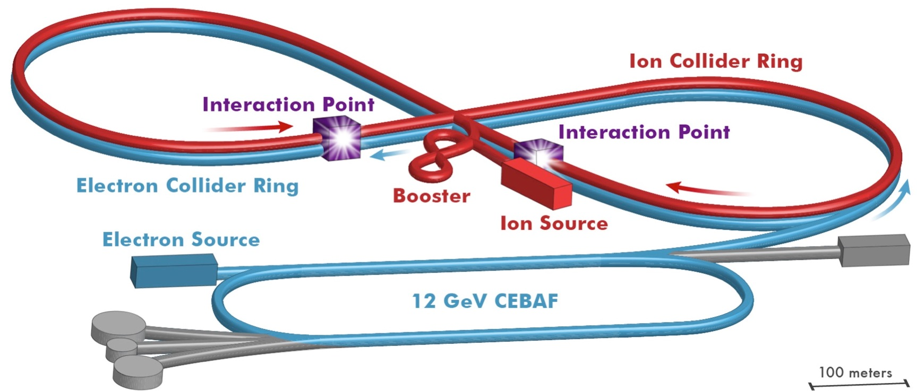
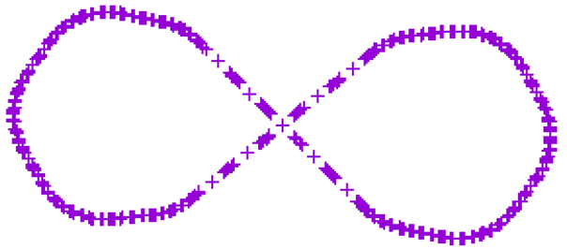
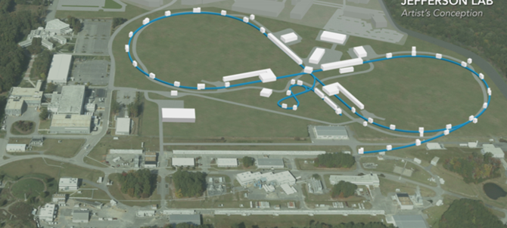
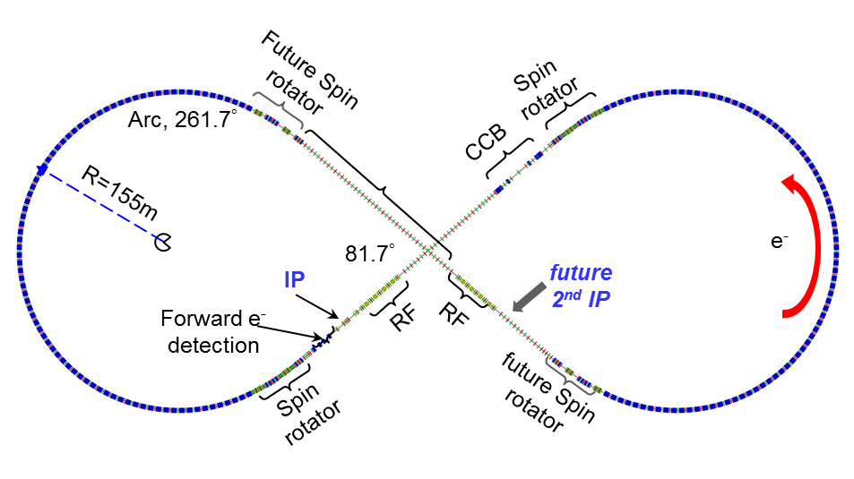
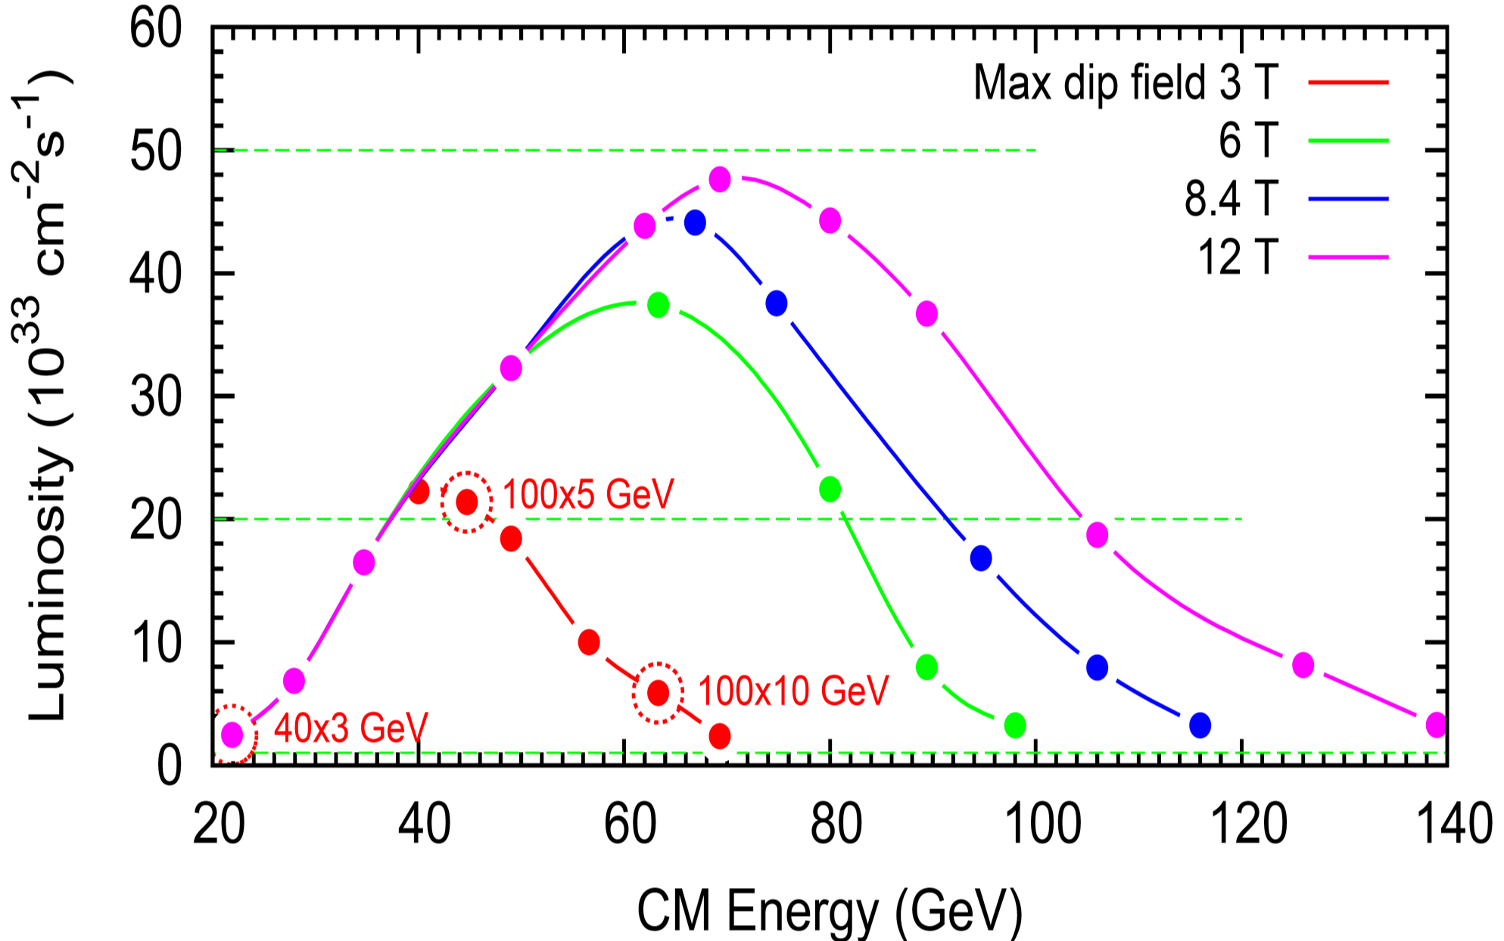
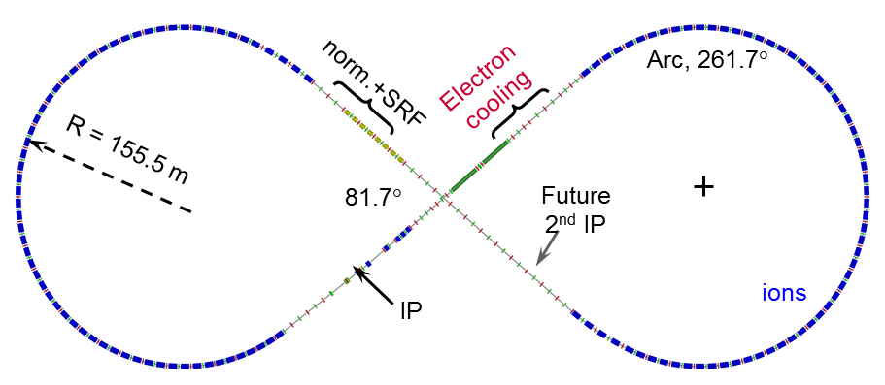
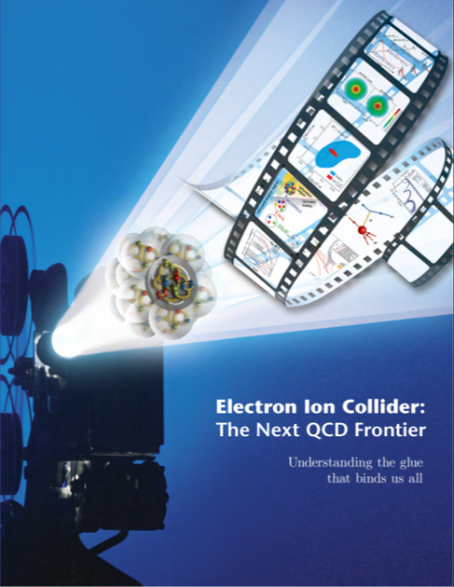
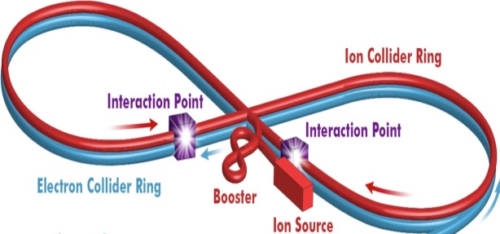
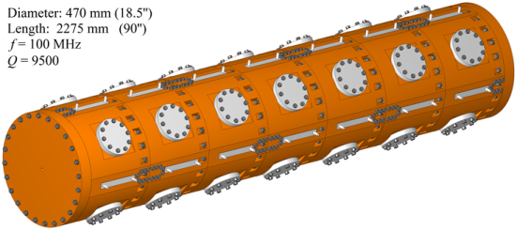
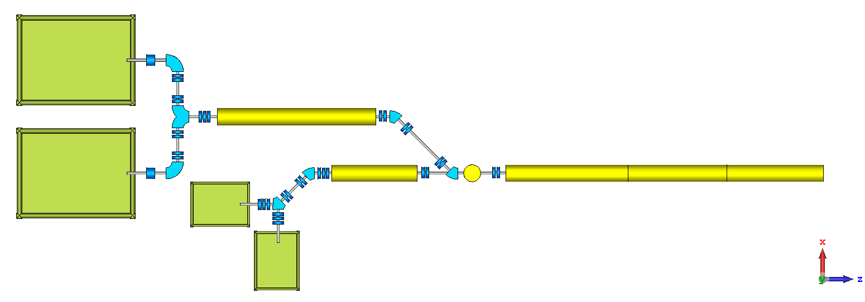
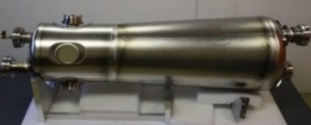
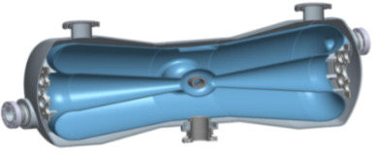
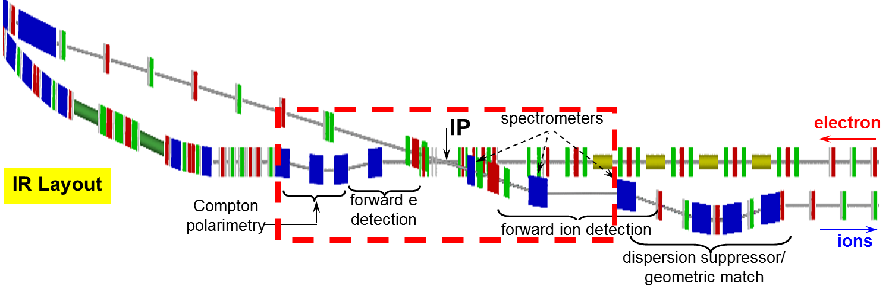
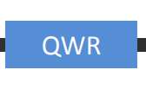
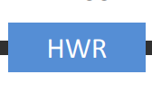
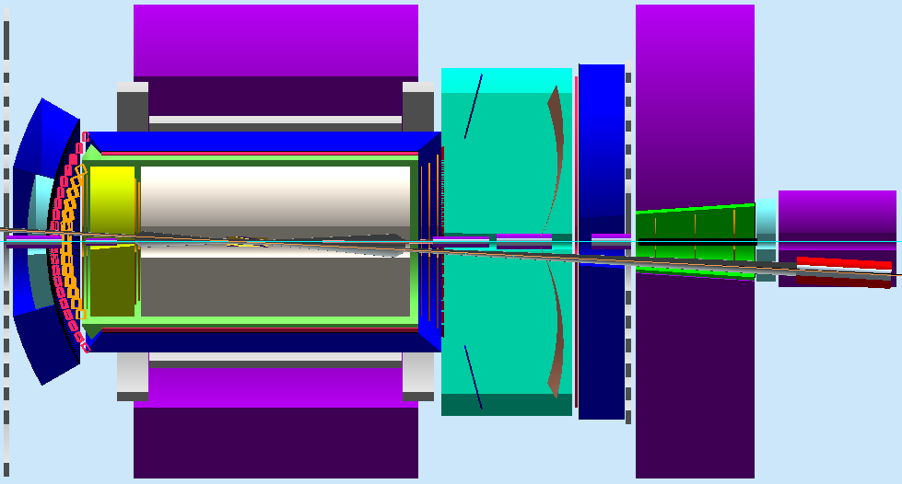
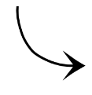
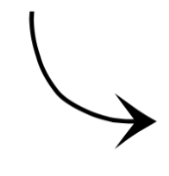
JLEIC Design*
Yuhong Zhang for JLEIC Team, Jefferson Lab, Newport News, VA 23606, USA
Thomas Jefferson National Accelerator Facility, Newport News, Virginia, USA, Managed by the Jefferson Science Associates, LLC for the U.S. Department of Energy, Office of Science
Abstract A polarized electron-ion collider with medium center-of-mass energy (20 to 100+ GeV) has been envisioned as a future accelerator facility for the QCD frontier. Over the last 15 years, Jefferson Lab has been engaged in a design study of such a collider (JLEIC) based on the existing CEBAF recirculated SRF electron linac. In this paper, we present a general discussion of optimization of the JLEIC design, particularly in certain areas that could be further exploit for enhancing the performance and for reducing the technical risk and project cost.
JLEIC for QCD Frontier
JLEIC is designed for delivering high luminosity, high polarization and full detector acceptance
The JLEIC design concept stable over the last 10 years
The implementation updated/optimized to enhance performance, mitigate technical risk and reduce costs
JLEIC Layout & on Site Map
Ion Booster Ring
Extraction energy: 8 GeV
Circumference: 313 m
Super-ferric magnets: 3 T,
fast ramping ~1 T/s
No transition crossing (γ_{T}~19)
8-100 GeV
High Luminosity Concept
Conventional approach for hadron colliders
Few colliding bunches➔ low bunch frequency
High bunch intensity ➔long bunch & large β*
JLEIC approach: high bunch repetition rate + short bunch colliding beams
A traditional approach for lepton colliders
(KEK-B reached > 2x10³⁴ /cm²/s)
JLEIC advantages
Based on CEBAF, already up to 1.5 GHz
New green field ion complex can be designed to deliver high bunch repetition rate
3-10 GeV
8 GeV
Linac
Collider Rings
Two rings have same footprint, stack vertically
Supports two IPs, horizontal crab crossing at IPs
 |  | p | e
Circum. | m | 2154
Crossing | deg | 81.7
Lattice |  | FODO
Dipole | m | 8 | 5.4
Quad | m | 0.8 | 0.45
Cell length | m | 22.8 | 15.2
Max. dipole | T | 3 | ~1.5
SR power | kW/m |  | 10
Transition γ_{tr} |  | 12.5 | 21.6
Beam Design
High repetition rate
Low bunch intensity
Short bunch length
Small emittance
IR Design
Very small β*
Crab crossing
Luminosity & Upgrade Potential
Damping Design
Synchrotron radiation
Electron cooling
Baseline
Upgrade to 100 GeV CM
Upgrade to 140 GeV CM
Upgrade to 115 GeV CM
(LHC SC magnet)
Staged Electron Cooling
Achieving very small emittance (order of magnitude reduction in all dimensions), short bunch length ~1 cm
Suppressing IBS induced emittance degradation
JLEIC: conventional electron cooling
Well established technology (in the low energy)
Figure-8 Ring for High Polarization
A brilliant invention of Dr. Ya. Derbenev
Enabled by a green field collider ring design
Spin precessions in the left & right parts of a figure-8 ring are exactly cancelled
-> net spin precession is zero → spin tune is zero
No cross of spin resonance during energy ramp
Spin can be controlled/stabilized by compact spin rotators (e.g., moving spin tune away from 0)
No need of Siberian Snakes
The only practical way to accelerate/store polarized deuterons in medium energy range
The electron ring follows the footprint of the ion ring, figure-8 helps the electron polarization under spin flip
JLEIC Baseline
Achieved Design Goals
Energy
Full coverage of CM energy from 15 to ~70 GeV
e: 3-12 GeV, p: up to 100 GeV, ions up to 40 GeV/u
Ion species
Polarized light ions: p, d, 3He, and possibly Li
Un-polarized light to heavy ions up to A above 200
Support 2 detectors with full acceptance capability
Luminosity
10³³ to 10³⁴ /cm²s/IP in a broad CM energy range,
Highest luminosity at CM energy around 45 GeV
Polarization
At IP: longitudinal for both, transverse for ions only
All polarizations >70%
Upgradable to higher CM energy (~150 GeV CM)
e: 14 GeV, p: up to 400 GeV, ions up to 160 GeV/u
Ring | Functions | Kinetic energy (GeV / MeV) |  |  | Cooler type
 |  | Proton | Lead ion | Electron
booster ring | Accumulation of positive ions |  | 0.1 (injection) | 0.054 | DC
collider ring | Maintain emitt. during stacking | 7.9 (injection) | 2 (injection) | 4.3 (proton) 1.1 (lead) | DC
 | Pre-cooling for emitt. reduction | 7.9 (injection) | 7.9 (ramp to) | 4.3 | DC
 | Maintain emitt. during collision | Up to 100 | Up to 40 | Up to 54.5 | ERL
Consistent with the EIC White Paper
ERL-Circulator Cooler
S
B
S
B
Figure-8 synchrotron
Conventional synchrotron
ERL ring
Circulator cooler ring
B
Beam Formation w/ Cooling
Spin precession/tune is energy dependent
Cross spin resonances during acceleration
Siberian Snake may help
Spin precessions in left and right ring are cancelled ➔ Spin turn is zero (energy independent)
New Ion Injector
booster
collider Ring
Bunch splitting
BB cooling
Up to 100 GeV
Multi-turn injection accumulation
Stacking/Pre-cool
ERL cooler
7.9 GeV
Baseline e-p Parameters
285 MeV
DC cooler
proton
CM energy | GeV | 21.9 (low) |  | 44.7 (medium) |  |  | 63.3 (high)
 |  | p | e | p |  | e | P | e
Beam energy | GeV | 40 | 3 | 100 |  | 5 | 100 | 10
Collision frequency | MHz | 476 |  | 476 |  |  | 476/4=119
Particles per bunch | 10¹⁰ | 0.98 | 3.7 | 0.98 | 3.7 |  | 3.9 | 3.7
Beam current | A | 0.75 | 2.8 | 0.75 | 2.8 |  | 0.75 | 0.71
Polarization | % | 80 | 80 | 80 | 80 |  | 80 | 75
Bunch length, RMS | cm | 3 | 1 | 1 | 1 |  | 2.2 | 1
Norm. emitt., (x/y) | μm | 0.3 | 24/24 | 0.5/0.1 | 54/10.8 |  | 0.9/0.18 | 432/87
Horiz. & vert. β* | cm | 8/8 | 13.5 | 6/1.2 | 5.1/1 |  | 10.5/2.1 | 4/0.8
Vert. beam-beam |  | 0.015 | 0.09 | 0.015 | 0.068 |  | 0.008 | 0.034
Laslett tune-shift |  | 0.06 |  | 0.055 |  |  | 0.056
Detector space, u/d | m | 3.6/7 | 3.2/3 | 3.6/7 | 3.2/3 |  | 3.6/7 | 3.2/3
Hourglass reduct. |  | 1 |  | 0.87 |  |  | 0.75
Lumi/IP, w/HG, 10³³ | cm⁻²s⁻¹ | 2.5 |  | 21.4 |  |  | 5.9
booster
collider Ring
Bunch splitting
BB cooling
Stacking, emittance preservation
Up to 40 GeV/u
Ion Linac
Multi-turn injection accumulation
Pre-cool
ERL cooler
7.9 GeV
100 MeV/u
2 GeV
DC cooler
Lead ion
ECR-IS
HI-RFQ
Options for RFQ: 4-vane bolted
DC cooler
DC cooler
EBIS
LI-RFQ
IH-DTL
Interaction Regions
Designed to satisfy geometric match (elements) and beam dynamics (chromatic compensation)
Crab crossing: large (50 mrad), avoiding parasitic collisions, optimizing detections
Polarized
Source
Un-polarized
Source
QWR
280 MeV protons
100 MeV/u Pb
βG=0.15
βG=0.3
HWR
JLEIC Collaboration: S. Benson, G. Biallas, A. Bogacz, P. Brindza, A. Camsonne, P. Degtyarenko, E. Daly, Ya. Derbenev, M. Diefenthaler, K. Deitrick, D. Douglas, R. Ent, R. Fair, Y. Furletova, R. Gamage, D. Gaskell, R. Geng, P. Ghoshal, J. Grames, K. Jorden, J. Guo, F. Hanna, L. Harwood, T. Hiatt, H. Huang, A. Hutton, C. Hutton, K. Jordan, A. Kimber, D. Kashy, G. Krafft, R. Lessiter, R. Li, F. Lin, M. Mamum, F. Marhauser, R. McKeown, T. Michalski, V. Morozov, E. Nissen, G. Park, H. Park, M. Poelker, T. Powers, R. Rajput-Ghoshal, R. Rimmer, Y. Roblin, T. Satogata, M. Spata, R. Suleiman, A. Sy, C. Tennant, H. Wang, S. Wang, G. Wei, C. Weiss, M. Wiseman, R. Yoshida, H. Zhang, S. Zhang, Y. Zhang, JLab; F. Pilat, ORNL ; Y. Cai, Y. Nosochkov, G. Stupakov, M. Sullivan, C. Tsai, M. Wang, SLAC; M. Blaskiewicz, H. Huang, Y. Luo, Q. Wu, F. Willeke, BNL; J. Qiang, G. Sabbi, LBNL; Z. Conway, S. Manikonda, B. Mustapha, U. Wienands, A. Zholents, ANL; D. Barber, DESY; Y. Hao, P. Ostroumov, A. Plastun, R. York, Michigan State University; S. Abeyratne, B. Erdelyi, Northern Illinois Univ..; Z. Zhao, Duke Univ.; J. Delayen, C. Hyde, S. De Silva, S. Sosa, B. Terzic, Old Dominion Univ.; J. Gerity, T. Mann, P. McIntyre, N. Pogue, A. Sattarov, Texas A&M Univ.; P. Nadel-Turonski, Stony Brook Univ.,; V. Dudnikov, R. Johnson, Muons, Inc.; D. Abell, D. Bruhwiler, Radiasoft; G. Bell, J. Cary, I. Pogorelov, Tech-X Corp..; A. Kondratenko, M. Kondratenko, Sci. & Tech. Laboratory Zaryad, Russia; Yu. Filatov, Moscow Institute of Physics and Technology, Russia; Y. Huang, X. Ma, L. Mao, Y. Yuan, H. Zhao, H.W. Zha, IMP, China; S. Ahmed, K. Beard, A. Castilla, Y. Chao, P. Chevtsov, L. Merminga, H. Sayed, B. Yunn, Gone but not forgotten
Central detector/solenoid
EIC Detection
Central Detector
Ion beamline
Scattered Electron
Electron beamline
Dipole
Dipole
Forward (Ion) Detector
Particles Associated with struck parton
Particles Associated
with Initial Ion
* Work supported by U.S. DOE Contract No. DE-AC05-06OR23177.

