Slide 1
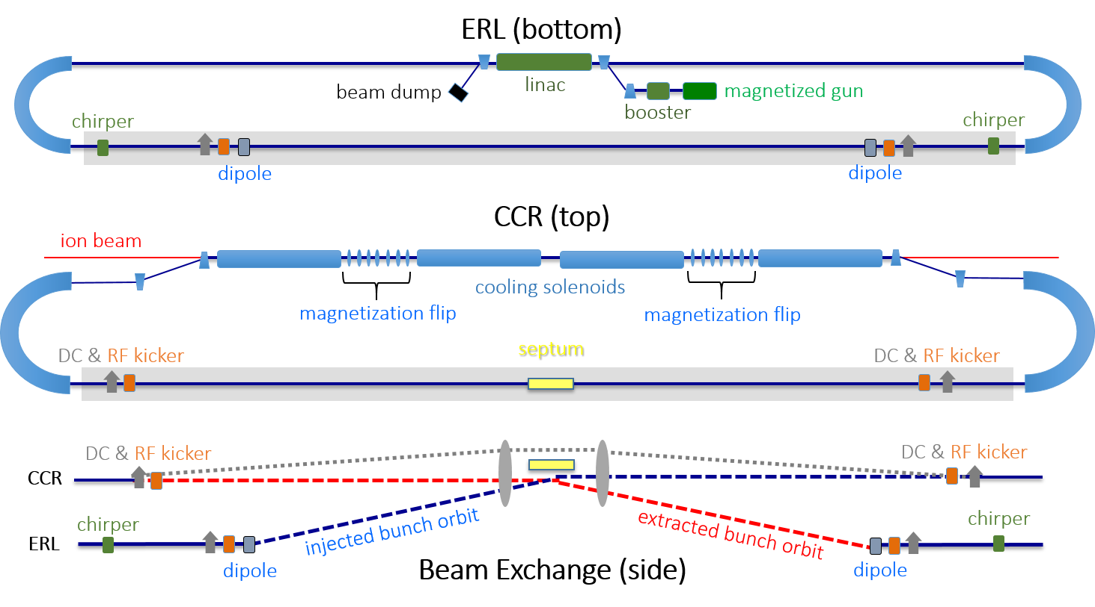
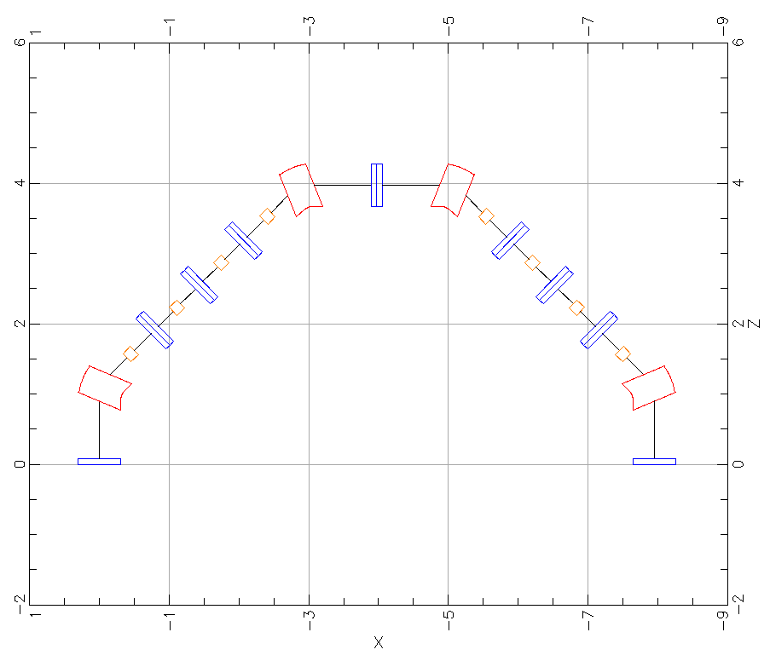
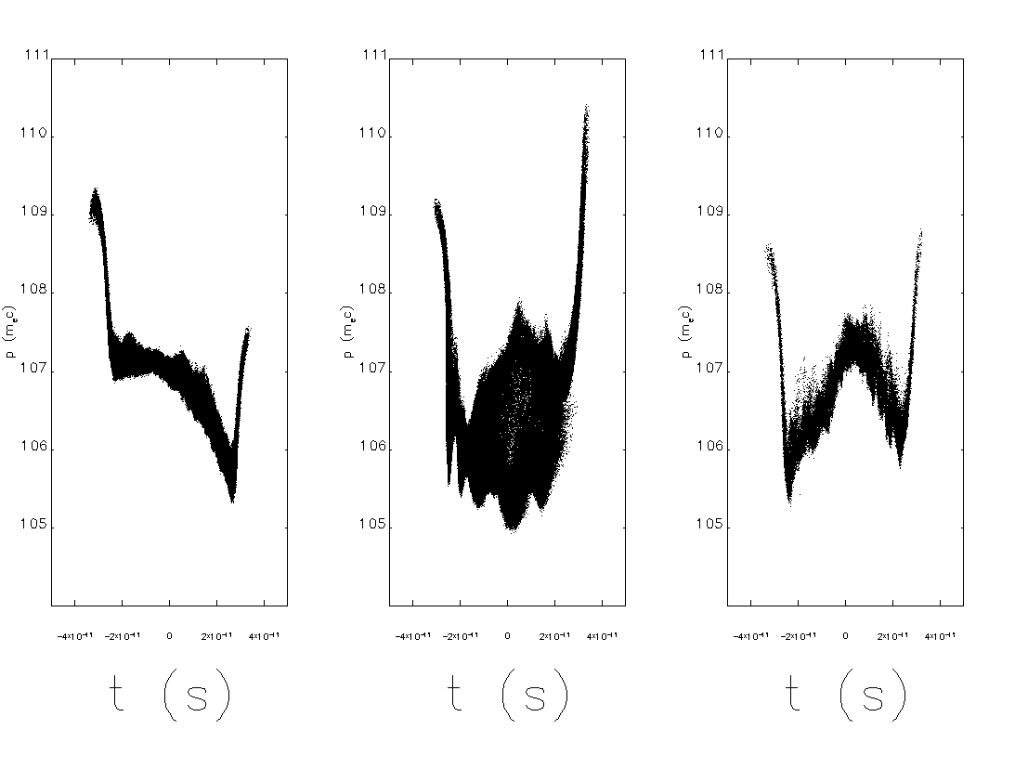
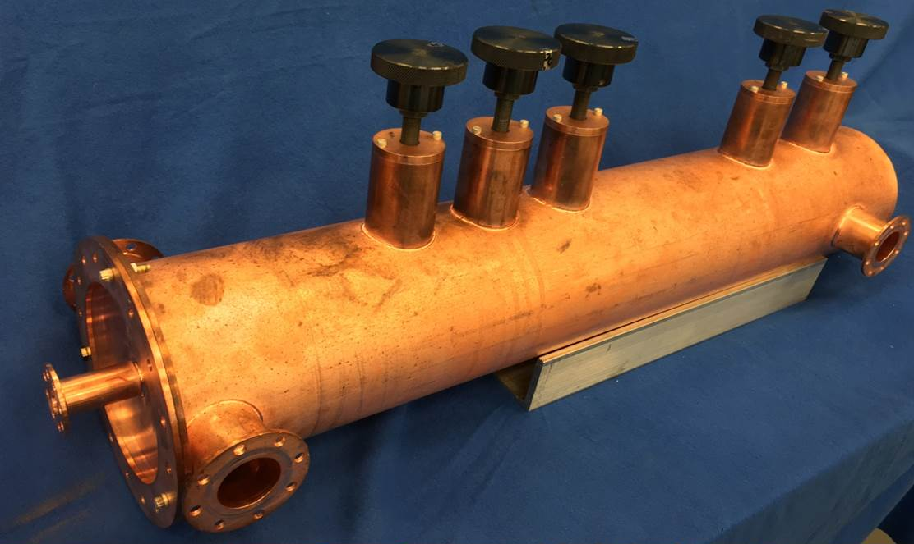
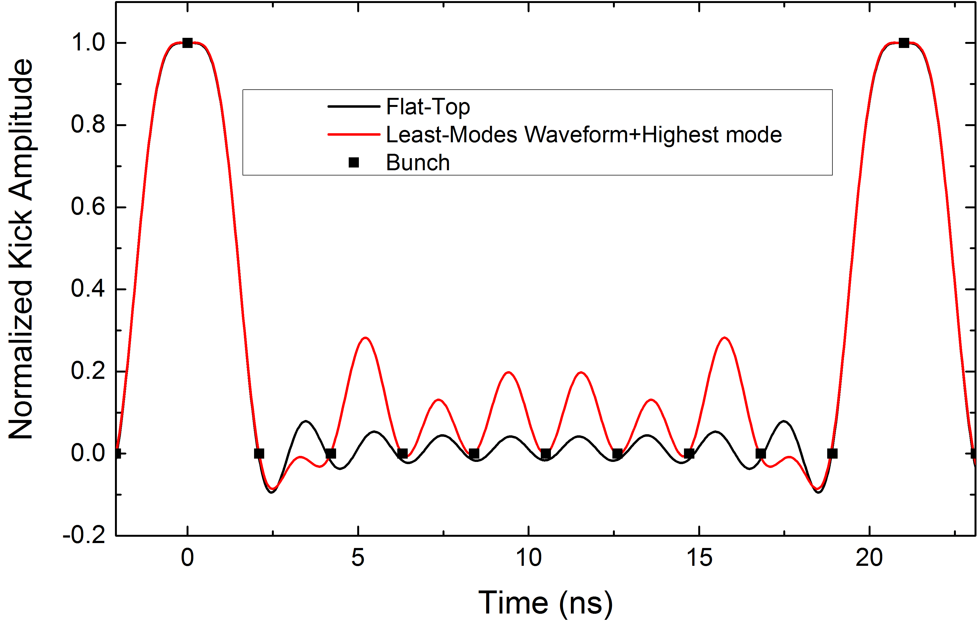
DEVELOPMENT OF A BUNCHED BEAM ELECTRON COOLER FOR THE JEFFERSON LAB ELECTRON-ION COLLIDER *
Stephen Benson†, Slava Derbenev, David Douglas, Fay Hannon, Andrew Hutton, Rui Li, Bob Rimmer, Yves Roblin, Chris Tennant, Haipeng Wang, He Zhang, Yuhong Zhang,
Jefferson Lab, 12000 Jefferson Avenue, Newport News, Virginia, USA
Abstract
Jefferson Lab is in the process of designing an electron ion collider with unprecedented luminosity at a 65 GeV center-of-mass energy. This luminosity relies on ion cooling in both the booster and the storage ring of the accelerator complex. The cooling in the booster will use a conventional DC cooler similar to the one at COSY. The high-energy storage ring, operating at a momentum of up to 100 GeV/nucleon, requires novel use of bunched-beam cooling. We will present a new design for a Circulator Cooler Ring for bunched-beam electron cooling. This requires the generation and transport of very high-charge magnetized bunches, acceleration of the bunches in an energy recovery linac, and transfer of these bunches to a circulating ring that passes the bunches 11 times through the proton or ion beam inside cooling solenoids. This design requires the suppression of the effects of space charge and coherent synchrotron radiation using shielding and RF compensation.
*Authored by Jefferson Science Associates, LLC under U.S. DOE Contract No. DE-AC05-06OR23177
Recirculated Beam
Injector Cryomodule
Injected Beam
Septum Magnet
RF Separator with Superposed Magnetic Field
ERL Cryomodule
Fig. 1b: Injector Layout
Figure 1c: RF merger concept
Circulating Cooling Ring (CCR)
The challenge of the CCR is to bend the beam through 22 arcs while preserving the beam quality and magnetization. We have looked at several different arc designs. In general, the arc should have the following properties:
Isochronous and Achromatic.
High periodicity with rational tune
Moderate size
Local axial symmetry
Local isochronicity⬄small compaction oscillations (for µBI)
Local dispersion suppression
In addition, the CCR as a whole must have no tune resonances beyond the coupling resonance.
One arc that seems to have good properties, especially low microbunching gain, is a simple four bend arc shown in figure 2. Note that the microbunching instability (µBI) gain must be no greater than unity or the net gain after 22 arcs will be quite large.
Figure 1a: Layout of the Circulating Cooler Ring (CCR) concept. The ion ring is cooled by a magnetized beam circulating for 11 passes of the CCR laying atop and fed by an Energy Recovery Linac (ERL) producing and recovering high charge, magnetized bunches at a 43.3 MHz repetition rate.
System Layout
Though this arc does possess excellent microbunching properties, it does not eliminate CSR wakes altogether. Beam chamber shielding may be used to reduce the strength of the longitudinal CSR wake. The core beam will also lose energy and develop an energy chirp but this can be compensated via an RF cavity in the CCR. Space charge forces are comparable to the longitudinal CSR wakes. The longitudinal distribution after 10 passes is shown in figure 3. Even though the microbunching gain is small, the correlated energy spread is much larger than the specification in table 1.
The baseline layout is show in figure 1. A high charge electron beam source provides magnetized beam to a booster that accelerates this beam to over 5 MeV. The electrons are then matched through a merger to the linac. The superconducting linac accelerates the beam off-crest to anywhere between 20 and 55 MeV. The first arc then transports the beam to the exchange region, where the beam is kicked up into the CCR via a septum and harmonic kicker. After circulating through the cooler and two recirculation arcs 11 times, the beam then exits the CCR via another harmonic cavity and septum. At this point the beam is bent back into the linac to be decelerated to the dump energy, where it is ejected into a water-cooled beam dump.
dipole
quadrupole
sextupole
System Requirements
Figure 2: Layout of a simple arc. This design has global but not local symmetry.
Exchange Region
As described in more detail in reference [1, MOPML003], Jefferson Lab is designing an electron-ion collider with unprecedented luminosity. The baseline design features a low emittance proton or ion beam with high frequency, low charge bunches at an energy of 40 to 100 GeV. To maintain the low emittance, it is necessary to aggressively cool the beam. We have chosen incoherent magnetized electron beam cooling as the most cost effective and low risk approach to cooling the full-energy beam [2, 3, TUPAL070]. This paper describes the initial design of such a cooler and describes some of the design challenges that must be met in the cooler ring.
Table 1. Electron cooler specifications
To bring in the 43.3 MHz bunches to the CCR and then eject them after 11 passes a combination of a harmonic kicker and a septum will be used. The beam will be bent upwards to the level of the CCR and then brought almost parallel to the CCR using a septum magnet [6]. The harmonic kicker will then kick the beam parallel to the CCR [7, TUPAL068].
The upstream and downstream harmonic kickers are 180° of betatron phase apart so that their time dependent effects are cancelled.
Parameter | Value
Energy |  | 20–55 MeV
Charge |  | 3.2 nC
CCR pulse frequency |  | 476.3 MHz
Gun frequency |  | 43.3 MHz
Bunch length (tophat) |  | 2 cm (23°)
Thermal emittance |  | <19 mm-mrad
Cathode spot radius |  | 2.2 mm
Cathode field |  | 0.1 T
Gun voltage |  | >400 kV
Norm. hor. drift emittance |  | 36 mm-mrad
rms Eng. spread (uncorr.) |  | 3x10⁻⁴
Energy spread (p-p corr.) |  | <6x10⁻⁴
Solenoid field |  | 1 T
Electron beta in cooler |  | 36 cm
Solenoid length |  | 4x15 m
Figure 3: Longitudinal phase space after 10 turns through the CCR with the simple arc. (L) no shielding or csr drift. (C) no shielding. (R) no csr drift.
Figure 4. Harmonic Beam Kicker. A first 952.6 MHz copper cavity has been prototyped, bench measured, and satisfies beam dynamic requirements for the CCR.
To reduce the current required from the linac we use a Circulating Cooler Ring (CCR) that circulates the high charge bunches 11 times through the cooler before returning them to the ERL. This hybrid of an ERL and a storage ring combines the best feature of the ERL (high brightness) with that of the storage ring (high current). We summarize the specifications in table 1.
Conclusions
We have developed a design for a bunched beam cooler for an electron ion collider. A separate presentation covers the DC coolers used at low energy [8, TUPAL071]. Though conservative in its choice of technologies and designs, the parameters are significantly beyond the state-of-the-art for ERLs. We will be testing out some aspects of the design in experimental tests in the coming years. One Challenge is the existence of simulation codes that work in this parameter regime [9, THPAK129].
Injector
The injector must provide bright, high charge bunches and preserve the magnetization of the beam. [4, THPMK107].
The beam must then be merged with the decelerating beam in the ERL. We are looking at several different designs:
A toroidal field merger similar to those used in DC coolers [5, THPAK127 ].
A magnetic merger using indexed dipoles.
An RF merger that kicks the energy recovered beam but not the injected beam.
An RF merger that uses the RF focussing in the linac module to merge the two beams.
Both DC photocathode guns and low frequency normal conducting photocathode guns are being considered. The RF guns provide higher gradients at the cathode and can provide higher energy from the gun but may introduce RF focussing effects.
References
[1] Y. Zhang, “On JLEIC Design”, in IPAC’18, Vancouver, Canada, May 2018, MOPML003.
[2] G. I. Budker and A. N. Skrinsky, Sov. Phys. Usp. 21, 277 (1978).
[3] Y. Zhang, and Y. Derbenev, “JLEIC Ion Beam Cooling Studies”, in IPAC’18, Vancouver, Canada, May 2018, -TUPAL070.
[4] F. E. Hannon., “Design of a High Charge, Low Energy, Magnetized Electron Injector”, in IPAC’18, Vancouver, Canada, May 2018, THPMK107.
[5] A. Sy, “Toroidal Merger Simulations for the JLEIC Bunched Beam Electron Cooler Ring”, in IPAC’18, Vancouver, Canada, May 2018, THPAK127.
[6] D.R. Douglas, C.D. Tennant, and S.V. Benson, “ERL⬄CCR Beam Exchange Region Design Revision 1.0”, JLAB-TN-17-012, 24 March 2017.
[7] G.-T. Park., J. Guo, R. Rimmer, H. Wang, S. Wang, S. A. Overstreet, “New Design and Improvement of Harmonic Kicker Cavity for the JLEIC CCR/ERL Cooler”, in IPAC’18, Vancouver, Canada, May 2018, TUPAL068.
[8] Y. Zhang, and Y. Derbenev, “JLEIC DC Cooler”, in IPAC’18, Vancouver, Canada, May 2018, Vancouver, Canada, May 2018, TUPAL071.
[9] C. Tennant, “Modeling Challenges for Energy Recovery Linacs With Long, High Charge Bunches”, in IPAC’18, Vancouver, Canada, May 2018, THPAK129.

