Slide 1

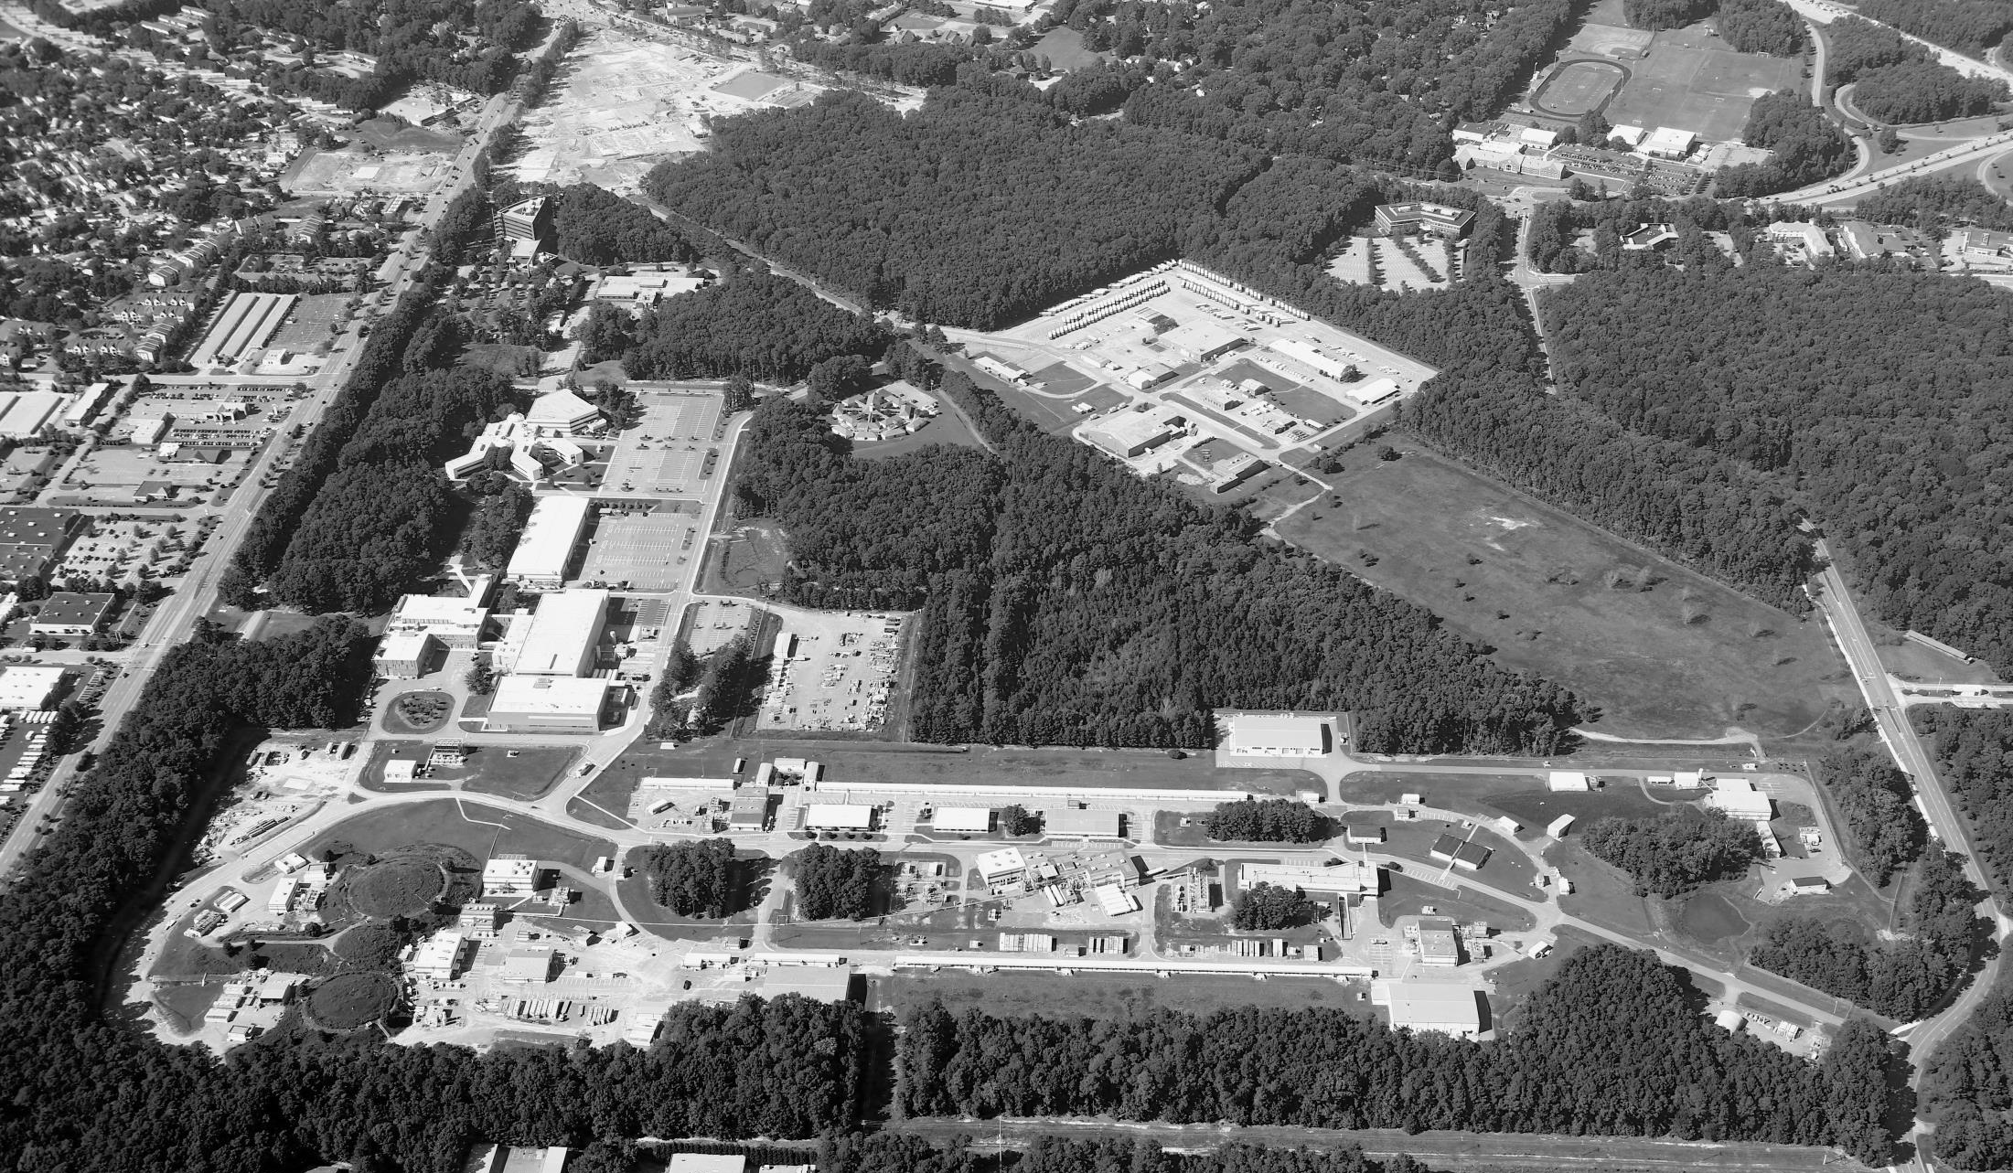
Design of the Polarized Medium-energy Electron Ion Collider (MEIC) at Jefferson Lab
Fanglei Lin for JLab’s MEIC Study Group
IPAC’15, Richmond
May 5, 2015

Slide 2
MEIC Study Group
A. Bogacz, P. Brindza, A. Camsonne, E. Daly, Ya.S. Derbenev, D. Douglas, R. Ent, D. Gaskell, R. Geng, J. Grames, J. Guo, L. Harwood, A. Hutton, K. Jordan, A. Kimber, G. Krafft, R. Li, F. Lin, T. Michalski, V.S. Morozov, P. Nadel-Turonski, F. Pilat, M. Poelker, R. Rimmer, Y. Roblin, T. Satogata, M. Spata, R. Suleiman, A. Sy, C. Tennant, H. Wang, S. Wang, H. Zhang, Y. Zhang, Z. Zhao, Thomas Jefferson National Accelerator Facility (JLab), Newport News, VA 23606 USA
D.P. Barber, Deutsches Elektronen-Synchrotron (DESY), 22607 Hamburg, Germany
A. Kondratenko, M. Kondratenko, Sci. & Tech. Laboratory Zaryad, Novosibirsk, Russia
Yu. Filatov, Moscow Institute of Physics and Technology, Dolgoprydny, and Joint Institute for Nuclear Research, Dubna, Russia
P. N. Ostroumov, Argonne National Laboratory, Argonne, IL 60439 USA
S. Abeyratne, B. Erdelyi, Northern Illinois University, DeKalb, IL 50115 USA
A. Castilla, J. Delayen, C. Hyde, K. Park, Old Dominion University, Norfolk, VA 23529 USA
Y. Cai, Y.M. Nosochkov, M. Sullivan, M-H Wang, U. Wienands, SLAC National Accelerator Laboratory, Menlo Park, CA 94305 USA
J. Gerity, T. Mann, P. McIntyre, N.J. Pogue, A. Sattarov, Texas A&M University, College Station, TX, USA

Slide 3
Outline
Science highlights and design strategies for the MEIC at JLAB
  MEIC baseline design
    Machine complex
    Detector integration
    Chromaticity compensation
    Crab crossing
    Electron cooling
    Polarization
    Machine performance
    Overview of R&D
Conclusions

Slide 4
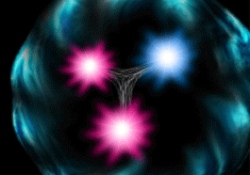
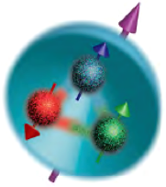
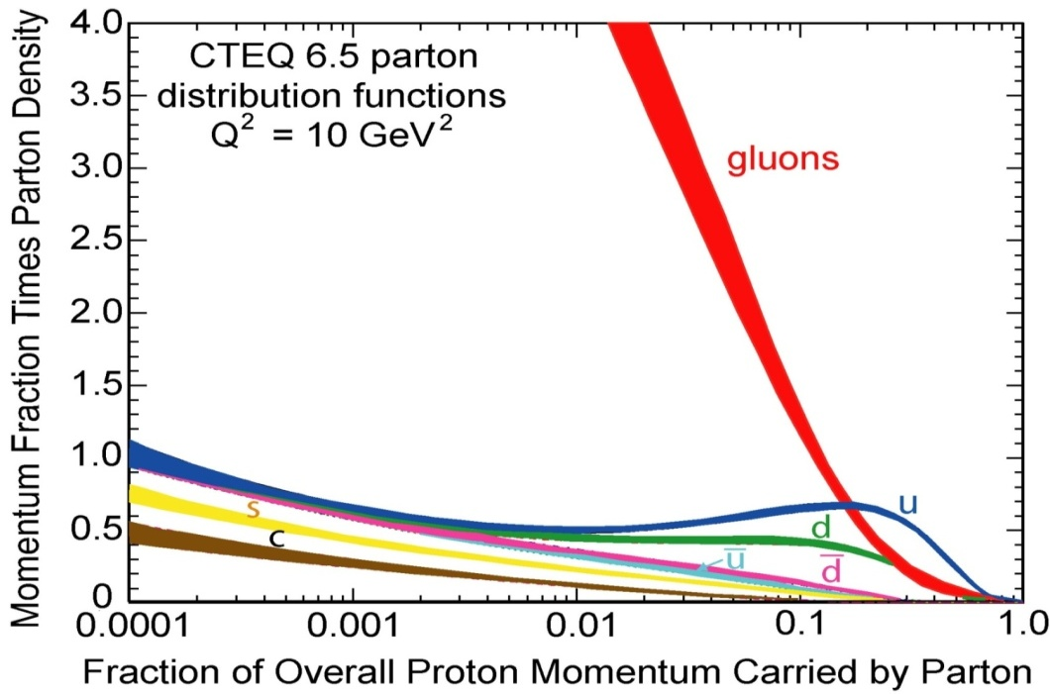
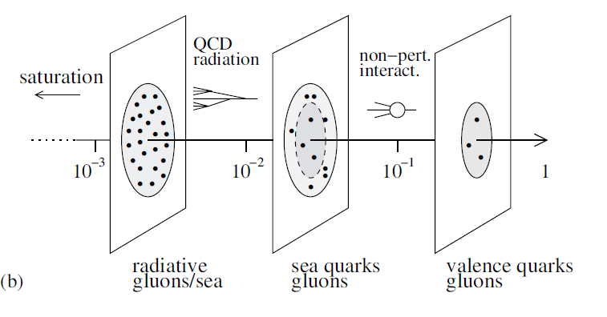
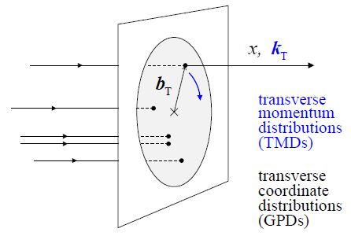
EIC Physics Highlights
An EIC aims to study the sea quark and gluon-dominated matter
  3D structure of nucleons and nuclei is not trivial
  Gluon dynamics plays a large role in proton spin
  Gluons in nuclei (splitting/recombining)
Need luminosity, polarization and good acceptance to detect spectator & fragments
JLab
12 GeV
Stage I (MEIC)
Stage I+II (MEIC + EIC)

Slide 5
MEIC Design Goals
Energy
  Full coverage of center-of-mass energy √s from 15 to 65 GeV
  Electrons 3 -10 GeV, protons 20 -100 GeV, ions 12 - 40 GeV/u
Ion species
  Polarized light ions: p, d, ³He, and possibly Li
  Un-polarized light to heavy ions up to A above 200 (Au, Pb)
2 detectors
  Full acceptance is critical for the primary detector
Luminosity
  10³³ to 10³⁴ cm⁻²s⁻¹ per IP in a broad CM energy range
Polarization
  At IP: longitudinal for both beams, transverse for ions only
  All polarizations >70%
Upgrade to higher energies and luminosity possible
  20 GeV electron, 250 GeV proton, and 100 GeV/u ion
  Design goals consistent with the White Paper requirements

Slide 6
Design Strategy for High Luminosity
The MEIC design concept for high luminosity is based on high bunch repetition rate CW colliding beams
KEK-B already reached above 2x10³⁴ /cm²/s
Beam Design
High repetition rate
Low bunch charge
Short bunch length
Small emittance
“Traditional” hadrons colliders
Small number of bunches
Small collision frequency f
Large bunch charge n₁ and n₂
Long bunch length
Large beta-star
IR Design
Small β*
Crab crossing
Damping
Synchrotron radiation
Electron cooling
Linac-Ring colliders
Large beam-beam parameter for the electron beam
Need to maintain high polarized electron current
Need High energy/current ERL

Slide 7
Design Strategy for High Polarization
Figure-8 shape has been chosen for all rings with the goal of achieving high ion and electron polarization
  Spin precession in one arc is exactly cancelled in the other
  Zero spin tune independent of energy
  Spin control and stabilization with small solenoids or other compact spin rotators
Advantage 1: Efficient preservation of ion polarization during acceleration
  Energy-independent spin tune
  High polarization of all light ions
Advantage 2: Ease of spin manipulation
  Any desired polarization orientation at the IP
  Spin flip
Advantage 3: A simple way to accommodate polarized deuterons
  Particles with small anomalous magnetic moment
Advantage 4: Strong reduction of electron depolarization thanks to the energy independent spin tune

Slide 8
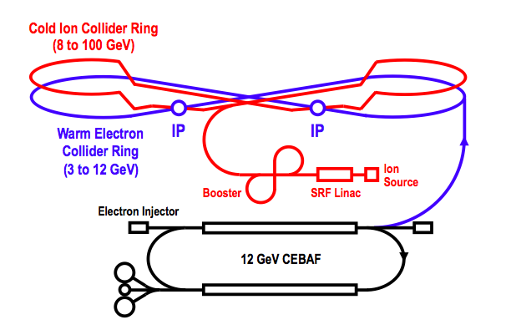
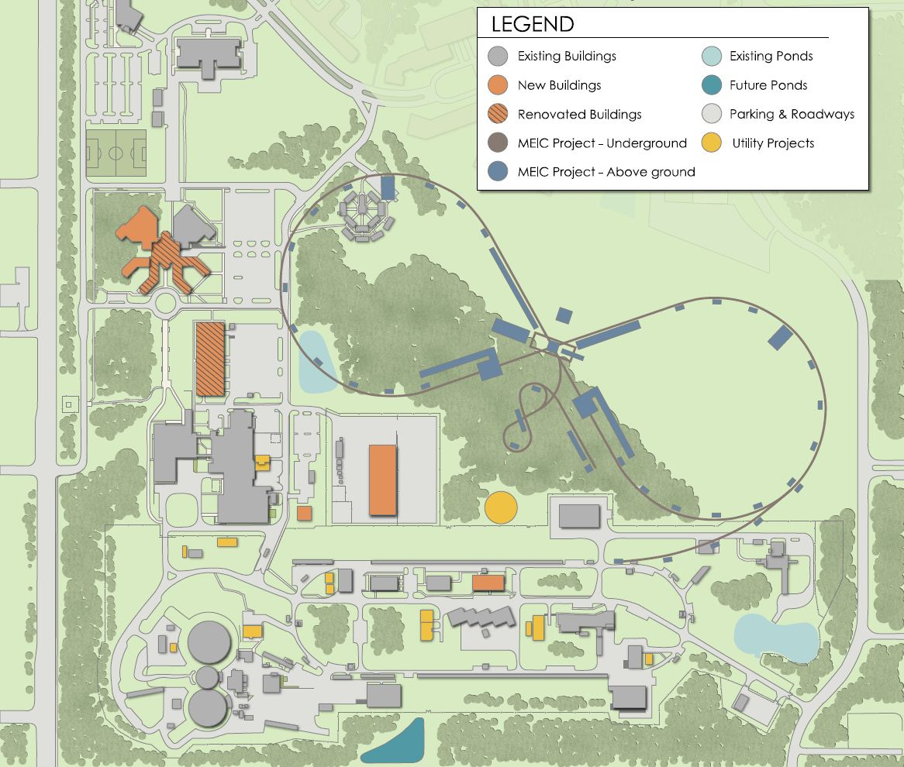
MEIC Layout
    Use of super-ferric magnets
Booster
  Re-use of the PEP-II machine components
Warm Electron
Collider Ring
(3 to 10 GeV)
Linac
Ion Source
Jlab campus layout
IP
MEIC
IP
~2.2 km collider ring circumference
Tunnel consistent with future high energy upgrade
CEBAF

Slide 9
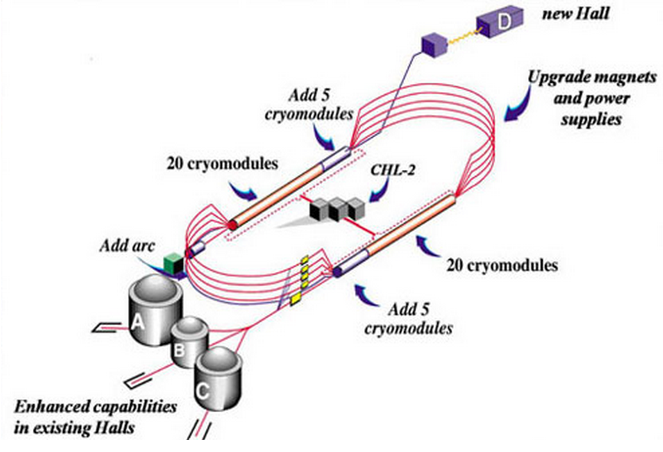
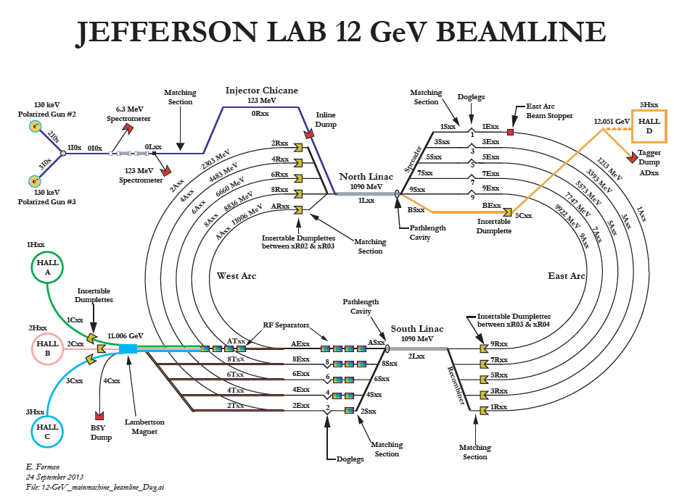
CEBAF - Full Energy Injector
CEBAF fixed target program
  5-pass recirculating SRF linac
  Exciting science program beyond 2025
  Can be operated concurrently with the MEIC
CEBAF will provide for MEIC
  Up to 12 GeV electron beam
  High repetition rate (up to 1497 MHz)
  High polarization (>85%)
  Good beam quality up to the mA level
new 5
cryomodules
new 5
cryomodules
Injection scheme: TUPTY083

Slide 10
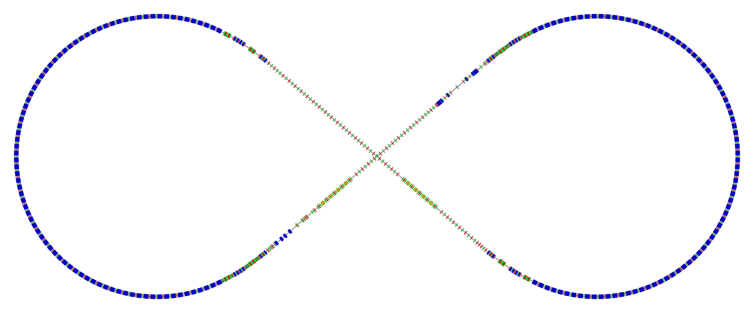
Electron Collider Ring Layout
Circumference of 2154.28 m = 2 x 754.84 m arcs + 2 x 322.3 straights
Figure-8 crossing angle 81.7°
  Electron collider ring w/ major machine components
Spin rotator
Spin rotator
CCB
Tune trombone & Straight FODOs
R=155m
81.7°
e⁻
Arc, 261.7°
Future 2nd IP
RF
RF
Spin rotator
IP
Spin rotator
Forward e⁻ detection
Electron ring design: TUPTY084

Slide 11
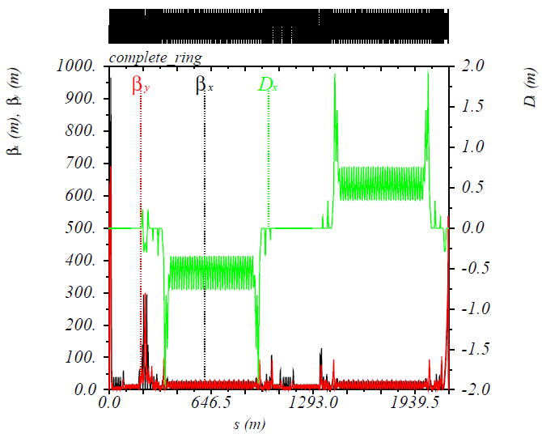
Electron Collider Ring
Electron collider ring design
  Meets design requirements
  Circumference of 2154.28 m = 2 x 754.84 m arcs + 2 x 322.3 m straights
  Provides longitudinal electron polarization at IP(s)
  Incorporates forward electron detection
  Accommodates up to two detectors
  Incorporates correction of beam nonlinearity
  Reuses PEP-II magnets, vacuum chambers and RF
Beam characteristics
  3A beam current up to 6.95 GeV
  Normalized emittance 1093 um @ 10 GeV
  Synchrotron radiation power density 10kW/m
  Total power 10 MW @ 10 GeV
CEBAF and electron collider provide the
required electron beams for the MEIC
IP
Electron Collider Ring Optics
D_{x}(m)
β_{x}(m), β_{y}(m)

Slide 12
Electron Ring Optics Parameters
Electron beam momentum | GeV/c | 10
Circumference | m | 2154.28
Arc/straight length | m | 754.84/322.3
RF frequency | MHz | 476
Bunch length | cm | 1.2
Beta stars at IP β*_{x,y} | cm | 10 / 2
Detector space | m | -3 / +3.2
Maximum horizontal / vertical β functions β_{x,y} | m | 949/692
Maximum horizontal / vertical dispersion D_{x,y} | m | 1.9 / 0
Horizontal / vertical betatron tunes ν_{x,y} |  | 45.(89) / 43.(61)
Horizontal / vertical chromaticities ξ_{x,y} ( one IP ) |  | -149 / -123
Momentum compaction factor α |  | 2.2 ×10⁻³
Transition energy γ_{tr} |  | 21.6
Horizontal / vertical normalized emittance ε_{x,y} | µm rad | 1093 / 378

Slide 13
Ion Injector Complex Overview
Booster (8 GeV)
(accumulation)
DC e-cooling
Ion Sources
SRF Linac (285 MeV)
Ion injector complex relies on demonstrated technologies for sources and injectors
  ABPIS for polarized or un-polarized light ions, EBIS and/or ECR for un-polarized heavy ions
  SRF linac (based on the ANL linac)
  8 GeV Booster design based on super-ferric magnet technology
  Conventional injection/extraction lines to/from Booster

Slide 14
Ion Linac – Parameters and Layout
RFQ
QWR
QWR
HWR
Ion Sources
IH
4 cryostats
2
10 cryostats
4 cryos
2 cryos
10 cryos
MEBT
Optimum lead stripping energy: 13 MeV/u
Linac design based on the ANL linac. Pulsed linac capably of accelerating multiple charge ion species (H⁻ to Pb⁶⁷+)
  Warm Linac sections (115 MHz)
    RFQ (3 m)
    MEBT (3 m)
    IH structure (9 m)
  Cold Linac sections
    QWR + QWR (24 + 12 m) 115 MHz
    Stripper, chicane (10 m) 115 MHz
    HWR section (60 m) 230 MHz
Ion species: p to Pb
Ion species for the reference design | ²⁰⁸Pb
Kinetic energy (p, Pb) | 285 MeV 100 MeV/u
Maximum pulse current: Light ions (A/Q<3) Heavy ions (A/Q>3) | 2 mA 0.5 mA
Pulse repetition rate | up to 10 Hz
Pulse length: Light ions (A/Q<3) Heavy ions (A/Q>3) | 0.50 ms 0.25 ms
Maximum beam pulsed power | 680 kW
Fundamental frequency | 115 MHz
Total length | 121 m

Slide 15
Booster
8 GeV Booster design based on super-ferric magnet technology
  Circumference of 273 m
  Achromatic arcs’ design with partly negative horizontal dispersion to minimize momentum compaction to avoid transition crossing
  Figure-8 shape for preserving ion polarization
Injection: multi-turn 6D painting + charge exchange
  0.22 – 0.25 ms long pulses ~180 turns
  Proton single pulse charge stripping at 285 MeV
  Lead 28-pulse drag-and-cool stacking at 100MeV/u
  Ion energies scaled by mass-to-charge ratio to preserve magnetic rigidity
E_{kin} = 285 MeV – 8 GeV
Crossing angle:
75 deg.
RF cavity
extraction
injection
70
7
BETA_X&Y[m]
DISP_X&Y[m]
0
0
BETA_X
BETA_Y
DISP_X
DISP_Y
272.306
-7
Inj. Arc (255⁰)
Straight
Arc (255⁰)
Straight (RF + extraction)

Slide 16
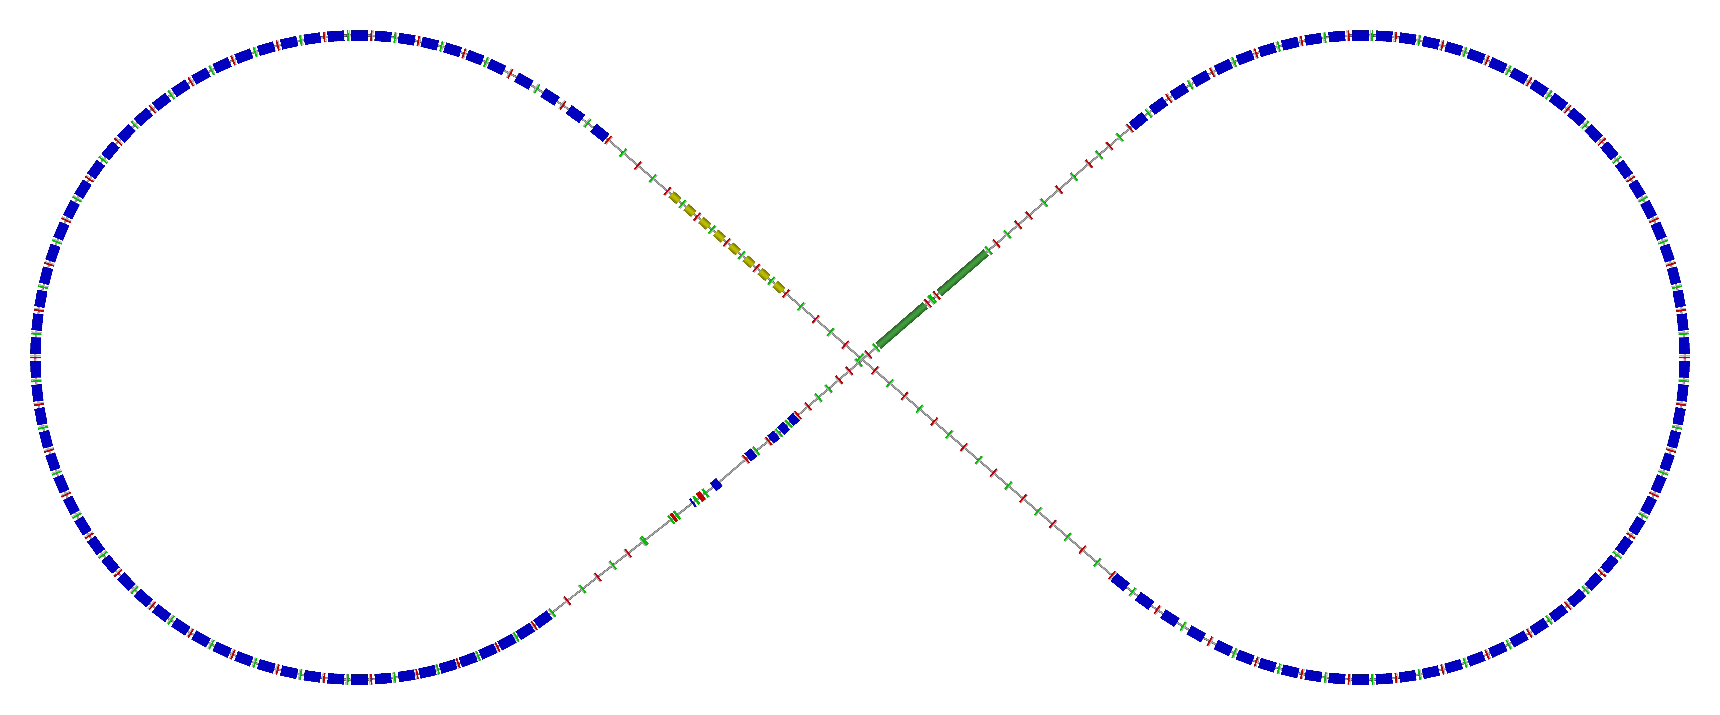
Ion Collider Ring Layout
Circumference of 2153.9 m
Figure-8 crossing angle 81.7°
  Ion collider ring w/ major machine components
disp. supp./
geom. match #3
disp. supp./
geom. match #2
norm.+
SRF
Arc, 261.7°
elec. cool.
tune
tromb.+
match
81.7°
R = 155.5 m
future 2nd IP
det. elem.
disp. supp.
ions
beam exp./
match
IP
disp. supp./
geom. match #3
disp. supp./
geom. match #1
Ion ring design: TUPWI031

Slide 17
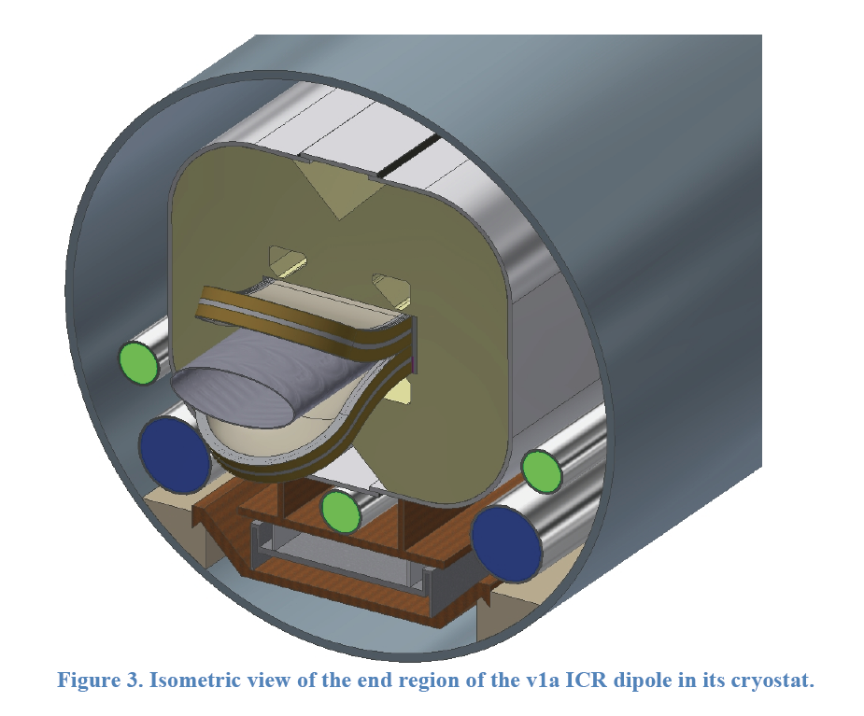
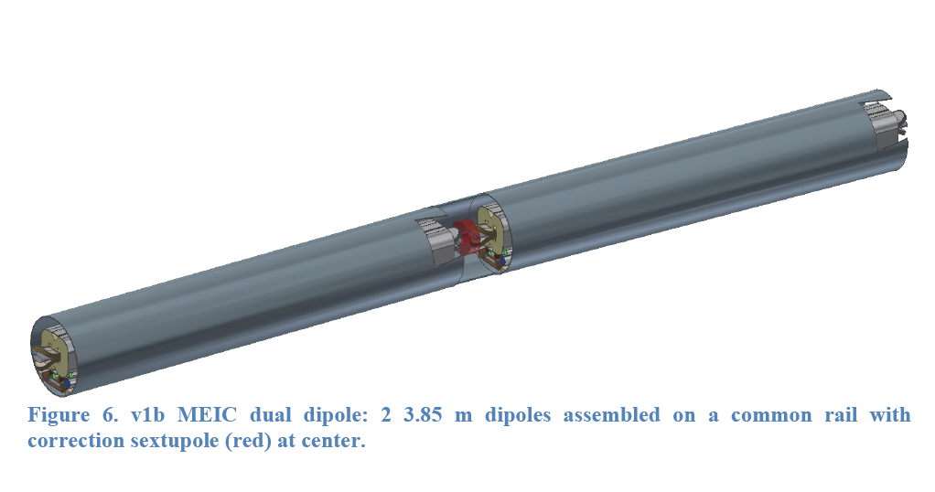
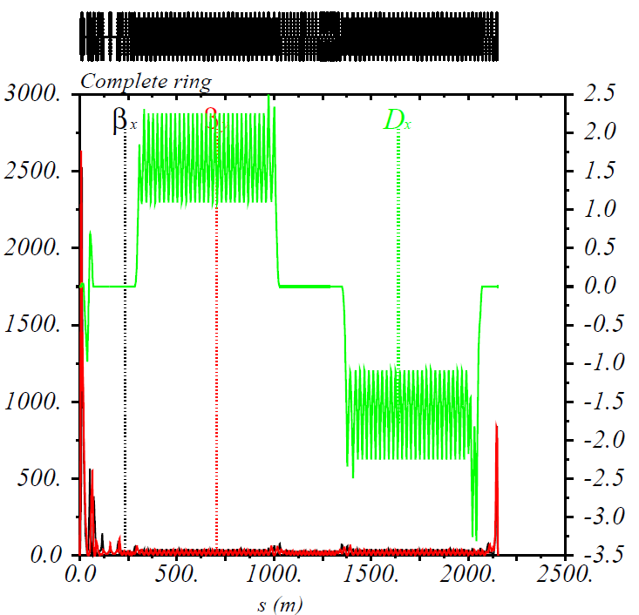
Ion Collider Ring
~2.2 km circumference to match the geometry of PEP-II-component-based electron ring
Use Super-ferric magnets
  ~3 T maximum field for maximum proton momentum of 100 GeV/c, 4.5 k operating temperature
  Cost effective construction and operation (factor of ~2 cheaper to operate, GSI)
Ion collider ring design
  Has an arc FODO cell
    length of 22.8 m (1.5 x PEP-II FODO cell)
    optimized for an 8m long SF dipole magnet
  Provides high polarization adjustable to any
  orientation at IP(s)
  Incorporates forward ion detection
  Accommodates up to two detectors
  Incorporates correction of beam nonlinearity
Ion collider ring design meets the MIEC
design requirements on both forward ion
detection and high polarization.
IP
Ion Collider Ring Optics
D_{x}(m)
β_{x}(m), β_{y}(m)

Slide 18
Ion Collider Ring Parameters
Proton energy range | GeV | 20(8)-100
Circumference | m | 2153.89
RF frequency | MHz | 476
Bunch length | cm | 1
Horizontal / vertical beta functions at IP β*_{x,y} | cm | 10 / 2
Detector space | m | -3.6 / +7
Maximum horizontal / vertical beta functions β_{x,y} _{max} | m | ~2500
Maximum horizontal dispersion D_{x} | m | 3.28
Horizontal / vertical betatron tunes ν_{x,y} |  | 24(.38) / 24(.28)
Horizontal / vertical natural chromaticities ξ_{x,y} (one IP) |  | -101 / -112
Momentum compaction factor α |  | 6.45 × 10⁻³
Transition energy γ_{tr} |  | 12.46
Normalized horizontal / vertical emittance ε_{x,y} | µm rad | 0.35 / 0.07
Horizontal / vertical rms beam size at IP σ*_{x,y} | µm | ~20 / ~4

Slide 19
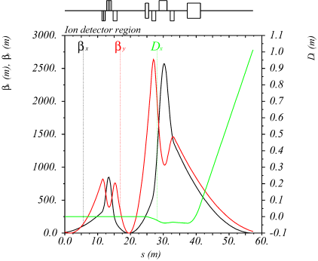
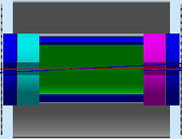
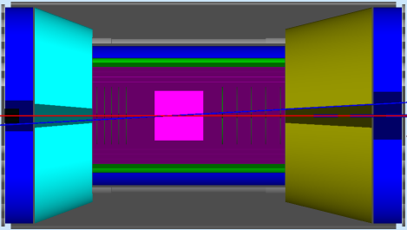
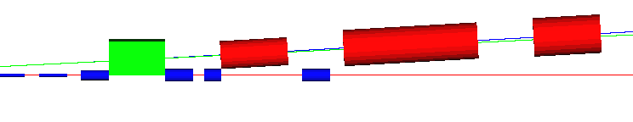
Full-Acceptance Detector
50 mrad crossing angle
  No parasitic collision, fast beam separation, improved detection
Forward hadron detection in three stages
  Endcap
  Small dipole covering angles up to a few degrees
  Far forward, up to one degree, for particles passing through accelerator quads
Low-Q² tagger
  Small-angle electron detection
IP
FP
central detector
with endcaps
small angle
hadron detection
far forward
hadron detection
low-Q²
electron detection
n, γ
large-aperture
electron quads
ion quads
~60 mrad bend
p
small-diameter
electron quads
e
p
Thin exit windows
Fixed trackers
50 mrad beam
(crab) crossing angle
Roman pots
(from GEANT4)
dual-solenoid in common cryostat
4 m coil
RICH
+
TORCH?
Endcap
1 m
1 m
Ion quadrupoles
barrel DIRC + TOF
2 Tm dipole
e/π threshold
Cherenkov
Electron quadrupoles
EM calorimeter
Tracking
EM calorimeter
Trackers and “donut” calorimeter
EM calorimeter

Slide 20
Chromaticity Compensation Scheme
Compensation of momentum dependence of betatron tunes (primarily due to strong focusing at IP) using properly-phased sextupole families
Distributed sextupole compensation strategy
  Build-up chromatic β wave in the arcs to cancel FFB’s chromatic kick
    Arc FODO cells with 90° phase advance in x/y
    Two sextupole families, each with an even number of magnets
    π phase advance between individual sextupoles of each family
    nπ+π/2 phase advance from the last sextupole of each family to IP
    Option of exciting β beat in the arcs if needed
  Compensation of residual linear chromaticity
    Two sextupole families, each with a multiple of 4 magnets
    π/2 phase advance between individual sextupoles of each family
  Control of chromatic driving terms (ξ⁽²⁾, D⁽²⁾, ∂β/∂δ ) and cancellation of geometric resonance driving terms to first order in sextupole strength
π/2
π
nπ
FFB
FFB
…
nπ+ π/2
IP
…
…
nπ+ π/2
…
π/2
π
nπ

Slide 21
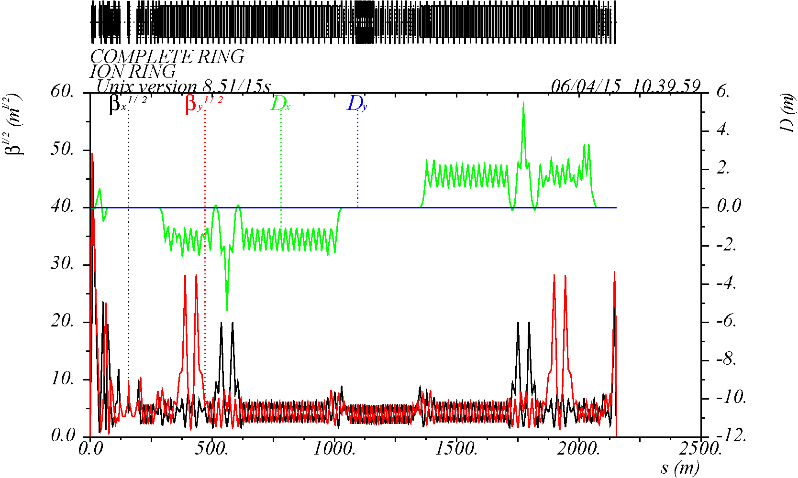
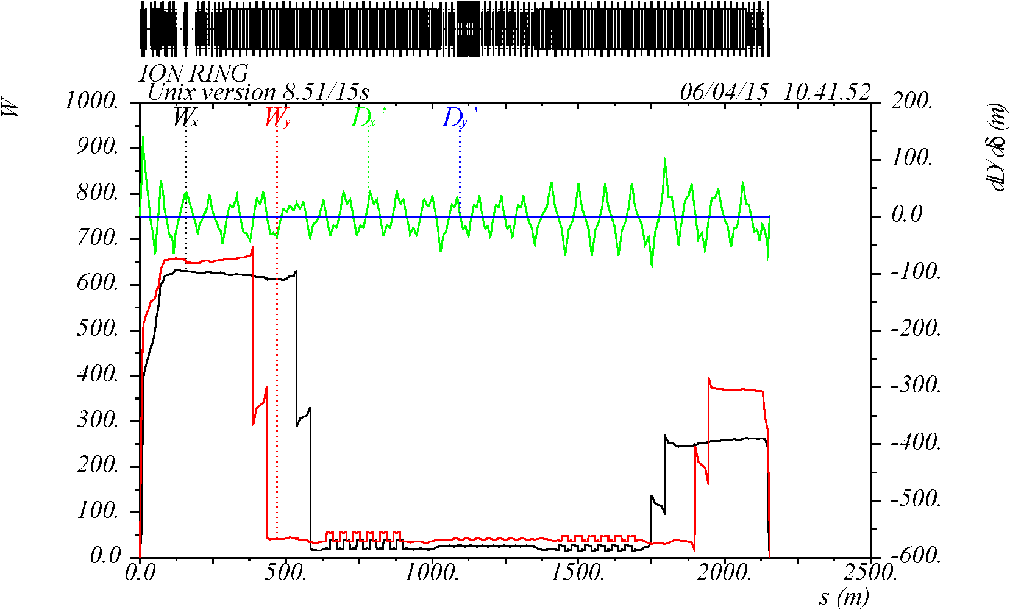
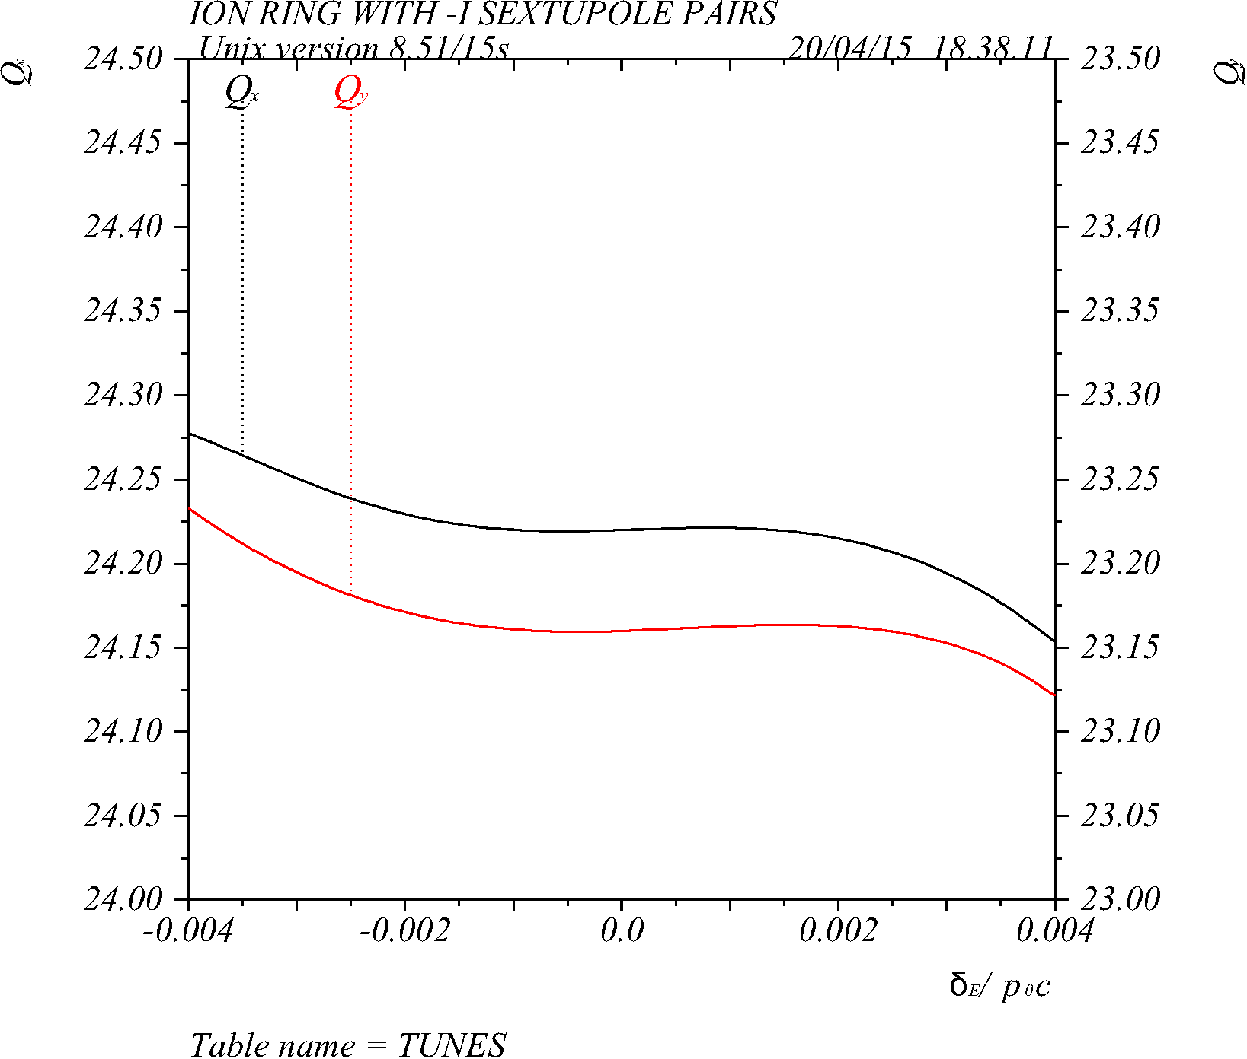
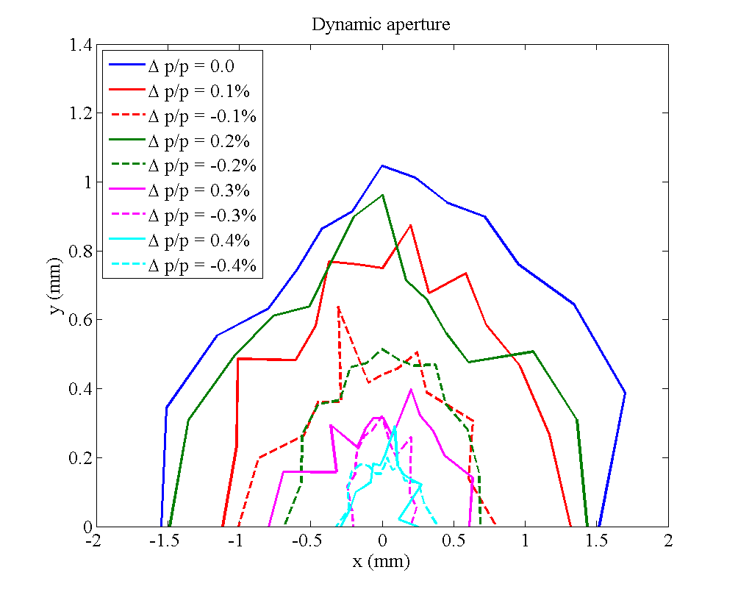
Momentum Acceptance & DA
ion ring optics
W-functions
IP
Dynamic Aperture (DA)
Momentum Acceptance
At Δp/p = 0.3%
(- 20σ_{x} , + 20σ_{x})
(- 40σ_{y} , + 40σ_{y})
(- 12σ_{Δp/p} , + 12σ_{Δp/p})
Nonlinear Beam Dynamics: TUPWI032

Slide 22
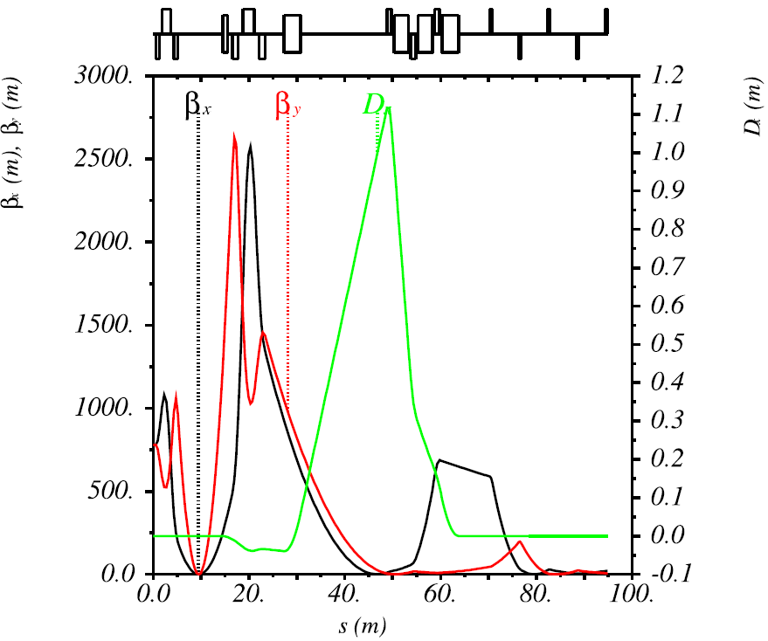
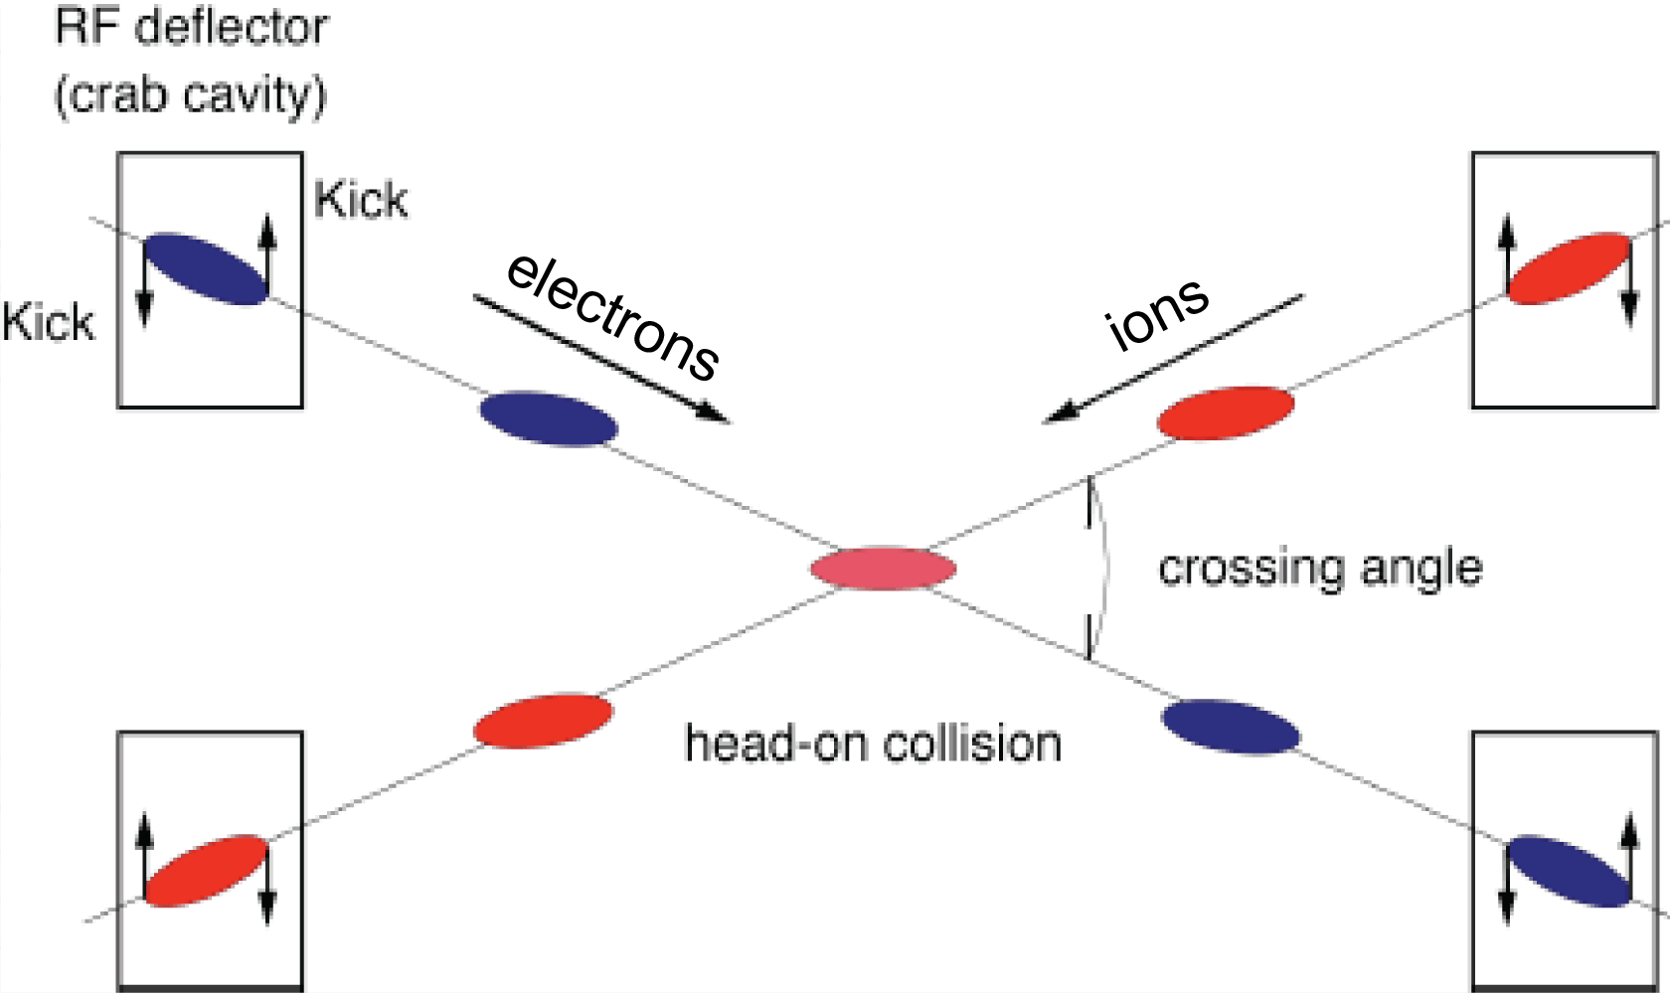
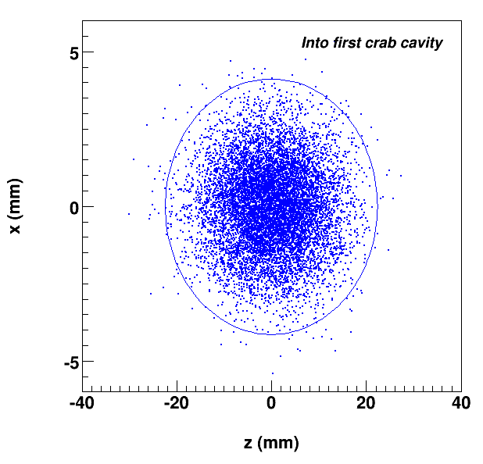
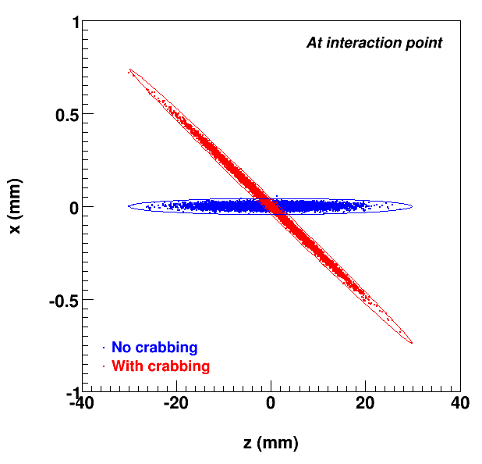
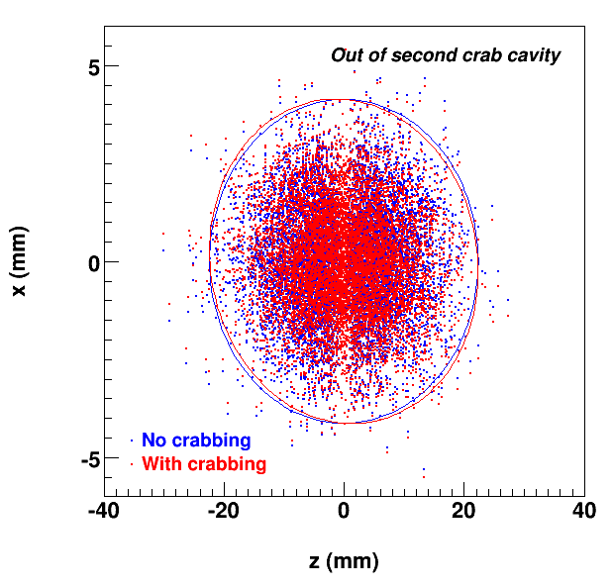
Crab Crossing
Effective head-on bunch collisions restored with 50 mrad crossing angle
Local crab scheme
Cavities are placed at (n+1)π/2 phase advance relative to IP
Large β_{x} at location of crab cavities for minimizing the required kicking voltage
Deflective crabbing using transverse
electric field of SRF cavities
  design and analysis completed
  Prototype fabricated and characterized
  Final testing with promising results
Location of crab cavities
π/2
3π/2
Incoming
At IP
Outgoing

Slide 23
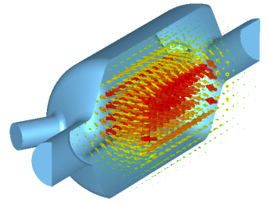
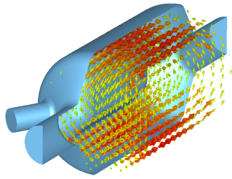
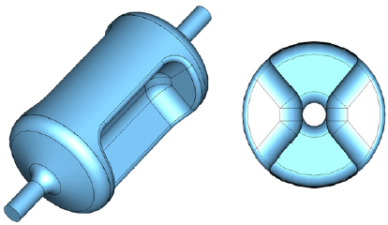
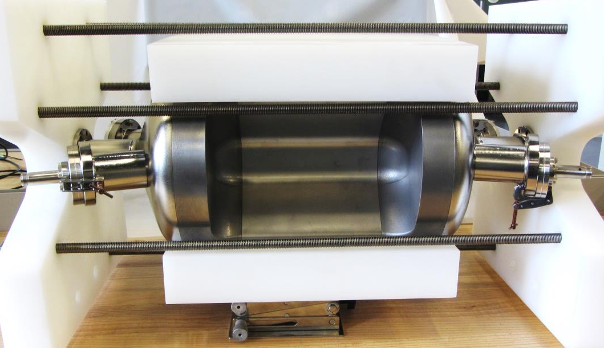
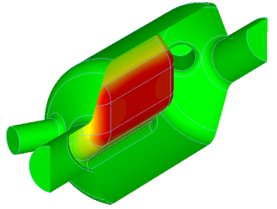
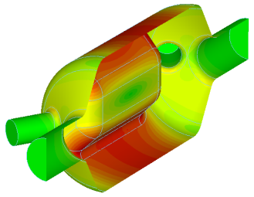
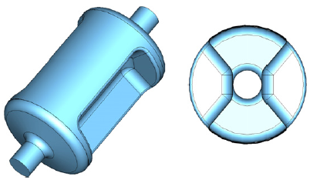
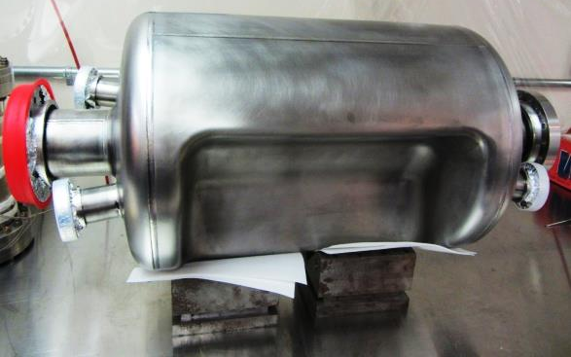
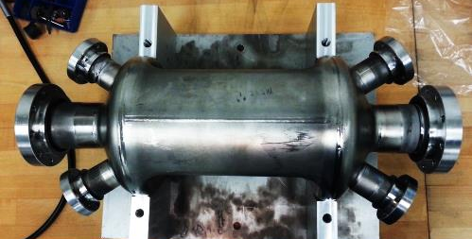
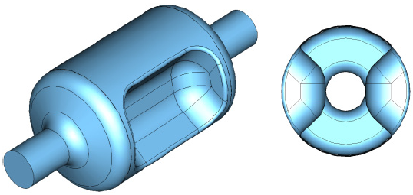
Deflective Crab Cavity
499 MHz Deflecting Cavity for Jefferson Lab 12 GeV Upgrade
44 cm
24 cm
400 MHz Crabbing Cavity for LHC HiLumi Upgrade
53 cm
SRFD test results
34 cm
750 MHz Crabbing Cavity
35 cm
19 cm
S. De Silva ICFA Workshop in HOMs for SRF 2014
Crab Cavities : TUPWI039, WEPWI034

Slide 24
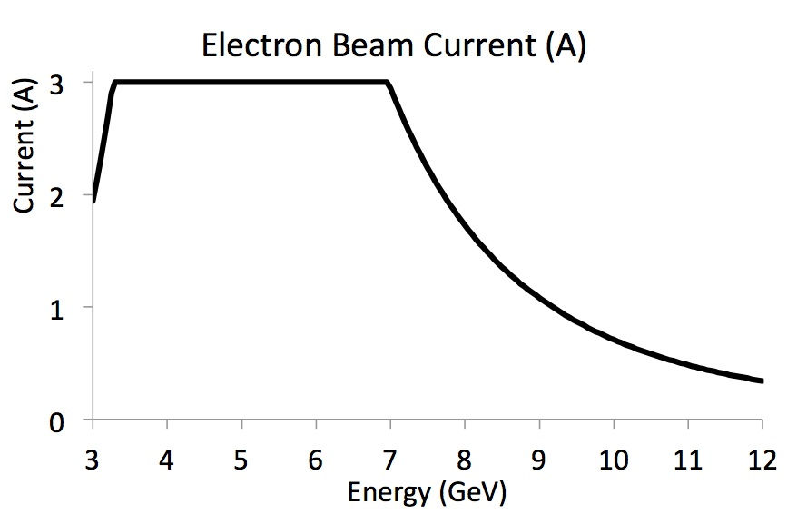
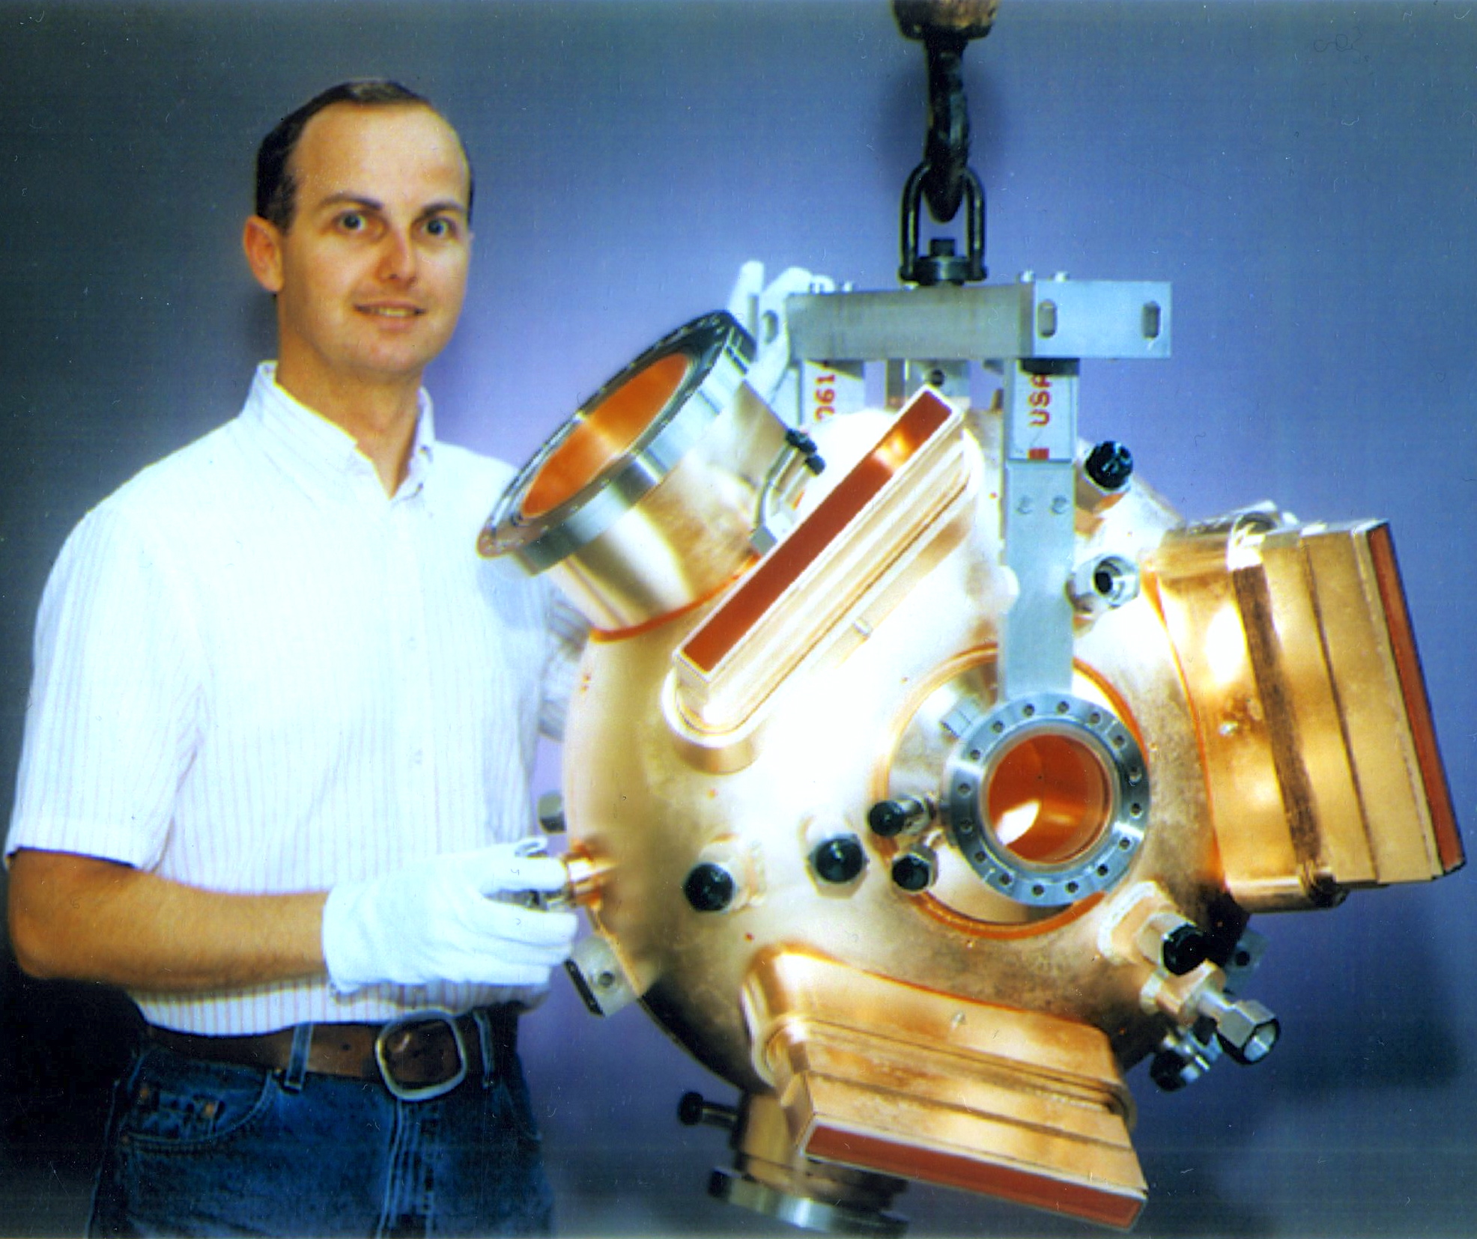
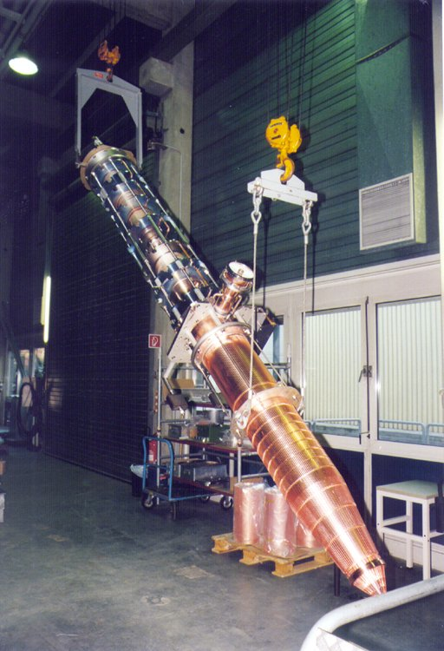
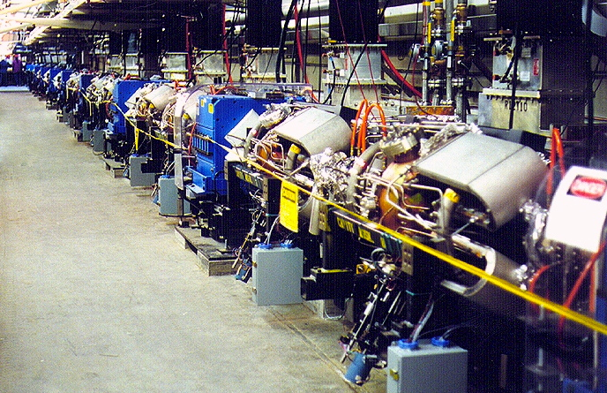
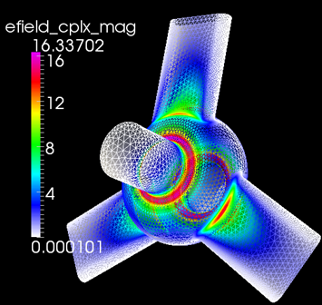
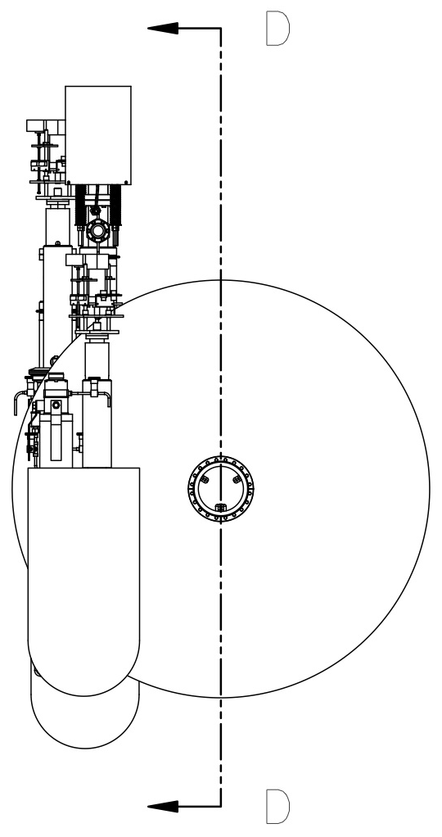
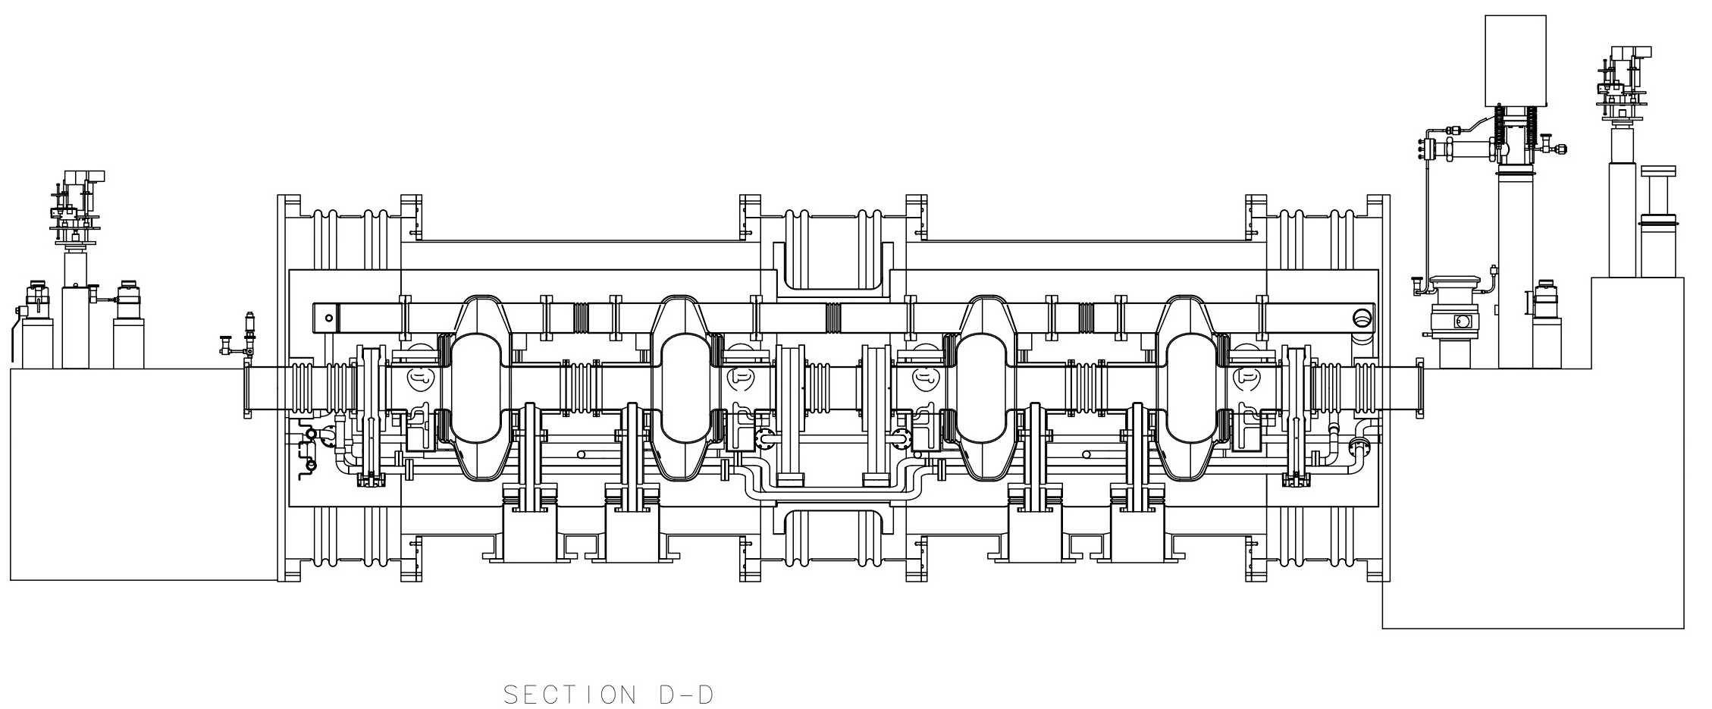
RF Cavities
Electron collider ring --- reuse PEP-II RF stations
  476 MHz HOM damped 1-cell cavities, 34 cavities available
  1.2 MW klystrons including power supplies etc., 13 available
  Current limited by synch. radiation power at high energy, impedance at low energy
nominal
Synchrotron power limited
Impedance limited
RF System: TUPWI034, WEPWI024
Ion collider ring --- design 952.6 MHz HOM damped 1-cell cavities
  Modular Jlab type cryomodule
  High frequency/high voltage for short bunch (re-bucket at energy)
  Lower power couples, no synch. radiation power
  Tunable within one harmonic (harmonic jumps for path length changes with energy)
  Current limited by space charge (limits charge per bunch)
  Impedance is still a concern so HOM damping is needed
New HOM damped cavity concept
952.6 MHz single cell 4-seater CM (~4.3m flange to flange)

Slide 25
Multi-Step Electron Cooling Scheme
Cooling of ion beams the MEIC is critical in delivering high luminosity over a broad CM energy range
  Help accumulation of positive ions
  Maintain the emittance
ion sources
BB cooler
ion linac
DC cooler
Booster
(0.285 to 8 GeV)
collider ring
(8 to 100 GeV)
Ring | Cooler | Function | Ion energy (GeV/u) | Electron energy (MeV)
Booster ring | DC | Injection/accumulation of positive ions | 0.11 ~ 0.19 (injection) | 0.062 ~ 0.1
 |  | Emittance reduction | 2 | 1.1
Collider ring | Bunched Beam Cooling (BBC) | Maintain emittance during stacking | 7.9 (injection) | 4.3
 |  | Maintain emittance | Up to 100 | Up to 55

Slide 26
Bunched Beam Electron Cooler
Baseline cooling requirements
  Emittance 0.5 to 1 mm-mrad -> reduce IBS effect
  Magnetized beam, up to 55 MeV energy, 200 mA current
  Linac for acceleration
  Must utilize energy-recovery-linac (beam power is 11 MW)
Solution : cooling by a bunched electron beam
Electron Cooling: MOPMN011, TUPWI037, TUPMA034, TUPMA035, TUPWI038, TUPWI040, WEPMN025
ion bunch
Electron energy | MeV | up to 55
Current and bunch charge | A / nC | 0.2 / 0.42
Bunch repetition | MHz | 476
Cooling section length | m | 60
RMS Bunch length | cm | 3
Electron energy spread | 10⁻⁴ | 3
Cooling section solenoid field | T | 2
Beam radius in solenoid/cathode | mm | ~1 / 3
Solenoid field at cathode | KG | 2
Cooling section solenoid
electron bunch
energy recovery
injector
SRF Linac
dump

Slide 27
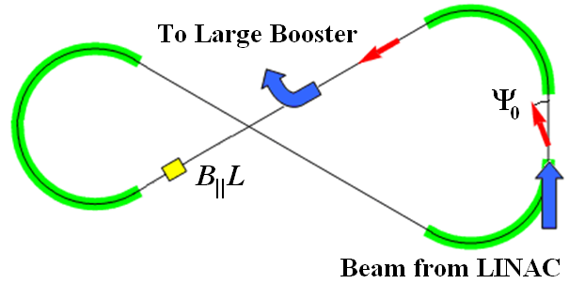
Ion Polarization in Booster
No special care is needed for ion polarization before the booster
  highly polarized ion source + no polarization loss in the linac
Polarization in Booster stabilized and preserved by a single weak solenoid
  0.7 Tm at 9 GeV/c
  ν_{d} / ν_{p} = 0.003 / 0.01
Longitudinal polarization in the straight with the solenoid
Comparison: Conventional 9 GeV accelerators require B||L of ~30 Tm for protons and ~110 Tm for deuterons
B_{II}L
Booster
beam from Linac
to Collider Ring

Slide 28
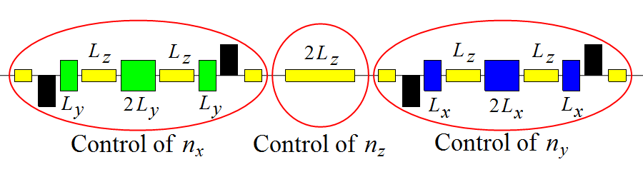
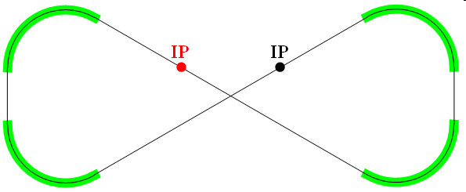
Ion Polarization in Collider
“3D spin rotator” rotates the spin about any chosen direction in 3D and sets the stable polarization orientation
Spin-control solenoids
Lattice quadrupoles
Vertical-field dipoles
Radial-field dipoles
x
y
z
z
Placement of 3D spin rotator in the collider ring
Integration of 3D spin rotator into the collider lattice
  seamless integration into virtually any lattice
Another 3D spin rotator suppresses the zero-integer
spin resonance
3D Spin
Rotator
ion
IP
Ion polarization: TUPWI029, TUPWI030

Slide 29
Electron Polarization
Comprehensive electron polarization strategies:
  Vertically-injected polarized electron beam from CEBAF
  Vertical polarization in the arcs (to avoid spin diffusion) and longitudinal at collision points
  Spin rotator for the polarization rotation
  Spin flipping through changing the source polarization
  Polarization configuration with figure-8 geometry removes electron spin tune energy dependence
  Compton polarimeter has been integrated to the interaction region design and is considered to measure the electron polarization
  Spin matching in some key regions is considered to further improve polarization lifetime
Spin Rotator
Photon
calorimeter
Laser + Fabry Perot cavity
γ_{c}
Low-Q² tagger for
low-energy electrons
Magnetic field
Low-Q² tagger for high-
energy electrons
Polarization
Electron
tracking detector
e⁻ beam
IP
e⁻
IP
Solenoid decoupling
Energy (GeV) | 3 | 5 | 7 | 9 | 10
Estimated Pol. Lifetime (hours) | 66 | 5.2 | 2.2 | 1.3 | 0.8
Half Sol.
Dec. Quad. Insert
Half Sol.

Slide 30
Performance of MEIC Baseline Design
For a full acceptance detector
CM energy | GeV | 21.9 (low) |  | 44.7 (medium) |  | 63.3 (high)
 |  | p | e | p | E | p | e
Beam energy | GeV | 30 | 4 | 100 | 5 | 100 | 10
Collision frequency | MHz | 476 |  | 476 |  | 159
Particles per bunch | 10¹⁰ | 0.66 | 3.9 | 0.66 | 3.9 | 2.0 | 2.8
Beam current | A | 0.5 | 3 | 0.5 | 3 | 0.5 | 0.72
Polarization | % | >70% | >70% | >70% | >70% | >70% | >70%
Bunch length, RMS | cm | 2.5 | 1.2 | 1 | 1.2 | 2.5 | 1.6
Norm. emitt., vert./horz. | μm | 0.5/0.5 | 74/74 | 1/0.5 | 144/72 | 1.2/0.6 | 1152/576
Horizontal and vertical β* | cm | 3 | 5 | 2/4 | 2.6/1.3 | 5/2.5 | 2.4/1.2
Vert. beam-beam param. |  | 0.01 | 0.02 | 0.006 | 0.014 | 0.002 | 0.013
Laslett tune-shift |  | 0.054 | small | 0.01 | small | 0.01 | small
Detector space, up/down | m | 3.6/7 | 3/3.2 | 3.6/7 | 3/3.2 | 3.6/7 | 3/3.2
Hour-glass (HG) reduction |  | 0.89 |  | 0.88 |  | 0.73
Lumi./IP, w/HG, 10³³ | cm⁻²s¹ | 1.9 |  | 4.6 |  | 1.0
For a high(er) luminosity detector
Horizontal and vertical β* | cm | 1.2 | 2 | 1.6 / 0.8 | 1.6 / 0.8 | 2 /1 | 1.6 / 0.8
Vert. beam-beam param. |  | 0.01 | 0.02 | 0.004 | 0.021 | 0.001 | 0.021
Detector space, up/down | m | ±4.5 | ±3 | ±4.5 | ±3 | ±4.5 | ±3
Hour-glass (HG) reduction |  | 0.67 |  | 0.74 |  | 0.58
Lumi./IP, w/HG, 10³³ | cm⁻²s¹ | 3.5 |  | 7.5 |  | 1.4

Slide 31
e-p Collision Luminosity
10³⁴
10³³

Slide 32
e-ion Collision Luminosity
For a full acceptance detector
 |  | Electron | Proton | Deuteron | Helium | Carbon | Calcium | Lead
 |  | e | P | d | ³He⁺⁺ | ¹²C⁶⁺ | ⁴⁰Ca²⁰⁺ | ²⁰⁸Pb⁸²⁺
Beam energy | GeV | 5 | 100 | 50 | 66.7 | 50 | 50 | 39.4
Particles/bunch | 10¹⁰ | 3.9 | 0.66 | 0.66 | 0.33 | 0.11 | 0.033 | 0.008
Beam current | A | 3 | 0.5 | 0.5 | 0.5 | 0.5 | 0.5 | 0.5
Polarization |  | >70% | >70% | > 70% | > 70% | - | - | -
Bunch length, RMS | cm | 1.2 | 1 | 1 | 1 | 1 | 1 | 1
Norm. emit., horz./vert. | μm | 144/72 | 1/0.5 | 0.5/0.25 | 0.7/0.35 | 0.5/0.25 | 0.5/0.25 | 0.5/0.25
β*, hori. & vert. | cm | 2.6/1.3 | 4/2 | 4/2 | 4/2 | 4/2 | 4/2 | 5/2.5
Vert. beam-beam parameter |  | 0.014 | 0.006 | 0.006 | 0.006 | 0.006 | 0.006 | 0.005
Laslett tune-shift |  |  | 0.01 | 0.041 | 0.022 | 0.041 | 0.041 | 0.041
Detector space | m | 3.2 / 3 | 7 / 3.6
Hour-glass (HG) reduction factor |  |  | 0.89 | 0.89 | 0.89 | 0.89 | 0.89 | 0.89
Lumi/IP/nuclei, w/ HG correction | 10³³ cm⁻²s⁻¹ |  | 4.6 | 4.6 | 2.2 | 0.77 | 0.23 | 0.04
Lumi/IP/nucleon, w/HG correction, | 10³³ cm⁻²s⁻¹ |  | 4.6 | 9.2 | 6.6 | 9.2 | 9.2 | 7.8
For a high(er) luminosity detector
β*, hori. & vert. | cm | 1.6/0.8 | 1.6/0.8 | 1.6/0.8 | 1.6/0.8 | 1.6/0.8 | 1.6/0.8 | 1.6/0.8
Vert. beam-beam parameter |  | 0.02 | 0.004 | 0.004 | 0.004 | 0.004 | 0.004 | 0.004
Detector space | m | 3 | 4.5
Hour-glass (HG) reduction factor |  |  | 0.74 | 0.74 | 0.74 | 0.74 | 0.74 | 0.74
Lumi/IP/nuclei, w/ HG correction | 10³³ cm⁻²s⁻¹ |  | 7.5 | 9.3 | 3.7 | 1.37 | 0.38 | 0.08
Lumi/IP/nucleon, w/HG correction, | 10³³ cm⁻²s⁻¹ |  | 7.5 | 15.1 | 11.1 | 15.1 | 15.1 | 17.3

Slide 33
Overview of R&D
Bunched beam electron cooling ERL only
  Test of bunched beam cooling at IMP (LDRD)
  Development of a 200 mA unpolarized e-gun (Experience from RHIC low energy cooling ?)
Low β* rings
  Chromatic and IR nonlinear correction schemes
  DA tracking with errors and beam-beam effect (Operational experience at hadron colliders ?)
Space charge dominated beams
  Simulations (DC cooling in booster, Operational experience at UMER and IOTA rings, Study of space charge compensation at eRHIC ??)
Figure 8 layout
  Spin tracking simulations
Super ferric magnets
  Early MEIC prototype (FY15-16) (Existing prototypes (SSC, GSI), Operational experience at GSI, Alternative cosθ designs ??)
Crab cavities
  Prototypes (operational experience at KEK-B and LHC, test of crab cavity in LERF (FEL) ?? )
SRF
  952 MHz RF development

Slide 34
Conclusions
The baseline design of MEIC based on a ring-ring concept can deliver a luminosity from a few 10³³ up to 10³⁴ cm⁻²s⁻¹ and polarization over 70% in a broad CM energy range with low technical risks.
MEIC baseline design meets the requirements of the white paper.
We continue the work for R&D items.
We continue to optimize the present design for cost and performance.
The design is upgradeable in energy and luminosity.

Slide 35
MEIC Posters
MOPMN011 Studies of Beam Cooling for MEIC
TUPWI029 Baseline Scheme for Polarization Preservation and Control in the MEIC Ion Complex
TUPWI030 Numerical Calculation of the Ion Polarization in MEIC
TUPWI031 Status of the MEIC Ion Collider Ring Design
TUPWI032 Progress on Optimization of the Nonlinear Beam Dynamics in the MEIC Collider Rings
TUPWI034 Capture, Acceleration and Bunching RF Systems for the MEIC Booster and Storage Rings
TUPWI037 Electron Cooling Study for MEIC
TUPMA034 Control of Coherent Synchrotron Radiation Effects During Recirculation with Bunch Compression
TUPMA035 Control of Coherent Synchrotron Radiation Effects During Recirculation
TUPWI038 A Multi-Gun Injector for the MEIC Bunched Beam Electron Cooling Facility
TUPWI039 Modeling Crabbing Dynamics in an Electron-Ion Collider
TUPWI040 Electron Cooling Simulation for MEIC
TUPTY083 Concepts for Using CEBAF as a Full-energy Injector for the MEIC Electron Ring
TUPTY084 Update on the MEIC Electron Collider Ring Design
WEPWI024 RF System Requirements for a Medium-Energy Electron-Ion Collider (MEIC) at Jlab
WEPWI034 Multipole Budget of Crab Cavities for an Electron-Ion Collider
WEPMN025 Harmonic Resonant Kicker Design for the MEIC Electron Circular Cooler Ring

Slide 36
Thank You for Your Attention !

Slide 37
Back Up

Slide 38
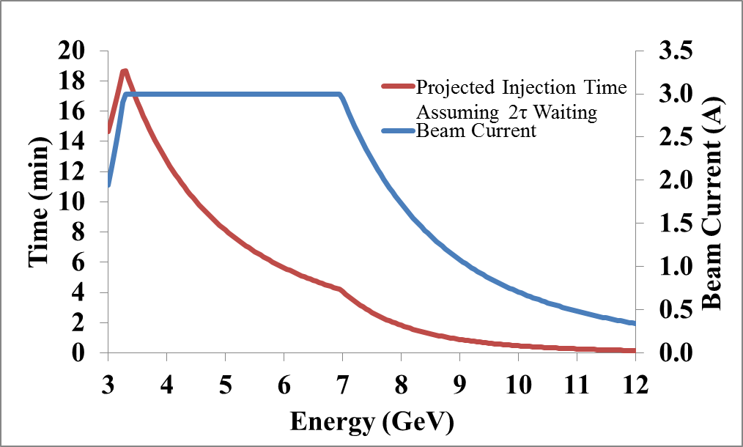

e⁻ Inj. from CEBAF to Electron Ring
Electron injection bunch pattern (@6 GeV) from CEBAF with
  f_{ring}/ f_{cebaf} = 476.3MHz/1497MHz = 7/22
  Two polarization states injection
  Existing CEBAF source gun
Injection Time and Beam Current vs. Energy
nominal
Mid-cycle 1, inject the 1st of every 7 buckets in the ring
Bunch train, up polarization
Impedance limit
Synchrotron power limit
220 bunches, 3.233µs
(I_{ave}= 0.9mA @6GeV CEBAF)
Bunch train, down polarization
14.69 ns, 68.05 MHz (7 ring buckets)
2ns, 476.3 MHz(ring freq.)
13 pC bunch
Waiting for damping 12-700ms
……
Waiting for 72.07µs
……
3416*10.5turns/476.3MHz=75.3ms
12-700ms, ~2× e-ring damping time at different energy
Transfer line 333.25m utilizes PEP-II LER dipoles (156) and quads (68)
Injection scheme starts with PEP-II-like design
  Dispersion free injection insertion
  Septum + DC + RF kickers
  Vertical injection because of greater dynamic aperture, absence of synchrotron oscillations and less

Slide 39

MEIC Super-Ferric Dipole
2 x 4 long dipole
NbTi cable
3 T
Correction sextupole
Common cryostat

Slide 40

Forward Hadron Detection
Large crossing angle (50 mrad)
  Moves spot of poor resolution along solenoid axis into the periphery
  Minimizes shadow from electron FFQs
Dipole before quadrupoles
  Further improves resolution in the few-degree range
Low-gradient quadrupoles
  Allow large apertures for detection of all ion fragments
Crossing angle
7 m from IP to first ion quad
Ion quadrupoles: gradient, peak field, length
36 T/m, 7.0 T, 1.2 m
Endcap detectors
1 m
1 m
89 T/m, 9.0 T, 1.2 m
51 T/m, 9.0 T, 2.4 m
Permanent magnets
2 T dipole
2 x 15 T/m
34 T/m
46 T/m
38 T/m
Electron quadrupoles
e
Tracking
Calorimetry
5 T, 4 m dipole

Slide 41


Far-Forward Hadron Detection
Good acceptance for ion fragments
  Large downstream magnet apertures/
  small downstream magnet gradients
Good acceptance for low-p_{T} recoil baryons
  Small beam size at second focus
  Large dispersion
Good momentum and angular resolution
  Large dispersion
  No contribution from D′ to angular spread at IP
  Long instrumented magnet-free drift space
Sufficient separation between the beam lines
Asymmetric IR (minimizes chromaticity)
ZDC
(n, γ)
20 Tm dipole (in)
Aperture-free drift space
2 Tm dipole (out)
p
solenoid
e
S-shaped dipole configuration optimizes acceptance for neutrals
50 mrad crossing angle
Thin exit windows
Roman pots at focal point

Slide 42
Forward e⁻ Detection & Pol. Measurement
Forward electron detection: Dipole chicane for high-resolution detection of low-Q² electrons
forward e⁻ detection
Compton polarimetry
forward ion detection
local crab cavities
local crab cavities
IP
e⁻
Local crab cavities
ions
Compton polarimetry has been integrated to the interaction region design
  same polarization at laser as at IP due to zero net bend
  non-invasive monitoring of the electron polarization
Photon
calorimeter
Laser + Fabry Perot cavity
ν_{c}
Low-Q² tagger for
low-energy electrons
Low-Q² tagger for high-
energy electrons
Electron
tracking detector
e⁻ beam

Slide 43
SRF-Dipole Cavity Prototypes
499 MHz Deflecting Cavity for
Jefferson Lab 12 GeV Upgrade*
Frequency | 499.0* | 400.0* | 750.0† | MHz
Aperture Diameter (d) | 40.0 | 84.0 | 60.0 | mm
d/(λ/2) | 0.133 | 0.224 | 0.3
LOM | None |  |  | MHz
Nearest HOM | 777.0 | 589.5 | 1062.5 | MHz
E_{p}* | 2.86 | 3.9 | 4.29 | MV/m
B_{p}* | 4.38 | 7.13 | 9.3 | mT
B_{p}*/E_{p}* | 1.53 | 1.83 | 2.16 | mT/ (MV/m)
[R/Q]_{T} | 982.5 | 287.0 | 125.0 | Ω
Geometrical Factor (G) | 105.9 | 140.9 | 136.0 | Ω
R_{T}R_{S} | 1.0×10⁵ | 4.0×10⁴ | 1.7×10⁴ | Ω²
At E_{T}* = 1 MV/m
44 cm
24 cm
400 MHz Crabbing Cavity for LHC HiLumi Upgrade*
53 cm
34 cm
750 MHz Crabbing Cavity for MEIC at Jefferson Lab†
35 cm
*S. De Silva, ODU.
†A. Castilla, ODU-Jefferson Lab.
19 cm

Slide 44










RF-Dipole Transverse Kick
$$V_{T}=\int_{−∞}^{∞}{\left[E_{x}\left(z\right)\cos{\frac{ωz}{c}}+cB_{y}\left(z\right)\sin{\frac{ωz}{c}}\right]dz}$$
$$E_{T}=\frac{V_{T}}{λ/2}⇒V_{T}^{∗}=0.2 MV$$
Electric Field
Magnetic Field
$$E_{T}^{∗}=1{MV}/m$$
$$V_{T,H}^{∗}=−0.2 MV$$
$$V_{T,E}^{∗}=0.4 MV$$
A. Castilla, ODU-Jefferson Lab.

Slide 45
High Current Un-polarized Electron Gun
We propose a three-gun injector, based on the CEBAF injector success
Beam current: 3 x 67 ~ 200 mA (Cornell, 60 mA)
Bunch charge: 0.42 nC, very comfortable for a DC/RF photo-cathode gun
All existing/demonstrated technologies
Steering (BPMs/kickers)
Beams from three individual guns
Gun
Solenoids (emittance compensation)
RF recombiner
One beam
dipole
collimation
buncher
CEBAF injector
dipole
Master slit
Polarized DC gun
Chopper cavity
Chopper cavity
A
Master slit
B
C
One beam
Three beam
One beam

