Slide 1
HE-JLEIC Luminosity Estimate
Yuhong Zhang
June 5, 2018

Slide 2
Assumption & Choice of Main Parameters
At 200 GeV
Beam emittance: 1.8 mm mrad horizontal
Beam current: 0.75 A / 2 ~ 0.375 A
Proton vertical beta-star: 1.2 cm → 1.35 cm

Slide 3
JLEIC Baseline (Proposed Revision)
CM energy | GeV | 21.9 (low) |  | 44.7 (medium) |  | 63.3 (high)
 |  | p | e | p | e | p | e
Beam energy | GeV | 40 | 3 | 100 | 5 | 100 | 10
Collision frequency | MHz | 476 |  | 476 |  | 476/4=119
Particles per bunch | 10¹⁰ | 0.98 | 3.7 | 0.98 | 3.7 | 3.9 | 3.7
Beam current | A | 0.75 | 2.8 | 0.75 | 2.8 | 0.75 | 0.71
Polarization | % | 80 | 80 | 80 | 80 | 80 | 75
Bunch length, RMS | cm | 3 | 1 | 1 | 1 | 2.2 | 1
Norm. emitt., horiz./vert. | μm | 0.3/0.3 | 24/24 | 0.5/0.1 | 54/10.8 | 0.9/0.18 | 432/86.4
Horizontal & vertical β* | cm | 8/8 | 13.5/13.5 | 6/1.2 | 5.1/1 | 10.5/2.1 | 4/0.8
Vert. beam-beam param. |  | 0.015 | 0.092 | 0.015 | 0.068 | 0.008 | 0.034
Laslett tune-shift |  | 0.06 | 7x10⁻⁴ | 0.055 | 6x10⁻⁴ | 0.056 | 7x10⁻⁵
Detector space, up/down | m | 3.6/7 | 3.2/3 | 3.6/7 | 3.2/3 | 3.6/7 | 3.2/3
Hourglass(HG) reduction |  | 1 |  | 0.87 |  | 0.75
Luminosity/IP, w/HG, 10³³ | cm⁻²s⁻¹ | 2.5 |  | 21.4 |  | 5.9
63.3 (high)
p | e
100 | 10
476
0.98 | 3.7
0.75 | 0.71
80 | 75
1 | 1
0.9/0.18 | 432/86.4
10.5/2.1 | 4/0.8
0.002 | 0.009
0.031
3.6/7 | 3.2/3
0.86
1.7

Slide 4
JLEIC Baseline Luminosity

Slide 5
HL-JLEIC “Baseline” Parameters
CM energy | GeV | 21.9 (low) |  | 44.7 (medium) |  | 63.3 (high) |  | 63.3 (high) |  | 89.4 (high)
 |  | p | e | p | e | p | e | p | e | P | e
Beam energy | GeV | 40 | 3 | 100 | 5 | 100 | 10 | 200 | 5 | 200 | 10
Collision frequency | MHz | 476 |  | 476 |  | 476 |  | 476 |  | 476
Particles per bunch | 10¹⁰ | 0.98 | 3.7 | 0.98 | 3.7 | 0.98 | 0.93 | 0.49 | 3.9 | 0.49 | 0.93
Beam current | A | 0.75 | 2.8 | 0.75 | 2.8 | 0.75 | 0.71 | 0.375 | 3 | 0.375 | 0.71
Polarization | % | 80 | 80 | 80 | 80 | 80 | 80 | 80 | 80 | 80 | 80
RMS bunch length | cm | 3 | 1 | 1 | 1 | 1 | 1 | 1 | 1 | 1 | 1
Norm. emitt., horiz. | μm | 0.3 | 24 | 0.5 | 54 | 0.9 | 432 | 1.8 | 54 | 1.8 | 432
Norm. emitt., vert. | μm | 0.3 | 24 | 0.1 | 10.8 | 0.18 | 86 | 0.18 | 5.4 | 0.18 | 86
Horizontial β* | cm | 10 | 16.8 | 6.5 | 5.5 | 12 | 4.55 | 13 | 20 | 21 | 8
Vertical β* | cm | 10 | 16.8 | 1.3 | 1.1 | 2.4 | 0.91 | 1.3 | 2 | 2.1 | 0.8
Vert. beam-beam |  | 0.015 | 0.092 | 0.015 | 0.068 | 0.002 | 0.009 | 0.005 | 0.037 | 0.001 | 0.005
Laslett tune-shift |  | 0.06 |  | 0.055 |  | 0.03 |  | 0.003 |  | 0.003
Detector space | m | 3.6/7 | 3.2/3 | 3.6/7 | 3.2/3 | 3.6/7 | 3.2/3 | 3.6/7 | 3.2/3 | 3.6/7 | 3.2/3
Hourglass (HG) |  | 0.98 |  | 0.88 |  | 0.89 |  | 0.92 |  | 0.87
Lumi/IP, w/HG, 10³³ | cm⁻²s⁻¹ | 2.0 |  | 20.0 |  | 1.5 |  | 6.2 |  | 0.85

Slide 6
HL-JLEIC “Baseline” Parameters
CM energy | GeV | 21.9 (low) |  | 44.7 (medium) |  | 63.3 (high) |  | 89.4 (Very high)
 |  | p | e | p | e | p | e | P | e
Beam energy | GeV | 40 | 3 | 100 | 5 | 200 | 5 | 200 | 10
Collision frequency | MHz | 476 |  | 476 |  | 476 |  | 476
Particles per bunch | 10¹⁰ | 0.98 | 3.7 | 0.98 | 3.7 | 0.49 | 3.9 | 0.49 | 0.93
Beam current | A | 0.75 | 2.8 | 0.75 | 2.8 | 0.375 | 3 | 0.375 | 0.71
Polarization | % | 80 | 80 | 80 | 80 | 80 | 80 | 80 | 80
RMS bunch length | cm | 3 | 1 | 1 | 1 | 1 | 1 | 1 | 1
Norm. emitt., horiz. | μm | 0.3 | 24 | 0.5 | 54 | 1.8 | 54 | 1.8 | 432
Norm. emitt., vert. | μm | 0.3 | 24 | 0.1 | 10.8 | 0.18 | 5.4 | 0.18 | 86
Horizontial β* | cm | 10 | 16.8 | 6.5 | 5.5 | 13 | 20 | 21 | 8
Vertical β* | cm | 10 | 16.8 | 1.3 | 1.1 | 1.3 | 2.0 | 2.1 | 0.8
Vert. beam-beam |  | 0.015 | 0.092 | 0.015 | 0.068 | 0.005 | 0.037 | 0.001 | 0.005
Laslett tune-shift |  | 0.06 |  | 0.055 |  | 0.003 |  | 0.003
Detector space | m | 3.6/7 | 3.2/3 | 3.6/7 | 3.2/3 | 3.6/7 | 3.2/3 | 3.6/7 | 3.2/3
Hourglass (HG) |  | 0.98 |  | 0.88 |  | 0.92 |  | 0.87
Lumi/IP, w/HG, 10³³ | /cm²s | 2.0 |  | 20.0 |  | 6.2 |  | 0.85

Slide 7
HE-JLEIC Luminosity Performance
JLEIC
HE-JLEIC

Slide 8
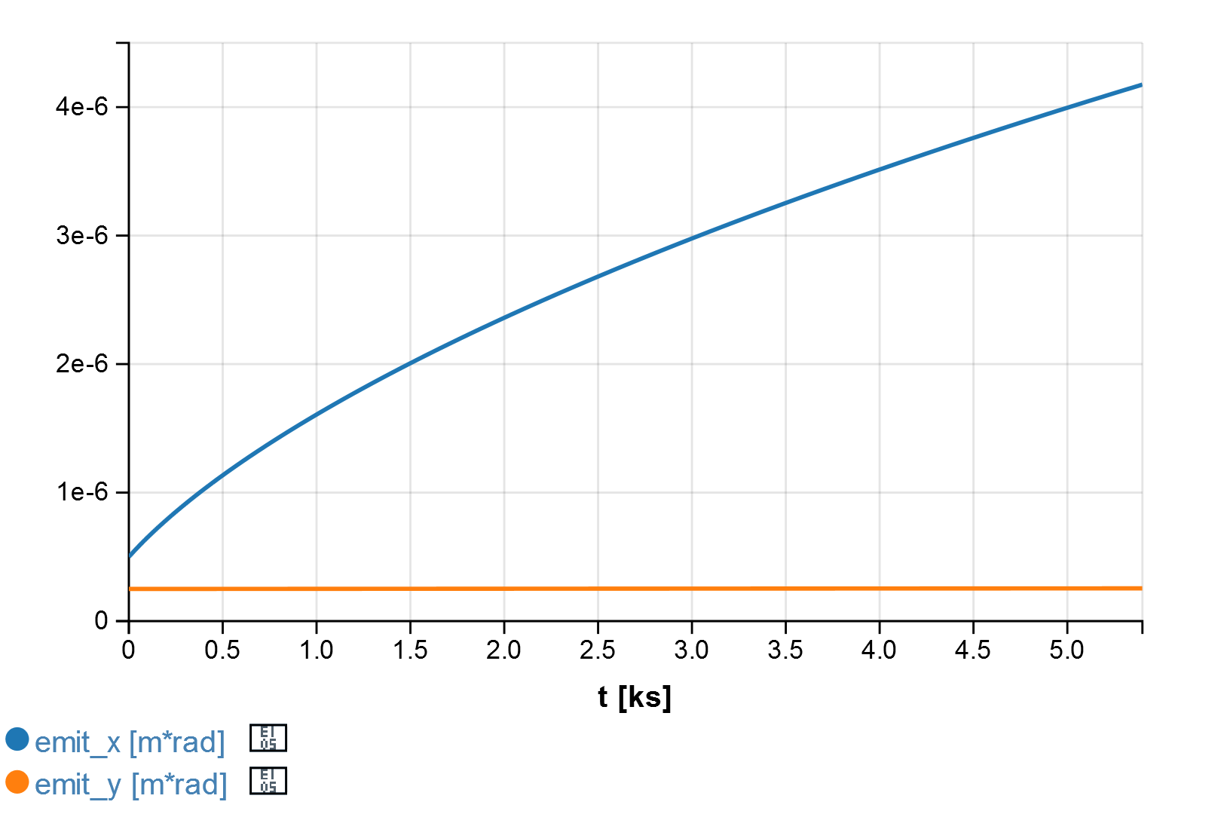
Emittance Evolution w/o ERL Cooling: 476 MHz
3.8 µm @ 75 min
2.8 µm @ 45 min
4.2 µm @ 90 min
3.3 µm @ 60 min
1.5 µm @ 15 min
Particles per punch: 9.8x10⁹
(bunch rep: 476 MHz)
Beam energy: 200 GeV
RMS Bunch length: 2 cm
Initial emittance: 0.5/0.25 µm
Energy spread: 7x10⁻⁴
2.2 µm @ 30 min
0.5 µm @ 0 min

Slide 9
HE-JLEIC Luminosity w/o Cooling: 5 GeV x 200 GeV
Beam formation time: 30 min

Slide 10
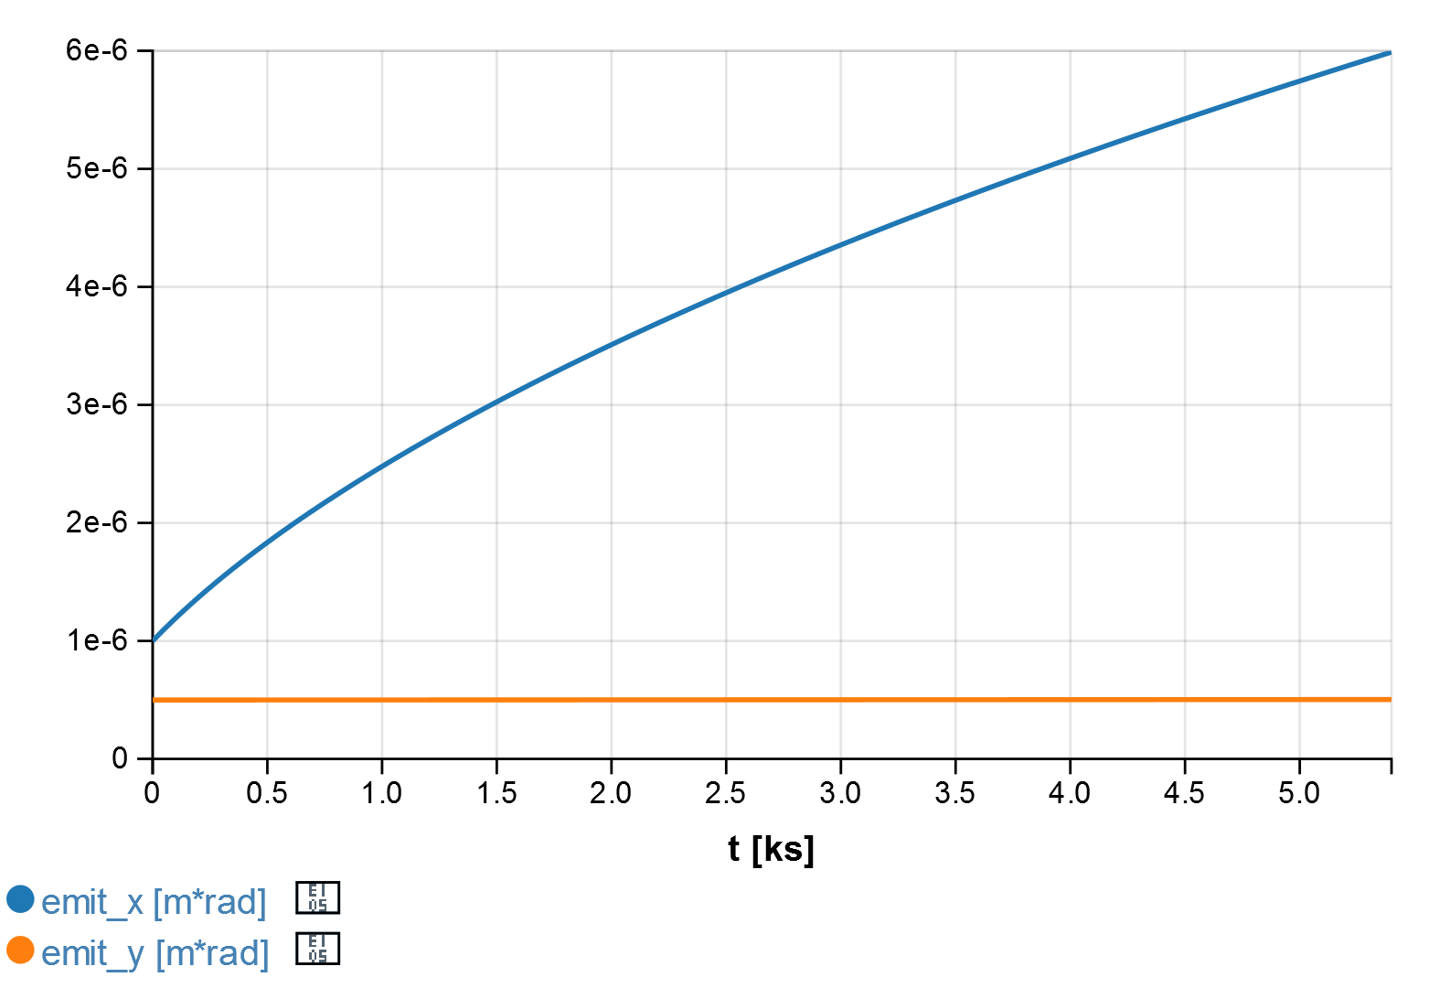
Emittance Evolution w/o ERL Cooling: 476/4 MHz
5.4 µm @ 75 min
6 µm @ 90 min
4.1 µm @ 45 min
4.8 µm @ 60 min
Particles per punch: 3.9x10¹⁰
(bunch rep: 476/4=119 MHz)
Beam energy: 200 GeV
RMS Bunch length: 3 cm
Initial emittance: 1/0.5 µm
Energy spread: 7x10⁻⁴
2.4 µm @ 15 min
3.3 µm @ 30 min
1 µm @ 0 min

Slide 11
HE-JLEIC Luminosity w/o Cooling: 10 GeV x 200 GeV
Beam formation time: 30 min

Slide 12
HL-JLEIC “Baseline” Parameters
CM energy | GeV | 63.3 (high) |  | 63.3 (high) |  | 89.4 (Very high) |  | 89.4 (Very high)
 |  | p | e | p | e | P | e | P | e
ERL cooling |  | Yes |  | No |  | Yes |  | No
Beam energy | GeV | 200 | 5 | 200 | 5 | 200 | 10 | 200 | 10
Collision frequency | MHz | 476 |  | 476 |  | 476 |  | 476
Particles per bunch | 10¹⁰ | 0.49 | 3.9 | 0.98 | 3.9 | 0.49 | 0.93 | 0.98 | 0.93
Beam current | A | 0.375 | 3 | 0.75 | 3 | 0.375 | 0.71 | 0.75 | 0.71
Polarization | % | 80 | 80 | 80 | 80 | 80 | 80 | 80 | 80
RMS bunch length | cm | 1 | 1 | 2 | 1 | 1 | 1 | 3 | 1
Norm. emitt., horiz. | μm | 1.8 | 54 | 0.5 | 54 | 1.8 | 432 | 1 | 432
Norm. emitt., vert. | μm | 0.18 | 5.4 | 0.25 | 5.4 | 0.18 | 86 | 0.5 | 86
Horizontial β* | cm | 13 | 20 | 3.76 | 1.6 | 21 | 8 | 7.5 | 1.6
Vertical β* | cm | 1.3 | 2 | 1.88 | 0.8 | 2.1 | 0.8 | 3.75 | 0.8
Vert. beam-beam |  | 0.005 | 0.037 | 0.013 | 0.054 | 0.001 | 0.005 | 0.006 | 0.027
Laslett tune-shift |  | 0.003 |  | 0.004 |  | 0.003 |  | 0.005
Detector space | m | 3.6/7 | 3.2/3 | 3.6/7 | 3.2/3 | 3.6/7 | 3.2/3 | 3.6/7 | 3.2/3
Hourglass (HG) |  | 0.92 |  | 0.72 |  | 0.87 |  | 0.63
Lumi/IP, w/HG, 10³³ | /cm²s | 6.2 |  | 23.8 (peak) |  | 0.85 |  | 5.0 (peak)
Aver. Lumi/IP, 10³³ | /cm²s | 5.8 |  | 12.0 (6.5) |  | 0.8 |  | 3.2 (2.2)
Nominal beam store: 8 hours;
Short store: 0.5 hour, with a stacking-cooling booster
Excluding 1st 15 min

Slide 13
HE-JLEIC Luminosity

Slide 14
HE-JLEIC Luminosity

Slide 15
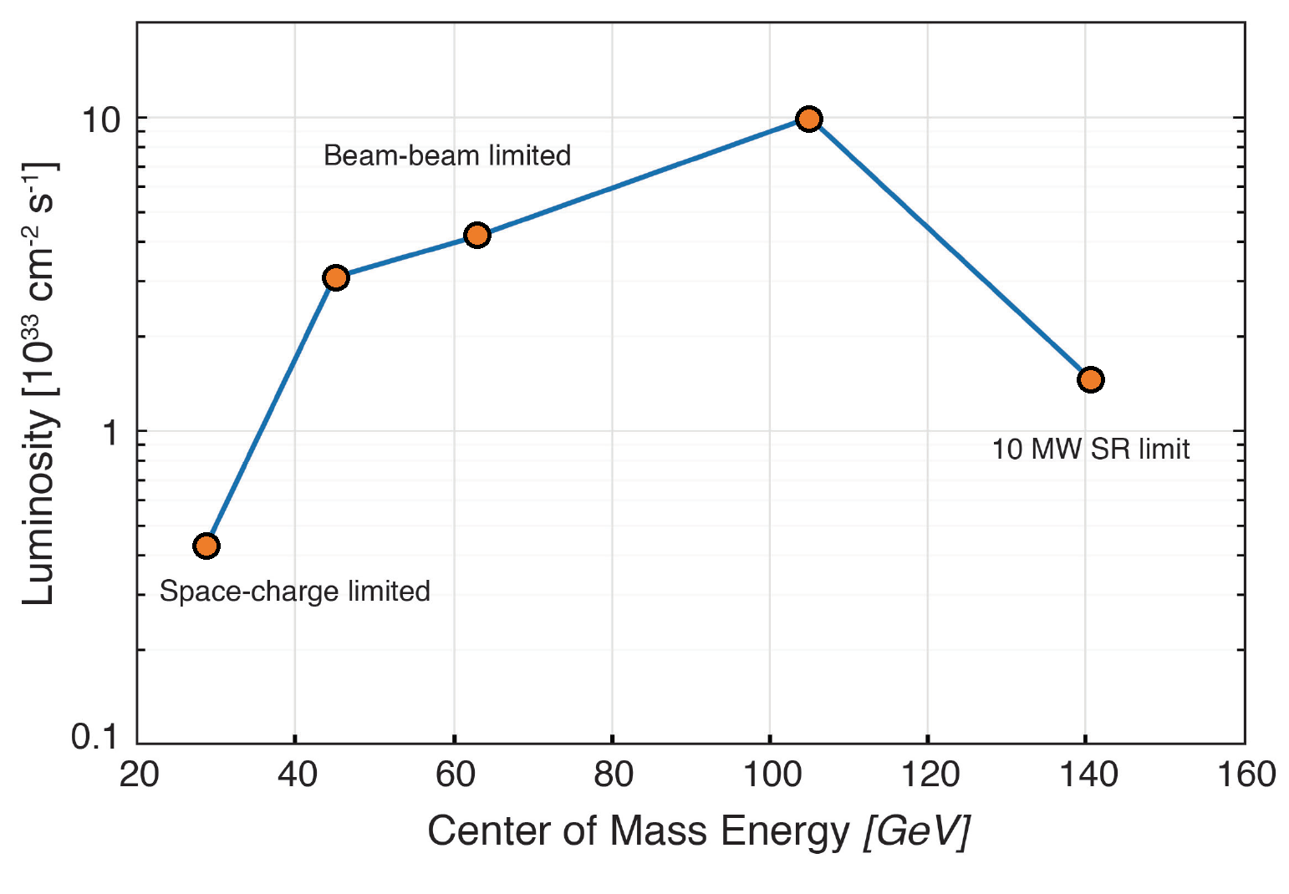
eRHIC Ring-Ring Luminosity

Slide 16
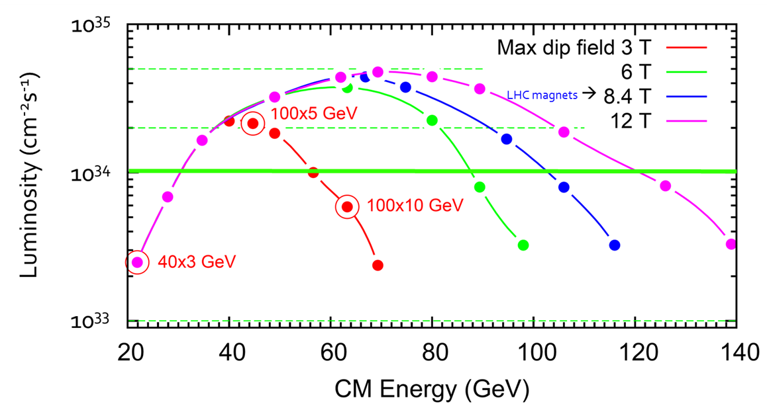
“Old” HL-JLEIC

