Slide 1
HE-JLEIC: Do We Have a Baseline?
Yuhong Zhang
June 5, 2018

Slide 2
Path to 100 GeV CM Energy
Physics requirement: Preserve high luminosity for CM energy below 69 GeV
Reach 100 GeV CM energy with good luminosity
Preserve full acceptance detections
Design strategy: High CM energy and full acceptance are highest priority
High luminosity at high energy is a plus
Risk, cost and accelerator R&D modest
The same design principles (concepts and
Electron complex: no change / no upgrade of CEBAF
Ion complex: collider ring energy double 100 GeV → 200 GeV
same foot print, double the dipole field: 3 T → 6 T
Modification of IR: basically the same,
doubling the quad lengths (longer focusing length)
Polarization: figure-8
High energy ERL cooling: (optional?)

Slide 3
Ion Collider Ring Magnets
Tim Michalski, Ruben Fair,
Renuka Rajput-Ghoshal,
Probir Ghoshal
There is a solution in cosine-theta magnets
6 T, Curved, 2 layer coil design has been prototyped and tested (IHEP)
Prototype program required
Need to get more information than what is presented in technical papers
Alternative
look at lower operating temperture as a means to get a 1 layer coil design (less technical risk for curved magnet, requires higher operating cost for cryogenics)
look at Nb3Sn to get a 1 layer coil design (higher cost magnets, brittle coil structure, can it be build curved, 4.5 K operation)
SIS 300, a fast-ramping heavy ion synchrotron with a rigidity of 300 T-m, with 6 T, 100 mm coil aperture 2.6 m long SC dipoles, ramped at 1 T/s [2].
The fast ramp rate requires a magnet design that minimizes AC losses and field distortions during ramping.
A two layer cos  magnet design, using a cored Rutherford cable, has been chosen.

Slide 4
Two Booster Injector (with a full size 2nd booster)
Relative higher injection energy into booster rings
High voltage DC cooler is within the state-of-art (4 MeV)
No need of 8 MeV DC cooling for 15 GeV proton beams,
there will be no technical risk for DC cooling
The 2nd booster ring ejection energy can be much higher
20 GeV or even 30 GeV (about 1 T magnet),
May eliminate transition energy crossing for all ion species at the collider ring
Small aperture magnet for the collider ring
The injected beam to the collider ring has small emittances/beam sizes
Stacking-cooling ring if no bunched beam ERL cooling
Stored beam must be replaced frequently due to IBS induced emittance growth
A new beam could be formed while the collider ring is in operation
When the used beam is ejected, the already formed new beam in the 2nd booster can be transferred into the collider ring immediate
The ion beam formation time can reduced from ~30 min to ~1 min.
This can increase the duty factor and the integrated luminosity.
Yuhong Zhang, Jiquan Guo

Slide 5
Two Booster Injector: Proton
Yuhong Zhang, Jiquan Guo
2nd booster (full size)
collider ring
ion sources
1st booster
BB cooling
SRF linac
DC cooling
DC cooling
Injection: 285 MeV
Accumulation
Accelerate to 8 GeV
Injection: 8 GeV
Stacking 56 long bunches with DC cooling (4 MeV)
Precooling (4 MeV DC)
Accelerate to ~25 GeV
Bunch splitting
Injection: ~25 GeV
Accelerating to collision energy
Bunched beam cooling
Energy
proton
collider ring
2nd booster
Ramp: 7.8
1st booster
Ramp: 3.6
emittance preservation
Ramp: 6.4
Up to 200 GeV
Stacking,
Pre-cooling
Bunch splitting
BB ERL cooler
up to 109 MeV
Multi-turn injection accumulation
Fast ramp
25 GeV
8 GeV
DC cooler 4.3 MeV
285 MeV

Slide 6
Two Booster Injector: Ion Lead
Yuhong Zhang, Jiquan Guo
2nd booster (full size)
collider ring
ion sources
1st booster
BB cooling
SRF linac
DC cooling
DC cooling
Injection: 100 MeV
Accumulation with cooling
Acceleration to 2 GeV
Injection: 2 GeV
Stacking 56 long bunches with DC cooling
Accelerate to ~8 GeV, then pre-cooling
Bunch splitting
Acceleration to 9.35 GeV
Injection: 9.35 GeV
Bucket-to-bucket transfer
Acceleration to ~20 GeV
Accelerate to collision energy
Bunched beam cooling
Energy
Lead Ion
collider ring
2nd booster
Ramp: 7.8
emittance preservation
1st booster
Ramp: 3.61
Bunch splitting
Ramp: 6.4
Up to 78.3 GeV/u
Stacking,
emittance preservation
BB ERL cooler
up to 42.6 MeV
Fast ramp
Pre-cool
~20 GeV/u
Multi-turn injection accumulation
9.35 GeV/u
8 GeV/u
2 GeV/u
DC cooler 4.3 MeV
100 MeV/u
DC cooler
1.1 MeV
DC cooler 55 keV

Slide 7
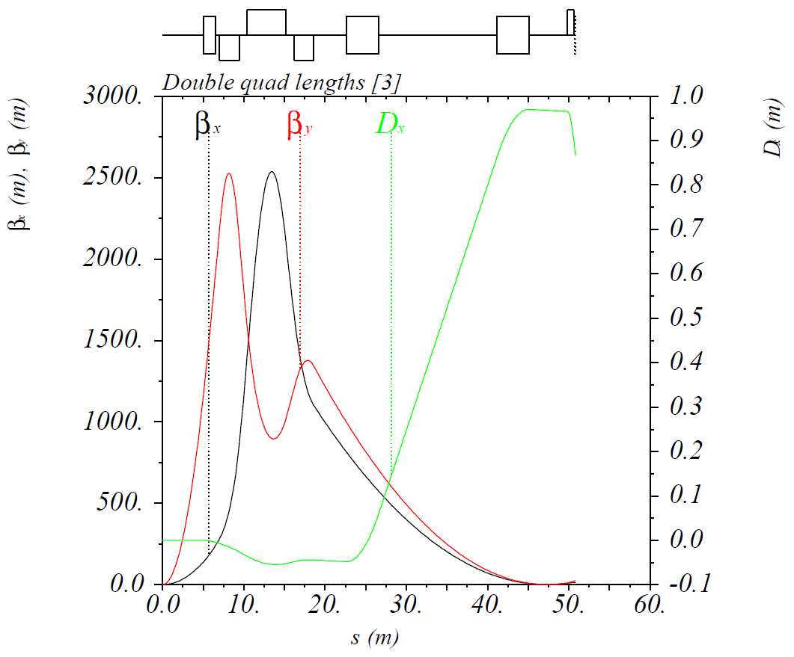
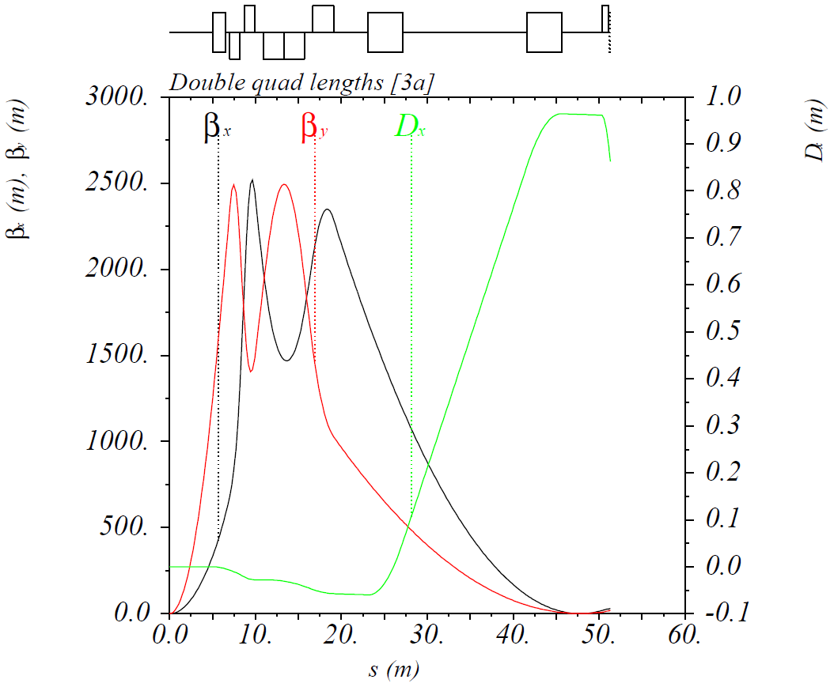
Interaction Region
Vasiliy Morozov
 |  | Quad radii (mm) | Quad $θ$ (mrad) | $D_{x}$ at roman pot (m) | $β_{x,y}^{∗}$ (cm) | Luminosity reduction factor
1 | Reduced FFQ apertures | 37 / 58 / 73 | 4.5 / 5.0 / 5.3 | 0.95 | 10 / 2 | 1
2 | Doubled detector space, halved crossing angle | 50 / 83 / 215 | 3.3 / 4.5 / 10.3 | 0.48 | 28 / 7.5 | 0.31
3 | Doubled quad lengths | 85 / 152 / 196 | 9.1 / 10.0 / 10.5 | 0.97 | 18 / 2.15 | 0.72
3.1 | Cut 1st FFQ in half, use 1st half only at < 65 GeV |  |  |  | 7.5 / 2 | 1.15
4 | 1.5 quad lengths, 2/3 crossing angle | 72 / 129 / 292 | 5.9 / 7.6 / 14.8 | 0.64 | 24 / 4.4 | 0.44
Keep maximum $β$-functions at ~2500 m ⇒ same maximum beam size
Quad apertures ≡ 6 T / $\left({∂B_{y}}/{∂x}\right)$ at 200 GeV/c = 85 / 152 / 196 mm (radius)
$θ≡$ Quad aperture / distance from IP to quad’s far end = 9.1 / 10.0 / 10.5 mrad
$β_{x,y}^{∗}$ = 18 / 2.15 cm, $D_{x}$ at roman pot = 0.97 m
Option 3.1
Option 3

Slide 8
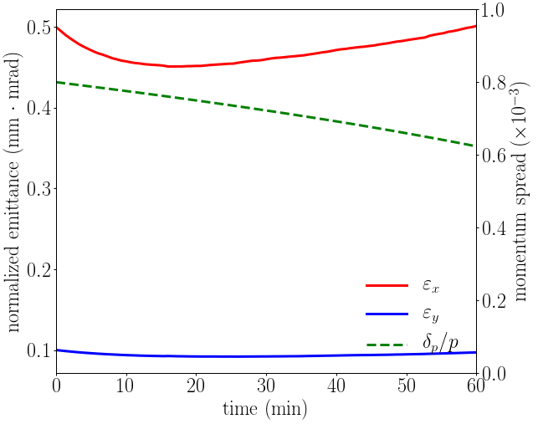
Cooling at Collision
Best result:
Reduce proton beam current to 40% of the nominal value ➔ 0.3 A
Dispersion: 1.8/0.3 m, coupling: 24%
Emittance was maintained for one hour.
Not in equilibrium, momentum spread is still decreasing.
Change of the ERL cooler
Injector and merger
Merger cavity twice as strong or half the angle if we go with RF merger.
Linac cryomodule : 1 ⇒ 2
Arcs and beam physics
Double magnet strength
Chirper and de-chirper twice the gradient
Space charge reduced
CSR and µBI should be about the same
Cooler insertion
Focusing magnets twice as strong
Exchange region
Focusing magnets twice as strong
Kickers twice as strong (4 time the power)
Beam dump may need more acceptance
Do we need ERL cooling?

Slide 10
JLEIC Baseline
63.3 (high)
p | e
100 | 10
476
0.98 | 3.7
0.75 | 0.71
80 | 75
1 | 1
0.9/0.18 | 432/86.4
10.5/2.1 | 4/0.8
0.002 | 0.009
0.031
3.6/7 | 3.2/3
0.86
1.7
CM energy | GeV | 21.9 (low) |  | 44.7 (medium) |  | 63.3 (high)
 |  | p | e | p | e | p | e
Beam energy | GeV | 40 | 3 | 100 | 5 | 100 | 10
Collision frequency | MHz | 476 |  | 476 |  | 476/4=119
Particles per bunch | 10¹⁰ | 0.98 | 3.7 | 0.98 | 3.7 | 3.9 | 3.7
Beam current | A | 0.75 | 2.8 | 0.75 | 2.8 | 0.75 | 0.71
Polarization | % | 80 | 80 | 80 | 80 | 80 | 75
Bunch length, RMS | cm | 3 | 1 | 1 | 1 | 2.2 | 1
Norm. emitt., horiz./vert. | μm | 0.3/0.3 | 24/24 | 0.5/0.1 | 54/10.8 | 0.9/0.18 | 432/86.4
Horizontal & vertical β* | cm | 8/8 | 13.5/13.5 | 6/1.2 | 5.1/1 | 10.5/2.1 | 4/0.8
Vert. beam-beam param. |  | 0.015 | 0.092 | 0.015 | 0.068 | 0.008 | 0.034
Laslett tune-shift |  | 0.06 | 7x10⁻⁴ | 0.055 | 6x10⁻⁴ | 0.056 | 7x10⁻⁵
Detector space, up/down | m | 3.6/7 | 3.2/3 | 3.6/7 | 3.2/3 | 3.6/7 | 3.2/3
Hourglass(HG) reduction |  | 1 |  | 0.87 |  | 0.75
Luminosity/IP, w/HG, 10³³ | cm⁻²s⁻¹ | 2.5 |  | 21.4 |  | 5.9

