Slide 1
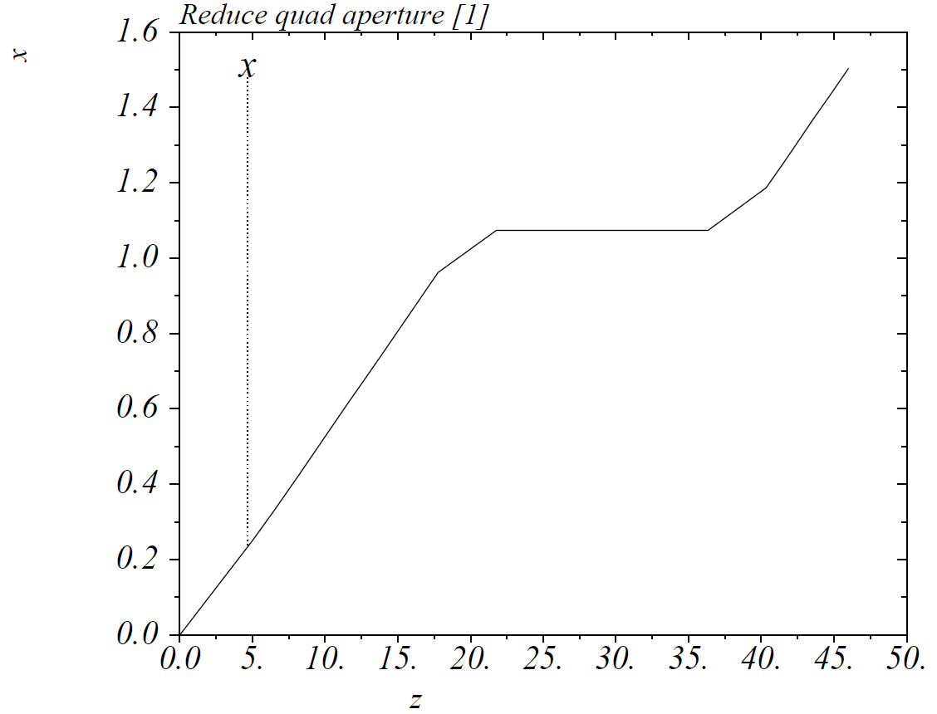
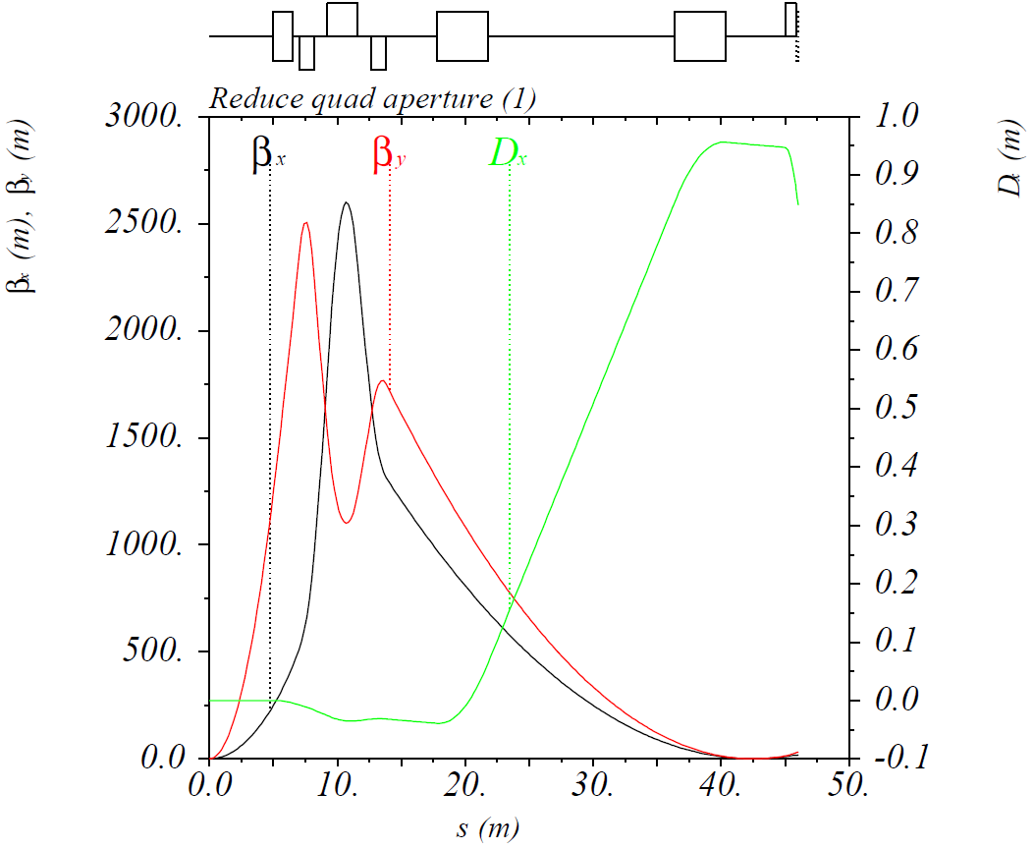
Option 1: Reduced FF Quad Apertures
Same optics and geometry
Quad apertures ≡ 6 T / $\left({∂B_{y}}/{∂x}\right)$ at 200 GeV/c = 37 / 58 / 73 mm (radius)
$θ≡$ Quad aperture / distance from IP to quad’s far end = 4.5 / 5.0 / 5.3 mrad
$β_{x,y}^{∗}$ = 10 / 2 cm, $D_{x}$ at roman pot = 0.95 m

Slide 2
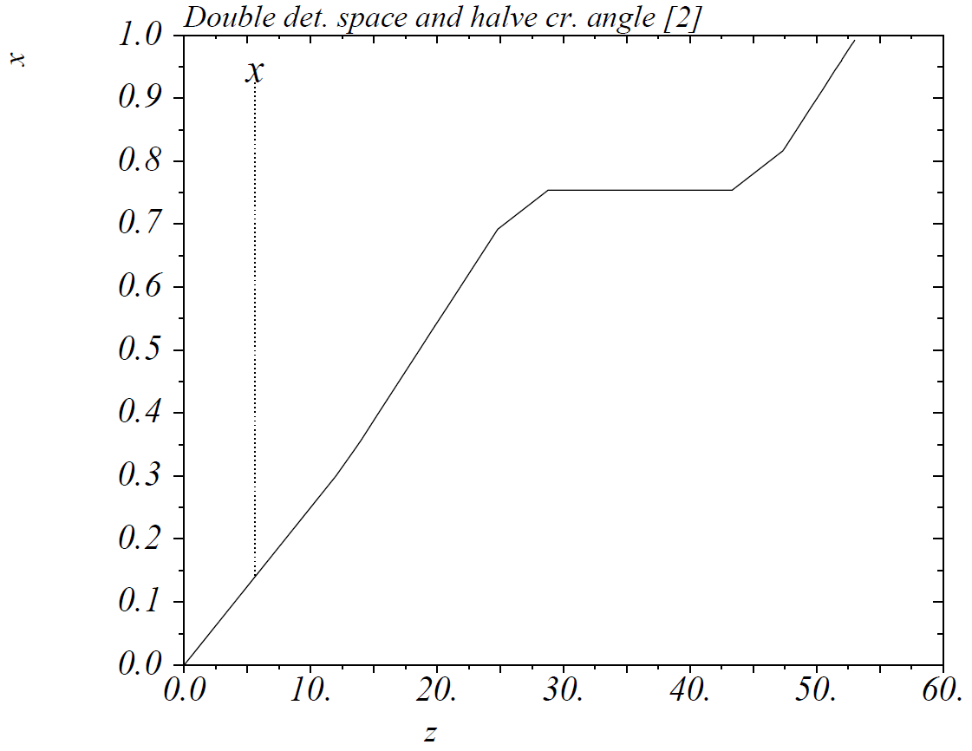
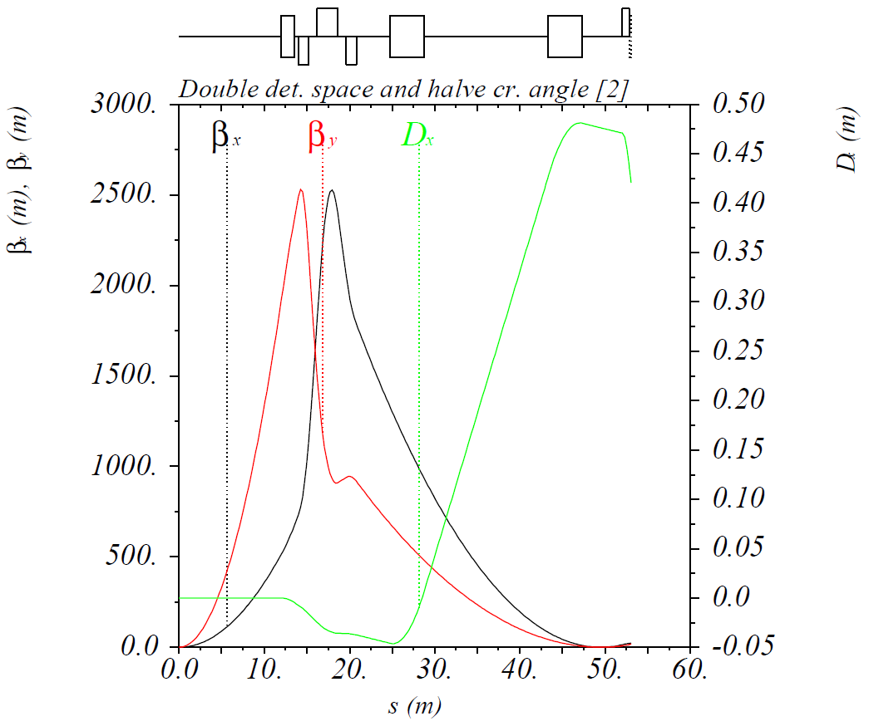
Option 2: Doubled Detector Space and Halved Crossing Angle
Keep maximum $β$-functions at ~2500 m ⇒ same maximum beam size
Quad apertures ≡ 6 T / $\left({∂B_{y}}/{∂x}\right)$ at 200 GeV/c = 50 / 83 / 215 mm (radius)
$θ≡$ Quad aperture / distance from IP to quad’s far end = 3.3 / 4.5 / 10.3 mrad
$β_{x,y}^{∗}$ = 28 / 7.5 cm, $D_{x}$ at roman pot = 0.48 m

Slide 3
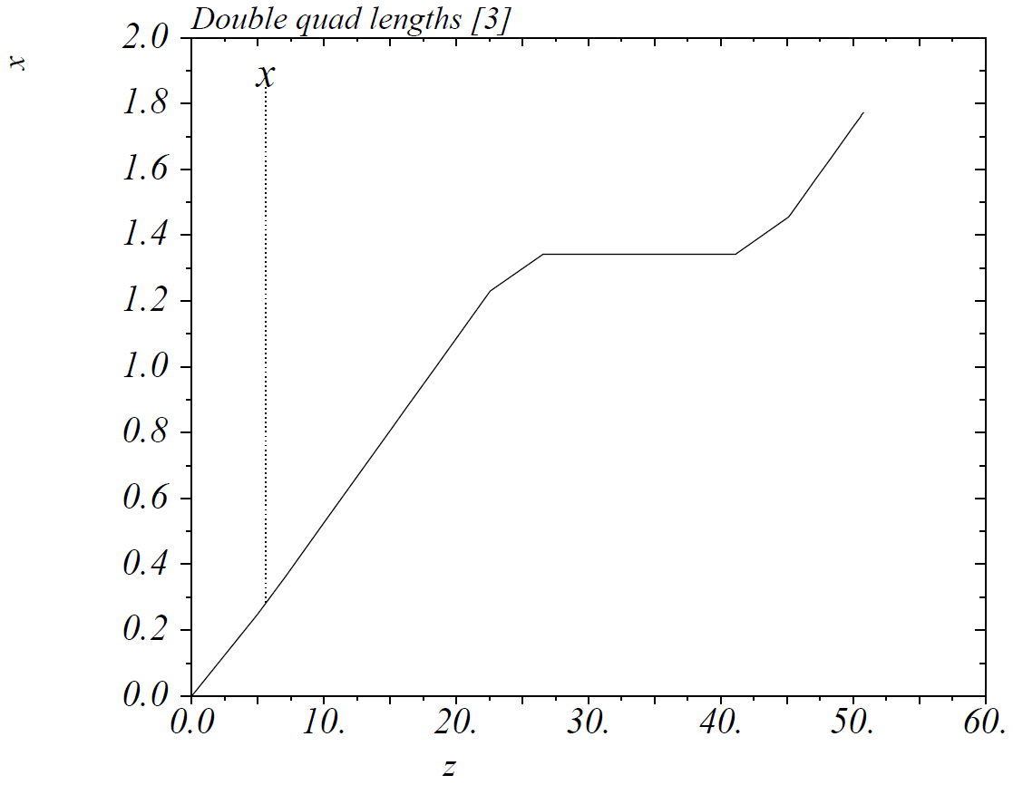
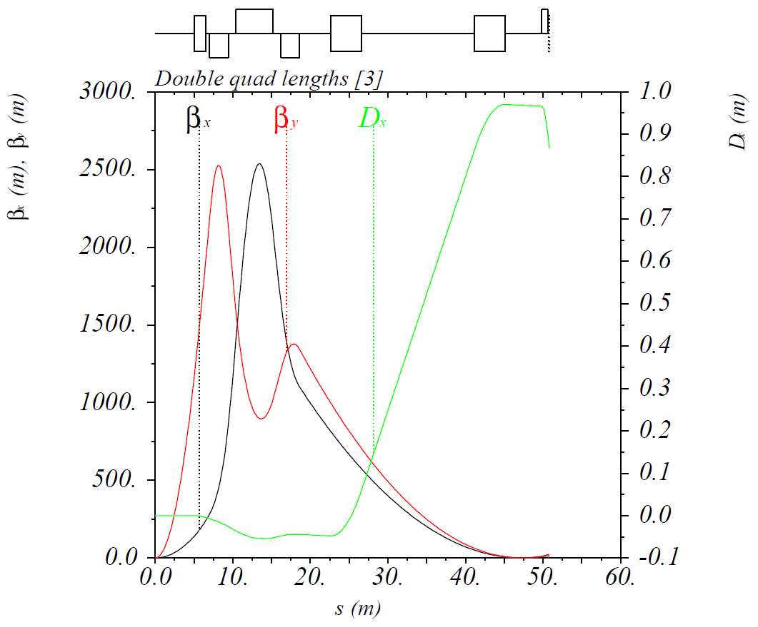
Option 3: Doubled Quad Lengths
Keep maximum $β$-functions at ~2500 m ⇒ same maximum beam size
Quad apertures ≡ 6 T / $\left({∂B_{y}}/{∂x}\right)$ at 200 GeV/c = 85 / 152 / 196 mm (radius)
$θ≡$ Quad aperture / distance from IP to quad’s far end = 9.1 / 10.0 / 10.5 mrad
$β_{x,y}^{∗}$ = 18 / 2.15 cm, $D_{x}$ at roman pot = 0.97 m

Slide 4
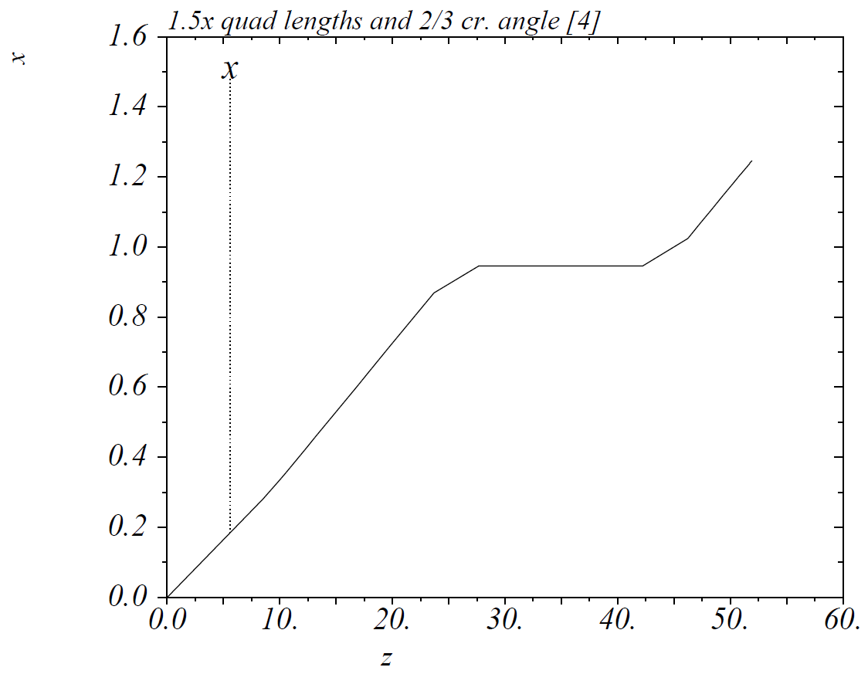
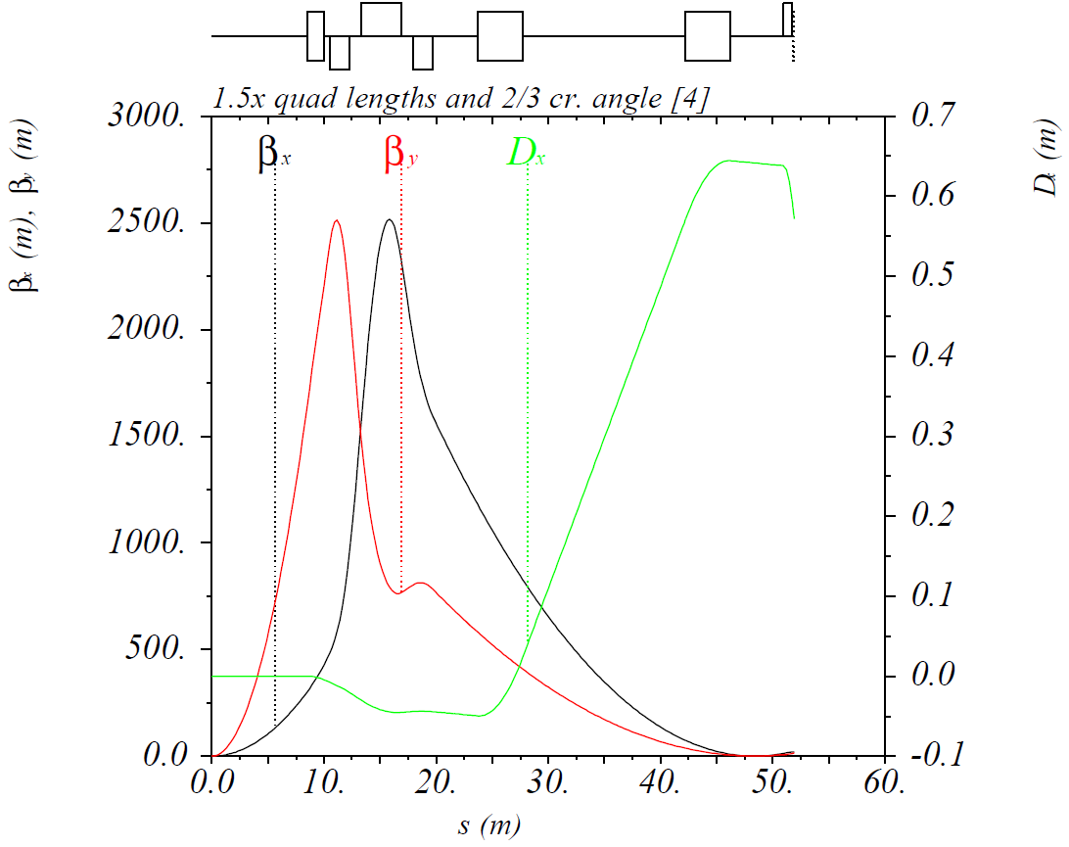
Option 4: 1.5x Quad Lengths and 2/3 Crossing Angle
Keep maximum $β$-functions at ~2500 m ⇒ same maximum beam size
Quad apertures ≡ 6 T / $\left({∂B_{y}}/{∂x}\right)$ at 200 GeV/c = 72 / 129 / 292 mm (radius)
$θ≡$ Quad aperture / distance from IP to quad’s far end = 5.9 / 7.6 / 14.8 mrad
$β_{x,y}^{∗}$ = 24 / 4.4 cm, $D_{x}$ at roman pot = 0.64 m

Slide 5
Summary
Option | Quad radii (mm) | Quad $θ$ (mrad) | $D_{x}$ at roman pot (m) | $β_{x,y}^{∗}$ (cm) | Luminosity factor
1 | 37 / 58 / 73 | 4.5 / 5.0 / 5.3 | 0.95 | 10 / 2 | 1
2 | 50 / 83 / 215 | 3.3 / 4.5 / 10.3 | 0.48 | 28 / 7.5 | 0.31
3 | 85 / 152 / 196 | 9.1 / 10.0 / 10.5 | 0.97 | 18 / 2.15 | 0.72
4 | 72 / 129 / 292 | 5.9 / 7.6 / 14.8 | 0.64 | 24 / 4.4 | 0.44

