Slide 1
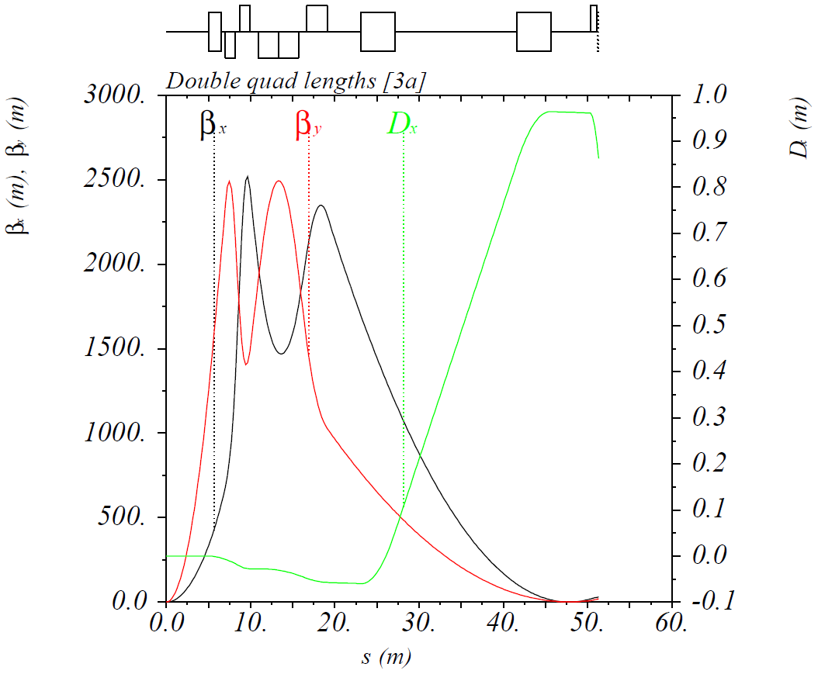
Option 3a: IR Optimization for Lower Energies
Cut first FFQ in half and use the halves as the first and second FFQs at lower energies
Can run in this mode up to 65 GeV
$β_{x,y}^{∗}$ = 7.5 / 2 cm, luminosity improvement by a factor of 1.15 (compared to baseline)

Slide 2
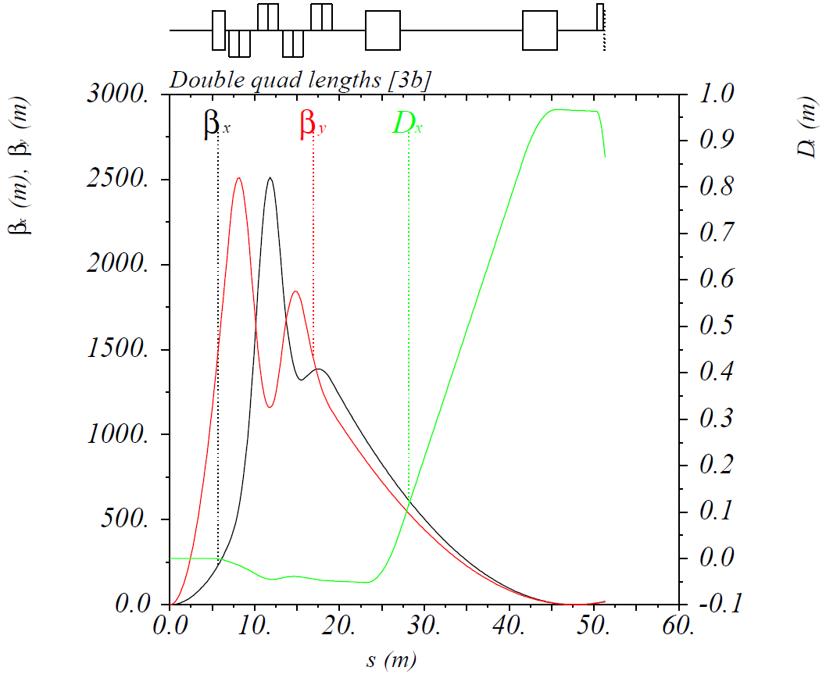
Option 3b: IR Optimization for Lower Energies
Cut second FFQ in half and use the halves as the second and third FFQs at lower energies
Can run in this mode up to 84 GeV
$β_{x,y}^{∗}$ = 14 / 2.15 cm, luminosity reduction by a factor of 0.82 (compared to baseline)

