Slide 1
Impact of Ion Energy Increase on Ion Polarization
A.M. Kondratenko, M.A. Kondratenko (Zaryad), Yu.N. Filatov (MIPT),
Ya.S. Derbenev, F. Lin, V.S. Morozov, Y. Zhang (JLab)

Slide 2
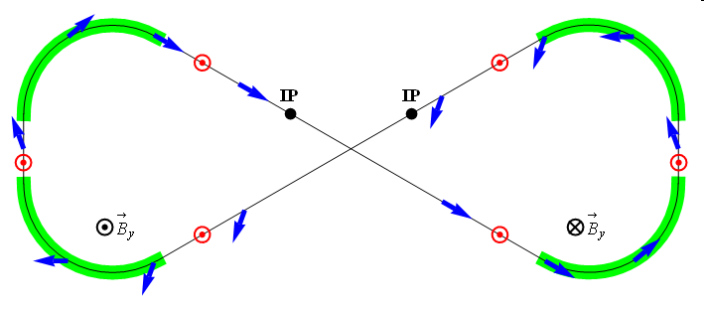
Figure-8 Scheme
Figure-8 ring is transparent to the spin motion: in an ideal structure, spin precession in one arc is cancelled by the other
Without additional fields, spin rotation is a priori unknown and occurs only due to closed orbit excursion and beam emittances
Additional fields are introduced to stabilize the spin motion by producing a spin rotation that is much greater than that due to imperfections
Required integrals of the additional fields are almost two orders of magnitude lower than those of full Siberian snakes
e.g. ~3 Tm vs. < 400 Tm for deuterons at 100 GeV
Figure-8 is an indispensable solution for deuterons in the whole EIC energy range and protons in the low-to-medium energy range as well as an excellent alternative solutions for high-energy protons and electrons
ν = 0

Slide 3
Zero-Integer Spin Resonance and Spin Stability Criterion
Total zero-integer spin resonance strength
$${\vec{w}}_{0}={\vec{w}}_{coherent}+{\vec{w}}_{emittance} , \left|{\vec{w}}_{emittance}\right|≪\left|{\vec{w}}_{coherent}\right|$$
is composed of
coherent part $w_{coherent}$ due to closed orbit excursions (due to imperfections); it does not lead to depolarization but causes coherent spin rotation about a priori unknown direction
incoherent part $w_{emittance}$ due to transverse and longitudinal emittances (proportional to beam emittance), it causes spin tune spread potentially leading to depolarization
Spin stability criterion
the spin tune induced by a spin rotator must significantly exceed the strength of the incoherent part of the zero-integer spin resonance
$$ν≫\left|{\vec{w}}_{emittance}\right|$$
for proton beam $ν_{p}={10}^{−2}$
for deuteron beam $ν_{d}={10}^{−4}$

Slide 4
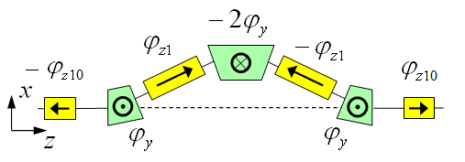
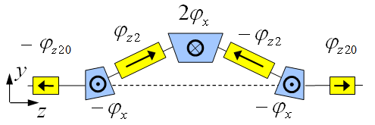
3D Spin Rotator in Ion Collider Ring
Provides control of the radial, vertical, and longitudinal spin components
Module for control of the radial component (fixed radial orbit bump)
Module for control of the vertical component (fixed vertical orbit bump)
Module for control of the longitudinal component
$ν_{p}^{max}={10}^{−2}$, $ν_{d}^{max}={10}^{−4}$ at 100 GeV/c
3D spin rotator
IP
ions

Slide 5
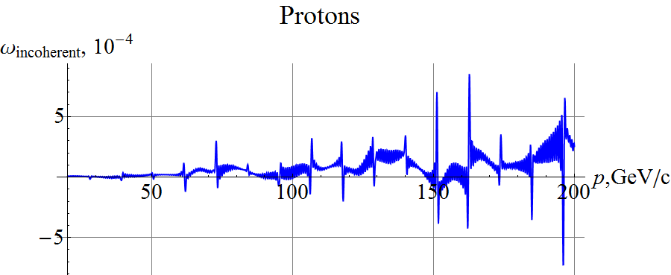
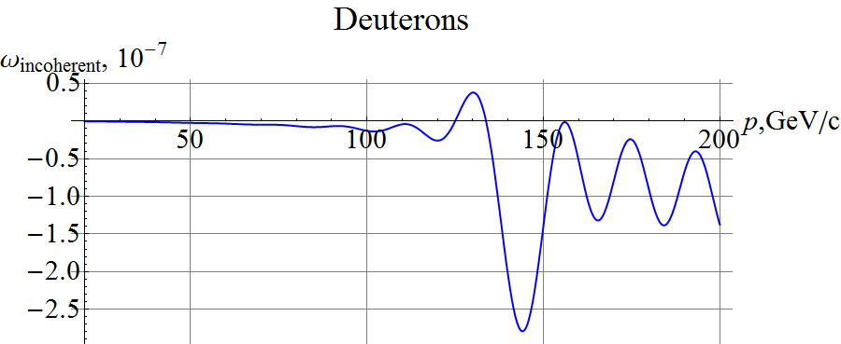
Incoherent Part of Zero-Integer Spin Resonance Strength
$ν_{p}^{max}=0.5⋅{10}^{−2}$, $ν_{d}^{max}=0.5⋅{10}^{−4}$ at 200 GeV/c are sufficient to stabilize the polarization
Assuming normalized vertical beam emittance of 0.07 μm rad

Slide 6
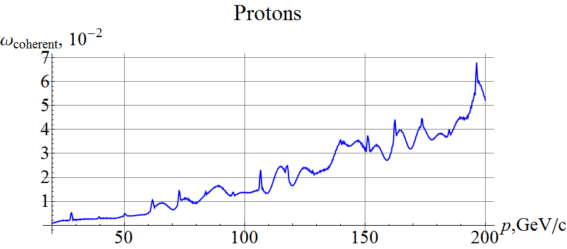
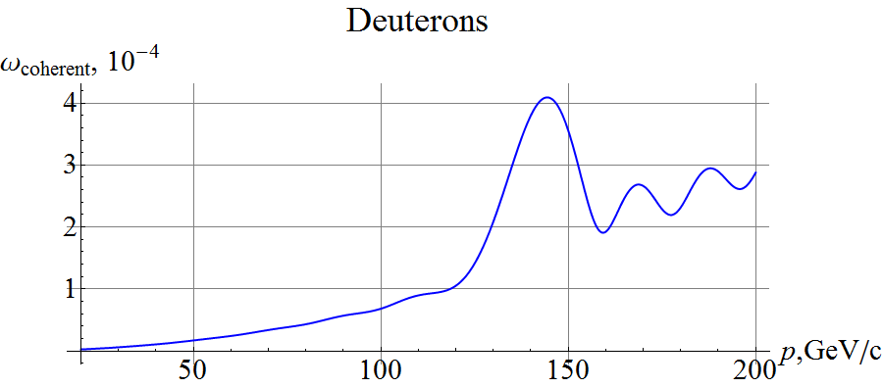
Coherent Part of Zero Integer Spin Resonance Strength
Above about 100 GeV/c, the 3D spin rotator strength is insufficient to compensate the coherent part of the resonance strength, which then determines the polarization orientation.
Assuming RMS closed orbit distortion of ~200 μm

Slide 7
Spin Control up to 200 GeV
The control solenoid strengths would have to be increased by up to a factor of 7 for protons and 4 for deuterons.
Solenoid spin rotation drops inversely proportionally to the beam momentum
Spin resonance strength grows proportionally to the beam momentum
Need to consider a 3D spin rotator based on transverse field. It is a much better option at high energies.
Orbit excursion drops
Spin rotation is essentially energy independent
For protons, the coherent part of the spin resonance strength can be reduced by a pair of compact longitudinal-axis transverse-field Siberian snakes.
Control of the ion polarization at a high energy needs further development.

