Slide 1
JLEIC SC Magnets: Replace SF and High CM Energy Needs
Tim Michalski, Ruben Fair, Renuka Rajput-Ghoshal, Probir Ghoshal

Slide 2
Superferric Magnets in JLEIC
To date, JLEIC has had Superferric (SF) Dipoles and Quadrupoles as the BASELINE technology for both the Booster Ring and Ion Collider Ring
SF Model Dipole Prototype and Test project did not get funded under the most recent FOA R&D Funding round
  Should JLEIC continue with an unvalidated technology as part of its baseline? Short answer is NO
  Need to define an alternative baseline SC magnet solution for all current applications of SF magnets in JLEIC
Main focus has been on the Dipoles in the Booster and Ion Collider Ring
  Booster: 3T, 1.42m Long, 10 cm x 6 cm Beam Pipe Aperture, Straight Magnets, 8.245° Bend Angle, 9.89m Bend Radius, 2.56 cm Sagitta, 1 T/s Ramp Rate
  Ion Collider Ring: 3T, 2 x 4m Long, 10 cm x 6 cm Beam Pipe Aperture, Straight Magnets, 4.2° Bend Angle, 109m Bend Radius, 1.83 cm Sagitta per 4m, .05 T/s Ramp Rate

Slide 3
Booster SC Dipole Alternatives
Booster: 3.45 T, 1.42m Long, 10 cm x 6 cm Beam Pipe Aperture, Straight Magnets, 8.245° Bend Angle, 9.89m Bend Radius, 2.56 cm Sagitta, 1 T/s Ramp Rate
  Consider 15% increase in field strength for High CM Energy design
  Conversion to a cosine-theta magnet design will create a round coil aperture – need a revised beam pipe aperture
SIS300 (INFN and IHEP versions) as reference designs
  Requires modified Rutherford cable for fast ramping to 1 T/s
  Both versions of SIS300 magnets are curved
GSI 001 Magnet Design - A body of work adapting a RHIC dipole towards SIS200/SIS300 performance
  Focus on new conductor design – low loss for fast ramping

Slide 4
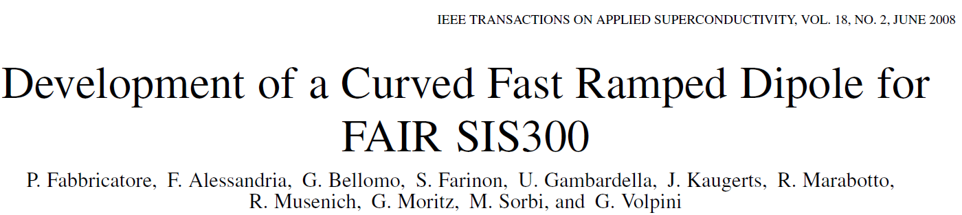
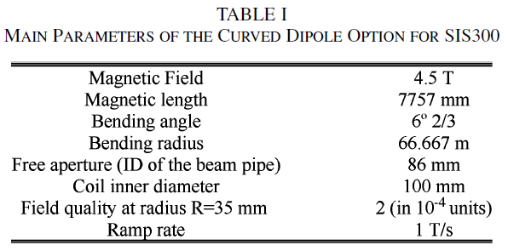
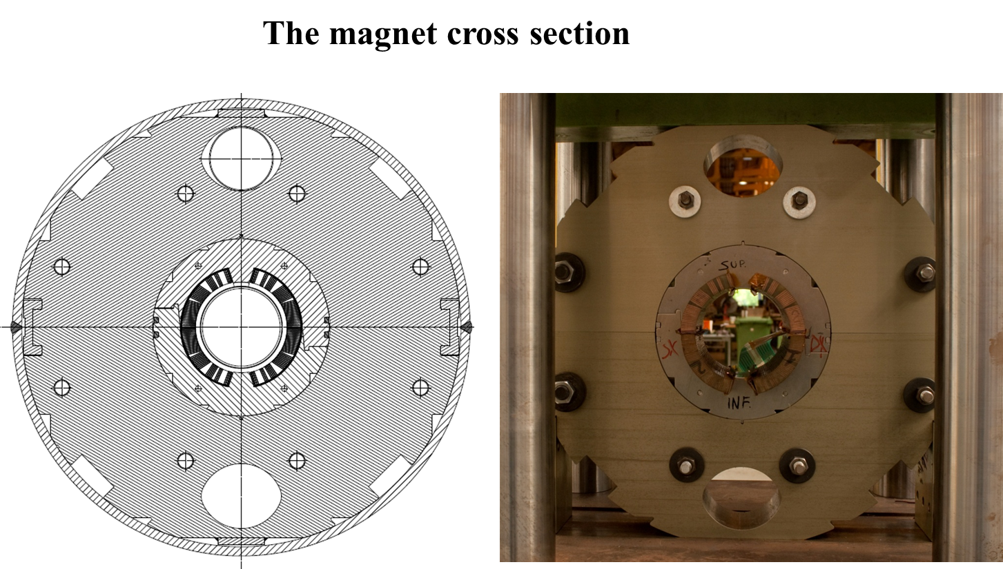
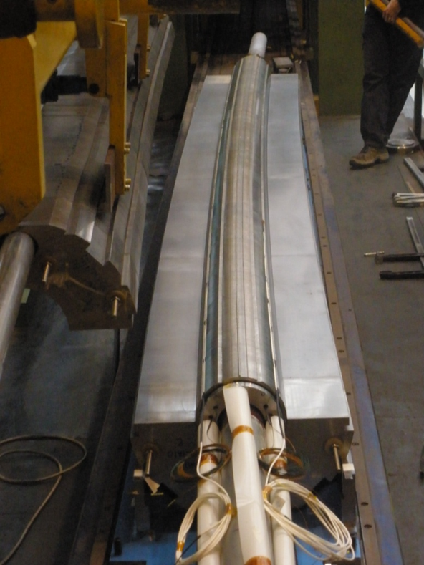
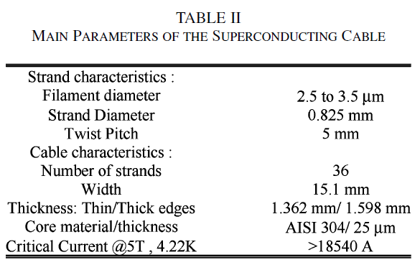
SIS300 INFN Magnet Design
P. Fabbricatore, et al, “The construction of the model of the curved fast ramped superconducting dipole for FAIR SIS300 synchrotron”, ASC 2010

Slide 5
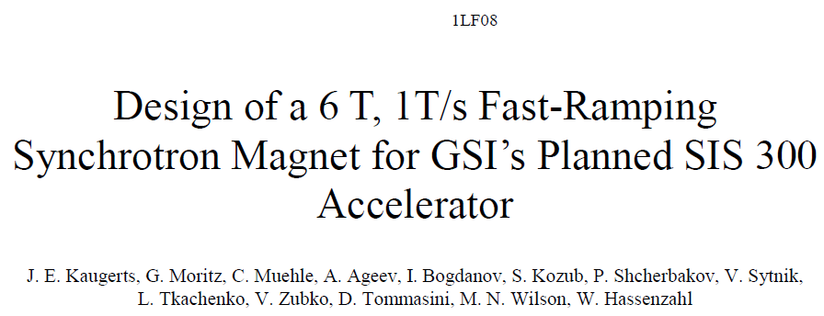
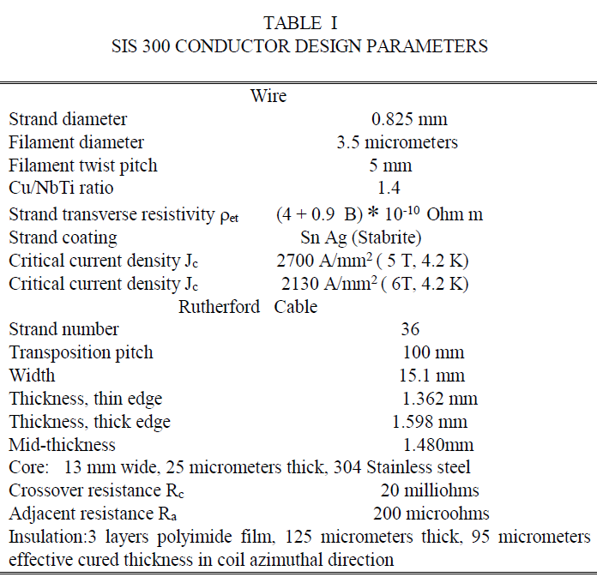
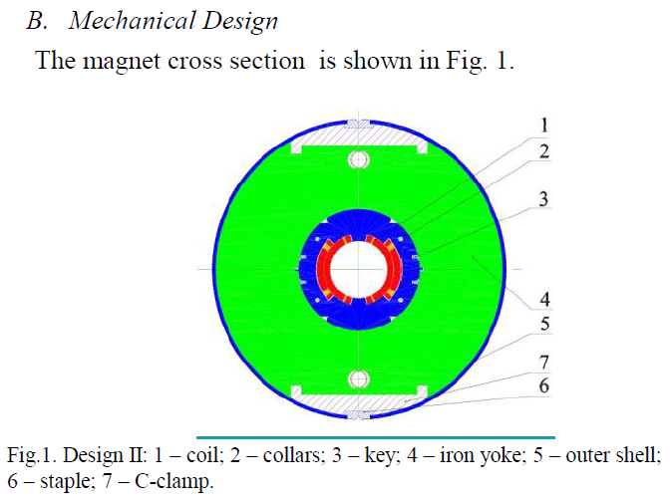
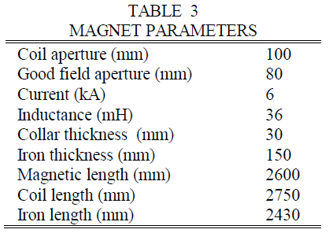
SIS300 IHEP Magnet Design
SIS 300, a fast-ramping heavy ion synchrotron with a rigidity of 300 T-m, with 6 T, 100 mm coil aperture 2.6 m long superconducting dipoles, ramped at 1 T/s [2]. The fast ramp rate requires a magnet design that minimizes AC losses and field distortions during ramping. A two layer cos  magnet design, using a cored Rutherford cable, has been chosen.

Slide 6
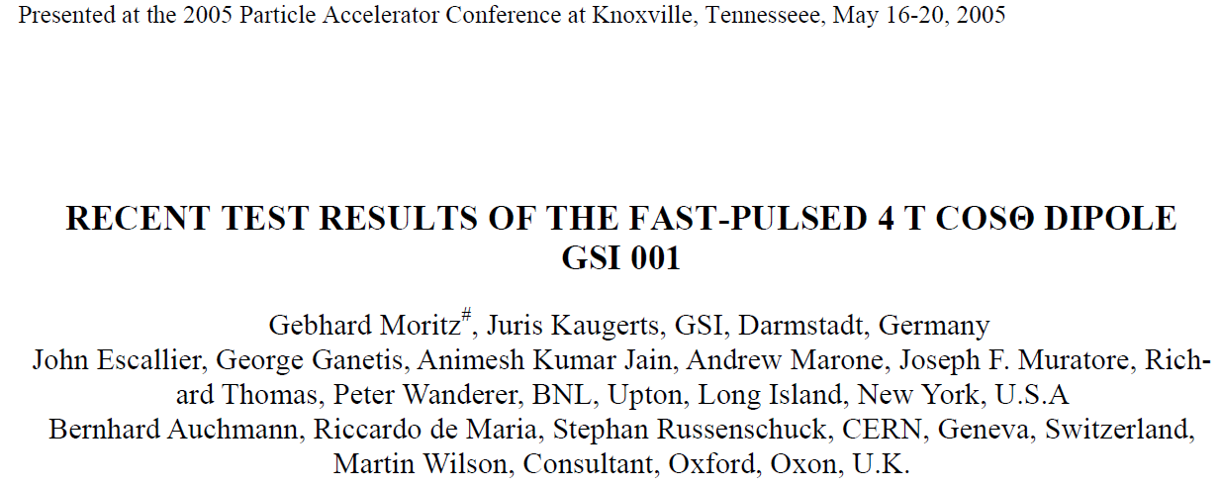
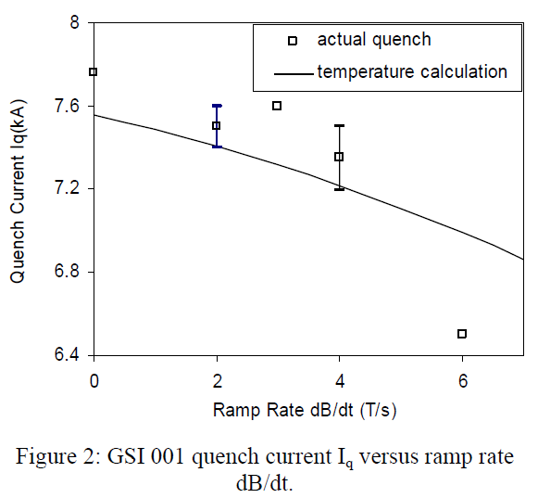
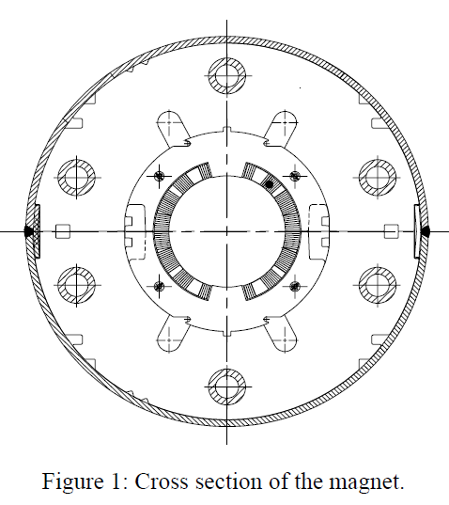
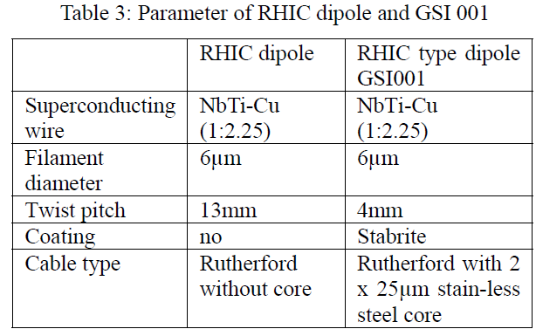
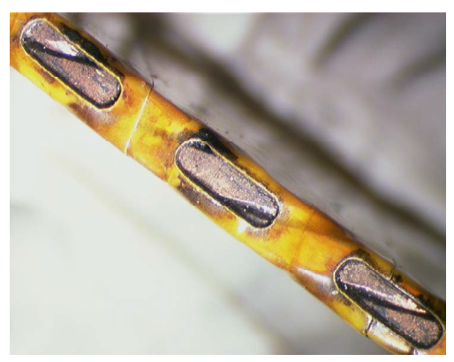
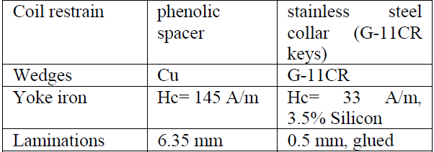
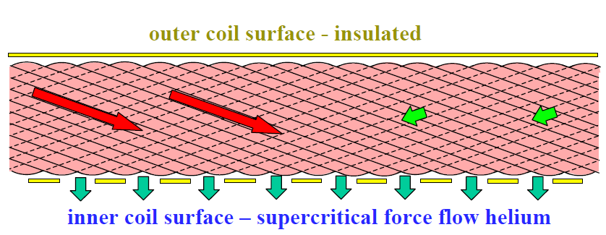
GSI 001 (BNL) Magnet Design
SIS200 1 m long model dipole GSI 001
Goal of 4T at 1 T/s ramp rate
Based on the RHIC dipole design but incorporating a number of loss reduction features

Slide 7
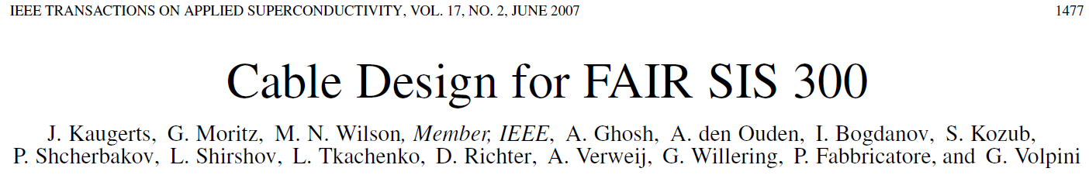
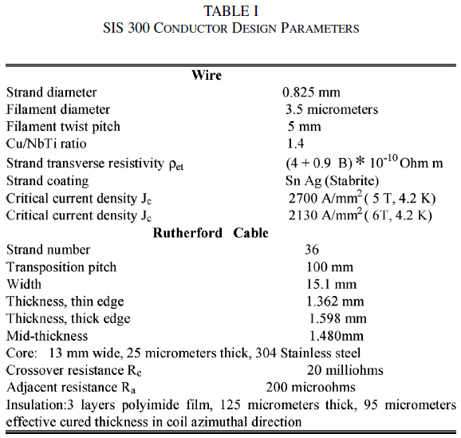
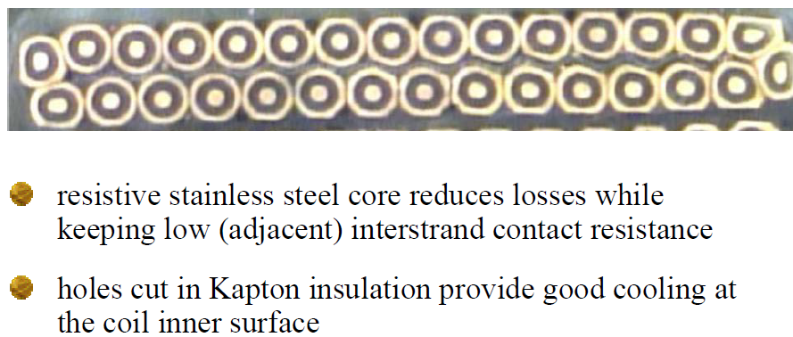
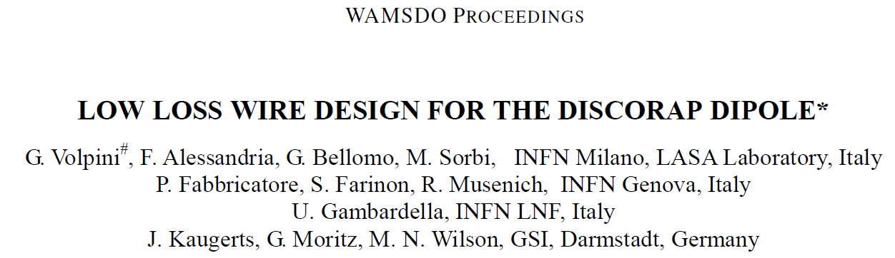
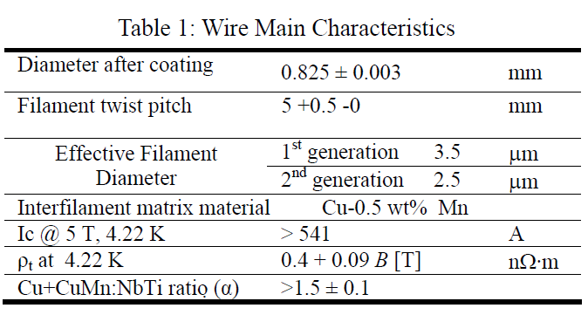
Rutherford Cable Design for High Ramp Rate
Required Changes from “Standard” Rutherford Cable
Reduced Filament Size
Reduced Filament Twist Pitch
CuMn Interfilamentary Matrix vs Cu
Stay Bright ® Strand Coating
Thin layer of SS between cable layers

Slide 8
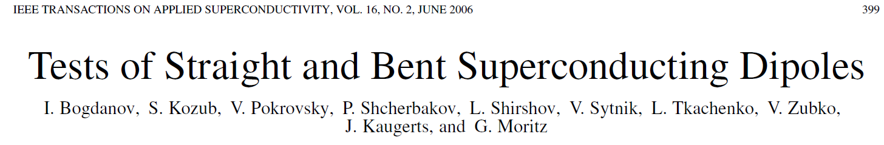
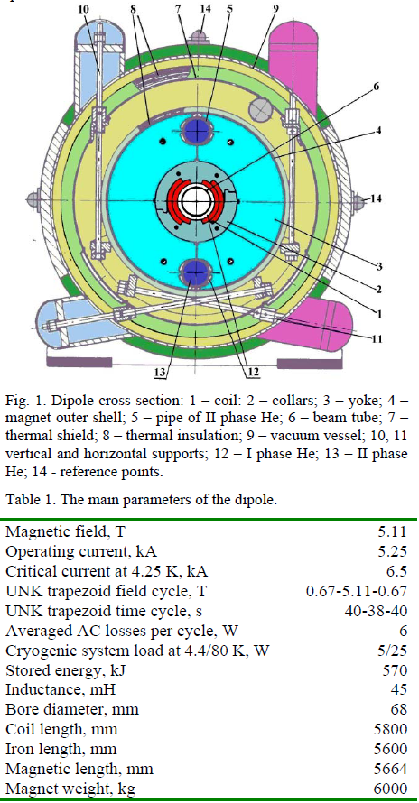
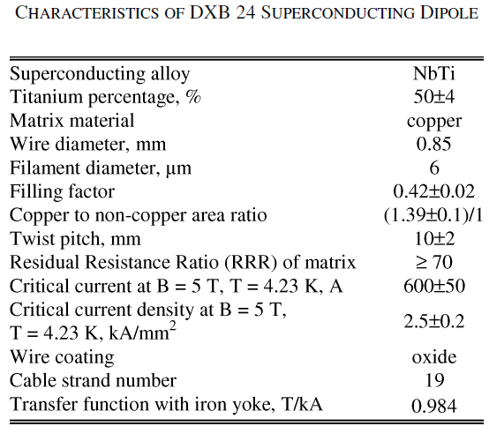
Curved vs Straight Dipole – Performance Testing
Historically, there are two techniques for building bent (curved) magnets, depending on the required radius of curvature of the magnet.
  Magnets with relatively large radius of curvature (RHIC).
    Collared coil, iron yoke and helium vessel half-shells (denoted as the cold mass, when assembled) are produced straight and after assembly the cold mass is bent with a special tool and then the helium vessel half-shells are welded.
    In this case a little curvature of the coil does not cause sufficient strains in the superconducting material (NbTi), to result in magnet degradation.
  Magnets with relatively small radius of curvature (INFN).
    The coil, iron yoke, collar sections, and helium half-shells are produced curved. This technique is essentially more complicated and more expensive in comparison with the first way.
To define a suitable bending technique, a 1 m long dipole, manufactured in the framework of the UNK project, was chosen. The straight dipole was tested, then bent with 50 m radius of curvature, and retested.
The dipole was bent by clamps in a special frame which supplied the bending of the dipole during test.
A 1 m long dipole bent at a 50 m radius requires a deflection in the center of 3 mm.
Straight and bent dipoles were tested without iron yoke and had practically equal AC loss values, which were higher by a factor of 1.3 than the losses in the dipole with iron yoke.

Slide 9
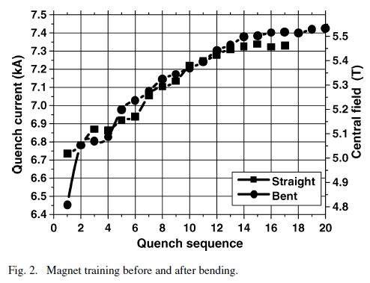
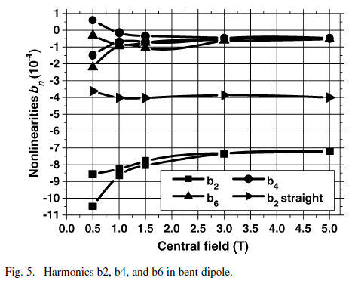
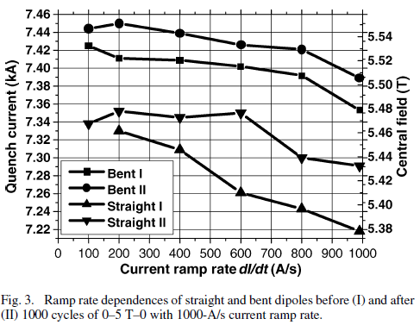
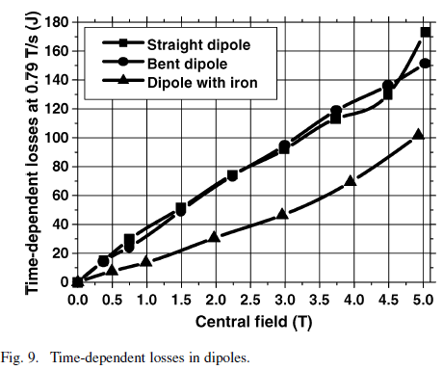
Curved vs Straight Dipole – Performance Testing
CONCLUSIONS
The main results of dipole test before and after magnet bending are the following:
1) Bending of the collared dipole coil (50 m curvature radius) did not produce turn-to-turn shorts and did not decrease ground insulation resistance.
2) The dipole begun to train afresh after the bending. Characteristics of training and ramp rate dependence of the straight and bent dipoles are similar.
3) The critical current of the dipole did not decrease after the bending which caused about 40 MPa stress in turns of the dipole.
4) 1000 cycles (0–5 T–0 with 0.75 T/s magnetic field ramp rate) practically did not influence the critical current value and ramp rate dependence in the bent dipole.
5) Cable losses had increased after a storage period of twelve years as the coil turns were under high pressure at room temperature without motion.
6) AC losses were practically unchanged, after dipole bending.
7) Harmonic was increased by dipole bending. This value should be taken into account during development of correction systems.

Slide 10
Ion Collider Ring – New Baseline
Ion Collider Ring: 3T, 2 x 4 m Long, 10 cm x 6 cm Beam Pipe Aperture, Straight Magnets, 4.2° Bend Angle, 109 m Bend Radius, 1.83 cm Sagitta per 4 m, .05 T/s Ramp Rate
New Baseline:
  3T
  8m Long – single magnet
  Cosine-Theta design – single layer coil
  Curved
  Need to address Beam Pipe Aperture – drives Coil Aperture
  109 m Bend Radius
  .05 T/s Ramp Rate
New Baseline requirements are essentially validated by the RHIC Dipole design
  Ion Collider Ring requires smaller bend radius (less than half of RHIC)
  Need to assess Beam Pipe Aperture with respect to Dynamic Aperture → Drives Coil Aperture

Slide 11
JLEIC Standard Energy Upgrade Path
JLEIC CM energy range is largely determined by the proton energy which is determined by the maximum field strength of the ion collider ring dipoles
3 T for the present baseline, super-ferric magnet is adopted for cost efficiency, sufficient for covering a sweet spot of EIC physics
For a future energy upgrade, new magnets of 6 T (super-ferric or cosine-theta), 8.4 T (LHC) and 12 T (HI-LHC R&D demonstrated) may be considered.
In principle, the electron collider ring energy may also be increased up to ~14 GeV (limited by synchrotron radiation), either requiring upgrade of CEBAF or ramping energy up in the ring
JLEIC energy upgrade can reach ultimately ~150 GeV (by 14 GeV e x 400 GeV p), following the same footprint of the present JLEIC baseline
Present JLEIC standard approach to meet EIC science
  Present baseline: 20 GeV to ~69 GeV CM energy
  ➔ 30 to 100 GeV proton energy,
  up to 40 GeV/u heavy ion energy
  3 to 12 GeV electron energy
  Energy upgrade: up to 98 GeV CM energy
  ➔ up to 200 GeV proton energy,
  up to 80 GeV/u heavy ion energy
  3 to 12 GeV electron energy
This standard approach will be documented in the pCDR
Standard Upgrade Path
(Most straightforward)
Doubling dipole field
Doubling proton energy
No touch on the electron ring

Slide 12
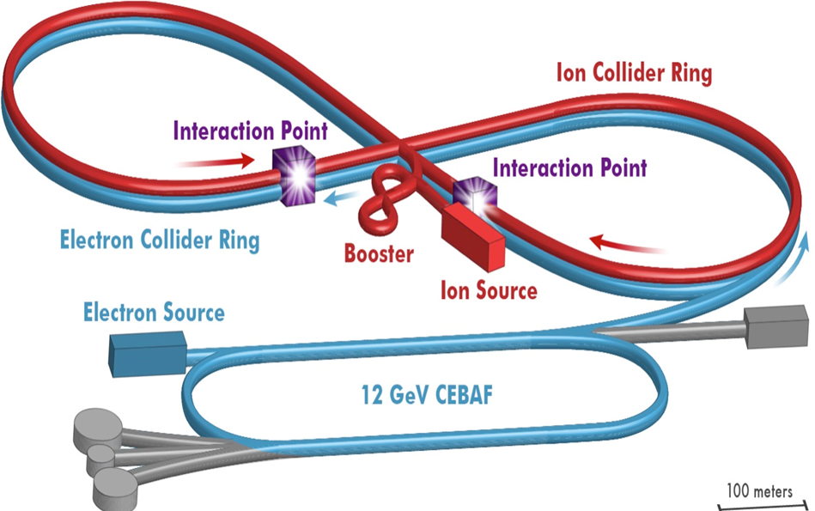

JLEIC Ion Complex Layout for Standard Upgrade
ion sources
DC cooler
DC/ERL cooler
ion linac
booster
(0.285 to 8 GeV)
Present baseline
collider
(8 to 100 GeV)
 | Single Booster Ring |  |  | Collider Ring
 | Injection (GeV) | Extraction (GeV) | Dipole range | Injection (GeV) | Collision (GeV) | Dipole range | DC cooling (MeV)
Baseline | 0.285 | 8 | 11.2 | 8 | 100 | 11.5 | 4.3
Upgrade | 0.285 | 9.2 | 12.9 | 9.2 | 200 | 20 | 5.0
Technology Assumptions for the Baseline:
  Booster is an 8 GeV injector to the Ion Collider Ring
  Ion Collider Ring uses 3T Superferric Dipoles (and associated quadrupoles)
  Ion Collider Ramp rate (injection to max energy in 1 minute) = ~.05 T/sec
  Bunch Control RF Cavities, Accelerating SRF Cavities, and Crab Cavities – quantities are baselined here
  IR FFQs are at reasonably high coil fields, requiring Nb₃Sn conductor
Design considerations:
SC dipole field range should not exceed a factor of 20
Prefer single booster ring (re-introducing the 2nd booster ring ➔ slow, complication, extra cost)
Within the DC cooling range (electron energy < 8 MeV, better < 6 MeV)

Slide 13
High CM Energy Solution – What Changes?
Assumptions for the High (100 GeV) CM Energy Ion Complex:
  Booster increase to 9.2 GeV injection to the Ion Collider Ring
  Arc dipole magnets from 3T to 6T – drop in replacement as an upgrade
  Double the strength of all other magnets in the arcs and straights
  IR layout change due to limits on FFQs
  Double the amp-turns, double the DC Power
  Ion Collider Ring ramp rate stays the same = ~.05 T/sec
  Double the Ion Collider Ring Crab Cavities and associated RF Power
  Double the Bunch Control Cavities and associated RF Power
  Impact to ERL Cooler (see Zhang presentation)
  LCW increase for additional DC Power and RF Power
  Service building space for DC Power and RF Power
  Increase in AC Power Utility

Slide 14
Arc Dipole Magnets from 3T to 6T
Due to the level of attention and scrutiny associated with this topic, JLEIC must present a 6T dipole solution which is a low technical risk and within the State-of-the-Art !
Drop in replacement, at the cryostat level
  Arc half-cell length is 11.4m, single cryostat
  Cryostat accommodates 8m dipole, .8m quadrupole, sextupole
Change from SF Technology with CICC to Cosθ with Rutherford Cable (Low Loss)
Impact to DC Powering:
  SF dipoles are 13.5kA, low voltage (~75V per arc string)
  Anticipate Cosθ to be lower current (8kA max as target), higher voltage
  Higher inductance due to higher stored energy and lower operating current
  Lower operating current – higher coil packing factor in order to achieve the required field and field quality with good magnetic/conductor efficiency
  Power supplies not compatible for two different magnet technologies
Cryogenic loads need to be evaluated
  Static heat load should be equivalent

Slide 15
Accelerator Dipole Comparison Chart
Parameter | Units | JLEIC 100 GeV Ions (Baseline) | JLEIC 200 GeV Ions (High Energy) | RHIC | SIS300 INFN Version | SIS300 IHEP Version
Technology |  | Superferric | Cos-Theta | Cos-Theta | Cos-Theta | Cos-Theta
Field Strength | T | 3.06 | 6.12 | 3.5 | 4.5 | 6
Operating Current | kA | 13.5 | 8 | 5.5 | 8.9 | 6
Aperture | mm dia or mm x mm | 100 x 60 Beam tube | 60- beam tube 80 - coil | 69 - beam tube 80 - coil | 86 – beam tube 100 - coil | 80 – beam tube 100 - coil
Layers of Conductor (Cos-Theta) |  | n/a | 2 | 1 | 1 | 2
Magnetic Length | m | 2 - 4m 8m total | 8 | 9.45 | 7.757 | 2.6
Sagitta (or center curve offset) | cm | 1.83 Per 4m segment | 7.3 | 4.85 | 11.3 | 1.7
Beampipe Straight/Curved |  | Straight 2 - 4m Dipoles 2 deg camber | Curved | Curved | Curved | Curved
Conductor |  | TAMU CICC | Low Loss Rutherford | Rutherford | Low Loss Rutherford | Low Loss Rutherford
Bending Radius | m | 109 | 109 | 243 | 66.7 | 50
Bending Angle | deg | 4.2 | 4.2 | 2.23 | 6.67 | 2.98
Ramp Rate | T/s | 0.05 | 0.05 | 0.06/.042 | 1 | 1
LHe Cooling |  | Flow inside CICC | Forced Flow Diffusion Cooling | Forced Flow Diffusion Cooling | Forced Flow | Forced Flow
Operating Temp | K | 4.5 | 4.5 | 4.6 | 4.5 | 4.5

Slide 16
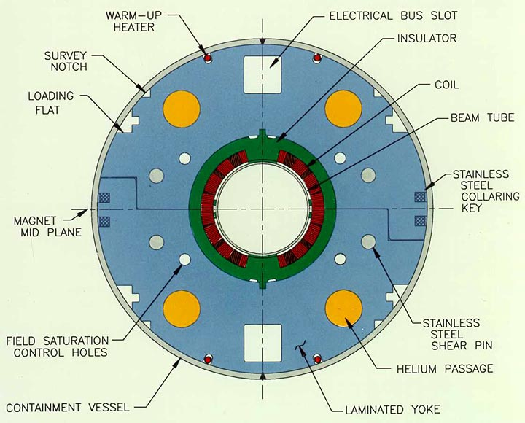
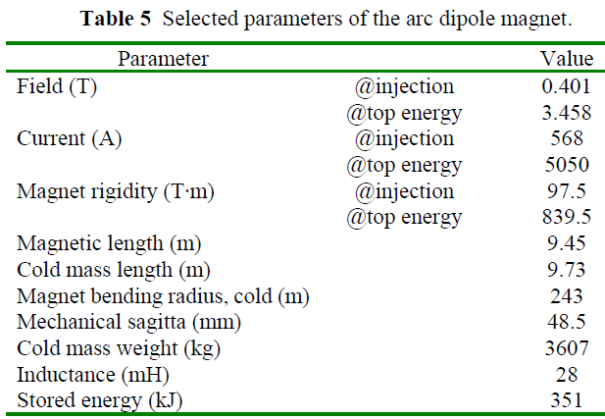
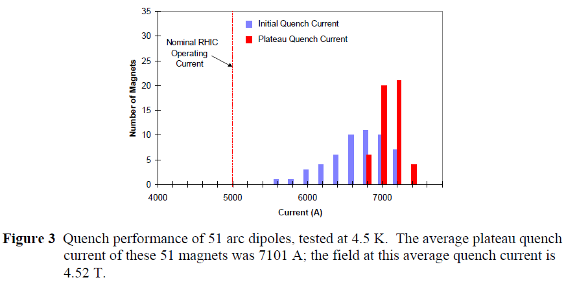
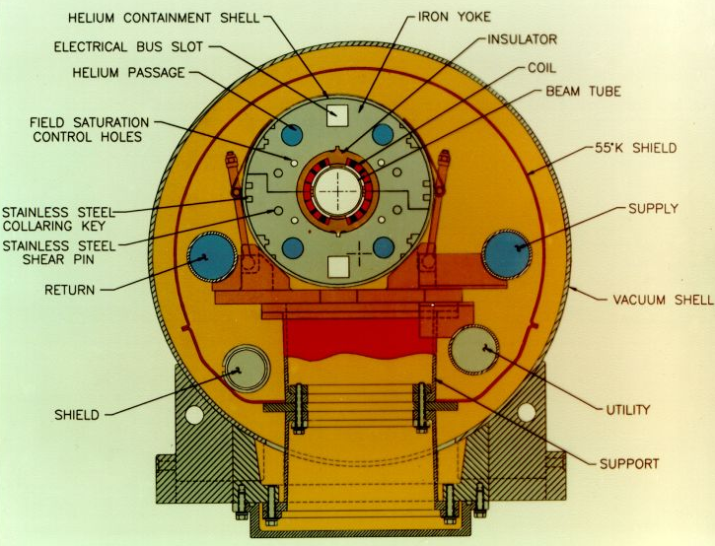
RHIC Dipole Magnets – Consider Direct Use
RHIC Magnets – 3.45 T, 9.45 m Magnetic Length, 243 m Bend Radius
From: “The RHIC Magnet System for NIM”, BNL Topic No. 610-20 (AM-MD-311)
  Performance at average quench current is 4.52 T
  Assume performance at min quench current less 10% - Max Field = 3.90 T

Slide 17
Summary
Booster Dipole Magnets:
  There is a solution in cosine-theta magnets
  Look at design limits of High CM Energy
  Ramp rate of 1 T/s is achievable – requires low loss Rutherford cable
  Preliminary validation by SIS300/GSI 001 magnet designs
  Prototype program still required
  Need to get more information than what is presented in technical papers
Ion Collider Ring Dipole Magnets:
  New Baseline in cosine-theta magnets is low technical risk
  RHIC magnet design validates most parameters
Ion Collider Ring, High CM Energy Dipole Magnets:
  There is a solution in cosine-theta magnets
  6 T, Curved, 2 layer coil design has been prototyped and tested (IHEP)
  Prototype program required
  Need to get more information than what is presented in technical papers
  Alternative – look at lower operating temperature as a means to get a 1 layer coil design (less technical risk for curved magnet, requires higher operating cost for cryogenics)
  Alternative – look at Nb3Sn to get a 1 layer coil design (higher cost magnets, brittle coil structure, can it be build curved, 4.5 K operation)
Direct Use of RHIC Dipole Magnets:
  Length and bend radius would require adaptation of JLEIC collider ring layout
  Bend radius is more than 2X

