Slide 1
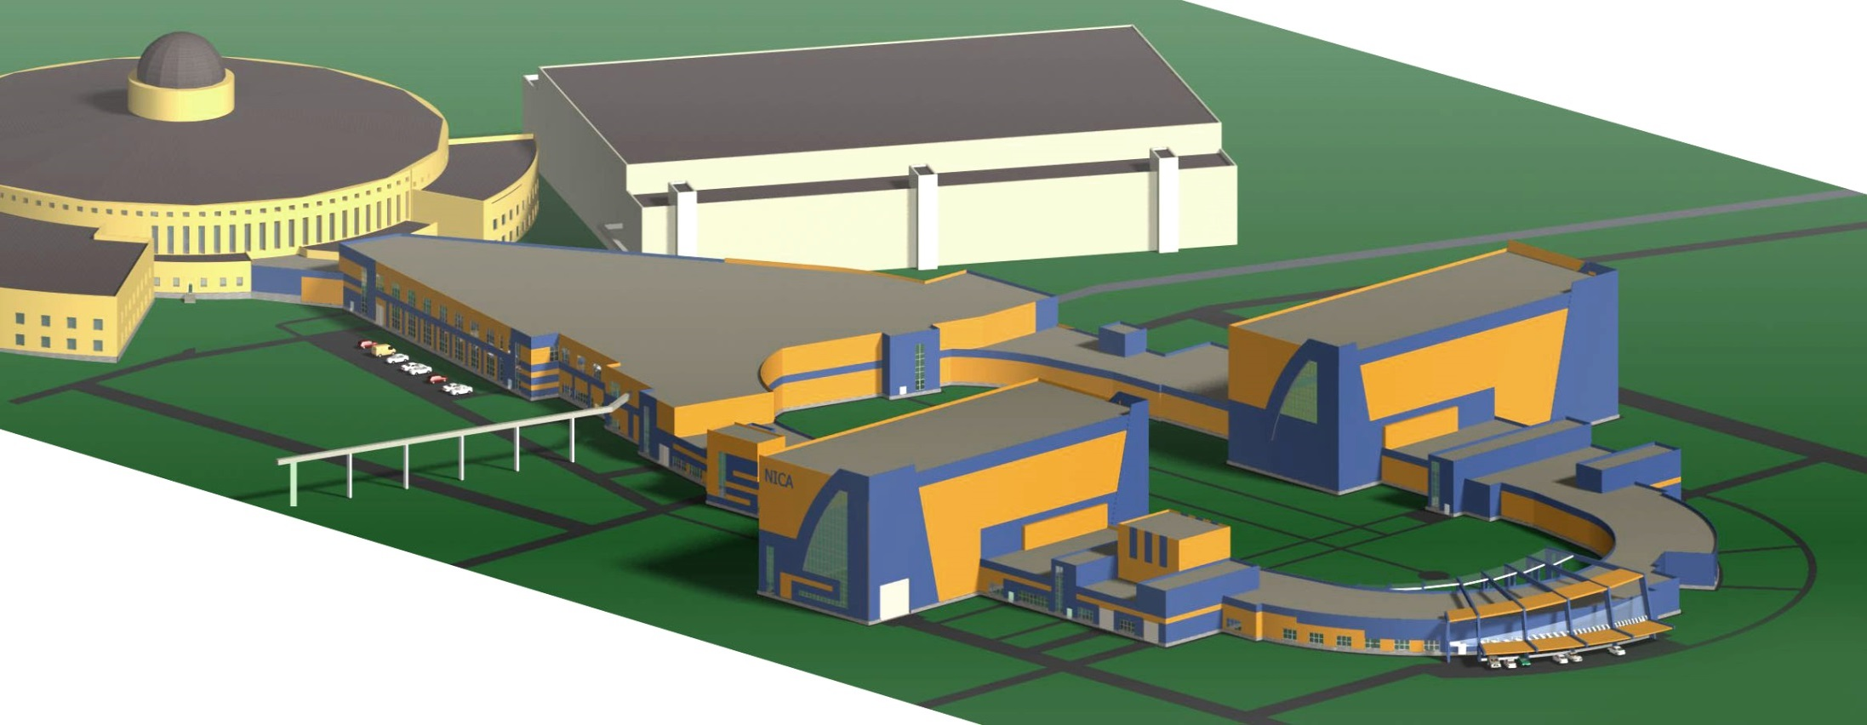
International Workshop on Beam Cooling and Related Topics
COOL’15
HV Electron Cooling System for NICA Collider
I.Meshkov for NICA Team
JINR, Dubna
Transfer
SPD
channels
MPD
HV E-Cooler
29 September 2015

Slide 2


Outline
Introduction: Why do we need HV E-Cooler for the NICA Collider
1. The experience we have
2. HV and HE electron coolers
3. The concepts
3.1. The first concepts – two beams or not…
3.2. Two concepts of the HV electron cooler with two electron beams
3.3. SC solenoids – what superconductor?
4. NICA Electron Cooler Design
4.1. The General View
4.2. The tank with the acceleration/decelaration tubes
4.3. The conic solenoid
4.4. The HV generator
4.5. Acceleration tubes
4.6. Modeling of the cooler elements
Concluding remarks
I.Meshkov NICA HV E-Cooler COOL’2015 29 September 2015

Slide 3
Introduction: Why do we need HV E-Cooler for the NICA Collider
NICA Collider Luminosity
Two Energy Ranges of the Collider and Two Regimes:
Space charge (SC) dominated regime => E_{ion} = 1 - 3 GeV/u
Electron cooling is mandatory (!),
acceptance is filled with ions up to ΔQ = ΔQ_{max} = 0.05,
L = L_{max} = (0.01 – 1) × 10²⁷ cm⁻² ⋅s⁻¹
Intrabeam scattering (IBS) regime => E_{ion} = 3 - 4.5 GeV/u
L = 1 × 10²⁷ cm⁻² ⋅s⁻¹
IBS is suppressed by stochastic and electron cooling,
L is artificially limited by max detector rate at E_{ion} > 3 GeV/u )
In this energy range electron and stochastic cooling are supposed to be used in the NICA Collider simultaneously providing a long life time of the Collider luminosity.
See details in: G.Trubnikov, Thursday, 11:10 - 11:40
I.Meshkov NICA HV E-Cooler COOL’2015 29 September 2015

Slide 4
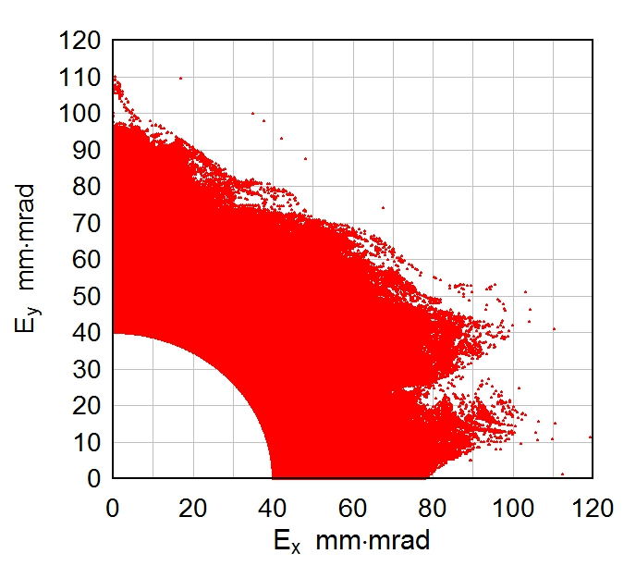
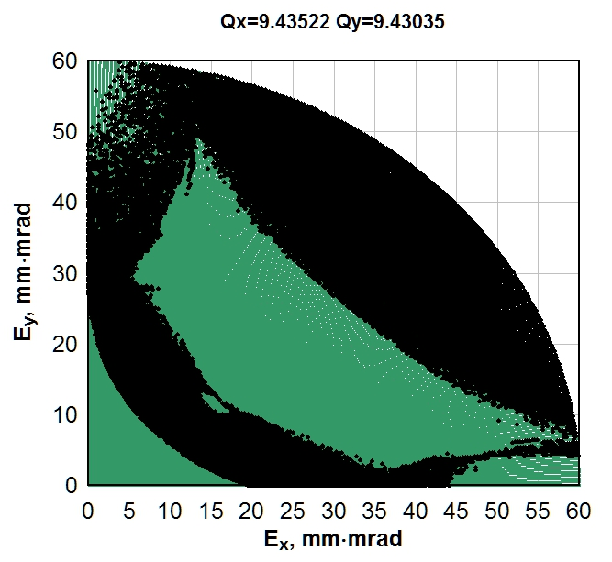
Introduction: Why do we need HV E-Cooler for the NICA Collider
Dynamics aperture of the NICA Collider
A.Bolshakov and P.Zenkevich (ITEP) for NICA
Preliminary
No magnet fringe fields
Does a cooling help?
Influence of the magnet fringe fields
Stable Unstable
Stable Unstable
I.Meshkov NICA HV E-Cooler COOL’2015 29 September 2015

Slide 5
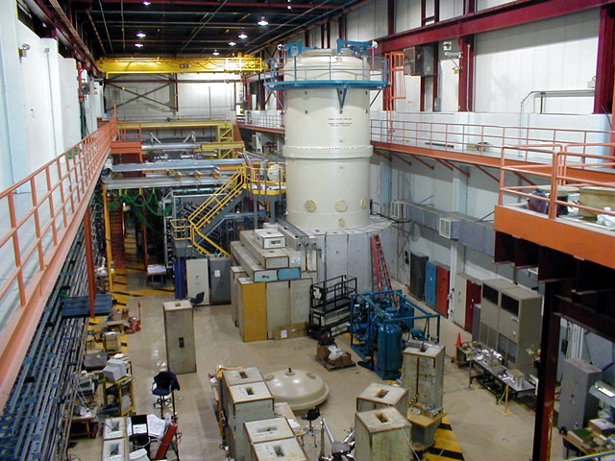
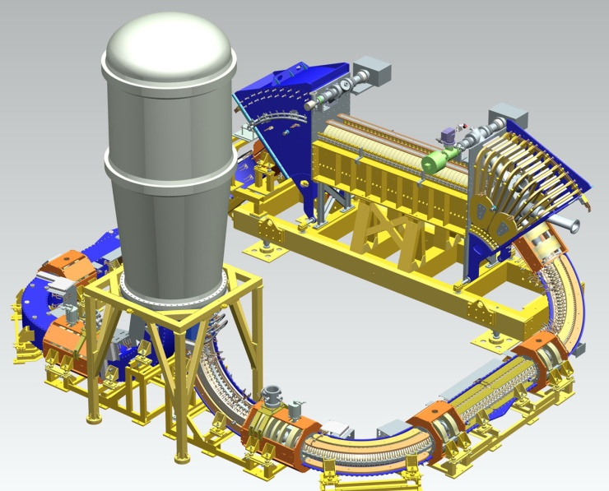
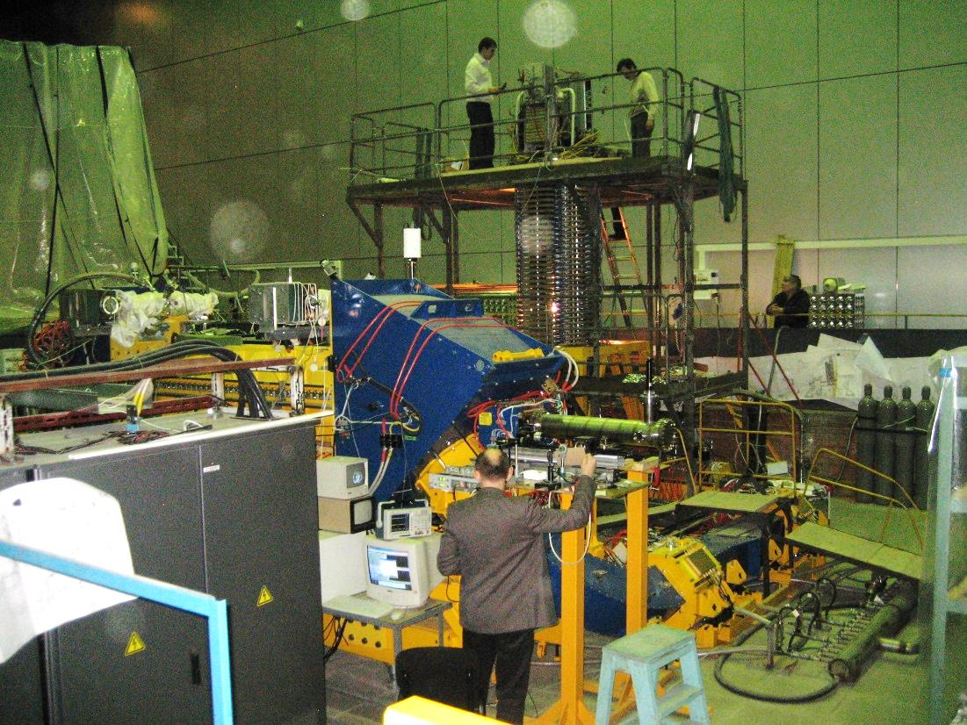
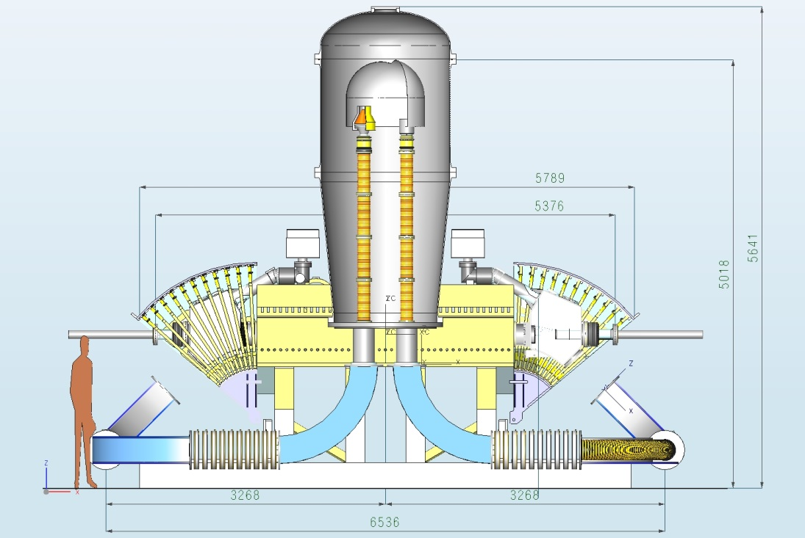
1. The experience we have
Max. electron energy, MeV 0.025 ÷ 2
Electron beam current, A 0.1 ÷ 3.0
HV generator Cascade transformator
Electron beam magnetized
[V.Parkhomchuk et al.,
Sarantsev seminar (Sep. 2015)]
Dec.2011
BINP
The work is
in progress
Max. electron energy, MeV 4.3
Working e-beam current, A 0.1 – 0.5 A
Max. e-beam current, A 1.6 (1.9)
Working I_{loss}/I_{beam} , ppm 1.0
HV generator Pelletron (“Van der Graaf”)
Unmagnetized electron beam
[A.Shemykin et al., FERMILAB-CONF-06-194-AD]
I.Meshkov NICA HV E-Cooler COOL’2015 29 September 2015

Slide 6
2. HV and HE electron coolers
1) High Voltage electron coolers – DC HV regime, 1 < E_{e} < 8 MeV
Projects under development: COSY (FZJ) NICA (JINR), HESR (FAIR), HIAF (Lanzhou)
2) High Energy electron coolers – RF acceleration, 8 > E_{e}:
ERL scheme, coherent e-cooling, optical e-cooling …
Projects under development: RHIC BES (BNL), MEIC (JLab)
At COOL’2015 we have:
6 oral contributions on HV e-coolers,
12 oral contributions on HE e-coolers and related topics.
The problem under active development
I.Meshkov NICA HV E-Cooler COOL’2015 29 September 2015

Slide 7
3. The concepts of a HV e-cooler
3.1. The first concepts – two beams or not…
1. Evident scheme – two beams (IM, 2008)
HV generator
e-gun
e-collector
e-collector
e-gun
The solution is technically good, however the electron beam is a feed back between two ion beams:
an instability in one ion beam excites electron beam that brings the instability signal to another ion beam, i.e. we have
“the three beams’ instability”!
2. More sophisticated scheme –
– one (common) electron beam (VP, 2011)
HV generator
e-gun
e-collector
Finally the scheme with common electron beam has been rejected.
I.Meshkov NICA HV E-Cooler COOL’2015 29 September 2015

Slide 8
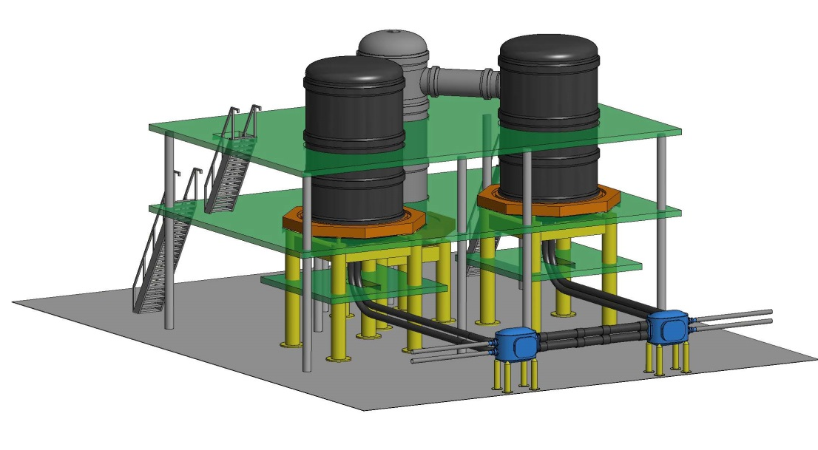
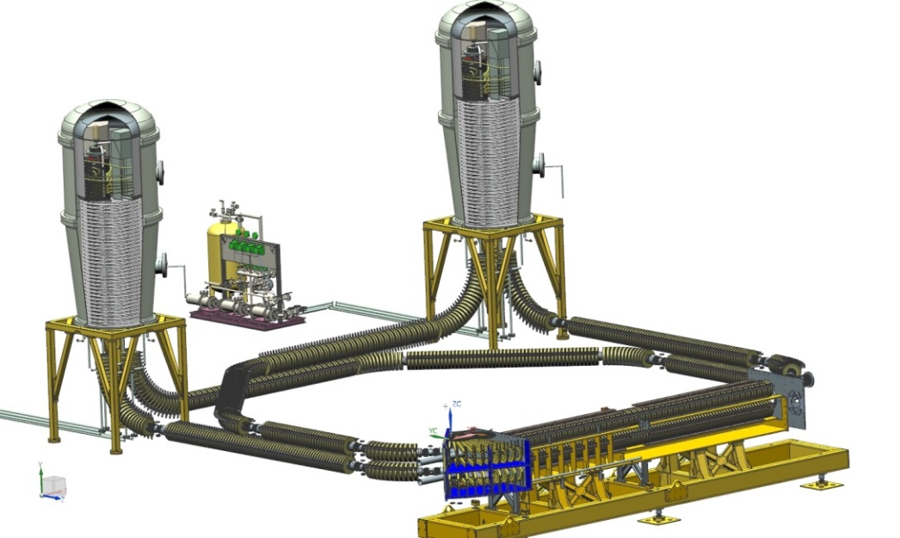

3.2. Two concepts of the HV electron cooler with two electron beams
9 m
Budker INP
JINR
10 m
7.0 m
1.5 m
6 m
Main parameters of the e-coolers
DC magnetized (!) electron beam
Electron energy, MeV | 0.5 – 2.5
Electron beam current, Amp | 0.1 – 1.0
Solenoid magnetic field, T | 0.1 – 0.2
Electron transverse temperature in PRF, eV | 1.0 – 5,0
Electron longitudinal temperature in PRF, meV | 5,0
Electron energy spread in Lab. system, ΔE/E | 1е-5
The solenoids in both concepts are supposed to be superconducting
Warm solenoids in JINR version (4 copper layers winding): P_{total} ∼ 500 kW
I.Meshkov NICA HV E-Cooler COOL’2015 29 September 2015

Slide 9


3. The concepts for a HV e-cooler
3.2. Two concepts of the HV electron cooler with two electron beams
Two “COSY – coolers” with independent solenoid systems
Advantage: COSY Cooler has been constructed and demonstrated its reliability in the first tests
(see yesterday talks by V.Kamerdzhiev and V.Reva).
Disadvantages: 1) a long solenoid system
2) Problematic design for SC solenoids inside the tanks (the COSY design is not applicable!
Budker INP
JINR
Three tanks system: the leftmost and rightmost tanks contain by two accelerating/decelerating tubes – one with the “blue” beam, another with the beam of the opposite direction – (electron guns and collectors), the middle tank contains the HV generator and terminal with the power supplies for the electron guns and the collectors.
Advantage: a short solenoid system (about twice shorter of the BINP system);
a reliable scheme of the voltage multiplier applied for HV generation.
Disadvantage: probable problems at tuning of the cooler regimes when electron beams
are ON.
I.Meshkov NICA HV E-Cooler COOL’2015 29 September 2015

Slide 10
3. The concepts for a HV e-cooler
3.3. SC solenoids – what superconductor?
9 m
Budker iNP
JINR
10 m
7.0 m
1.5 m
6 m
SC solenoids
JINR version
NbTi cable φ 0.5 мм 0.9 $/m L = 275 km $250 k
HTSC tape 12 х 0.5 мм² 30 $/m L ≈ 11.5 km $350 k
I.Meshkov NICA HV E-Cooler COOL’2015 29 September 2015

Slide 11

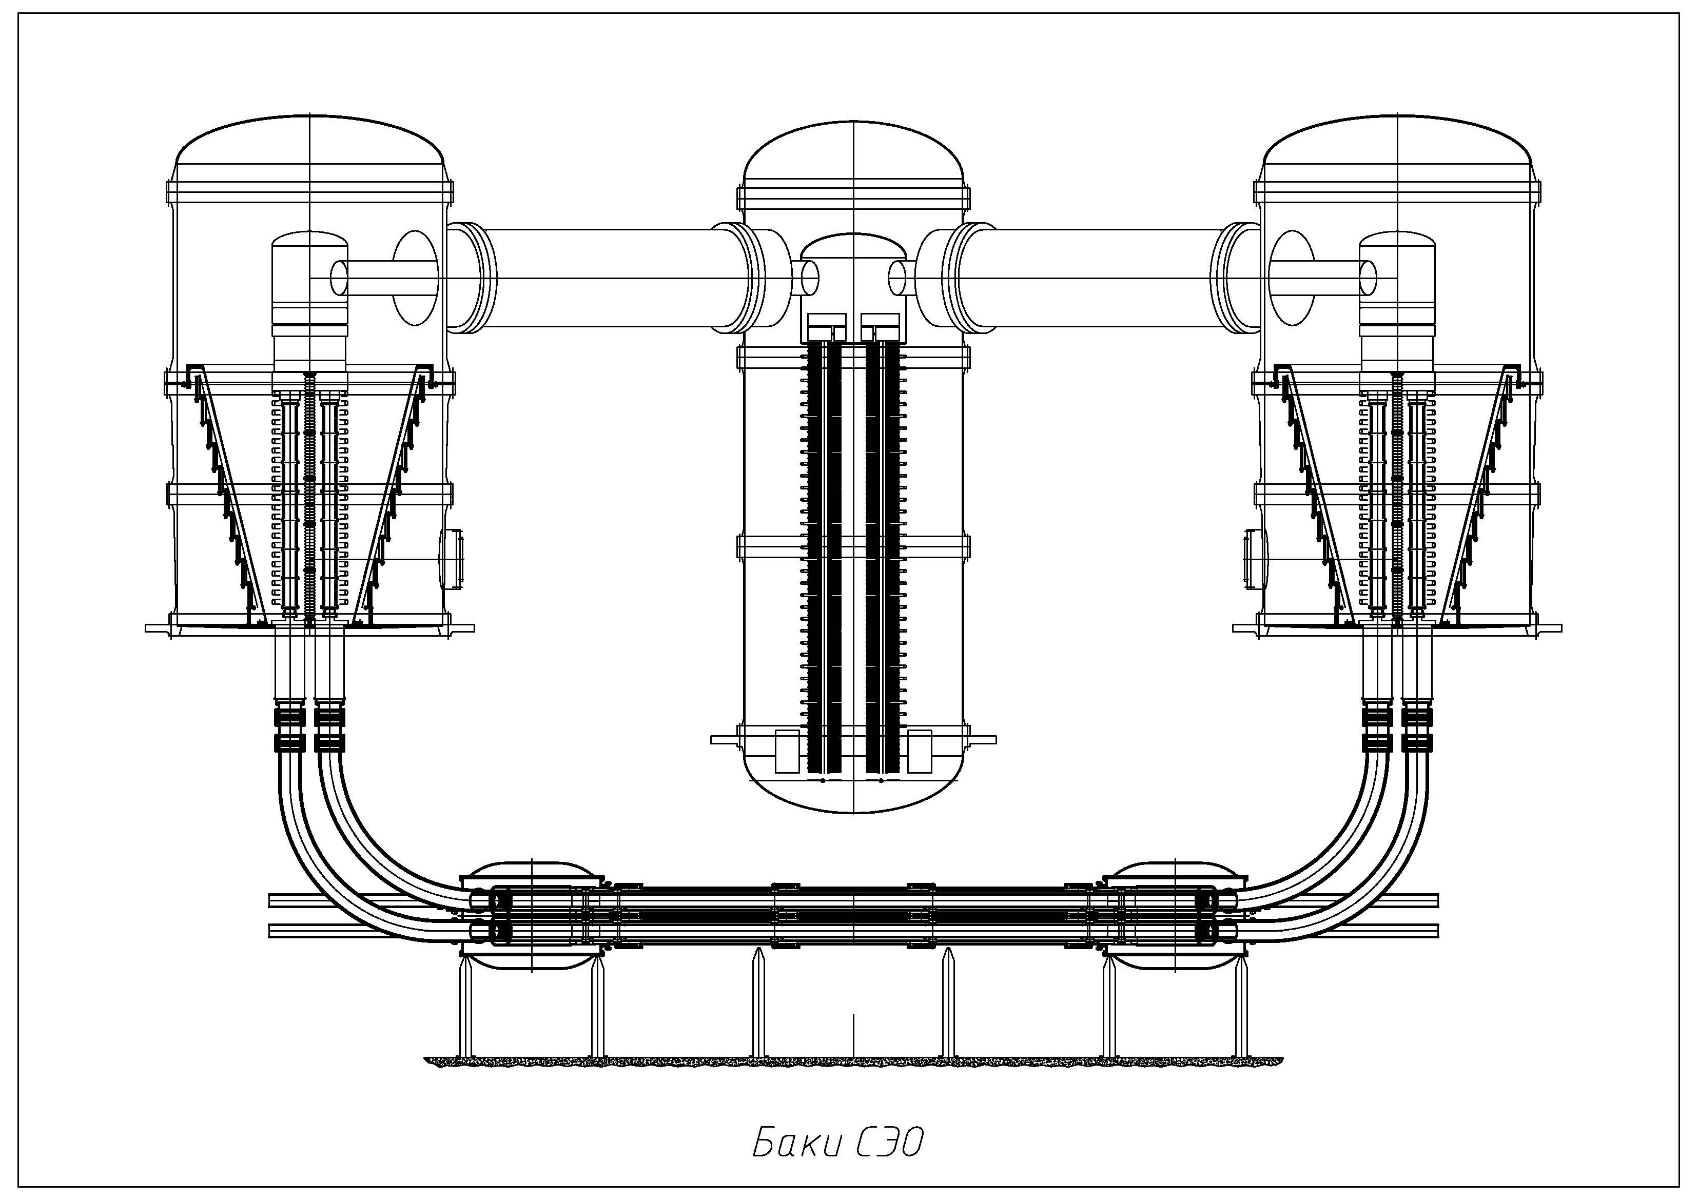
4. NICA Electron Cooler Design
4.1. The General View
Tanks with the acceleration/deceleration tubes
SC conic solenoids
Toroidal solenoids
Cooling section
I.Meshkov NICA HV E-Cooler COOL’2015 29 September 2015

Slide 12

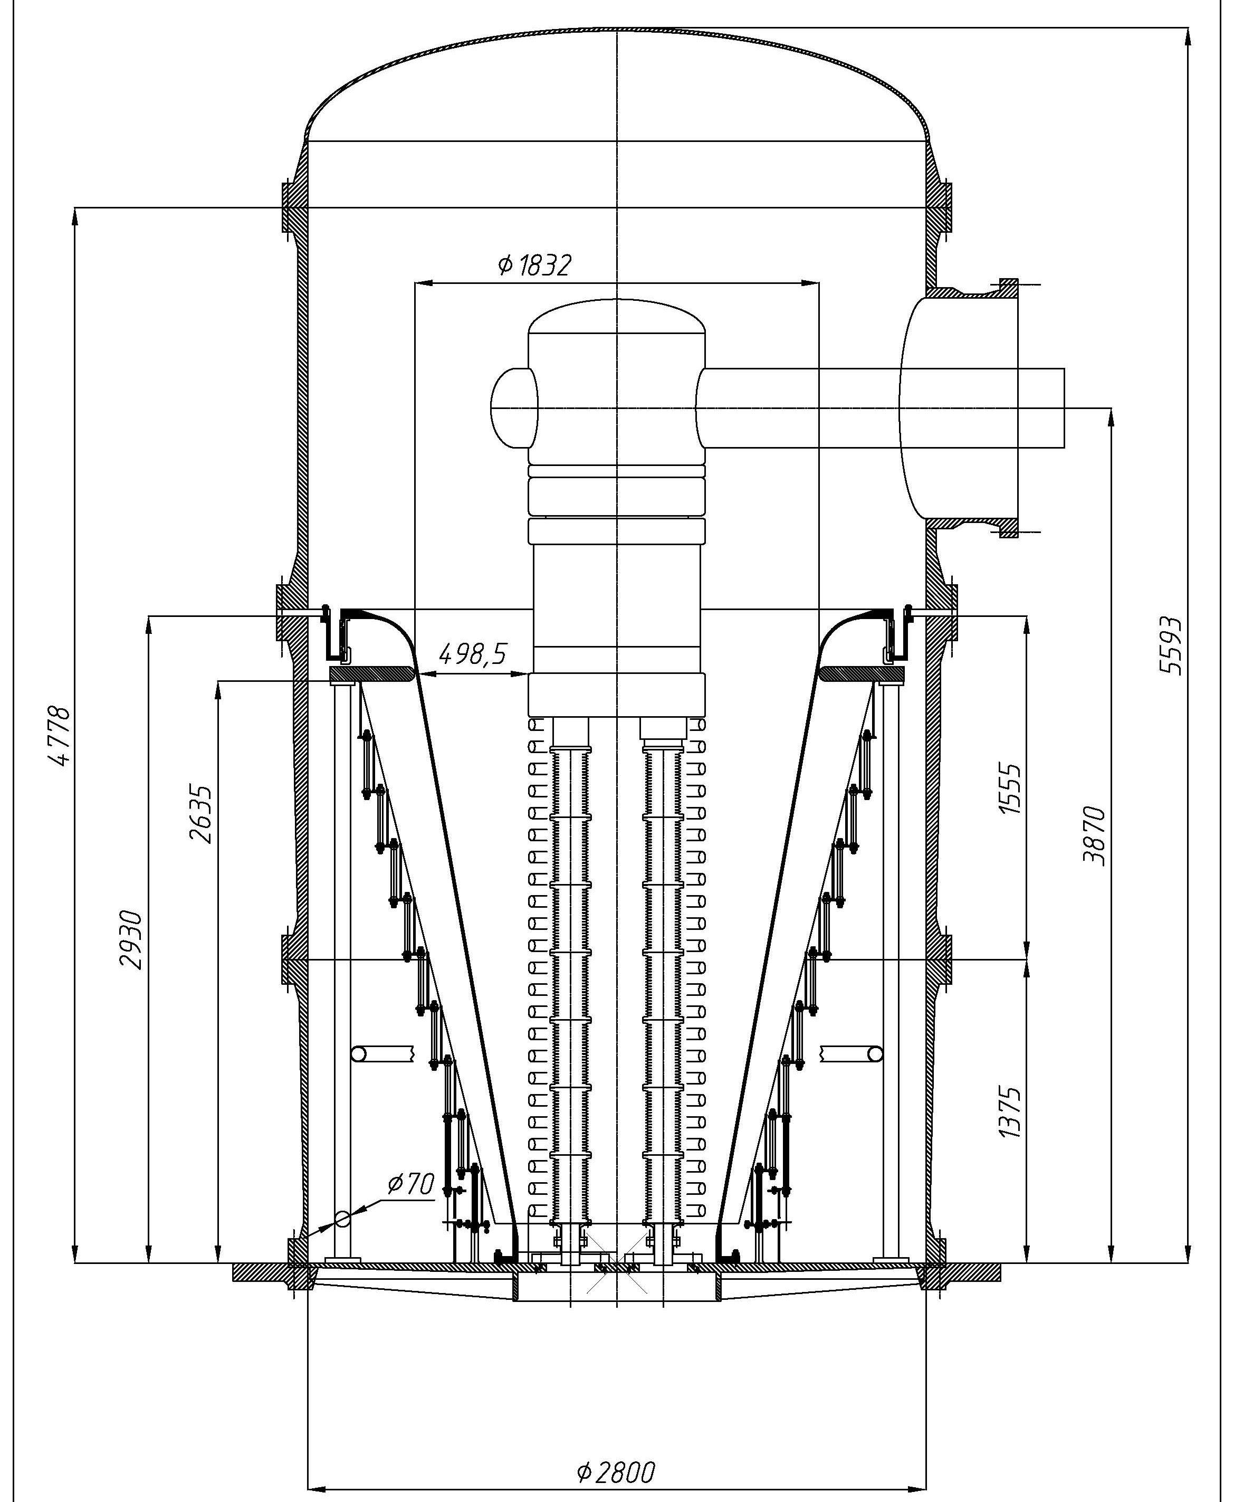
4. NICA Electron Cooler Design
4.2. The tank with the acceleration/decelaration tubes
…filled with SF6
HV insulation of 6 bar pressure
The tank with the acceleration/deceleration tubes…
HV coaxial transmission line
HV terminal with the gun of the upper beam and the collector of the lower beam
Magnetic shield decreasing the magnetic field on the HTSC winding
The acceleration/deceleration tubes
Conic HTSC solenoid
Electrostatic pressurizable screen
Vacuum space (thermal insulation)
I.Meshkov NICA HV E-Cooler COOL’2015 29 September 2015

Slide 13
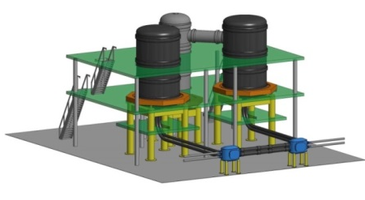
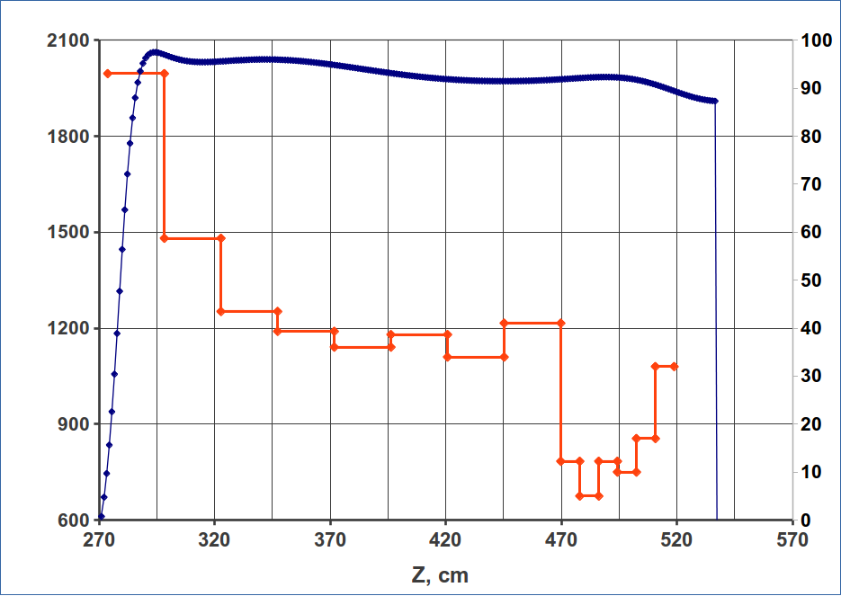
4. NICA Electron Cooler Design
4.3. The conic solenoid
Magnetic field on the conic solenoid axis and
the current distribution (kAxTurns) in HTSC coils
B
[G]
N_{turn}×I
[kA]
The gun cathode location
I.Meshkov NICA HV E-Cooler COOL’2015 29 September 2015

Slide 14

4. NICA Electron Cooler Design
4.3. The conic solenoid
The HTSC winding
Critical magnetic field for the HTSC tapes at 77 K (LN₂) 1.0 T
Maximum magnetic field on the HTSC winding of the conic solenoid 0.4 T
I.Meshkov NICA HV E-Cooler COOL’2015 29 September 2015

Slide 15
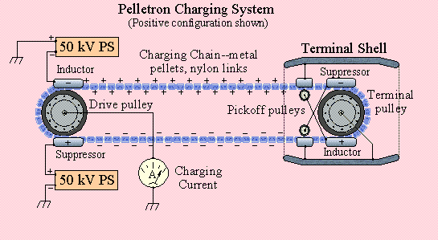
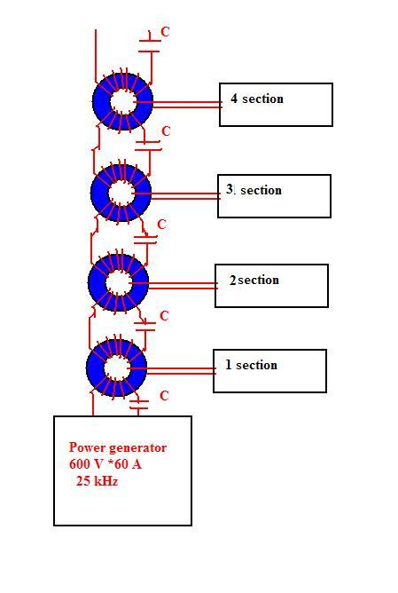
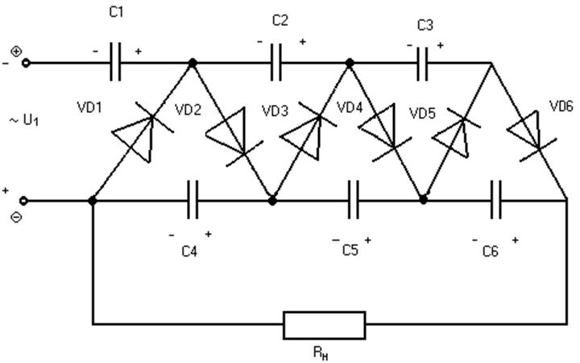
4. NICA Electron Cooler Design
4.4. The HV generator
The choice of the HV generator type:
1) Pelletron (van der Graaf)
2) Cascade transformer
3) Dynamitron scheme
4) Voltage multiplier (“Cockroft – Walton”)
V.Parkhomchuk et al
5) Turbine driven generator (V.Parkhomchuk et al.) – see the next slide
I.Meshkov NICA HV E-Cooler COOL’2015 29 September 2015

Slide 16
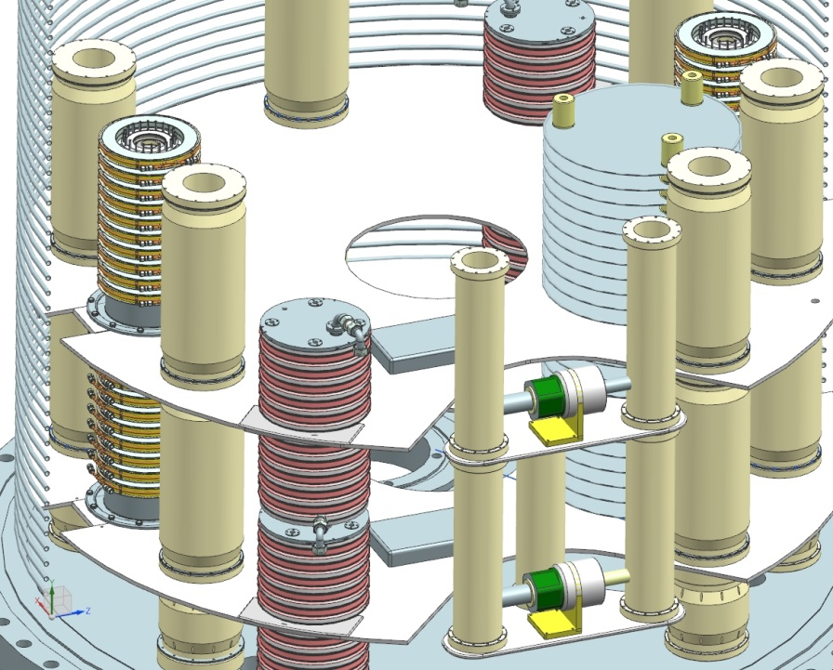
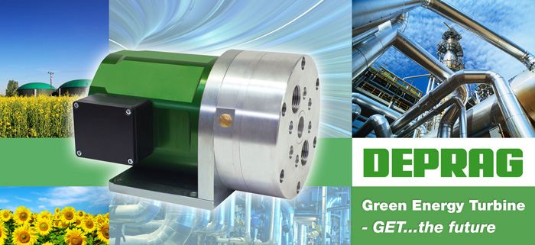
4. NICA Electron Cooler Design
4.4. The HV generator
5) Turbine driven generator
(V.Parkhomchuk et al., Sarantsev seminar’2015, Alushta, Crimean, September 2015 )
The developmental work on cascade transformers feeding with gas turbine generators of DEPRAG Cº
Collaboration BINP – Mainz University
See the poster MOPF02
and
http://accelconf.web.cern.ch/AccelConf/IPAC2014/papers/mopme051.pdf
I.Meshkov NICA HV E-Cooler COOL’2015 29 September 2015

Slide 17
4. NICA Electron Cooler Design
4.4. The HV generator
Typical parameters of HV generators
Generator type | Max. voltage [MV] | Max. current [mA] | Reliability
1) Pelletron | 13.0 | 0.1 (per chain) | Longstanding experience (Nat. Electrostatic Corp., Madison, USA)
2) Cascade transformer | 2.0 | 1.0 (?) | BINP, commissioning stage
3) Dynamitron | 25.0 | ? | World experience
4) Voltage multiplier | 5.0 | 2.0 | ARIE, Moscow, RF (“old” experience)
5) Turbine driven generator | ? | ? | BINP & Mainz Univ. R & D (very promising)
I.Meshkov NICA HV E-Cooler COOL’2015 29 September 2015

Slide 18
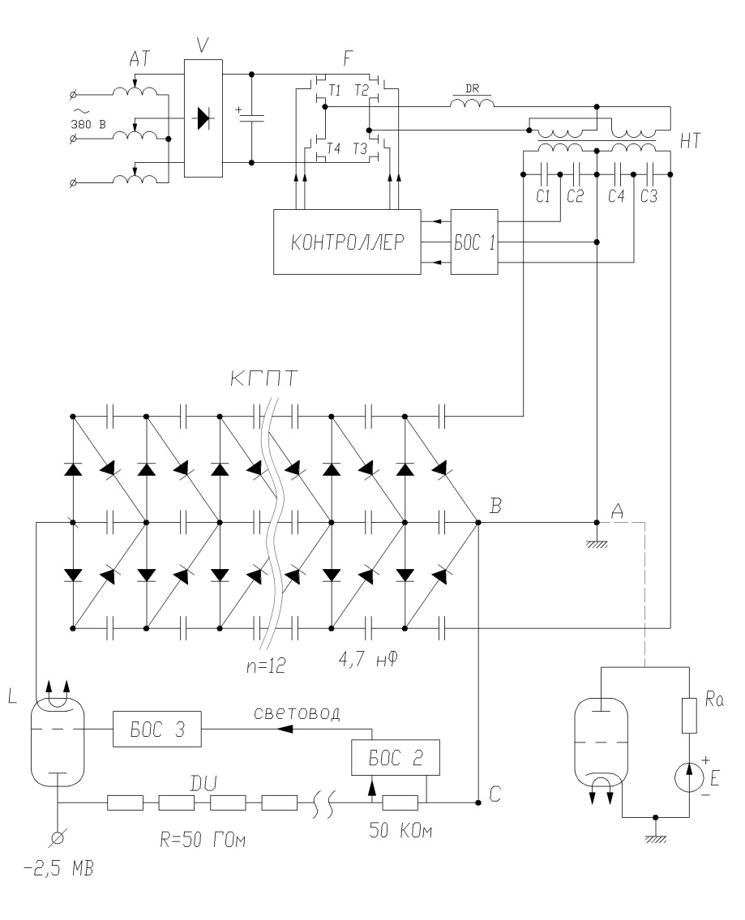
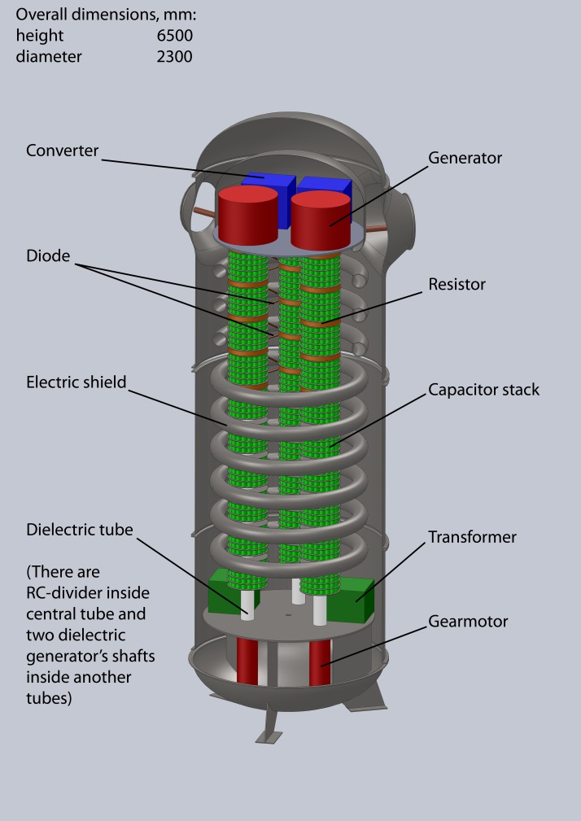
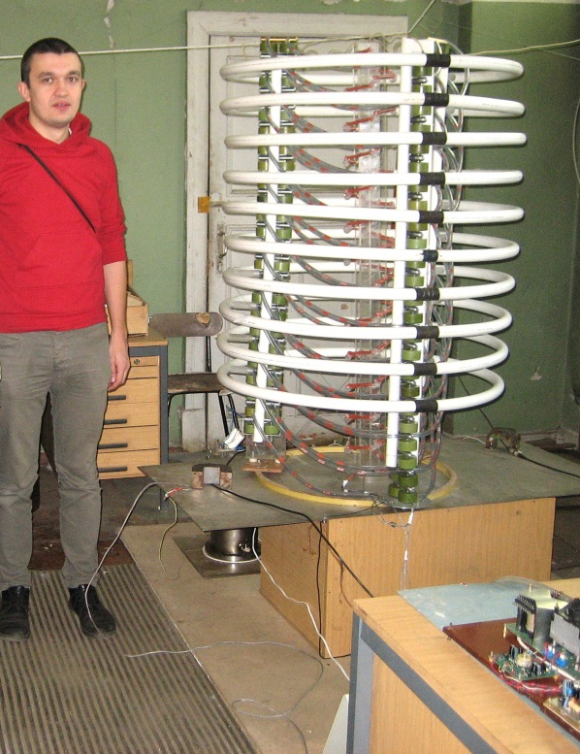
4. NICA Electron Cooler Design
4.4. The HV generator
Lenin All-Russian Institute for Electrotechnique (Moscow)
Generator stability ΔV / V ~ 10⁻³ , 0.5 < ΔV < 2.5 kV
Feedback via rotor voltmeter and capacity connector
provides stabilization level up to δV / V ~ 10⁻⁵
Project electron current 1 mA
Voltage multiplier schematic diagram
Test model of 350 kV
The middle tank of the cooler
I.Meshkov NICA HV E-Cooler COOL’2015 29 September 2015

Slide 19
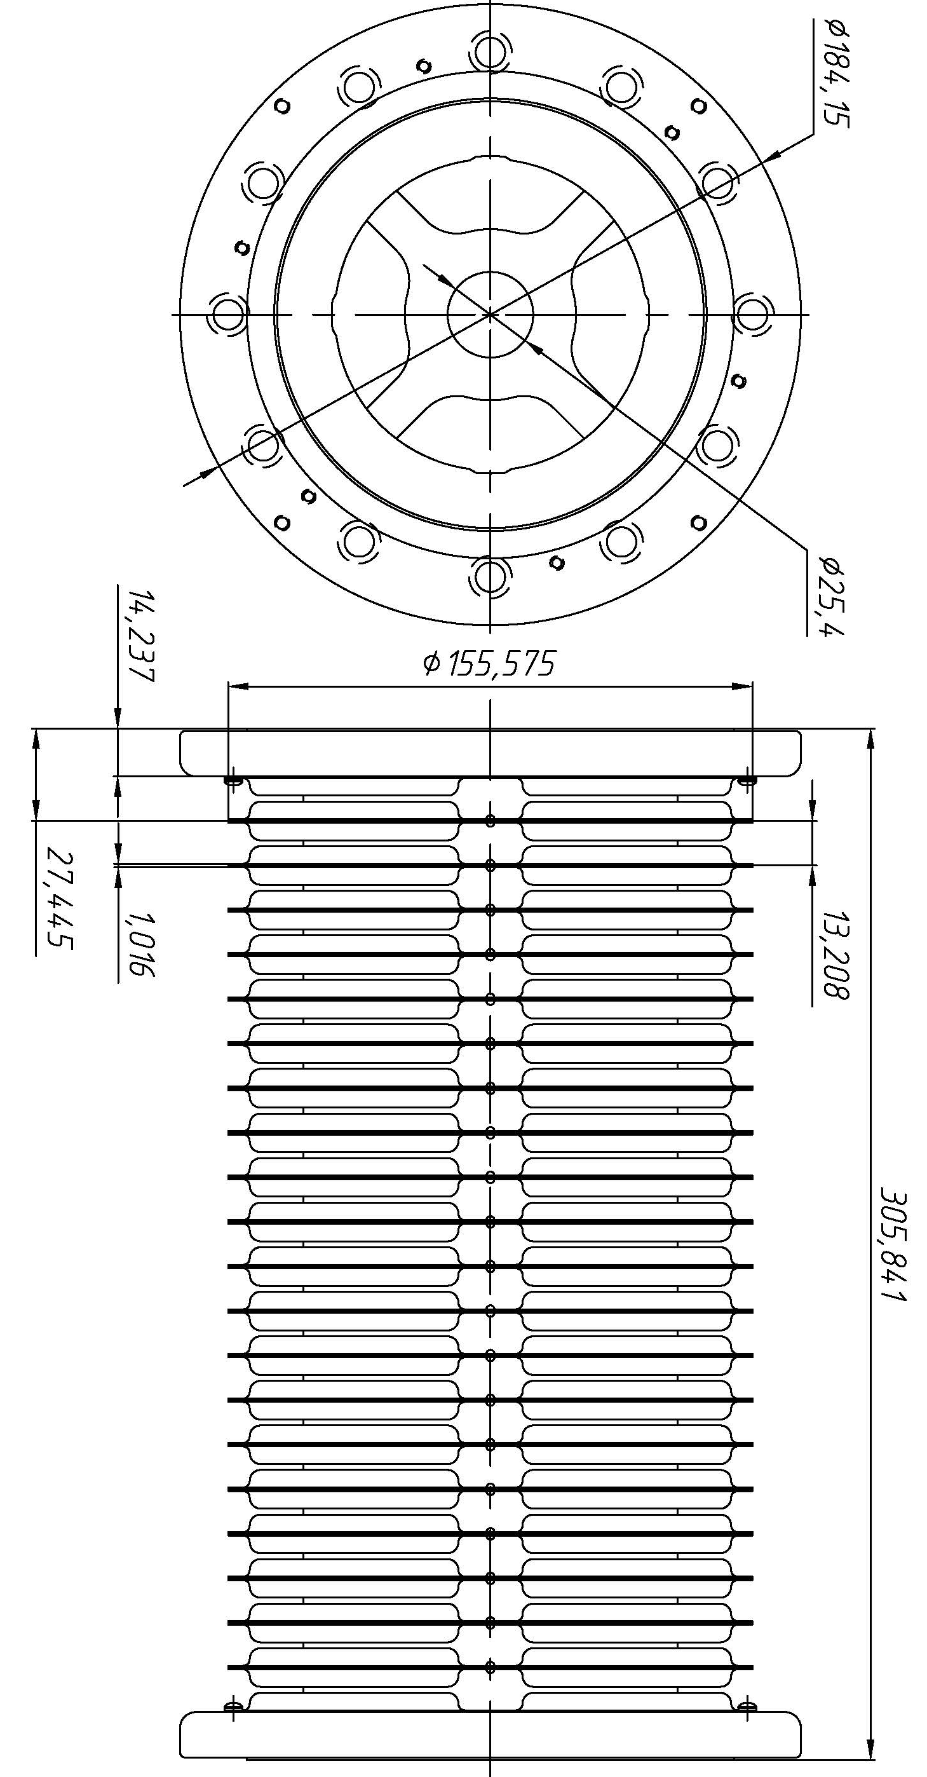
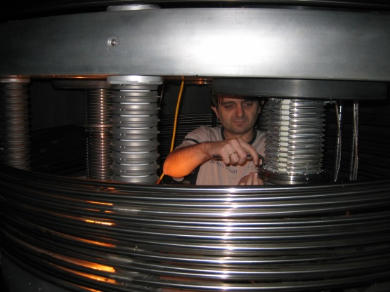
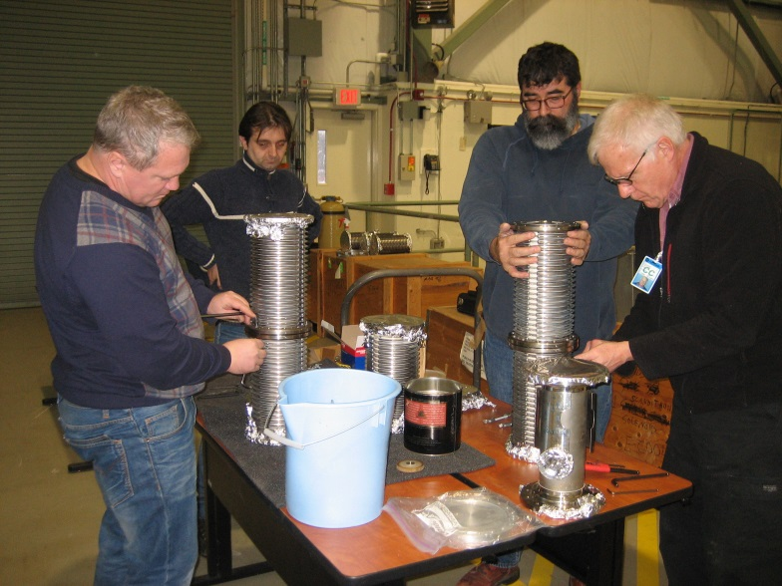
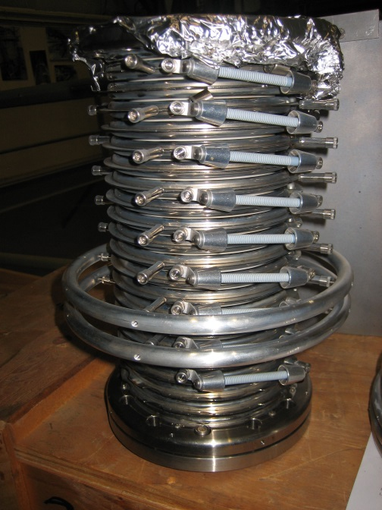
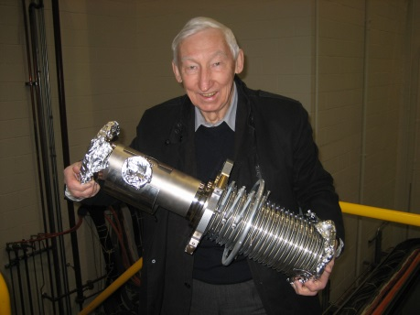
4. NICA Electron Cooler Design
4.5. Acceleration tubes
The sections of the Pelletron/NEC acceleration tubes
Dismantling and packing
of the Pelletron tubes
9 – 10 December 2013
The experts and
the porter
The drawing of the section and its photo
I.Meshkov NICA HV E-Cooler COOL’2015 29 September 2015

Slide 20
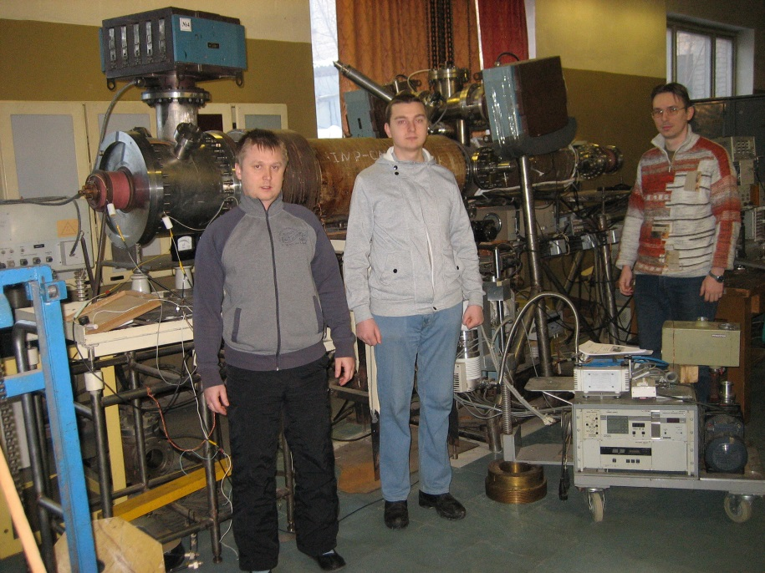
4. NICA Electron Cooler Design
4.6. Modeling of the Cooler Elements
The test bench “Recuperator” –
- it was used at the end of the 1980th – beginning of the 1990th for test of the electron collector and electron gun for the electron cooler of LEAR and is used today for development of the elements of HV electron cooler of the NICA Collider.
The test bench is a good training ground for young researchers. The Electron Cooling Group of Dzhelepov Lab. of Nucl. Problems of JINR is developing new schemes of the electron collector and electron gun for the HV electron cooler of the NICA Collider and the methods for testing parameters of these devices.
I.Meshkov NICA HV E-Cooler COOL’2015 29 September 2015

Slide 21
Concluding remarks
1. HV electron cooler for an ion collider has to be equipped with two independent
beams of magnetized electrons (preferably),
which are generated by an electron gun with a “hollow” electron beam and
the sectioned “Pierce electrode”. It allows one to avoid/reduce recombination
of the ions to be cooled with the cooling electrons and provide electron beam
positioning using the beam current modulation and PU electrodes in the beam
transfer line.
2. The electron cooler solenoids are to be superconducting. Application of HTSC winding looks realistic presently and is very promising.
3. Application of the HV generator of the voltage multiplier type looks most
practical for the moment.
4. The three tanks scheme seems adequate to the parameters of the HV electron cooler for the NICA collider .
Thank you for your attention!
I.Meshkov NICA HV E-Cooler COOL’2015 29 September 2015

