Slide 1
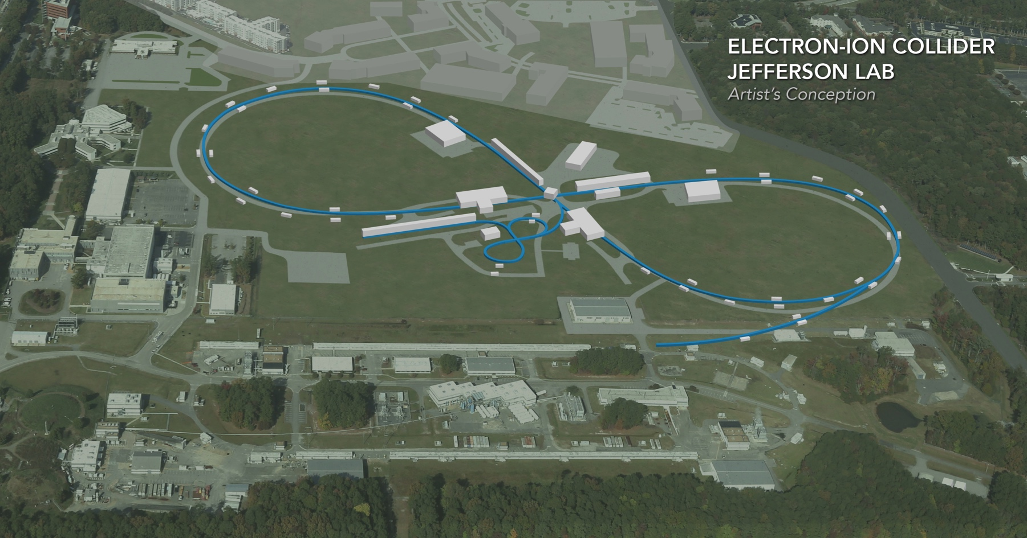
Electron Beam Top-off Injection in JLEIC
Fanglei Lin, Jiquan Guo,
Yuhong Zhang, Mark Wiseman,
Marcy Stutzman
JLEIC R&D Meeting, Nov. 14, 2019

Slide 2
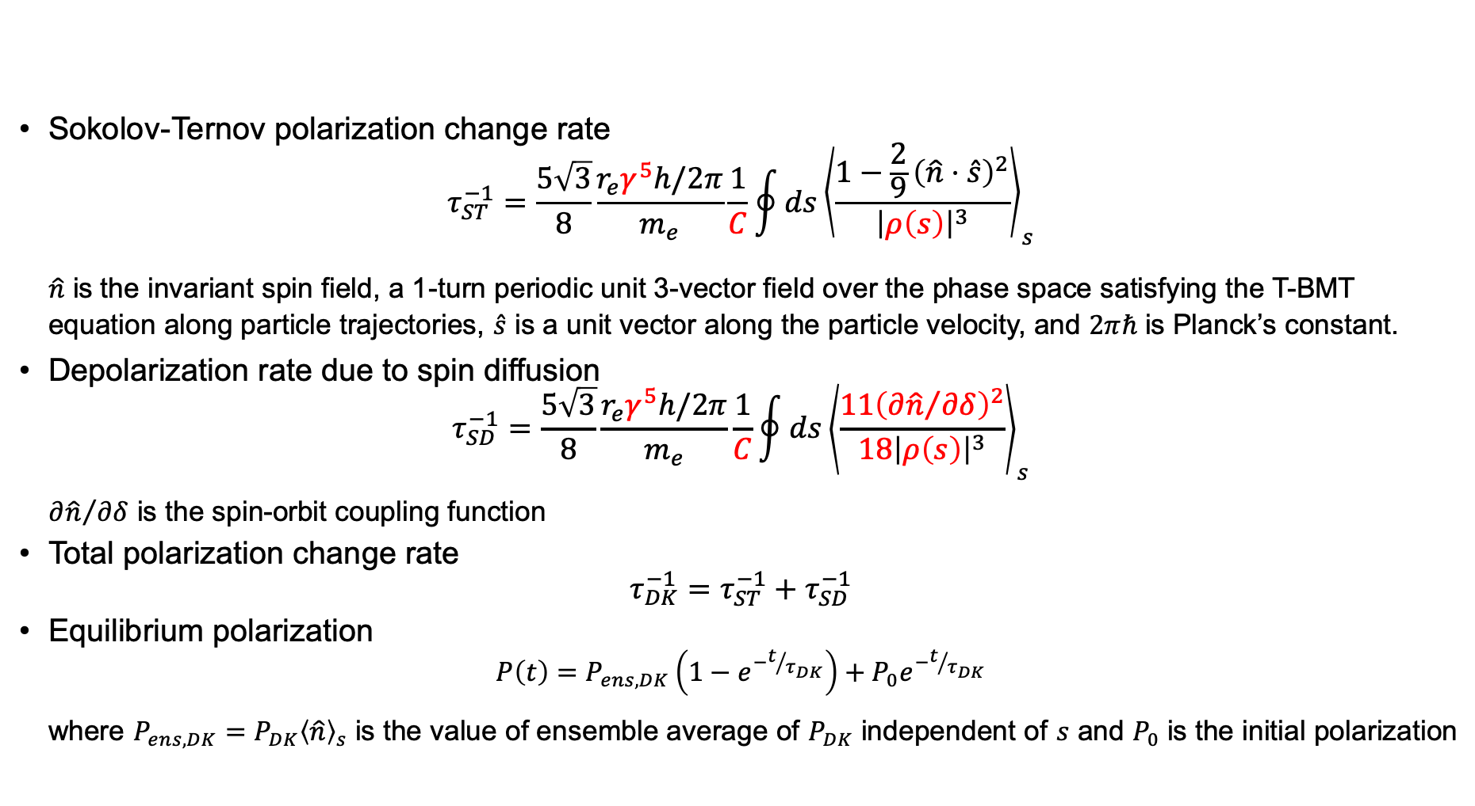
Radiative Polarization
Sokolov-Ternov polarization change rate
$$τ_{ST}^{−1}=\frac{5\sqrt{3}}{8}\frac{r_{e}γ^{5}h/2π}{m_{e}}\frac{1}{C}\oint{ds{\left\langle \frac{1−\frac{2}{9}{\left(\hat{n}⋅\hat{s}\right)}^{2}}{{\left|ρ\left(s\right)\right|}^{3}}\right\rangle }_{s}}$$
$\hat{n}$ is the invariant spin field, a 1-turn periodic unit 3-vector field over the phase space satisfying the T-BMT equation along particle trajectories, $\hat{s}$ is a unit vector along the particle velocity, and $2πℏ$ is Planck’s constant.
Depolarization rate due to spin diffusion
$$τ_{SD}^{−1}=\frac{5\sqrt{3}}{8}\frac{r_{e}γ^{5}h/2π}{m_{e}}\frac{1}{C}\oint{ds{\left\langle \frac{{11\left({∂\hat{n}}/{∂δ}\right)}^{2}}{18{\left|ρ\left(s\right)\right|}^{3}}\right\rangle }_{s}}$$
${∂\hat{n}}/{∂δ}$ is the spin-orbit coupling function
Total polarization change rate
$$τ_{DK}^{−1}=τ_{ST}^{−1}+τ_{SD}^{−1}$$
Equilibrium polarization
$$P\left(t\right)=P_{ens,DK}\left(1−e^{−t/{τ_{DK}}}\right)+P_{0}e^{−t/{τ_{DK}}}$$
where $P_{ens,DK}=P_{DK}{\left\langle \hat{n}\right\rangle }_{s}$ is the value of ensemble average of $P_{DK}$ independent of $s$ and $P_{0}$ is the initial polarization

Slide 3
Electron Polarization Configuration in Figure-8 JLEIC
Two depolarization sources: i) Sokolov-Ternov effect, ii) spin diffusion effect
Equilibrium polarization due to these two depolarization sources is zero
Two co-existing polarization states experience the same decay rate
Top-off injection (i.e. continuous injection) of highly polarized electron beam can maintain high final equilibrium polarization

Slide 4
Top-off Injection Bunch Train
Mid-cycle 1, inject the 1st of every 7 buckets in the ring
Polarization Up
Polarization Down
68.05MHz bunch train, 3.9 µs, I_{pulse} = 2 mA
14.69 ns, 22 CEBAF or 7 ring buckets
2.1ns, 476.3 MHz (1 ring bucket )
1ps, 30 pC bunch
……
……
τ_{w} = 0.06-8 s
τ_{w} = 0.06-8 s
I_{inj} = 1 - 127 nA
Determined by 85% polarization

Slide 5
Polarization vs. Averaged Injection Current
P = 85%
Assume 90% polarization from CEBAF.
With an average injected current up to 127 nA, an equilibrium polarization of 85% can be achieved in the whole energy range.

Slide 6
Polarization vs. Beam Lifetime
6 minutes
32 minutes
1 minute
24 seconds
Assume 90% polarization from CEBAF.
The shortest beam lifetime is 24 seconds at 12 GeV electron beam energy in order to keep equilibrium polarization of 85%.

Slide 7
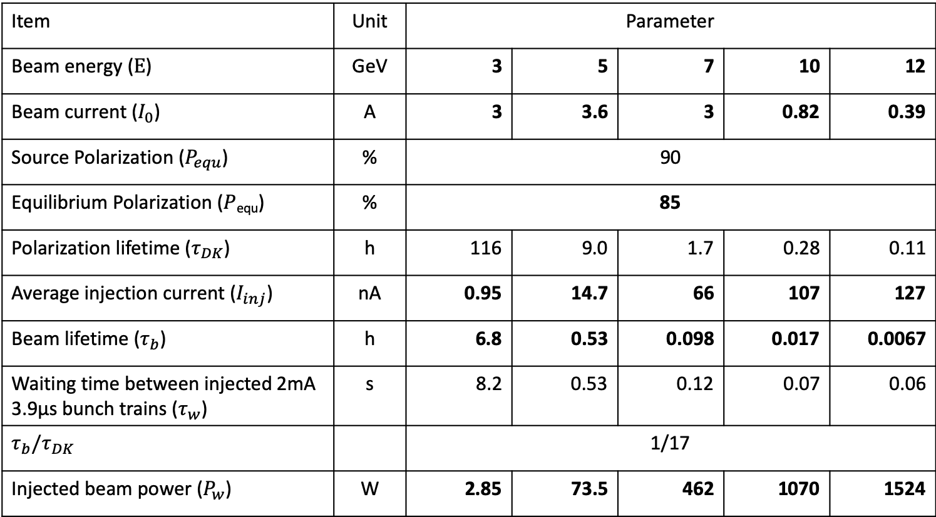
Top-off Parameters (assuming no damping wiggler)
Item | Unit | Parameter
Beam energy ($E$) | GeV | 3 | 5 | 7 | 10 | 12
Beam current ($I_{0}$) | A | 3 | 3.6 | 3 | 0.82 | 0.39
Source Polarization ($P_{equ}$) | % | 90
Equilibrium Polarization ($P$_{equ}) | % | 85
Polarization lifetime ($τ_{DK}$) | h | 116 | 9.0 | 1.7 | 0.28 | 0.11
Average injection current ($I_{inj}$) | nA | 0.95 | 14.7 | 66 | 107 | 127
Beam lifetime ($τ_{b}$) | h | 6.8 | 0.53 | 0.098 | 0.017 | 0.0067
Waiting time between injected 2mA 3.9µs bunch trains ($τ_{w}$) | s | 8.2 | 0.53 | 0.12 | 0.07 | 0.06
$$τ_{b}/τ_{DK}$$ |  | 1/17
Injected beam power ($P_{w}$) | W | 2.85 | 73.5 | 462 | 1070 | 1524
Goals
Goals
Calculated results
Required in order to reach 85% polarization
Required in order to keep required average injection current
Resulted

Slide 8
Average Injection Current and Beam Lifetime vs. Beam Energy
Polarization is 85% in the electron energy range of 3 to 12 GeV
6.8 h
127 nA
107 nA
66 nA
32 min
6 min
1 min
24 s
0.95 nA
14.7 nA

Slide 9
Shorten Beam Lifetime
Schemes to shorten beam lifetime |  | Control of potential issues
Local control of up to 1.5kW beam power | Scrape the beam | One or two local scrape(s) with local pump(s) to remove the heat (see slide 10) Active radiation shield may be needed - for example, 4-8 inches of lead to shield ~ 2kW beam power in dumplets in CEBAF
Global control of up to 1.5kW beam power ( < 1W/m) | Reduce the dynamic aperture | Pumps in the whole ring to remove the heat Active radiation shield may not be needed (?)
 | Use fast feedback system to destabilize a specific bucket before re-injection (Andrew Hutton)
Slide 11 for more ideas/comments in detail

Slide 10
Local Scraping and Pumping
Tune trombone, straight FODO, RF
Spin rotator
Spin rotator
Arc
Arc
70.94º
Future IP
Spin rotator
Spin rotator
IP
Spin rotator
Forward e⁻ detection, polarimetry
Scrape the beam locally, after the downstream crab cavities and before the arc (spin rotator). Local pump following the scraping can remove most of the heat immediately. Pumps for arc dipoles can remove the rest of heat.

Slide 11
Ideas and Comments
Single bunch injection => Source needs generate a few of nC polarized electron bunch;
CEBAF needs tolerate electron beams with a large energy
spread caused by the cavity voltage droop.
From Marcy Stutzman:
  Would it make any sense to add a potential RF kicker to kick the unwanted beam down a beam tube or into a pumping and absorbing area? The deflection needed would be small.
From Mark Wiseman:
  I think it would be best if we can use a kicker, etc. to put the beam in a spot we can design to and control.
  If not, 1.5 kW of diffuse loss in the arcs would probably not be a problem for heating as the there is plenty of cooling in the vacuum chambers. I think there is probably adequate vacuum pumping as well. We already have 10kW/m of SR radiation to control. I think the SR shields on the RF bellows would help act as a shield for this as well. Of course any concentrated power could get us in trouble. If the loss is in the straights, then we should review the designs to make sure. I just don't know the straight designs well enough to say off hand. It really depends on how diffuse the beam loss is. In either case we should consult with radiation safety on this. It is certainly less than ideal.
  Certainly we don't want any losses in the cryogenic sections, IP magnets and IP chambers, Crab cavities, etc.

Slide 12
Other Studies are Needed
Injection kicker with long pulse (us) vs. short pulse
Measure the beam current
Polarization lifetime with wigglers

Slide 13
Back Up

Slide 14
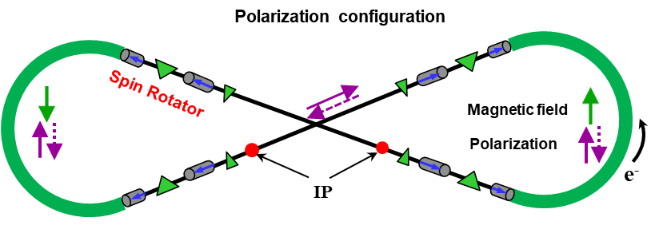
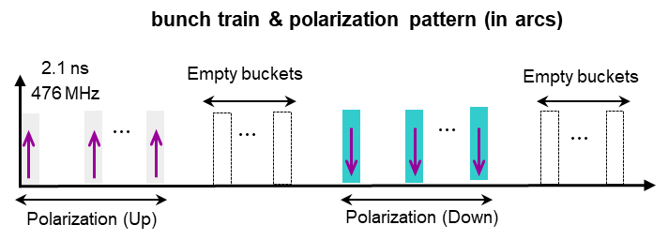
Electron Polarization Strategies
Highly vertically polarized electron beam from CEBAF
  High equilibrium polarization maintained by continuous injection
  Two oppositely polarized bunch trains
Polarization vertical in the arc to avoid spin diffusion and longitudinal at collision points
  Universal spin rotator with fixed orbit from 3 to 12 GeV
Energy independent spin tune
Spin matching considered
Compton polarimeter

