Slide 1
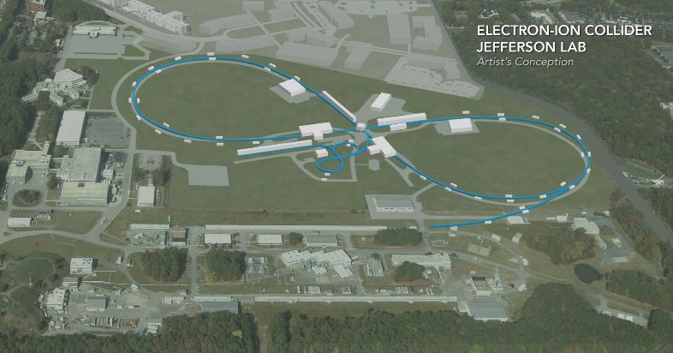
JLEIC Bored Tunnel Cross Sections
Tim Michalski
Paul Hansen
February 20, 2019

Slide 2
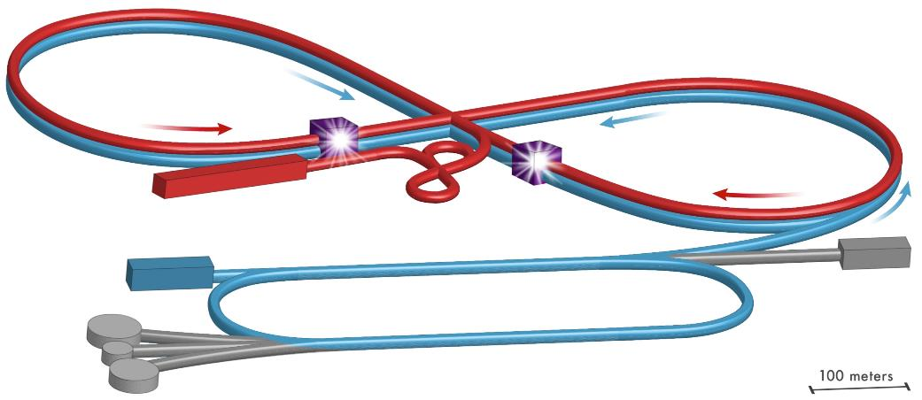
Which Cross-Sections Are We Looking At?
ARCs
ICR – Top
ECR Bottom
Booster
Synchronization Chicane
RF/SRF
Side by side beam lines
COOLING:
DC in Booster
ERL in ICR
ARCs
ICR – Top
ECR Bottom
Booster
Synchronization Chicane
IP-1
Side by side beam lines
IP-2
Side by side beam lines

Slide 3
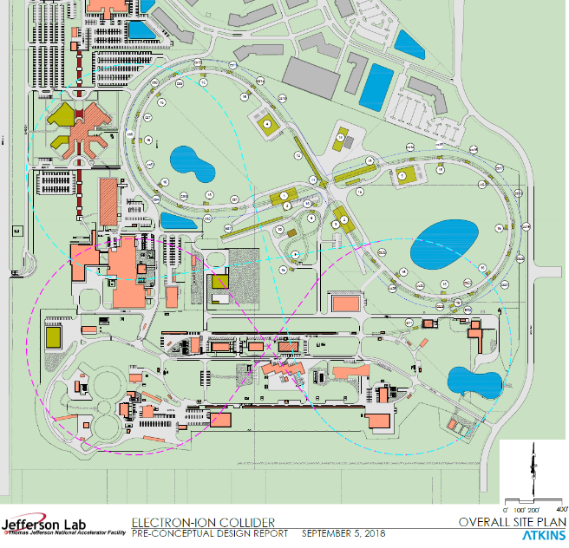
Options for Tunneled JLEIC
Showing 2 options for an expanded JLEIC footprint
Allows for larger arcs and longer straight sections
Fits on JLab site with appropriate setbacks from boundaries
Requires tunneling under buildings and CEBAF

Slide 4
Assumptions & Guiding Factors
Vertical beam line spacing in arcs – 1.2m (may increase to 1.6m, but should not affect what is presented here)
Horizontal beam line spacing in straights – 1.5m
Horizontal beam line shift at center of ECR chicanes – 1.2m
Beamlines shifted to outer wall in arcs
  Allows for maximum beam path length on site
  Aisle is towards the inside of the radius
Desired aisle width is 1.83 m (6’), – allows for tug and/or side loader
  Transport of 1 m diameter magnet cryostat (plus flanges), 11.4m long
Definitions:
  ECR – Electron Collider Ring
  ICR – Ion Collider Ring
  IP – Interaction Point
  CM – Cryomodule
  TBM – Tunnel Boring Machine
  NATM – New Austrian Tunneling Method
  SC – Superconducting

Slide 5
Comments from Meeting with John Osborne & Ben Swanson (CERN) – 12/19/18
5.8m vs 6m are considered the same size – go to 6m everywhere. 6-8m OD is a reasonable size. Going to 10-12m diameter is a different beast.
ESS uses 2 tunnels – 2nd is for RF with waveguides - Access requirements drive separate tunnel in addition to not wanting to bore a tunnel 2x the diameter. Boring 2nd tunnels in the straights is probably going to be very expensive option, per John.
CERN has done both TBM and NATM. Anything less than 2 km, don’t use TBM. John feels TBM with our soil conditions and 2.5-3km length is the right approach.
6 months to set up a TBM – doing a 2nd one ends up being much more expensive.
Launch TBM from just about any location, including the halls, and then develop a steel structure to be able to remove the TBM. More of a detailed planning consideration.
Shaft costs are much more than the cost per meter of tunnel.
Is it feasible to cut and cover the straights and TBM the arcs – even if they are at a different depth?
  John considers a cut and cover tunnel over the bored tunnel is probably a better option.
  John also mentioned option to Diaphragm Walls for the straights and then structure the base tunnel for the collider with a second level for the RF gallery.

Slide 6
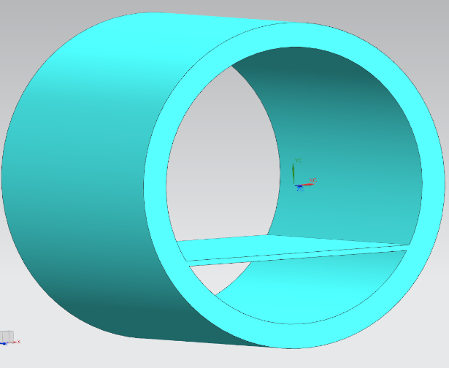
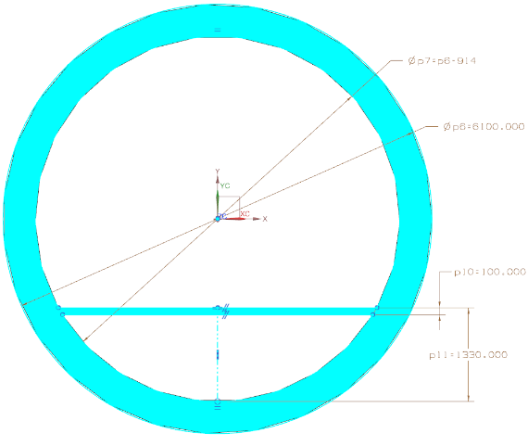
Tunnel Size for Assessment – 6.1m (20.0’) OD, 5.2m (17.0’) ID
Floor is offset – allows for piping and cable trays – same ID as HERA tunnel, wall thickness (1.5’) from Schnabel (tunneling contractor to our AE)
P. HANSEN 2/1/19

Slide 7
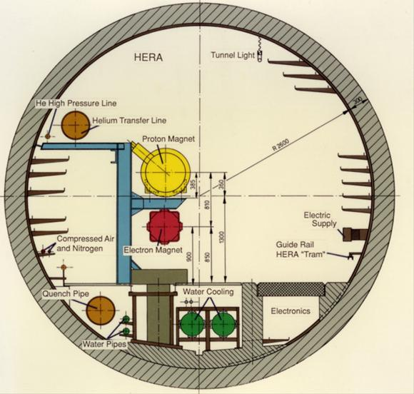
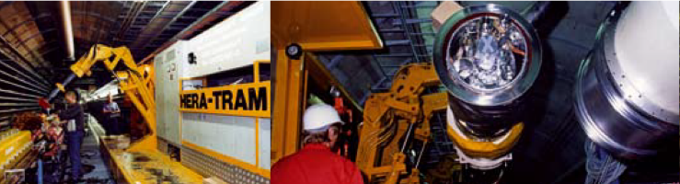
The HERA Tunnel (Reference Design)
5.2m ID, 0.3m wall, 5.8m OD (The difference here is 1’ vs 1.5’ wall)
Estimate Tram width at 1.53m (~5’) – HERA magnets are smaller OD
Tram uses 2 hydraulic arms to place components

Slide 8
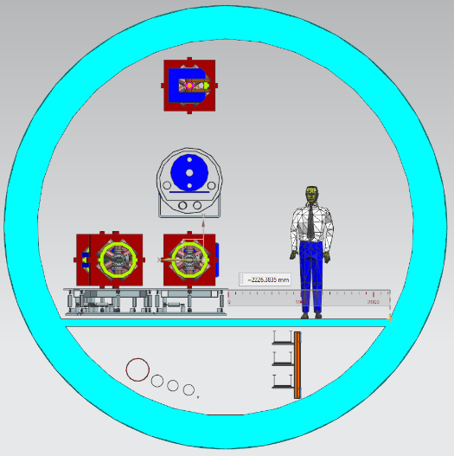
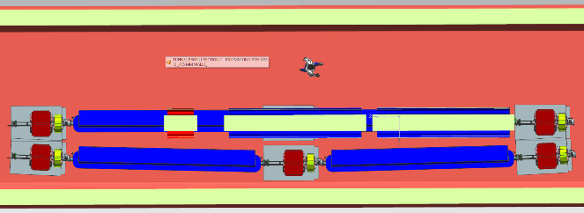
Arc Tunnel Cross Section
Aisle Width = 2.22m (7.30’), with 6.1m OD tunnel
Both Low Energy and Relativistic Energy Ion locations shown for ECR magnet chicane (1.2m shift).

Slide 9
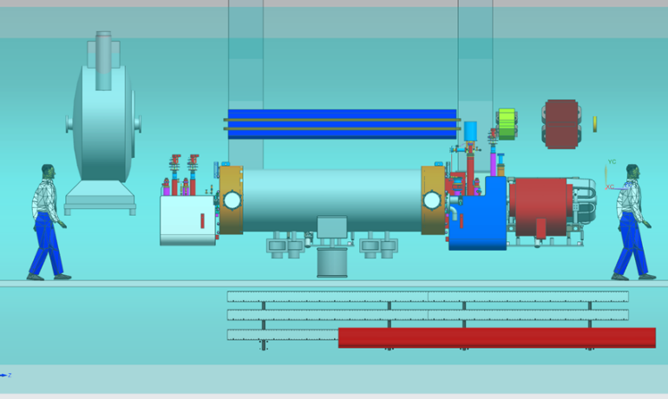
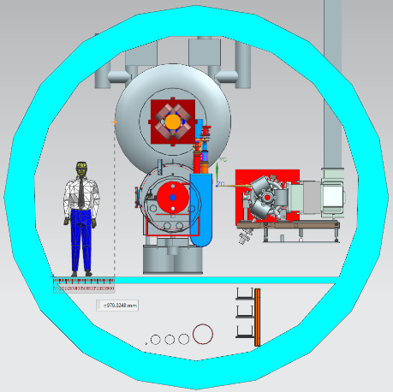
RF/SRF Tunnel Cross Section – North-West Straight – 6.1m OD Tunnel
Aisle Width at Bunching Cavity = 0.97m (3.2’),
Aisle Width at Cryomodule = 1.3m (4.3’)
May be able to make beam lines closer than 1.5m – considerations for waveguides on CM
No consideration given for u-tubes to make cryogenic connections to SRF CMs
Vacuum pump elements at the top of the bunching cavity must be repositioned

Slide 10
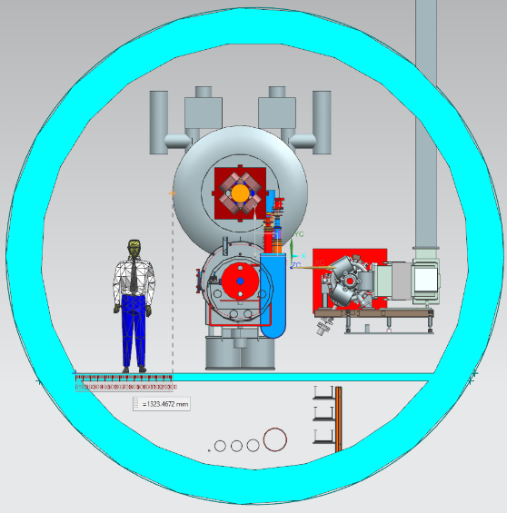
RF/SRF Tunnel Cross Section – North-West Straight – 6.8m (22.3’) OD Tunnel
Aisle Width at Bunching Cavity = 1.32m (4.3’) (Note: 5’ at cryomodule level)
Alternate design considerations:
  Interleave 2m OD Buncher Cavity with elements on ICR
  Move Buncher Cavities towards the center crossing point of the collider tunnel so that no (very few) elements would ever have to move past them
Have to remove elements from one aisle side beamline to access elements in the other beamline (develop some plan for maintenance access).

Slide 11
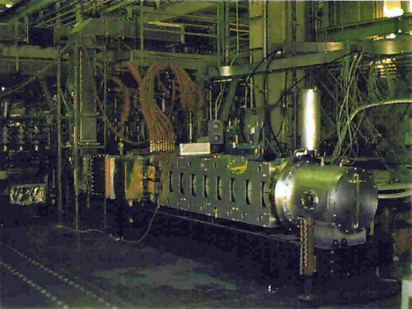
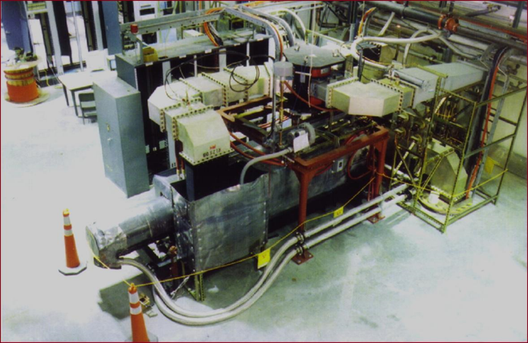
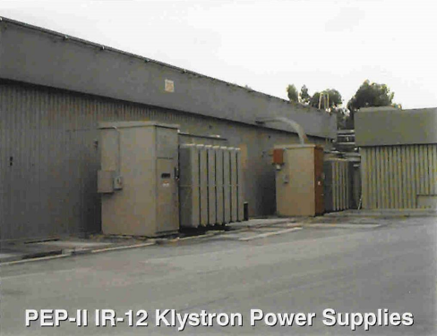
PEP-II RF System Elements
Klystron, circulator, 5 support cabinets, waveguide
1 PS for each klystron

Slide 12
C100 RF System with Support Racks and PS
←Control, LLRF, I&C, Cryo control racks
Power Supply →
Klystron banks

Slide 13
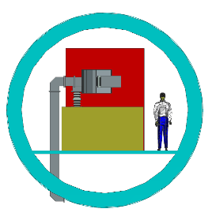
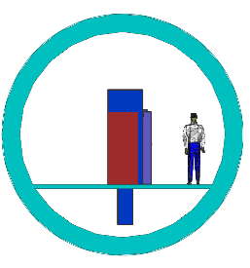
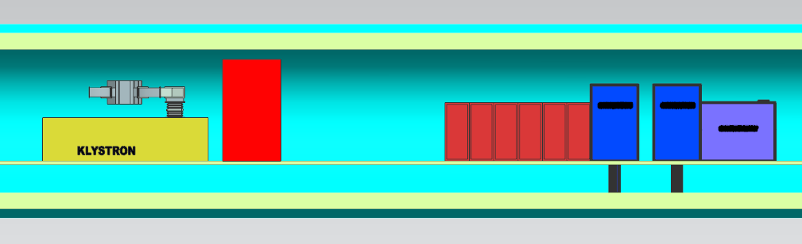
PEP-II RF System and SRF (C100) RF System
6.1m OD Tunnel
It appears that both RF systems will fit in a 6.1m OD tunnel.
May consider relocating the power supplies
Need to consider how to distribute the RF/SRF along the length of the N-W straight. Will it all fit if separated end to end for the various cavities and RF/power system?
34 PEP-II cavities take up ~107m of beam line.
PEP-II RF System
SRF (C100) RF System
6.8m OD Tunnel

Slide 14
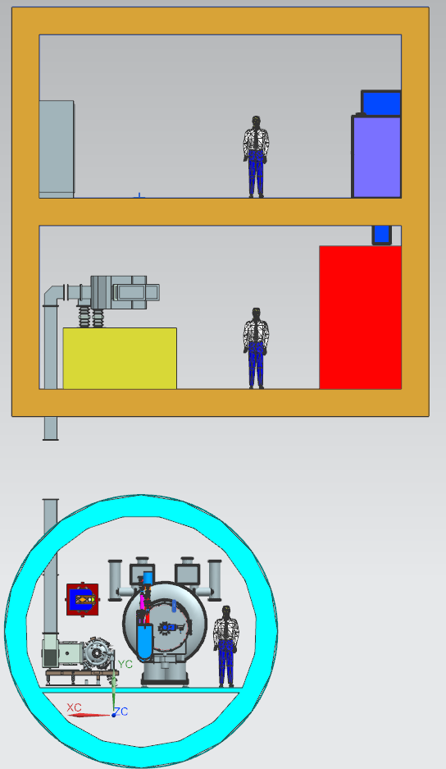
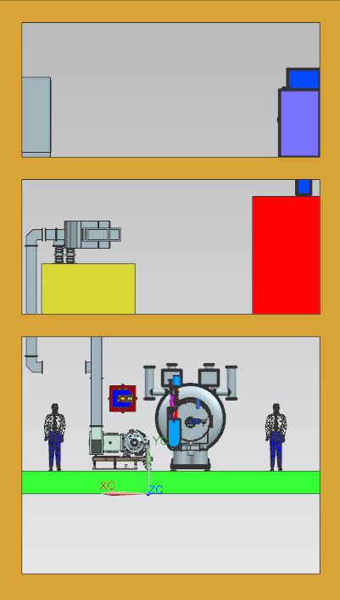

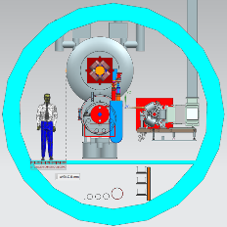
RF/SRF Region – North-West Straight
Diaphragm Walled - Gallery over Tunnel
Side by Side Tunnels with connecting shafts
Cut and Cover Gallery over Bored Tunnel

Slide 15
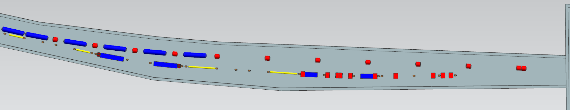
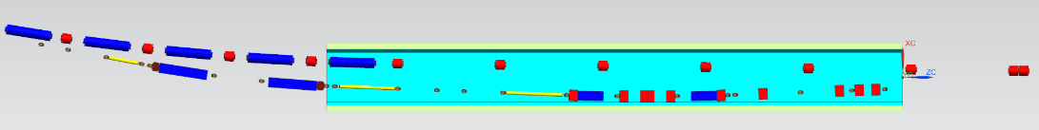

IP-1 Tunnel Cross Section – South-West Straight
IP is to the right of the beam line views. Shows beamlines transitioning from west arc into straight.
“Ideal” tunnel, allowing for aisles for both beam lines. Routing is the desired path for approaching (ICR) and exiting (ECR) the IP-1.
6.1m OD tunnel. No practical space for an aisle, could get 1m aisle width.
Beam paths shown are the desired paths for approaching (ICR) and exiting (ECR) the IP-1.
6.1m OD tunnel. Aisle Width = 1.77m (5.9’)
Shifted ICR beam lines to accommodate a 1.5m spacing. (Not desired path for ICR)

Slide 16
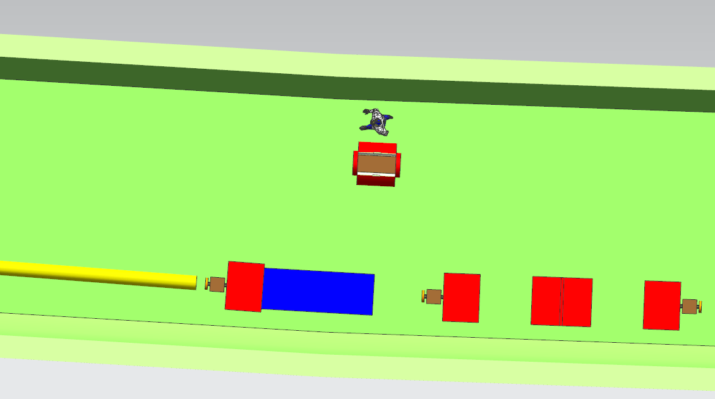
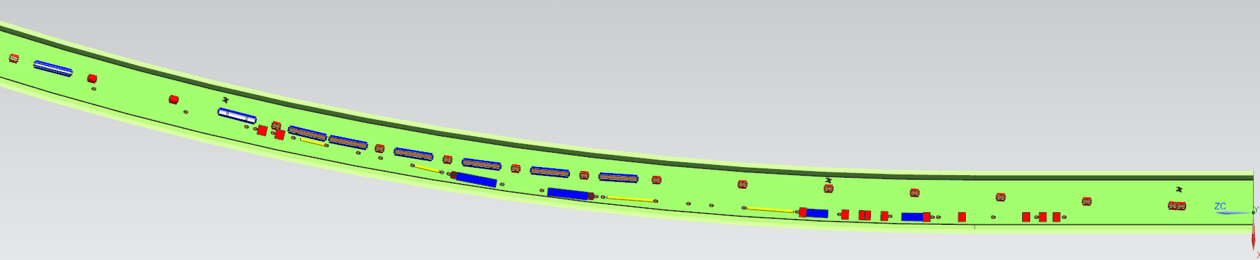
IP-1 Tunnel Cross Section – South-West Straight
This a top view of a 6.8m OD tunnel.
Aisle Width = 1m (~3’)
Options:
  Larger OD tunnel?
  Have removable drift sections between SC quads
  Disconnect and move ICR SC quads out of the way when moving large elements

Slide 17
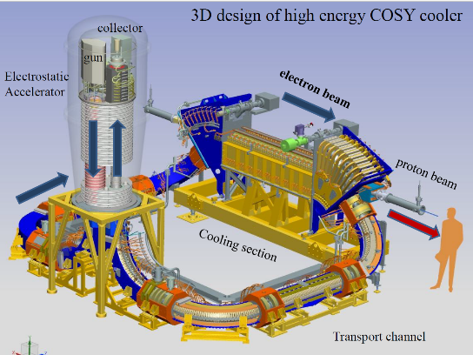
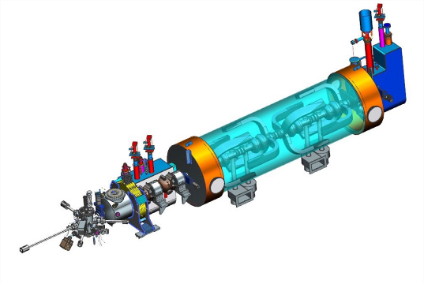
Elements in the Cooling Region – North-East Straight
COSY Cooler (note Solenoid is ~3m)
JLEIC Solenoid will be 15m long
ERL Cooler Injector

Slide 18
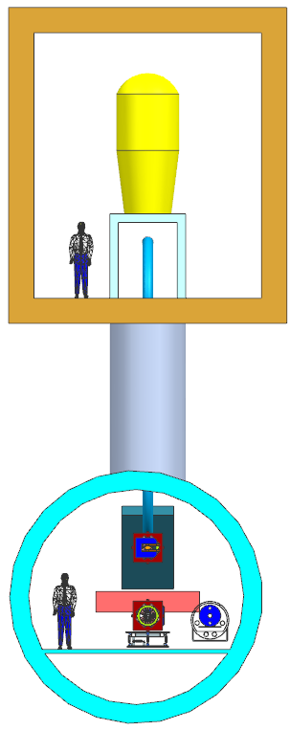
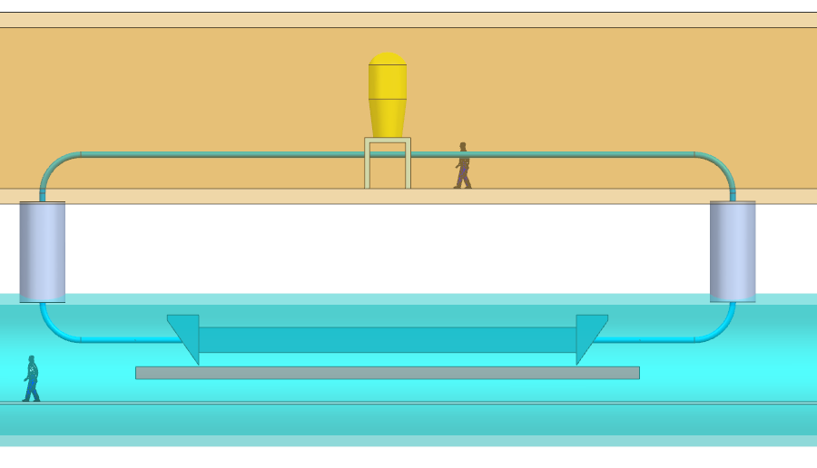
Cooling Region – North-East Straight – DC Cooler
Aisle Width at Solenoid Base = 1.29 m (4.2’) (Note: 6.3’ at Solenoid body)
Cooler electrostatic accelerator will not fit in 6-7m tunnel. Expect a cut and cover vault above the tunnel.

Slide 19
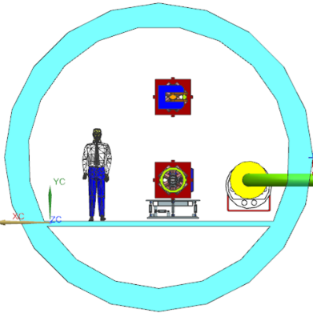
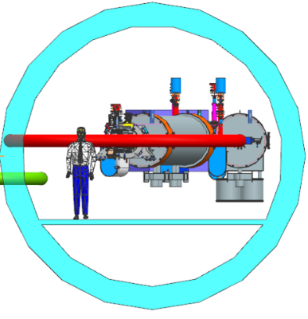
Cooling Region – North-East Straight – ERL Cooler – Horizontal Configuration
6.1 m OD Tunnels
  ERL Ring (red) and CCR (Green) must be parallel
  Left tunnel is the Collider Tunnel
  Right tunnel is the ERL Ring
  The ERL Ring does not appear to fit in the 6.1m tunnel size

Slide 20
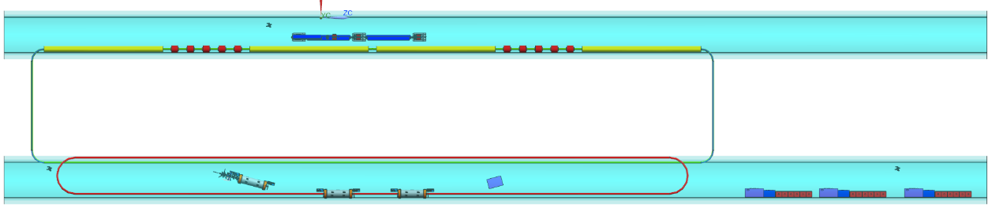
Cooling Region – North-East Straight – ERL Cooler – Horizontal Configuration
SIDE VIEW
TOP VIEW

Slide 21
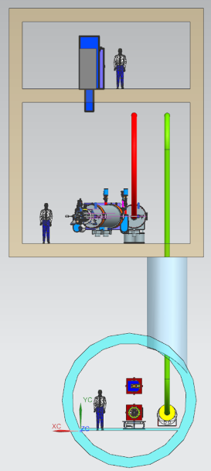
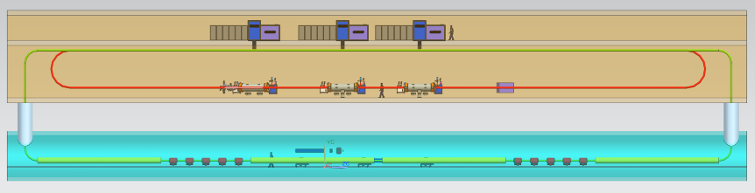
Cooling Region – North-East Straight – ERL Cooler – Vertical Configuration

Slide 22
SUMMARY
6.1m OD Tunnel works in most regions.
6.8m OD Tunnel appears to work for the RF/SRF region. Do we want to burden the entire machine with a tunnel for 1 region?
3 Options for RF Systems in RF/SRF Straight
2 Options for Cooling Region Straight – DC and ERL Cooler Locations
Need to look at the Downstream ICR from the IR. Need to determine where the Spectrometer Dipoles and Downstream Detectors (e.g. Roman Pots) are located

Slide 23
Questions to consider
Look at cost impacts for:
  6.1m (20’) OD tunnel
  7.0m (23’) OD tunnel
Connector tunnel:
  Can you have vertical penetrations into the top of the tunnel?
  Can vertical penetrations be offset from the tunnel centerline? If so, by how much?
  Does the wall thickness of a connector tunnel have to equal that of the main tunnel? If not, what is the requisite thickness?
Boring a tunnel into a chamber:
  If a cut and cover chamber is required to be inline (same centerline) with the bored tunnel, how is this done?
  Is the bored tunnel done first then cut and cover chamber or the inverse?
Parallel tunnels:
  What is the minimum distance between parallel tunnels (OD to OD)?
  If two parallel tunnels are not at the same elevation, can the distance between them be reduced?
Transfer line tunnels:
  A transfer line is required from CEBAF’s elevation to the collider tunnel. The expectation is they are on different elevations. The diameter or cross section of the transfer line tunnel only has to contain a single beam line of warm magnets. How is this achieved? What considerations are required for connecting with the bored tunnel?

Slide 24
Thank you for your attention.
Are there any questions?

Slide 25
Backup Slides

Slide 26
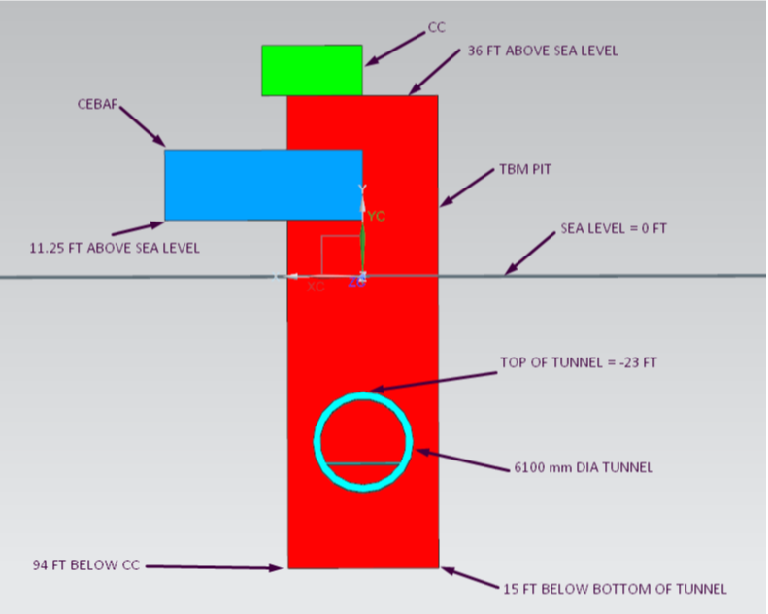
JLEIC ELEVATIONS
Tunnel depth may be shallower than shown

Slide 27
