Slide 1

JLEIC: Two Possible Affordable Roads to 100+ GeV CM Energy
Yuhong Zhang
Oct. 15, 2017
Presented at JLEIC Accelerator R&D Meeting Nov. 9, 2017

Slide 2
JLEIC Highest Risk at Present Time
Report of the Community Review of EIC Accelerator R&D (Jones Panel) for the Office of Nuclear Physics, Feb. 13, 2016
“Higher risk based on fundamental limitations on fully addressing the technical requirements presented in the long range plan”
Initial Closeout Report of the JLab Accelerator Advisory Committee (JLAAC), Sept. 13-15, 2017
“There is a clear emphasis on an important design issue for the JLEIC which is the attainable center-of-mass (CM) energy. 3T does limit the CM reach.”
“We advise to further optimize the superconducting magnet field level higher than 3 T in the proton storage ring but within established technologies (12 T is not yet practical), in order to be more realistic, less risky, and more cost-effective in balance with the maximum energy of the project. “
“Consider geometric siting solutions that are not co-planar with the current CEBAF (allowing a larger circumference), coupled with higher dipole fields, to permit better matching to design requirements for the CM energy.”

Slide 3
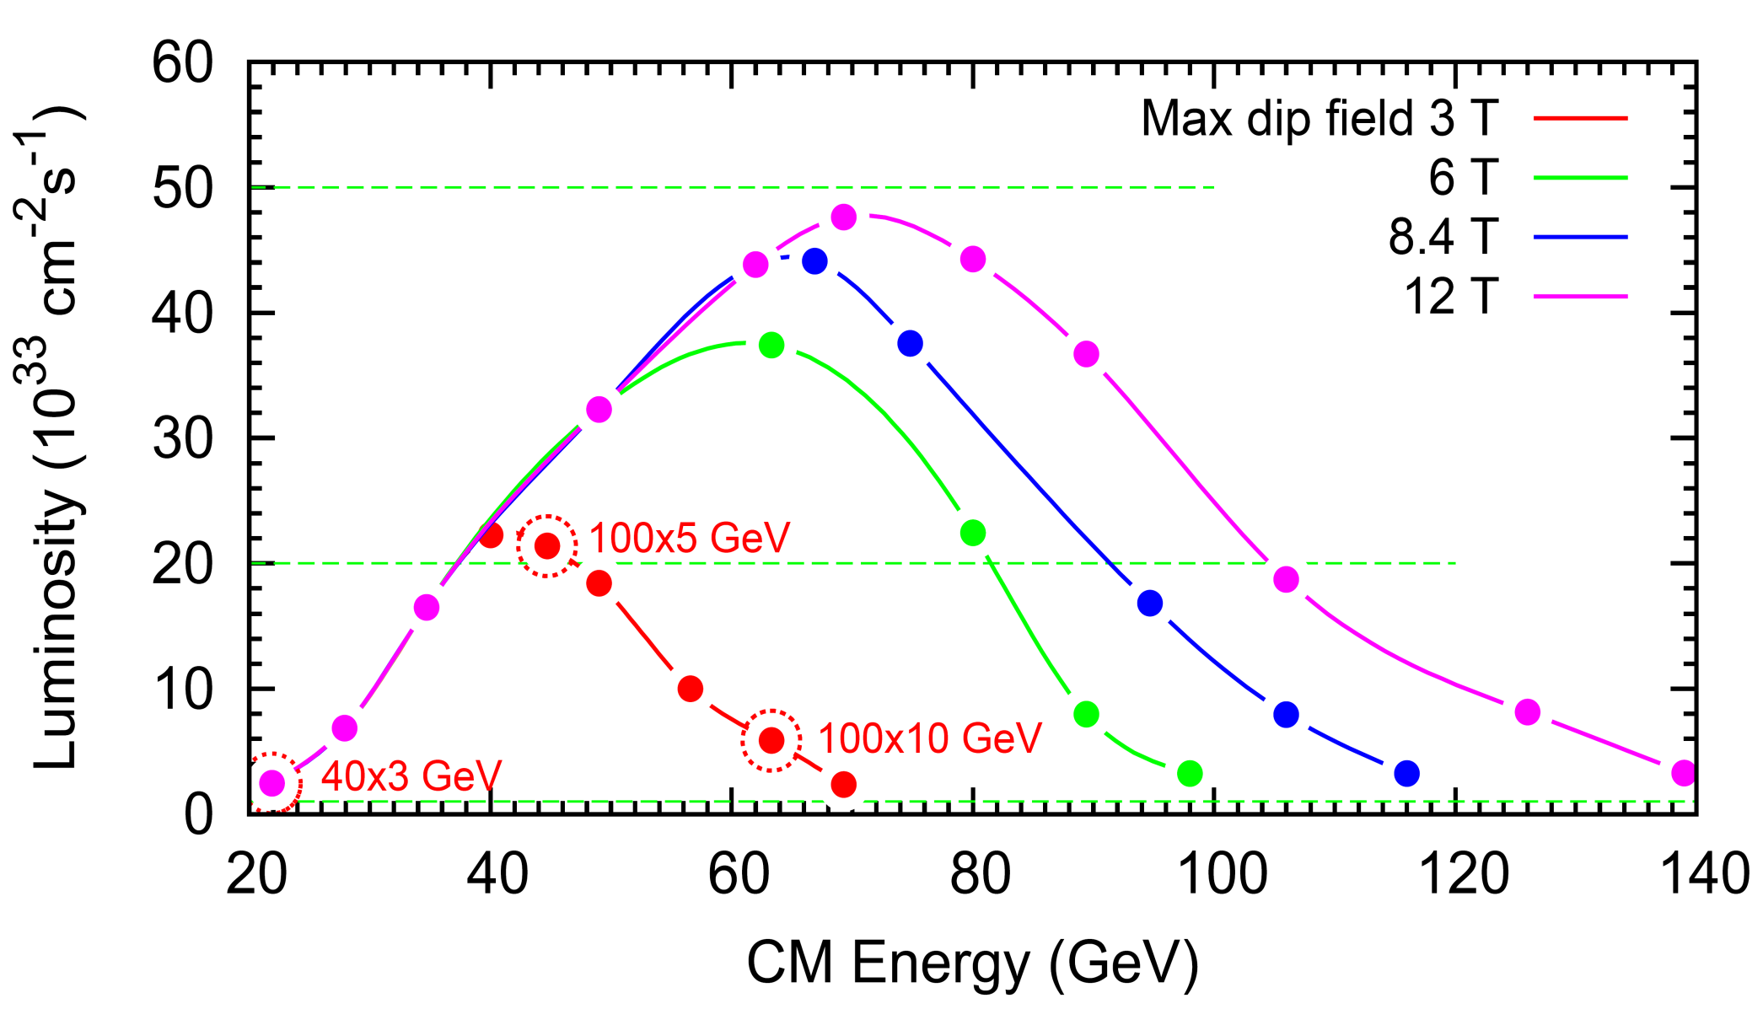
JLEIC Upgrade Potential
Present baseline
5x10³⁴
100 GeV CM
115 GeV CM
LHC SC magnet
140 GeV CM
SC magnet 3 T to 6 T:
Δ ~ $0.5B
(Harwood estimate, 2016,
including everything)
2x10³⁴
10³⁴
If the baseline design moves to high field SC magnets for the ion ring, there will be substantial cost increase

Slide 4
Lesson from Failure of SSC
“Originally estimated to cost $4.4 billion, the U.S. House of Representatives voted to kill the project in the summer of 1992, when costs had risen to $8.25 billion, but it was saved by the Senate, although a $100-million cut below requested funds put the project further behind schedule, increasing its costs even more. By the fall of 1993 the estimated cost had risen to a minimum of $11 billion (equivalent to $18 billion today), in part because administrative overhead proved larger than anticipated, and refined calculations of expected beam losses lead to a magnet redesign. (There were to be about 10,000 of them in the ring.) The latter’s increased cost, about $2 billion, could have been avoided by accepting a smaller ring and its resulting lower energy, but that idea was rejected by upper scientific and academic management.”
I heard this redesign was primarily for doubling physical aperture of SC magnets
“The Supercollider That Never Was”
By David Appell
“Scientific American”, October 15, 2013

Slide 5
What I learnt and Like to Suggest
Fact
As I learnt from the magnet experts
magnet cost is roughly linearly proportional to its
physical aperture, some time can be even worse
(of course there are many conditions for this statement)
Idea
If we can make the aperture of superconducting magnets much
smaller, then we may be able to save the magnet cost substantially
➔ kind of reverse of the SSC magnet design history
Opportunity
JLEIC ion beam has a much smaller emittance achieved by cooling
(at least there is a pre-cooling by DC cooler)
Note: I had first “played” this idea about 3 years ago, at that time I was exploring options to reuse RHIC dipole magnets for the JLEIC ion collider ring, also for the purpose of cost saving. This is a revisit of this idea

Slide 6
What Would Affect Aperture Size?
Beam stay-clear
  Transverse beam emittance
  Beam size (maximum betatron function and dispersion)
  Orbital steering (+/- 5 mm)
  Number of sigma (6 to 10)
Dynamic aperture (with low beta insertions)
Injection (beta-squeeze easies the problem)
Collimaton (transverse tails)
Scatterings (beam life-time)
Electron cooling

Slide 7
Magnet Aperture: A Great Opportunity to Exploit?
Cooling |  | No |  |  |  | Yes
Kinetic energy | GeV | 8 Injection | 50 | 100 | 210 | 10 injection | 50 | 100 | 210
CM energy (Electron energy) | GeV |  | 24.7 (3 GeV) | 69.6 (12 GeV) | 100.6 (12 GeV) |  | 24.7 (3 GeV) | 69.6 (12 GeV) | 100.6 (12 GeV)
Emittance, normalized | µm | 2.5 | 2.5 | 2.5 | 2.5 | 0.5 | 0.5 / 0.25 | 0.5 / 0.1 | 0.5 / 0.1
Emittance, unnorm. | nm | 266.9 | 46.1 | 23.2 | 11.1 | 43.0 | 9.2 / 4.6 | 4.6 / 0.93 | 2.2 / 0.44
Energy spread (δp/p) | 10⁻⁴ | 10 | 10 | 10 | 10 | 3 | 3 | 3 | 3
Maximum beta in arc | m | 38 | 38 | 38 | 38 | 38 (32) | 38 | 38 | 38
Maxi dispersion in arc | m | 2.2 / 0 | 2.2 / 0 | 2.2 / 0 | 2.2 / 0 | 2.2 / 0 | 2.2 / 0 | 2.3 / 0 | 2.2 / 0
Max beam size in arc | mm | 3.9 / 3.2 | 2.6 / 1.3 | 2.4 / 0.94 | 2.3 / 0.65 | 1.4 / 1.3 | 0.89 / 0.42 | 0.78 / 0.19 | 0.72 / 0.13
Beam stay-clear | mm | 39 / 32 (10 σ) | 26 / 13 (10 σ) | 23.9 / 9.4 (10 σ) | 24 / 6.5 (10 σ) | 8.2 / 7.7 (6 σ) | 5.3 / 2.5 (6 σ) | 4.7 / 1.1 (6 σ) | 4.3 / 0.8 (6 σ)
Magnet saggitt | mm | 18.3 | 18.3 | 18.3 | 18.3 | 18.3 | 18.3 | 18.3 | 18.3
Beam steering | mm | ± 5 | ± 5 | ± 5 | ± 5 | ± 5 | ± 5 | ± 5 | ± 5
Required phys. Aperture | mm | 106 x 74 | 80 x 37 | 76 x 29 | 74 x 23 | 46 / 25 | 39 / 15 | 38 x 12 | 37 / 12
100 mm x 60 mm is the present baseline
42% x 34%
Is a 50 mm x 30 mm aperture enough?
Can we get away with a half-size aperture for the JLEIC ion collider ring high-field dipoles so we can save half the cost?

Slide 8
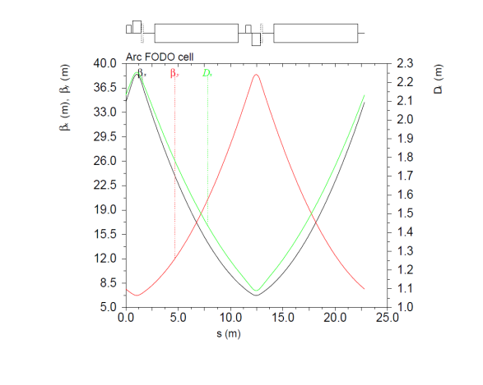
Present JLEIC Ion Collider Ring Arc Cell
D_{x}=2.05 m
β_{y}~31.5 m
β_{x}~31.5 m
50 mm x 30 mm should give 8σ_{x} and 8σ_{y} for dipoles
D_{x}=1.2 m
β_{x}~8 m

Slide 9
Key to Make This Idea Work
The proton/ion beam emittance in the collider ring must be kept very small for the ENTIRE beam cycle
That means small injection beam emittance ⬅ pre-cooling must be done in the booster ring ⬅ space charge limit must be carefully managed
That also means small emittance must be maintained during collision ➔ strong bunched beam electron cooling must success at collision energies
(we will see whether we can relax this condition)
Ring | Functions | Kinetic energy (GeV / MeV) |  |  | Cooler type
 |  | Proton | Lead ion | Electron
booster ring | Accumulation of positive ions | 0.285 (injection) | 0.1 (injection) | 0.054 | DC
 | Pre-cooling for emittance reduction | 2 (ramp to) | 2 (extraction) | 1.1 | DC
collider ring | Maintain emittance during stacking | 10 (injection) | 2.1 (injection) | 5.4 (proton) 1.5 (lead) | DC
 | Maintain emittance during collision | Up to 210 | Up to 83 | Up to 114 | ERL
only
Pre-cooling back to the booster ring

Slide 10
Beam Formation with Multi-Stage Cooling
proton
collider Ring
Bunch splitting,
emittance preservation
booster
Stacking,
Emittance preservation
Up to 210 GeV
ERL cooler
up to 114 MeV
Fast ramp
Multi-turn injection accumulation
Pre-cool
10 GeV
10 GeV
~2 GeV
DC cooler 5.4 MeV
285 MeV
DC cooler
1.1 MeV
Lead ion
collider Ring
Bunch splitting,
Emittance preservation
booster
Up to 82 GeV/u
Stacking, emittance preservation
ERL cooler
44.8 MeV
Multi-turn injection accumulation
Pre-cool
2.7 GeV
2.7 GeV
100 MeV/u
DC cooler
1.5 MeV
DC cooler
1.5 MeV
DC cooler

Slide 11
Booster Extraction Energy
Several issues under consideration
Collider ring maximum proton energy: 200+ GeV
Collider ring magnet ramp range: < 20
Collider ring proton injection energy: DC cooler available
(not too far from state-of-art)
Collider ring injector energy: higher is better for space charge
 | Injection kinetic energy | Extraction kinetic energy | Ramp range of dipole field | Cooling at injection in collider ring
 | GeV | GeV |  | MeV
Linac |  | 0.285
Booster | 0.285 | 10 (12) | 13.9 (16.4) | 5.4 (6.5) (DC)
Collider ring | 10 | 210 | 19.4 (16.3) | Up to 114 (ERL)

Slide 12
Why a 2nd and Large Booster May Not Be a Good Design Option?
Old baseline: 3 GeV pre-booster, ~25 GeV large booster, 100+ GeV collider ring
large booster has a same footprint as the collider ring
Variations: ➔ Electron collider ring as a large booster (down to 15 to 18 GeV)
➔ 3 GeV circular or square-sharp pre-booster
Advantages
Allow a short ion linac (130 MeV proton and 40 GeV/u lead ion)
Avoid crossing of transition energy in all rings
Disadvantages
Inject very low energy beam (~3 GeV) to a full-size collider ring, space charge may be an issue
No DC cooling at injection energy of the collider ring (stacking)
Less efficient and take longer time for beam formation
May have additional cost for the large booster

Slide 13
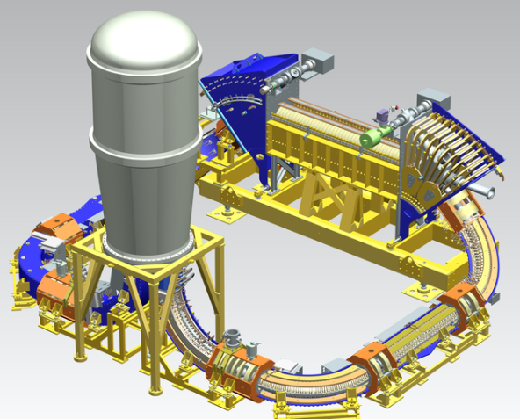
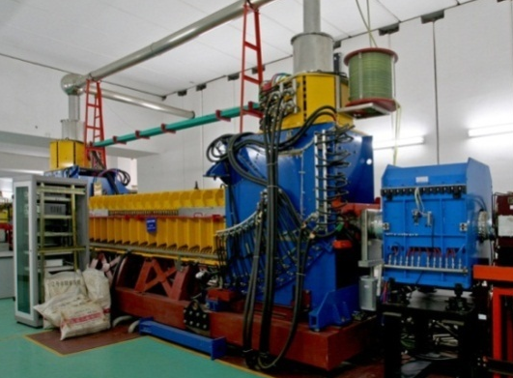
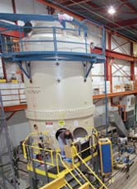
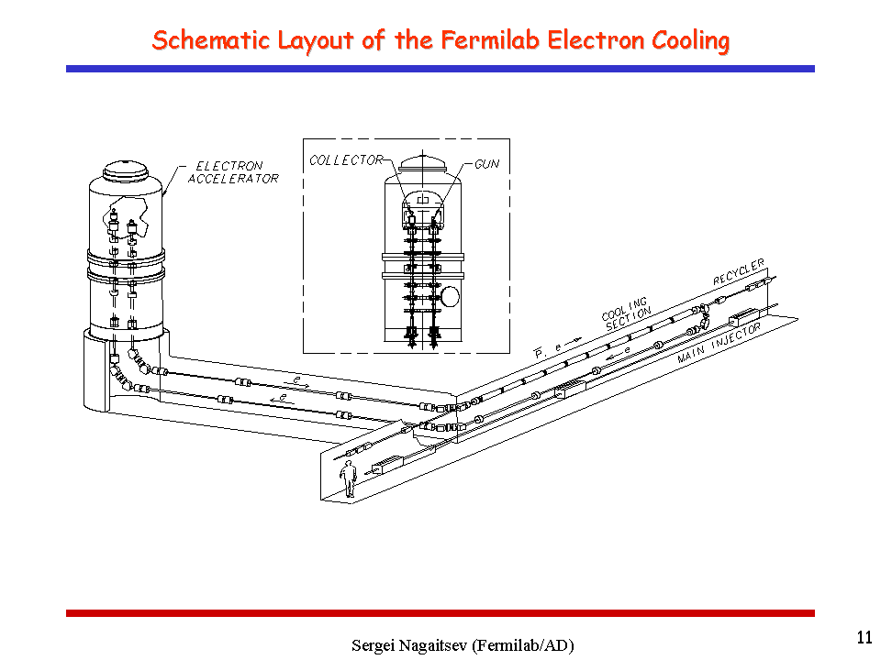
DC Cooler: Not Far From State-of-Art
Low energy DC cooler @ IMP, China
Low energy (100 KeV) DC Cooler @ COSY, Julich
2 MeV Magnetized DC cooler @ COSY Jülich
4.3 MeV non-magnetized DC cooler @ Recycler, Fermilab
New high voltage (turbine) technology for 8 MeV magnetized DC cooler @ HESR/FAIR, GSI
K. Aulenbacher, COOL’17

Slide 14
Injection Limited by Space Charge
Present baseline: the proton beam (0.75 A) is injected into the collider ring and pre-cooled to the design value of small emittance at 7.9 GeV kinetic energy, the space charge tune-shift is under the pre-set limit (0.15). With injection at 10 GeV kinetic energy, the tune-shift is even smaller
Kinetic energy of lead ion injection beam is much lower (~2.7 GeV/u with the same magnet rigidity), then the emittance must be even smaller to fit into the small magnet aperture (namely, the ion emittance value should be scaled with βγ from the proton emittance value). The low emittance can be achieved by pre-cooling at the booster ring. The beam current must also be scaled down to make the space charge tune-shift at the injection lower than the pre-set limit
Assuming the injected ion beam is a round one, it becomes an oval/flat one after the beam is ramped to higher energy , due to the balance of IBS and cooling
Δν_{sp} = λ r₀ R / 2ε_{n,y} β γ²
σ_{lead} = σ_{proton} ➔ ε_{n,p} / (βγ)_{p} = ε_{n,lead} / (βγ)_{lead}
 |  | Proton |  |  | Lead Ion
Kinetic energy at injection (corresponding proton KE) | GeV | 7.9 | 10 | 12 | 2.65 (7.9) | 3.46 (10) | 4.23 (12) | 6.58 (18)
Beam current | A | 0.75 | 0.75 | 0.75 | 0.13 | 0.2 | 0.29 | 0.61
Particles in collider ring | 10¹³ | 3.36 | 3.36 | 3.36 | 0.0073 | 0.011 | 0.016 | 0.033
Emittance, norm, x/y | µm | 0.5 | 0.5 | 0.5 | 0.2 | 0.2 | 0.2 | 0.2
Space charge tune-shift |  | 0.133 | 0.086 | 0.062 | 0.15 | 0.15 | 0.15 | 0.15

Slide 15
Fall-Back: If There is No Bunched Beam Cooling
Would this become a single point total failure for a JLEIC design with small SC dipole aperture?
Then the emittance will grow due to IBS
How large is the (cut-off) emittance such that the beam is too fat to fit into the aperture?
And how long time the emittance grows to that cut-off value?
σ_{x,max} = ( ε_{n,x} β_{x}^{max} / βγ )^{1/2}
 |  | Design | Design | Cut-off | Design | Cut-off
Energy | GeV | 10 | 50 | 50 | 210 | 210
Emittance, norm | µm | 0.5 | 0.5 / 0.25 | 2.3 / 2.3 | 0.5 / 0.1 | 9.7 / 9.7
Growth ratio |  |  |  | 4.7 / 9.2 |  | 19.4 / 97
Beam spot | mm | 1.4 / 1.3 | 0.86 x 0.42 | 1.4 x 1.3 | 0.72 x 0.13 | 1.4 / 1.3

Slide 16
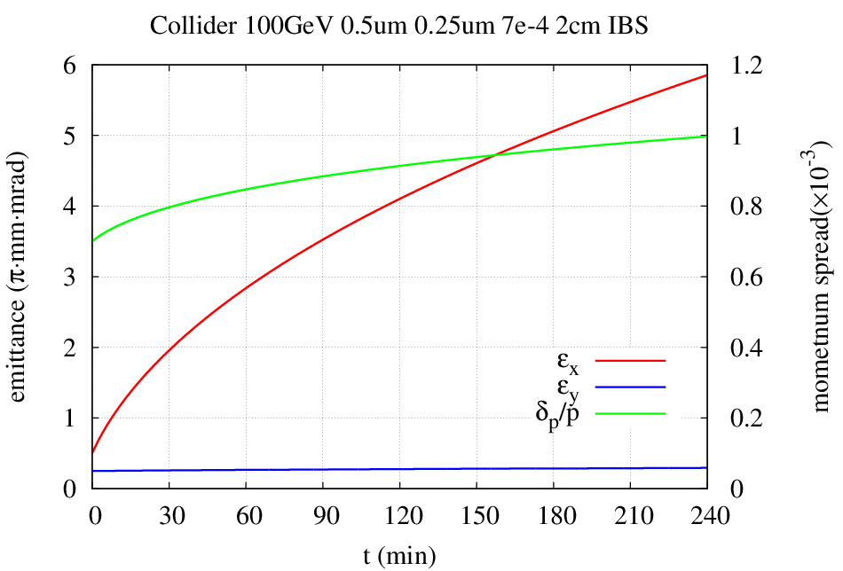
Emittance Evolution w/o Cooling During Collision

Slide 17
Conclusion for Route 1
It seems there is a possibility to reduce the physical aperture of arc SC magnets by half, therefore, thus, significantly reduce the cost
It requires multi-step beam cooling, both strong DC cooling in the booster and strong bunched ERL cooing during collision
Weak bunched beam ERL cooling is OK provided to reduce proton/ion beam current (so a reduction of the luminosity)
Key to ensure this idea works is preserving very small designed ion emittance in the entire cycle in the collider ring, otherwise the beam will be lost
However, bunched beam ERL cooling is not a potential show-stopper
Without a strong ERL cooling, the ion beam emittance will grow due to IBS, then the ion beam must be frequently replaced. This may provide a safe net (fall-back position) of the small-aperture design concept
This may also be applied to 3 T SF magnets

Slide 18
JLEIC Ion Collider Ring Made by RHIC Magnets (A Revisit)
In about three years ago, we studied the issue whether we can reuse the RHIC magnets for the ion collider ring.
Back at that time, we had a constraint condition on the geometry of the ring: 81.7° figure-8 crossing angle and ~2.15 km ring circumference
The results are summarized in the following presentations
  “MEIC Alternative Design Part 2” by Yuhong Zhang (August 28, 2014)
  “MEIC Alternative Design Part 3” by Yuhong Zhang (Sept. 4, 2014)
  “MEIC Alternative Design Part 6” by Yuhong Zhang (Nov. 6, 2014)
  “MEIC Alternative Design Part 7” by Yuhong Zhang (Nov. 20, 2014)

Slide 19
RHIC Magnets Only
 |  | RHIC | JLEIC |  |  | Present baseline
Maximum proton kinetic energy | GeV | 275 | 160 | 175 | 200 | 100
Max CM energy (electron 12 GeV) |  |  | 87.6 | 91.7 | 97.9 | 69.3
Dipole (magnetic) length | m | 9.45 | 9.45 | 9.45 | 9.45
Dipole maximum field | T | 3.77 | 3,77 | 3.77 | 3.77
Dipole bending radius | m | 243 | 141 | 156 | 177
Dipole bending angle | deg | 2.23° | 3.83° | 3.50 | 3.06
FODO cell length & packing factor | m | 29.6 & 0.638
Figure-8 crossing angle |  | -- | 100° | 104° | 114° | 81.7°
Cells in each arc |  | 13.5 | 36.6 | 40.6 | 47.8
Total dipoles in the ring |  | 162 (x2) | 146 | 162 | 191
Arc length (6 arcs for RHIC) | m | 400 | 1082 | 1200 | 1415
Arc radius | m | 381 | 221 | 242 | 277
Straight length | m |  | 372 | 378 | 366 | 360
Ring circumference | m | 3840 | 2907 | 3158 | 3564 | 2140
Enlarged by |  |  | 1.4 | 1.5 | 1.7
Footprint, length x width | m |  | 1021 x 443 | 1099 x 484 | 1217 x 554 | 787x310
Enlarged by |  |  | 1.3 x 1.4 | 1.4 x 1.6 | 1.5 x 1.8

Slide 20
Ways for Reducing Footprint
RHIC cell: 29.6 m, 3.77 T, 3.06° x 2 = 6.12°
New magnet cell: 29.6 m, 7.54 T, 6.12° x 2 = 12.24°
This can be small aperture
RHIC cell
New magnet cell
Dipole |  | RHIC | New
Length | m | 9.45 | 9.45
Field | T | 3.77 | 7.54
Bending (@200 GeV) |  | 3.06° | 6.12°
Radius | m | 176.9 | 88.5
Seggitta | mm | 6.31 | 12.6

Slide 21
Ways for Reducing Footprint
Proton energy | GeV | 100 | 200 | 200 | 200 | 200
Max field, RHIC & new dipoles | T | 3.8/ 7 .5 | 3.8/ 7 .5 | 3.8/ 7 .5 | 3.8/ 7 .5 | 3.8/ 7 .5
RHIC cells in super-period |  | Present baseline | 1 | 1 | 2 | 4
New magnet cell in super-period |  |  | 0 | 1 | 1 | 1
Total cells in super-period |  |  | 1 | 2 | 3 | 5
Total length of super-period | m |  | 29.6 | 59.2 | 88.8 | 148
Total bend per super-period |  |  | 6.12° | 18.36° | 24.5° | 36.7°
Figure-8 crossing angle |  | 81.7° | 114° | 91° | 97.5° | 103.5°
Arc length | m |  | 1415 | 874 | 1007 | 1143
Super-periods per arc |  |  | 47.8 | 47.8 | 11.3 | 7.72
Dipoles in ring: RHIC & New |  |  | 191 & 0 | 59 & 59 | 91 & 45 | 123 & 31
Arc radius | m |  | 277 | 185 | 208 | 231
Straight length | m | 360 | 366 | 363 | 364.5 | 364.1
Ring circumference | m | 2140 | 3564 | 2474 | 2742 | 3013
Enlarged by |  |  | 1.7 | 1.15 | 1.3 | 1.4
Footprint, length x width | m | 787x310 | 1217x554 | 888x370 | 969x416 | 1050x462
Enlarged by |  |  | 1.5x1.8 | 1.1x1.2 | 1.3 / 1.3 | 1.3x1.5
Upgrade, proton and CM energy (electron energy 14 GeV) | GeV | 251 / 119 | 478 / 164 | 292 / 130 | 339 / 138 | 385 / 147

Slide 22
Conclusions for Route 2
Reusing RHIC Dipoles for JLEIC figure-8 shape ion collider ring is possible
Bending angle of RHIC dipoles is limited by magnet sagitte.
It requires a large footprint (and large circumference) if using RHIC dipole magnet alone
To reduce the footprint and circumference substantially, one may mix the RHIC dipoles with new high field dipoles.
There are many ways to combine use of RHIC and RHIC dipoles. Perhaps the best approach is alternating cell based, i.e., RHIC cells and non-RHIC cells
There is a natural upgrade approach by replacing the RHIC cells

Slide 23
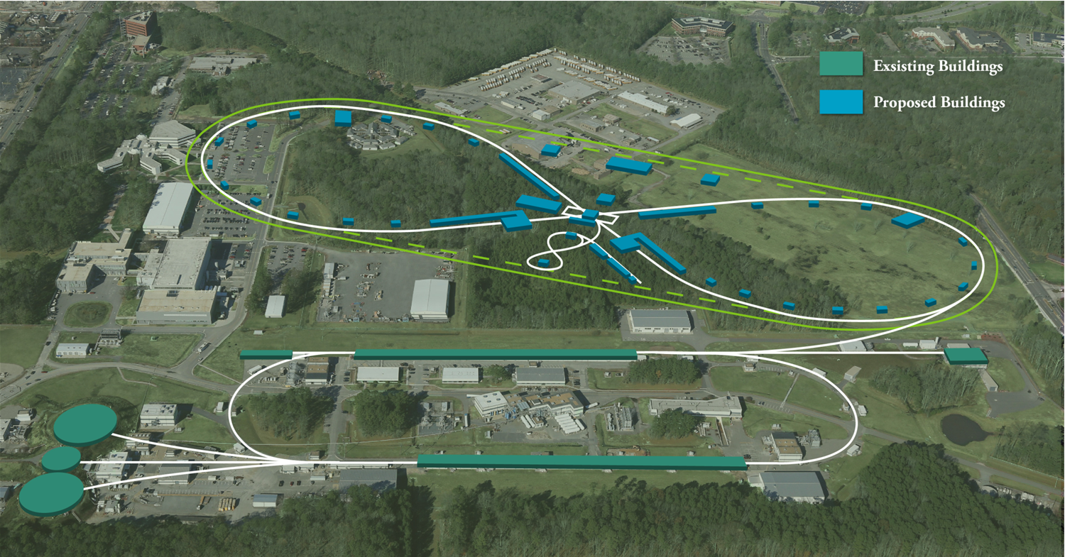
Other Ways to 100 GeV CM Energy

Slide 24
Summary: Most Promising Routes from
A Personal View
Is JLEIC going to die either on cost or on CM energy reach or both?
--- That should not be necessary!
CM energy range
Cost
Site filler
Luminosity
Technology R&D
Reliability
Operability
High field dipoles with half aperture
RHIC dipoles mixed with new dipoles
  Hybrid dipole cell
RHIC dipole
New dipole
  Hybrid lattice
RHIC cell
New magnet cell

