Slide 1
“Straight” Merger
Andrew Hutton
Concept suggested independently by Haipeng Wang

Slide 2
Straight Merger with No Bending of Low Energy Beam
Recirculated Beam
Injected Beam
Injector Cryomodule
Septum Magnet
RF Separator with Superposed Magnetic Field
ERL Cryomodule

Slide 3
Concept (1)
Use an RF Separator to separate the injected beam from the recirculating beam
Immerse the RF Separator in a DC magnetic field
Arrange timing and relative amplitudes so that the injected beam is not deflected
Bunches are at maximum of RF deflection – bunch center has zero slope
This means that the kick seen by the recirculated beam is doubled
Needs to be sufficient to provide adequate separation at the septum

Slide 4
Waveforms
Injected Bunch
Recirculated Bunch

Slide 5
Concept (2)
Use an RF Separator to separate the injected beam from the recirculating beam
Immerse the RF Separator in a DC magnetic field
Arrange timing and relative amplitudes so that the injected beam is not deflected
This means that the kick seen by the recirculated beam is doubled
Bunches are at maximum of RF deflection – bunch center has zero slope
Needs to be sufficient to provide adequate separation at the septum
The injector beam and the recirculating beam are further separated by a septum magnet
Injected beam sees zero field
Recirculating field sees deflecting field to provide adequate separation at the last injector cryomodule

Slide 6
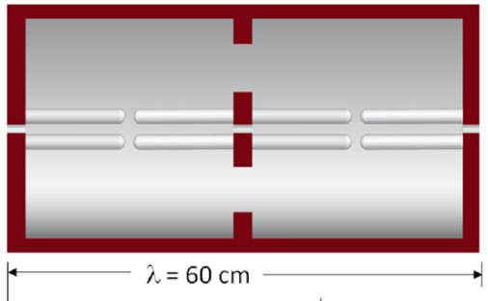
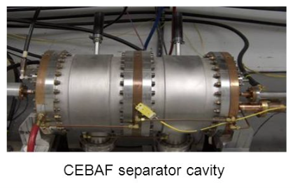
Hardware – RF Separator
Example: CEBAF 500 MHz separator cavity
Provides a kick of >15 mrad for a 55 MeV beam using 3.5 kW RF power
The magnetic field adds an equal kick
Field ~100 G
Total kick for 55 MeV beam is >30 mrad
Assume a drift length of 2 meter
Separation at the septum is >60 mm
Aperture of CEBAF RF separator is 30mm
Injector beam is large, but not deflected
Recirculating beam is deflected ~18 mm within separator
Needs more aperture at downstream end for recirculated beam

Slide 7
Deflection by CEBAF 499 MHz RF Separator
Deflection of 55 MeV beam ≈ 15 mrad
Deflection of 5 MeV beam ≈ 170 mrad
Mike Spata (private communication)

Slide 8
Separation at Septum
Separation of 60 mm accommodates halo and misalignments
60 mm
2” OD
2” OD
10 mm

Slide 9
Curvature of Injected Bunch (Banana effect)
RF deflection of bunch center ≈170 mrad
Assume 952 MHz RF separator (maximum curvature)
Wavelength = 31.5 cm
Bunch length = ±1 cm
RF deflection at bunch ends = 170 cos (1/31.5) mrad
= 170 x 0.9995 = 169.9 mrad
Maximum deviation at bunch ends = 170 x .0005 mrad = 85 μrad
Significantly less than the beam divergence

Slide 10
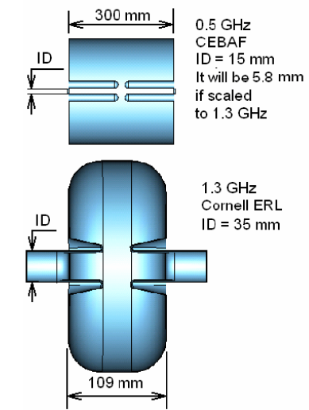
Example of Alternate RF Separator Cavity (Cornell)
https://www.classe.cornell.edu/rsrc/Home/Research/SRF/2010/Deflecting_cavity.pdf
Kick is too weak for this use Try reducing aperture?

Slide 11
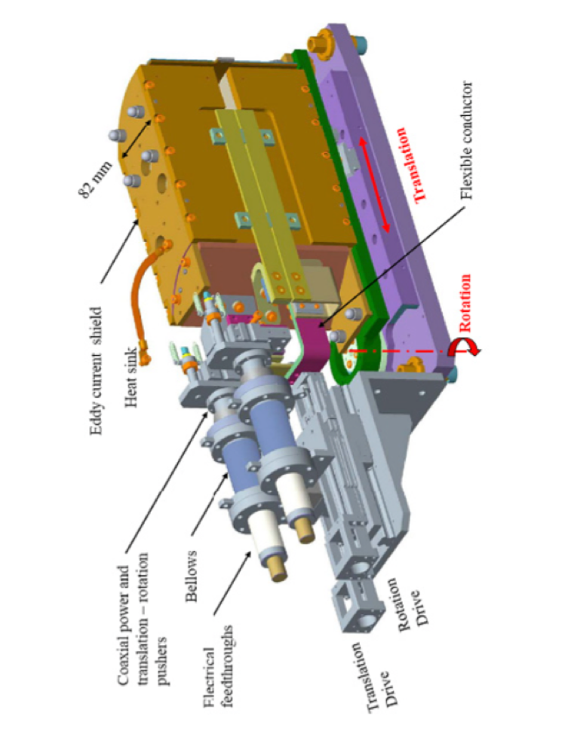
Septum Magnet
The septum magnet must bend the 55 MeV beam so that it misses the Injector Cryostat ~ 50 cm
Assume a drift of 1.5 meter – this means a bend angle of 17°
Assume the EMMA Septum
The septum length is ~8.2 cm
EMMA Septum
Provides 65°-70° at 10 – 20 MeV
Provides 25° at 55 MeV 55 MeV
EMMA Septum is acceptable as is

Slide 12
Timing
The injected and recirculated bunches should be separated by 5.5 wavelengths inside the 952 MHz ERL
Then phase of the RF Separator should be set for the injected beam
The length of the arcs needs to be (n + ½) λ for energy recovery
The phase of the separator is then automatically correct for the recirculated beam
There is no additional requirement for the position of the RF Separator

Slide 13
Total Length of Merger
Start from ERL cryostat end
Diagnostic = 20 cm
RF Septum = 60 cm
Drift distance = 200 – (60/2) = 170 cm
Could include diagnostics and/or solenoid for focusing
Septum = 10 cm
Drift distance = 150 – (10/2) = 145 cm
Could include diagnostics and/or solenoid for focusing
Diagnostic = 20 cm
Injector cryostat end
Total = 425 cm, about ½ of FEL merger (cryostat-to-cryostat)

Slide 14
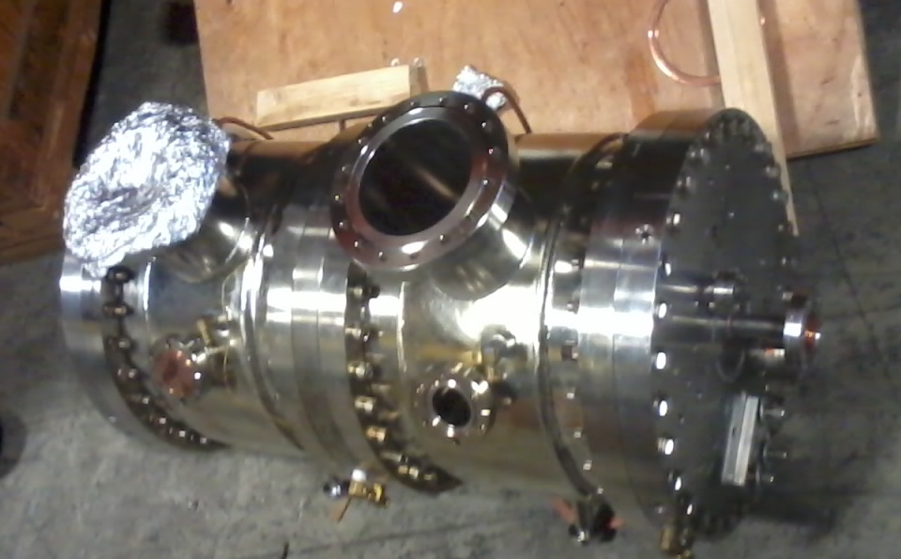
Test of Concept

Slide 15
Gun Test Stand Status and Plans
Riad, Matt and Carlos have built a test stand which is now routinely delivering a 4.5 mA magnetized beam
At this time, there is no RF structure, the gun is producing DC beam
Lasers are being developed to provide bunches at a tunable RF frequency
Diode laser up to 100 pC/bunch
Mode-locked laser up to 1 nC/bunch
They will then test the gun at different bunch charge and total beam current to try and separate the two effects on beam quality
Will take a few months

Slide 16
“Straight” Merger at the Gun Test Stand
Concept: install the spare CEBAF RF Separator in the GTS line with a superposed magnetic field
Goal: evaluate the effect on a magnetized beam and study the banana effect
Basic set-up: RF Separator and amplifier exist at the lab; diagnostics exist on the GTS line, most of the other equipment can be found at the lab
RF Separator could provide ~6 times the kick to the magnetized beam than the proposed merger due to low beam energy
Should be enough to see possible effects
By changing relative phase of laser and RF separator, banana effect can be enhanced
Should be able to see onset of effects
Would be an excellent thesis project!

Slide 17
“Straight” merger at the Gun Test Stand
Installation of a test of the ”straight” merger would be possible in FY18
Requires
Detailed layout (Reza Kazimi ?, Joe Gubeli)
Simulations (Reza Kazimi ?)
An existing spare CEBAF 500 MHz separator cavity (Mark Wissmann)
Building a dipole coils around the separator (Kevin Jordan)
Installing separator and dipole coils on a GTS girder
An existing 500W, 499 MHz RF SSA (Solid State Amplifier) (John Musson)
Magnet power supply (borrowed)
Stands for RF Separator and magnet
Installation labor
Operation for ~1 month to evaluate the effect of the RF separator/dipole on magnetized beam quality

Slide 18
Vision
Install RF Separator/Dipole at GTS (December 2017?)
Test with low-power laser (~100 pC/bunch)
Wait for high-power laser to be built
Test with high-power laser (~1 nC/bunch) (July 2018?)
Design new LERF merger using existing hardware as much as possible
Phase 1 includes only the low energy beam
“Straight” merger would be one of the possible merger options
Choose the most promising
Seek funding for new LERF merger (Manouchehr, LDRD)
Install LERF merger with magnetized gun (FY19?)
Install diagnostics in zone 3
Measure performance of beam out of the gun/booster(?)/merger/cryomodule
Seek funding for completion of merger (FY20?)
Phase 2 includes the recirculated beam
Evaluate performance at highest bunch charge obtainable in (FY20?)

