Slide 1
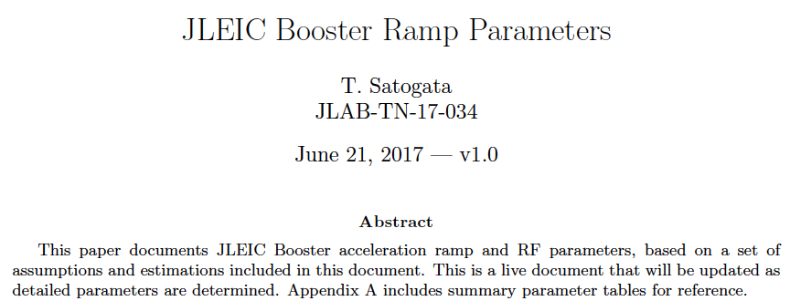
Booster Ramp Development and Parameters
Comments from JLab TN-17-034, DocDB-doc-111-v1
A live document, but last updated 21 Jun 2017
Intended to become a prototype for machine parameter reference documents
Motivated by suggestions from Andrew from LEP parameters

Slide 2
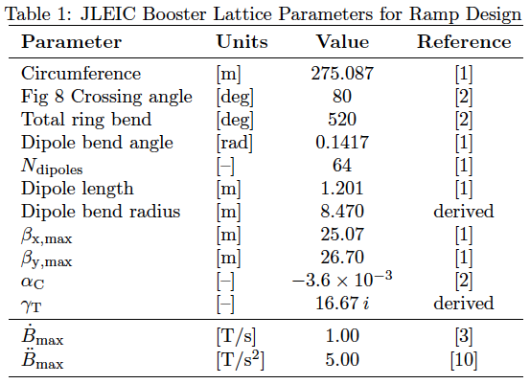
Appendix A: Reference Parameters
Appendix contains summary reference parameter tables
Includes references to other documents for provenance
Nearly “cut and paste” for eventual pCDR, CDR

Slide 3
Appendix A: Reference Parameters
Appendix contains summary reference parameter tables
Includes references to other documents for provenance
Nearly “cut and paste” for eventual pCDR, CDR
References svn
lattice with version
and date

Slide 4
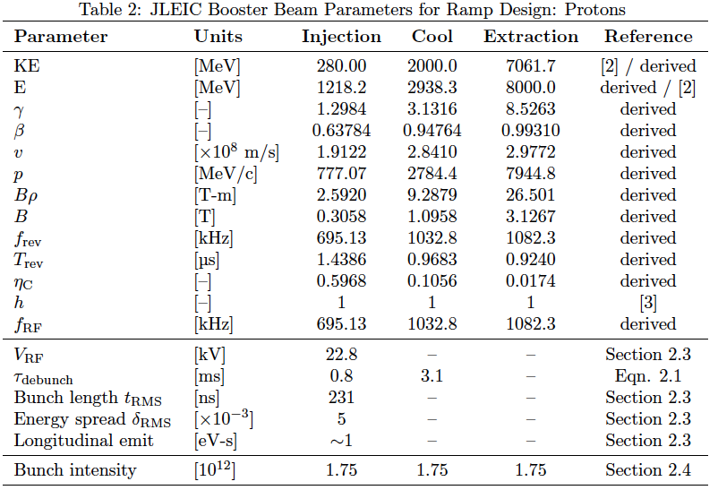
Appendix A: Reference Parameters
Includes only proton ramp
Pb ramp to be added (soon?)

Slide 5
Appendix A: Reference Parameters
Includes only proton ramp
Pb ramp to be added (soon?)
Historical
KE vs E_{tot}
RampCalculator
(svn)
Internal references
for parameter choices

Slide 6
Main Text
The main text includes
More detailed parameters and documentation
e.g. parameters input to RampCalculator calculations
Here, this includes some RampCalculator documentation
Motivations for parameters, decisions between options
e.g. why chosen magnet ramp is parabolic/linear/parabolic
Callouts to potential concerns
e.g. superconducting magnet snapback during fast ramping
Details of calculations not included elsewhere
e.g. how quickly can we bunch injected beam?
e.g. what is rough expected momentum aperture at injection?

Slide 7
Example: Injection RF voltage

Slide 8
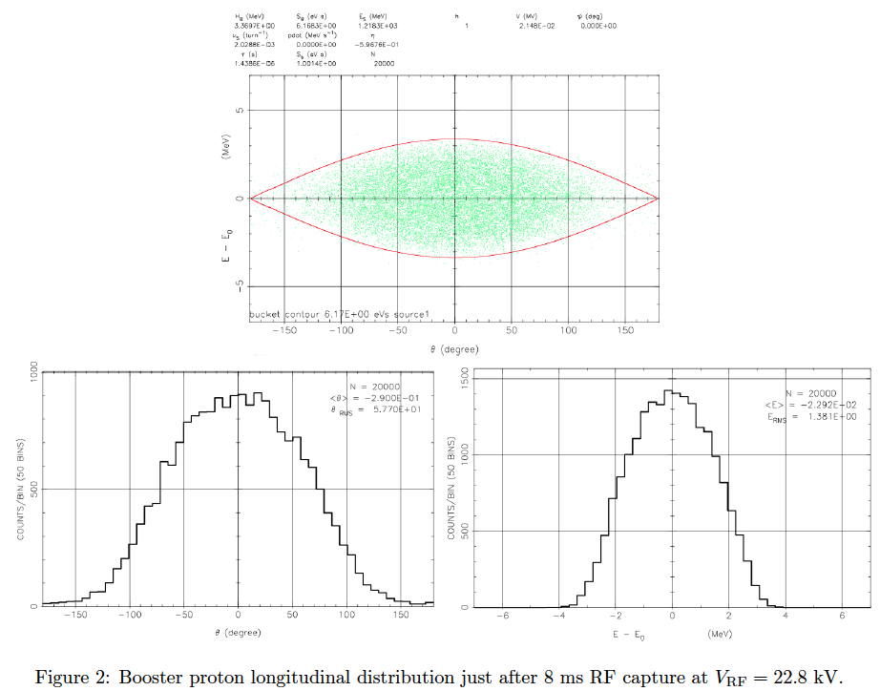
Example: Booster Injection Capture
δ_{rms} ~ 5e-3
E_{rms} ~ 1.38 MeV
t_{rms} ~ 231 ns
θ_{rms} ~ 58 degrees
h = 1

Slide 9
Booster Bunch Intensity
Extrapolate from collision parameters, bunch splitting baseline
(Optimistic) efficiency estimates/budgets
85% transfer, 95% acceleration, 90% rebucketing/RF
Produces Booster cycle requirement of 1.75e12 protons
Vs proton linac single-pulse estimate of 6e12
2 mA in 0.5 ms

Slide 10
Open Items / Next Steps
Booster
Add more realistic RF ramps (in progress)
e.g. lowering RF voltage immediately after rebucketing
Coordinate RF ramp tools with Ed/Synergia
Add ion reference tables
Is Pb the baseline reference species?
Add rough space charge, impedance limits
How to treat DC electron cooling?
Other machines
Start producing skeleton tables/documents
Update wiki to point to reference documents

