Slide 1
JLEIC Main Parameters with Strong Electron Cooling
Yuhong Zhang
Jan. 12, 2017

Slide 2
Motivations
The current baseline and main parameters
Right before the cost review (Jan. 2015)
Lowering cost and technical risk was the main driving force.
Cost optimization measures: PEP-II magnets/vacuum chambers
PEP-II RF (both cavities and power sources)
Super-ferric magnets,
Eliminating the large booster
(Short ion linac for lower energy)
Risk reduction measures: Weak cooling (single pass ERL cooler)
Performance was compromised
Large electron emittance (large PEP-II dipoles)
Large proton/ion emittance (weak cooling)
Lower emittance: up to 4x10³³ (full acceptance detector), and
8x10³³ for high luminosity detector
< 10³⁴ for any type of detectors

Slide 3
Motivations
EIC science
NSAC LRP completed, NAS review is in progress
Demands higher luminosity (>10³⁴) on Day 1
CM energy: current baseline up to 63 GeV
EIC White Paper up to 100 GeV
eRHIC (both linac-ring & ring-ring) aims for up to 140 GeV
(Can we match it?)
Accelerator
Electron ring study: evaluation of small emittance design based on new magnets
Cooler studies: better understanding of transport/manipulation of magnetized
electron beam, cooling ring design
RF fast kicker: 10-turn developed, 20-turn seems feasible
IR design: smaller detector spaces: proton 7/7 m ➔ 3.5/7 m,
electron 4.5/4.5 m ➔ 3.2/3 m (~1.7 m)
Dynamic aperture: good progress and large aperture achieved
Ion beam formation: scheme developed, space charge mitigation

Slide 4
Highlight of New Baseline
New electron ring: new magnets, same footprint
reaches 12 GeV ➔ 69 GeV CM
two optics designs (FODO and TME)
same SR (10 kW/m, ~10MW), twice accelerating cavities
Strong cooling is back: circulator cooler ring,
1 to 2 A current in cooling channel
up to 20 circulation, 50 to 100 mA current in ERL
Higher ion current: 500 mA ➔ 750 mA (up to 50% luminosity increase)
(this is very substantial change, seems OK with ion
injector/DC cooling, bunched cooling needs study)
Smaller beta-star: β*_{y} 2 cm ➔ 1.2 cm (up to 67% luminosity increase)
eliminating “full-acceptance” and “high luminosity” labels
both detectors for Full-Acceptance” and “High-Luminosity”

Slide 5
JLEIC Baseline Parameters
CM energy | GeV | 21.9 (low) |  | 44.7 (medium) |  | 63.3 (high)
 |  | p | e | p | e | p | e
Beam energy | GeV | 40 | 3 | 100 | 5 | 100 | 10
Collision frequency | MHz | 476 |  | 476 |  | 476/4=119
Particles per bunch | 10¹⁰ | 0.98 | 3.7 | 0.98 | 3.7 | 3.9 | 3.7
Beam current | A | 0.75 | 2.8 | 0.75 | 2.8 | 0.75 | 0.71
Polarization | % | 80 | 80 | 80 | 80 | 80 | 75
Bunch length, RMS | cm | 3 | 1 | 1 | 1 | 2.2 | 1
Norm. emitt., hor./vert. | μm | 0.3/0.3 | 24/24 | 0.5/0.1 | 54/10.8 | 0.9/0.18 | 432/86.4
Horizontal & vertical β* | cm | 8/8 | 13.5/13.5 | 6/1.2 | 5.1/1 | 10.5/2.1 | 4/0.8
Vert. beam-beam param. |  | 0.015 | 0.092 | 0.015 | 0.068 | 0.008 | 0.034
Laslett tune-shift |  | 0.06 | 7x10⁻⁴ | 0.055 | 6x10⁻⁴ | 0.056 | 7x10⁻⁵
Detector space, up/down | m | 3.6/7 | 3.2/3 | 3.6/7 | 3.2/3 | 3.6/7 | 3.2/3
Hourglass(HG) reduction |  | 1 |  | 0.87 |  | 0.75
Luminosity/IP, w/HG, 10³³ | cm⁻²s⁻¹ | 2.5 |  | 21.4 |  | 5.9

Slide 6
Playing Same Luminosity Tricks
JLEIC baseline luminosity peaks around 4 x 100 GeV (40 GeV CM)
At low CM energy ⬅ both beam energies are low
Electron: 3~4 GeV, proton: 30~40 GeV
electron can deliver high current 3 A or above,
Ion bunch is limited by space charge effect
Making the bunch length can hold more charges, 1cm→3cm ➔ 3 times q
Stronger hour-glass effect: ~10% loss ➔ ~30% loss (net gain)
Beam dynamics (eg. beam-beam vs. synch-betatron) needs study
At high CM energy ⬅ both beam energies are high
Electron: 8~12 GeV, proton: 100 GeV
Ion space charge is no longer problem
Electron current (bunch charge) is limited by strong SR
Reducing the bunch frequency would boost luminosity L~n₁n₂f_{b} ~ I₁I₂/f_{b}
However, requires even higher cooling bunch intensity (average current same)
Electron emittance increases, to match beam spot at IP, proton emittance can be much large (requiring less cooling)

Slide 7
Upgrade 100 GeV and 140 GeV CM Energy
Present upgrade path: 6 T ➔ 200 GeV proton (69 GeV CM)
Question: can JLEIC reach 140 GeV CM Energy?
Answer: without upgrade the electron ring and CEBAF
it needs 400 GeV proton to reach 140 GeV CM
It needs 12 T SC magnets

Slide 8
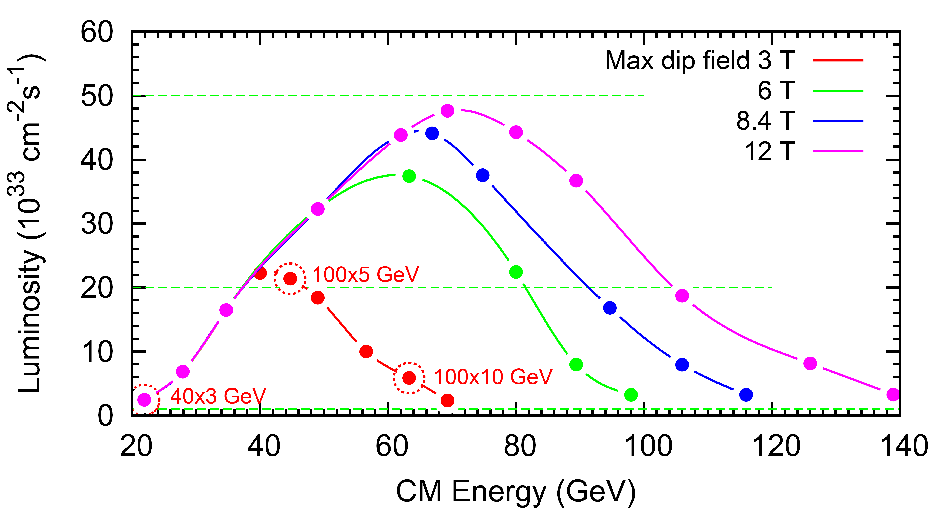
JLEIC e-p Luminosity

Slide 9
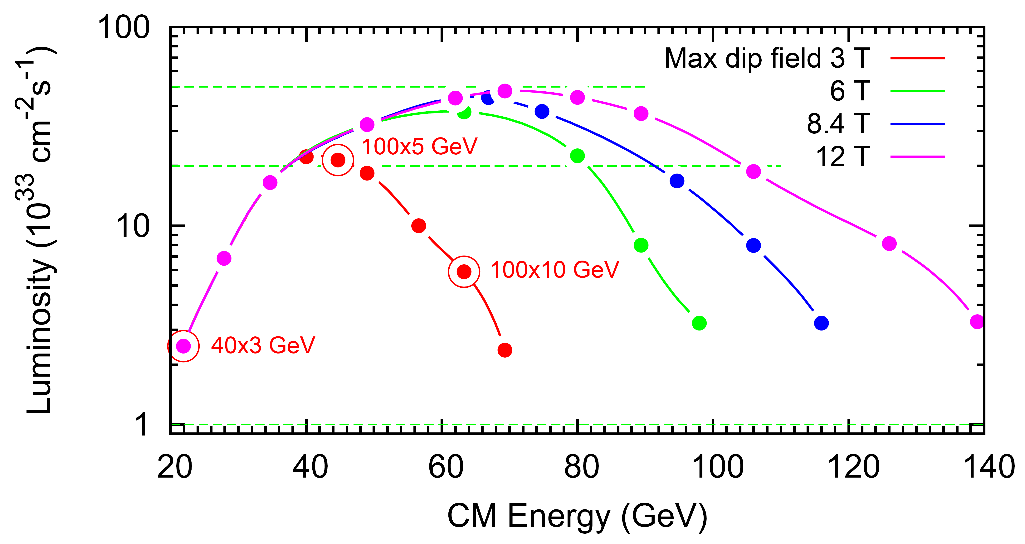
JLEIC e-p Luminosity

Slide 11
e-p Luminosity
100 GeV x 5 GeV
100 GeV x 10 GeV
40 GeV x 3 GeV

