Slide 1

Vlasov Analysis of Microbunching Gain for Magnetized Beams
Cheng-Ying Tsai
September 12, 2016
NAPAC’16 at Chicago

Slide 2
Outline
Introduction: micro-bunching instability (MBI)
Motivation: early design of JLEIC Circulator Cooling Ring
Theory of MBI for magnetized beams
Example
Summary and Possible future work

Slide 3
Outline
Introduction: micro-bunching instability (MBI)
Motivation: early design of JLEIC Circulator Cooling Ring
Theory of MBI for magnetized beams
Example
Summary and Possible future work

Slide 4
Micro-bunching instability (MBI)
Physical mechanism:
  Heifets, Stupakov, and Krinsky, PRST-AB 5, 064401 (2002)
  Huang and Kim, PRST-AB 5, 074401 (2002)
MBI can be an issue for linac-based machines, e.g. FEL light sources.
MBI can be a more serious issue for recirculating machines, because of many more dipoles (multi-stage amplification).

Slide 5
Outline
Introduction: micro-bunching instability (MBI)
Motivation: early design of JLEIC Circulator Cooling Ring
Theory of MBI for magnetized beams
Example
Summary and Possible future work

Slide 6
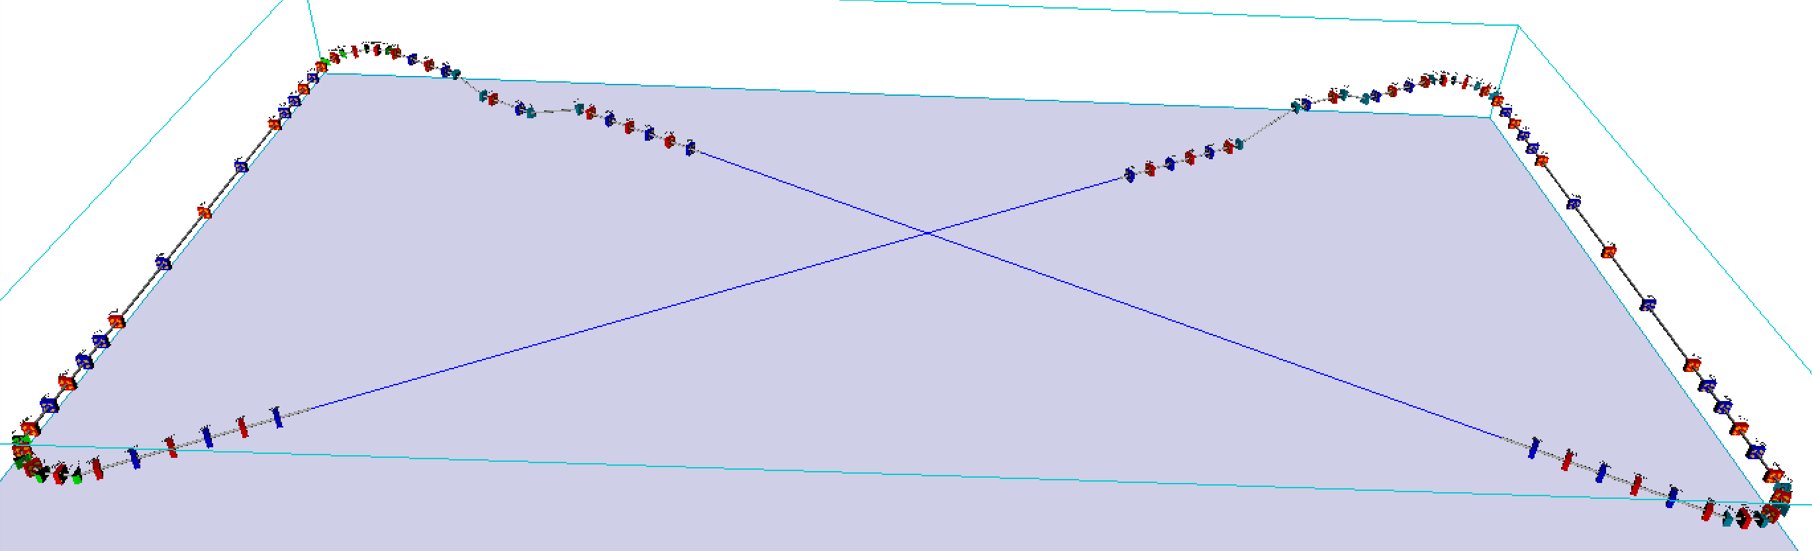
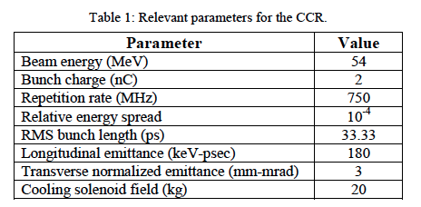
JLEIC Circulator Cooling Ring
Early design of JLEIC Circulator Cooling Ring (CCR)
  serious microbunching instability
  due to coherent synchrotron radiation (CSR) and longitudinal space charge (LSC)
MEIC Design Report (2012)
Notes:
8 dipoles in the 1st and 3rd arcs
4 dipoles in the 2nd and 4th arcs
total 24 dipoles

Slide 7
JLEIC Circulator Cooling Ring
Early design of JLEIC Circulator Cooling Ring (CCR)
non-magnetized beam

Slide 8
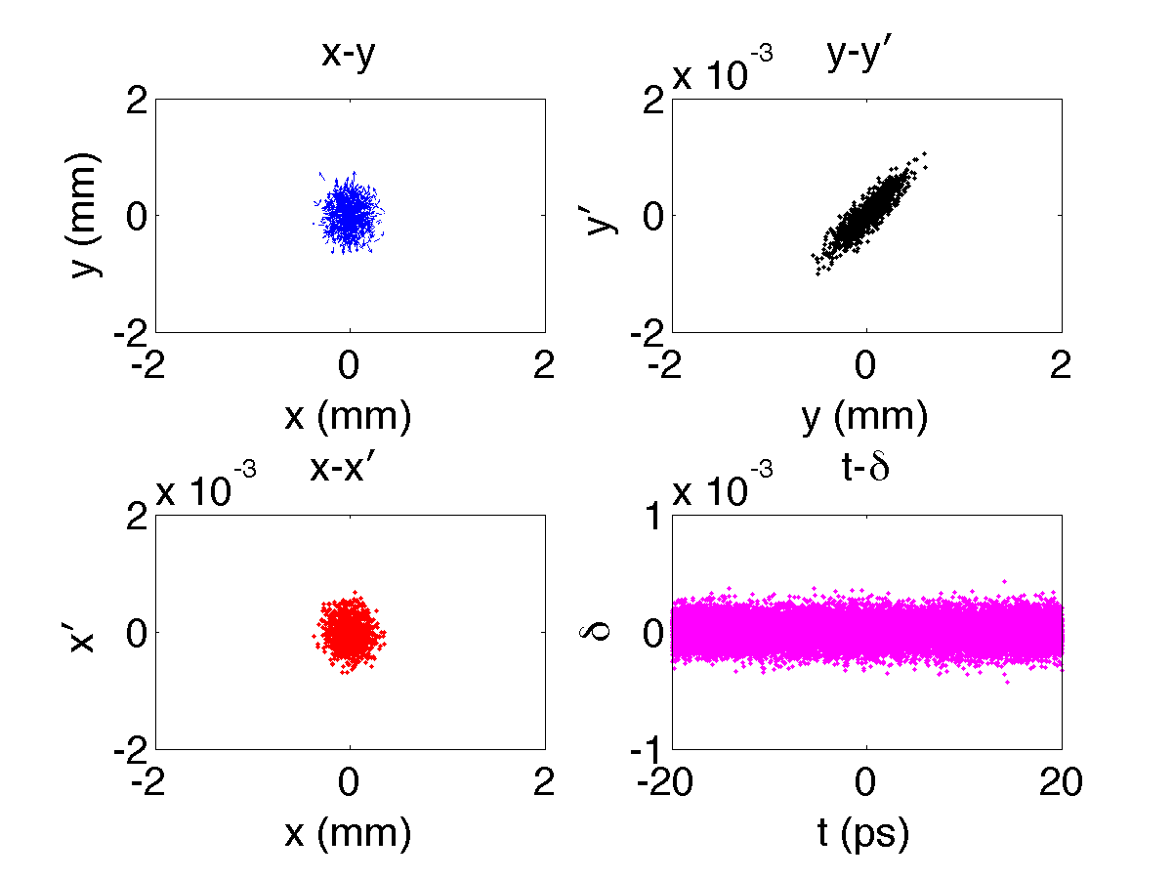
JLEIC Circulator Cooling Ring
Early design of JLEIC Circulator Cooling Ring (CCR)
Particle tracking
Vlasov simulation
λ = 350 μm (1.2 ps)
  C. -Y. Tsai et al., ERL2015 (TUICLH2034)

Slide 9
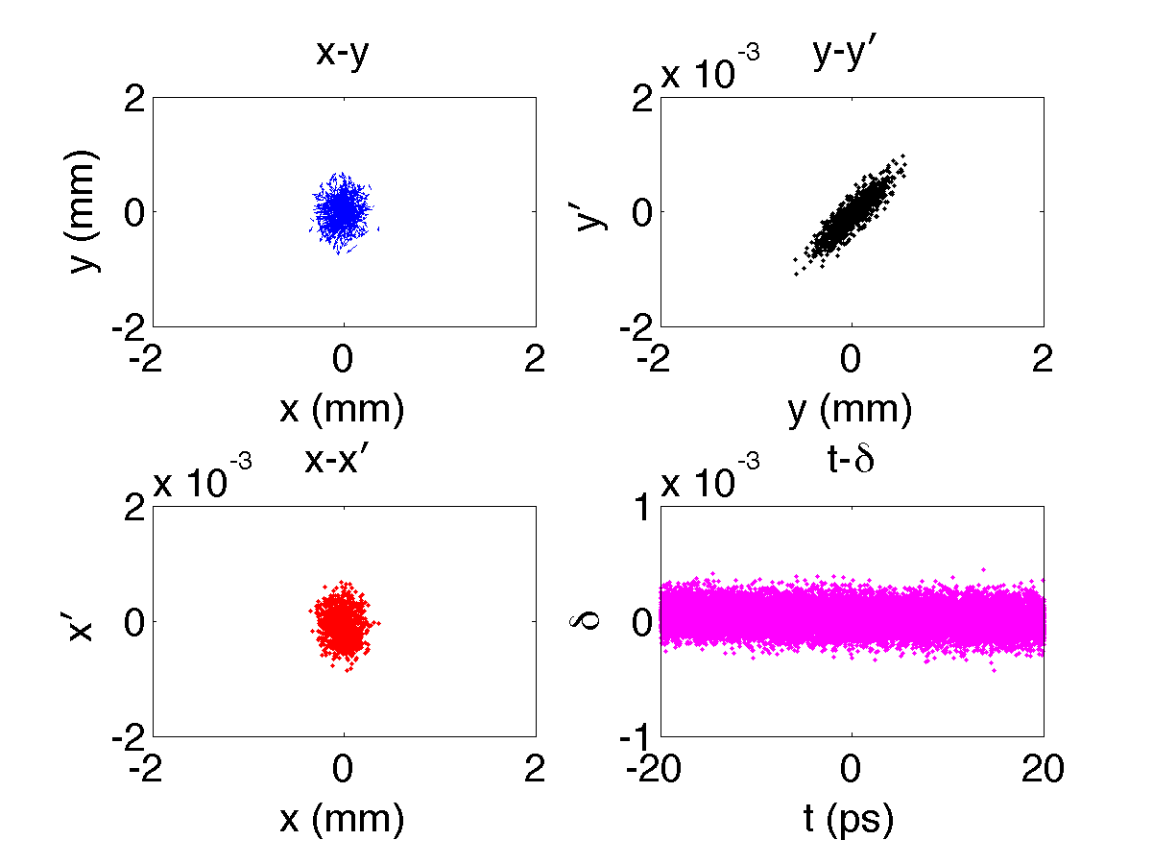
JLEIC Circulator Cooling Ring
Early design of JLEIC Circulator Cooling Ring (CCR)
Particle tracking
Vlasov simulation
λ = 350 μm (1.2 ps)
  C. -Y. Tsai et al., ERL2015 (TUICLH2034)

Slide 10
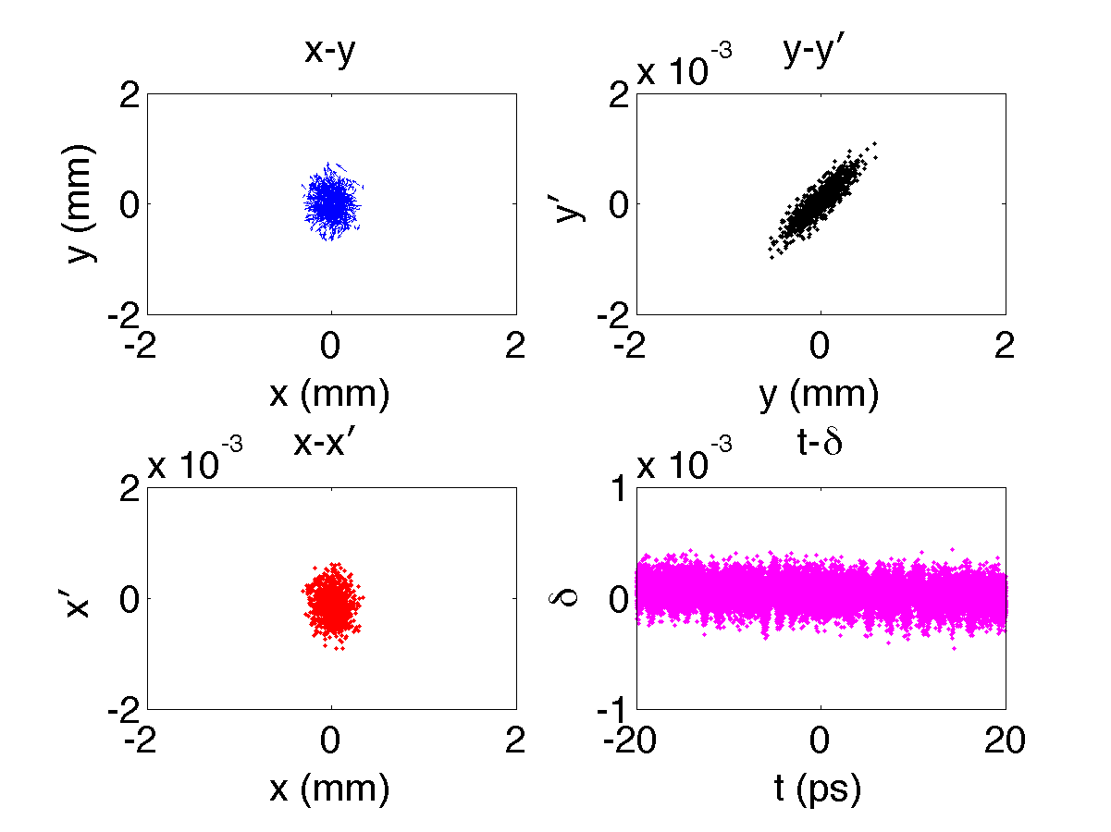
JLEIC Circulator Cooling Ring
Early design of JLEIC Circulator Cooling Ring (CCR)
Particle tracking
Vlasov simulation
λ = 350 μm (1.2 ps)
  C. -Y. Tsai et al., ERL2015 (TUICLH2034)

Slide 11
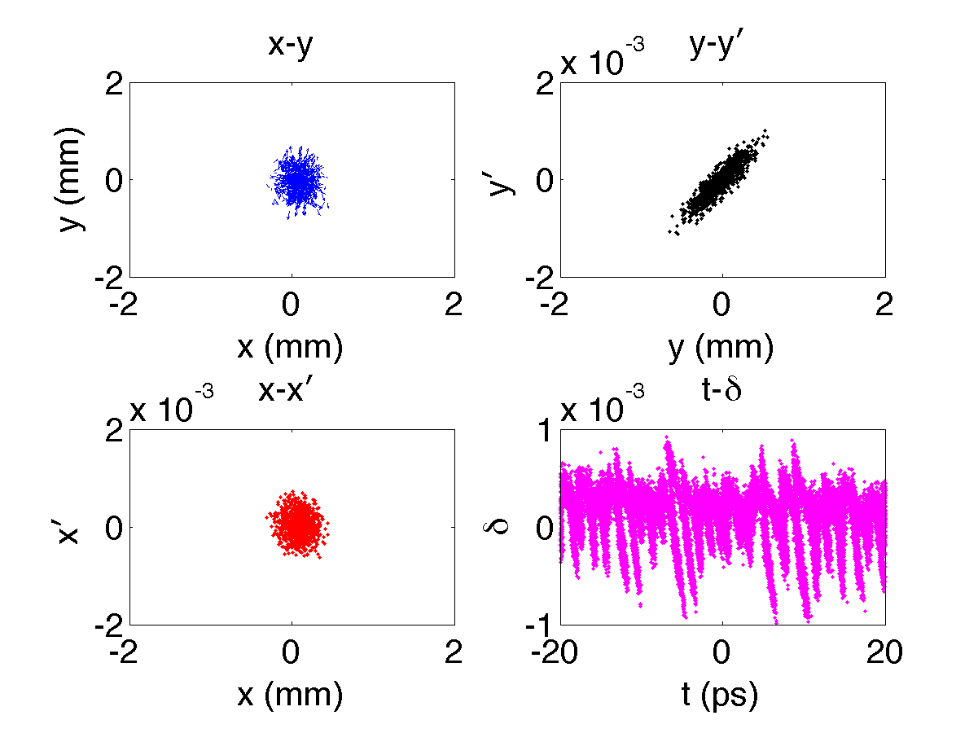
JLEIC Circulator Cooling Ring
Early design of JLEIC Circulator Cooling Ring (CCR)
Particle tracking
Vlasov simulation
λ = 350 μm (1.2 ps)
  C. -Y. Tsai et al., ERL2015 (TUICLH2034)

Slide 12
JLEIC Circulator Cooling Ring
Early design of JLEIC Circulator Cooling Ring (CCR)
Particle tracking
Vlasov simulation
λ = 350 μm (1.2 ps)
  C. -Y. Tsai et al., ERL2015 (TUICLH2034)

Slide 13
JLEIC Circulator Cooling Ring
Mitigation of micro-bunching instability (MBI)
  Our main interest of this talk
  Larger beam size should help suppress MBI
Improvement of cooling performance
  Cooling beam: low temperature (emittance), beam size comparable to ion beam
  For non-magnetized beam, difficult to meet the requirements simultaneously for small emittance (or low temperature)
  For magnetized beam, easier to satisfy the above requirements while maintaining small Larmor emittance
Slava’s Idea: use magnetized beam
Cathode immersed in solenoid field. Beam has non-zero angular momentum.

Slide 14
Outline
Introduction: micro-bunching instability (MBI)
Motivation: early design of JLEIC Circulator Cooling Ring
Theory of MBI for magnetized beams
Example
Summary and Possible future work

Slide 15
Vlasov formalism
Theory is not new
  Heifets, Stupakov, and Krinsky, PRST-AB 5, 064401 (2002)
  Huang and Kim, PRST-AB 5, 074401 (2002)
We extend to more general case of transverse coupled beams

Slide 16
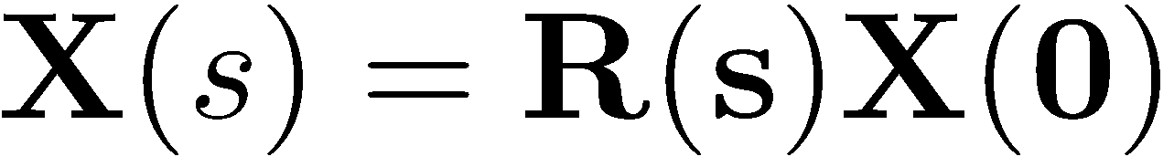
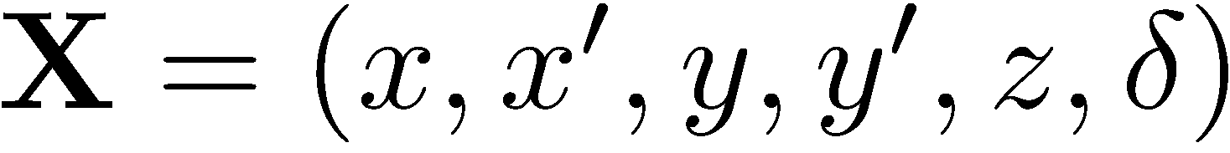
Vlasov formalism
Model assumptions
Beam dynamics:
  coasting beam approximation
  linear beam transport where

Slide 17
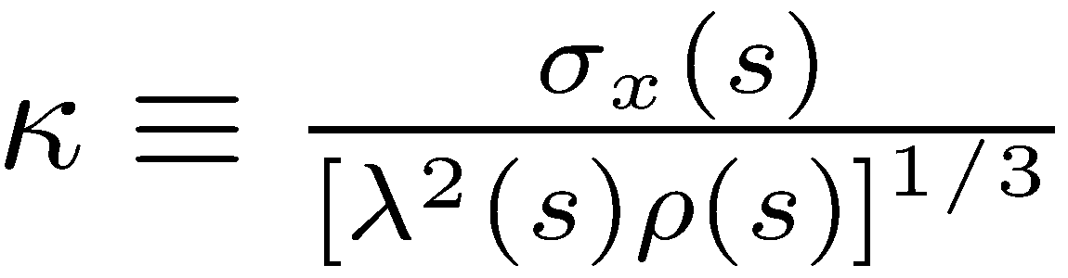
Vlasov formalism
Model assumptions
Beam dynamics:
  coasting beam approximation
  linear beam transport where
Electrodynamics:
  1-D CSR: assume Derbenev ratio is small
  Note: this assumption can be violated for typical magnetized beam
A. Seryi, Unifying Physics of Accelerators, Lasers and Plasmas

Slide 18
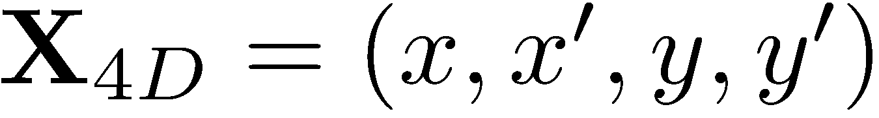
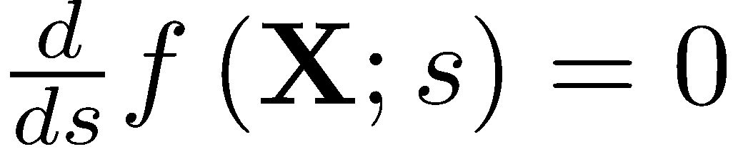
Vlasov formalism
Define
Phase space distribution function satisfies Vlasov equation

Slide 19
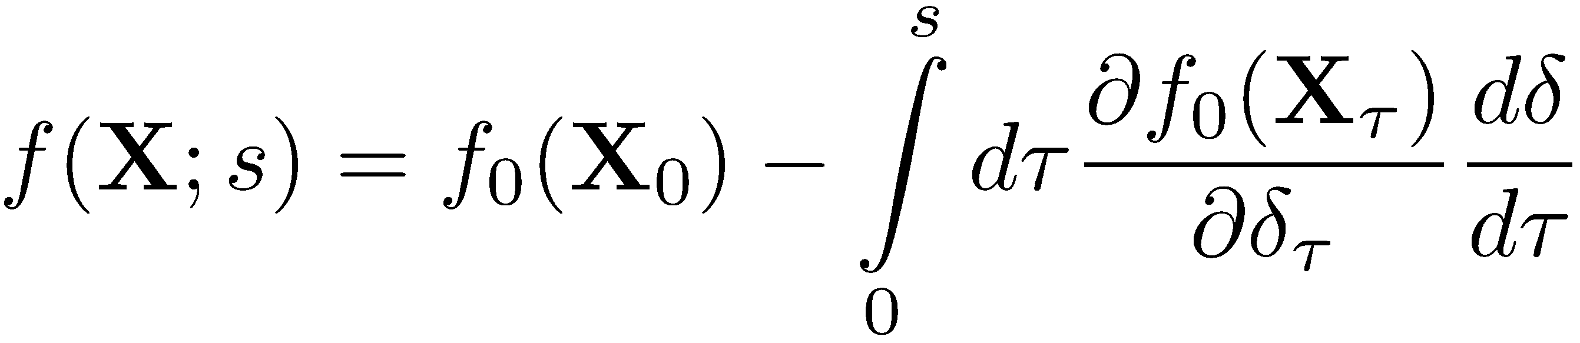
Vlasov formalism
Define
Phase space distribution function satisfies Vlasov equation
Formulate perturbed phase space distribution (to first order)

Slide 20
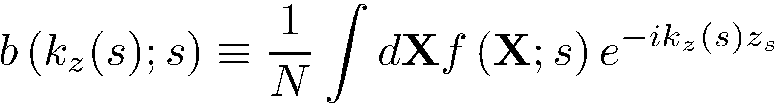
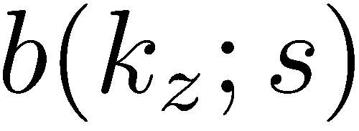
Vlasov formalism
Define
Phase space distribution function satisfies Vlasov equation
Formulate perturbed phase space distribution (to first order)
Micro-bunching can be quantified by
Goal: obtain governing equation for

Slide 21
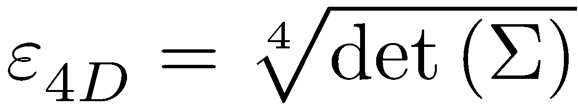
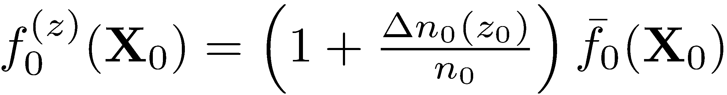
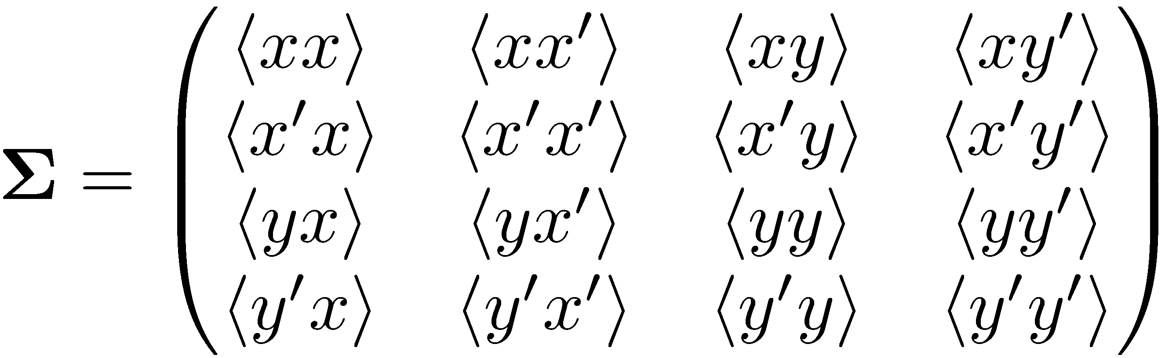
Vlasov formalism
To be more specific, given an initial beam phase space distribution,
with density modulation on top of z,
where the beam sigma matrix

Slide 22
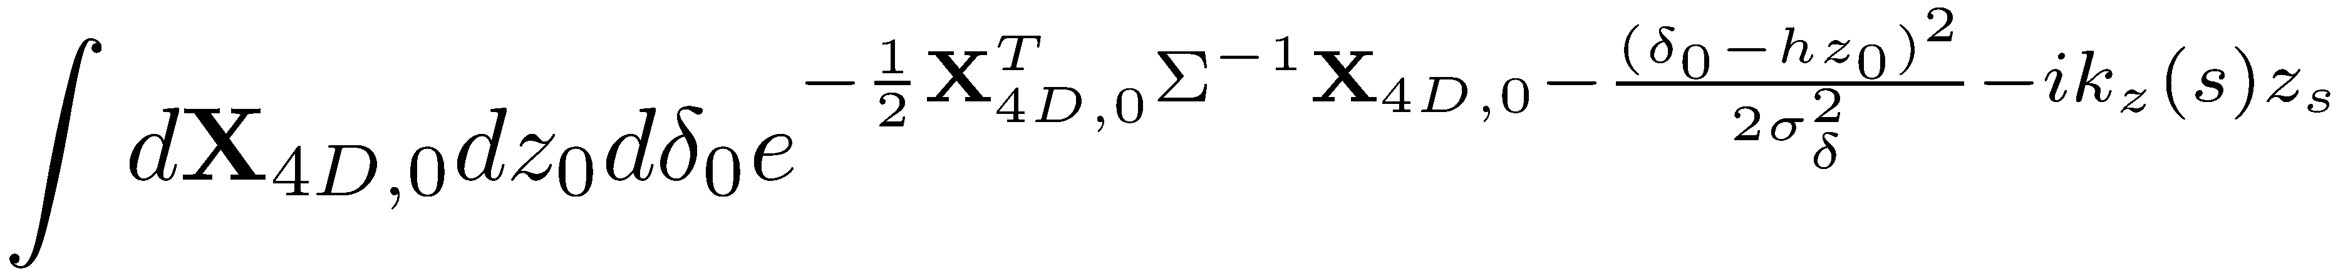
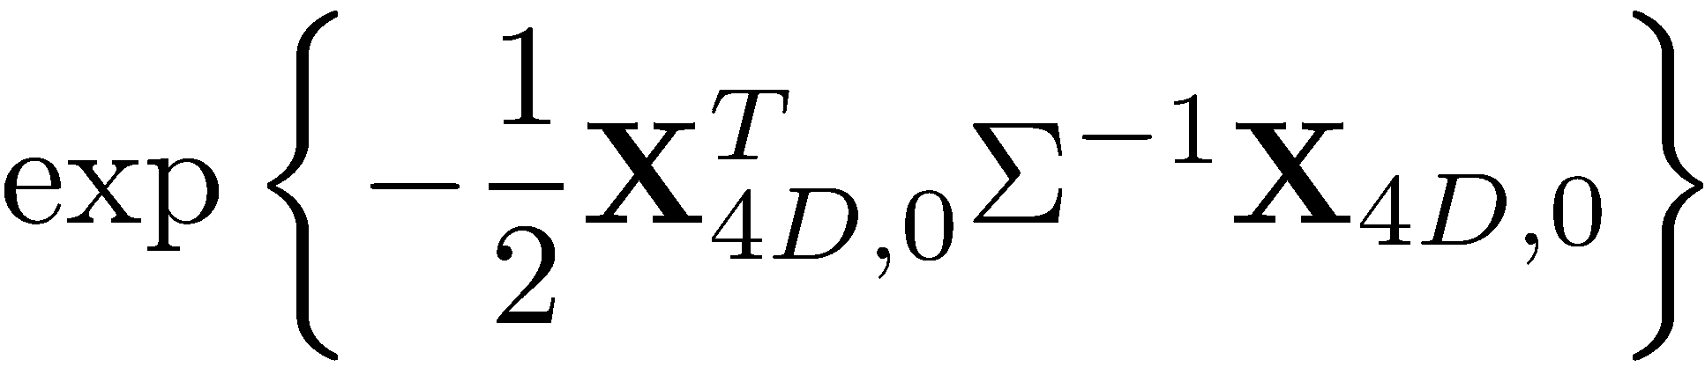
Vlasov formalism
Remember we want to calculate
When we proceed, we will encounter the integration

Slide 23
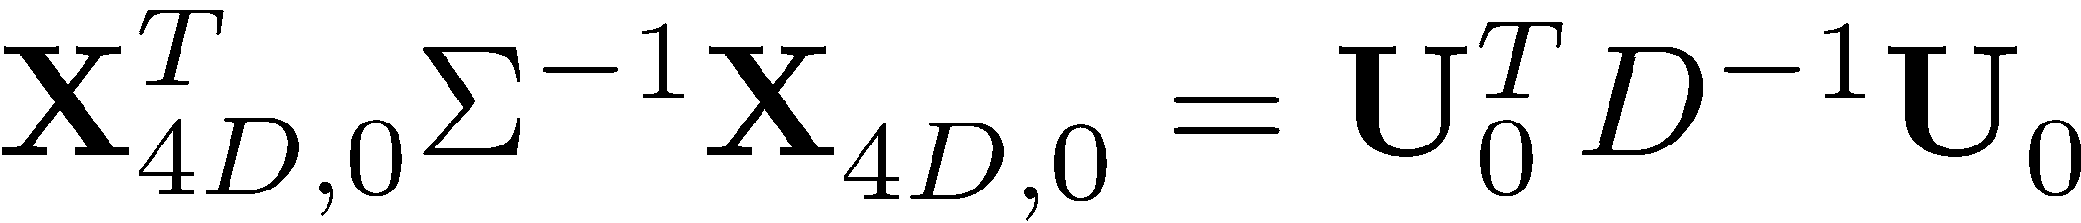
Vlasov formalism
Remember we want to calculate
When we proceed, we will encounter the integration
Assume there exists diagonal matrix such that

Slide 24
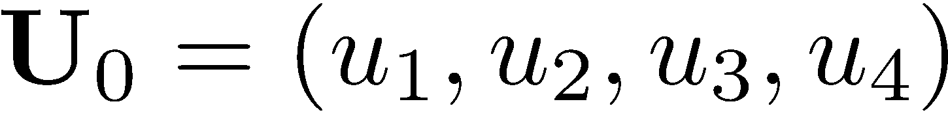
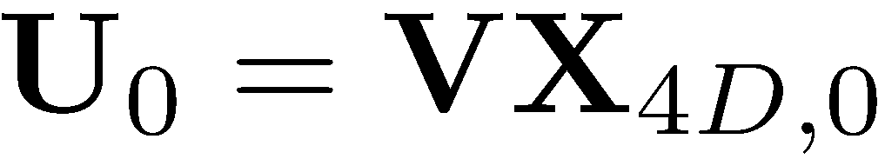
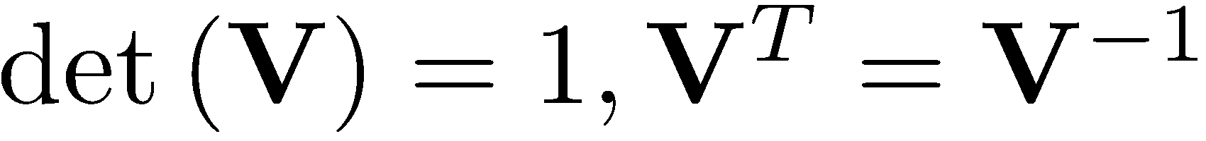
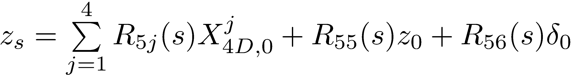
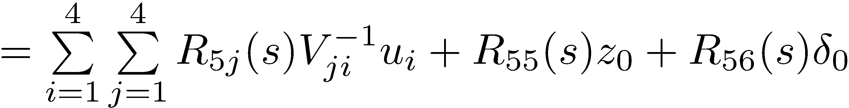
Vlasov formalism
Remember we want to calculate
When we proceed, we will encounter the integration
Assume there exists diagonal matrix such that
where
Then
All dynamics information
is contained in D.
Courant-Snyder parameters
for the (coupled) system are
contained in V.

Slide 25
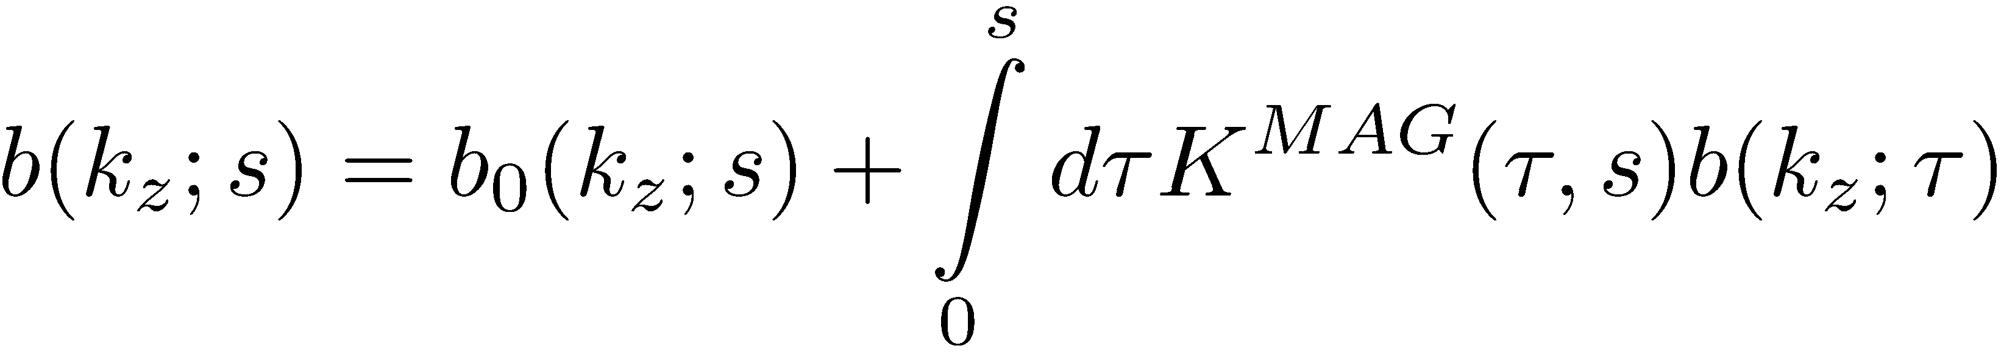
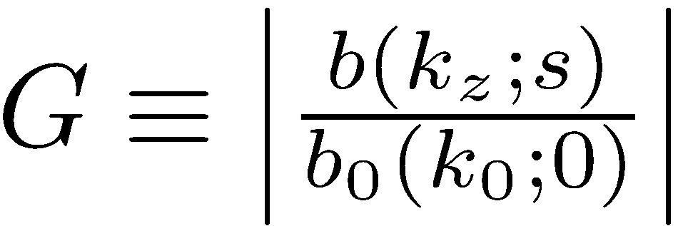
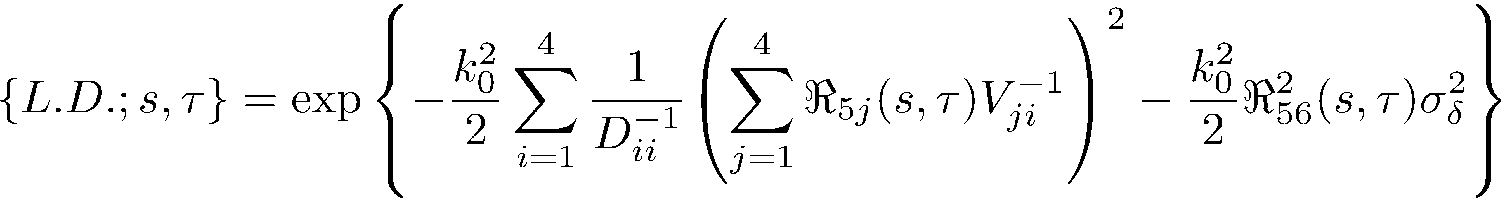
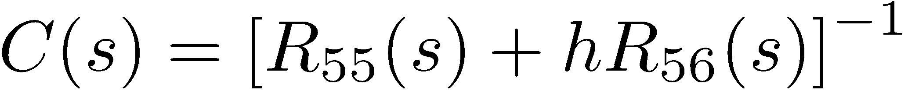
Vlasov formalism
Putting all together,
where

Slide 26
Outline
Introduction: micro-bunching instability (MBI)
Motivation: early design of JLEIC Circulator Cooling Ring
Theory of MBI for magnetized beams
Example
Summary and Possible future work
ERL cooler design [S. Benson, JLEIC Collaboration Meeting, Spring 2016]

Slide 27
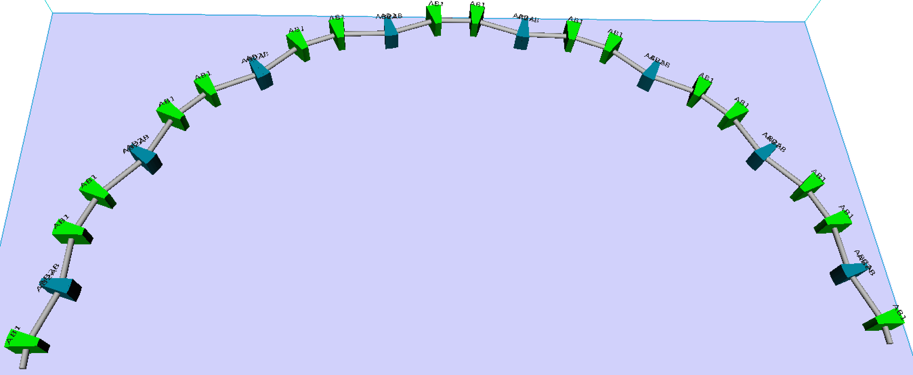
Example
achromatic
24 dipoles; 16 inward bending, 8 outward bending
½-indexed dipoles to preserve beam axial symmetry
combined-function dipole to focus/defocus the beam
Name | Value | Unit
Energy | 55 | MeV
Sliced rms energy spread | 1.5 × 10⁻⁴
Chirp, h | 4.645 | m⁻¹
Bunch charge | 420 | pC
Initial/final bunch (peak) current | 22.5/6.3 | A
Compression/Decompression factor | 0.28/3.57
4-D geometric emittance ε_{4D} | 1.11 × 10⁻⁵ | cm

Slide 28
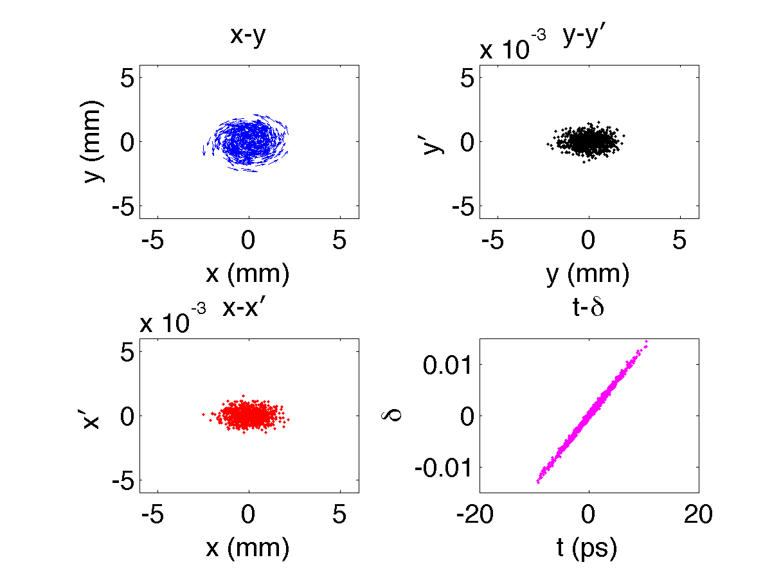
Particle tracking
achromatic
24 dipoles; 16 inward bending, 8 outward bending
½-indexed dipoles to preserve beam axial symmetry
combined-function dipole to focus/defocus the beam

Slide 29
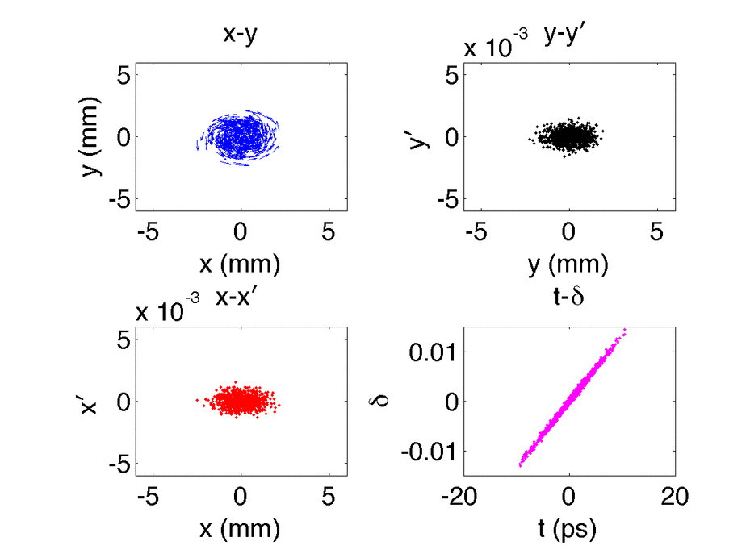
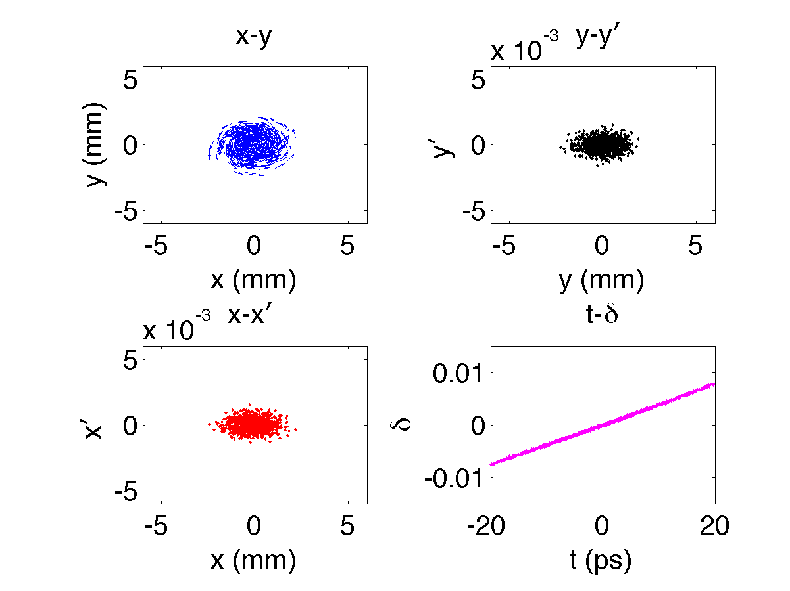
Particle tracking
achromatic
24 dipoles; 16 inward bending, 8 outward bending
½-indexed dipoles to preserve beam axial symmetry
combined-function dipole to focus/defocus the beam

Slide 30
Vlasov simulation
λ = 300 μm

Slide 31
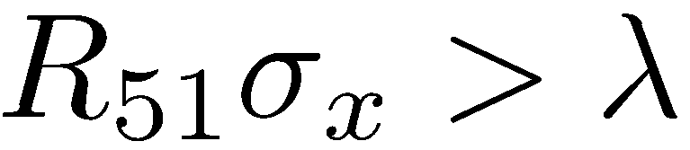
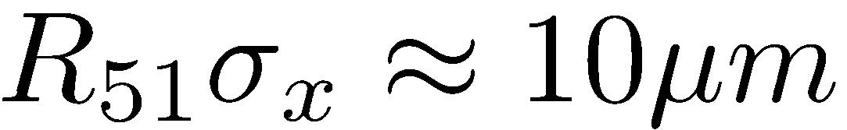
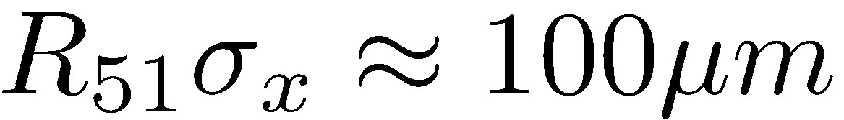
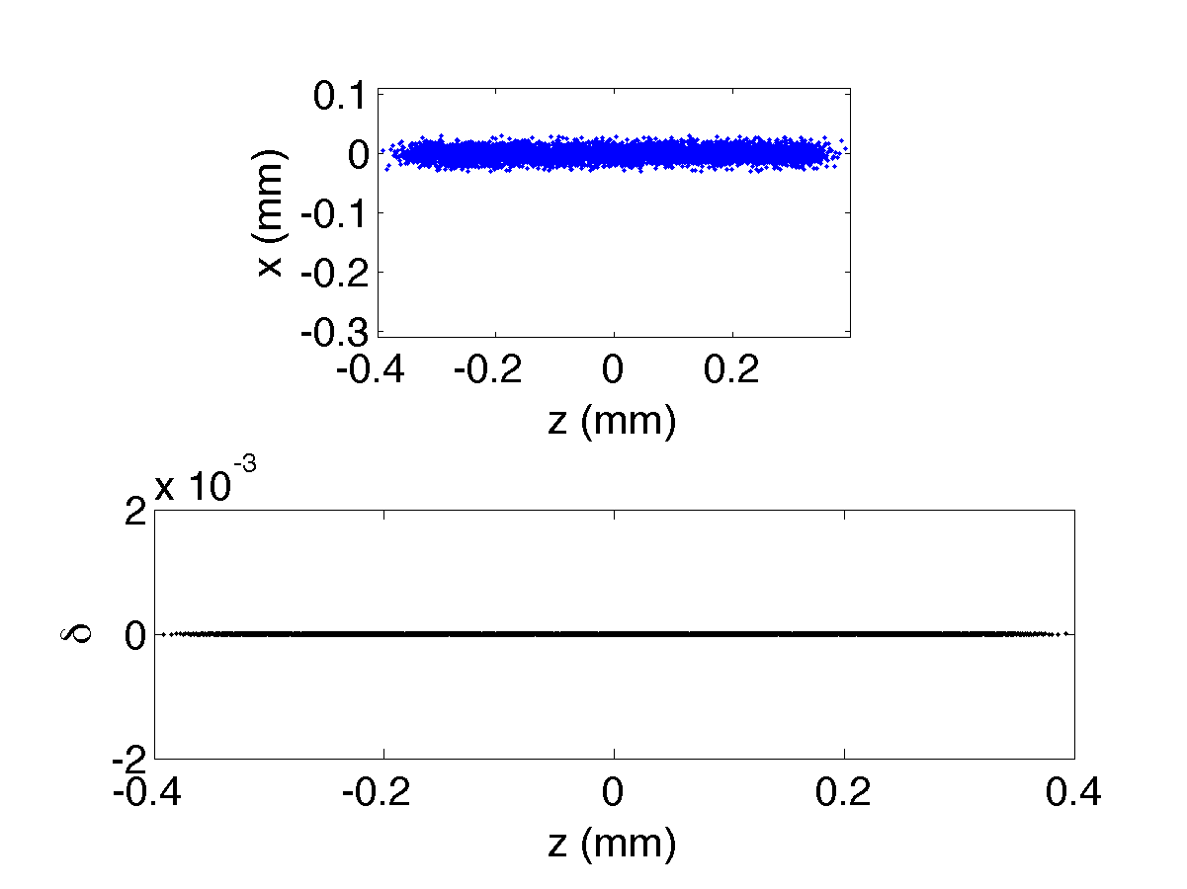
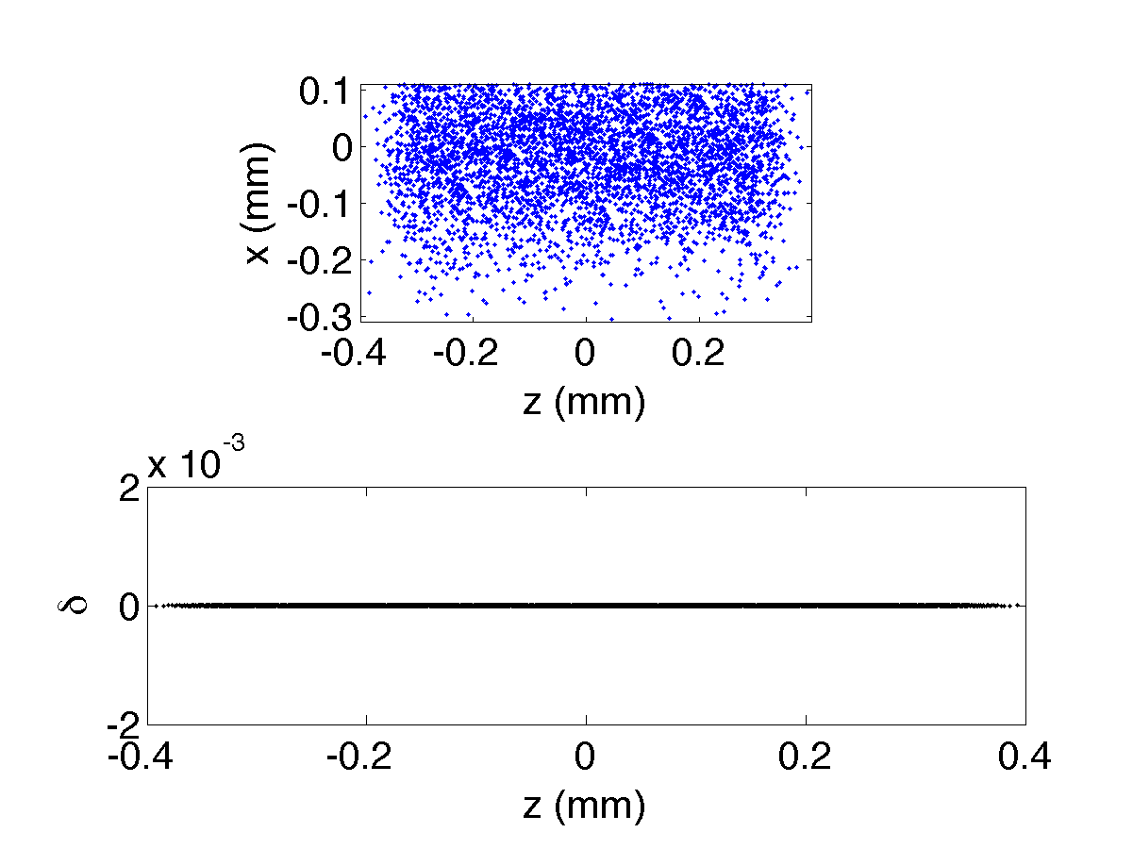
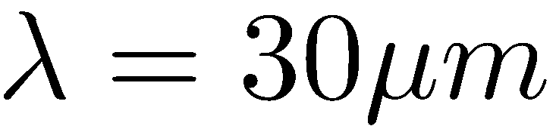
Discussion
Smearing effect due to R₅₁
Effective phase mixing when

Slide 32
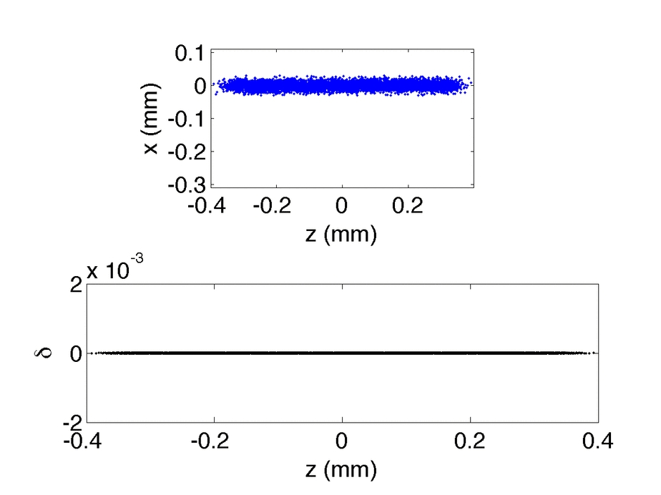
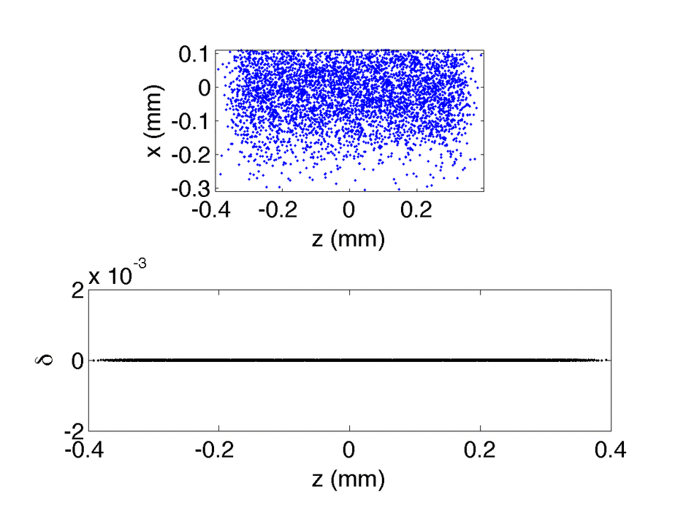
Discussion
Smearing effect due to R₅₁
Effective phase mixing when
Our Example:
Early design of CCR:

Slide 33
Outline
Introduction: micro-bunching instability (MBI)
Motivation: early design of JLEIC Circulator Cooling Ring
Theory of MBI for magnetized beams
Example
Summary and Possible future work

Slide 34
Summary and Possible future work
Extend Vlasov approach to micro-bunching for magnetized beams
Demonstrate MBI gains for a magnetized-beam transport arc
Results benchmarked against particle tracking simulation
The arc design does not show MBI gain growth (gain ≈ 1)
Larger beam size provides effective suppression of MBI
Parametric dependencies of MBI for magnetized beams, e.g. angular momentum
More aspects of MBI under study (see also THPOA35)
More complete analysis can be done when full-ring lattice is available
Extend the formalism to nonlinear beam transport

Slide 35
Thank you for your attention

Slide 36

Acknowledgements
Thanks to my advisors, co-authors for their kind support, insights, discussion and stimulation:
  Rui Li (JLab) and Mark Pitt (Virginia Tech)
  Steve Benson, Slava Derbenev, Dave Douglas, Chris Tennant, He Zhang, Yuhong Zhang (JLab)
Thanks to NAPAC’16 graduate student travel funds
This material is based on work supported by the U.S. Department of Energy, Office of Science, Office of Nuclear Physics under contract DE-AC05-06OR23177.

Slide 37
BACKUP SLIDES

Slide 38
Vlasov simulation
λ = 300 μm

Slide 39
Current dependence of maximal gain
The new ERL cooler design is for weak electron cooling. For comparison, if we increase the bunch charge (i.e. peak bunch current), how about the current dependence of maximal MBI gain?
Note: only steady-state CSR effect is considered.

Slide 40
MEIC CCR with 420 pC
For comparison, if the bunch charge is reduced to 420 pC, same as that for the new arc design, how about the MBI gain curve for (old) MEIC CCR?
Note: only steady-state CSR effect is considered.
λ = 350 μm (1.2 ps)

Slide 41
Benchmarking for MEIC CCR x10 ε_{x} & ε_{y}
C. -Y. Tsai et al., JLAB-TN-16-030

Slide 42
More aspects of microbunching

