Slide 1
Cooling of C6+ ion beam with pulsed electron beam
Preliminary data analysis by IMP collogues only
IMP&JLab collaboration group
Presentation by Lijun Mao on May 19, 2016
and He Zhao on June 1, 2016

Slide 2
Ion beam condition:
7 MeV/u C6+ ions provided by cyclotron;
Injected into cooling storage ring (CSRm) by strip injection method;
More than 2E8 particles in the ring;
Lifetime is better than 40s (1/e, without cooling);
The standard operation cycle is 25 s (one injection);
The RF cavity works 5s during one cycle, the RF voltage we used is 300V to 1500V, the RF frequency is 458 kHz (2 harmonic number);
Electron beam condition:
Electron beam energy is 3762V;
Electron beam peak current is up to 70 mA, we always use around 10 mA for experiments, due to the “fast” cooling time for such low energy beam;
Electron pulse repetition frequency is up to 225 kHz, equal to the revolution frequency of ion beam;
The electron beam can be triggered by timing system, the phase between ion and electron pulse can be changed by “delay time”.

Slide 3
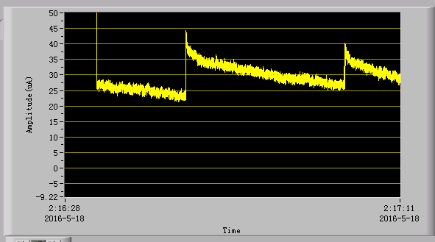
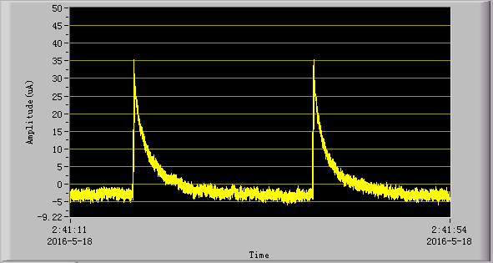
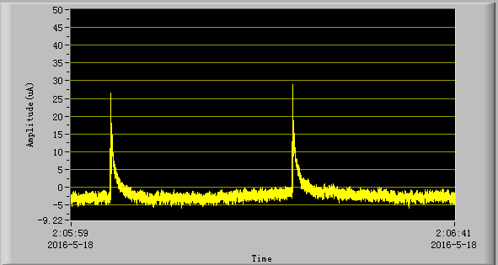
The first day we found the coasting beam lifetime reduced during we apply pulse electron beam:
Without e beam
With pulsed e beam
With pulsed e beam

Slide 4
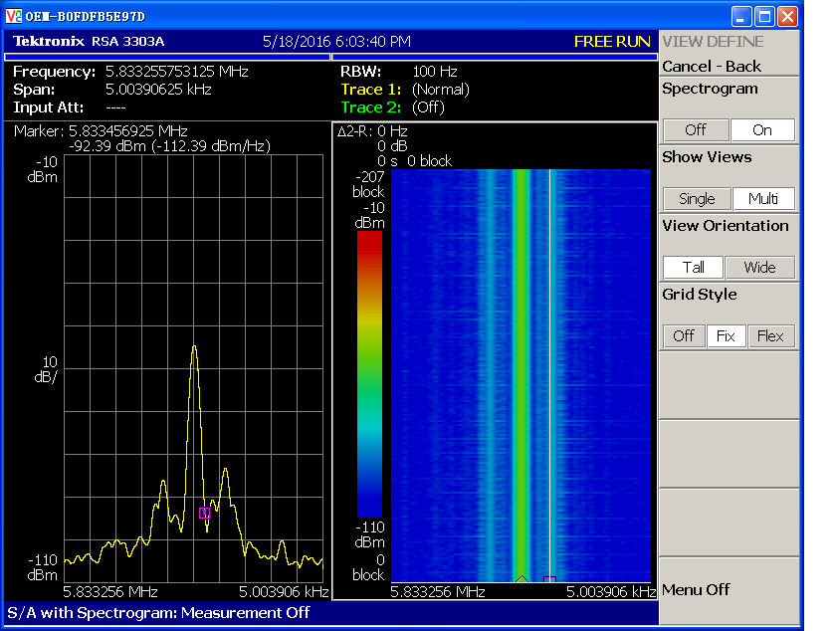
Coasting ion beam “bunched ” by pulsed electron beam

Slide 5
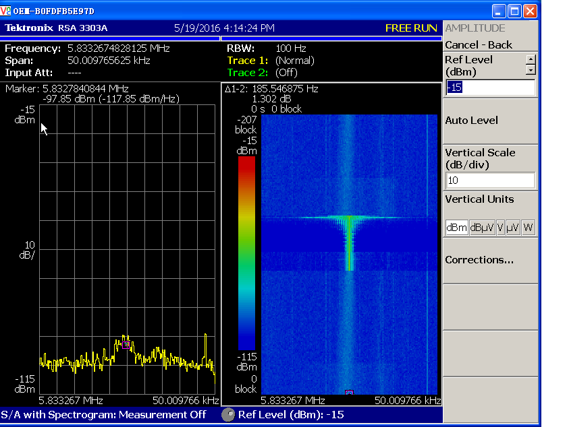
Cooling of bunched ion beam with pulsed electron beam

Slide 6
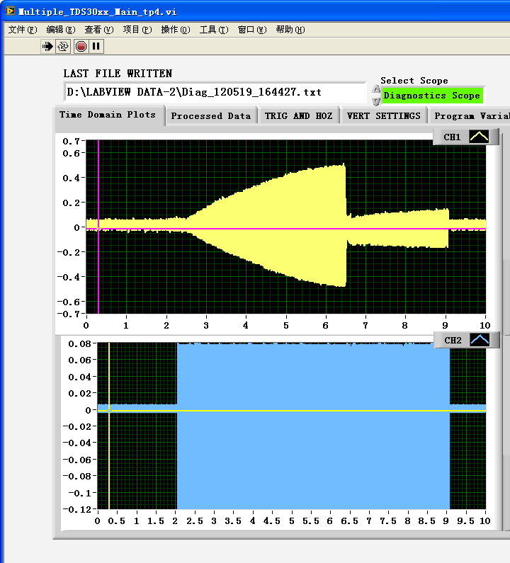
Cooling of bunched ion beam with pulsed electron beam

Slide 7
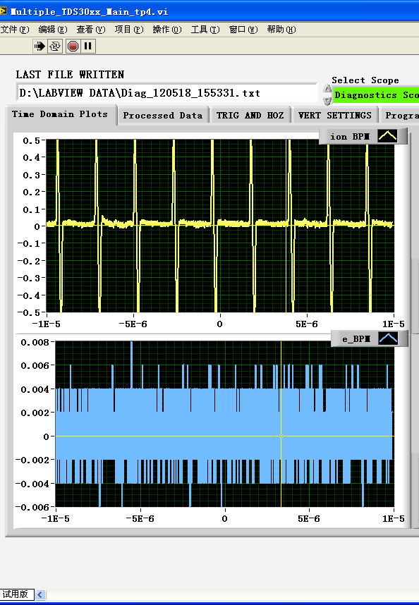
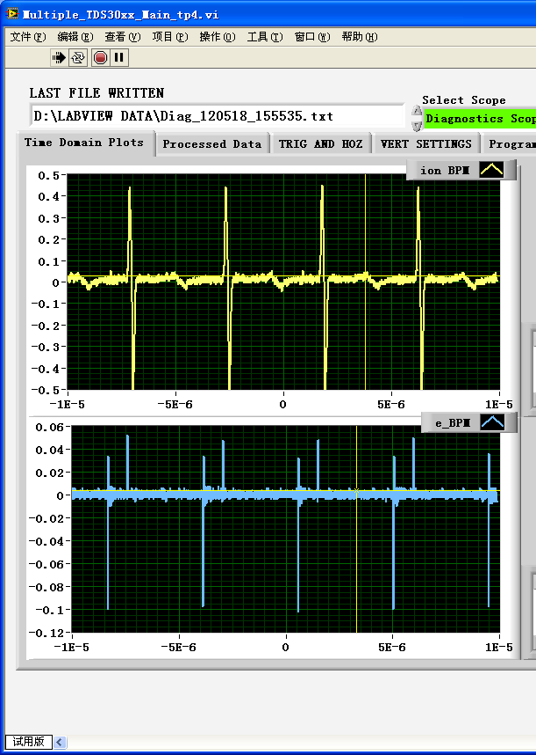
Cooling of bunched ion beam with pulsed electron beam
With DC e beam
With pulsed e beam

