Slide 1
An Alternative Ion Complex Agenda
/some preliminary estimations/
Yaroslav Derbenev
derbenev@jlab.org
JLEIC R@D Meeting
04.07.16

Slide 2
Basic bodies
135 MeV linac
3 GeV racetrack booster (warm or SF)
ECR used as 20 GeV Large Booster
100-200 GeV ICR (SF or Cos)

Slide 3
Small Booster
(0.5 - 0.3) GeV/c injected momentum (p - Pb)
Strip-injection for H-, D-.
DC cooler for stacking ions
3(Z/A) GeV accelerated beam

Slide 4
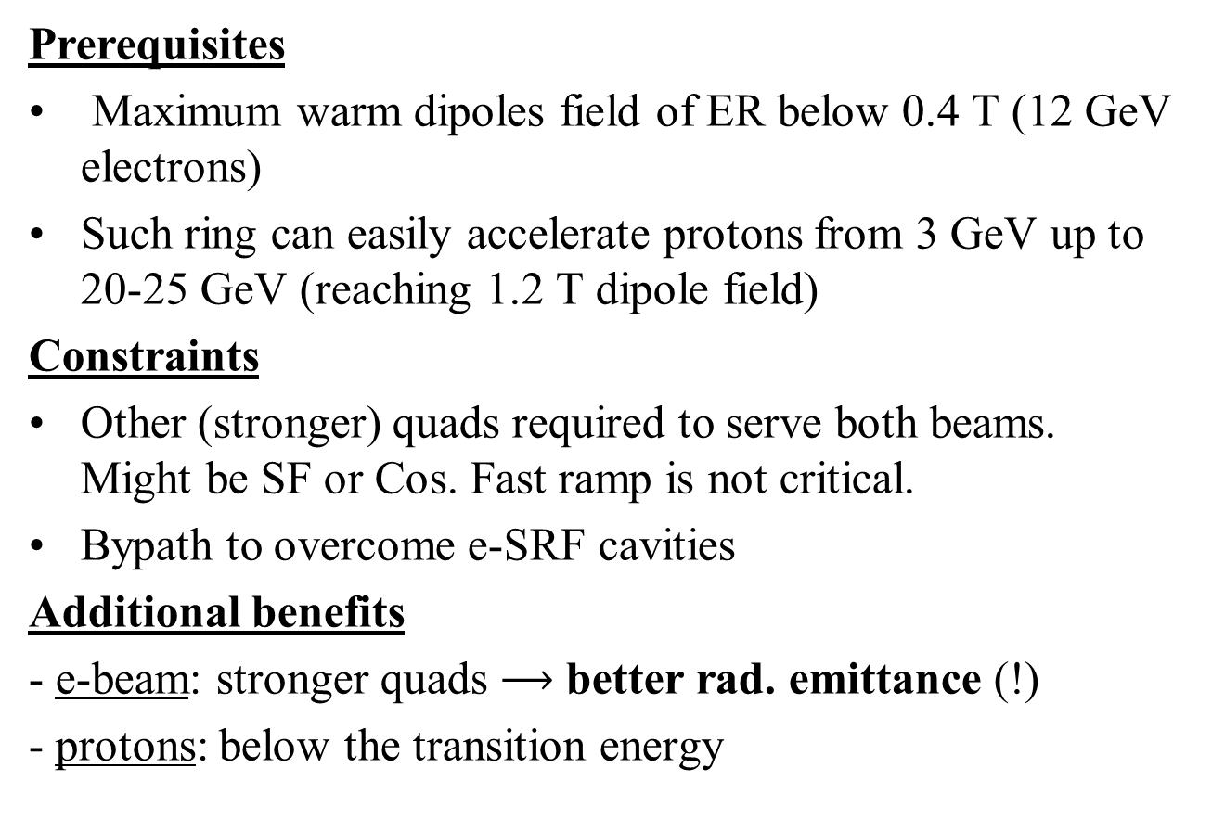
e-Collider Ring used as Large Booster
Prerequisites
Maximum warm dipoles field of ER below 0.4 T (12 GeV electrons)
Such ring can easily accelerate protons from 3 GeV up to 20-25 GeV (reaching 1.2 T dipole field)
Constraints
Other (stronger) quads required to serve both beams. Might be SF or Cos. Fast ramp is not critical.
Bypath to overcome e-SRF cavities
Additional benefits
- e-beam: stronger quads $⟶$ better rad. emittance (!)
- protons: below the transition energy

Slide 5
Injection to ICR
30 – 40 meters as long step (including septums) for ejection/injection to ICR after acceleration
Does not present an issue, according to my estimation

Slide 6
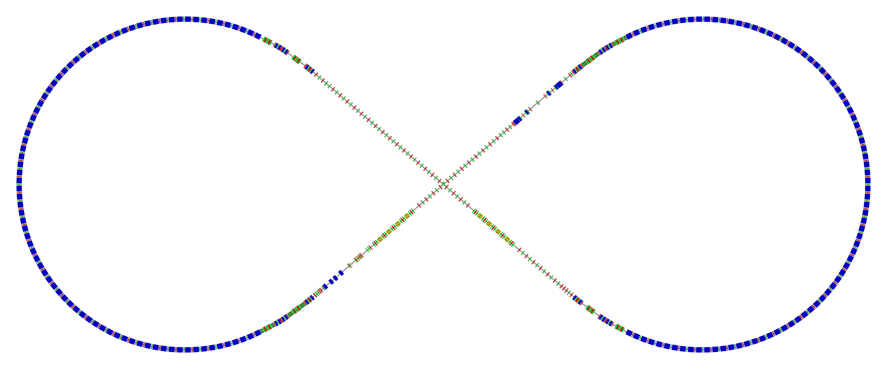
Electron Collider Ring Layout
Circumference of 2154.28 m = 2 x 754.84 m arcs + 2 x 322.3 straights
Figure-8 crossing angle 81.7°
  Electron collider ring w/ major machine components
Spin rotator
Spin rotator
CCB
Tune trombone & Straight FODOs
R=155m
81.7°
e⁻
Arc, 261.7°
Future 2nd IP
RF
RF
Spin rotator
IP
Spin rotator
Forward e⁻ detection

Slide 7
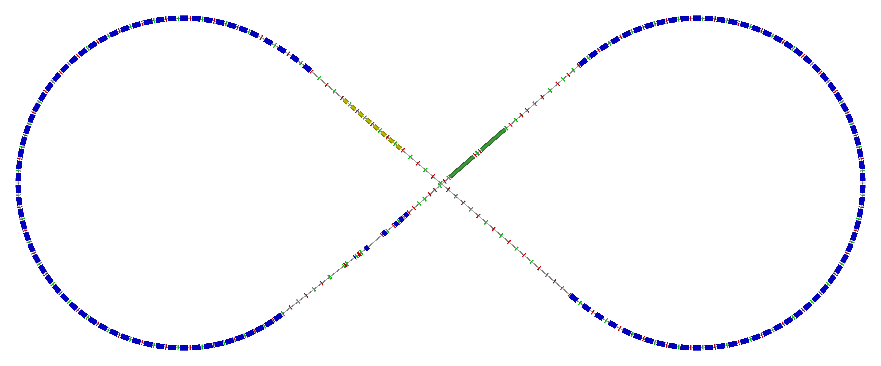
Ion Collider Ring Layout
Figure-8 ring with a circumference of 2153.9 m
Two 261.7° arcs connected by two straights crossing at 81.7°
disp. supp./
geom. match #3
disp. supp./
geom. match #2
norm.+
SRF
Arc, 261.7°
elec. cool.
tune
tromb.+
match
81.7°
R = 155.5 m
future 2nd IP
Polarimeter
det. elem.
disp. supp.
ions
beam exp./
match
IP
disp. supp./
geom. match #3
disp. supp./
geom. match #1

