Slide 1


Progress Report on the Ultra-fast Harmonic Kicker Cavity Design and Beam Dynamic Simulation
Yulu Huang^{1,2}
H. Wang¹, R. A. Rimmer¹, S. Wang¹
1.Thomas Jefferson National Accelerator Facility , Newport News, VA,23606
2.Institute of Modern Physics ,Chinese Academy of Science, Lanzhou, Gansu,730000

Slide 2
Outline
Fast Kicker Requirements for the JLEIC
Kicker Waveform
  Challenges and Solutions
  Beam Dynamics Tracking for One Kicker Scheme
  Beam Dynamics Tracking for Two Kicker Scheme
Kicker Cavity Design
    Multi-Cavity Kick-Drift Model Tracking
    Prototype Cavity Progress
Conclusion
Acknowledgement

Slide 3
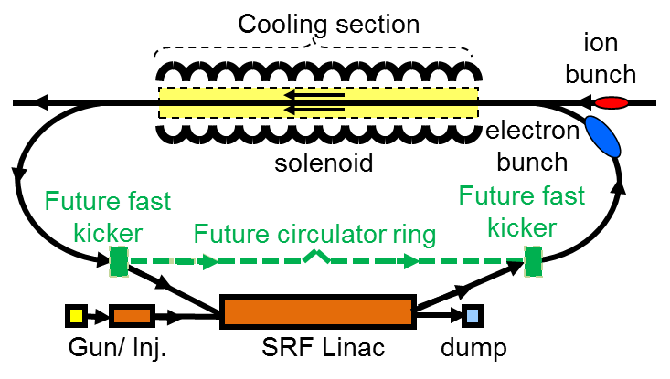
Kicker Requirements for the JLEIC
Electron cooling is essential for achieving high luminosity
High energy bunched electron cooling is part of multi-phased cooling scheme of JLEIC
To achieve very high current for bunched beam cooling in the future high luminosity upgrade, a circulator ring was adopted to reuse the electron bunches
Electrons circulate 10 to 30 turns in the circulator ring, beam current and bunch repetition frequency in the ERL can be reduced by a factor of 10 to 30
One or two ultra-fast kickers are required for this circulator ring

Slide 4
Challenges and Solutions
Few mrad
Few kV
~ns
~10 of ns
Pulsed power supplies, especially with these characteristics are beyond state of the art.
An alternative driving method is summing simple cosine waves at sub-frequencies of the final beam repetition frequency to generate a continuous waveform.

Slide 5
Kick Waveforms to Kick Every 10th Bunch
10 Harmonics+DC offset
9 Harmonics+DC offset

Slide 6
One Kicker Scheme Tracking
Transverse effects on kicked and unkicked bunches in a circulator ring simulated using ELEGANT
Circulator ring approximated with 1 turn linear transfer matrix
Kicker waveform generated using a series of zero-length RF deflectors with appropriate frequencies, phases, and amplitudes
Monitor was put after the kicker
Tracking parameter get from Amy
P [MeV/c] | 55
ε_{x}, ε_{y} [nm] | 10
β_{x}, β_{y} [m] | 10
σ_{s} [cm] | 3
σ_{Δp/p} | 3e-4
f [MHz] | 476.3
n | 10
V_{kick} [kV] | 55
kicker
Monitor
Incoming bunch
Outgoing bunch

Slide 7
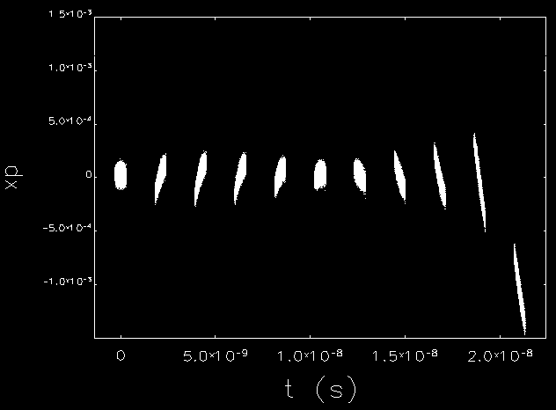
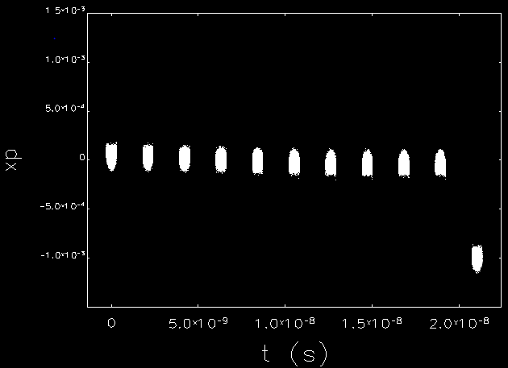
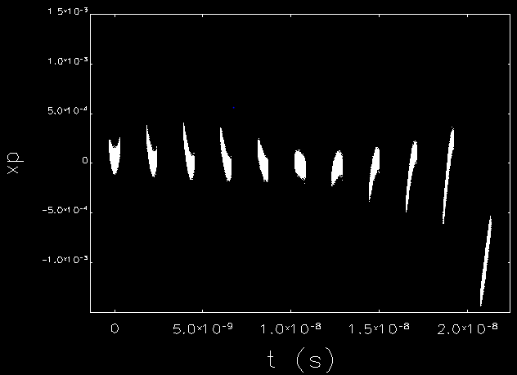
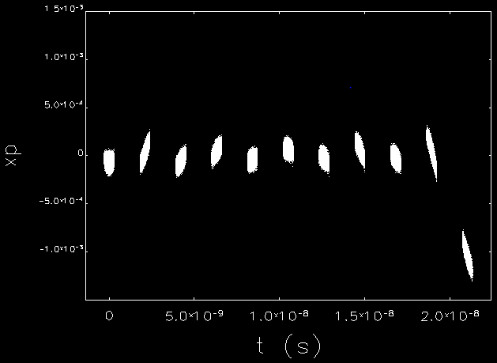
One Kicker Tracking Result
Flat-Top
Zero-Gradient
Equal-Amplitude
Lease-Modes

Slide 8
Emittance Growth During Recirculate

Slide 9
Two Kicker Scheme Tracking
x’
Kicker 2
Kicker 1
Recirculating bunch
x’
Monitor 1
x
1 mrad
Monitor 2
Monitor 3
Incoming bunch
Outgoing bunch
x
-1 mrad
Pi Matrix
(180 degree phase advance in x-x’ plane)
x’
x’
x’
x
~0 mrad
x
x
~0 mrad
Recirculating bunch

Slide 10
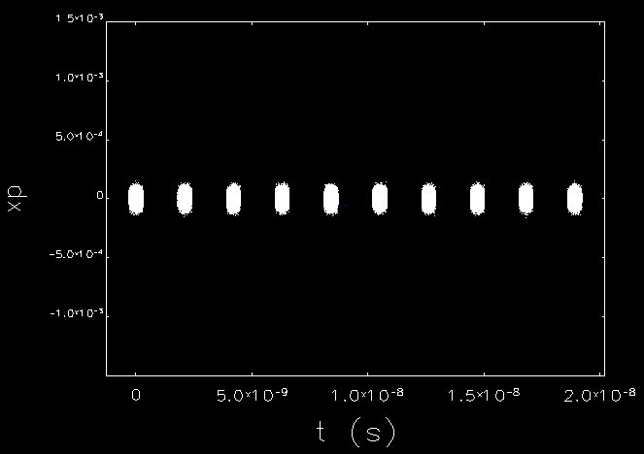
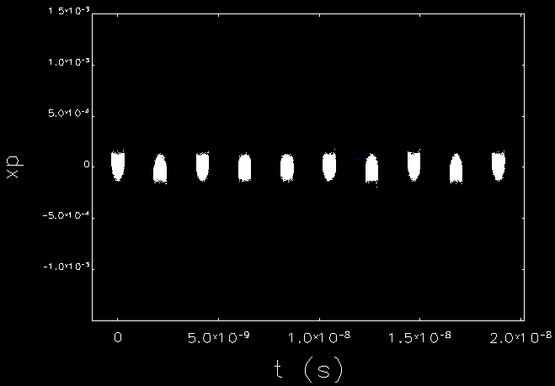

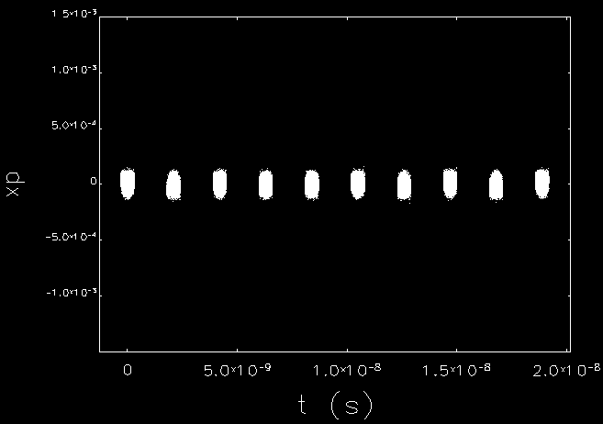
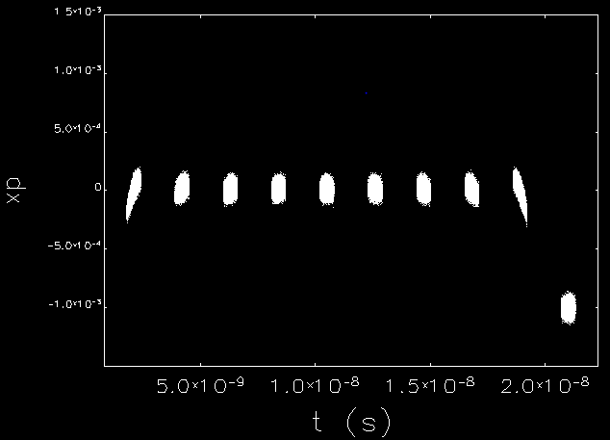

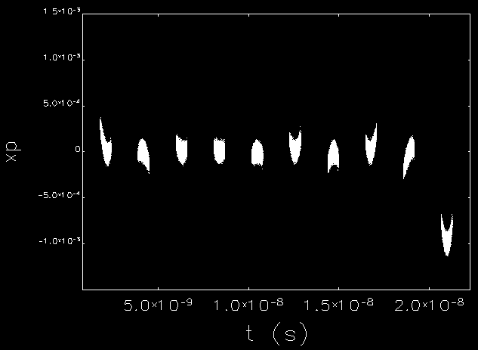

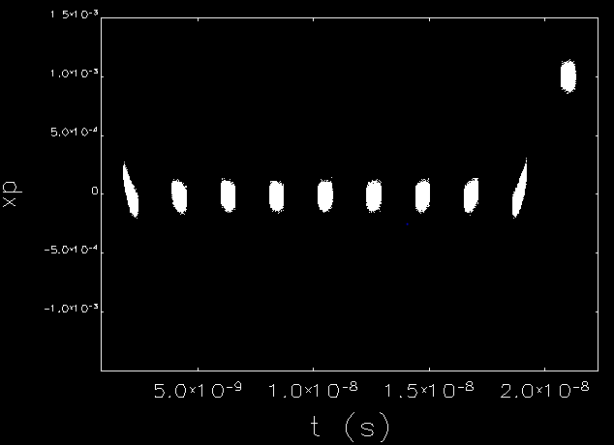
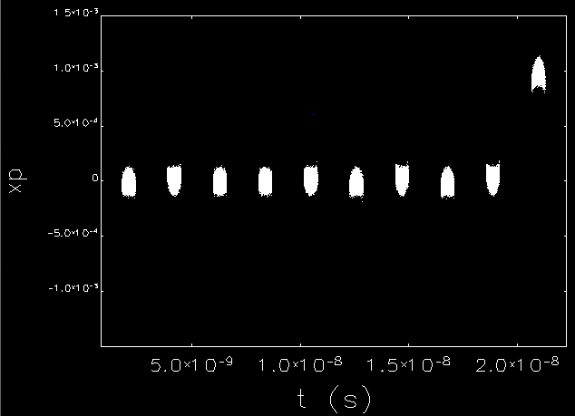

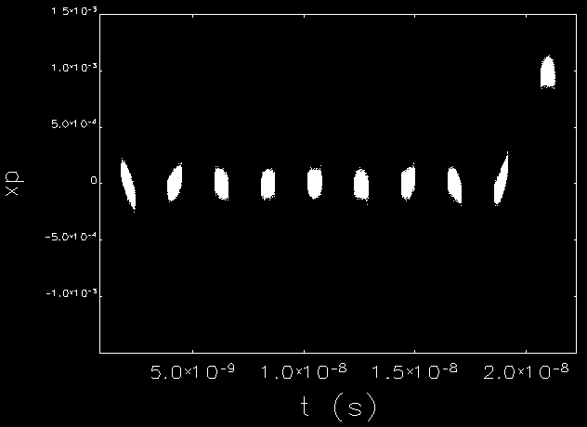
Two Kicker Tracking Result
Flat-Top
Zero-Gradient
Equal-Amplitude
Least-Modes
Monitor 1
Monitor 1
Monitor 1
Monitor 1
Monitor 2
Monitor 2
Monitor 2
Monitor 2
Monitor 3
Monitor 3
Monitor 3
Monitor 3

Slide 11
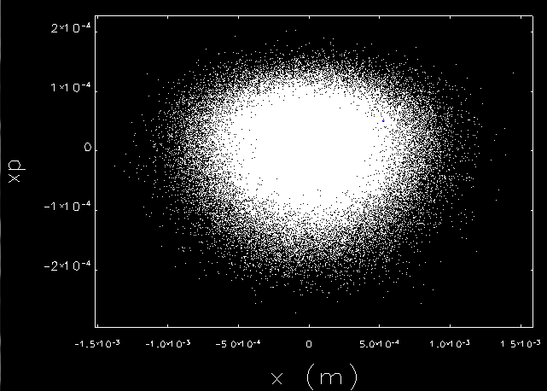
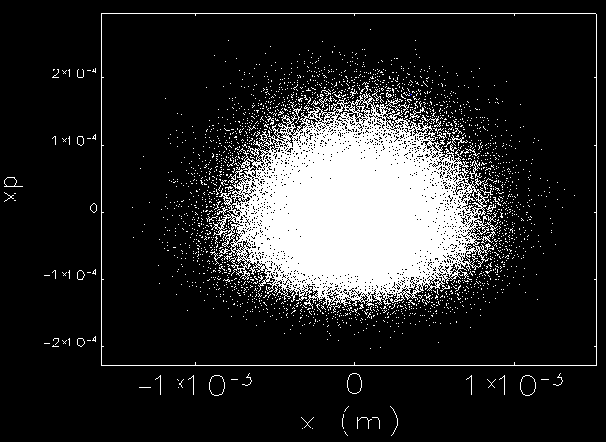
Passing through the Pi matrix
Monitor 3
Monitor 2
180 degree phase advance in x-x’ plane

Slide 12
Emittance Growth During Recirculate

Slide 13
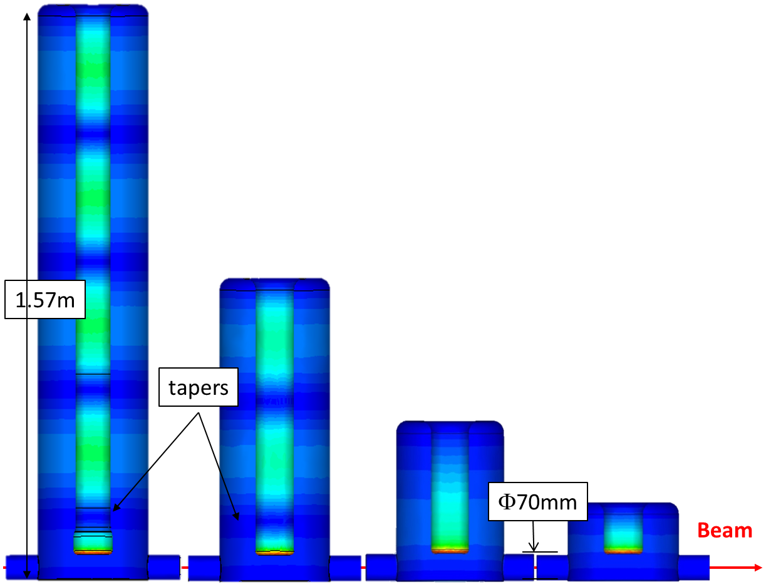
Kicker Cavity Model
Mode (MHz) | FFT Kick Voltage (kV) | CST Trans. Shunt Impedance (Ω) | Dissipated Power (W)
47.63 | 13.711 | 7.13E6 | 26.37
95.26 | 12.462 | 1.14E7 | 13.62
142.89 | 10.532 | 4.09E6 | 27.12
190.52 | 8.1290 | 1.35E7 | 4.89
238.15 | 5.5030 | 3.14E6 | 9.64
285.78 | 2.9170 | 6.09E6 | 1.40
333.41 | 0.6300 | 2.65E6 | 0.15
381.04 | -1.2090 | 1.65E7 | 0.09
428.67 | -2.4320 | 2.40E6 | 2.46
476.3 | -3.0110 | 4.57E6 | 1.98
DC | 8.2760
Total | 55.508 | 3.56E7 | 87.72
5 harmonics 47.63MHz×1,3,5,7,9
3 harmonics 47.63MHz×2,6,10
1 harmonics 47.63MHz×4
1 harmonics 47.63MHz×8

Slide 14
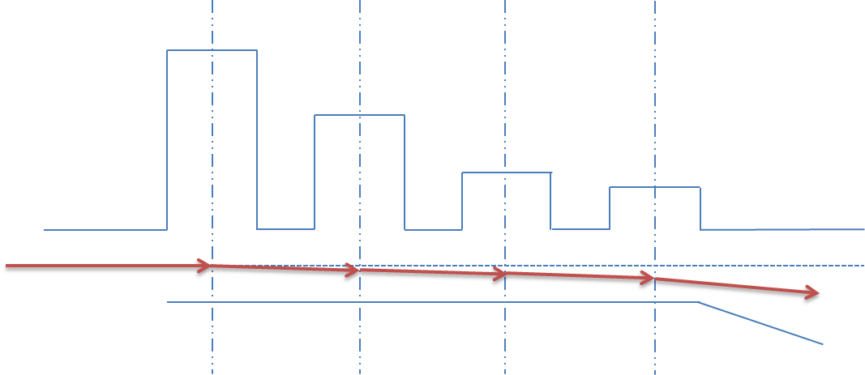
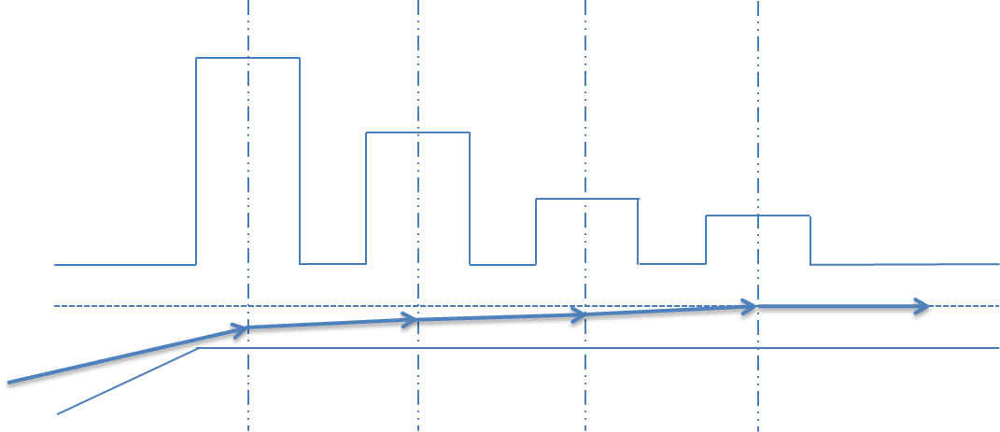
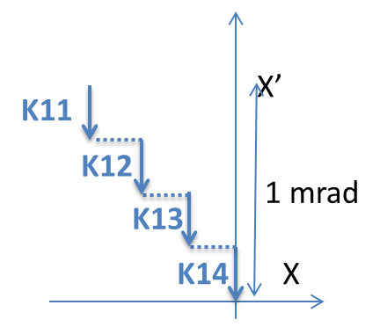
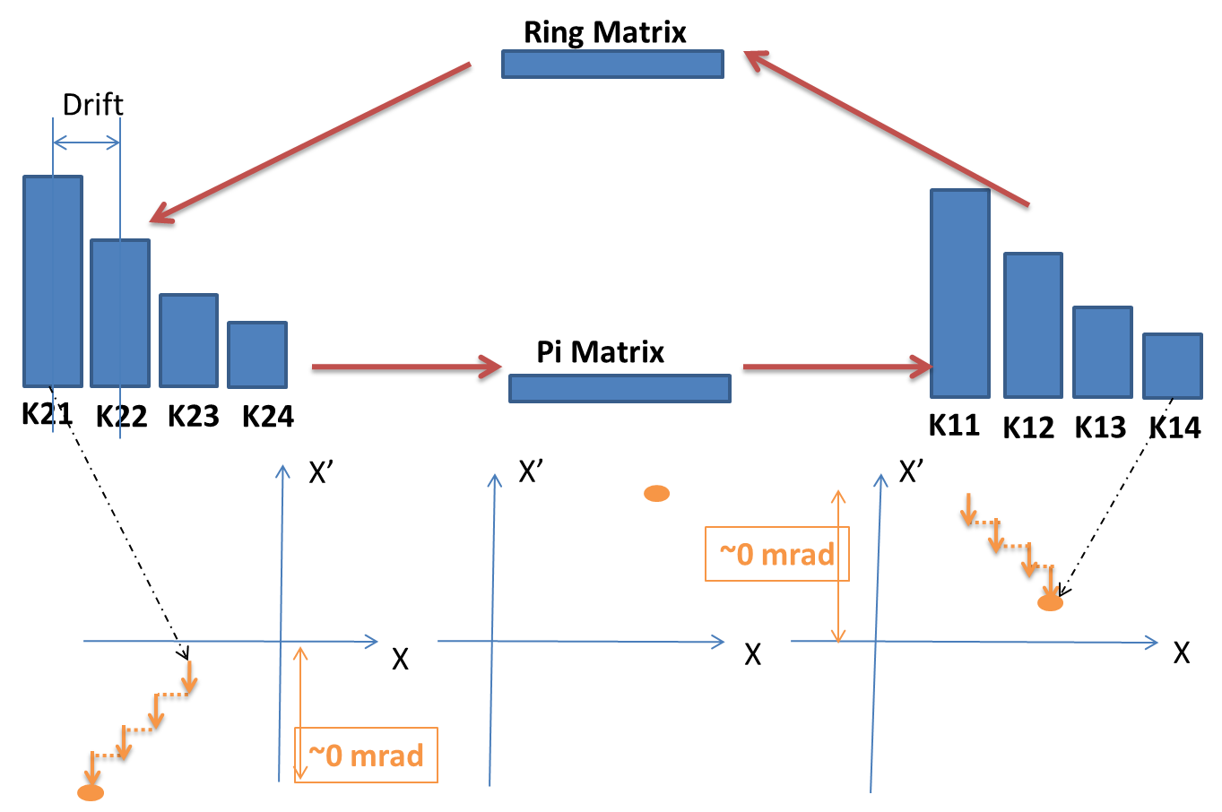
Multi-Cavity Kick-Drift Model
X’
Incoming bunch
X
1 mrad
Outgoing bunch
Recirculating bunch

Slide 15
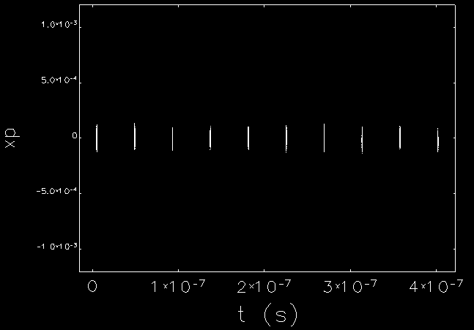
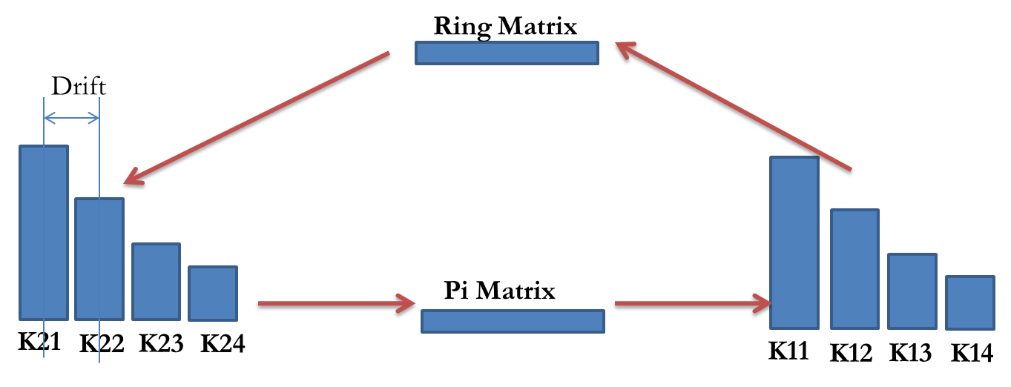
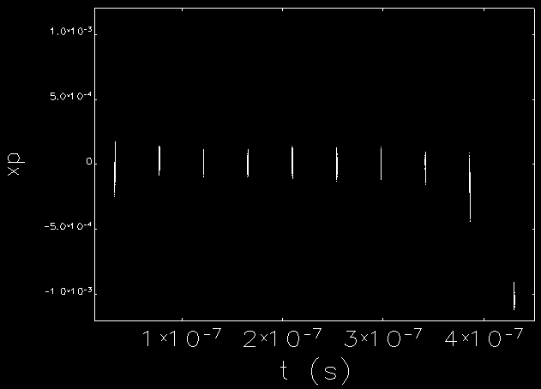
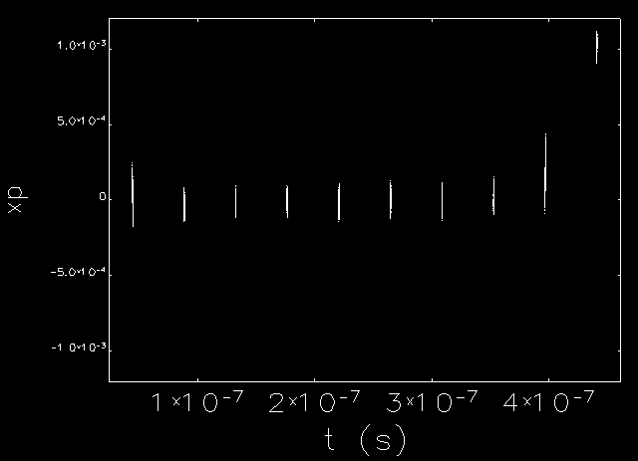
Multi-Cavity Kick-Drift Tracking
Monitor 1
Monitor 1
Monitor 2
Monitor 3
Monitor 2
Monitor 3

Slide 16
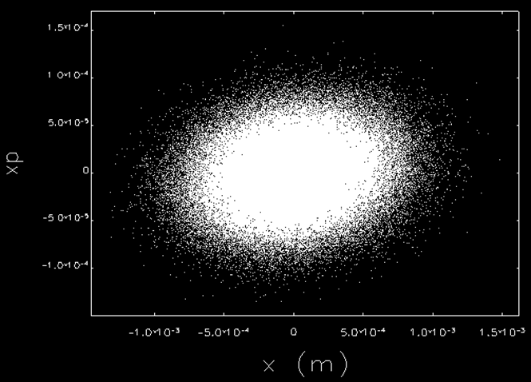
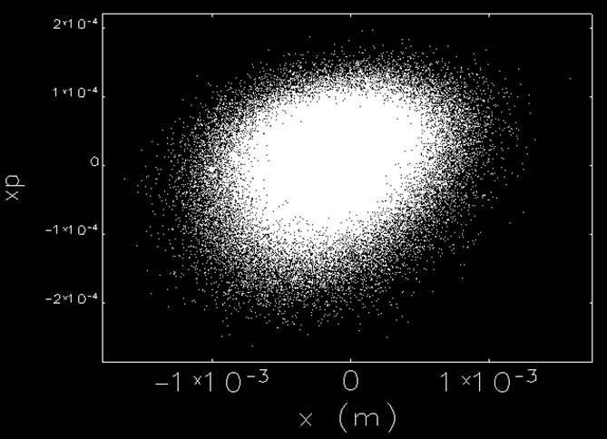
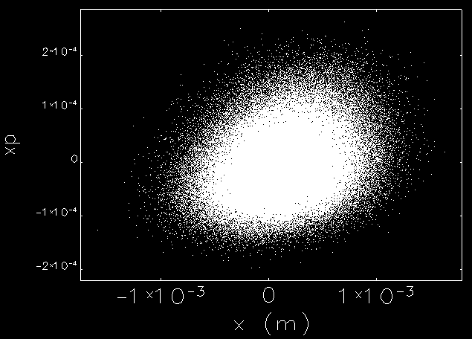
Multi-Cavity Kick-Drift Tracking
Monitor 1
Monitor 1
Monitor 2
Monitor 3
Monitor 2
Monitor 3

Slide 17
Emittance Growth During Recirculate
Initial Normalized Emittance
(Flat-Top Scheme)

Slide 18
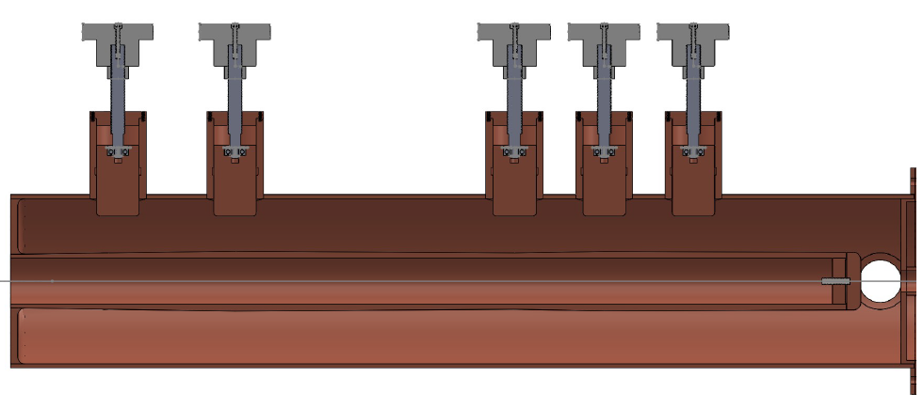
Half-Scale Prototype Cavity
Engineering drawings were already finished
The material is already delivered

Slide 19
Conclusions
An Ultra-fast , high repetition rate kicker was conceptual developed.
Several kick waveform were discussed with the beam dynamics tracking in ELEGANT.
A series harmonic kicker cavities with great power efficiency were designed to generate such kind of kick waveform. Beam dynamics tracking is also studied for this multi-cavities scheme.
An half scale prototype cavity is under manufactured.
A 3-D bead-pull system is set up for the future bench test

Slide 20
Acknowledgement
Acknowledge to Amy Sy for the help on ELEGANT tracking!

