Slide 1
Longitudinal Single-Bunch Instability in JLEIC Design
Rui Li
(2/18/16)

Slide 2
Outline
Introduction
Collective interaction of a bunch via wakefield or impedance
Longitudinal single-bunch Instability
Threshold in JLEIC designs
Summary

Slide 3
1. Introduction
External magnetic or RF fields determine single particle dynamics for the design optics
High intensity bunches could interact with itself via direct EM field interaction or via boundary conditions of vacuum pipe
These collective interaction could cause the beam to undergo longitudinal or transverse instabilities
There are many types of coherent instabilities.
Bunch-induced fields with wavelengths short compared to bunch length may induce microwave instability in a single bunch.
Longitudinal single bunch instability is one of the most early discovered instabilities, and has been well studied by theory, simulation and experiments.

Slide 4
This instability could cause potential-well distortion, longitudinal microwave instability or turbulent bunch lengthening
It is not a fatal instability---not causing beam loss, but it causes bunch lengthening and increase of momentum spread.
At JLEIC, we are mostly safe from this instability. However, because of the wide energy range, ion species, and the electron cooling during collision, we should be cautious of the possibility of encountering this instability
Space charge at low energy in the booster ring may cause concern.

Slide 5
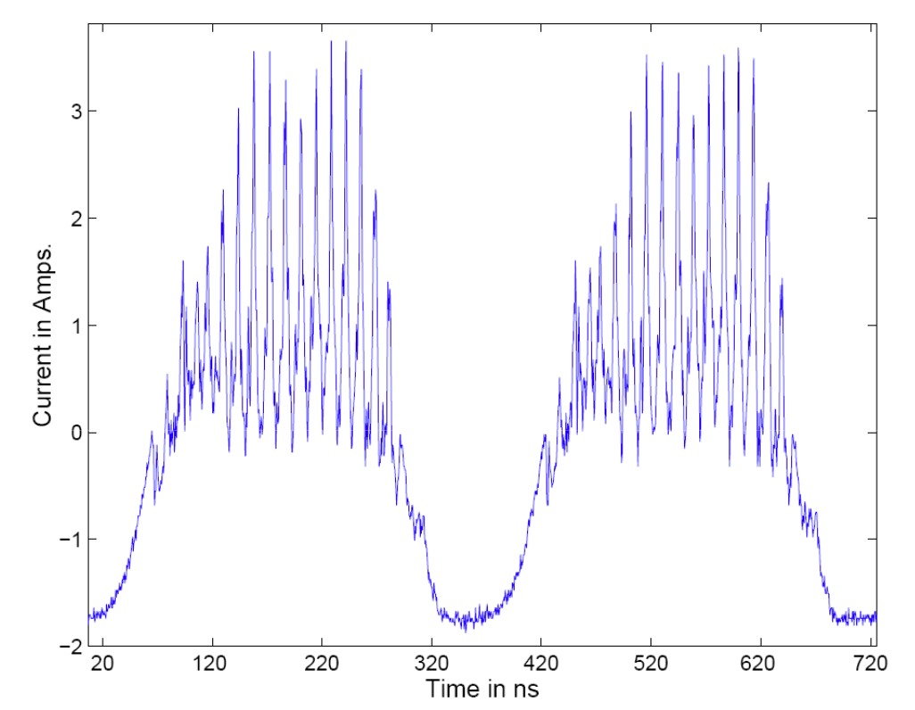
Example Observation of Longitudinal Single-Bunch Instabilities
Observation at PSR
of Los Alamos

Slide 6
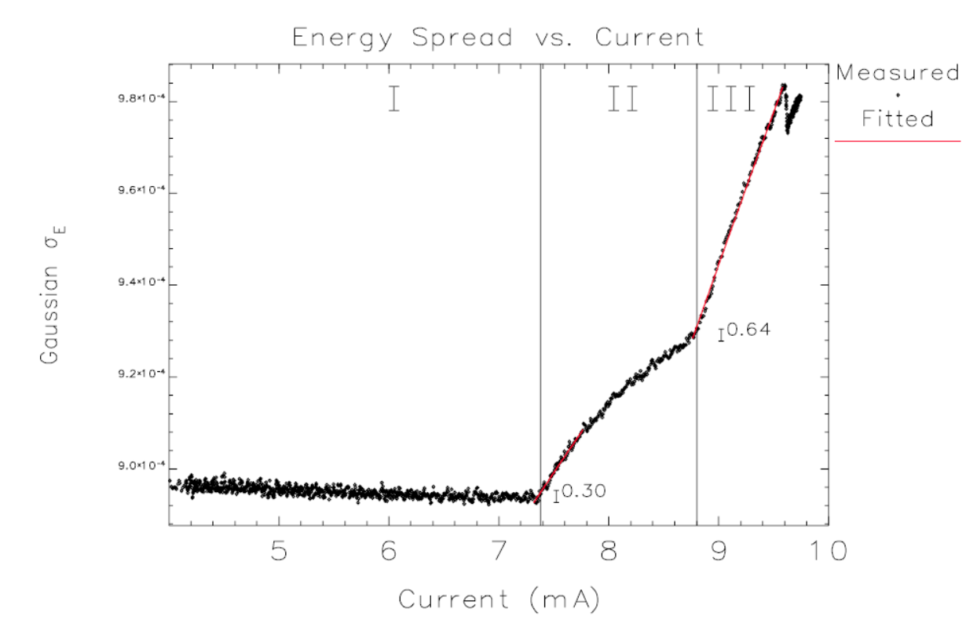
Increase of Energy Spread
Y.-C. Chae et al, “Measurement of the longitudinal microwave instability in
the APS storage ring,” (2001)

Slide 7
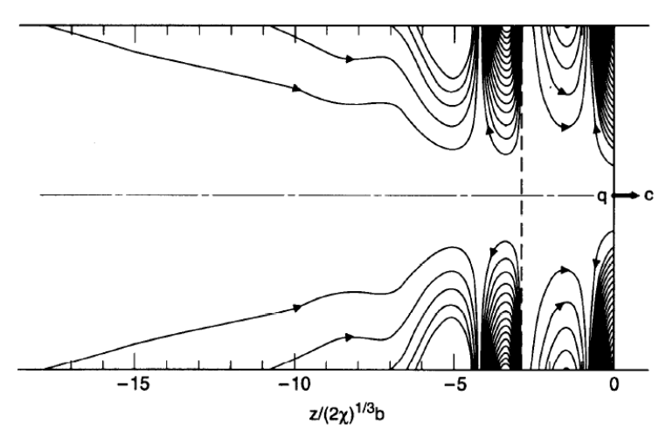
2. Bunch Collective Interaction
Charged particles are guided, focused and accelerated by external dipole, quadruple magnetic field and RF fields
Each charged particle in a beam carries with it the self EM fields, which could be scattered or diffracted by vacuum pipe boundaries
The particles experience collective fields by direct interaction via space charge or CSR, or by indirect interaction via the image charge generated fields
Wakefield following a point
charge in a cylindrical pipe
with resistive wall (K. Bane)

Slide 8
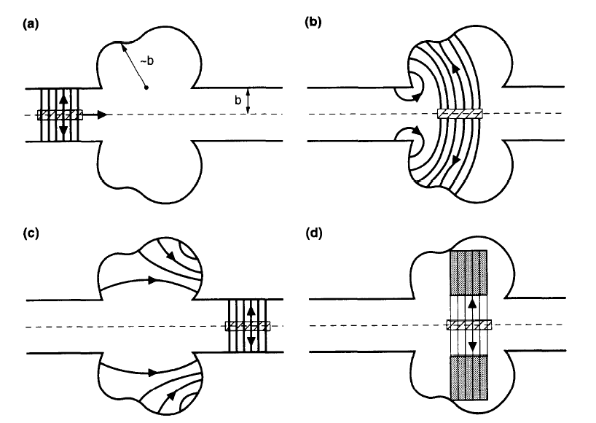
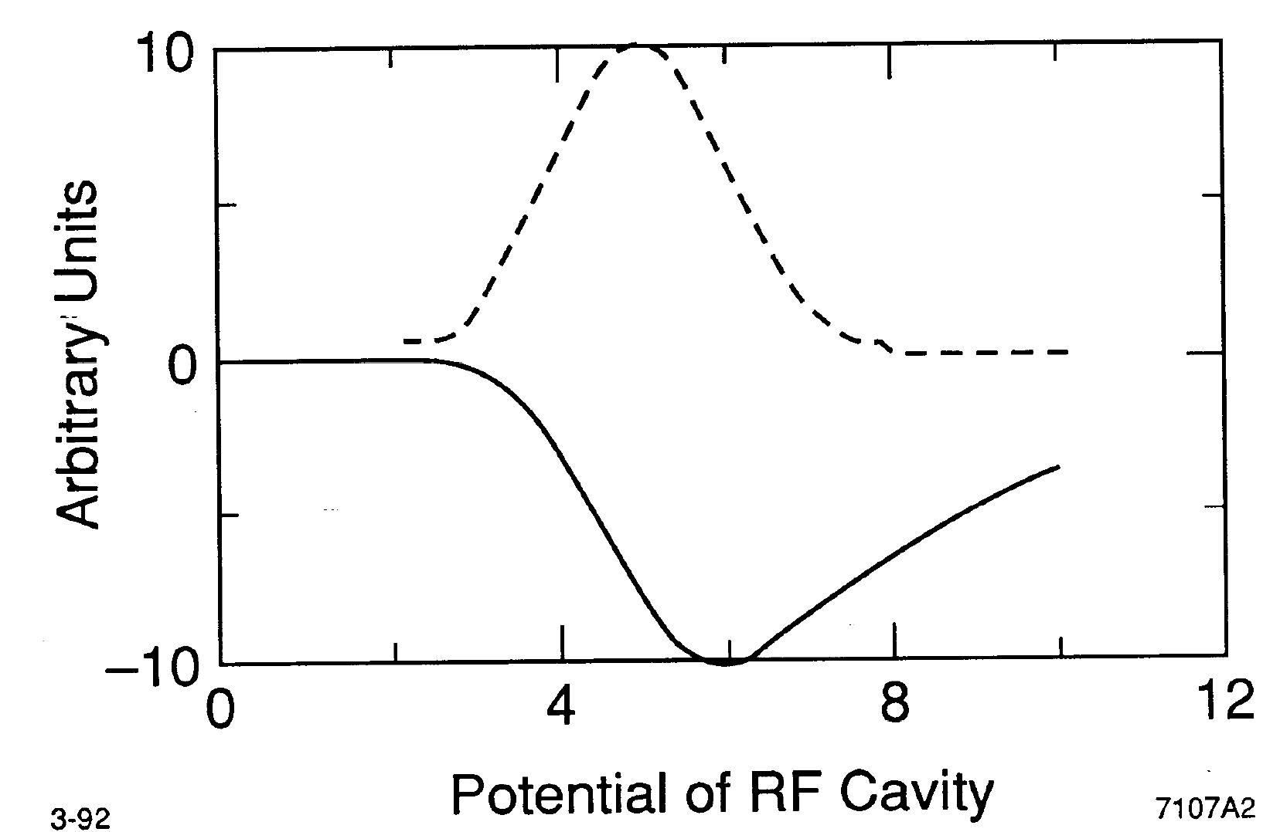
Field from a bunch traversed a cavity structure

Slide 9
Impedance Generating Elements
RF cavities
Resistive walls
Shielded bellows
Unshielded bellows
Tapers
Flanges
BPMs
Pumping slots
Vacuum valves
Injection kickers
Abort kickers
Strip line kicker
(feedback system)
Clearing electrodes
Space charge
CSR
Collimators
Interaction region
We need to develop impedance budget by assessing impedance
from all such elements in JELIC beamlines

Slide 10
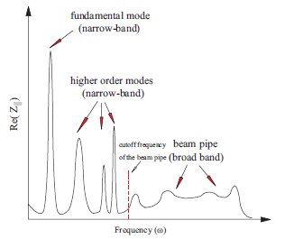
Typical Impedance Behavior
Cause coupled bunch
instability
Cause single bunch
instability

Slide 11
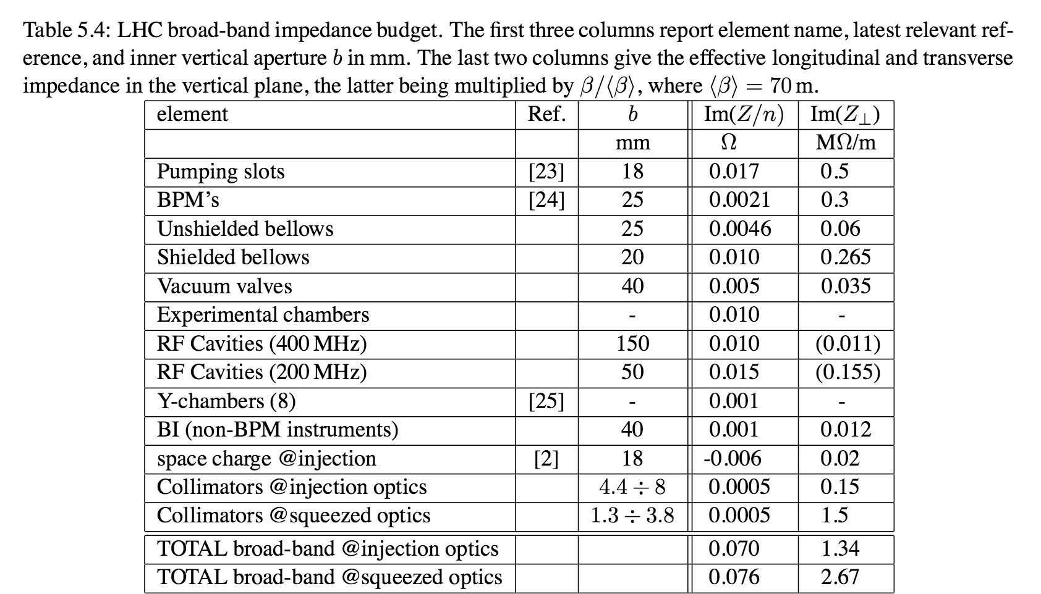
Example of LHC broad-band impedance budget

Slide 12
Collective Instabilities
Machine
Type
Beam
dynamics
Collective
Interaction
Coherence
Single
bunch
Linac
Longitudinal
coherent
Storage
ring
Transverse
Multi
bunch
Recirculating
Accelerator or ERL
incoherent
Synchro
-betatron
Two
stream

Slide 13
3. Single-bunch Longitudinal Instability
Potential well distortion
Incoherent & coherent synchrotron tune shift
Longitudinal microwave instability

Slide 14
Single Particle Longitudinal Dynamics
Equation of motion
Hamiltonian
Unperturbed stationary distribution for bunched electron beam
Solution of Haissinski equation (with quantum excitation due to SR)
What about equilibrium for ion beam under ecooling?

Slide 15
Potential Well Distortion
The RF field generates a potential well for the particles
The wakefield of beamline cause distortion of the potential well modifies the incoherent synchrotron motion
The wakefield of the bunch is determined by the bunch length or the bunch longitudinal distribution
The potential well in turn determines the synchrotron tune shift and stationary bunch distribution in self-consistent way
Above transition, a inductive impedance will cause bunch lengthening
Potential well deformation is an incoherent effect
Hassinski
Solution
for e-beam
equilibrium

Slide 16
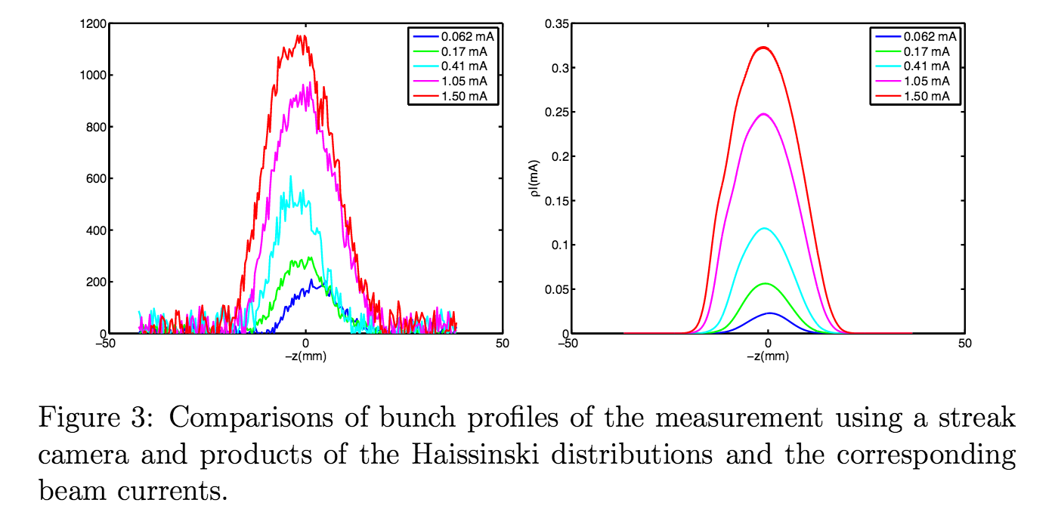
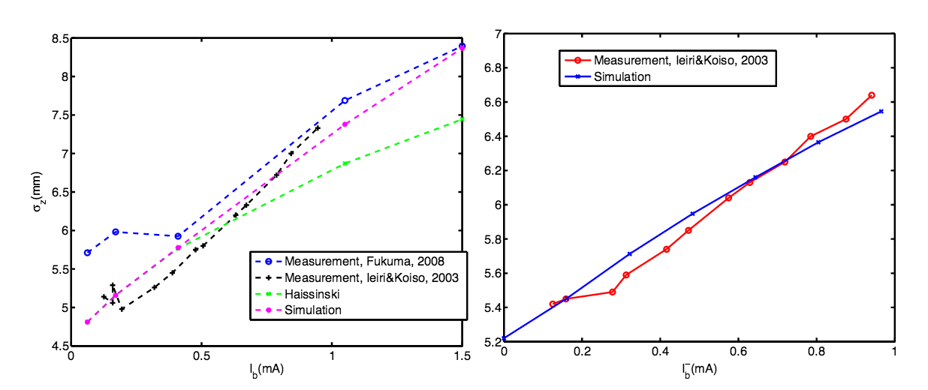
Experimental Observation of Bunch Lengthening
KEKB: L= 96nH (LER) and L=104nH (HER)
Wake model:
Measurement
Simulation
(Y. Cai, SLAC-PUB-13570)
LER
HER

Slide 17
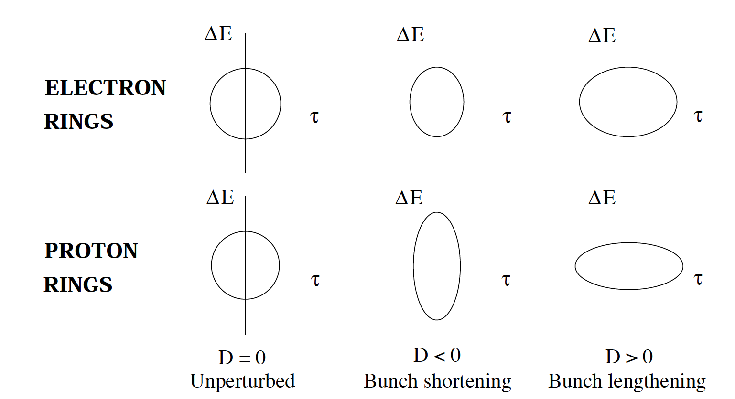
Phase Space Ellipse Distortion for Electron or Proton Beams

Slide 18
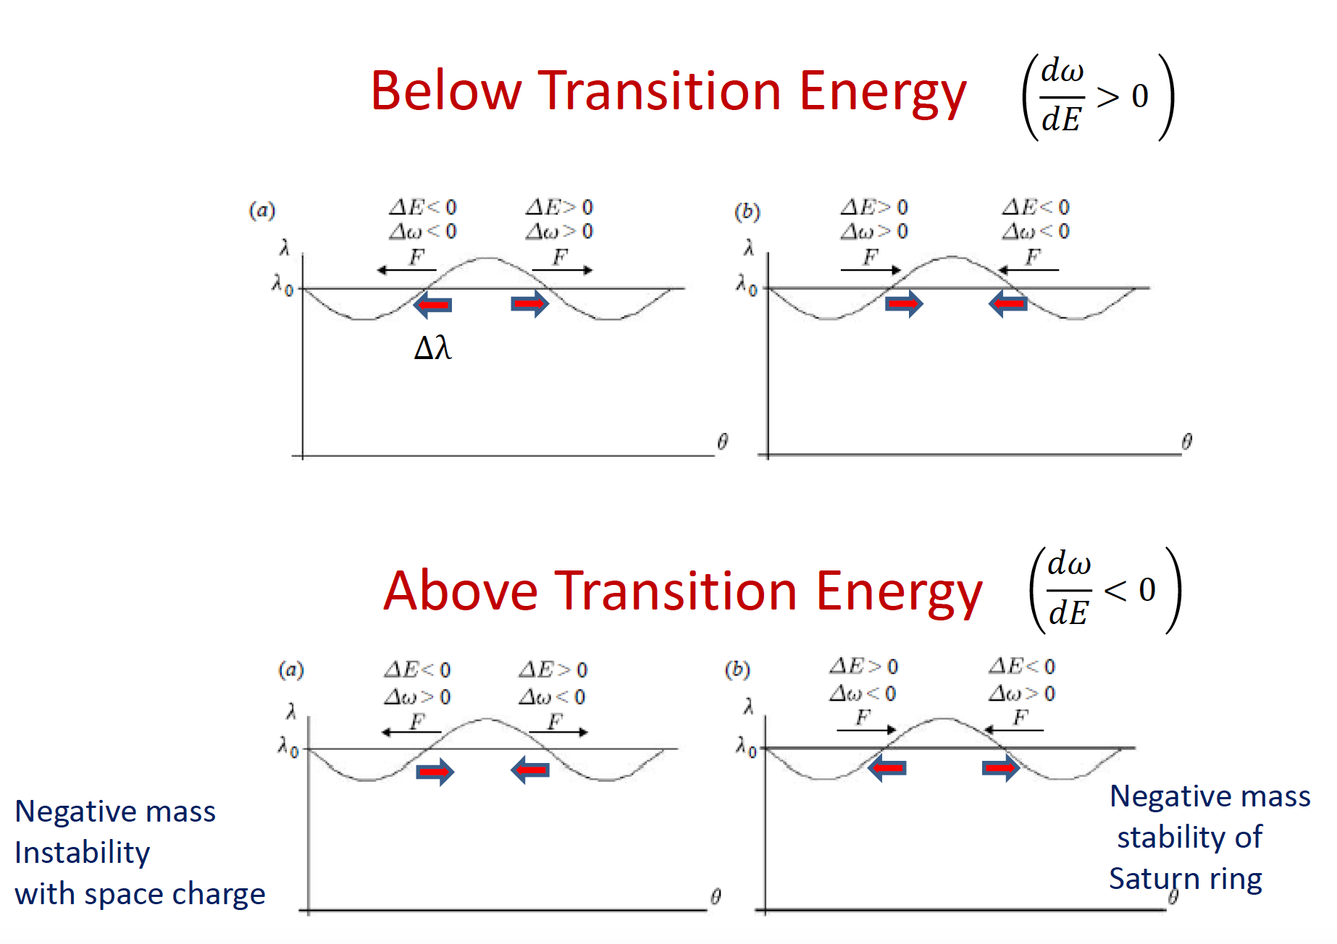
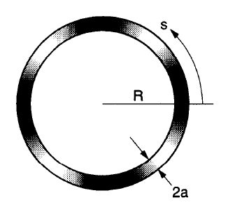
Longitudinal Microwave Instability (LMWI)
Density perturbation may occur on top
of stationary distribution
System responds to the perturbation
through wakefield or impedance
This could combine with slip factor
to cause microwave instability
Negative mass instability is space charge
caused by LMWI above transition

Slide 19
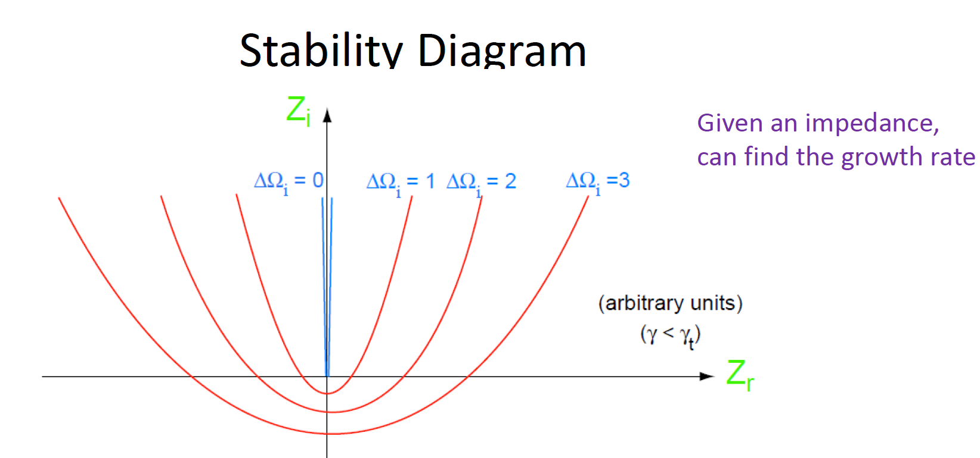
LMWI for a Coasting Beam (zero energy spread)
-CSR,LSC
-resistive wall
-RF cavity,etc
Dispersion relation
Phase space
continuity

Slide 21
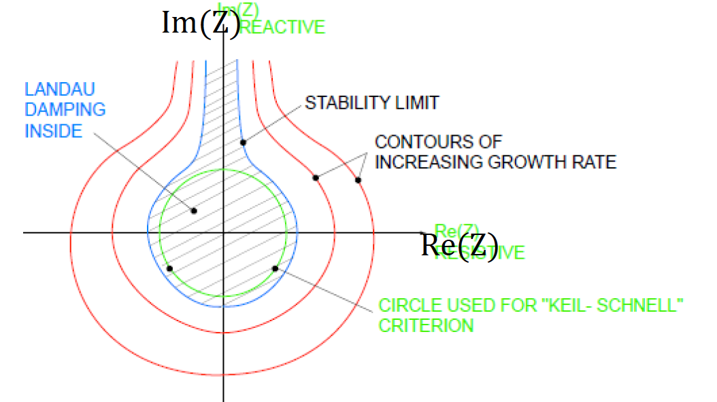
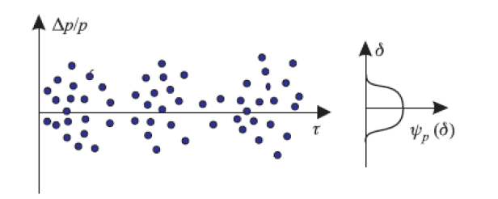
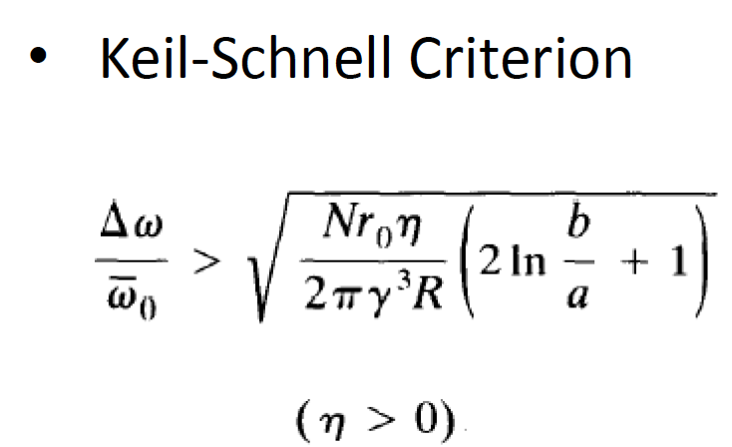
LMWI for a Coasting Beam (finite energy spread)
Energy spread cause decoherence
or Landau damping
Stability Diagram
Threshold of LMWI
or

Slide 22
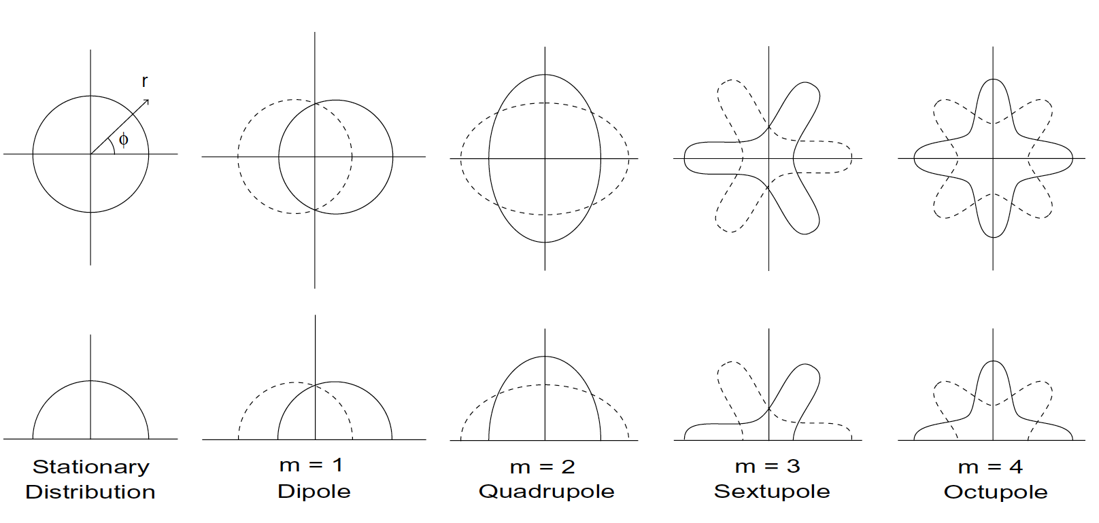
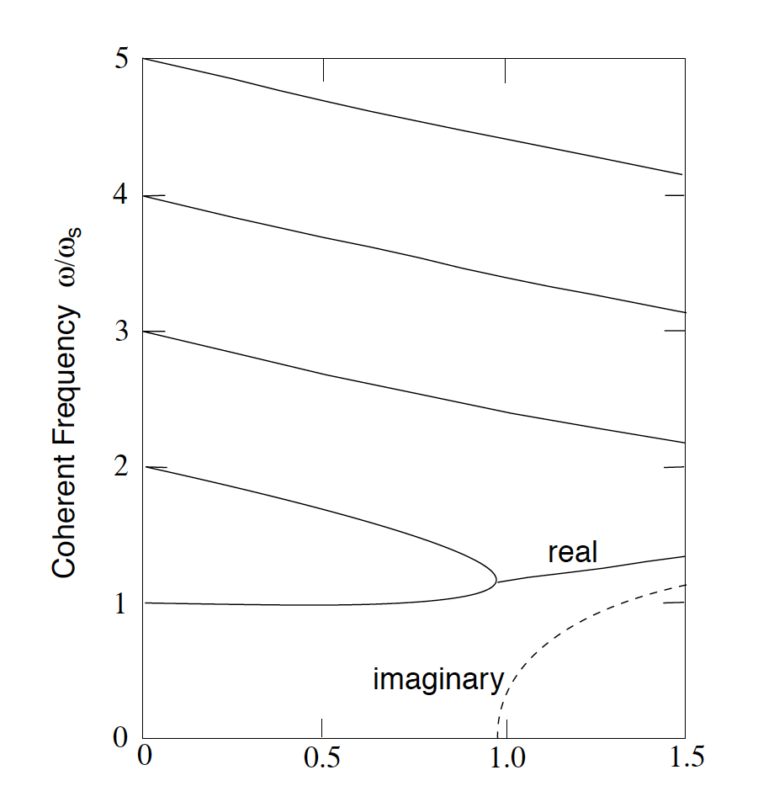
LMWI for a Bunched Beam
Modes in longitudinal phase space
Mode mixing
Note:

Slide 23
4. Estimation of LMWI for JLEIC
General formula and its parametric dependence
LMBI threshold for PEP-II LER and JLEIC e-ring
LMBI threshold for RHIC and JLEIC ion rings

Slide 24
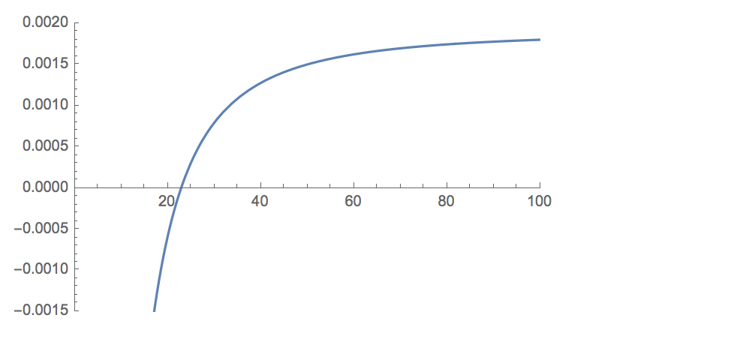
LMBI Impedance Threshold and Parametric Dependences
LMWI threshold
Acceleration:
RF rebucketing, IBS, cooling:
Bunch splitting:
Machine impedance:

Slide 25
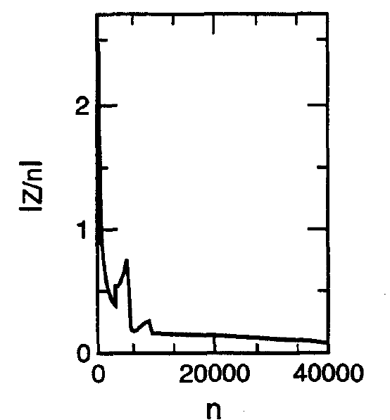
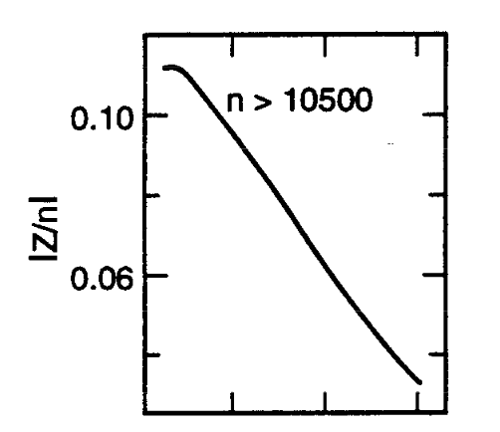
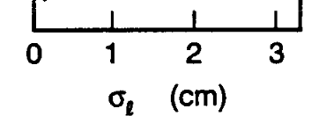
LMWI for e-Ring: LER of PEP-II
PEP-II LER
 | 3.1
 | 113
 | 1.31
 | 8.0
 | 0.14
Estimation of impedance threshold
Effective impedance in the machine
-average of impedance over bunch power spectrum
-Empirically obtained SPEAR-scaling:
Threshold
estimation
-Compare threshold with machine impedance:
Machine
effective
impedance
vs. bunch length
(more realistic
Impedance result
show LER is safe from LMWI)
(PEP-II CDR)

Slide 26
LMWI for e-Ring: JLEIC Electron Ring
 | PEP-II (LER) | JLEIC Electron Ring
 | 3.1 | 4 | 5 | 10
 | 113 | 44.6 | 62.35 | 62.35
 | 1.31 | 2.2 | 2.2 | 2.2
 | 8.0 | 3.64 | 4.55 | 9.1
 | 0.14 | 0.12 | 0.23 | 2.56
Impedance threshold estimation:
JLEIC e-ring is safe from LMBI at nominal energy
At low energy the impedance threshold is comparable to that for
PEP-II LER
Machine impedances:
JLEIC e-ring reuses the RF cavities, vacuum pipe, etc in PEP-II
Further detailed impedance studies need to be done for e-ring in JLEIC

Slide 27
LMWI for Ion ring: RHIC Proton Beam
(RHIC/AP/36)
Proton
beam
rebucketing
store
250
(20 ms)
(10 hrs)
acceleration
IBS
(60 sec)
29
injection
(30 sec)
(illustration not to scale)
 | injection | acceleration | store
 | 29 | 250 | 250
 | 5.4 | 5.4 | 26.6
 | 0.72 | 1.9 | 1.9
 | 4.66 | 0.54 | 2.65
 | 5.2 | 2.1 (1.6) | 7.9
Estimated
impedance
threshold
Machine impedance:
safe
Bunch spectrum around 400 MHz,

Slide 28
LMWI Threshold for RHIC Gold Beam
Gold
beam
rebucketing
store
100
(20 ms)
(10 hrs)
acceleration
(53 sec)
IBS
11
injection
(6.5 sec)
(114 sec)
(illustration not to scale)
Estimated
impedance
threshold
safe
safe
safe
safe
Machine impedance
(RHIC/AP/36)

Slide 29
LMWI for Ion Ring: JLEIC Booster Ring
extraction
8
acceleration
Proton
beam
Emittance
reduction
2
(cooling)
acceleration
accumulation
(cooling for ions)
(illustration not to scale)
 | injection
 | 2
 | 0.49
 | 10
 | 2
 | 10.2
Estimating impedance threshold
Need bunch longitudinal
phase space evolution for
the whole cycle
Machine impedance
Need impedance studies
for the booster
Estimated
impedance
threshold
May be susceptible to space charge impedance

Slide 30
LMWI Threshold for JLEIC Ion Collider Ring
Proton
beam
Bunch splitting?
store
250
Barrier bucket?
(cooling)
acceleration
29
stacking
(cooling)
(illustration not to scale)
 | store
 | 100
 | 15.3
 | 6.45
 | 3
 | 23.8
Estimating impedance threshold
Need (1) bunch formation
scheme (2) know bunch
longitudinal phase space
evolution for the whole cycle
Machine impedance
Need impedance studies
for ion ring
Estimated
impedance
threshold
Safe here

Slide 31
Summary
General physics of longitudinal single-bunch instability is discussed.
Initial estimation is started for LMWI-imposed impedance thresholds for e-ring and ion rings in the JLEIC design
Space-charge impedance at low energy may cause concern
The estimations are compared with similar studies in PEP-II for e-ring and in RHIC for ion rings.
In most scenarios JLEIC is safe from LMWI. However, because of unique feature of JLEIC, caution is needed.
wide energy range and ion species
electron cooling
transition crossing
Etc
Further information are required for a more complete study
Bunch formation scheme for the ion beams
Evolution of bunch longitudinal phase space distribution for the whole cycle
Machine impedance studies

