Slide 1

Dynamic Aperture with Realistic Multipole error of Super-Ferric Dipole for MEIC Ion Collider Ring
G. Wei, V.S. Morozov, Fanglei Lin
MEIC R&D Meeting, JLab, Oct 27, 2015

Slide 2
Contents
Error types
Purpose of error study
Misalignment, strength error and correction
Multipole error of Super-Ferric Dipole
Dynamic Aperture Study with Multipole error of Super-Ferric Dipole
Summary & Questions

Slide 3
Error types
Magnets:
  Super-Ferric dipole, Quads, Sextupole, corrector
static errors : independent on time
  Misalignment, strength error of magnets; offset of BPM
  Multipole error of magnets
  (systematic error & random error)
dynamic errors: dependent on time
  Noise signal of BPM
  Field jitter of magnets

Slide 4
Purpose of error study
static errors : independent on time
  Misalignment, strength error of magnets;
  Multipoles of magnets (systematic & random error)
  Give requirement on misalignment
  Give requirement on multipole error of magnets
  Get influence to dynamic aperture, Ext: IP
dynamic errors: dependent on time
  Noise signal of BPM
  Field jitter of magnets
  Give requirement on BPM noise and magnet jitter
  Get influence to dynamic aperture, Ext: IP

Slide 5
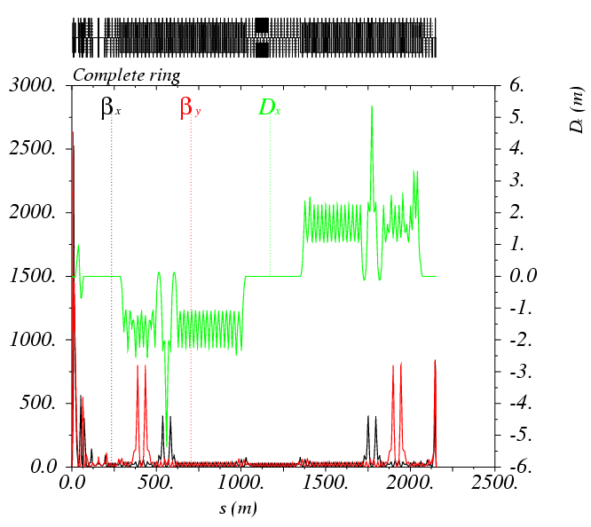
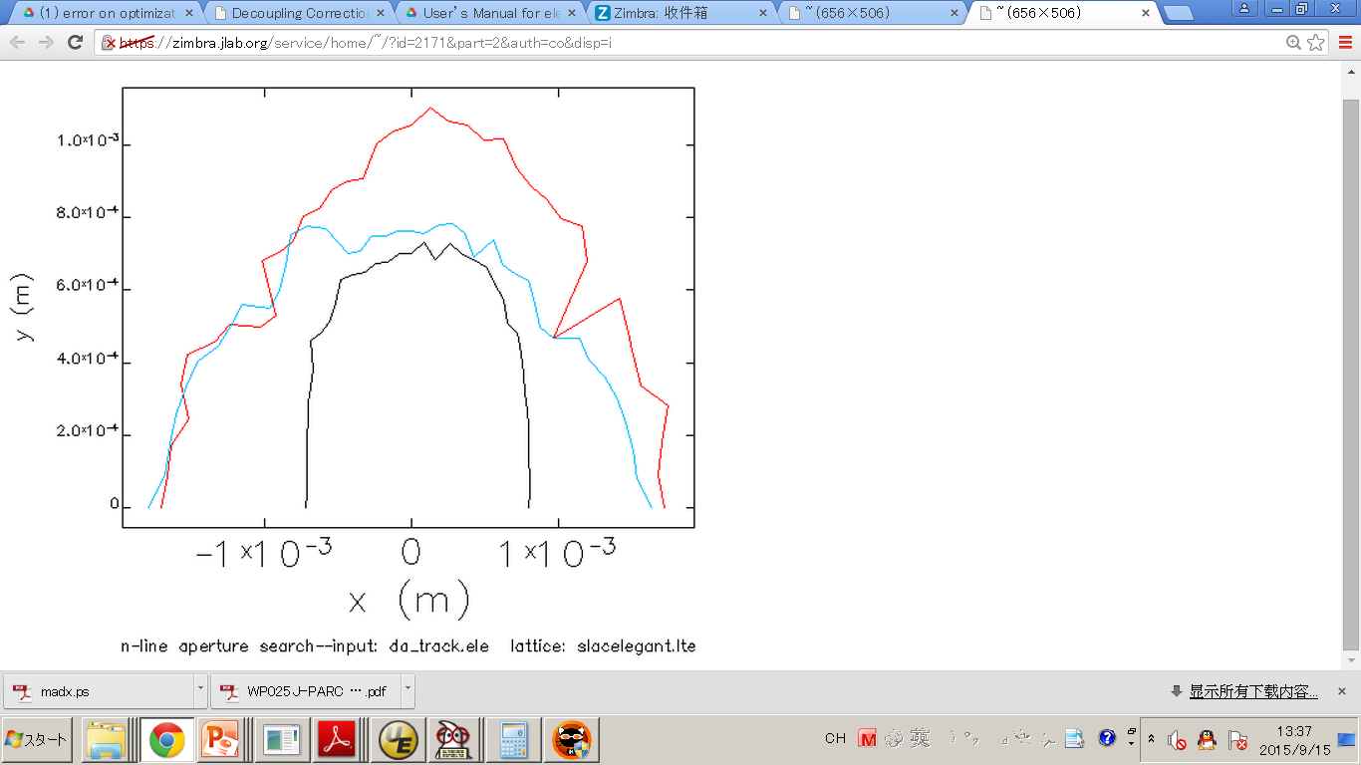
Lattice of -I Scheme for Error Study
From Yuri Nosochkov & Ming-Huey Wang
Δp/p=0
Δp/p= 0.3%
Δp/p=-0.3%

Slide 6
Misalignment, strength error &correction
  Suggested by Uli Wienends: 3 times larger
 | Dipole | Quadrupole | Sextupole | BPM(noise) | Corrector
x misalignment(mm) | 0.3 | 0.3, FFQ0.03 | 0.3 | 0.02 | -
y misalignment(mm) | 0.3 | 0.3, FFQ0.03 | 0.3 | 0.02 | -
x-y rotation(mrad) | 0.3 | 0.3, FFQ0.05 | 0.3 | - | 0.3
s misalignment(mm) | 0.3 | 0.3, FFQ0.03 | 0.3 | - | -
Strength error(%) | 0.1 | 0.2, FFQ0.03 | 0.2 | - | 0.01

Slide 7
Misalignment, strength error &correction
  Closed orbit correction
  Beta-beat correction
  Tune correction
  Chromaticity correction
  Decoupling

Slide 8
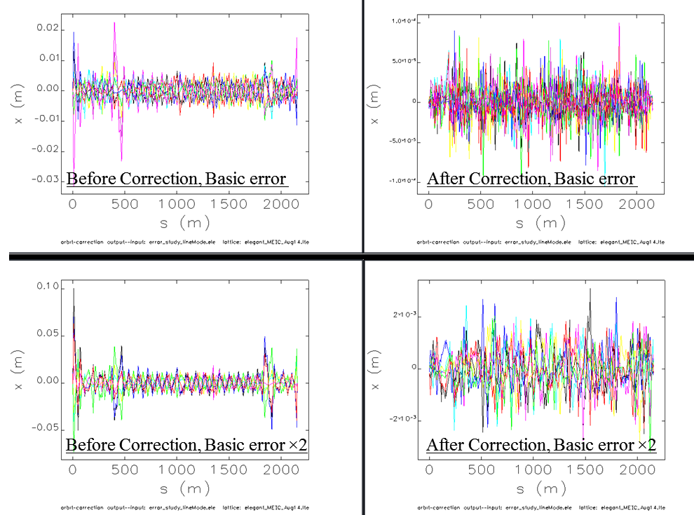
Closed Orbit Distortion and correction
+10⁻⁴
-10⁻⁴
+2 mm
-2 mm

Slide 9
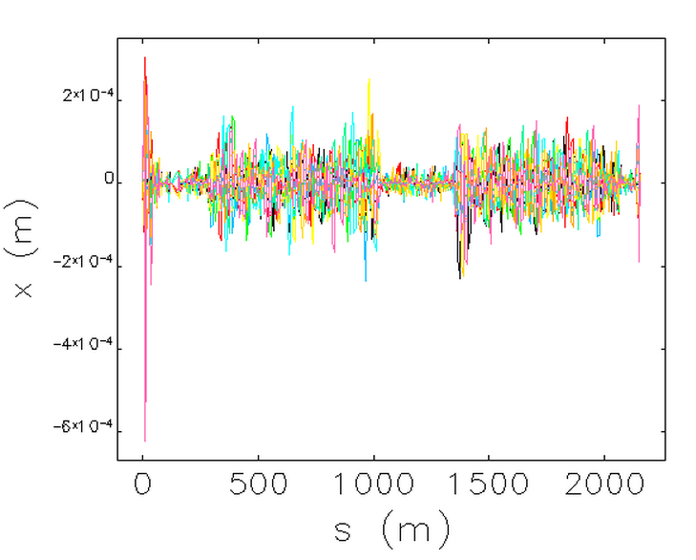
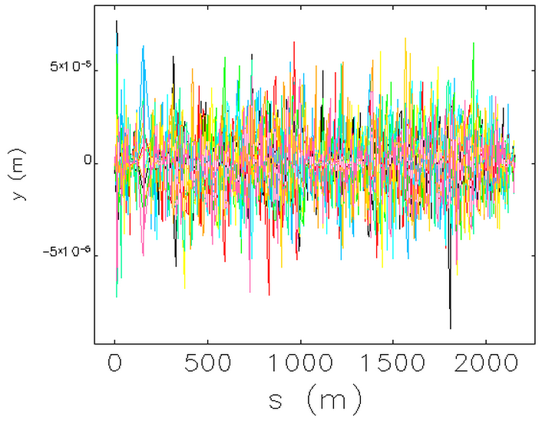
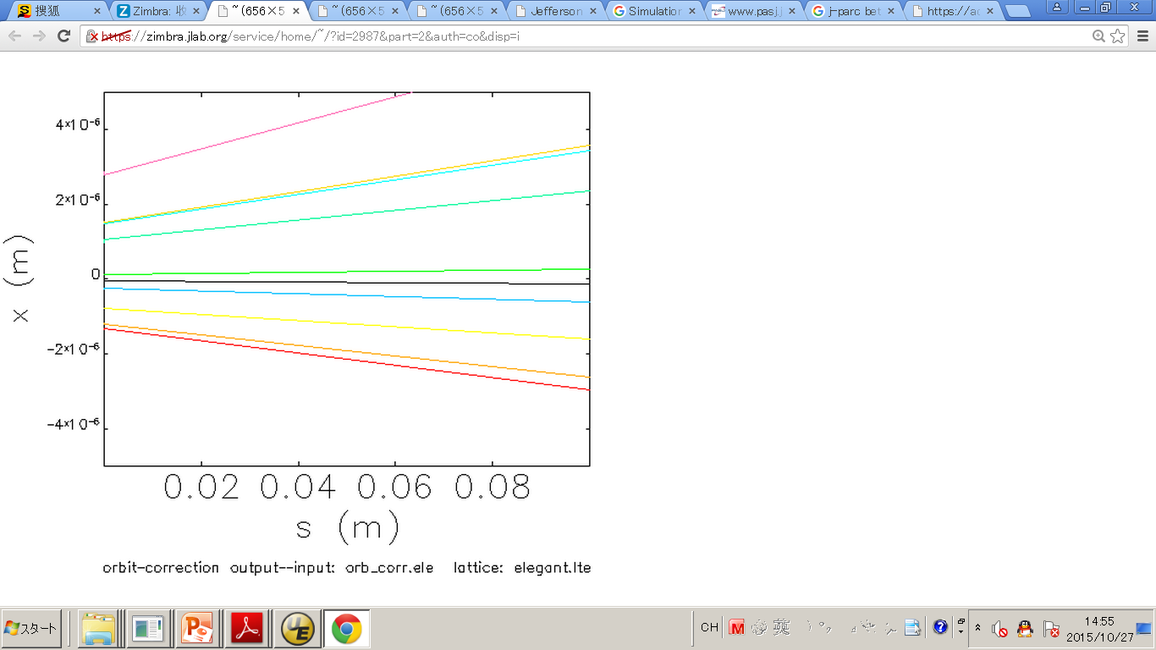
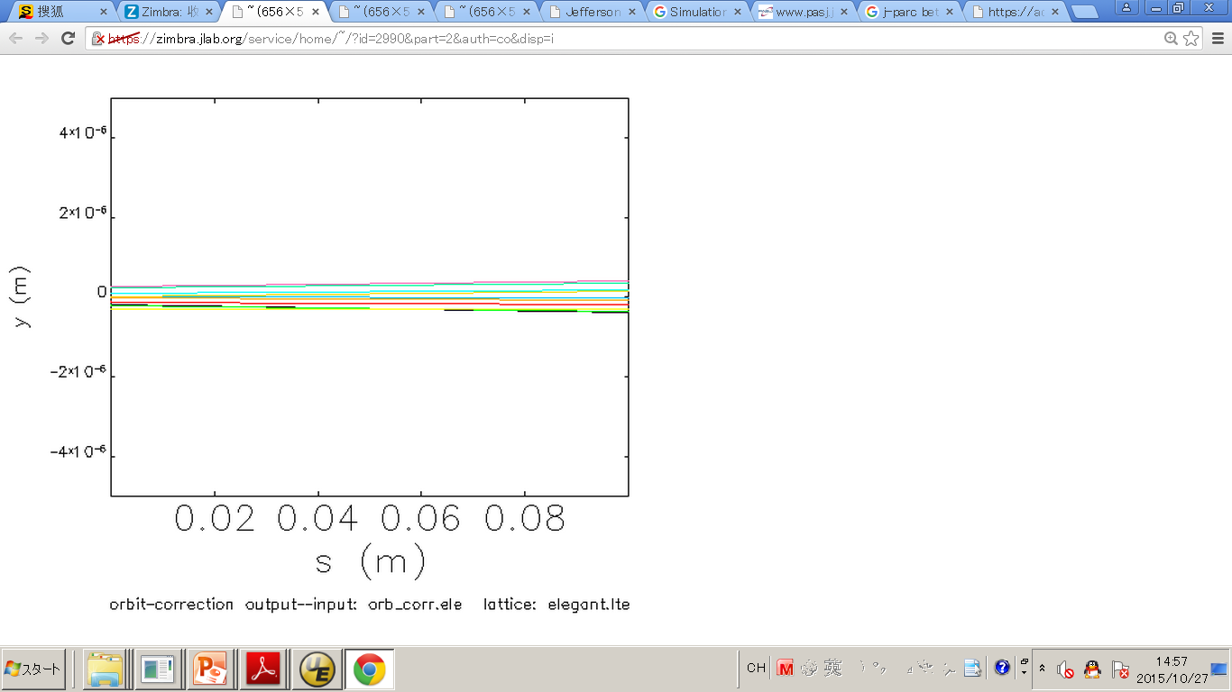
Closed Orbit Distortion and correction
+10⁻⁴
-10⁻⁴
5*10⁻⁶
5*10⁻⁶

Slide 10
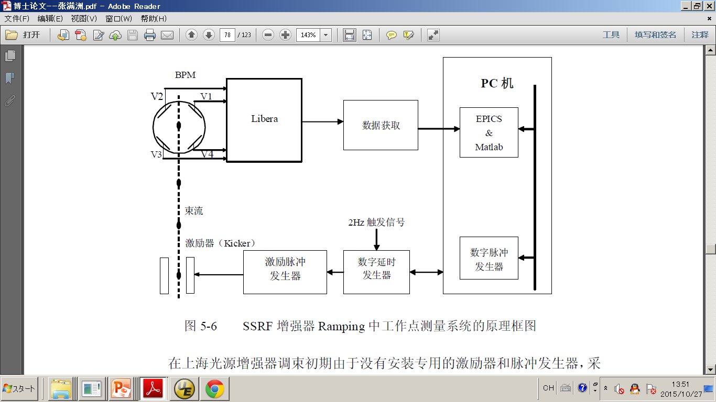
Tune correction
Tune correction (Tune measurement error < 0.001)
  Tune error : < 0.1 %
PC
data
Beam
Kicker
Time
Gene-rator
Pulse Mode
Pulse

Slide 11
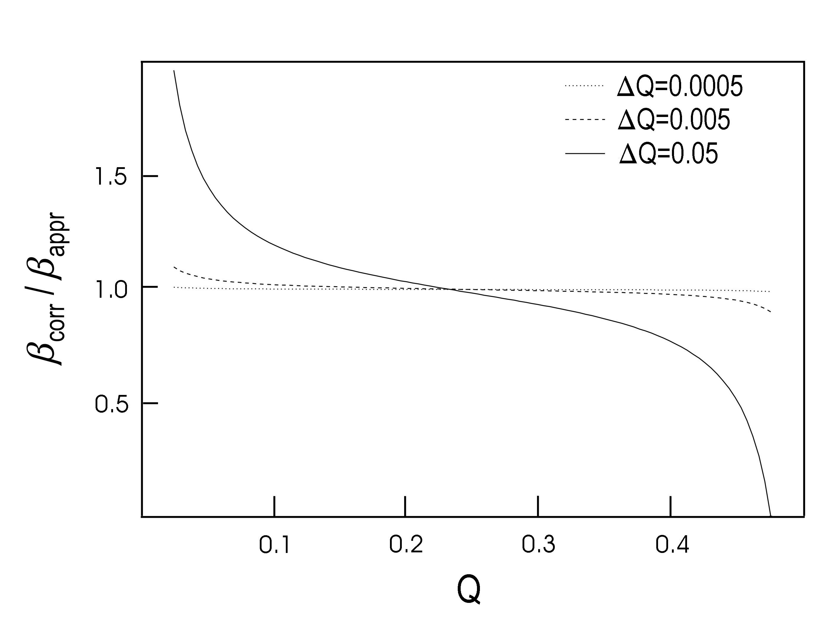
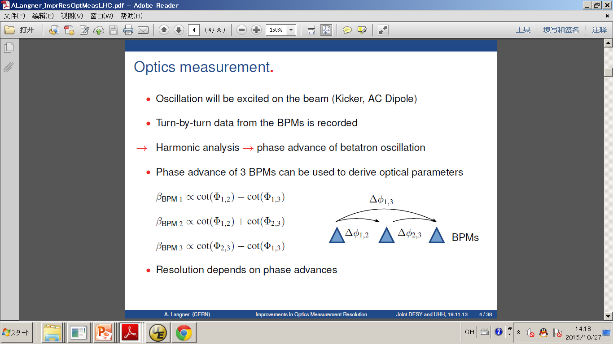
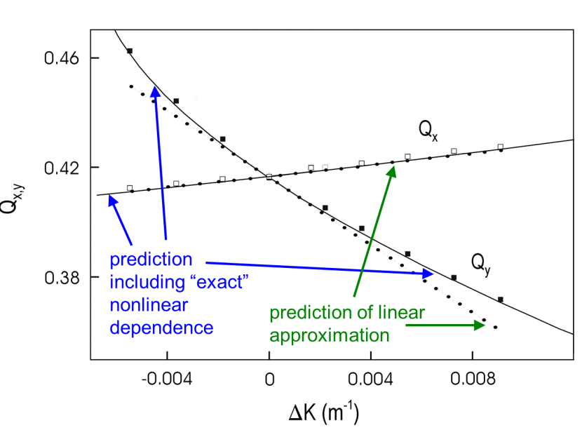
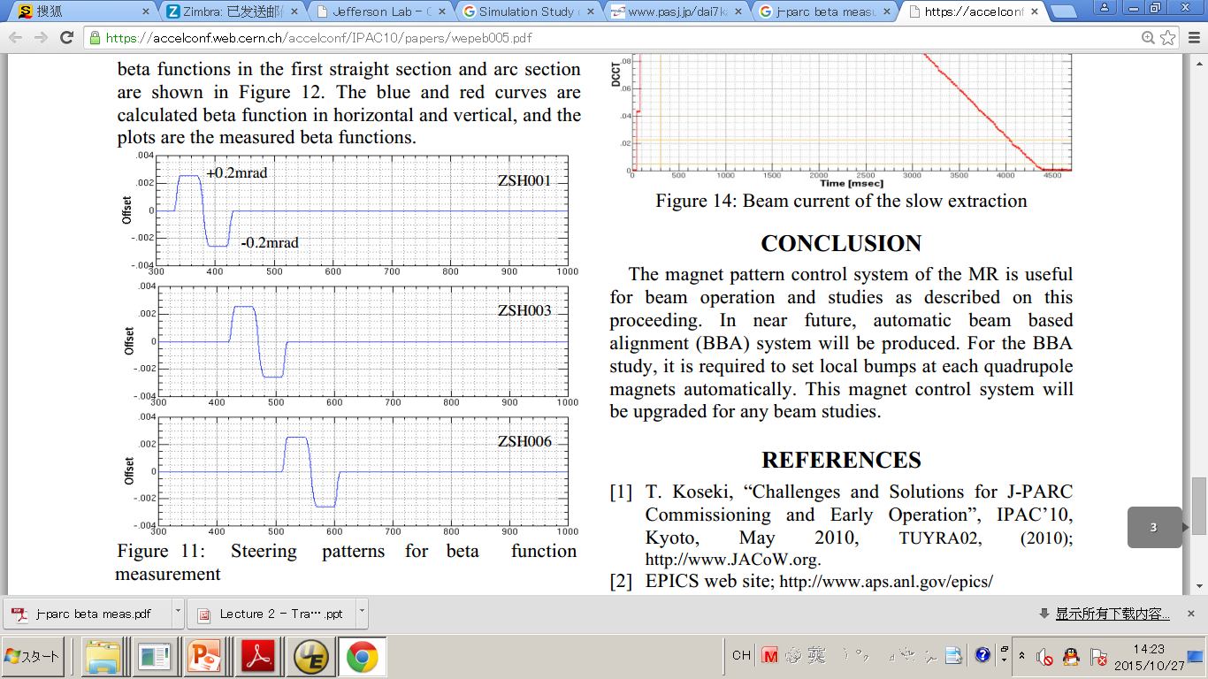
Beta-beat correction
Beta-beat correction: beta measurement
Fermilab Recycler Ring, Mar.2000
LHC: 2008; J-PARC: 2008

Slide 12
Beta-beat correction
Beta-beat correction: beta measurement
  Beta error at IP & Beta > 500 : < 1 %
  Beta error at Beta < 500 : < 5 %

Slide 13
Beta-beat correction
Beta-beat correction:
  Matrix corrction (-I or SVD method)
  This moment, I just use simple matching.

Slide 14
Chromaticity correction
  Linear Chromaticity (+1, +1)
  W function at IP = (0, 0)

Slide 15
Decoupling
We can calculate the off-diagonal terms of
The optimum positions for four coupling correctors are at
.

Slide 16
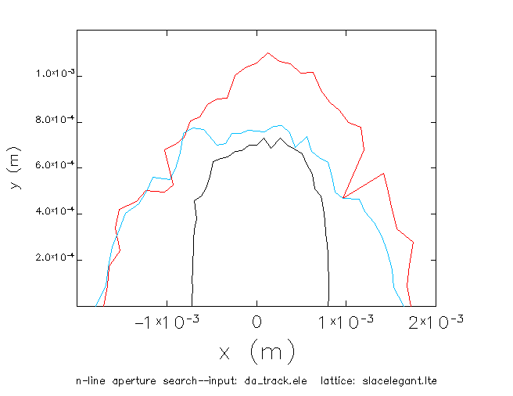
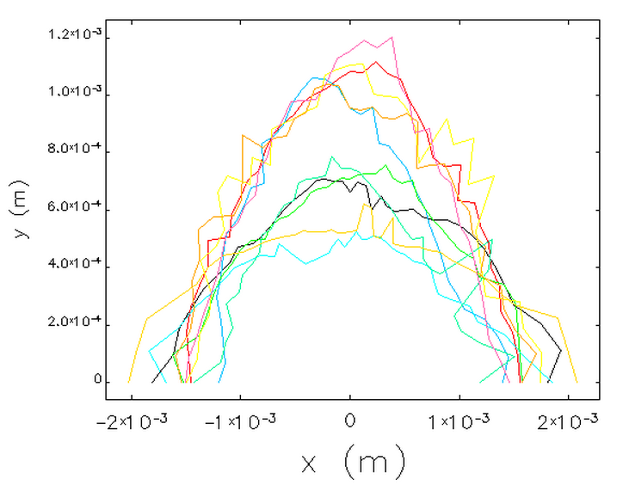
Dynamic Aperture after Correction
Without error
After Correction
Δp/p=0
Δp/p= 0.3%
Δp/p=-0.3%
All seeds: Δp/p=0

Slide 17
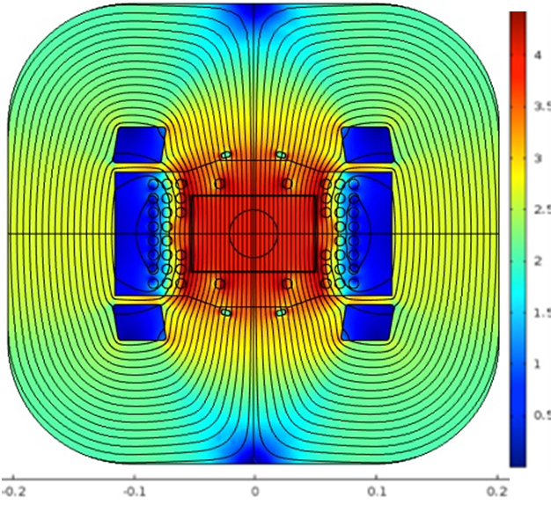
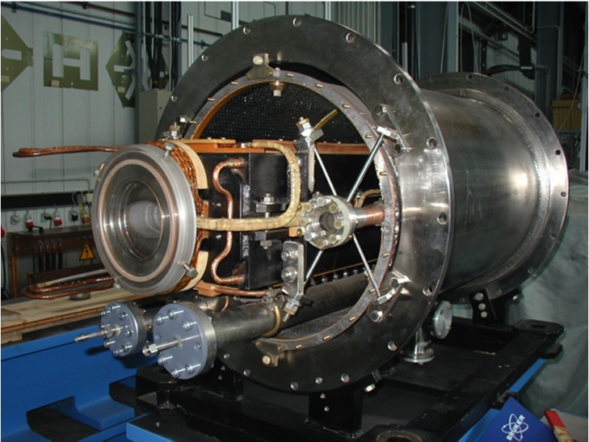
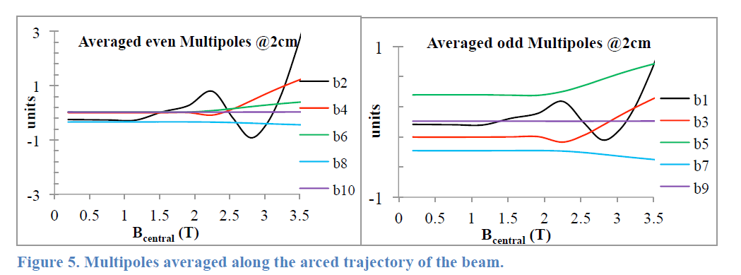
Multipoles of Super-Ferric dipole

Slide 18
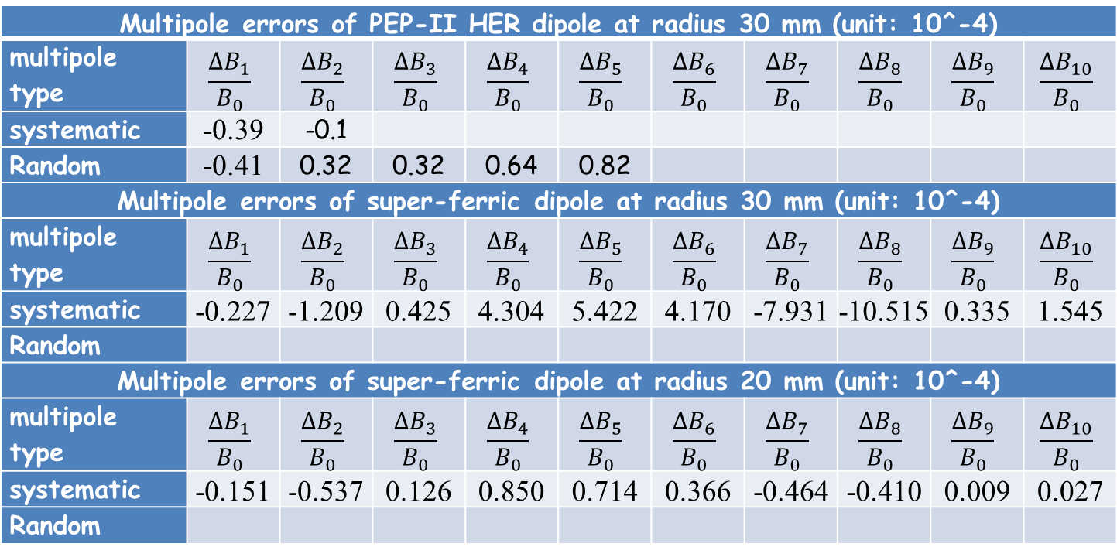
Multipoles of Super-Ferric dipole
ΔBn is the field due to order of n
B0 is the main dipole field
Multipole errors of PEP-II HER dipole at radius 30 mm (unit: 10^-4)
multipole type | $$\frac{∆B_{1}}{B_{0}}$$ | $$\frac{∆B_{2}}{B_{0}}$$ | $$\frac{∆B_{3}}{B_{0}}$$ | $$\frac{∆B_{4}}{B_{0}}$$ | $$\frac{∆B_{5}}{B_{0}}$$ | $$\frac{∆B_{6}}{B_{0}}$$ | $$\frac{∆B_{7}}{B_{0}}$$ | $$\frac{∆B_{8}}{B_{0}}$$ | $$\frac{∆B_{9}}{B_{0}}$$ | $$\frac{∆B_{10}}{B_{0}}$$
systematic | -0.39 | -0.1
Random | -0.41 | 0.32 | 0.32 | 0.64 | 0.82
Multipole errors of super-ferric dipole at radius 30 mm (unit: 10^-4)
multipole type | $$\frac{∆B_{1}}{B_{0}}$$ | $$\frac{∆B_{2}}{B_{0}}$$ | $$\frac{∆B_{3}}{B_{0}}$$ | $$\frac{∆B_{4}}{B_{0}}$$ | $$\frac{∆B_{5}}{B_{0}}$$ | $$\frac{∆B_{6}}{B_{0}}$$ | $$\frac{∆B_{7}}{B_{0}}$$ | $$\frac{∆B_{8}}{B_{0}}$$ | $$\frac{∆B_{9}}{B_{0}}$$ | $$\frac{∆B_{10}}{B_{0}}$$
systematic | -0.227 | -1.209 | 0.425 | 4.304 | 5.422 | 4.170 | -7.931 | -10.515 | 0.335 | 1.545
Random
Multipole errors of super-ferric dipole at radius 20 mm (unit: 10^-4)
multipole type | $$\frac{∆B_{1}}{B_{0}}$$ | $$\frac{∆B_{2}}{B_{0}}$$ | $$\frac{∆B_{3}}{B_{0}}$$ | $$\frac{∆B_{4}}{B_{0}}$$ | $$\frac{∆B_{5}}{B_{0}}$$ | $$\frac{∆B_{6}}{B_{0}}$$ | $$\frac{∆B_{7}}{B_{0}}$$ | $$\frac{∆B_{8}}{B_{0}}$$ | $$\frac{∆B_{9}}{B_{0}}$$ | $$\frac{∆B_{10}}{B_{0}}$$
systematic | -0.151 | -0.537 | 0.126 | 0.850 | 0.714 | 0.366 | -0.464 | -0.410 | 0.009 | 0.027
Random

Slide 19
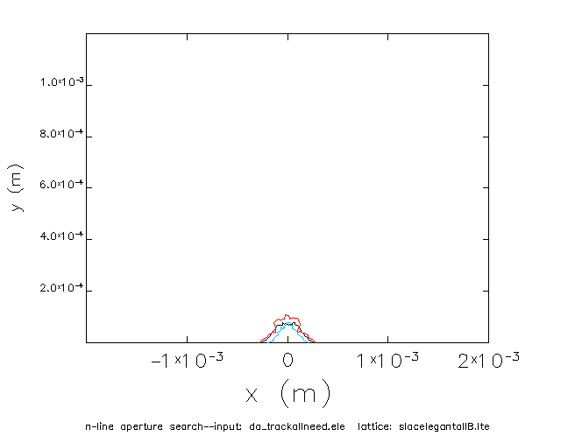
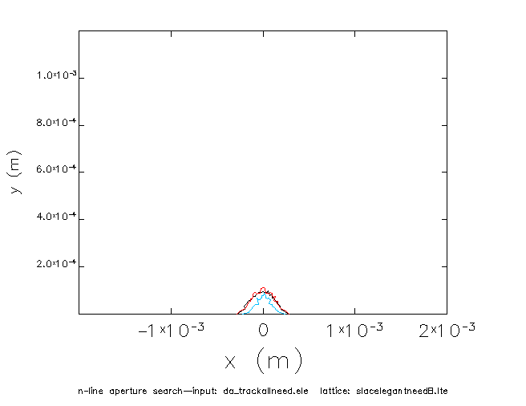
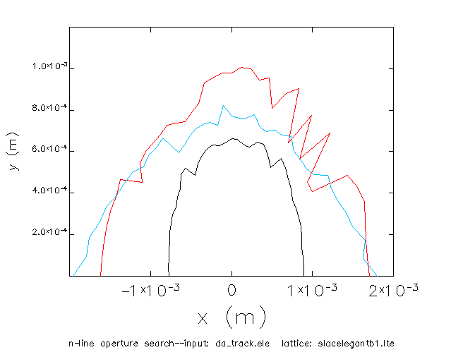
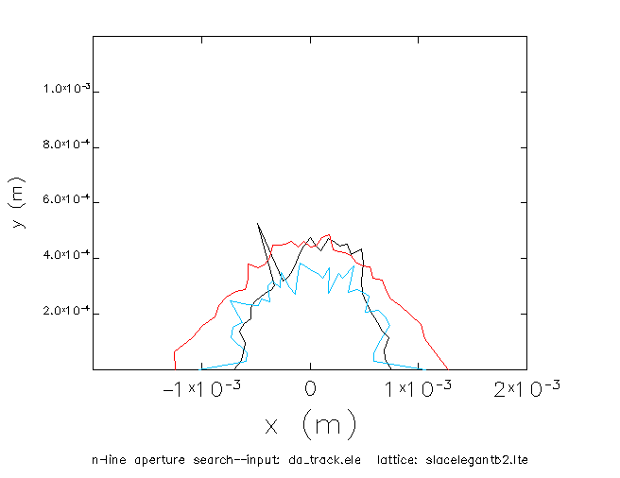
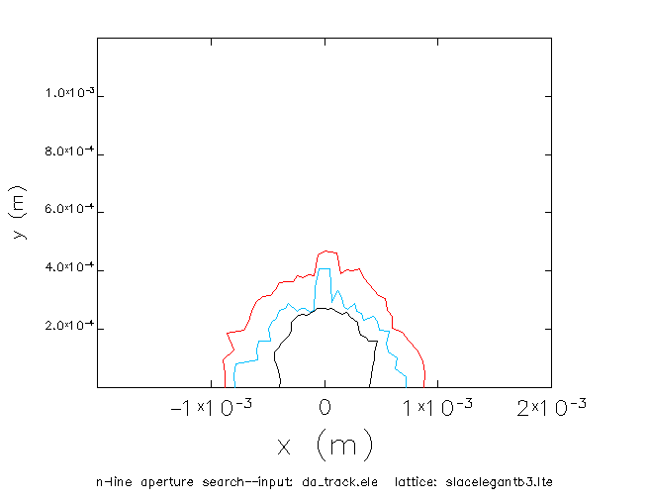
Multipoles of Super-Ferric dipole 100 GeV
Without error
Multipole all
Multipole 3-8
Δp/p=0
Δp/p= 0.3%
Δp/p=-0.3%
Multipole 1
Multipole 2
Multipole 3

Slide 20
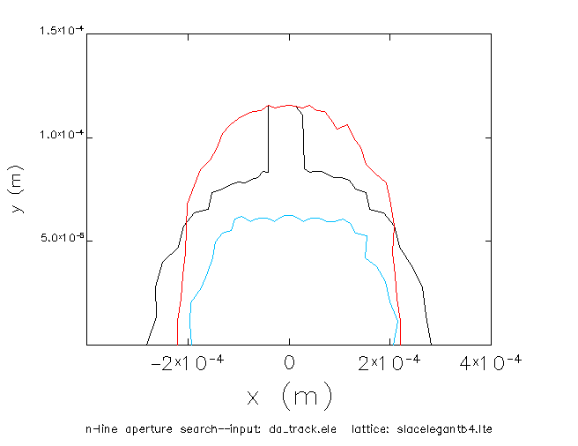
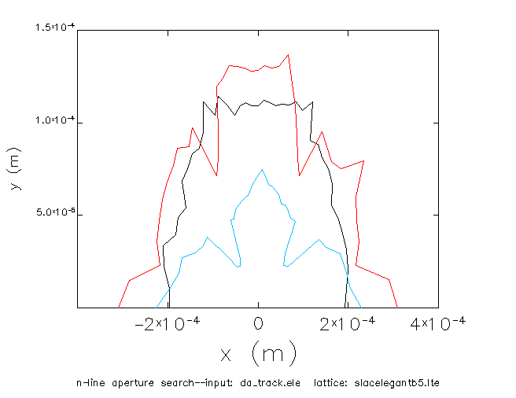
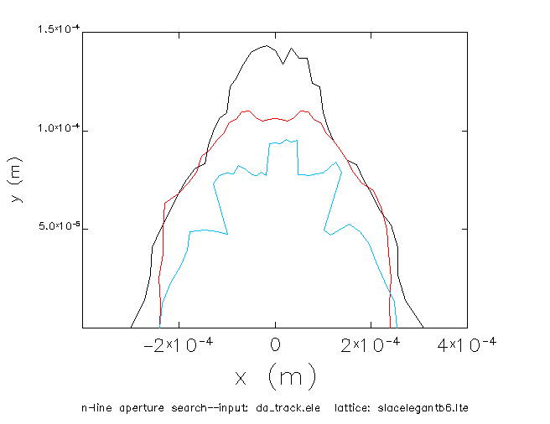
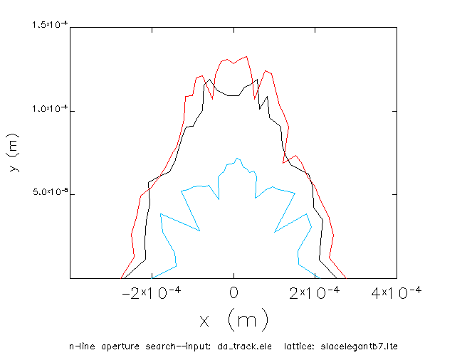
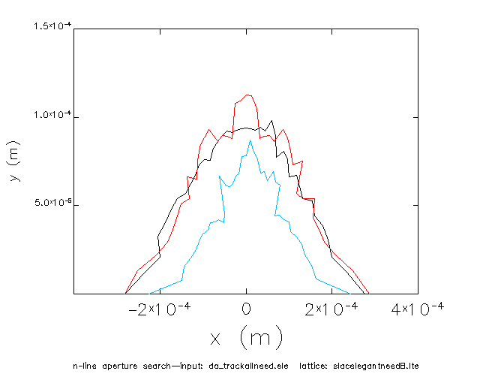
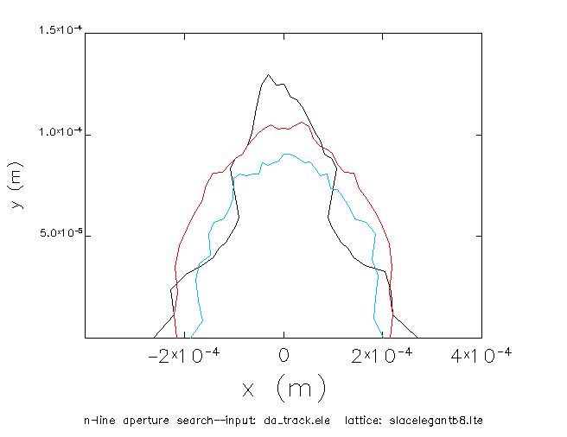
Multipoles of Super-Ferric dipole 100 GeV
Multipole 4
Multipole 5
Multipole 6
10 sigma H & V (1.8, 0.36) e-4
Multipole 7
Multipole 3-8
Multipole 8

Slide 21


Multipoles of Super-Ferric dipole 60 GeV
Without error
Multipole all
Multipole 3-8
Δp/p=0
Δp/p= 0.3%
Δp/p=-0.3%
Multipole 1
Multipole 2
Multipole 3

Slide 22
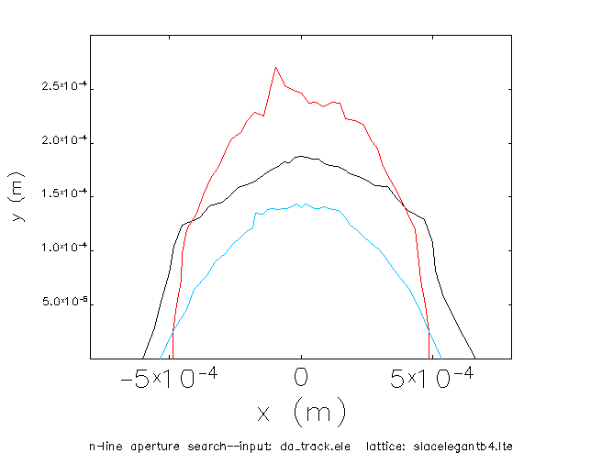
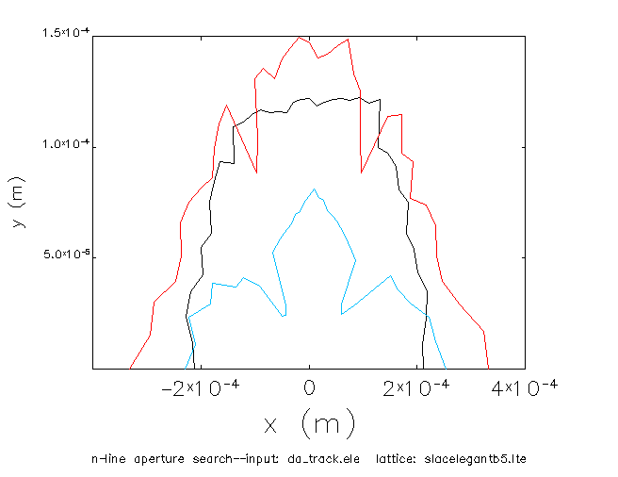
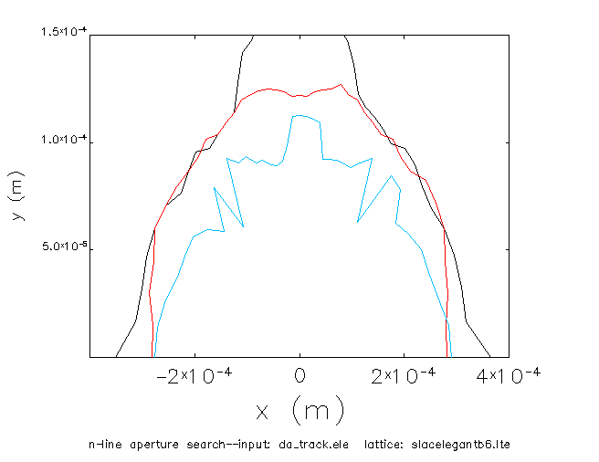
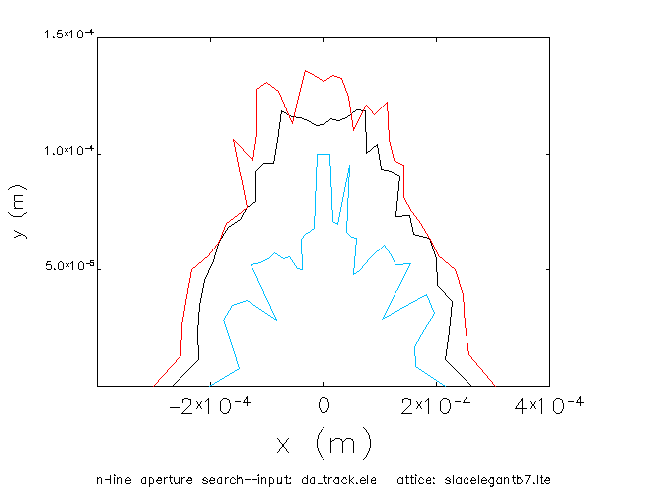
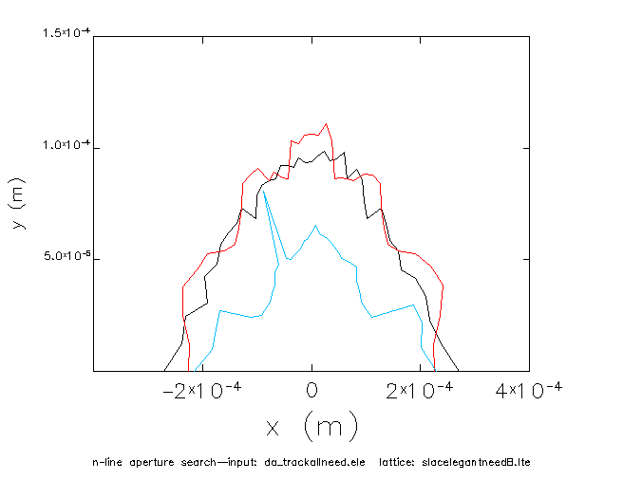
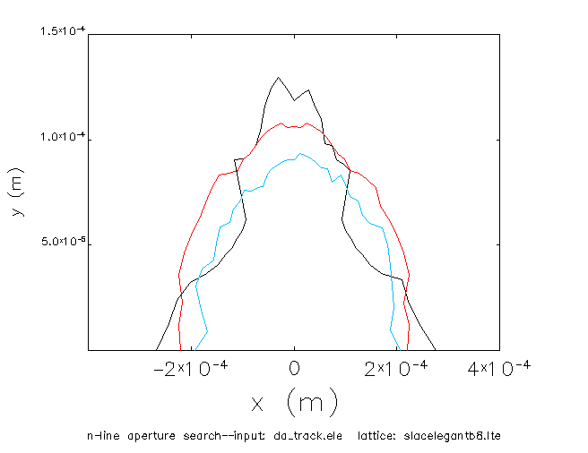
Multipoles of Super-Ferric dipole 60 GeV
Multipole 4
Multipole 5
Multipole 6
10 sigma H & V (2.3, 0.46) e-4
Multipole 7
Multipole 3-8
Multipole 8

Slide 23
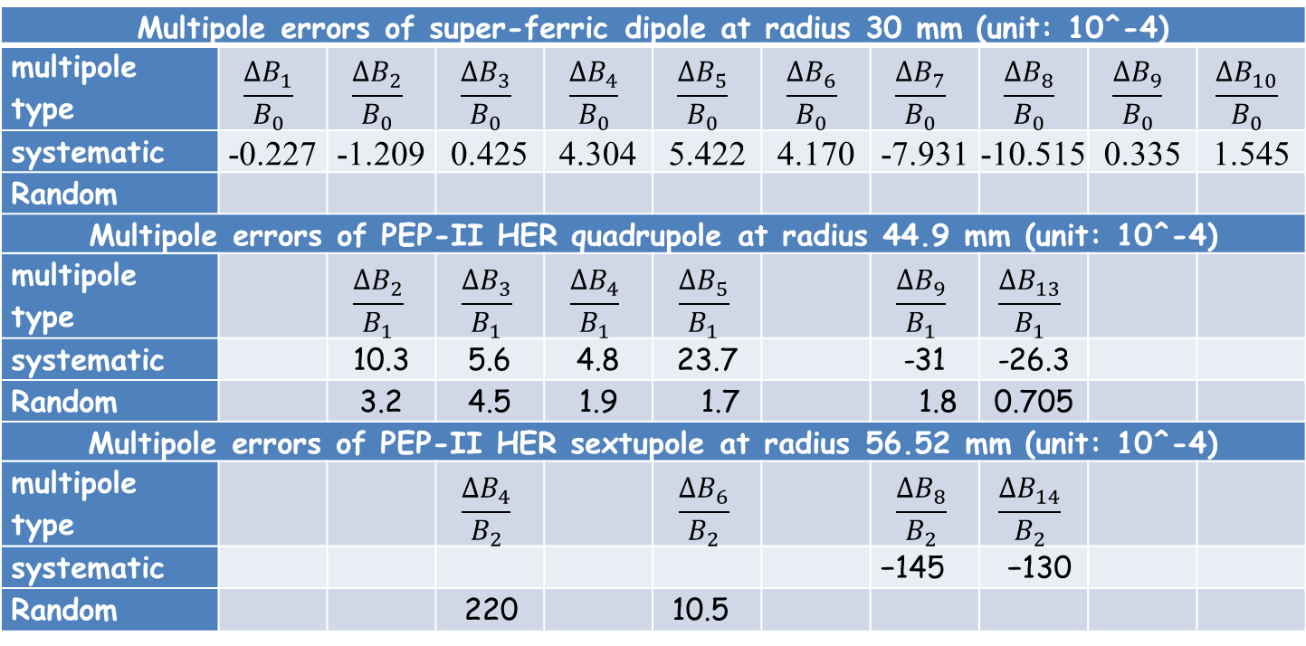
Multipoles of Super-Ferric dipole
ΔBn is the field due to order of n
Bn is the main field
Multipole errors of super-ferric dipole at radius 30 mm (unit: 10^-4)
multipole type | $$\frac{∆B_{1}}{B_{0}}$$ | $$\frac{∆B_{2}}{B_{0}}$$ | $$\frac{∆B_{3}}{B_{0}}$$ | $$\frac{∆B_{4}}{B_{0}}$$ | $$\frac{∆B_{5}}{B_{0}}$$ | $$\frac{∆B_{6}}{B_{0}}$$ | $$\frac{∆B_{7}}{B_{0}}$$ | $$\frac{∆B_{8}}{B_{0}}$$ | $$\frac{∆B_{9}}{B_{0}}$$ | $$\frac{∆B_{10}}{B_{0}}$$
systematic | -0.227 | -1.209 | 0.425 | 4.304 | 5.422 | 4.170 | -7.931 | -10.515 | 0.335 | 1.545
Random
Multipole errors of PEP-II HER quadrupole at radius 44.9 mm (unit: 10^-4)
multipole type |  | $$\frac{∆B_{2}}{B_{1}}$$ | $$\frac{∆B_{3}}{B_{1}}$$ | $$\frac{∆B_{4}}{B_{1}}$$ | $$\frac{∆B_{5}}{B_{1}}$$ |  | $$\frac{∆B_{9}}{B_{1}}$$ | $$\frac{∆B_{13}}{B_{1}}$$
systematic |  | 10.3 | 5.6 | 4.8 | 23.7 |  | -31 | -26.3
Random |  | 3.2 | 4.5 | 1.9 | 1.7 |  | 1.8 | 0.705
Multipole errors of PEP-II HER sextupole at radius 56.52 mm (unit: 10^-4)
multipole type |  |  | $$\frac{∆B_{4}}{B_{2}}$$ |  | $$\frac{∆B_{6}}{B_{2}}$$ |  | $$\frac{∆B_{8}}{B_{2}}$$ | $$\frac{∆B_{14}}{B_{2}}$$
systematic |  |  |  |  |  |  | −145 | −130
Random |  |  | 220 |  | 10.5

Slide 24
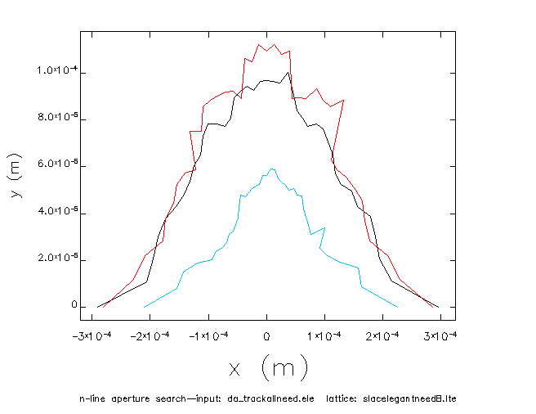
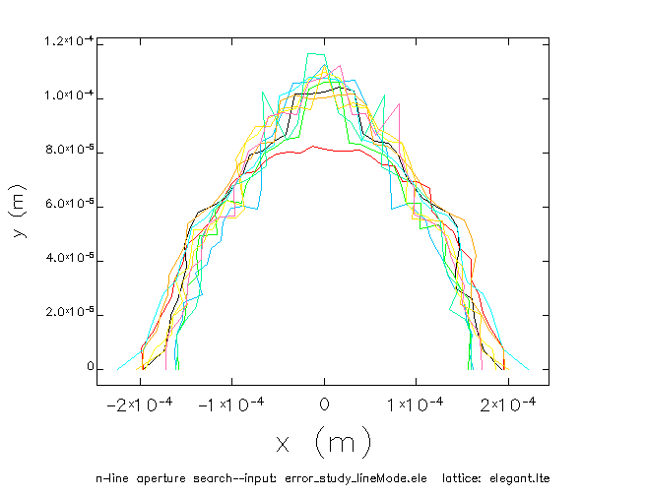
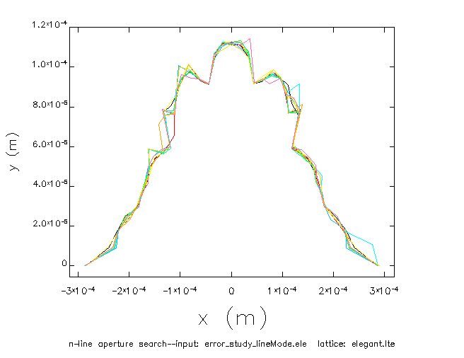
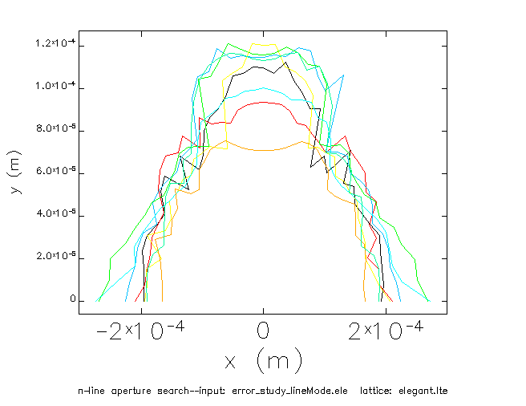
multipoles of Super-Ferric dipole
SC + dp/p
SC + FFQ + Q
FFQ + Q
SC + FFQ

Slide 25
Summary
Magnets with larger misalignment suggested by Uli Wienands has been studied.
Multipole error would be the main reason to cause dynamic aperture shrinking
With multipole data of super-ferric dipole supported by Akhdiyor I Sattarov, James Gerity and Peter McIntyre, 10 sigma H & V can be attained for the final dynamic aperture of 100 GeV and 60 GeV proton
By using multipole error of PEP-II HER quadrupole as multipole error of FFQ, Larger shrinking will occurred for the dynamic aperture

Slide 27
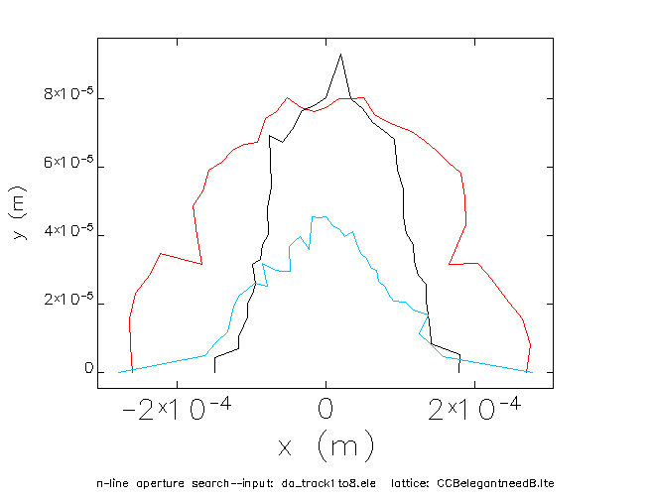
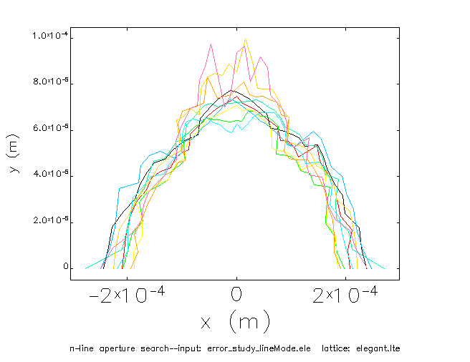
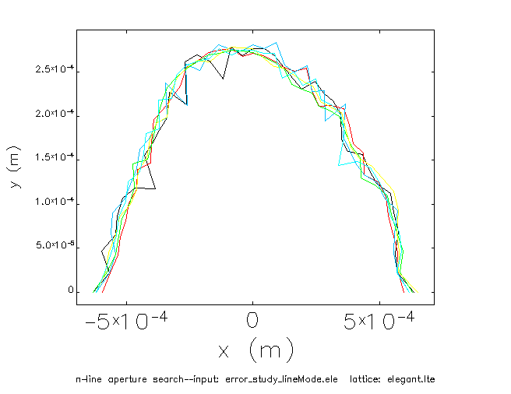
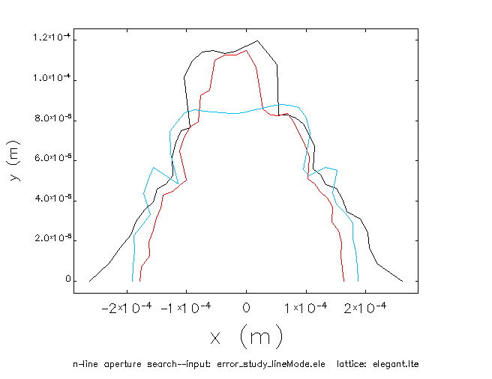
multipoles of Super-Ferric dipole
SC + dp/p
SC + FFQ + Q
FFQ + Q
SC + FFQ

Slide 28
Dynamic Aperture requirement in different energy
σx:10⁻⁶
σy:10⁻⁶

Slide 29
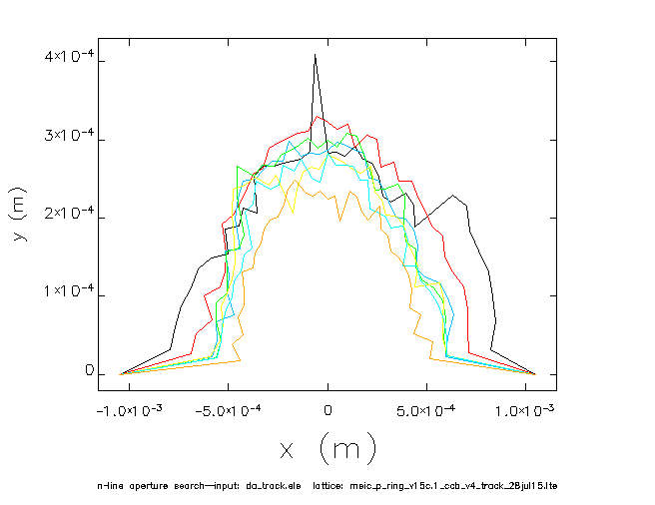
multipoles of Super-Ferric dipole
Δp/p=0
Δp/p= 0.3%
Δp/p=-0.3%
25.22,23.16

