Slide 1
Analytical estimations of longitudinal Space Charge in a magnetized cooler
Y. Derbenev
MEIC R&D meeting
JLab, 09.17. 2015

Slide 2
Outline
LSC energy spread after a DC gun
LSC after a compressor
LSC after ERL
LSC in cooling solenoid
LSC budget
Recommendations
Moderation

Slide 3

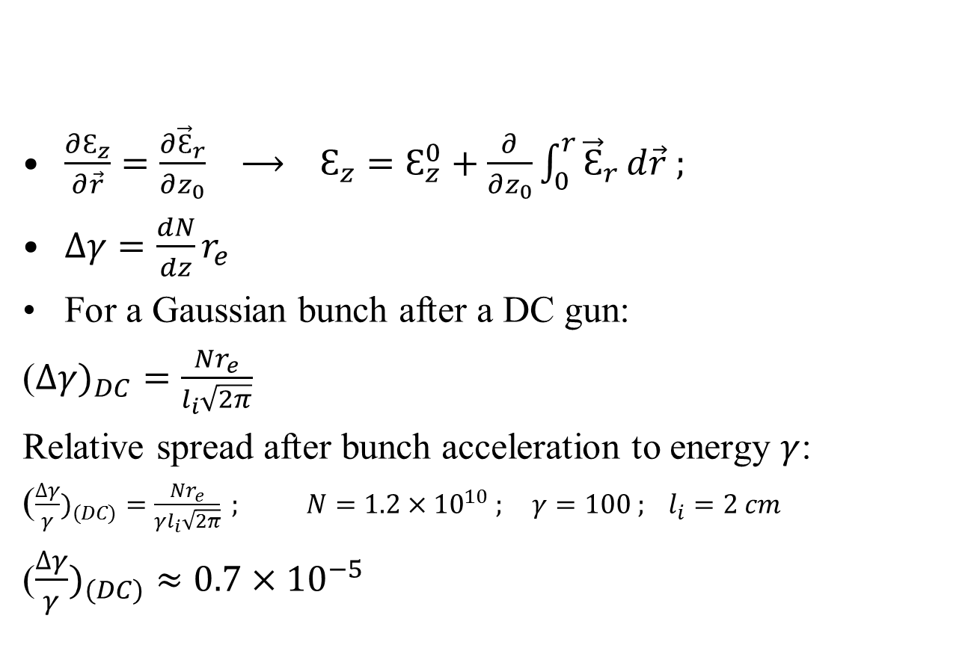
DC energy spread
$\frac{∂Ԑ_{z}}{∂\vec{r}}=\frac{∂{\vec{Ԑ}}_{r}}{∂z_{0}} ⟶ Ԑ_{z}=Ԑ_{z}^{0}+\frac{∂}{∂z_{0}}\int_{0}^{r}{{\vec{Ԑ}}_{r}}d\vec{r} ;$
$∆γ=\frac{dN}{dz}r_{e}$
For a Gaussian bunch after a DC gun:
($∆γ)_{DC}=\frac{{Nr}_{e}}{l_{i}\sqrt{2π}}$
Relative spread after bunch acceleration to energy $γ$:
($\frac{∆γ}{γ})_{(DC)}=\frac{{Nr}_{e}}{γl_{i}\sqrt{2π}} ; N=1.2×{10}^{10} ; γ=100 ; l_{i}=2 cm$
($\frac{∆γ}{γ})_{(DC)}≈0.7×{10}^{−5}$
$${Ԑ_{z}^{0}≡Ԑ}_{z}\left(r=0\right)$$

Slide 4
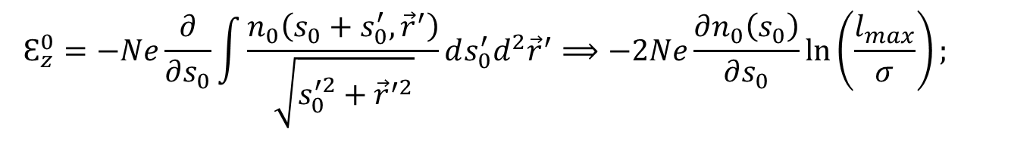
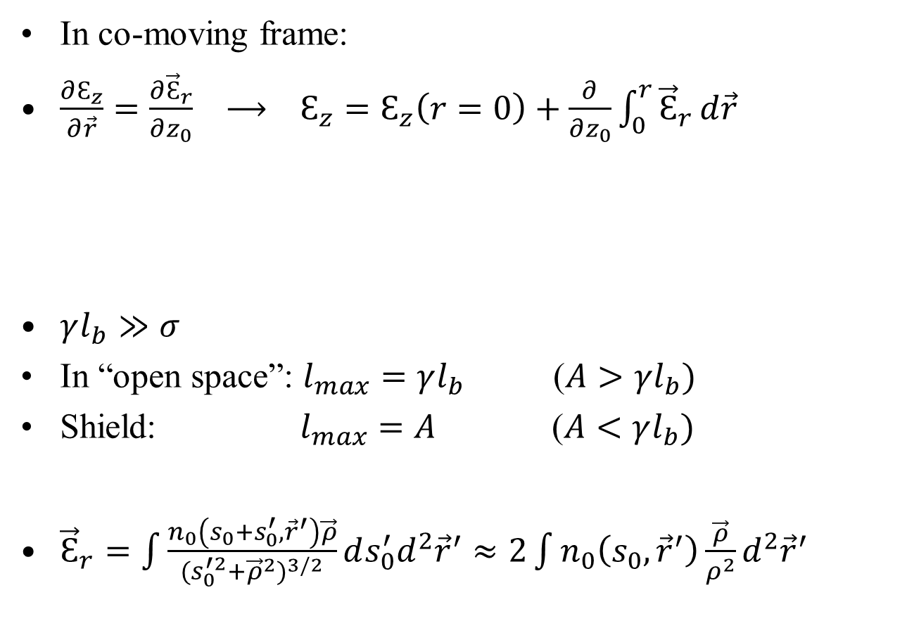
Bunch-induced spread genesis
In co-moving frame:
$\frac{∂Ԑ_{z}}{∂\vec{r}}=\frac{∂{\vec{Ԑ}}_{r}}{∂z_{0}} ⟶ Ԑ_{z}=Ԑ_{z}\left(r=0\right)+\frac{∂}{∂z_{0}}\int_{0}^{r}{{\vec{Ԑ}}_{r}}d\vec{r}$
$γl_{b}≫σ$
In “open space”: $l_{max}=γl_{b}$ ($A>γl_{b})$
Shield: $l_{max}=A$ ($A<γl_{b})$
${\vec{Ԑ}}_{r}=\int{\frac{n_{0}\left(s_{0}+s_{0}^{′}, {\vec{r}}^{′}\right)\vec{ρ}}{{(s}_{0}^{′2}+{\vec{ρ}}^{2})^{3/2}}}ds_{0}^{′}d^{2}{\vec{r}}^{′}≈2\int{n_{0}\left(s_{0},{\vec{r}}^{′}\right)\frac{\vec{ρ}}{ρ^{2}}}d^{2}{\vec{r}}^{′}$
$$Ԑ_{z}^{0}=−Ne\frac{∂}{∂s_{0}}\int{\frac{n_{0}\left(s_{0}+s_{0}^{′}, {\vec{r}}^{′}\right)}{\sqrt{s_{0}^{′2}+{\vec{r}}^{′2}}}}ds_{0}^{′}d^{2}{\vec{r}}^{′}⟹−2Ne\frac{∂n_{0}\left(s_{0}\right)}{∂s_{0}}ln\left(\frac{l_{max}}{σ}\right);$$

Slide 5
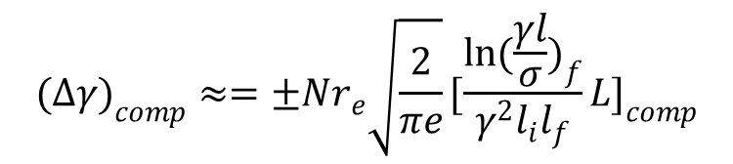

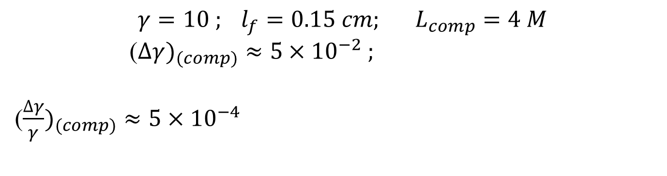
Compressor
$(∆γ)_{comp}≈±\frac{Nr_{e}}{γ^{2}}\sqrt{\frac{2}{πe}}\int{\frac{\ln\left(\frac{γl}{σ} \right)}{l^{2}}}dL=±\frac{Nr_{e}}{γ^{2}}\sqrt{\frac{2}{πe}}\int{\frac{\ln\left(\frac{γl}{σ} \right)}{l^{2}}}\frac{dl}{l^{′}}$
$$(∆γ)_{comp}≈=±Nr_{e}\sqrt{\frac{2}{πe}}[\frac{\ln{(\frac{γl}{σ}})_{f}}{γ^{2}l_{i}l_{f}}L]_{comp}$$
$$γ=10 ; l_{f}=0.15 cm; L_{comp}=4 M$$
($∆γ)_{(comp)}≈5×{10}^{−2} ;$
($\frac{∆γ}{γ})_{(comp)}≈5×{10}^{−4}$

Slide 6
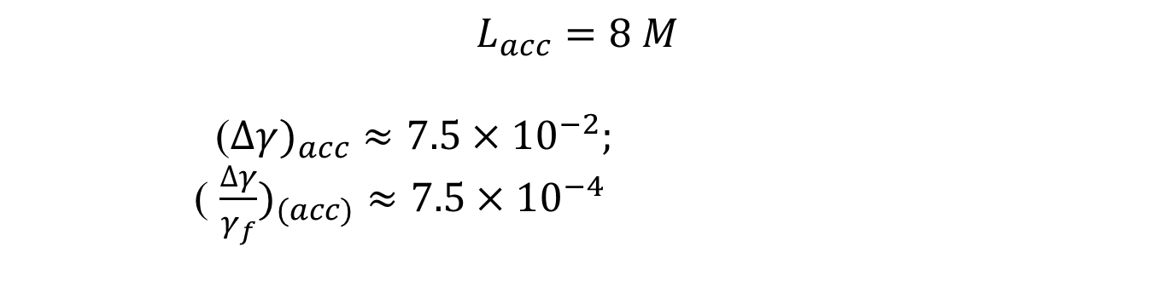

ERL
$\int{\frac{ln(\frac{γl}{σ} )}{(γl)^{2}}}dL=\frac{1}{l_{a}^{2}} \int{ln(\frac{γl}{σ})\frac{dL}{γ^{2}}}=\frac{1}{l_{a}^{2}} \frac{1}{γ^{′}} \int{ln(\frac{γl}{σ})\frac{dγ}{γ^{2}}}≈$
$$≈[\frac{L}{γ_{i}γ_{f}l^{2}}ln(\frac{γl}{σ} )_{i}]_{a}$$
$$({∆γ)}_{a}=±[\frac{Nr_{e}L_{a}}{γ_{i}γ_{f}l^{2}}\sqrt{\frac{2}{πe}}ln(\frac{γl}{σ} )_{i}]_{a} ;$$
$$L_{acc}=8 M$$
($∆γ)_{acc}≈7.5×{10}^{−2};$
( $\frac{∆γ}{γ_{f}})_{(acc)}≈7.5×{10}^{−4}$

Slide 7
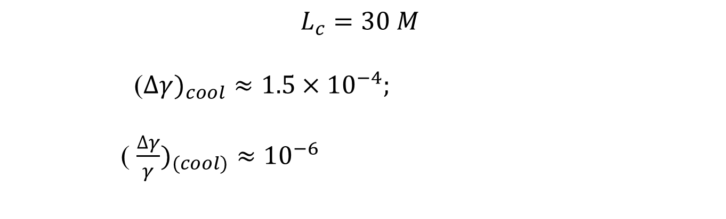

Cooling solenoid
$(∆γ)_{c}=±Nr_{e}L_{c}\sqrt{\frac{2}{πe}}[ \frac{ln(\frac{A}{σ} )}{(γl)^{2}} ]_{c}$
$$L_{c}=30 M$$
($∆γ)_{cool}≈1.5×{10}^{−4};$
( $\frac{∆γ}{γ})_{(cool)}≈{10}^{−6}$

Slide 8
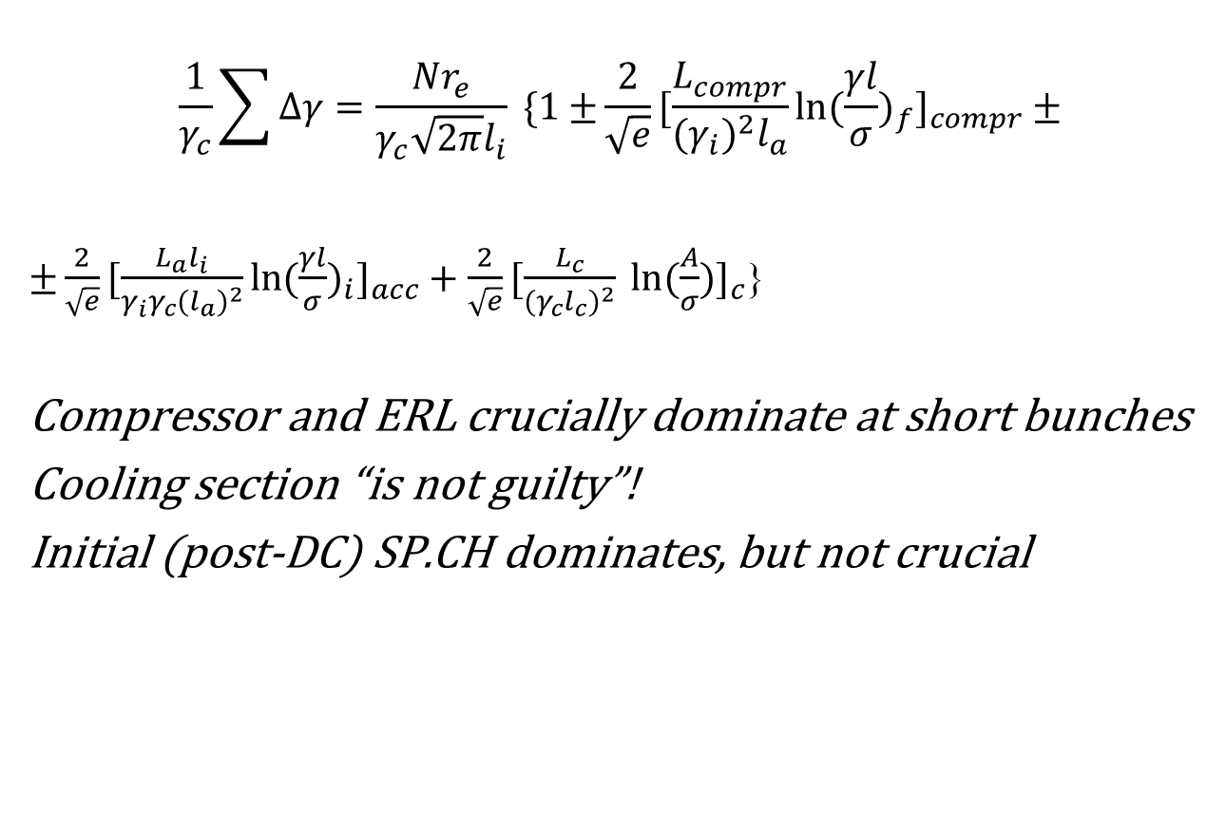
Budget
$$\frac{1}{γ_{c}}\sum{∆γ=\frac{Nr_{e}}{γ_{c}\sqrt{2π}l_{i}} \{1±}\frac{2}{\sqrt{e}}[\frac{L_{compr}}{(γ_{i})^{2}l_{a}}\ln{(\frac{γl}{σ}})_{f}]_{compr}±$$
$±\frac{2}{\sqrt{e}}[\frac{L_{a}l_{i}}{γ_{i}γ_{c}(l_{a})^{2}}ln(\frac{γl}{σ})_{i}]_{acc}+\frac{2}{\sqrt{e}}[\frac{L_{c}}{(γ_{c}l_{c})^{2}} ln⁡(\frac{A}{σ}{)]}_{c}$}
Compressor and ERL crucially dominate at short bunches
Cooling section “is not guilty”!
Initial (post-DC) SP.CH dominates, but not crucial

Slide 9
Moderation
Recommendations
Do not try to generate very short bunches!
Do not try to accelerate very short bunches!
Accelerate longer bunches (1-2 cm)
Bunch compressor might be (or may be not?) needed
Stretcher after ERL would not be needed
Possible “adjustment s“
Use lower frequency ERL
Insert harmonic compensator after ERL

