Slide 1

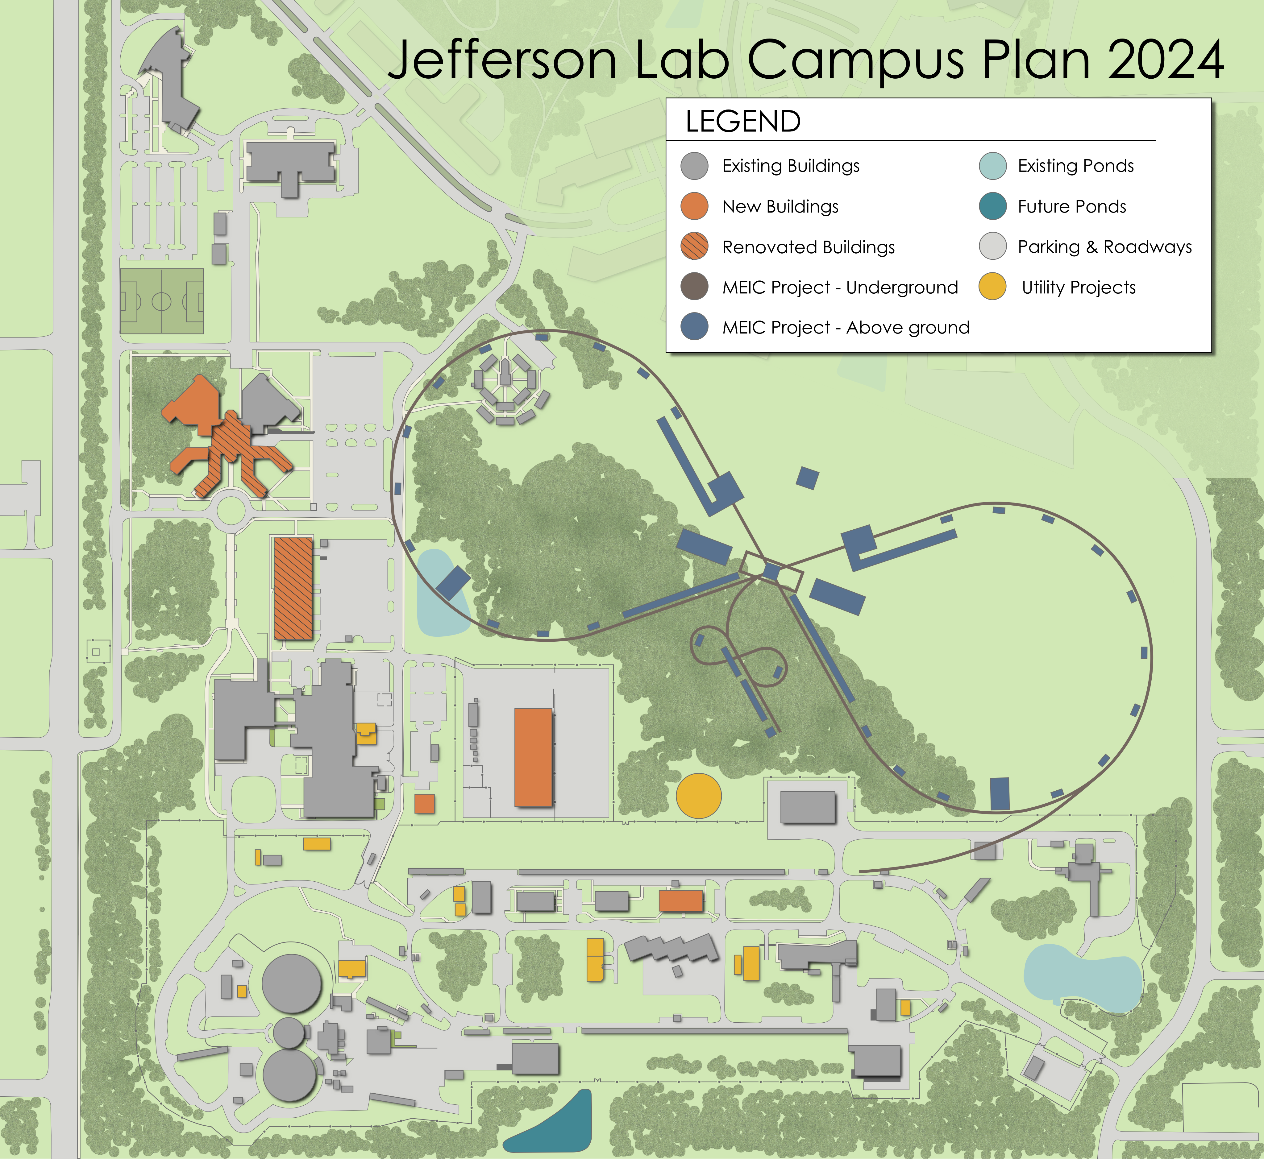
PEPII Magnet Feasibility in the MEIC Electron Collider Ring
T. Hiatt
T. Hiatt 8/20/2015

Slide 2
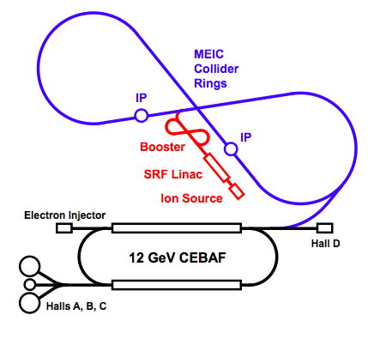
Introduction
Background
Available Quantities
Dipole Analysis
Quadrupole Analysis
Sextupole Analysis
Future Plans
Summary
Booster
Linac
Ion Source

Slide 3
Background
PEPII HER magnets are being considered for repurposing in the MEIC ECR
A deck was proposed (Dec 2014) that specifies quantities and strengths for several types of PEPII magnets
The MEG is endeavoring to understand the feasibility of using the repurposed PEPII magnets as prescribed in the deck
Cross checked magnet availability between the deck and PEP publications
Conducted several analysis to evaluate their usefulness
  Field Analysis
    Linear hand calculations of field strength (order of scale sanity checks)
    2d Tosca modeling (some 3d too but chamfering which reasonably matched, but 3d ends were not chamfered)
      Saturation effects
      Field strength
      Gauge field quality
  Cooling Analysis
    Pressure drop
    LCW velocity
    Temperature rise

Slide 4
Available Quantities
We need to know how many and what kinds of magnets are available to put in the ECR.
There are two sources for the information - ’93 PEPII CDR and the ‘07 SuperB documents
  The way the two documents refer to the magnets don’t match but the physical and magnetic characteristics do…mostly…
  ‘93 CDR named magnets by physical characteristic ie. “2.8C212”
  SuperB named magnets by function/location ie. “IR Soft Bends”
  Key to matching between the two documents was by physical and performance characteristics
Combed through the Deck magnet characteristics and grouped them by like types and field strengths
  Deck element names are associated with location and type ie. “BXARCL”
  Deck specified other (non-PEPII) magnets as “new”

Slide 5
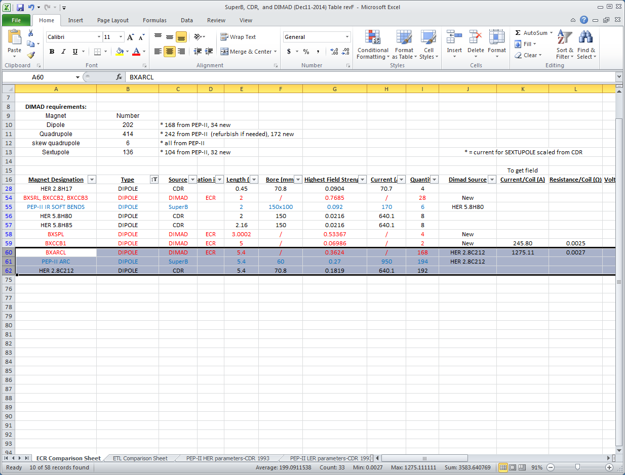
Available Quantities (cont.)

Slide 6
Available Quantities (cont.)
Magnet Name (‘93 CDR) | MEIC – ECR Quantity Required | 2007 SuperB CDR Available Quantity | 1993 PEPII CDR Available Quantity | ECR Field Strength Required (T, T/m or T/m²)
2.812C212 | 168 | 194 | 192 | 0.3624
4Q22 | 166 | 202 | 94 | 16.96
4Q29 | 88 | 81 | 82 | 17.53
10SF/10SD | 136 | 104 | 144 | 210
The two sources for quantities don’t reconcile
  ‘07 SuperB document doesn’t match ’93 PEPII CDR
  Uli says SuberB is likely correct
Will perform another count at SLAC to confirm available quantities
Any shortages can be handled during the procurement of the new magnets that will be required in the ECR

Slide 7
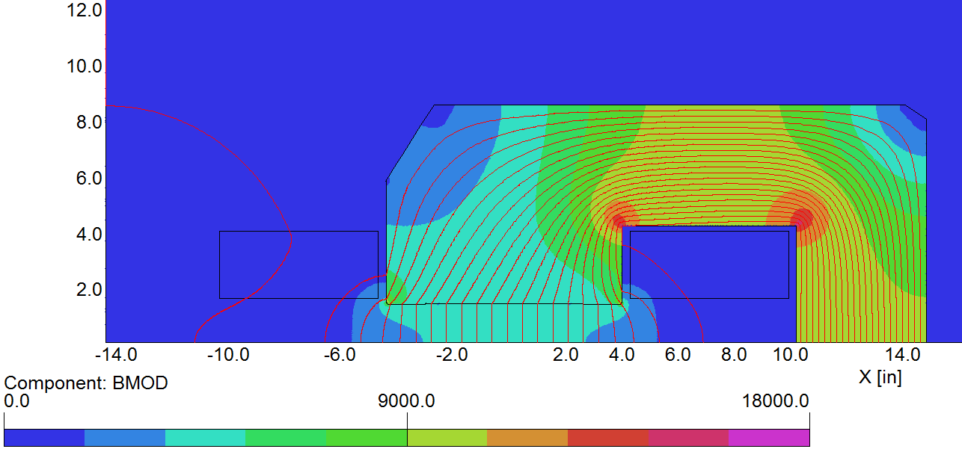
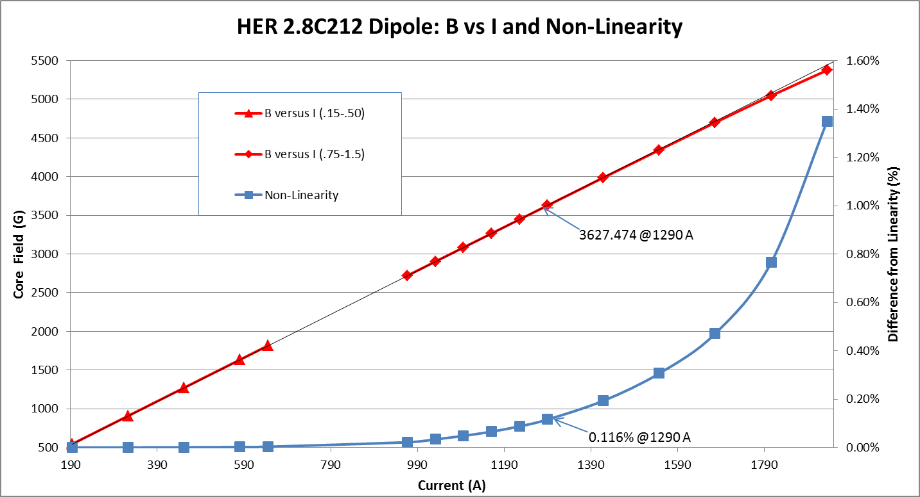
Dipole Analysis
0.36T Dipole (“2.8C212” – ‘93 CDR name)
  0.3627 T @ 1290 A
  <0.2% saturation
  ~19 °C dT per coil @ 100 psid

Slide 8
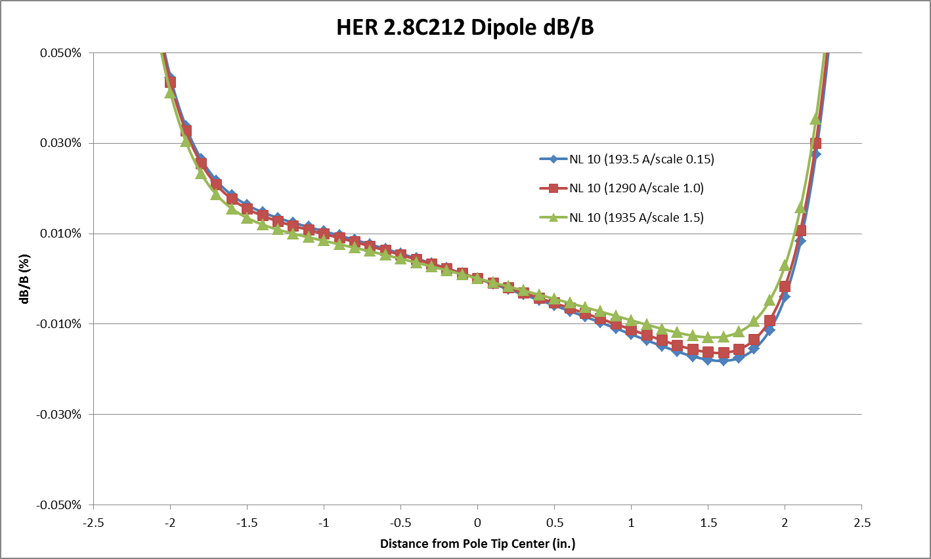
Dipole Analysis (cont.)
0.36T Dipole (“2.8C212”)
  Currents = 15%, 100% and 150% of nominal
  dB/B ~0.06% over +/- 2 in.

Slide 9
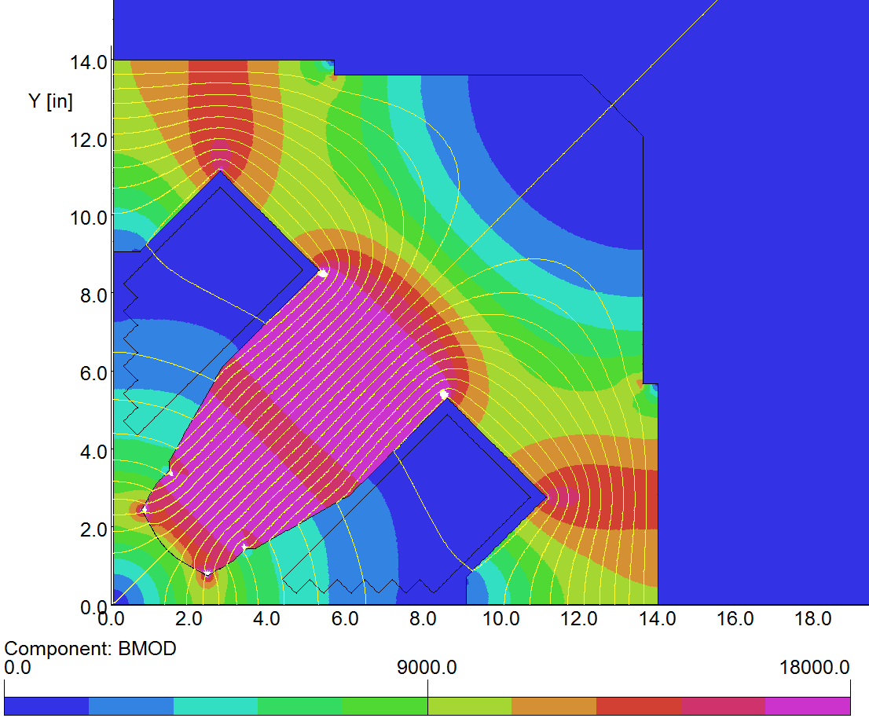
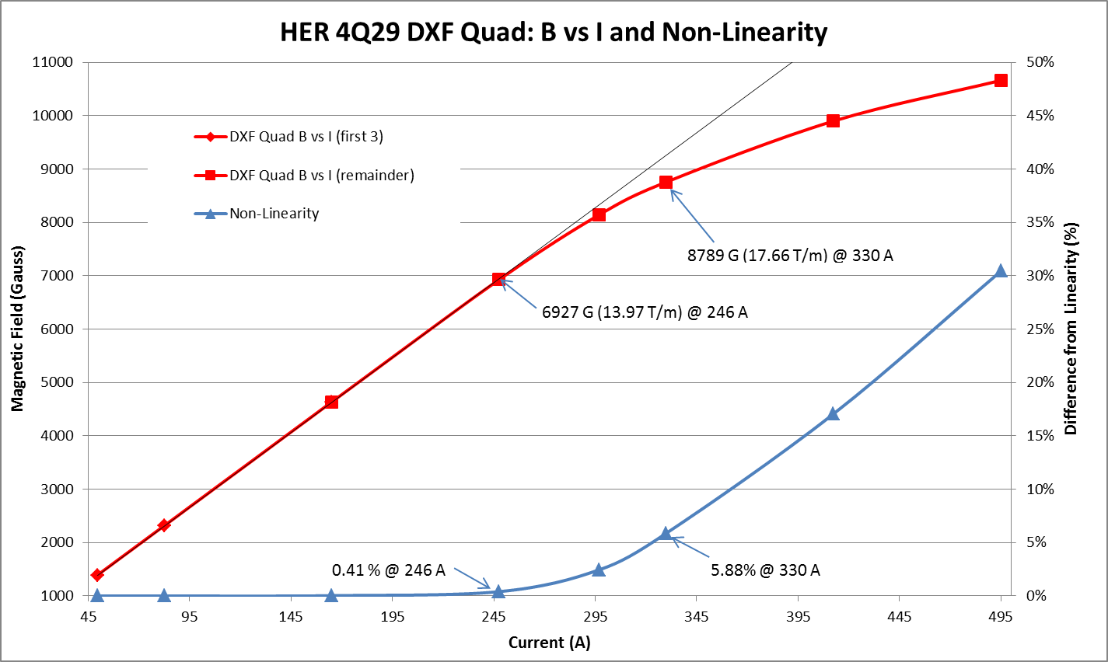
Quadrupole Analysis
17.5 T/m (“4Q22” and “4Q29”)
  Both quads have the same cross
  section
  17.7T/m @ 330 A
  ~6% saturation
  ~11°C dT @ 100 psid per coil

Slide 10
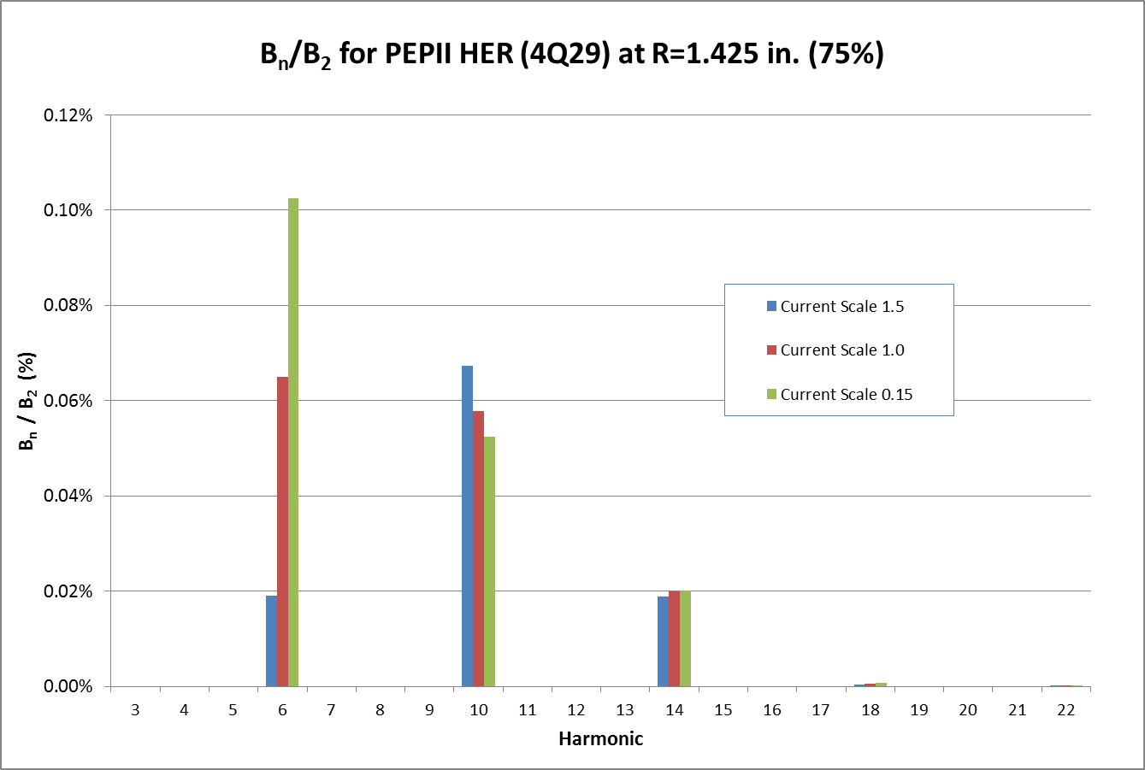
Quadrupole Analysis (cont.)
17.5 T/m (“4Q22” and “4Q29” –’93 CDR name)
  Harmonics taken at 75% aperture, 15%, 100% and 150% nominal current
  N=6 variance is likely a result of the relative magnitude of slight modeling inaccuracies when compared to the small quadrupole term (n=2) generated at ~15% nominal current.

Slide 11
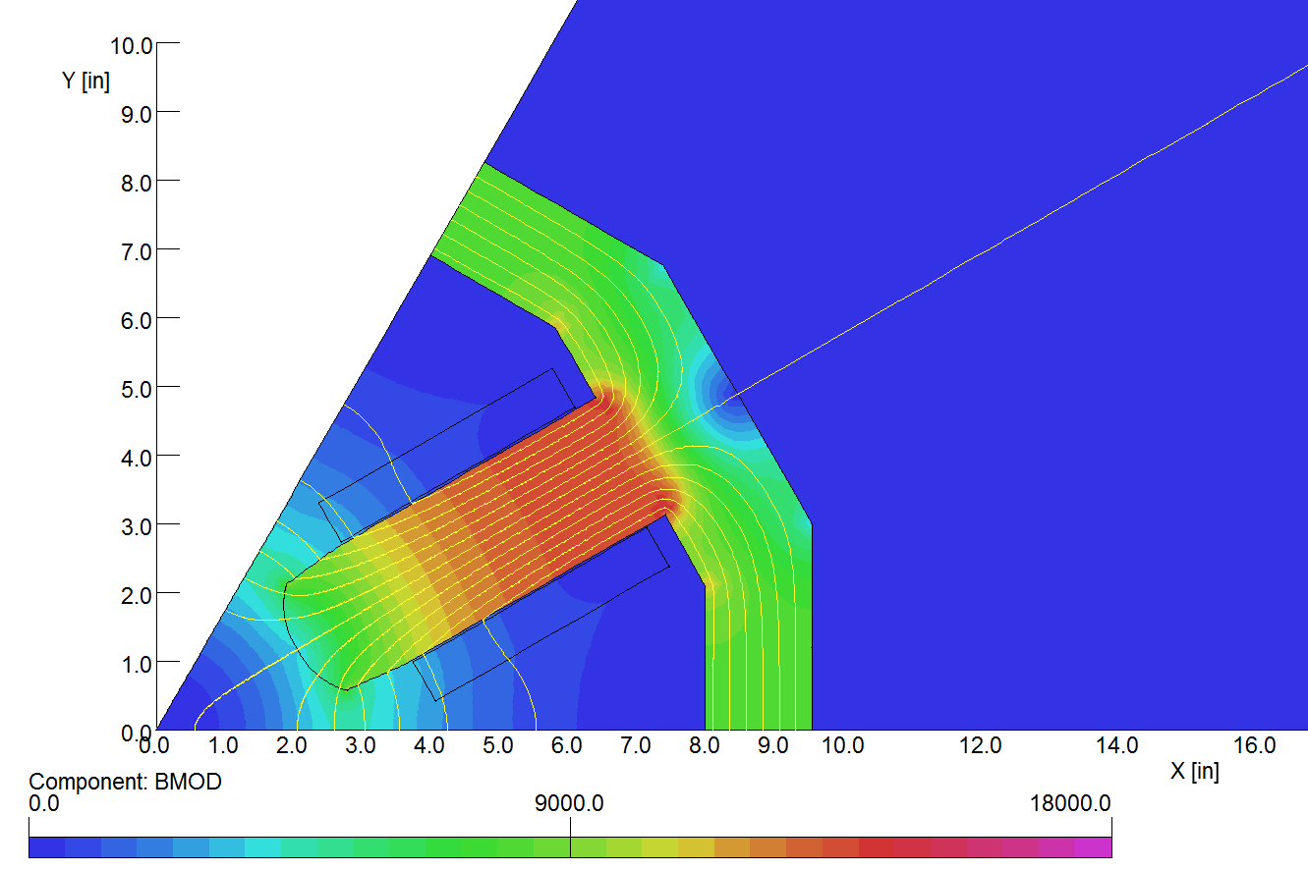
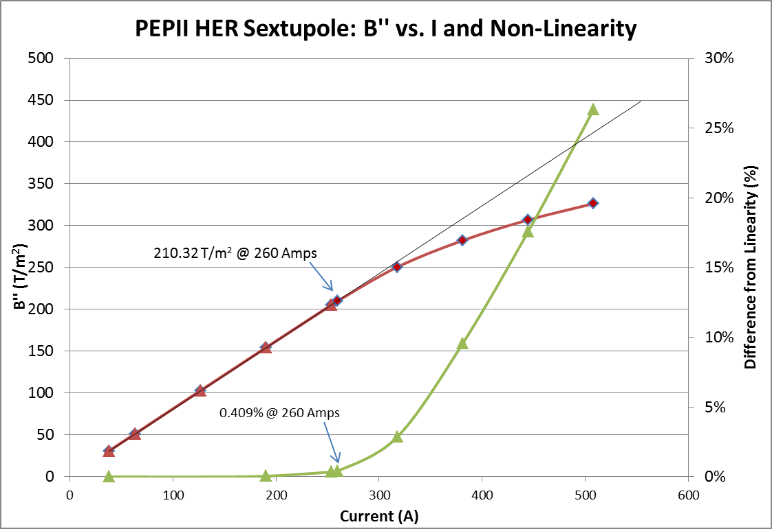
Sextupole Analysis
210 T/m² (“10SD”/”10SF”)
  Documentation doesn’t distinguish “10SD” from “10SF”
  210 T/m² @ 260A
  <0.5% saturation
  ~7°C dT @ 100 psid per coil

Slide 12
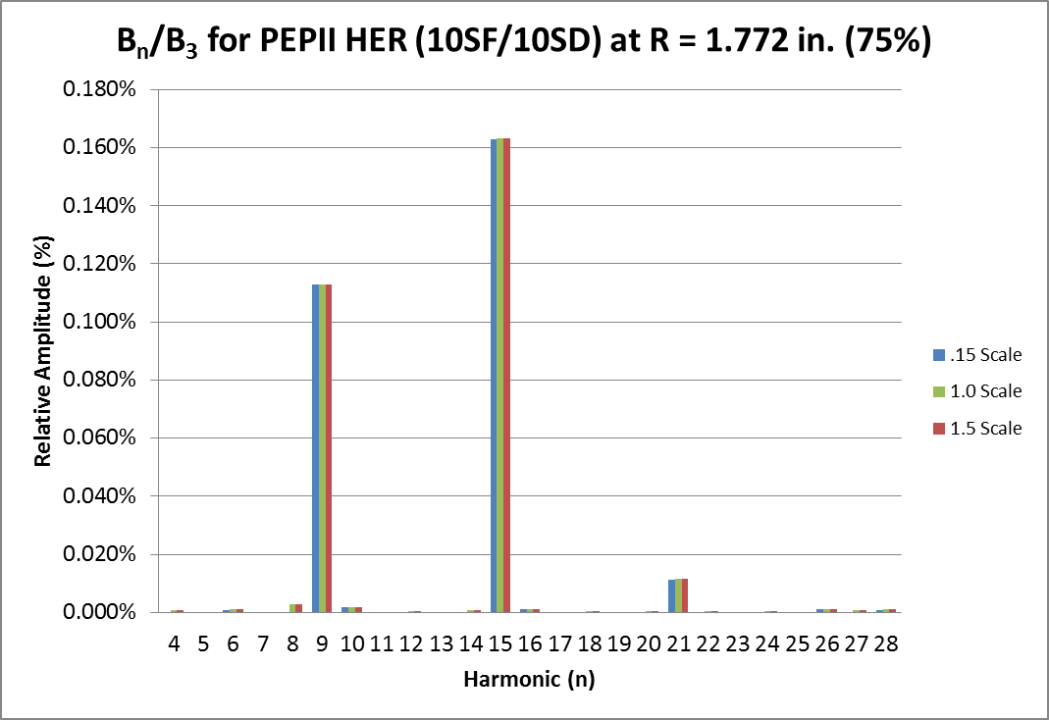
Sextupole Analysis (cont.)
210 T/m² (“10SD”/”10SF” – ’93 CDR name)
  Harmonics taken at 75% aperture
  ~15%, 100% and ~150% nominal current

Slide 13
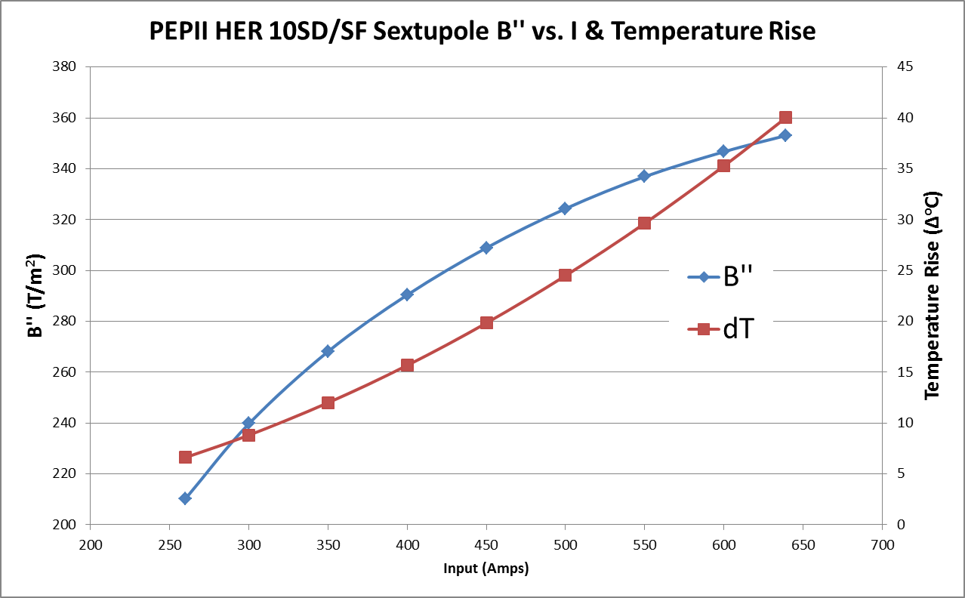
Sextupole Analysis
Max achievable sextupole field ~360 T/m²
  Saturation limits field
  Joule heating limits current (@100 psid)

Slide 14
Future Plans
The plan is to continue to evolve our understanding of repurposing issues
A magnet team will visit the PEPII ring
  Count magnets
  Visually examine magnets in situ
    Maybe even hipot or flow check some of the magnets
Several magnets (at least one of each type) will be identified for removal and shipment to JLab
Magnets will be assessed and measured at JLab
  Understand the full scope of refurbishment requirements
  Understand field characteristics
    Compare to models
    Provide harmonic and strength information to CASA

Slide 15
Summary
All of the magnets can achieve the field strength requirements prescribed in the Dec 2014 deck
All of the magnets can be sufficiently cooled at those field strengths (LCW rise less than 40 °C per coil)
A magnet team will visit the PEPII ring to count and examine magnets
Any shortages in magnet availability can be handled in conjunction with new magnet procurements
Several magnets (at least one of each type) will be identified for removal and shipment to JLab
  Magnets will be assessed and measured to understand the full scope of refurbishment requirements and field characteristics

