Slide 1
Proposed R&D S. Derbenev
MEIC R&D meeting , July 30, 2015
R&D planning

Slide 2
Two items:
1. Scanning Synchronization conceptual and experimental study
2. MEIC advanced beam physics study with a prototype of a front-end ion accelerator complex

Slide 3
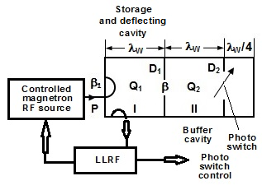
Scanning Synchronization
Physical concept
The RF kicker is supposed to provide transverse variation of bunch traces in the Interaction Region (IR)
Electro-dynamic concept
Modeling of energy transfer into the buffer cavity
Conceptual scheme
Concept of energy recovery is a fast transfer of the energy stored in the deflecting cavity into buffer cavity and back by beats.
7.30.2015
G. Kazakevich

Slide 4
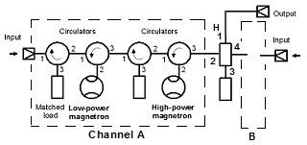
Controlled Magnetron RF Source for Scanning Synchronization
A novel method of the scanning synchronization of colliding bunches for the MEIC project has been proposed. The method utilizes a controlled RF deflection of electron bunches, combined with the intrinsic magnetic optics of the Interaction Region, providing a periodically moving (in length) bypass controlled by the RF power.
The magnetron transmitter providing a wideband phase and power control
A novel method of energy recovery in the deflecting cavities, based on a fast transfer by beats of the stored energy in coupled high Q-factor cavities has been proposed and considered for use at the scanning synchronization.
The proposed RF energy recovery method using efficient transmitters based on magnetrons frequency-locked by phase-modulated wide-band signal will be cost-effective and will allow a significant decrease of the RF power required for the deflecting cavities at the scanning synchronization.
7.30.2015
G. Kazakevich

Slide 5
Photoconductive Semiconductor Switch (PCSS) for use in “MEIC Scanning Synchronization”.
The PCSS switch was proposed as an advanced alternative to the PIN diode microwave switching circuit for control the energy transfer process in coupled resonators-cavities (see. G. Kazakevitch Conceptual scheme).
The PCSS switch is a very fast photo-electrical switch-device with a lot of potential applications including sub-nanosecond fast microwave switching. However, for use in the MEIC Scanning Synchronization the microwave circuit with embedded one or more optically controlled PCSS devices has to be designed, simulated and tested. Some PCSS models and semiconductor raw material dedicated for application in PCSS are available from the market (Kyma Technologies).

Slide 6
List of questions which need to be answered:
1. What type of semiconductor is preferred
2. On/Off timing and ratio.
3. Insertion loss
4. Long term stability
5. Operation inside of high strength microwave field.
A possible microwave circuit and light pulse control system also must be designed and tested.

Slide 7
Proposal II
Polarized ion source, universal
RFQ and DTL 10 MeV
Small booster-synchrotron 200 MeV with DC EC
Coupled optics (circular modes)
Polarimetry
Study spin resonance, natural and RF
Space charge with CMs
Matched EC for low 4D emittance

