Slide 1
Effect of the Electron Beam Momentum Spread on Friction Force and Cooling Rate for MEIC
He Zhang
MEIC R&D Meeting, 07/09/2015

Slide 2
Magnetized Friction Force
Parkhomchuk formula: $F=−V\frac{4Z^{2}e^{4}n_{e}L_{p}}{m}\frac{1}{{\left(V^{2}+Δ_{e,eff}^{2}\right)}^{\frac{3}{2}}}$
Ion beam $V^{2}=V_{⊥}^{2}+V_{∥}^{2}$
Electron beam $Δ_{e,eff}^{2}=v_{eff}^{2}+v_{e,∥}^{2}$
$L_{p}$ has a weak dependence on $v_{e,∥}$, ignore it.
Consider a proton beam at 100 GeV. Normalized emittance 0.3 um. Momentum spread ~${10}^{−4}$. Cooler length 30m. $β_{⊥}=10$ m, $α_{⊥}=0$ at the center of the cooler.
$γ=108.4$, $β=$0.99996.
$σ=\sqrt{β_{⊥}⋅\frac{ε_{n}}{βγ}}=0.166$ mm, $σ^{′}=\frac{ε}{σ}=\frac{ε_{n}}{βγσ}=1.66×10^{−5}.$
$V_{⊥,lab}=σ^{′}βc=4990$ m/s, $V_{⊥}=γV_{⊥,lab}=5.41×{10}^{5}$ m/s
Assuming momentum spread $5×{10}^{−4}$, $V_{∥}=V_{∥,lab}=1.5×{10}^{5}$ m/s
$V^{2}=V_{⊥}^{2}+V_{∥}^{2}=31×{10}^{10}$ m²/s², $V=5.6×{10}^{5}$ m/s

Slide 3
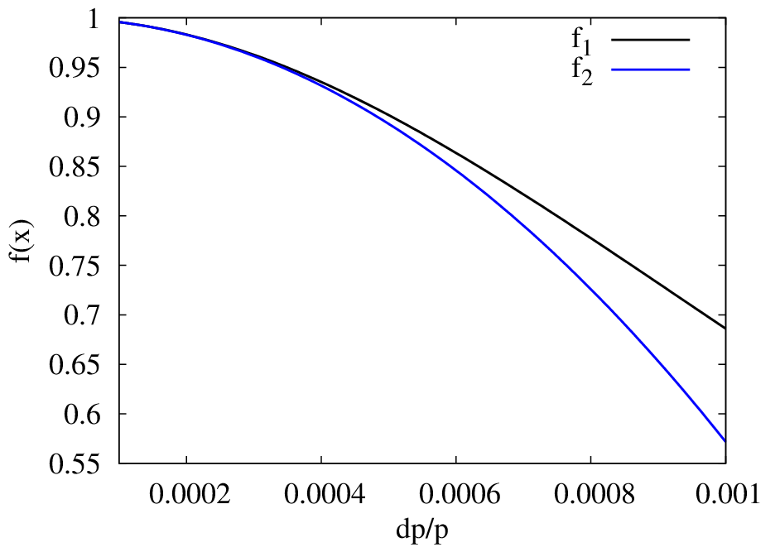
Magnetized Friction Force
Electron beam $Δ_{e,eff}^{2}=v_{eff}^{2}+v_{e,∥}^{2}$
$F=−V\frac{4Z^{2}e^{4}n_{e}L_{p}}{m}\frac{1}{V^{2}}\frac{1}{{\left(1+\frac{Δ_{e,eff}^{2}}{V^{2}}\right)}^{\frac{3}{2}}}=F_{0}\frac{1}{V^{2}}(1−\frac{3}{2}\frac{Δ_{e,eff}^{2}}{V^{2}}$), for $\frac{Δ_{e,eff}^{2}}{V^{2}}≪1$.
Effective transverse velocity $v_{eff}=0$ for an ideal case.
$$f_{1}=\frac{1}{{\left(1+\frac{Δ_{e,eff}^{2}}{V^{2}}\right)}^{\frac{3}{2}}}$$
$$f_{2}=1−\frac{3}{2}\frac{Δ_{e,eff}^{2}}{V^{2}}$$
$$Δ_{e,eff}=v_{e,∥}=\frac{dp}{p}⋅c$$

Slide 4
Cooling Rate
Consider a proton with emittance $ε$, the dynamic invariant is
$I=β{x_{β}^{′}}^{2}+2αx_{β}x_{β}^{′}+γx_{β}^{2}=2ε$, $α,β,γ$ are TWISS parameters at the cooler
Consider an easy case with $α=0$.
Assuming the friction force gives the proton a kick, ${Δx}_{β}^{′}$, NO change on $x_{β}$.
$$ΔI=β{\left(x_{β}^{′}+Δx_{β}^{′}\right)}^{2}−β{x_{β}^{′}}^{2}=2βx_{β}^{′}Δx_{β}^{′}+β{{Δx}_{β}^{′}}^{2}$$
Cooling effect is weak: $Δx_{ β}^{′}≪x_{β}^{′}$
$$ΔI∝{Δx}_{β}^{′}∝Δp∝Ft∝F$$
Above is only for a single proton. Consider the proton beam:
Cooling rate:
$$〈\frac{Δε}{ε}〉\frac{1}{T}=〈\frac{ΔI}{I}〉\frac{1}{T}∝〈F〉\frac{1}{T}$$
$〈〉$ means average on all particles.
?

Slide 5
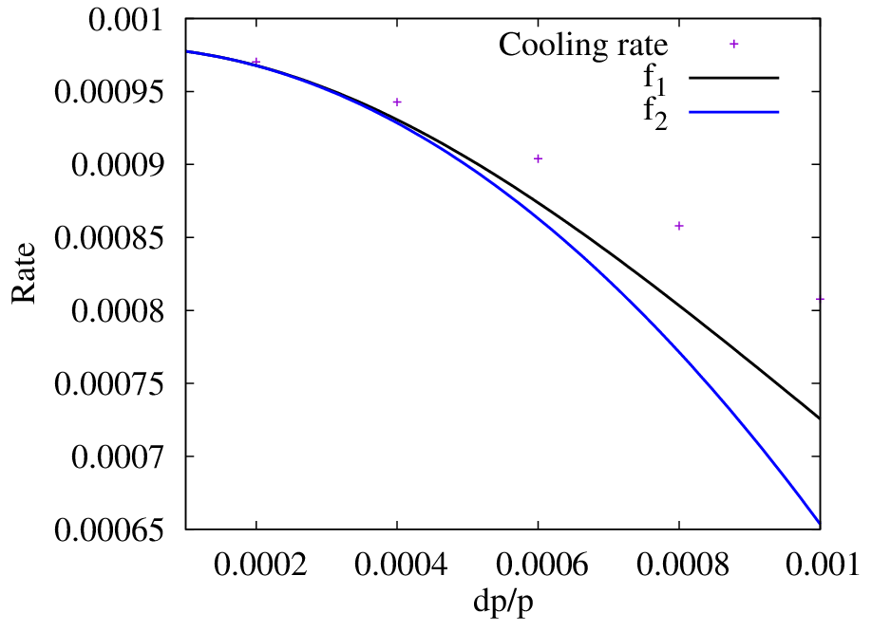
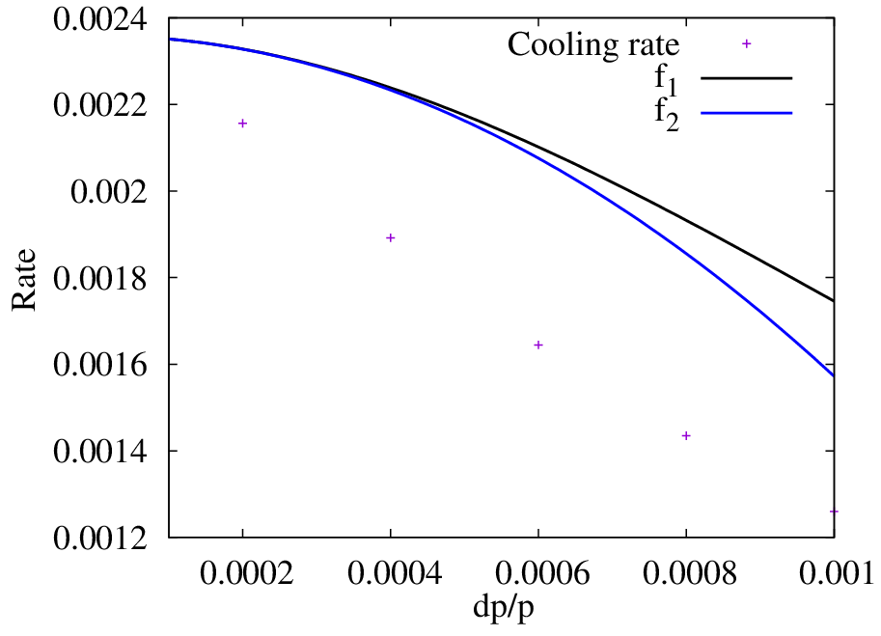
Numerical Calculation (BETACOOL)
Proton beam at 100 GeV, $ε_{n}=0.4$um, dp/p = 4E-4. Gaussian bunch.
Electron beam: Gaussian bunch, $σ_{⊥}=0.2$mm, $σ_{∥}=2.1$ cm, n_{e}=1.4E10/bunch
Cooler: 2 sections, 30 m, B=2T, $β=10$ m, $α=0$
IBS rate: $R_{⊥}$ = 0.002359831948, $R_{∥}$= 0.001168723792, 100% coupling
Dispersion = 0
Transverse
Longitudinal

Slide 6
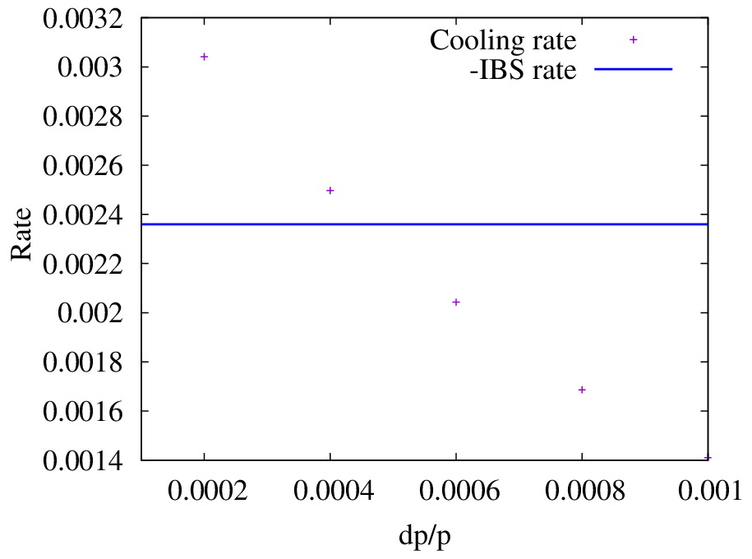
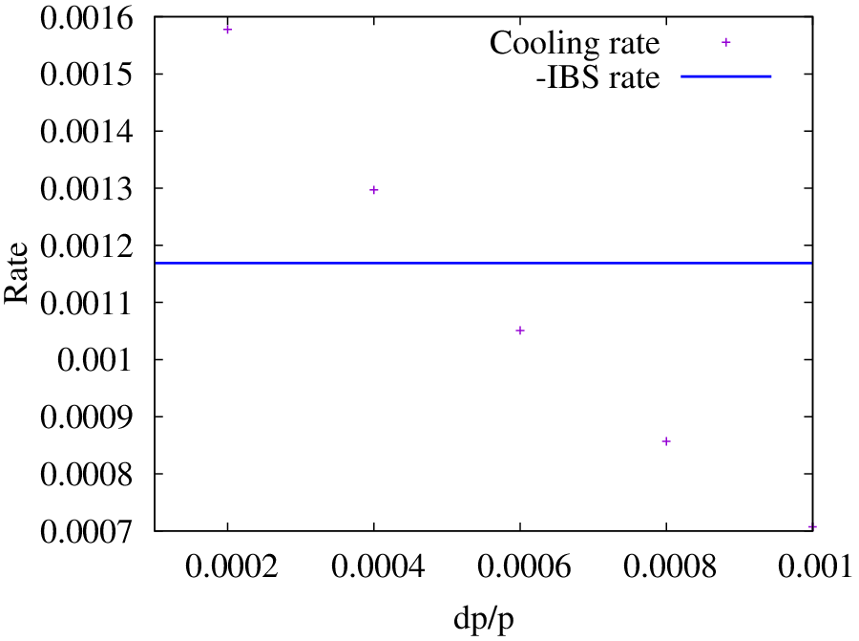
Numerical Calculation (BETACOOL)
Insufficient cooling in transverse direction, and surfeit cooling in longitudinal direction.
Set dispersion function to transfer the cooling effect.
Dispersion = 0.7 m
Transverse
Longitudinal

