Slide 1

Fast kicker beam dynamics simulations
A. Sy
05-28-2015

Slide 2

Fast kicker LDRD
Fast kicker project aims to drive a transverse kicker with “CW” waveform generated by summing subharmonics of bunch frequency
  For n bunches in train, summed waveform has effective frequency of f/n
  Summed waveform applies transverse kick to every n^{th} bunch, leaving other n-1 bunches undisturbed
Beam dynamics simulations to investigate effects on both kicked and unkicked bunches

Slide 3
Waveform generation
Subharmonics of bunch frequency with appropriate amplitudes, zero phase offset sum to generate sharp kicking pulse
Desired properties:
  Rise/fall time of kicking pulse == bunch spacing
  Zero amplitude, zero gradient at arrival times of unkicked bunches in train
  Applied transverse deflection vs. angular spread of kicked bunch

Slide 4
Waveform generation
Initial bunch frequency f=476 MHz
f = 0 MHz

Slide 5
Waveform generation
f = 43 MHz

Slide 6
Waveform generation
f = 87 MHz

Slide 7
Waveform generation
f = 130 MHz

Slide 8
Waveform generation
f = 173 MHz

Slide 9
Waveform generation
f = 216 MHz

Slide 10
Waveform generation
f = 260 MHz

Slide 11
Waveform generation
f = 303 MHz

Slide 12
Waveform generation
f = 346 MHz

Slide 13
Waveform generation
f = 389 MHz

Slide 14
Waveform generation
Effective bunch frequency f/(# bunches)
For unkicked bunches, V=0, dV/dt = 0
f = 433 MHz

Slide 15
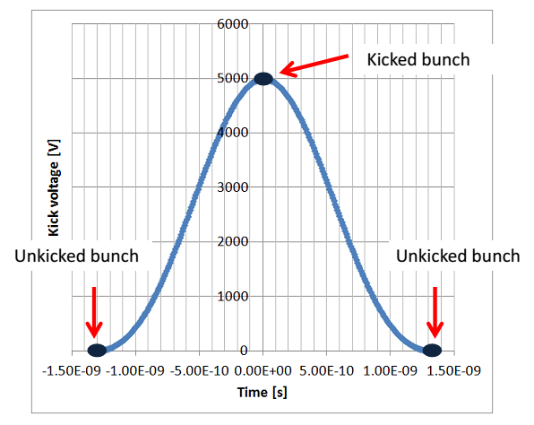
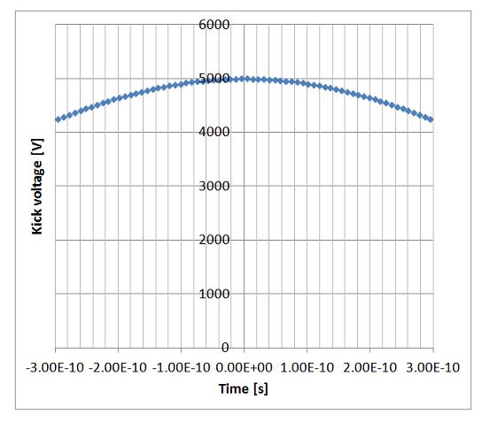
Nonuniformity of kicking pulse
For full beam size of 2 mm transverse, 600 ps longitudinal (+/- 3σ)
  At head/tail of bunch, V = 0.85 V_{peak} for f=748.5 MHz
  V = 0.934 V_{peak} for f=476 MHz
*Plots shown for f=748.5 MHz

Slide 16
Elegant simulations
55 MeV electrons to cool 100 GeV protons
Bunch frequencies f=476, 748.5 MHz
Kicker waveform generated using series of RF deflectors with appropriate phase and amplitude
Kicked bunch circulates n times in cooler ring approximated by one-turn transfer matrix matched to initial bunch

Slide 17
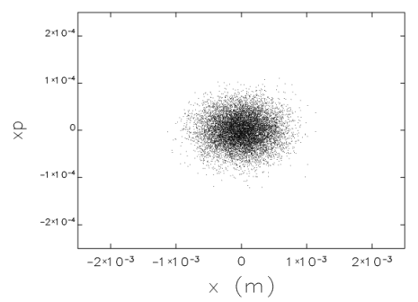
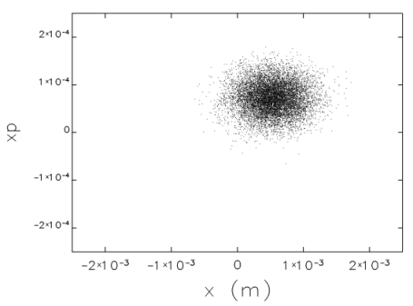
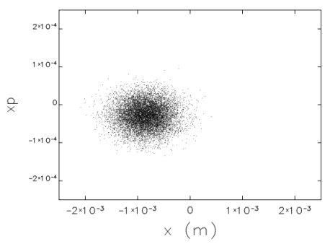
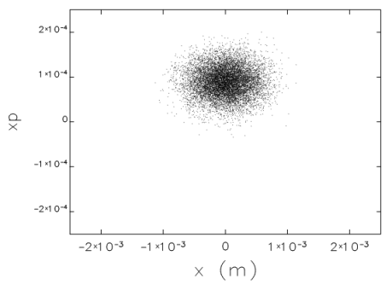
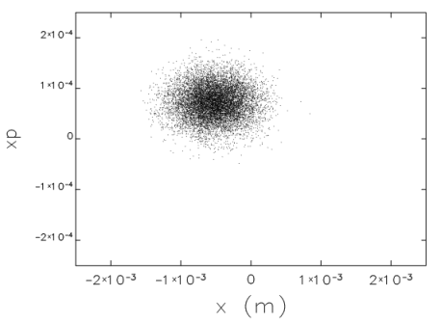
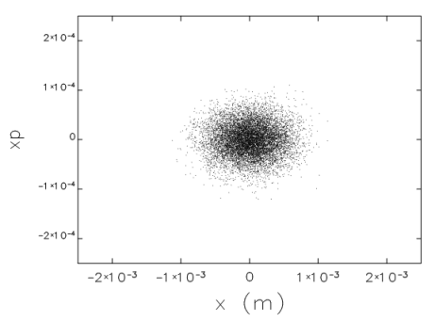
Particle phase space plots
x-x’, f=476 MHz, n=31 bunches
Unkicked bunch
Turn 2
Turn 8
Turn 21
Turn 30
Turn 31
Receives opposite kick

Slide 18
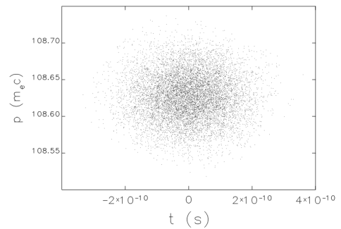
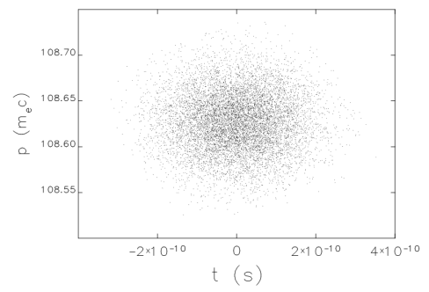
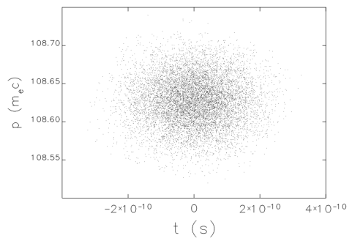
Particle phase space plots
t-p, f=476 MHz, n=31 bunches
No appreciable change in t-p phase space
Unkicked bunch
Turn 2
Turn 31

Slide 19
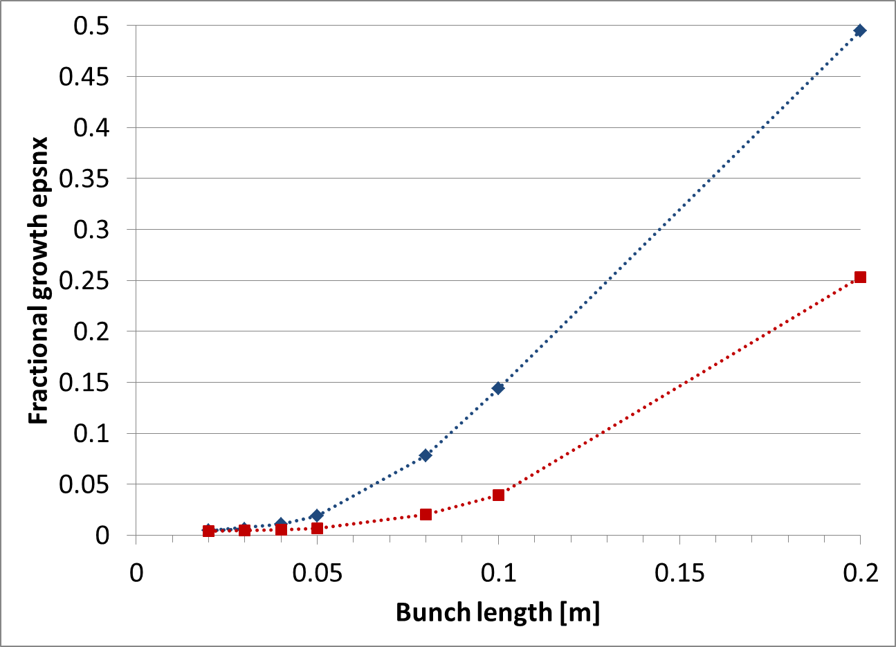
Growth of normalized emittance
Red: 476 MHz
Blue: 748.5 MHz
Less than 2% growth of ε_{nx} for bunch length less than 5 cm
3% reduction of ε_{ny}

Slide 20
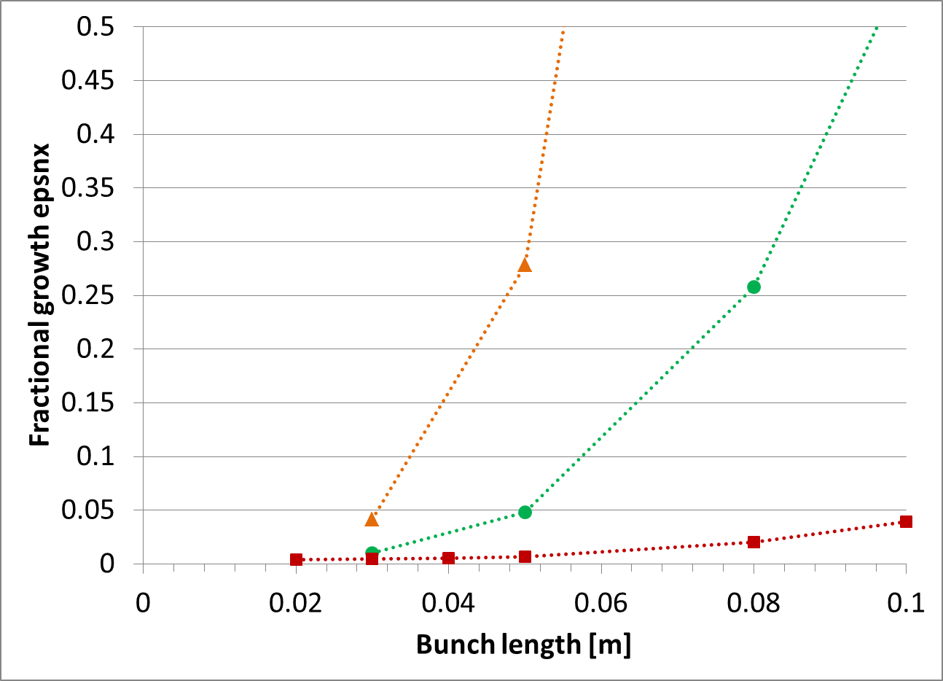
Kick voltage amplitude
476 MHz
Red: 5 kV
Green: 20 kV
Orange: 50 kV

Slide 21
Summary
Nonuniformity of kicking pulse (up to 85% of peak voltage) does not seriously degrade transverse emittance of kicked bunch for relevant electron bunch lengths
Further work to be done:
  Effects (if any) of residual waveform on unkicked bunches
  Verification of proper waveform generation in Elegant
  Replace one-turn matrix for cooler ring with more realistic design

