Slide 1
Thoughts on Optimization of the MEIC
Ion Injector & Cooling
Yaroslav Derbenev
derbenev@jlab.org
MEIC Accelerator R&D Meeting Date: Thursday, May 21, 2015 Time: 2:30 PM Place: ARC 728

Slide 2
Outline
I. Optimizing the conventionalities
Space Charge limitations
The shorter first booster is the better
Low energy i-linac designs /Y. Zhang, P. Ostroumov/
Small booster design /P. Ostroumov/
Then the large booster is needed
Use e-ring as large ion booster – why not ?... Limitations ?...
II. Going further
A background controversy: low emittance from linac – but large emittance in the rings due to the Laslett limit
An investment: Circular Modes Optics for Low 4D emittance
Advantages: 1) Potential to raise the e-cooling rate
2) Potential to overcome the SC limitation of luminosity
RF-painting for stacking in one CM
Matched Cooling

Slide 3
Low energy i-linac design /Y. Zhang, P. Ostroumov/
Universal up to Pb
Proton energy 120 MeV
Heavy ions (Pb) 40 MeV/n
Beam emittance (norm.) : 0.05 -0.1mm.mrad

Slide 4
The first (small) booster
High current is accumulated via the stripping injection of negative ions (H-, D-) or e-cooling (heavy ions and light positive ions)
A background controversy: low emittance from linac – but large emittance in SB after stacking due to the Laslett limit of the space charge
Laslett tune shift must be small after stacking:
$∆ν=\frac{∆ψ}{2π}=\frac{I_{peak}}{I_{A}}\frac{Zm_{e}}{m_{i}}\frac{Π}{4πγ^{2}β_{L}ε_{n}}≪1$ (0.1 - 0.2)
The shorter the first booster is, the better
SB could be shortened more at use of superferrics
However, small booster is not able to accelerate to high energies
On the other hand, injection energy to collider should not be low: better to be 20 to 30 GeV
Notes:
High current is accumulated via the stripping injection of negative ions (H-, D-) or e-cooling (heavy ions)

Slide 5
Then the large booster is needed
$∆ν=\frac{∆ψ}{2π}=\frac{I_{peak}}{I_{A}}\frac{Zm_{e}}{m_{i}}\frac{Π}{4πγ^{2}β_{L}ε_{n}}$
Larger energy (compared to injection from linac to SB) – larger the circumference suited for injection to the collider ring
A proposal: use e-collider ring as LB for ions
Suitable energy range (10 to 12 GeV of e-beam)
Dipoles of electron orbit do not reach maximum available field (less than 0.4 T at 12 GeV)
At maximum field 1.5 T proton energy would be more than 40 GeV … .
Solution for Transition Energy of deuterons and heavy ions?
Focusing and Tr. En. issues should be considered
Notes:
Larger energy (compared to injection from linac to pre-booster) – larger circumference, suited for injection to the collider ring

Slide 6
Circular Modes Optics for Low 4D Emittance
Design beam transport around a ring with strong coupling (inserting the skew quads “on regular basis”), creating two circular modes (CM) of two naturally opposite helicities.
Each of two individual CMs will look at a point of the orbit as a round (more generally, elliptical) turn by turn rotating pencil of particles with some phase advance.
Similar to magnetized beam phase space structure, beam space charge can be “settled” just to one of two CMs, leaving other “empty” i.e. having a very low emittance.
Such state can be achieved by initial filling one mode by injection from linac to the first, small booster (pre-booster)

Slide 7
Circular Modes Optics for Low 4D Emittance

Slide 8
Potential to raise the e-cooling rate
EC rate is fundamentally limited by the electron current (trivial!) and proton bunches 6D phase space size (less trivial…).
Once the 6D emittance decreased by having one transverse canonical emittance small, one can account on a significant increase of cooling rate when cooling the large (as usual) emittance of the “large” CM.
Naturally IBS will try to heat the low emittance CM. But EC would prevent the heating to some degree, anyway (see below in more detail).

Slide 9
Potential to overcome the SC limitation of luminosity
While maintaining such cooled state around the ring, one can transform round to flat beam to the IP, in this way gaining luminosity over the SC limit.

Slide 10
The Matched Cooling
Ion beam will rotate at the cooling section
Electron beam will follow the solenoid field force lines
One can try to design the solenoid field with force lines diverging off the center of the cooling section, to follow the ion beam envelope.
Electron Larmor circles will experiencing drift along the magnetic force lines. In this way (also taking into account drift due to the SC), one can eliminate ruction of the cooling rate by differency in average velocities at a point of geometrical space.

Slide 11
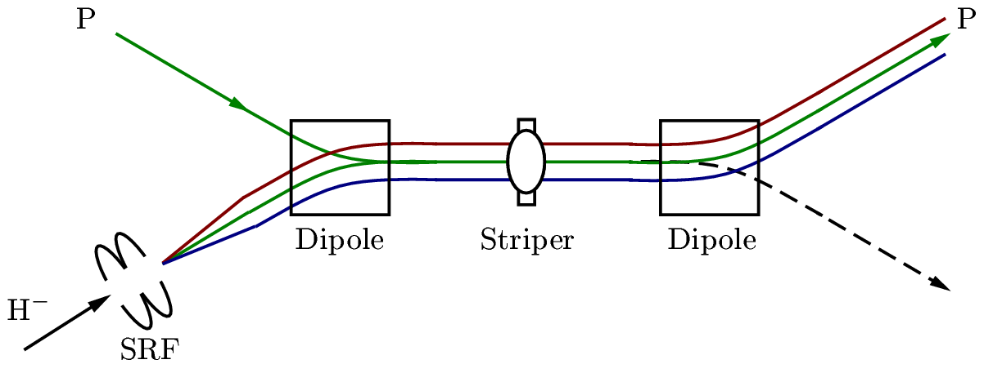
RF-painting for stacking in one CM

Slide 12
Summary
Is this interesting enough to be seriously examined?
Thank you for your attention.

