Slide 1
Transient Beam Loading Effects in RF System for the Electron Storage Rings and its Control Strategies to the MEIC Injection, Storage and Synchronization (Part I)
Haipeng Wang
also Discussion Results from Robert Rimmer,
Shaoheng Wang, Jiquan Guo and Fanglei Lin
CASA R&D Meeting on June 26, 2014

Slide 2
References
Abstract
Electron bunch train structure changes like a gap for safe aborting, charge variation, the phase slippage due to injection or beam optic abbreviation can cause a large beam loading change to the (S)RF system control in a storage ring. We will review the longitudinal beam instability criteria in steady states with open loop (Robinson) and with feedback loops (Pederson). Initial tracking simulations for these transient effects will be shown for the benchmark to the ALS ring at LBNL and for the design of MEIC e-ring from 3GeV to 12GeV. Based on these initial results, the (S)RF control strategies in low level and high level for the beam injection, storage and collision will be discussed. The technical challenges and R&D items associated with these preliminary physics design parameters will be marked up.
J. M. Byrd etc., Transient Bean loading Effects in Harmonic RF Systems for Light Sources, PRST-AB, Vol 5, 092001 (2002).
D. Briggs, etc., Computer Modelling of Bunch-by-bunch Feedback for the SLAC B-Factory Design, Proceedings of PAC 1991.
http://www-als.lbl.gov/index.php/beamlines/storage-ring-parameters.html Webpage of Advanced Light Source at Berkeley Lab

Slide 3
References
J. Byrd, Simulation of the ALS Longitudimal Multibunch Feedback System, Proceedings of PAC 1993.
B. Taylor etc., The ALS Storage Ring RF System, Report of LBL-33291/UC-410/LGSGN-125, May 1993.
J. M. Byrd etc., Lifetime Increase Using Passive Harmonic Cavities in Synchrotron Light Sources, PRST-AB, Vol 4, 030701 (2001).
J. Byrd etc., Transient Beam Loading in the ALS Harmonic RF System, Proceedings of EPAC2000, SLAC-PUB-9719.
J. M. Byrd, etc., Commissioning of a Higher Harmonic RF System for the Advanced Light Source, eScholarship of University of California, and LBNL, March 31, 2000.
F. Pederson, A Novel RF Cavity Tuning Feedback Scheme for Heavy Beam Loading, IEEE Trans. on Nuclear Science, Vol. NS-32, No. 5, Oct. 1985.
F. Pederson, IEEE Trans. Nuclear Science, Vol. NS-22, No. 3, June 1975, Proceedings of PAC 1975.
P. Krejcik and F. Pederson etc., RF Feedback for beam Loading Compensation in the SLC Damping Rings, Proceedings of PAC 1993.
R. W. Robinson, CEA, Report No. CEAL-1010, 1964.

Slide 4
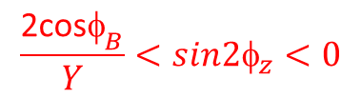
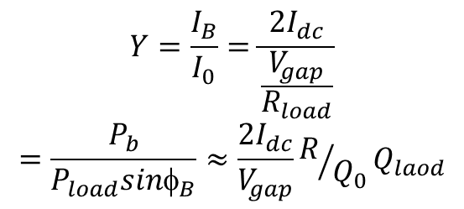
Robinson (1964) Open Loop Model of Phase Stability with Beam Loading
Relative beam loading:
Klystron power P_{f} =I _{G} V
load angle
$$Y=\frac{I_{B}}{I_{0}}=\frac{2I_{dc}}{\frac{V_{gap}}{R_{load}}}$$
$$=\frac{P_{b}}{P_{load}sinφ_{B}}≈\frac{2I_{dc}}{V_{gap}}R/{Q_{0}}Q_{laod}$$
Synchronous phase
Gap voltage
detune angle
For MEIC e-ring 12GeV, 0.11A
unstable
above parabola
Unstable for ψ_{z}>0
φ_{B}=163.5º, φ_{L}=20º
Both Robinson and Pederson models used sin(φ_{B}) function for energy gain calculation, and φ_{B} >90º is on the stable side for sychrotron motion (90º is on crest):.
Working point
φ_{B}=122.4º, φ_{L}=0º
Robinson stability
(η>0 ) requires:
$$\frac{\text{2}\text{cos}{\text{φ}}_{B}}{Y}<sin2φ_{z}<0$$

Slide 5
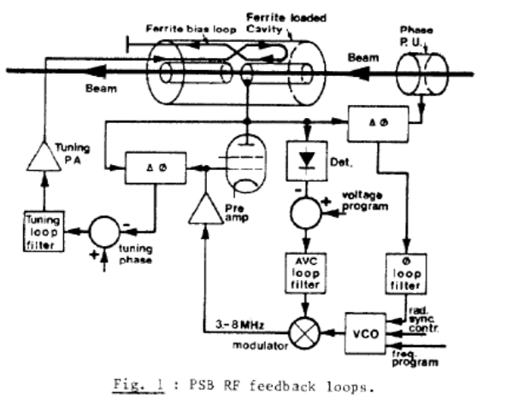
Pederson (1975-1985) Close Loop Models of RF Feedback Systems
1. Tuning feedback loop
Mechanical
Or magnetic to tune φ_{z}
Slow compare to transient
1
2
3
ω_{Τ} is tuning loop bandwidth, σ (α_{E}) is radiation damping rate
ω_{s} =υ_{s}ω₀ is synchrotron frequency
2. 3. Phase and Amplitude feedback loops
Maintain φ_{L} by AVC regulation
P&A cross-talk thru. detuned cavity
May lose Robinson stability
4. LL Feed Forward feedback loop
Same as P&A control but in LL
Let I_{G}=-I_{B}
More stable at fixed frequency

Slide 6

Pederson (1975-1985) Models of RF Feedback Systems
5. HL amplifier feed forward loops
5
6
H is open loop gain
Effective R_{sh} is reduced by 1+H
Can be for variable frequency
6. Second HL amplifier feed forward loop
Separated I_{G}*=-I_{B}
No detune, φ_{z}=0
Could be power limit caused instability
7
7. HL amplifier feedback with tuning loops
Higher limit on Y*=Y/(1+H)
Large error on φ_{L} due to small perturbation on φ_{L}*
Large error could change sign of tuning loop gain

Slide 7
Tracking Simulation Studies Based on Ref. 1 Open Loop
Case 1, ALS storage ring without 3rd harmonic system :
Input Parameters | Value | Unit
main RF total peak voltage | 1.1 | MV
harmonic number | 328
main rf frequency | 499.66 | MHz
beam energy | 1.9 | GeV
momentum compaction factor | 1.62e-3
Injection phase relative synchronous | 1.0 | rad
synchrotron radiation static loss per turn | 245 | keV
dc beam current | 0.335 | A
main rf cavity number | 2
main rf cavity R/Q (V²/(ωU) | 250 | Ω
unloaded Q of main rf cavities | 4.0e4
loaded Q of main rf cavities | 2.0e4
cavity to klystron loading angle | 0 | deg
empty bucket/harmonic # (gap percentage) | 17 | %
radiation damping rate per turn | 4.9e-5

Slide 8
Tracking Simulation Studies Based on Ref. 1, Open Loop
Case 1, ALS storage ring without feedback system :
Calculated Parameters and Tracking Result | Value | Unit
main rf peak voltage per cavity (cell) | 0.55 | MV
main cavity detune needed for beam loading | -88.17 | kHz
main rf operation frequency | 499.572 | MHz
main rf cavities detuning angle | -80.4 | deg
synchronous phase by Pederson | 166.09 | deg
Beam loading factor Y=2I_{b}/I₀₁ | 7.273
single bunch charge | 80.85 | nC
single bunch loss factor to fundamental mode | 19.62 | V/pC
main rf generator on cavity gap voltage | 0.253 | MV
turn-by-turn phase span after 25000 turns since inj. | 11.2 | deg
max. energy deviation after 25000 turns after inj. | 1.5e-3
DC Robinson stable for non-uniform filling? | No

Slide 9
Tracking Result Graphs from MathCAD
Case 1, ALS storage ring without feedback system :
This simulation result agrees with experimental observation, i.e. Ref (8).
335mA, 17% gap filling

Slide 10
Tracking Result Graphs from MathCAD
Case 1, ALS storage ring without feedback system :
335mA, uniform filling
turn-by-turn phase span after 25000 turns since inj. | 3.02 | deg
max. energy deviation after 25000 turns after inj. | 3.7e-4
DC Robinson stable for uniform filling? | yes

Slide 11
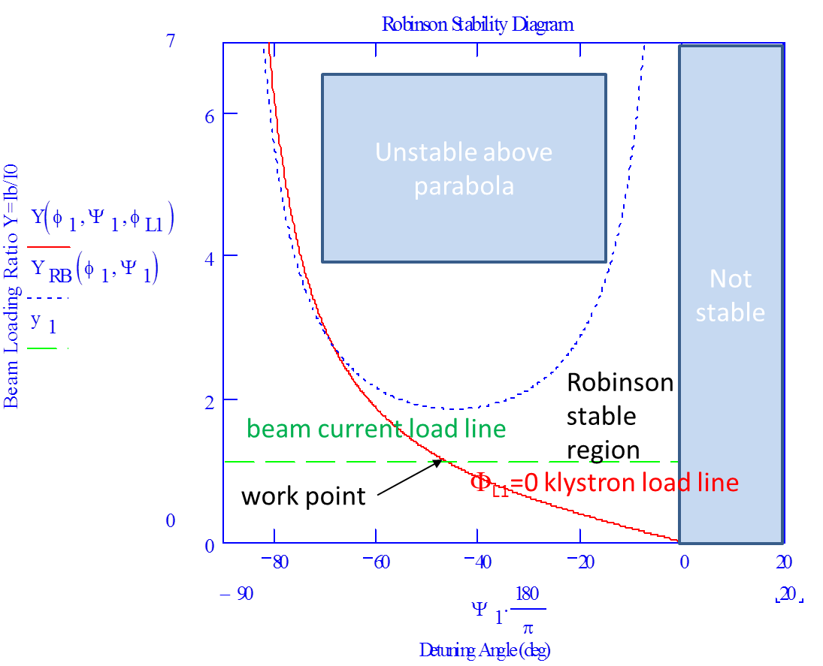

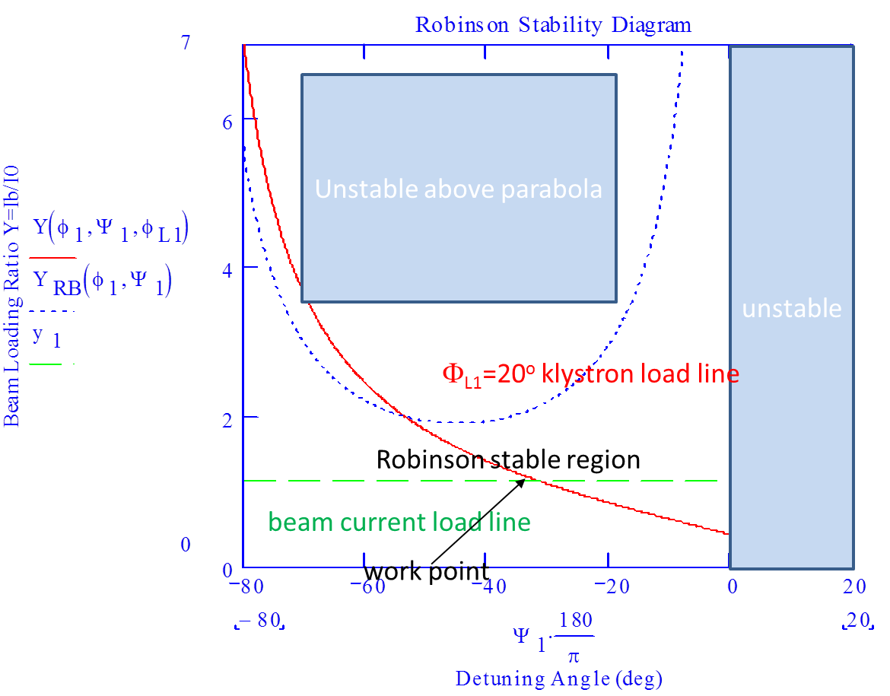
Robinson Stability Working Points with Main RF only without Feedback System and with Uniform Beam Filling Pattern
Energy: 3 GeV
Beam current: 0.24 (3) A
Cavity number: 1
Cavity detune: -39.04 kHz (-4.88kHz)
Detune angle: -46.2º (-52.54º)
Cavity Qext: 1e4 (1e5 Need feedback
system Gain=100?)
Vgap: 0.45 MV
Beam/cavity current load Y: 1.12 (1.4)
Load angle: 0º (5º )
Synchronous angle: 158.67º
Beam stored energy: 2.4(30) J/m or
3.40kJ (42.5kJ)
Aborting gap: ?
Energy: 5 GeV
Beam current: 3 A
Cavity number: 8
Cavity detune: -6.83 kHz
Detune angle: -42.4º
Cavity Qext: 5e4 (Need feedback system Gain=100?)
Vgap: 0.2875 MV
Beam/cavity current load Y: 1.10
Load angle: 10º
Synchronous angle: 178.19º
Beam stored energy: 50.0 J/m or 70.8kJ
Aborting gap: Yes
Energy: 12 GeV
Beam current: 0.11A
Cavity number: 20
Cavity detune: -1.85 kHz
Detune angle: -31.29º
Cavity Qext: 1.2e5
Vgap: 2.502 MV
Beam/cavity current load Y: 1.14
Load angle: 20º
Synchronous angle: 163.53º
Beam stored energy: 4.4 J/m or 6.23kJ
Aborting gap: ?
SPEAR3 at SLAC has no aborting gap at 5 J/m or 1.17kJ of stored beam energy

Slide 12
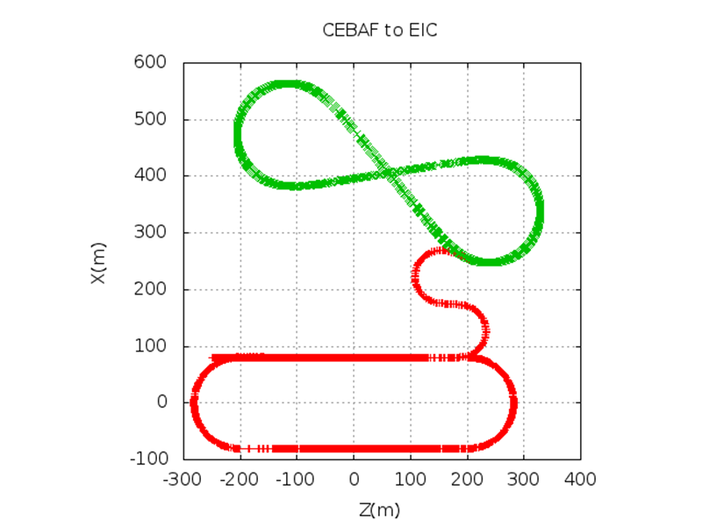



Concept of Beam Injection at both fixed CEBAF and E-Ring Frequencies
CEBAF runs at 3-12GeV, fixed frequency of 748.5MHz with CW (full charge at 2.4pC?) injector capability
E-ring RF (SRF) cavities are detuned at fixed frequency of 748.5MHz-112kHz for one IP (or 748.5MHz-2*112kHz for two IPs) for a maximum (20cm) collision path length difference and at certain e-ion energy collision levels
Cavity detuning direction (less) is the same as the cavity detuning requirement for the beam loading compensation and will be in additional detuning amount
Cavity detuning for the beam loading could be as high as -683kHz for the 5GeV, 3A case, so a large cavity detuning for the SRF cavities is needed anyhow
The cavity detuning (lower frequency) and path length change (increase) for the synchronization to the ion ring beam collision are benefit from this feature, but in additional to the beam loading detuning.
Using e-ring’s RF phase-momentum acceptance range to capture the injection bunch trains from the CEBAF which has the phase slippage to the beam synchronous phase
Injection bunch trains from CEBAF
RF buckets of e-ring
Y. Roblin
MEIC e-ring beam filling factor:
FFe$=\frac{∆∅∗f_{rf}}{2π{∆f}_{rf}h}$
RF bucket acceptance (slippage) range in radian
RF frequency detune in Hz
h=3535

Slide 13
Momentum Acceptance with Main RF only without Feedback System at Zero Loading Angle and with Pulsed Beam Filling Pattern
Energy: 3 GeV
Total RF voltage: 0.45 MV
Synchronous angle: 158.67º
Phase acceptance: 220.7º
Momentum deviation near “fish mouth”: 5.2e-4
Max. bunch # in injection: 4068
Energy: 5 GeV
Total RF voltage: 2.30 MV
Synchronous angle: 146.33º
Phase acceptance: 175.9º
Momentum deviation near “fish mouth”: 2.2e-3
Max. bunch # in injection: 3239
Energy: 12 GeV
Total RF voltage: 50.04 MV
Synchronous angle: 122.36º
Phase acceptance: 98.2º
Momentum deviation near “fish mouth”: 1.9e-3
Max. bunch # in injection: 1800
RF bucket envelop equation:

Slide 14
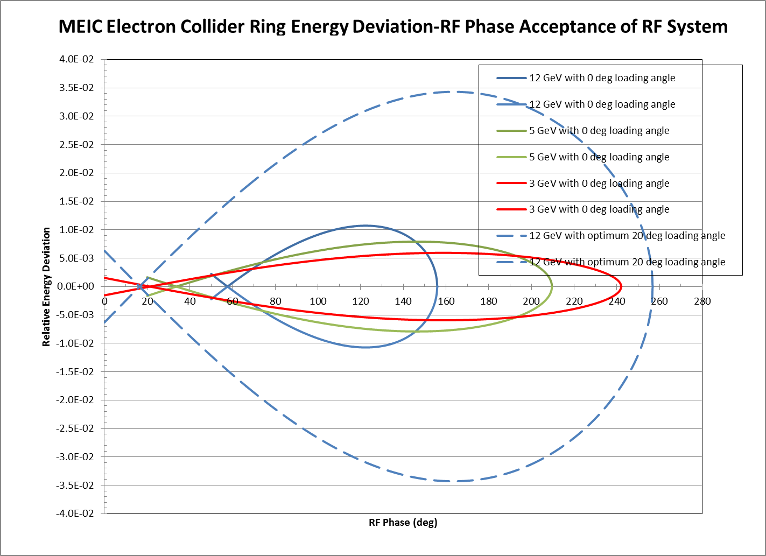
From φ_{L}=0º to φ_{L}=20º only 6% more overhead power from klystron is needed

Slide 15
Tracking Simulation Studies for MEIC E-ring
Case 2, MEIC e-ring without feedback system at 12GeV:
Input Parameters | Value | Unit
main RF total peak voltage | 50.04 | MV
harmonic number | 3535
main rf frequency | 748.5 | MHz
beam energy | 12 | GeV
momentum compaction factor | 7.6e-4
Injection phase relative synchronous | 0.4 | rad
synchrotron radiation static loss per turn | 42.27 | MeV
dc bean current | 0.11 | A
main rf cavity number | 20
main rf cavity R/Q (V²/(ωU) | 105 | Ω
unloaded Q of main rf cavities | 1.29e10
loaded Q of main rf cavities | 1.23e5
cavity to klystron loading angle | 20 | deg
empty bucket/harmonic # (gap percentage) | 15 | %
radiation damping rate per turn | 3.524e-3

Slide 16
Tracking Simulation Studies for MEIC E-ring
Case 2, MEIC e-ring without feedback system at 12GeV:
Calculated Parameters and Tracking Result | Value | Unit
main rf peak voltage per cavity (cell) | 2.502 | MV
main cavity detune needed for beam loading | -1.849 | kHz
main rf operation frequency | 748.498 | MHz
main rf cavities detuning angle | -31.292 | deg
synchronous phase by Pederson | 158.67 | deg
Beam loading factor Y=2I_{b}/I₀₁ | 0.282
single bunch charge | 172.9 | pC
single bunch loss factor to fundamental mode | 0.1235 | V/pC
main rf generator on cavity gap voltage | 3.006 | MV
turn-by-turn phase span after 3000 turns since inj. | lost | deg
max. energy deviation after 3000 turns after inj. | 0.12
DC Robinson stable for non-uniform filling? | No
However, below 15% filling gap, beam capture and storage is stable

Slide 17
Tracking Result Graphs from MathCAD
Case 2, MEIC e-ring without 3rd harmonic system at 12GeV:
Beam lost after injection ~2000 turns due to RF transient in the filling gap.
110mA, 15% gap filling

Slide 18
Injection Beam loading Transient Tracking Simulation:
12GeV, 2.4pC per bunch in injection
with a 50% filling gap (1767 bunches in the ring)
optimized loading angle of 20º
Injection phase slippage span from -131.7º to 57.1º (188.8º)
after injection of first polarization bunches 80 turns 378μs, the 50% gap is then filled by another polarization 1767 bunches
Nearly all bunches are captured the beam storage becomes stable.

Slide 19















12GeV Injection Bunch Pattern from CEBAF (after F. Lin and S. Wang)
2.36μs, ~1767 bunches (I_{ave}= 1.8 mA)
Bunch trains
from CEBAF injector
2.36μs, ~1767 bunches (I_{ave}= 1.8 mA)
1.33 ns, 748.5 MHz
2.4 pC
duty factor 4.3e-4
1.33 ns, 748.5 MHz
2.4 pC
duty factor 4.3e-4
50 ps
50 ps
……
……
macro bunch trains
from CEBAF
……
0.38 ms
140 ms (~29642 turns)
I_{ave} = 59.1 nA
storage transient
……
bunch trains
In storage ring, half-half filled with opposite polarizations
Injection transient
0.38 ms (80 turns)
140 ms (~29642 turns)
I_{ave} = 0.11A
Injection time is inversely proportional to the injection charge
Beam energy | Gev | 3 | 5 | 6 | 7 | 9 | 11 | 12
Beam current | A | 3 | 3 | 2.0 | 1.1 | 0.4 | 0.18 | 0.11
Injection time | s | 234 | 234 | 156 | 86 | 31 | 14 | 8.6
V. damping time | ms | 167.2 | 36.2 | 20.8 | 13.2 | 6.2 | 3.4 | 2.7

Slide 20
Storage Beam loading Transient Tracking Simulation:
12GeV, 292pC per bunch in storage
with a 50% filling gap (1767 bunches in the ring)
optimized loading angle of 20º
Injection phase slippage span from -131.7º to 57.1º (188.8º)
after injection of first polarization bunches 80 turns 378μs, the 50% gap is then filled by another polarization 1767 bunches
All bunches are captured the beam storage becomes stable.

Slide 21
Pederson Model with HL Amplifier Feedback for 5GeV MEIC e-Ring
Effective cavity impedance
With Gain=100, group delay=300ns
Open loop
Close loop
unstable
unstable
Effective cavity phase
φ_{L}=10º
Working point

Slide 22
Tracking simulation result highlights
Open loops
At 12GeV, 0.11A stored beam (173pC per bunch), up to 15% gap (3004 bunches in the ring) is stable. (h=3535)
At 12GeV, 294pC per bunch, with a 50% gap (1767 bunches in the ring), at optimized loading angle of 27º, beam lost after 540 turns.
At 12GeV, 2.4pC per bunch in injection, with a 50% gap (1767 bunches in the ring), at the optimized loading angle of 20º, after injection of first polarization bunches 80 turns, the 50% gap is then filled by another polarization bunches, the beam becomes stable.
At 12GeV, with a half-half polarization filling injection scheme, with switching polarization time within 0.3ms, injection up to storage current of 0.11A, with the optimized loading angle of 20º, without a feedback system, the beam capturing and storage are stable.
Close loops, feedback stability (like saw tooth) is unknown yet
At 5GeV, with a 47.5%-47.5% polarization filling injection scheme, leaving 5% gap (236ns, 177 buckets) with switching polarization time within 0.38ms, injection up to storage current of 3A, with the optimized loading angle of 10º, with a feedback system gain of 100, group delay of 300ns, the beam capturing and storage are stable.

Slide 23
Storage Beam loading Transient Tracking Simulation:
5GeV, 8.44nC per bunch in storage
with a 52.5% filling gap (1732 bunches in the ring)
optimized loading angle of 10º
Injection phase slippage span from -131.7º to 60.9º (192.6º)
after injection of first polarization bunches 80 turns 378μs, the 52.5% gap is then filled by another polarization 1732 bunches, leave a 5% gap for safe aborting
All bunches are captured the beam storage becomes stable.

Slide 24

5GeV Injection Bunch Pattern from CEBAF (after F. Lin and S. Wang)
2.36μs, ~1767 bunches (I_{ave}= 1.8 mA)
Bunch trains
from CEBAF injector
2.36μs, ~1767 bunches (I_{ave}= 1.8 mA)
1.33 ns, 748.5 MHz
2.4 pC
duty factor 4.3e-4
1.33 ns, 748.5 MHz
2.4 pC
duty factor 4.3e-4
50 ps
50 ps
……
……
macro bunch trains
from CEBAF
……
0.38 ms
140 ms (~29642 turns)
I_{ave} = 59.1 nA
storage transient
5% gaps for aborting
……
bunch trains
In storage ring, half-half filled with opposite polarizations
Injection transient
0.38 ms (80 turns)
140 ms (~29642 turns)
I_{ave} = 3A
Injection time is inversely proportional to the injection charge
Beam energy | Gev | 3 | 5 | 6 | 7 | 9 | 11 | 12
Beam current | A | 3 | 3 | 2.0 | 1.1 | 0.4 | 0.18 | 0.11
Injection time | s | 234 | 234 | 156 | 86 | 31 | 14 | 8.6
V. damping time | ms | 167.2 | 36.2 | 20.8 | 13.2 | 6.2 | 3.4 | 2.7

Slide 25
Preliminary tracking simulation result summary
Beam Energy (GeV) | Beam Current (A) | Cavity # | Qext | 1st Pol. inj. % of Ring | 2nd Pol. inj. % of Ring | FB Loop Gain | Group Delay (nS) | Abort Gap (nS)
12 | 0.11 | 20 | 1e5 | >42.5% | >42.5% | 0 | n.a. | n.a.
5 | 3 | 8 | 5e4 | >47.5% | >47.5% | 100 | 300 | <236
3 | 0.24 | 1 | 1e4 | >42.5% | >42.5% | 0 | n.a. | n.a.
3 | 3 | 1 | 1e5 | >47.5% | >47.5% | 100 | 300 | <236

Slide 26
Feasibility, Technical Challenges and R&D Items
Beam in 47.5%-47.5%-5% injection and storage filling pattern has nearly no instability problem with the optimization of more overhead klystron power and high level feedback control at 5GeV, 3A. But high gain~100, <300ns group delay time needs more R&D.
Fixed CEBAF and e-ring RF frequency with detune on ring cavity and path length increase can solve synchronization to the ion beam collision problem. Feedback control is critical, need more Simulink simulation studies.
Development of high current SRF cavity, single-cell, with heavy HOM damping, large detuning amount is still a critical R&D item.
Fast kicker with <200nS response time for aborting high current beam is needed.
Beam filling gap requirement from ion trapping and for clearing needs to study in detail.
Transient beam loading in CEBAF for pulsed, flipped polarization bunch trains need to be studied in order to satisfy small energy spread requirement to the e-ring injection. Feed forward system may need to be developed.
Second or third harmonic RF systems for the e-ring for beam bunch lengthening (life time improvement) or high luminosity may be needed in additional to main RF system.
Coupled bunch instability needs to continue study for the HOM damping and feedback system requirements.

