Slide 1
Robinson Instability Criteria for MEIC e Ring
Shaoheng Wang, Haipeng Wang, Robert Rimmer

Slide 2
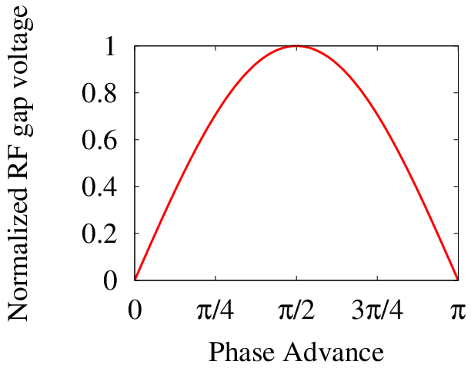
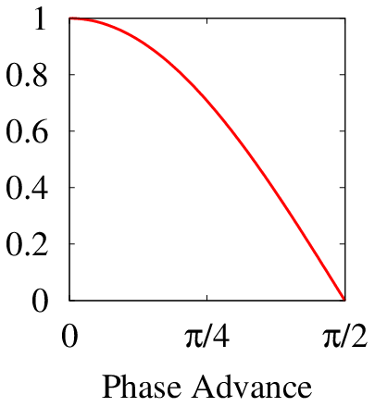
The Definitions of Synchronous Phase
Below transition
SY Lee, etc
$$ψ_{s}$$
$$V_{acc}=V_{0}\text{sin}ψ_{s}$$
Above transition
Wiedemann, Robinson, etc
SY Lee, etc
Merminga, etc
$$ψ_{s}$$
$$ψ_{s}$$
$$ψ_{s}$$
$$V_{acc}=V_{0}\text{sin}ψ_{s}$$
$$V_{acc}=V_{0}\text{sin}ψ_{s}$$
$$V_{acc}=V_{0}\text{cos}ψ_{s}$$

Slide 3
Synchronous phase is used in several physical relations
Acceleration
SR equilibrium bunch length
Synchrotron tune
Beam loading optimization
Robinson Instability
$$V_{acc}=V_{0}\text{sin}ψ_{s}$$
$$V_{peak}cos⁡(ψ_{s})=\frac{−2πc^{2}ηE}{ω^{2}σ^{2}He}{\left(\frac{δE}{E}\right)}^{2}$$
$$υ_{s}=\sqrt{\frac{HeV_{peak}\left|ηcos⁡(ψ_{s})\right|}{2πE}}$$
$$β_{opt}=1+\frac{2IR_{shunt}sin⁡(ψ_{s})}{V_{gap}}$$
$$tan⁡(ψ)=\frac{−{2I}_{0}R_{s}}{V_{gap}(β+1)}\text{co}sφ_{s}$$
$$0\text{<}\text{sin}\left(−2ψ\right)<\frac{2V_{gap}\text{cos}\text{(}ψ_{s})}{R_{L}I_{ave}}$$

Slide 4
Synchronous phase and acceleration
$$V_{acc}=V_{0}\text{sin}ψ_{s}$$
$$ψ_{s}$$
$$ψ_{s}$$
Fit both cases

Slide 5
Synchronous phase and synchrotron tune
$$υ_{s}=\sqrt{\frac{HeV_{peak}\left|ηcos⁡(ψ_{s})\right|}{2πE}}$$
$$ψ_{s}$$
$$ψ_{s}$$
Fit both cases

Slide 6
Synchronous phase and SR equilibrium bunch length
$$σ=\frac{c\left|η\right|}{ω_{s}}\frac{δE}{E}=\frac{\sqrt{2π}c}{ω_{0}}\sqrt{\frac{E}{HeV_{peak}}\left|\frac{η}{\text{cos}ψ_{s}}\right|}\frac{δE}{E}$$
$$ψ_{s}$$
$$ψ_{s}$$
Fit both cases

Slide 7
Synchronous phase and matching beam loading
$$β_{opt}=1+\frac{2IR_{shunt}sin⁡(ψ_{s})}{V_{gap}}$$
$$tan⁡(ψ_{T})=\frac{{−2I}_{0}R_{s}}{V_{gap}(β+1)}\text{co}sφ_{s}$$
$$ψ_{s}$$

Slide 8
Synchronous phase and Robinson Instability
$$0\text{<}\text{sin}\left(−2ψ_{T}\right)<\frac{2V_{gap}\text{cos}\text{(}ψ_{s})}{R_{L}I_{ave}}$$
$$ψ_{s}$$

Slide 9
Beam Loading and Phasor Diagram
V_{cavity}
I_{G}
V_{B}
Ψ_{L}
V_{G}
Ψ_{S}
Ψ_{T}
-I_{B}
Ψ_{T}

Slide 10
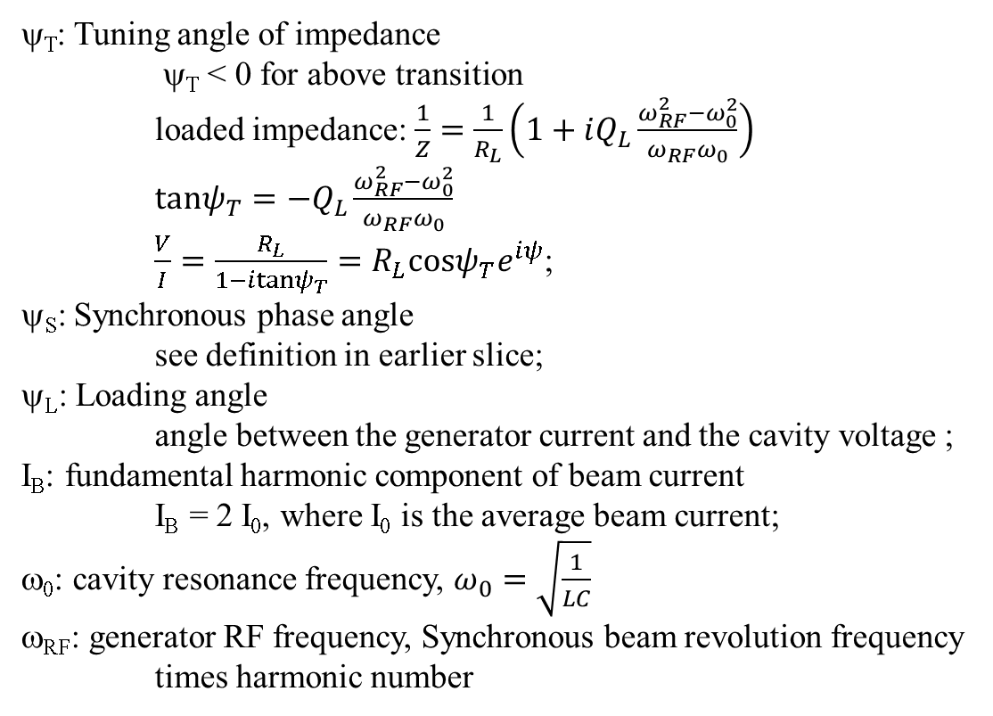
Phasor Diagram Parameters
ψ_{T}: Tuning angle of impedance
ψ_{T} < 0 for above transition
loaded impedance: $\frac{1}{Z}=\frac{1}{R_{L}}\left(1+iQ_{L}\frac{ω_{RF}^{2}−ω_{0}^{2}}{ω_{RF}ω_{0}}\right)$
$tanψ_{T}=−Q_{L}\frac{ω_{RF}^{2}−ω_{0}^{2}}{ω_{RF}ω_{0}}$
$\frac{V}{I}=\frac{R_{L}}{1−itanψ_{T}}=R_{L}\text{cos}ψ_{T}e^{iψ}$;
ψ_{S}: Synchronous phase angle
see definition in earlier slice;
ψ_{L}: Loading angle
angle between the generator current and the cavity voltage ;
I_{B}: fundamental harmonic component of beam current
I_{B} = 2 I₀, where I₀ is the average beam current;
ω₀: cavity resonance frequency, $ω_{0}=\sqrt{\frac{1}{LC}}$
ω_{RF}: generator RF frequency, Synchronous beam revolution frequency
times harmonic number

Slide 11
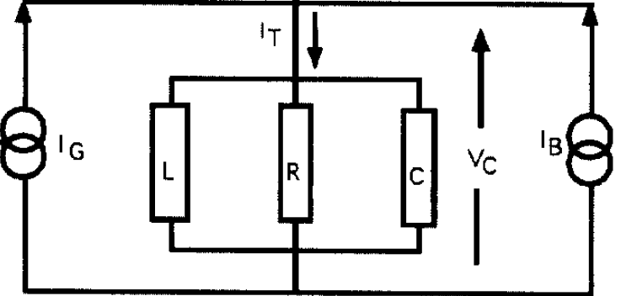
Loaded Generator-Cavity-Beam System
Both generator and beam are considered as current source,
generator feed energy in to cavity;
beam extracts energy from cavity.
$$V_{G}=R_{L}I_{G}\text{cos}ψ_{T}e^{iψ_{T}}$$
R_{L}
$$V_{B}=R_{L}I_{B}\text{cos}ψ_{T}e^{iψ_{T}}$$
When above transition, particles with higher energy have larger revolution time. Beam current needs to lags cavity voltage to satisfy the phase stability criteria, which means the beam effective impedance is inductive.
So, for the generator to see a resistive impedance, the cavity needs to be capacitive-detuned, it means ψ_{T} < 0 and ω₀ < ω_{RF}, and voltage lags beam current by the phase |ψ_{T}|, because then cavity impedance looks capacitive.

Slide 12
Ψ_{S} in Phasor Diagram
V_{cavity}
$$ψ_{s}$$
$$V_{acc}=V_{0}\text{sin}ψ_{s}$$
Ψ_{S}
-I_{B}
I_{B}
Ψ_{S}

Slide 13
Ψ_{S} in Phasor Diagram
V_{cavity}
$$ψ_{s}$$
$$V_{acc}=V_{0}\text{sin}ψ_{s}$$
Ψ_{S}
-I_{B}
I_{B}

Slide 14
Ψ_{S} in Phasor Diagram
V_{cavity}
$$ψ_{s}$$
$$V_{acc}=V_{0}\text{cos}ψ_{s}$$
-I_{B}
Ψ_{S}
I_{B}

Slide 15
Phasor Diagram, above transition, Ψ_{T}<0
V_{cavity}
I_{G}
V_{B}
Ψ_{L}
V_{G}
Ψ_{S}
Ψ_{T}
-I_{B}
Ψ_{T}

Slide 16
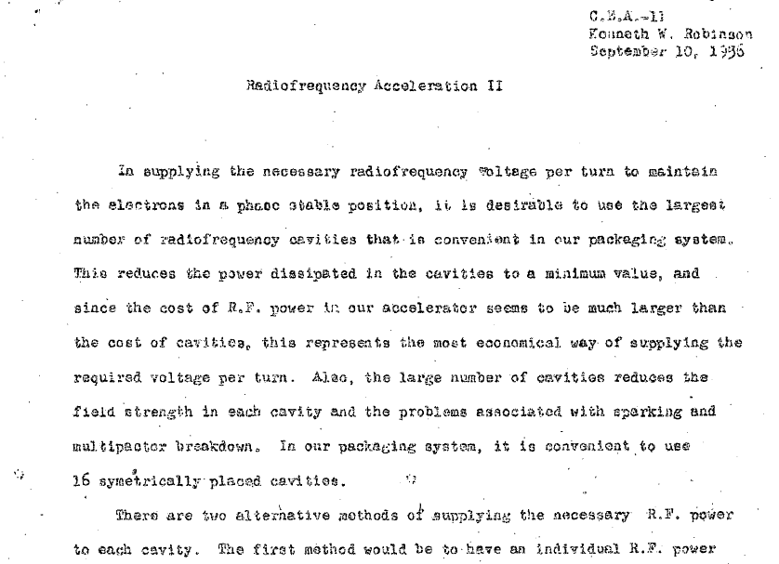
Robinson Instability Criteria --- CEA-11

Slide 17
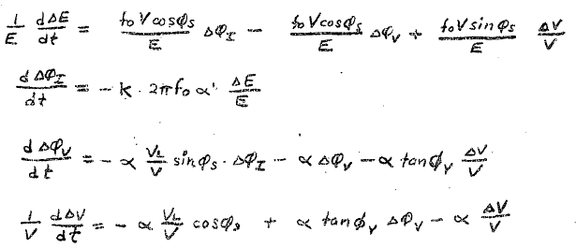
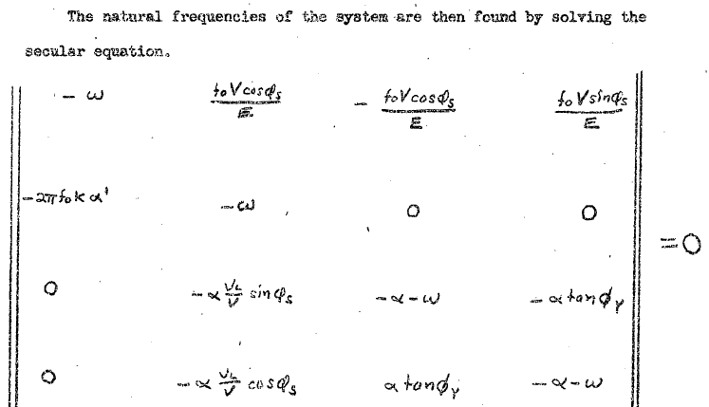
Equations of Cavity and Beam System

Slide 18
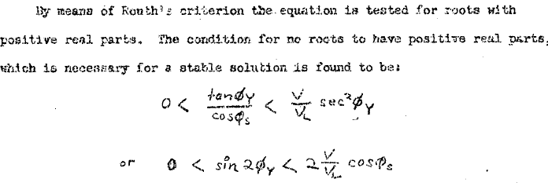
Stable Condition

Slide 19
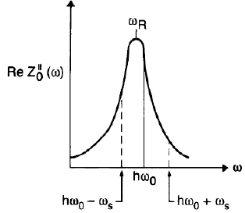
Further clarified in CEA-1010

Slide 20
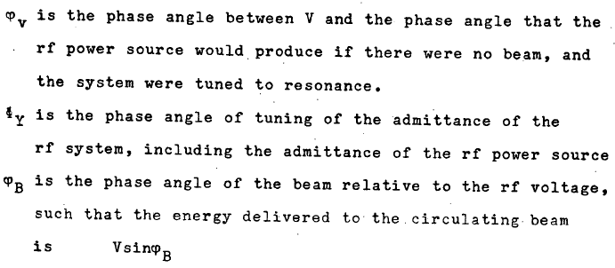
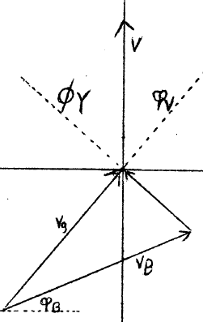
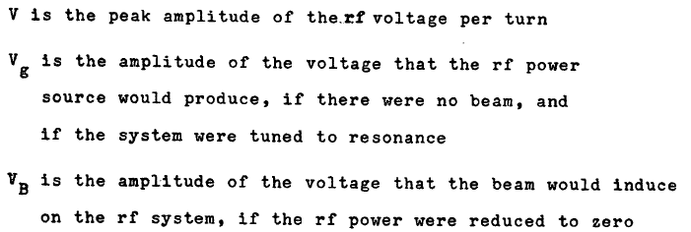
Ψ_{S} in Phasor Diagram in CEA-1010
Not impedance angle
=- $ψ_{T}$
$${=ψ}_{s}$$
$$ψ_{s}$$
$$V_{acc}=V_{0}\text{sin}ψ_{s}$$

Slide 21
@ 12 GeV
R_{L} | 12.9 | MΩ
I_{B} | 2*0.11 | A
Ψ_{T} | -32.4 | degree
Ψ_{S} | 57.6 | degree
Ψ_{L} | 0 | degree
V_{cavity} | 2.5 | MV
V_{B} | 2.5 | MV
V_{G} | 2.93 | MV
I_{G} | 0.39 | A
@ 12 GeV
V_{cavity}
V_{B}
I_{G}
Ψ_{S}
Ψ_{T}
Ψ_{T}
-I_{B}
V_{G}

Slide 22
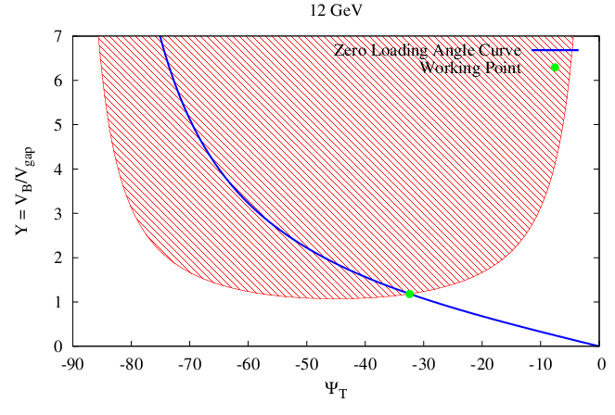
Robinson work point @ 12 GeV
Q_{ext@12GeV} = 1.23e5

Slide 23
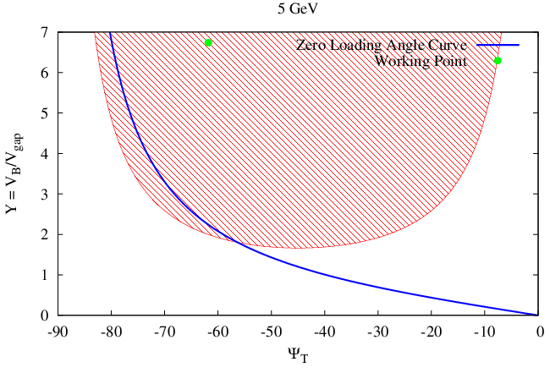
Robinson work point @ 5 GeV
Q_{ext@5GeV} = 0.01* Q_{ext@12GeV}

Slide 24
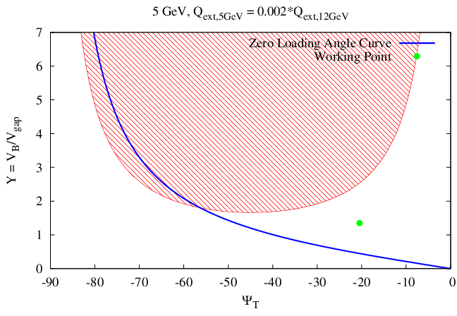
Robinson work point @ 5 GeV
Q_{ext@5GeV} = 0.002* Q_{ext@12GeV}

Slide 25
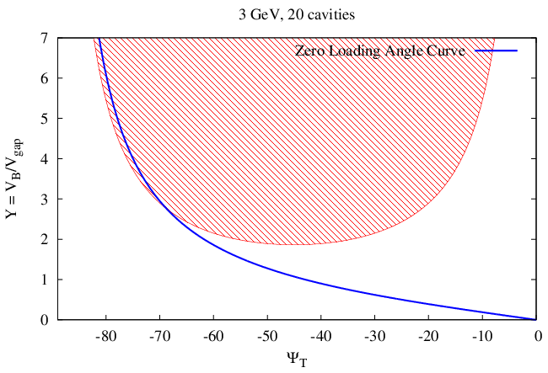
Robinson work point @ 3 GeV
Y = 268.2, tuning angle = -88.8 degrees
20 cavities
Q_{ext@5GeV} = Q_{ext@12GeV}

Slide 26
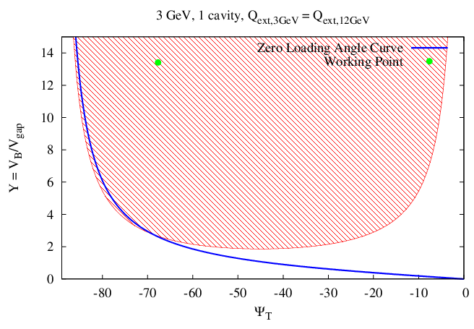
Robinson work point @ 3 GeV
1 cavity
Q_{ext@5GeV} = Q_{ext@12GeV}

Slide 27
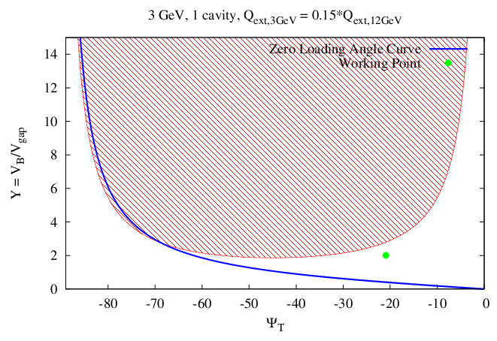
Robinson work point @ 3 GeV
1 cavity
Q_{ext@5GeV} = 0.15*Q_{ext@12GeV}

Slide 28
