Slide 1

MEIC Electron Cooling:
Do we have a Baseline Design and What is it?
MEIC R&D Meeting, Feb. 21, 2014

Slide 2
Why We need Electron Cooling?
Cooling of proton/ion beams for achieving high luminosity
  Very small emittance ➔ small beam spot size at IP
  Very short bunch (with strong SRF) ➔ allows strong final focusing (β* ≥ σ_{z})
  Suppressing IBS, expanding high luminosity lifetime
High bunch repetition
  Requiring a very small bunch charge even the beam has a high average current
  Reduction of many intensity-dependent collective effects
  Enabling (and optimizing) crab crossing
MEIC adopts traditional electron cooling
  Stochastic cooling is too slow for the proton beam
  Coherent electron cooling & optical stochastic cooling have not been proved yet
High cooling efficiency at low energy and small 6D emittance

Slide 3
Multi-Phased Cooling Scheme
DC cooling
High Energy cooling
ion sources
SRF Linac
pre-booster (3 GeV)
(accumulation)
large booster (25 GeV)
medium energy collider ring
Assisting (positive) ion accumulations (anti-proton recycle at Fermilab)
Pre-cooling at low energy (3 & 25 GeV) ➔ taking advantage that γ is still small (not in eRHIC, why?)
Final-cooling at high energy (up to 100 GeV) ➔ taking advantage ε_{6d} is already small after a pre-cooling (yes in eRHIC, but with large 6D emittances)
Continuous cooling for suppressing IBS (yes in eRHIC)
 | Stage | Ion (GeV/u) | Electron (MeV) | Cooler
Pre-booster | Accumulation of positive ions | 0.1 (injection) | 0.59 | DC
 | Emittance reduction | 3 (ejection) / long bunch | 2.1 | DC
Collider ring | Emittance reduction | 25 (injection) / long bunch | 13 | Bunched / ERL
 | Emittance reduction | Up to 100 ( bunched) | 55 | Bunched / ERL
 | During collision (suppressing IBS) | Up to 100 (RMS ~1 cm) | 55 | Bunched /ERL
state-of-art

Slide 4
MEIC Electron Cooling Simulations
Simulations based on BETACOOL code
IBS and cooling rates calculated at various stages (not a front-to-end simulation)
Assuming an ideal cooling electron beam (no effect in the circulator ring)
Electron beam is magnetized
Additional effects will be included in future studies
 |  | Pre-booster | Collider Ring
Proton energy | GeV | 3 | 25 (20) | 100 (60)
Proton number |  | 2.52×10¹² | 1.3×10¹³ | 4.2×10⁹/bunch
Proton bunch | cm | Long bunch | Coasting | 1
Solenoid Field in cooler | T | 1 | 2 | 2
Cooler section length | m | 10 | 2×30 | 2×30
Electron beam current | A | 3 | 1.5 | 1.5
Electron bunch length | cm | DC | 1.2 | 1.2

Slide 5
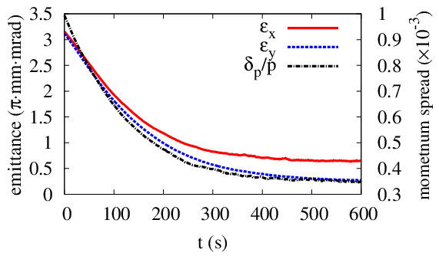
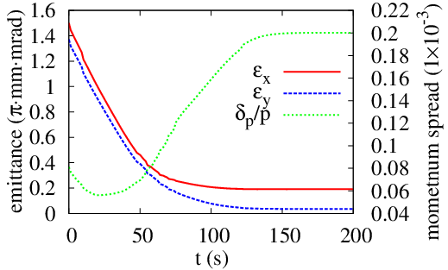
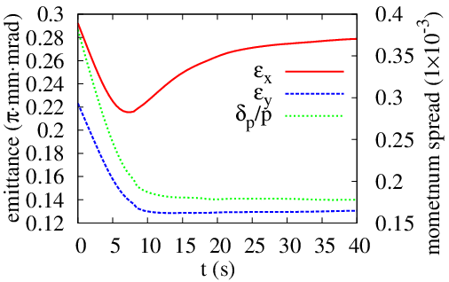
MEIC Electron Cooling Simulations
3 GeV
20 GeV
What simulations have shown
if the cooling electron beam can be provided as designed, the MEIC nominal design values of ion beam emittance & energy spread can be achieved
This is the best simulation we can do but it is always a question how accurate these results are
60 GeV

Slide 6
High Energy Cooling Parameters
Proton energy | GeV | 25 to 100
Lead ion energy | GeV/u | 10 to 40
Electron energy | MeV | 5.48 to 54.8
Proton/ion nominal current | A | 0.5
Cooling electron beam current | A | 1.5
Bunch repetition rate | MHz | 750
Electron bunch charge | nC | 2
Electrons per bunch | 10¹⁰ | 1.33
Bunch length | cm | 2~3
Electron beam energy spread | 10⁻⁴ | ~ 5
Normalized transverse emittance | mm mrad | ~5
Cooling channel length | m | 2x30
Solenoid field in the cooling channel | T | 2

Slide 7
ERL Circulator Cooler Concept
Perspective on high energy cooling
Up to 55 GeV
Must use RF/SRF linac for acceleration
Beyond state-of-art
Cooling by a bunched electron beam
Making of high energy, current/intensity electron beam
Cooler Design choices
Energy recovery linac (ERL)
Compact circulator ring
To meet technical challenges
High beam power (up to 81 MW)
Long source lifetime (up to 1.5 A)
Cooling section
ion bunch
electron bunch
eliminating the long return path doubles the cooling rate
solenoid
recirculating 10+ turns ➔ reduction of current from an ERL by a same factor
Solenoid
injector
circulator ring
Fast kicker
Fast kicker
energy recovery
SRF
injector
SRF Linac
dump
dumper
Notes:
7

Slide 8
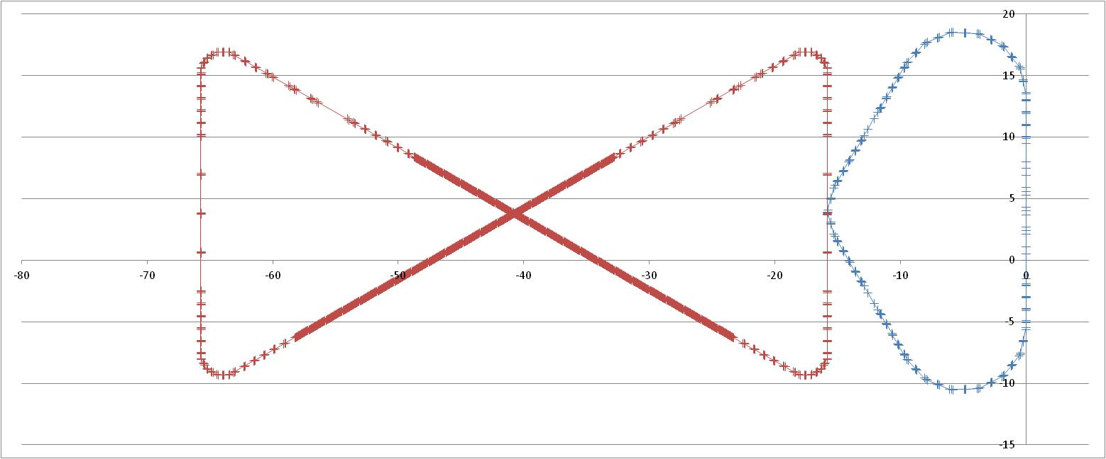
ERL-Circulator Cooler (Non-magnetized)
decompression
CCR
dump
dechirper
beam exchange system
cooling solenoids
ERL
SRF
rechirper
injector
recompression

Slide 9
ERL-CCR Design Parameters
Injection energy (momentum) p_{inj} (MeV/c) | 5
Injected longitudinal emittance e_{z} (keV-psec) | 80
RMS injected bunch length s_{l} (psec) | 5
RMS injected energy spread s_{dp/p} | 0.003
Linac on-crest energy gan (MeV) | 50.4
Full energy (momentum) p_{full} (MeV/c) | 54
Acceleration phase (deg) | -13º (ahead of crest)
Recovery phase (deg) | 166º (ahead of trough)
Decompression arc compactions (m) M₅₆, T₅₆₆, W₅₆₆₆ | 1.615, -3.93, 253
Dechirper on-crest energy gain (MeV) | 1.8
Dechirper phase (deg) | 90º (descending portion of waveform)
RMS bunch length s_{l} at CCR (cm; psec) | 1; 33 – 3; 100
RMS energy relative spread s_{dp/p} at CCR | <10⁻⁴
CCR compaction (m) M₅₆ | 0 (isochronous)
Dechirper on-crest energy gain (MeV) | 1.8
Dechirper phase (deg) | -90º (ascending portion of waveform)
Decompression arc compactions (m) M_{56,} T_{566,} W₅₆₆₆ | 2.2, 4, 250
Energy at dump (MeV) | 5.3
Charge/bunch (nC) | 2
Ring/ERL rep rate (MHz) | 750/(750, 75, 7.5)

Slide 10
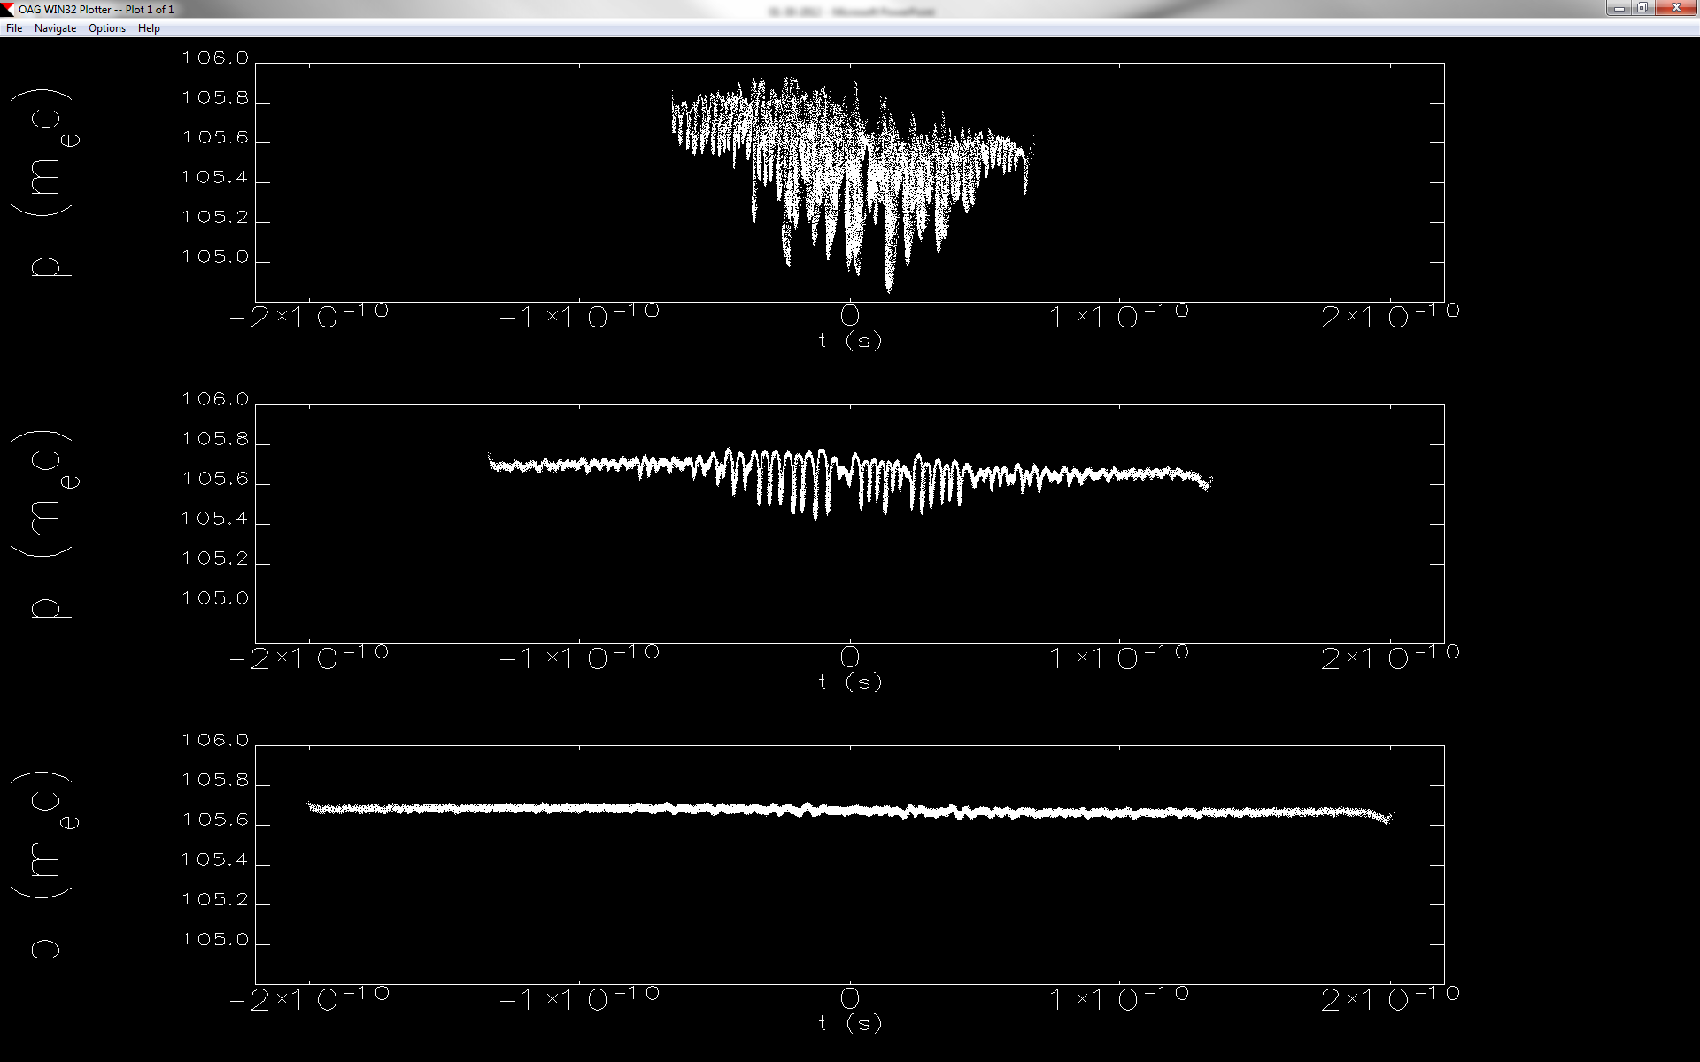
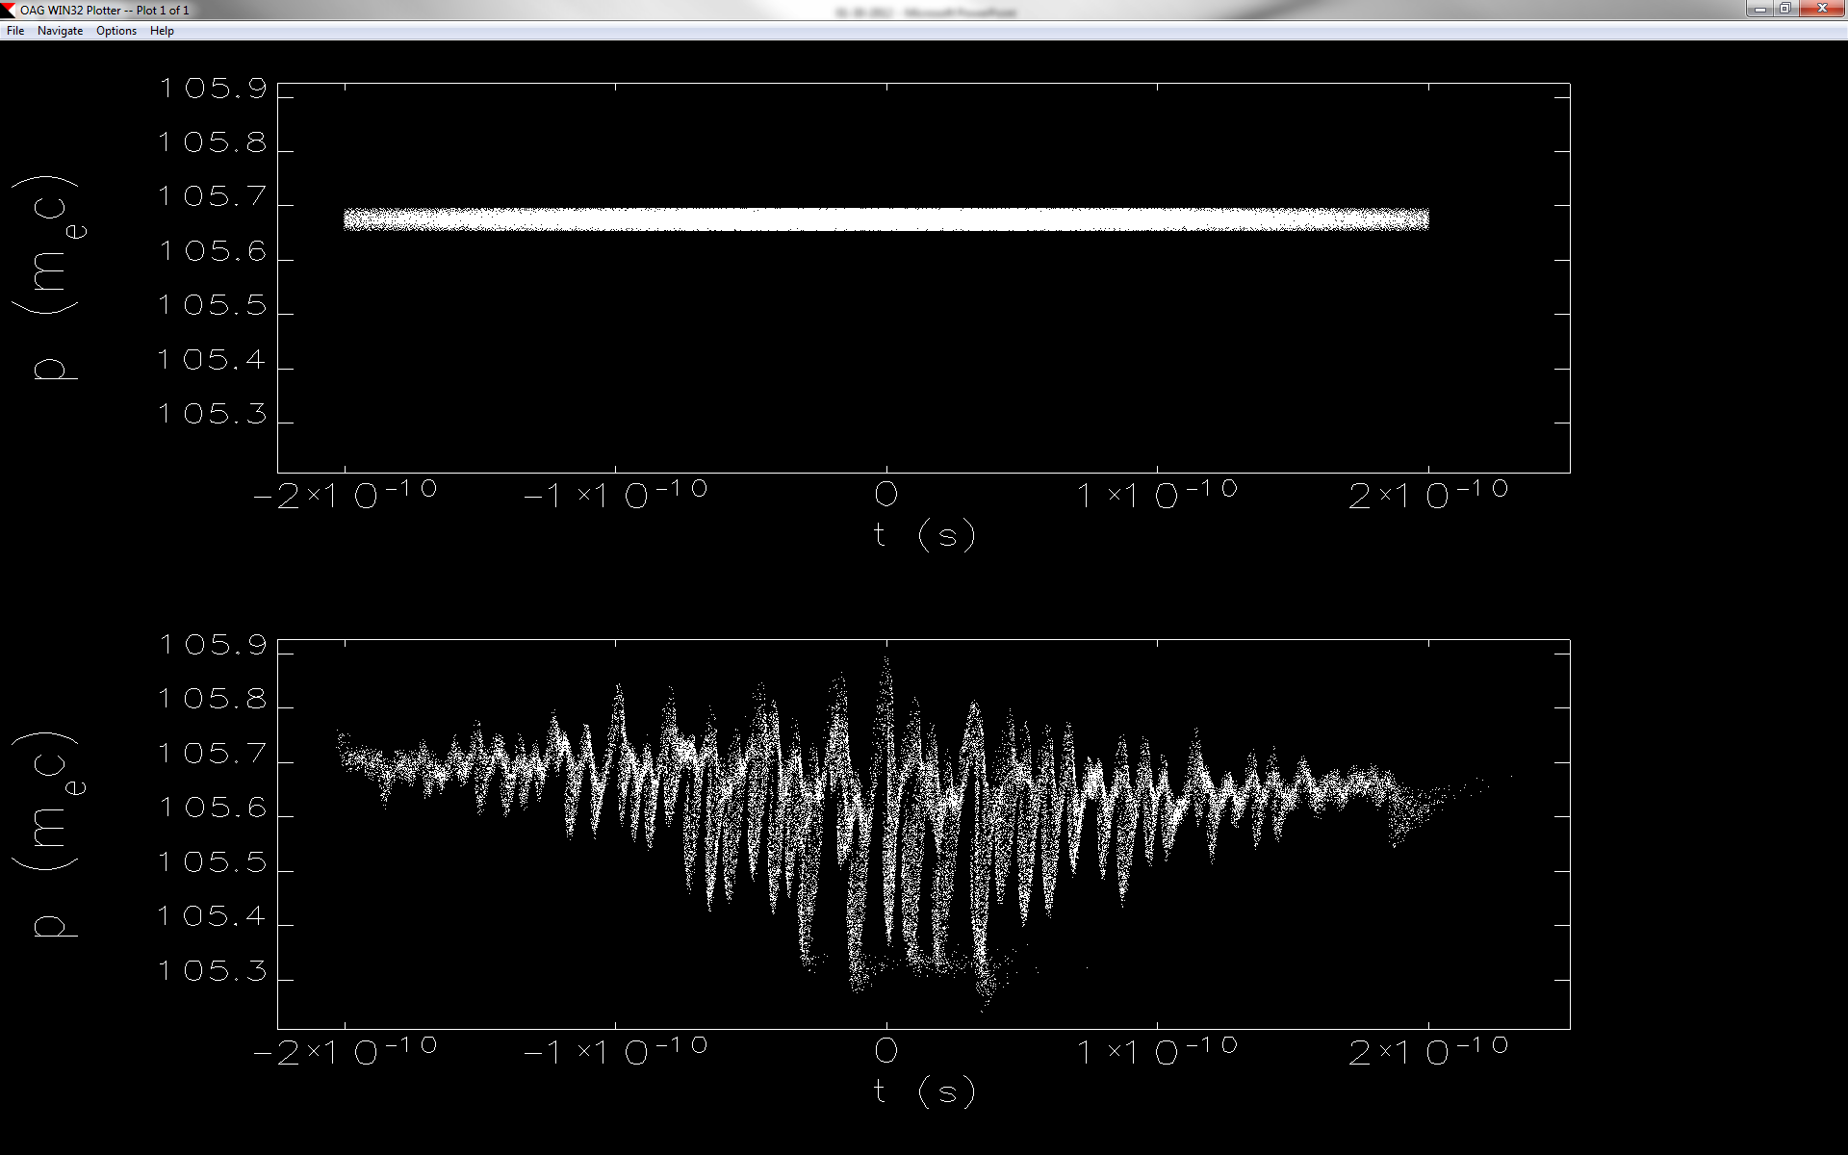
Beam Dynamics In A Circulator Ring
Particle tracking (ELEGENT) simulations of an e-bunch in the circulator cooler ring
  0.5 to 2 nC bunch charge
  1 to 3 cm bunch length
  < 0.01% energy spread
Coherent synchrotron radiation (CSR) could induce micro-bunching instabilities, thus limits number of recirculation turns in the circulator cooler.
2 nC,
After 10 turns
1 cm
2 cm
3 cm
0.5 nC, 3 cm, 100 turns
Δp/p~10⁻⁴
Δp/p~9x10⁻⁴

Slide 11
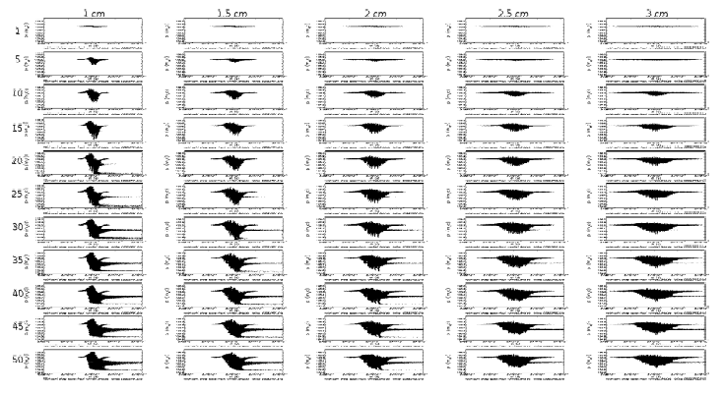
Beam Dynamics In A Circulator Ring
Energy distribution vs. bench length

Slide 12
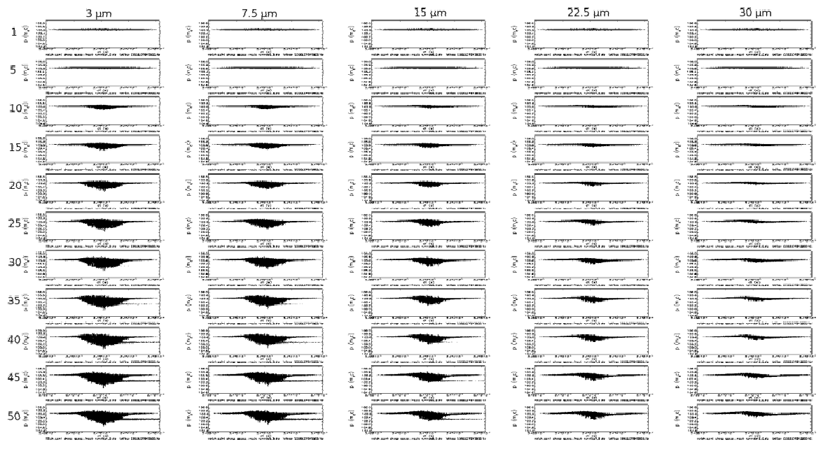
Energy distribution vs. emittance aspect ratio

Slide 13
What Simulations Tell US?
CSR could introduce micro-bunching instabilities at some parameter regimes
For the parameters that MEIC e-Cooler is interested (2 nC bunch charge, 3 cm bunch length, 5 mm mrad horizontal emittance, and aspect ratio 5, and a few of 10⁻⁴ energy spread), we have already achieved about 20 revolutions
Smaller bunch (0.5 nC) can go as high as 100 turns
Mitigation of CSR and suppressing micro-bunching instabilities is needed in order to increase number of the revolutions under which the electron beam is still away from the instabilities.
However
We don’t know how good these simulations are (how to bunch-mark the code?)
We also don’t know how bad are the other effects (space charge, inter/intra beam scatterings, reheating/back-reaction, particularly) on the cooling beam

Slide 14
ERL-CCR Minimum Design Parameters
Max/min energy of e-beam | MeV | 54/5.4
Electrons/bunch | 10¹⁰ | 1.25
Electron bunch charge | nC | 2
Bunch revolutions in CCR |  | ~25
Current in CCR/ERL | A | 1.5/0.06
Bunch repetition in CCR/ERL | MHz | 750/30
CCR circumference | m | ~160
Cooling section length | m | 30x2
RMS Bunch length | cm | 3
Electron beam energy spread | 10⁻⁴ | 1-3
Solenoid field in cooling section | T | 2
Beam radius in solenoid | mm | ~1
Thermal cyclotron radius | μm | ~3
Beam radius at cathode | mm | 3
Solenoid field at cathode | KG | 2
Long. inter/intra beam heating | μs | 200
set as the design goal
60 mA is possible

Slide 15
What CSR Mitigation Options We Have?
Magnetized electron beam
Special optics
Magnetized electron beam
Tremendous reduction of Laslett tune, thank to the huge CAM emittance (large beam size in solenoid)
Strong reduction (suppression) of CSR (by use of a large longitudinal slip in arcs due to large beam size)
Strong reduction of impacts of e-beam high transverse temperature and short-range misalignments to cooling rates (magnetized EC)
Easing the kicker constraints - by use of round to flat beam transformations

Slide 16
ERL-CCR Design With Magnetized Beam
decompression
CCR
dump
dechirper
beam exchange system
cooling solenoids
SRF
ERL
rechirper
Flat beam transform
Magnetized source
recompression
Advanced design elements
Magnetize electron beam/source
Round-to-flat transform

Slide 17
CSR Management: dM/C/S Approach
diMitri/Cornacchia/Spampinati PRL Jan’13 => give potential methodology
Use of longitudinally periodic achromat
  CSR control
  uBI suppression
Longitudinally aperiodic/large amplitude compaction oscillation achromat => μBI enhancement
A 2nd order achromat based on individually isochronous & achromatic superperiods meets all requirements stated in dM/C/S for compensating CSR-driven emittance dilution
  Every emittance-degrading CSR-induced momentum shift is matched by an identical one generated at a location with the same bunch length, same Twiss parameters, but a half-betatron wavelength away
Can readily generate lattices over broad range of energies that satisfy such conditions
  Have solutions for ~200 MeV through a few GeV

Slide 18
CSR Management: JLab Patented Approach
Based on recent JLab emittance-preserving transport analysis (US Patent Pending)
  2nd order achromat composed of multiple individually isochronous & achromatic superperiods self-compensates CSR-induced emittance effects and suppresses microbunching instability
Compact arc based on 1990’s vintage three-bend isochronous achromat (Robin, Neuffer)
  TBA with small-angle reversed center bend
    Alleviates required focusing strength in, e.g., Steffan system
  Individually achromatic/isochronous superperiods with ¾ integer bend-plane tunes
  4 periods = 2nd order achromat
    Very good chromatic properties
  Extremely robust suppression of CSR-induced emittance growth and microbunching

Slide 19
Do We Have A Clear Path Forward?
Magnetized beam is in principle good not only for CSR mitigation, but also for space charge and high cooling efficiency.
Do we have a quantitative estimation on the CSR mitigation by introducing a magnetized beam? How easy to get this?
How to demonstrate the effectiveness of the optical approaches?

Slide 20
Cooler Components and Topics
Generation and accelerator of the cooling electron beam
  Magnetized source
  ERL
Transport of the cooling electron beam
  Longitudinal matching
  Beam switching between ERL and CCR (scheme and hardware)
  Flat-to-round transform
Circulation of the cooling electron beam
  Optics (CSR mitigation, etc.)
  Collective effect (CSR, space charge, IBS)
  Intra-beam effect (scatterings and heating)

Slide 21
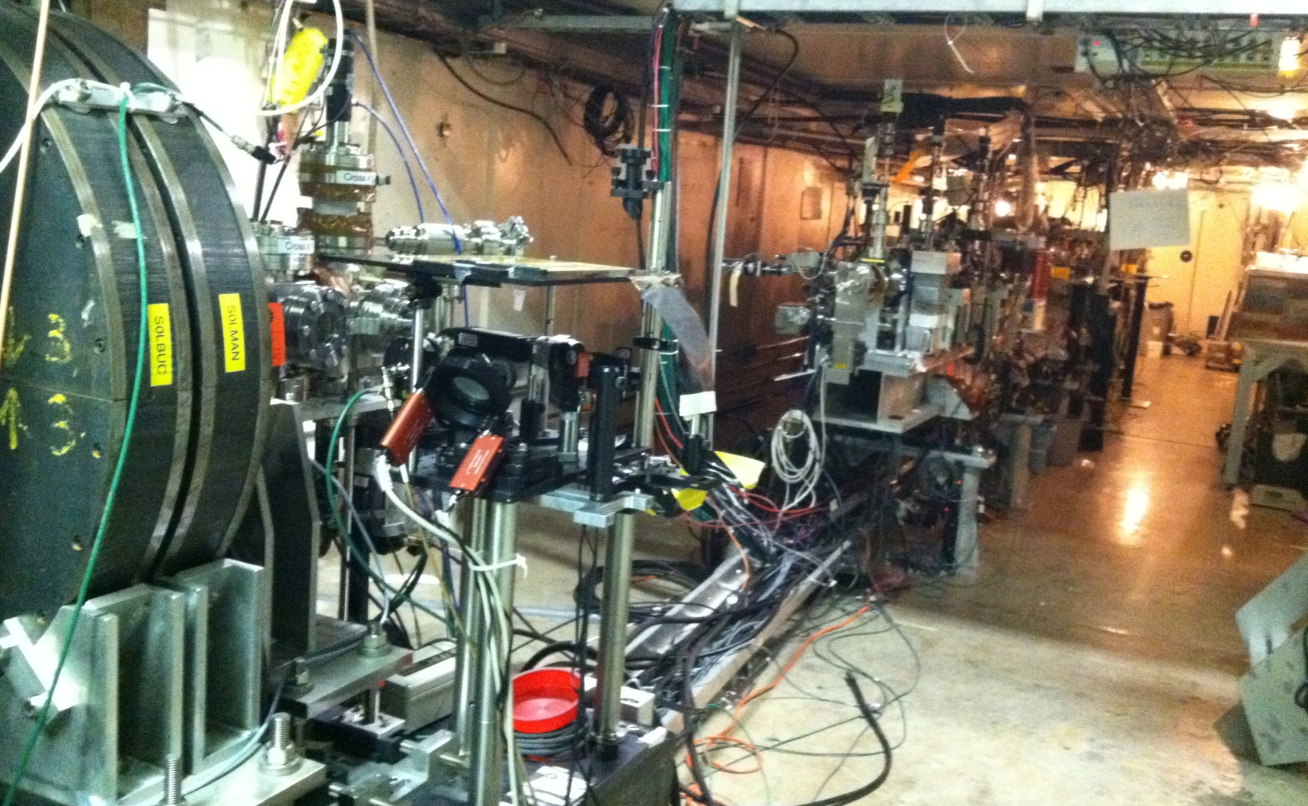
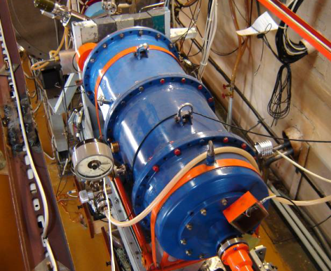
Electron Source Development
RF photo-cathode gun (like A0 at Fermilab)
  (1.3 GHz, 1.625-cell NC RF gun, 4 MeV; 12 MeV SC cavity, Cs₂Te photocathode; 0.2–1 nC)
Grid-operated DC / RF thermionic gun (like BINP)
  (300 kV DC acceleration tube, 1.8 A peak, 1.3 ns, 10 mm mrad
  upgraded to RF gun, 1.23 nC, 47.22 mm, 16.2 mm mrad)
BINP
A0@FNAL

Slide 22
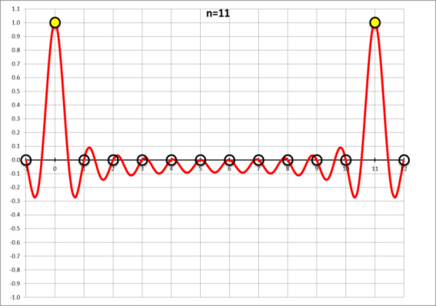
Cooler Technology Development
ERL and longitudinal phase space matching
  Short bunch in high frequency ERL, converting to a long (1 to 3 cm) bunch in the circulator cooler ring;
  Very long bunch in in gun (less space charge), compressing to 3 cm and send to ERL and the circulator ring
ERL-CCR beam exchange and fast kicker
  Bunch-by-bunch vs. (bunch) train-by-train replacement
  RF harmonic kicker (JLab LDRD)
  Beam-beam kicker (proposed by V. Shiltsev)
F
c
Harmonic kicker
h
kicking beam
v<<c

Slide 23
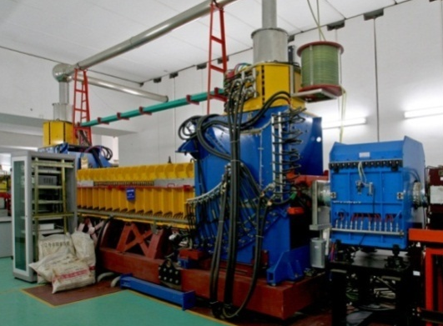
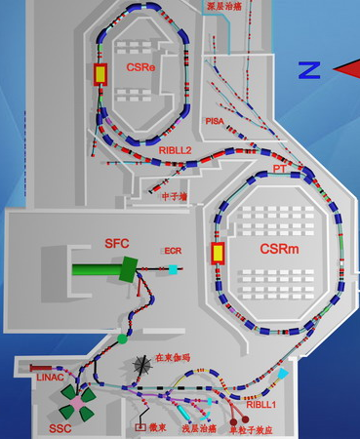
Demonstration of Cooling with a Bunched Electron Beam
Institute of Modern Physics, Chinese Academy of Science
A. Hutton (JLab), H. Zhao (IMP)
DC cooler
IMP has two storage rings, each has a DC cooler for ion coasting beams (built in collaboration with BINP)
Idea: modulating a DC electron beam into a bunched beam with a high repetition rate by applying a pulsed voltage to the bias-electrode of the electron gun
Non-invasive experiment, supported by IMP leadership
Phase 2: adding an RF cavity for bunching the ion beams to test a bunched electron beam to cool a bunched ion beam
Medium energy
Bunched beam
ERL
Circulator ring
Technology Development
A collaboration of JLab, IMP (China) and BINP
Slide 23

Slide 24
Questions
Do we have a clear goal/scope of this experiment?
Do have a technical design? Or it is too straight-forward that we don’t need one?
Can we do some simulations to make a prediction of the experiment outcome?
What diagnostic do we need?
What are the JLab role/contribution in this collaboration?
What code banch-marking we should do?
How to extend this experiment?

Slide 25
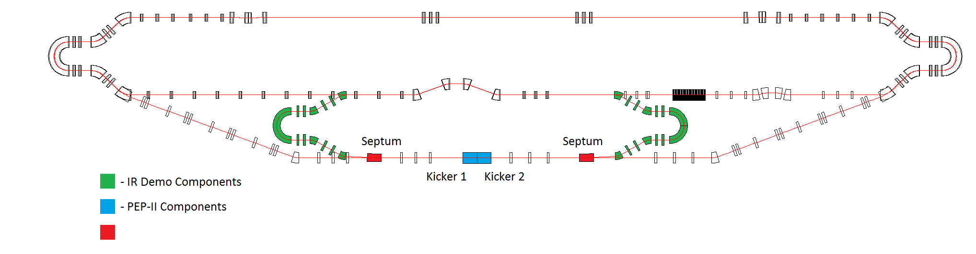
Demonstration of ERL-Circulator Cooler and technology Development
Dechirper
Rechirper
Cooler Test Facility @ JLab FEL ERL
Purpose
  Demonstrate the cooler design concept
  Develop/test key technologies (fast kickers, etc.)
  Study dynamics of the cooling bunches in a circulator ring
Phase 1 scope
  Using the existing ERL without upgrade, adding two 180°dipoles (available at JLab)
  Supporting MEIC to deliver the high luminosity (5.6~14 x 10³³ 1/cm²/s),
Medium energy
Bunched beam
ERL
Circulator ring
Technology Development

Slide 26
Hutton Questions
What are the tests that we believe must be completed before the down-select (to emphasize the point, not before CD1 but before the down-select)? If we are strapped for cash (as we may well be), what would be the wisest use of this money? If we have a convincing theoretical analysis of the stability of the cooling ring, do we actually need a cooler test before the down-select? For the rings, we will need frequency-agile SRF cavities. If we have a design, do we need a prototype before the down-select? Etc, etc. In other words, while we should continue pushing for funding for MEIC R&D from the DOE and other funding agencies, internally we should evaluate whether we have vulnerabilities that really cannot be addressed without a hardware test (and I fully understand that we would all like to be able to fully test any new component).
A second set of questions revolves around whether cooling ring tests can be carried out on an existing facility. There is a high up-front cost to a ring test in the FEL; are there existing rings that could host these tests? Or a subset of the tests? Or can be used to bench-mark codes? I think that the DOE-HEP initiative on Advanced Accelerator R&D would be very interested in a cross-lab initiative to evaluate something as fundamental as CSR.

Slide 27
Questions
What is the most important goal for this experiment? for this test facility?
What are the 1st experiment? 2nd experiment?
Without upgrading the gun/ERL, what experiments we can do and what they can tell/prove?
Can we do the experiments without fast kickers?
Let us give a try
For the first phase (before down-selection) I only want to answer one question: how many turns the beam can survive?
(after magnetizing the beam and/or trying the CSR mitigation schemes, or whatever we can do)
If the outcome is promising (>25), we work hard to develop technologies (sources and kickers, etc.)
We can do this test without a faster kicker?
We can mimic the real cooler condition (intensity, etc) with the existing facility
We need to develop simulations to accurately predict the results.

