Slide 1

EXPERIMENTAL STUDIES OF OPTICS SCHEMES AT CEBAF FOR SUPPRESSION OF COHERENT SYNCHROTRON RADIATION INDUCED EMITTANCE GROWTH
Yves Roblin, Computational Accelerator Physics Group, CASA
A.Hofler, D. Douglas, G. Krafft, C. Tennant

Slide 2
Introduction
MEIC cooling design uses recirculator
  Very sensitive to CSR microbunching
  Methods to reduce effect of CSR microbunching
    Di Mitri et al, Phys. Rev. Lett. 110 (2013) 014801
    outlined method based on symmetric CSR kicks, i.e lattice structure
    Douglas et al, JLAB-ACP-14-1751 extended to more generic lattices
Notes:
Recently reexamined by DiMitri et al, although there has been earlier work on that.
Based on the fact that transverse momentum kicks coming from CSR can be compensated by the opposite kick half a betatron phase away given a properly configured lattice. Its easy to see with even number of super periods.
It was recently extended to arbitrary number of super periods by realizing that this cancelation occurs on a slice by slice
basic in the longitudinal phase space.

Slide 3
Goal of this LDRD
Carry out studies to prepare a proposal for an actual experiment at CEBAF.
Scope:
  Design optics to enhance/suppress CSR in east ARC (ARC1 or ARC3)
  Study transport from injector to ARC, optimize
  for high charge.
  Determinate optimal injector setup
Notes:
Amongst the things to do are :
1) Find the optimal longitudinal phase space configuration that is supported by CEBAF conducive to this experiment.
2) Design optimal lattices for CEBAF, find what are the requirements on the beam properties out of the injector
3) Recommend an injector configuration to support this.
4) We have extensive experience from FEL to build upon.

Slide 4
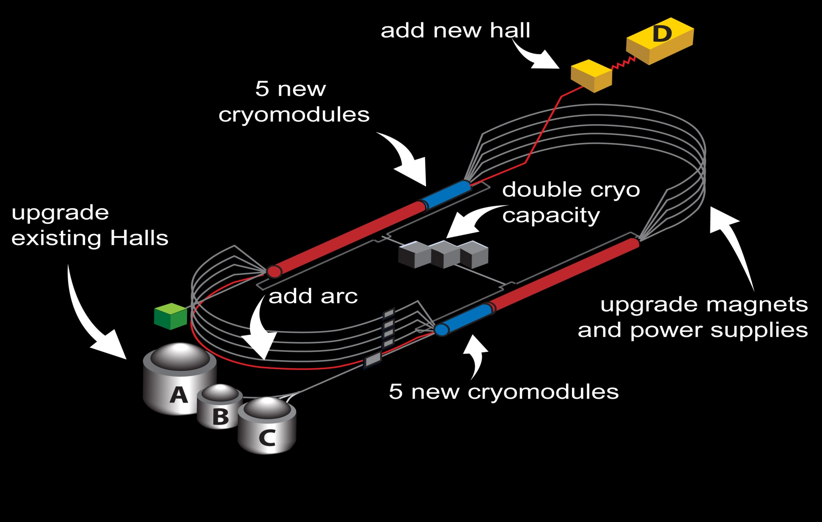
CEBAF layout
Notes:
6GeV: Recirculating SRF linacs, low emittance, low dp/p machine. Dp/p dominated by bunchlength and rf linac phases
Arcs are isochronous bends to keep M56=0, and hence, keep bunch short (avoid head-tail effects which grows emittance)
We will reconfigure CEBAF to accelerate at around 500 MeV and go through ARC3, terminating the beam at the end of the ARC. No recirculation. We have a 123 MeV/c injector followed by a chicane with tunable M56, a linac and a two step spreader leading to a recirculation arc for each pass. We propose to do the experiment in the recirculation arc. We will reconfigure the injector to deliver a high brilliance beam, compressing at the chicane and at the spreader. Lattices will be installed in the east ARC (ARC3) for “good” and “bad” CSR.
12GeV: emittance growth and dp/p now dominated by Synch. Rad. We can relax M56 condition and go to DBA to reduce transverse emittance
Added an extra half pass and another arc to deliver to hallD a 12 GeV beam.
ARC1 and ARC2, high dispersion arcs for centroid and energy spread monitoring
SPREADER: achro. Vert. bend to move beam from linac to arc + matching section
RECOMBINER achro. Vert. bend to move beam from arc to linac. + matching section
ARC3-ARCA 180 isochronous achromatic bends (unless its DBA) l
Beam is send to hallD on a target which produces photons. Electron beam is then deflected into a tagger magnet for momentum determination and terminates at the dump. Photon beam is collimated and goes to the experimental target located in the detector package.

Slide 5
CSR suppression lattice
Recipe:
  2nd order achromat with achromatic and isochronous super periods to suppress CSR induced emittance growth in transverse emittance
  Low M56 variations within the lattice to also reduce the microbunching gain.
  CEBAF lattices can meet that requirement.

Slide 6
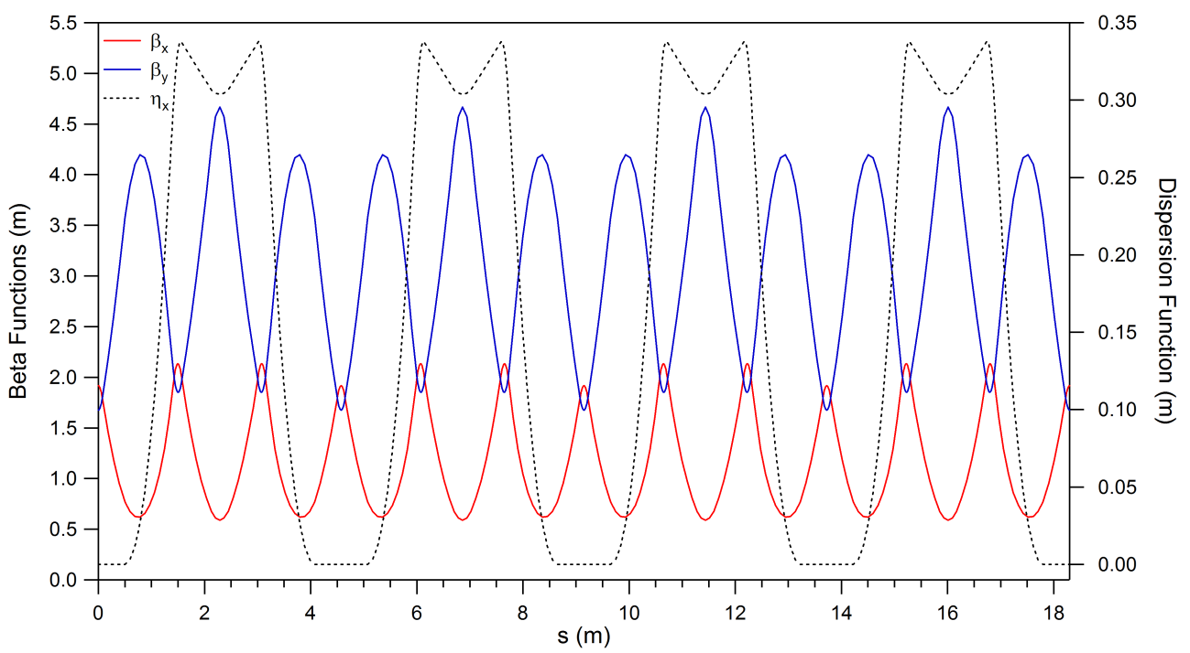
CSR suppressed lattice
JLAB-ACP-14-1751
Notes:
This is the lattice designed as a proof of principle that we used in the paper. It’s a low energy recirculation ARC based on a Triple bend achromat design.

Slide 7
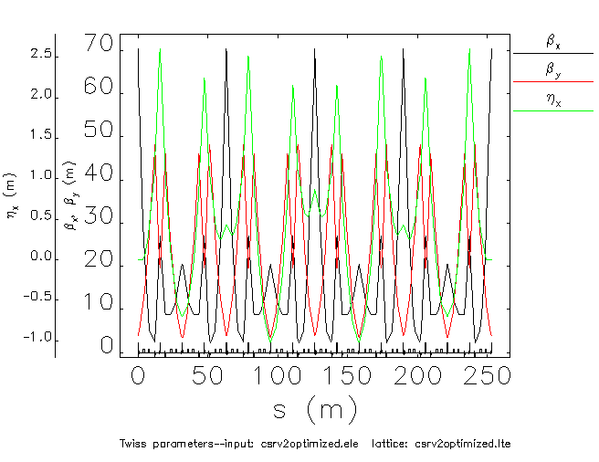
CEBAF ARC3 CSR SUPRESSED LATTICE
Notes:
Satisfy all conditions, its achromatic and isochronous to 2nd order. Bending plane beta (betax) is small at dipoles, close to TME criterion for minimum emittance growth. Based on split tunes of 5/4 and ¾ just like CEBAF.

Slide 8
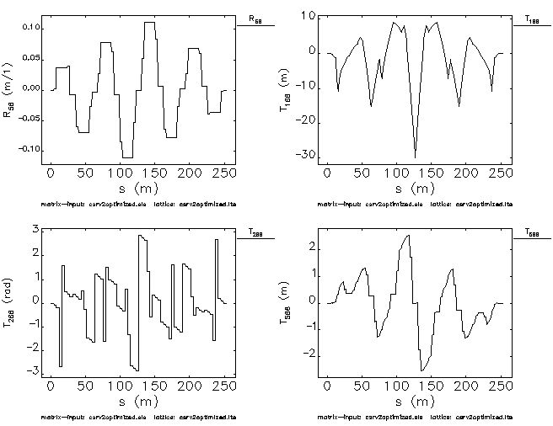
CSR ARC3 suppressed lattice (cont)
Notes:
It is achromatic and isochronous to 2nd order. Shown are R56, T166, T266 and T566. (T16 is shown on previous slide as dispersion)

Slide 9
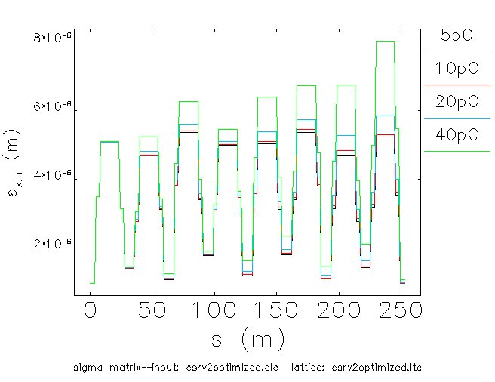
CSR
Suppressed Lattice (cont)
Bunchlength 300 fs, transverse emittance 1mm.mrad
Notes:
This is for 1mm.mrad of transverse emittance and 300 fs bunchlength. No sign of emittance growth at end of arc up to 40 pC. Its true for much higher bunch charges too but we cant reach them in CEBAF (insertable dump power limit amongst other things)

Slide 10
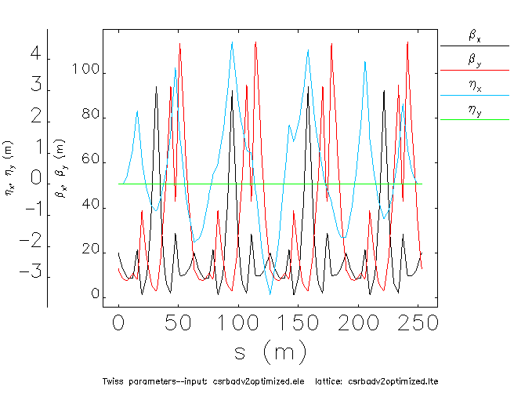
CSR Enhancing Lattice
Notes:
Based on a mismatched dispersion pattern. Superperiods are not individually achromatic and isochronous. Instead the whole arc is corrected to 2nd order globally. This results in large variations in R56 inside the lattice and produce
a large microbunching gain.

Slide 11
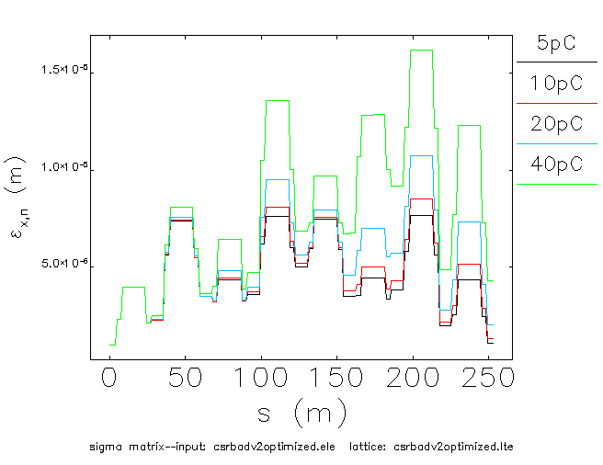
CSR Enhancing Lattice
Notes:
That is for 1mm.mrad transverse emittance and 300fs bunchlength.
We start seeing emittance growth right away at 5pC. Note that we can not go much beyond 40pC in the machine for lack of place to dump the beam (dump limit=2kW) unless we recirculate and energy recover in the south linac…

Slide 12
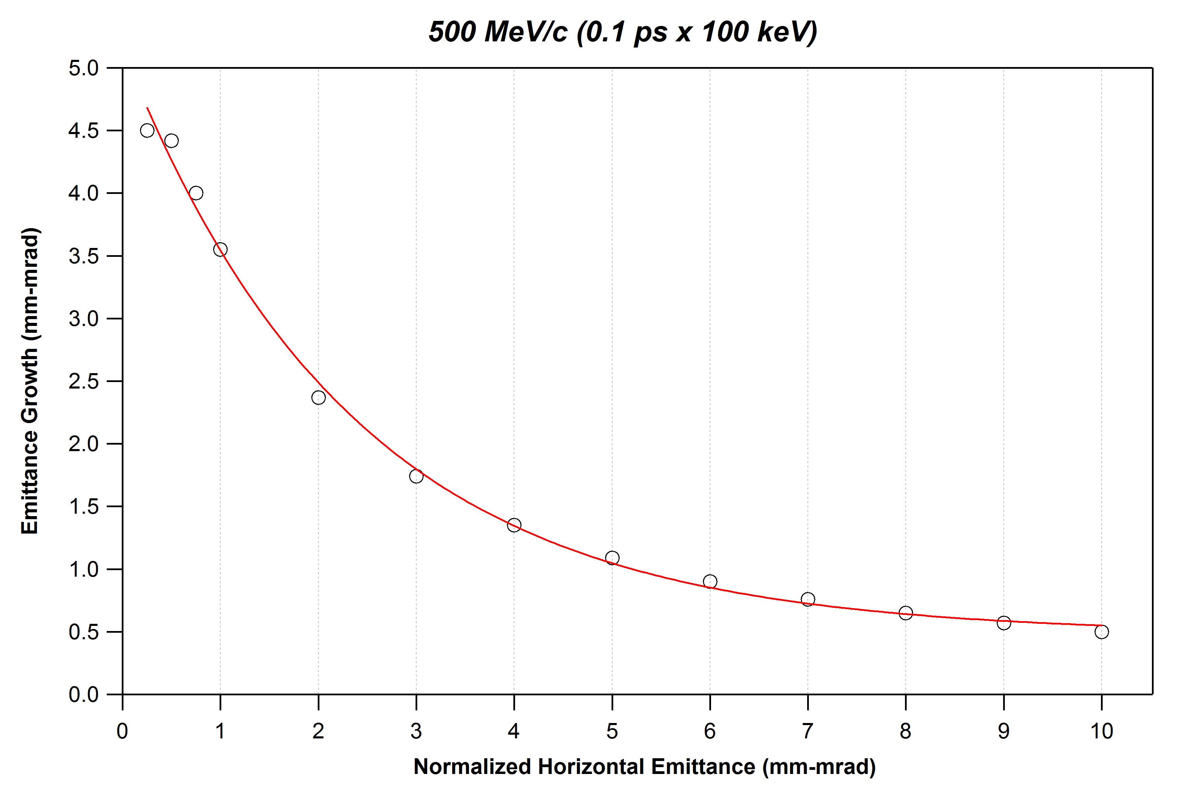
CSR Induced Emittance Growth
courtesy C. Tennant
Notes:
Need to keep transverse emit well below 5 mm.mrad ? To get significant growth (measurable) for 20pC.
Brightness is important. We have to control both charge and transverse emittance.

Slide 13
Preliminary Injector simulations
(courtesy A. Hofler)
Notes:
That was with 350 KeV gun in front of machine. GA optimization. That’s the pareto front at entrance of ¼ cryo.
This study shows that one has to consider an alternate injector configuration. Reaching low transverse emittance while achieving high bunch charge is impossible due to the long injector transport line (that was designed for fractions of pC).

Slide 14
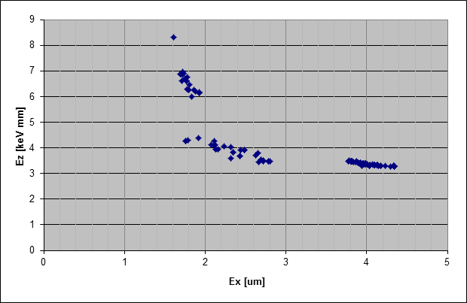
Alternate front end, FEL like.
F. Hannon has done several optimizations of the FEL gun (350 keV)
Simulations include ¼-unit, but no merger – these results represent best case scenario (lower limit on achievable brightness)
For 20 pC transverse emittances of 0.3 mm-mrad are possible*
For 135 pC transverse emittances of ~2 mm-mrad are possible*
135 pC
20 pC
(courtesy F. Hannon)
(courtesy F. Hannon)
*subject to details of the simulation (number of particles,
not including head-tail kicks of couplers, etc.)
courtesy C. Tennant

Slide 15

Roadmap
Design Lattices as in JLAB-ACP-14-1751 specific for CEBAF
Estimate conditions needed for measuring the effect
Optimize the longitudinal match of the machine (in progress)
Study suitable injector configurations (in progress)
Check linac transport with high bunch charge
Define Beam macro pulse structure
Develop diagnostics such as transverse phase space tomography (we did it in the FEL)
Notes:
50 microseconds tune pulse (instead of 250microseconds) will give us 50e-6*60=3e-3 duty cycle
40e-12pC*31e6Hz=1.24 mA (running 31Mhz laser with 40pC). At 500 Mev it is 620 kW. With the tune mode duty cycle we
End up with 620*3e-3=1.86kW

Slide 16
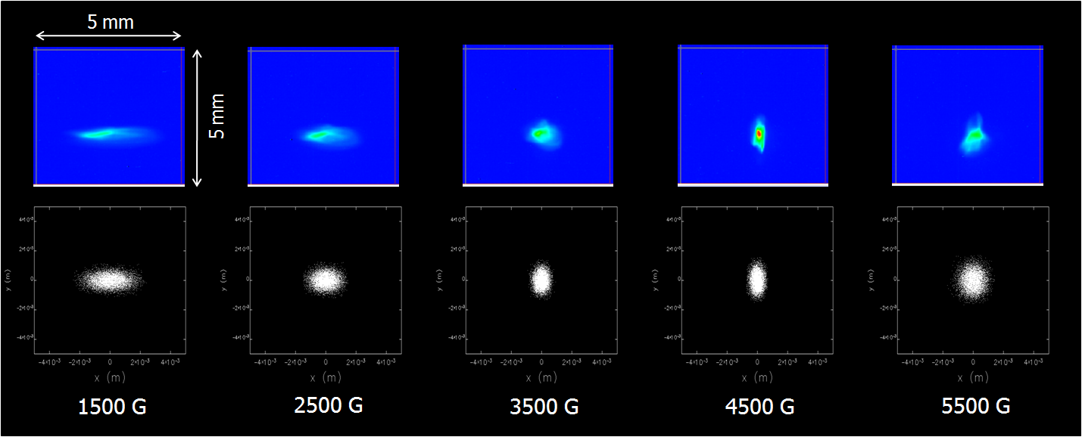
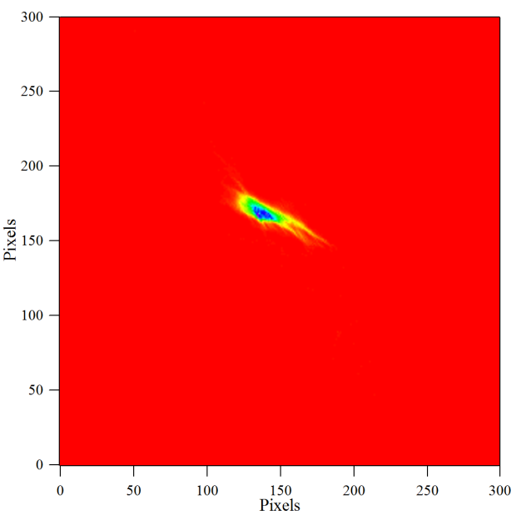
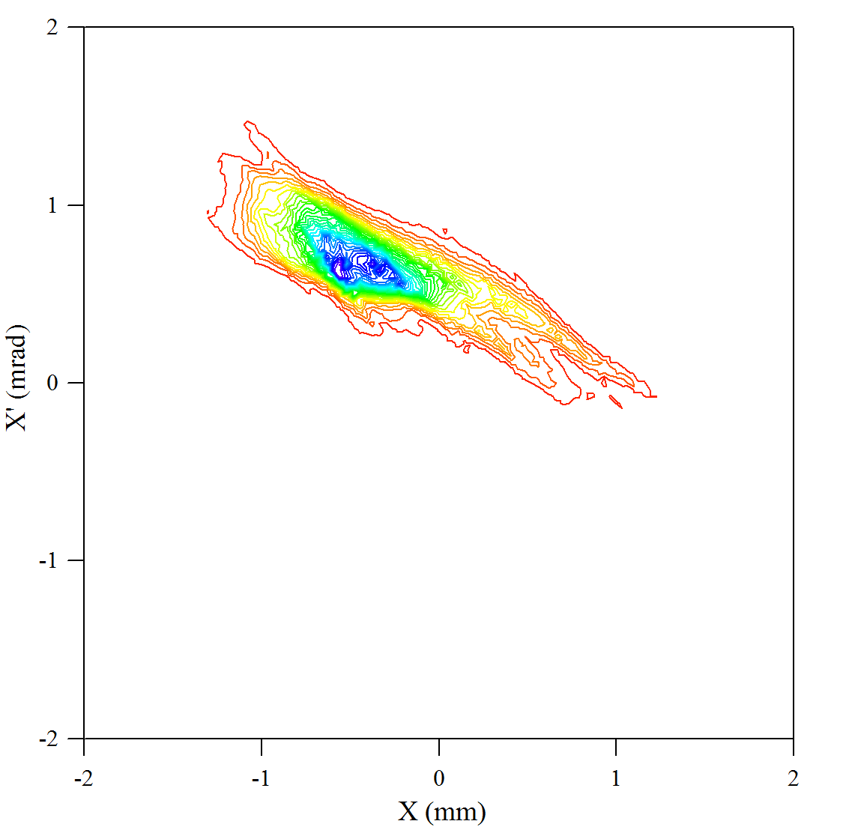
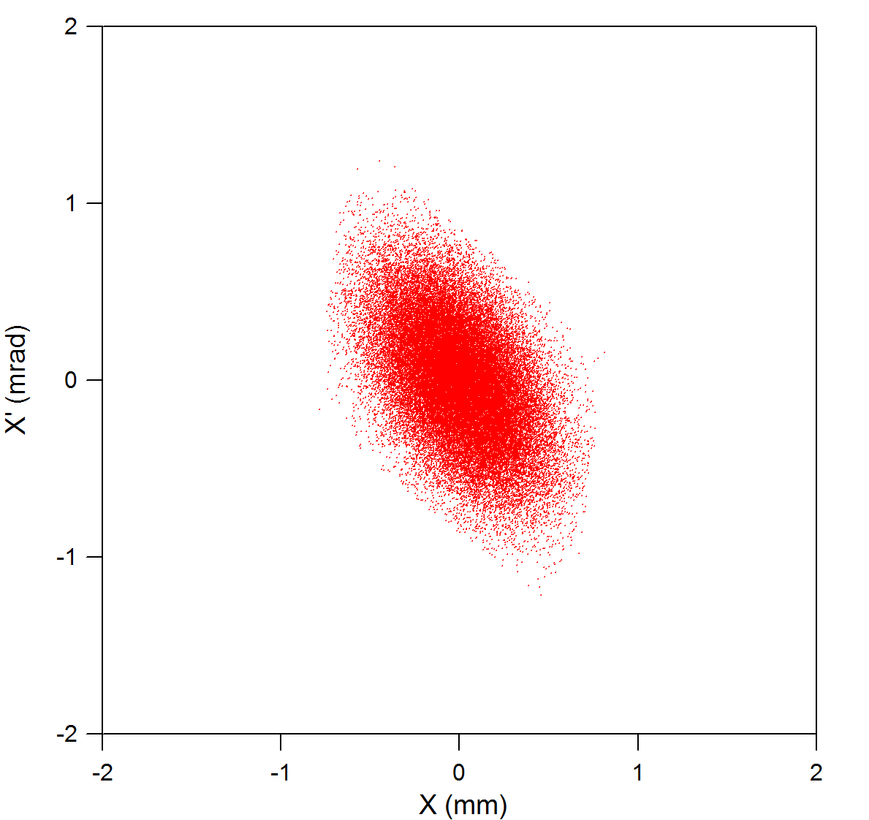
Tomography at the FEL
With similar phase coverage (157°) we were able to reconstruct horizontal phase space in the FEL Upgrade Driver (TN-09-021)
Actual beam spots
Simulated beam spots
MENT output
courtesy C. Tennant
Reconstructed (x,x’)
Simulated (x,x’)

Slide 17
Staffing
Staff | Weeks
Alicia Hofler | 6
Geoff Krafft | 3
D. Douglas | 1
C. Tennant | 3
Y. Roblin | 6
Total 19 weeks.
Reallocate rest of funds to buy a 96 CPU computer for
GPT simulations for injector models.
Notes:
Not shown during talk. For Fulvia’s info.

