Slide 1
Induction Cell Synchrotron for MEIC Ion Complex
S Wang, J Guo, R Rimmer, H Wang
3/30/2015
JLAB

Slide 2
Contents
Why
Induction Cell in Accelerators
Induction Cell and Induction Linac
Induction synchrotron
Barrier bucket
Energy Ramping
KEK experiments
MEIC Ion Complex with Induction Cell

Slide 3
WHY
Induction cell synchrotron could provide:
Accelerate all species of ions with one synchrotron at low energy for MEIC;
Provide a longer uniformly distributed bunch before rebunching at colliding energy, so colliding bunch chain will have uniform bunch charge
Easy transition crossing difficulty

Slide 4
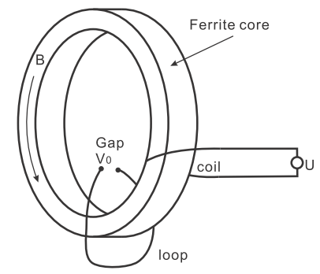
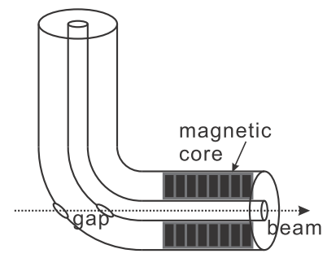
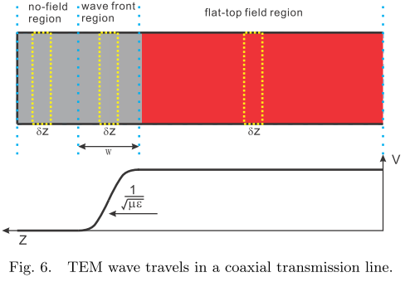
Induction Cell
Non-resonant structure, low impedance, works in pulsed mode.
Transformer Type (Earlier)
Transmission Line Type (Modern)
The change of ﬂux in the magnetic core induces an axial electric ﬁeld, which is the acceleration ﬁeld and appears at the gap of the secondary loop,
The power supply cable and the acceleration module are considered as one transmission line ﬁlled with diﬀerent materials. Charged particles are accelerated by the voltage diﬀerence between the inner and outer conductor of the transmission line and travel inside the inner conductor.
ASTRON-I, N. Christofilos, R. Hester, W. Lamb, D. Reagan, W. Sherwood,
and R. Wright, Rev. Sci. Instrum 35, 886 (1964).
Shaoheng Wang, J. Deng, “Acceleration modules in linear induction accelerators”, Chinese Physics C, Vol. 38, No. 5 (2014) 057005

Slide 5
Resonant Ferrite Loaded Cavity and Pulsed Induction Cell
In revolution frequency variable accelerators, like proton booster, the resonant working point is varied by varying DC bias current, the relative permeability of the core is changed, so is the resonance frequency.
Induction cells use large hysteresis loop area to get large Volt-Second number

Slide 6
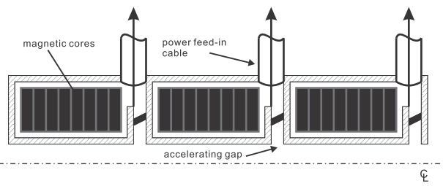
Induction Linac
Induction cells are cascaded to form the induction linac.
Typical parameters:
Gradient: 0.25 MV/cell,
beam energy: 20 MeV,
beam current: 2~3 kA,
0.1~2 us pulse width
rep rate, single pulse or a couple of pulses
(for example, a burst of 3 pulses)

Slide 7
Induction Synchrotron
The induction synchrotron concept for accelerating charged particles, was introduced by K.Takayama and his colleagues in 2000:
Induction cells are placed in synchrotron to replace RF cavities to provide
acceleration and barrier bucket.
Demonstrated using the KEK 12 GeV synchrotron at KEK.
Typical parameters:
Gradient: several kV/cell,
driving current: 20 A,
us pulse level pulse width
rep rate, upto around 1 MHz

Slide 8
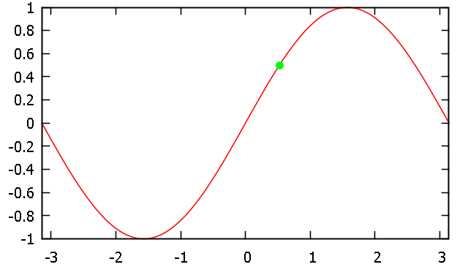
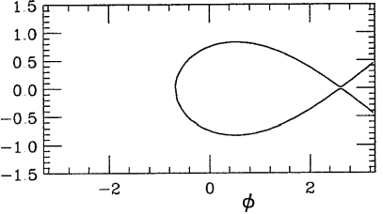
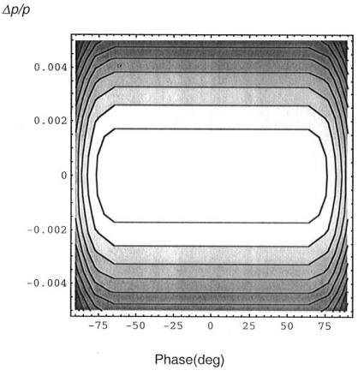
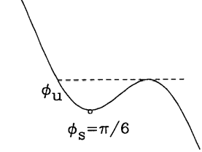
RF Cavity vs Induction Cell
Cell
set 1
tail
head
$$V_{RF}=$$
$$Vsin(φ_{s})$$
$$φ_{s}$$
+
head
tail
Acceleration
Cell
set 2
Bucket in
phase space
Below transition
Potential well
Confinement
The potential well hints the uniform bunch charge density distribution

Slide 9
Barrier Bucket (below transition)
V_{bb}
$$\frac{d}{dt}\left(\frac{ΔE}{ω_{0}}\right)=\left\{\begin{matrix}−\frac{eV_{bb}}{2π} & φ_{1}<φ<φ_{1}+δφ \\ 0 & {−φ}_{1}<φ<φ_{1} \\ \frac{eV_{bb}}{2π} & {−φ}_{1}−δφ<φ<{−φ}_{1}\end{matrix}\right.$$
$$\frac{dφ}{dt}=\frac{{Hω}_{0}^{2}η }{β^{2}E}\frac{ΔE}{ω_{0}}$$
$$η=\frac{1}{γ_{T}^{2}}−\frac{1}{γ^{2}}$$
τ_{bb}
τ_{flat}
τ_{bb}
−φ₁-δφ
φ₁+δφ
$$\ddot{φ}=\left\{\begin{matrix}−\frac{{Hω}_{0}^{2}η }{β^{2}E}\frac{eV_{bb}}{2π} & φ_{1}<φ<φ_{1}+δφ \\ 0 & {−φ}_{1}<φ<φ_{1} \\ \frac{{Hω}_{0}^{2}η }{β^{2}E}\frac{eV_{bb}}{2π} & {−φ}_{1}−δφ<φ<{−φ}_{1}\end{matrix}\right.$$
−φ₁
φ₁
In Barrier Bucket region:
$$t=0 \text{is} \text{when} \text{entering} \text{the} \text{barrier}$$
$$ΔE=\left\{\begin{matrix}−\frac{{eω_{0}^{}V}_{bb}}{2π}t+ΔE_{1} & φ_{1}<φ<φ_{1}+δφ & \\ \frac{{eω_{0}^{}V}_{bb}}{2π}t−ΔE_{1} & {−φ}_{1}−δφ<φ<{−φ}_{1} & \end{matrix}\right.$$
ΔE₁
−ΔE₁
$$φ=\left\{\begin{matrix}−\frac{KV_{bb}}{2}t^{2}+\frac{{Hω}_{0}^{}η }{β^{2}}\frac{ΔE_{1}}{E}t+φ_{1} & φ_{1}<φ<φ_{1}+δφ & \\ \frac{KV_{bb}}{2}t^{2}−\frac{{Hω}_{0}^{}η }{β^{2}}\frac{ΔE_{1}}{E}t−φ_{1} & {−φ}_{1}−δφ<φ<{−φ}_{1} & \end{matrix}\right.$$

Slide 10
Barrier Bucket (below transition), con’t
For given $δφ$ and $ΔE_{1}$, we have
$$T_{bb}=\frac{4π}{eω_{0}}\frac{ΔE_{1}}{V_{bb}}$$
$$V_{bb}=\frac{Hπη{ΔE_{1}}^{2}}{β^{2}Eeδφ}$$
(φ₁, ΔE₁)
T_{flat}
T_{bb}
T_{bb}
2.15 km ion ring of MEIC:
Ramping top, before rebunching,
β = 0.99996
η = −6.327e−3
E = 100 GeV
ΔE/E = 2e-4,
ΔE₁= 20 MeV
H=1
T_{flat}
$V_{bb}=\frac{79.5}{δφ} \text{V}$
If we let the BB depth to be 2 colliding bucket lengh (harmonic number = 6832) then
$${δφ=2×2π/6832, V}_{bb}=43.2 \text{kV}$$

Slide 11
Synchrotron Oscillation Period
(φ₁, ΔE)
T_{flat}
T_{bb}
T_{bb}
T_{flat}
(−φ₁, -ΔE)
$$T=2T_{flat}+2T_{bb}=4\frac{β^{2}}{ω_{0}η}\frac{φ_{1}}{{ΔE}/E}+4\frac{2πE}{eω_{0}}\frac{{ΔE}/E}{V_{bb}}$$

Slide 12
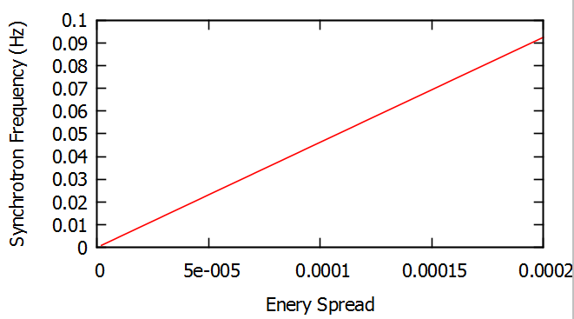
Synchrotron Frequency
$$f_{syn}=1/T=\frac{1}{\frac{0.00216}{\frac{ΔE_{1}}{E}}+66.61\frac{ΔE_{1}}{E}}≈\frac{1}{0.00216}\frac{ΔE_{1}}{E}$$
2.2 km ion ring of MEIC
β = 1
f₀ = 139 kHz
η = −6.327e−3
φ₁ = 0.5*(0.95*2π)
ΔE/E = 2e-4
E = 100 GeV
V_{bb} = 43.2 kV
H=1

Slide 13
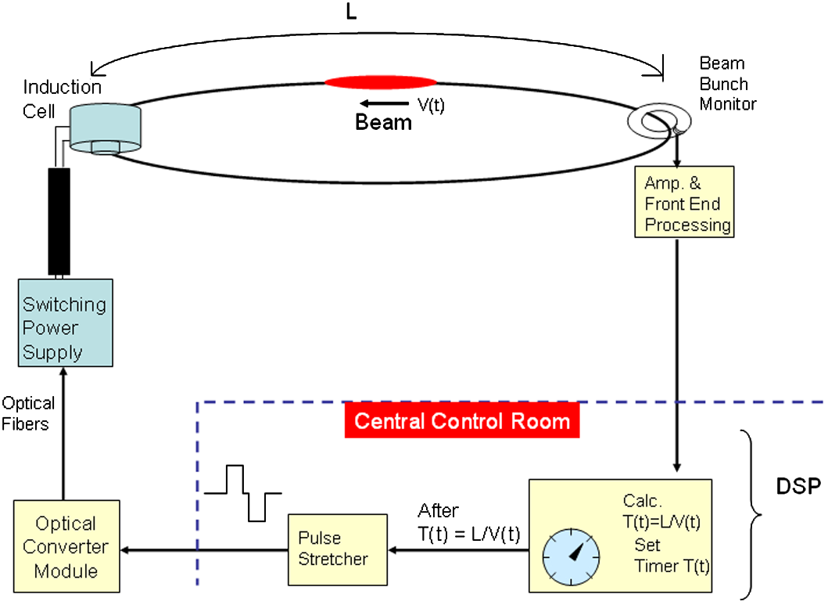
Operation of Induction Cell Synchrotron
Phys. Rev. ST Accel. Beams 14, 071301 (2011)
Suitable to accelerate all ion species in large enrgy range
because of the tunable pulse firing timing

Slide 14
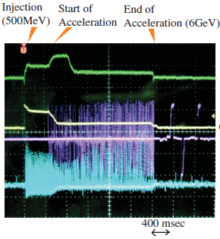
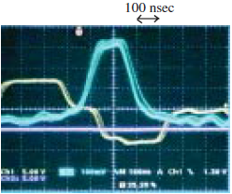
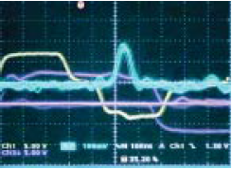
KEP PS, Induction Cell, BB + Acc
A single 100 ns, 500 MeV, 0.3% momentum spread proton bunch is injected and captured by the barrier bucket created by the induction step-voltages, and accelerated to 6 GeV in the KEK proton synchrotron.
Proton bunch trapped by step barrier voltages before acceleration. Sky blue, bunch signal;
yellow, barrier voltage
The net V_{bb} magnitude of 1.8 kVx6=10.8 kV was sufﬁciently to accommodate the injected bunch.
Proton bunch in the middle of acceleration.
Sky blue, bunch signal;
yellow, barrier voltage;
purple, induction acceleration voltage
Four induction acceleration cells of an output voltage of 1.6 kV per cell were employed to get a total of 6.4 kV.
yellow, beam current (10¹²/div);
sky blue, bunch monitor signal ;
purple, gate pulse density vs time;
green, central beam position (ΔR) (10mm/div).
PRL 98, 054801 (2007)

Slide 15
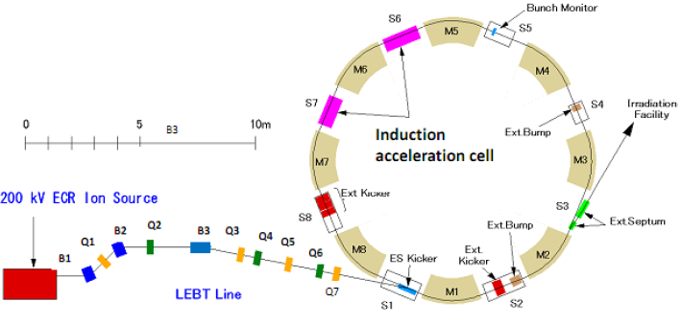
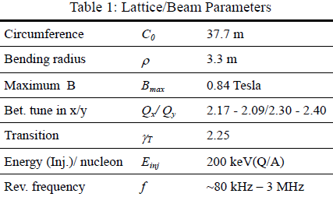
KEK Digital Accelerator
The KEK digital accelerator is a renovation of the former KEK 500 MeV Booster, the injector to the KEK 12GeV proton synchrotron.
RCS, ramping rate of 10 Hz,
Rev. frequency of 56 kHz to 1 MHz emonstrated
K.Takayama, IPAC’11
The ion beam intensity acceptable at the injection stage is limited by space-charge effect
Phys. Rev. ST Accel. Beams 14, 071301 (2011)

Slide 16
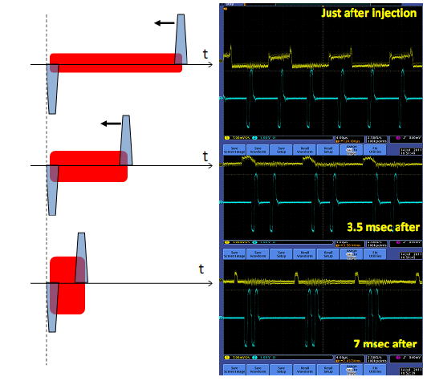
Bunch Length Manipulation
Yellow:
Bunch intensity
Blue:
Barrier Bucket pulses

Slide 17
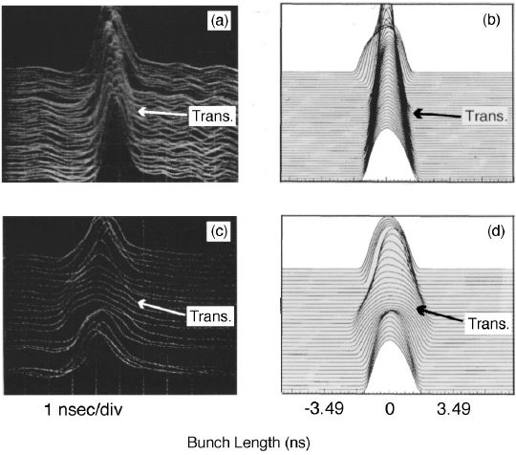
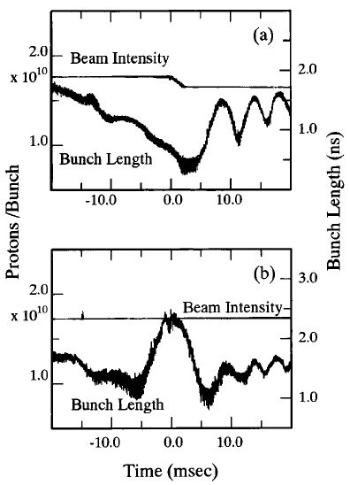
Focusing-Free Transition Crossing
In a RF bucket the bunch shape is remarkably deformed by an inherently nonadiabatic nature in the synchrotron oscillation in the vicinity of a transition energy.
Grifﬁn proposed to eliminate the ﬁeld gradient of the fundamental harmonic by imposing the 2nd or 3rd harmonics during the transition crossing. It has been demonstrated in the Fermilab Main Ring,
5% drop
[(a) and (b)]: normal transition crossing
[(c) and (d)]: with flattened rf wave
Beam intensity and the bunch length during the transition
normal transition crossing
with flattened rf wave.
Phys. Rev. Lett., 96:134801–134804, 2006; Phys. Rev. E 55, 1028 (1997); Fermilab-tm-1734

Slide 18
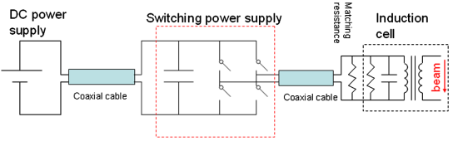
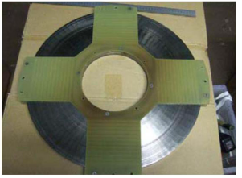
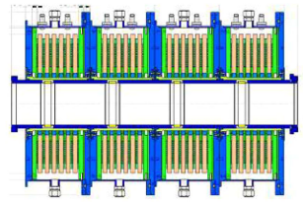
Hardwares
The Switching power supply (SPS), which modulates a DC voltage, is operated in a full bridge circuit. The single switching arm consists of MOSFETs connected in series, which enables high-frequency switching at 1 MHz with an output voltage of 2.5 kV and peak current of 20 A.
In induction cell, FINEMET has been employed as the magnetic core material to maintain a couple of us long pulse.
Phys. Rev. ST Accel. Beams 14, 071301 (2011)

Slide 19
MEIC Ion Collider Ring
Current Scheme:
Use 7 ferrite loaded low frequency (~1.2 MHz) cavities to accelerate protons from 8 GeV to 100 GeV in 12 seconds, harmonic number is 9;
Energy ramping;
Nine long bunches are debunched into coasting beam;
Rebuching into ~6800 bunches with 952 MHz SRF cavities for colliding
Abort gap production?
Uniformity of bunch charge of the ~6800 bunches?
Large emittace reproduced during rebunching process against cooling result?
====================================================
Suggested Scheme with Induction Cell:
One or two super bunch are formed at injection from booster;
Energy ramping;
Length-variable gap production;
Rebunching into ~6800 bunches with 952 MHz SRF cavities for colliding
Gap length is variable
Uniform bunch charge of the ~6800 bunches

Slide 20
Instability Issue
Head-Tail
It is noted that Δp/p and ω_{s} in the barrier bucket are not independent. In general, ω_{s} in the barrier bucket is extremely small compared to that in the RF bucket, therefore, the growth rate in the barrier bucket is much smaller than that in the RF bucket.
Takayama K. “Induction Accelerators”

Slide 21
MEIC Booster Ring
If use induction cell scheme, we can have longer bunch to decrease the most concerned space charge effect in booster.

Slide 22
The End
Thank you !

Slide 23
Volt-Second Number of the Cell
The change of flux in the magnetic core induces an axial electric field, which is the acceleration field and appears at the gap of the secondary loop
V₀: the voltage pulse amplitude
τ : the voltage pulse width
ΔB_{m}: magnetic core flux density
varying range
S: core cross section area

Slide 24
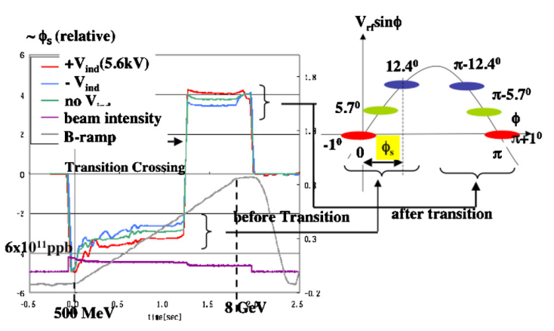
KEK PS, Induction Acc + RF Bucket
A single 500 MeV proton bunch injected and captured in the RF bucket, was accelerated from 500 MeV to 8 GeV, including the transition crossing, for three cases
with induction acceleration
with induction deceleration
without induction acceleration

Slide 25
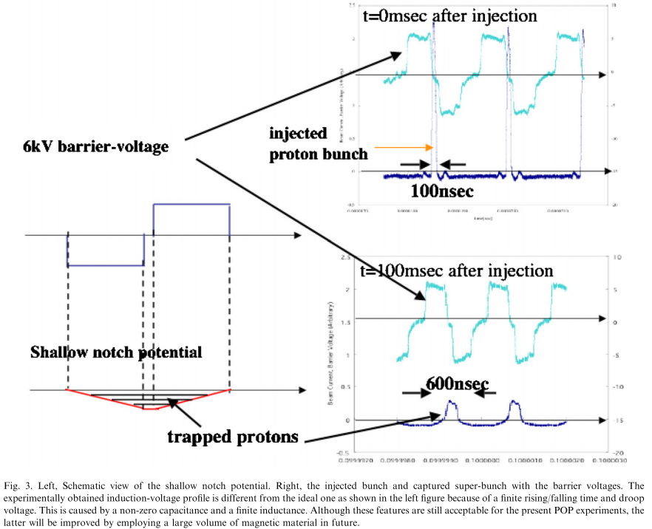
KEK PS, Induction Barrier Bucket
The proton bunch is captured by the induction barrier voltages at an injection energy of 500 MeV, and survived for more than 450 ms. The induction step-barrier voltages create a shallow notch potential. A long barrier-voltage pulse-length was ensured so as to fully capture the injected bunch with a momentum spread of 0.4%.

Slide 26
KEK-DA, various ions
Phys. Rev. ST Accel. Beams 17, 010101 (2014)

Slide 27
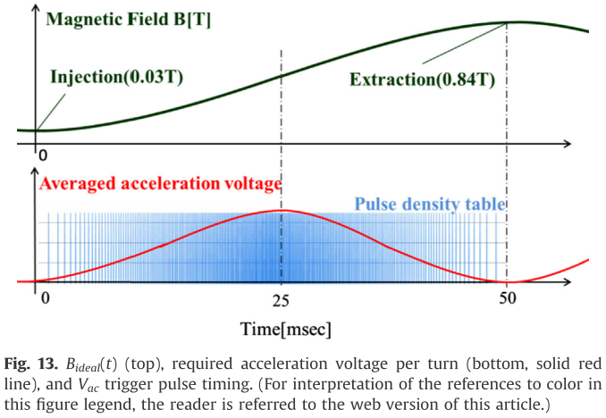
Ramping
Production of conﬁnement and accelerating voltage pulses is controlled by FPGA gate signals for SPSs. The SPS generates a set of positive and negative pulses to prevent the saturation of cell magnetic cores.
The conﬁnement voltage is generated every turn, whereas the accelerating voltage is intermittently generated because of the limited capabilities of the induction acceleration system.
two induction cells produce
two sets of set/reset voltage pulses, where pulse height and length are ﬁxed to be 1 kV and 150 ns, respectively, and the time duration between the two sets is changed in proportion to the revolution period.

