Slide 1
MEIC Ion Injector Complex − Present Status
Alex Bogacz

Slide 2
MEIC Complex − Baseline Layout
Electron-Ion Collider
Rings
IP
3-10 GeV
8 to100 GeV
8 GeV Booster
Future IP
SRF Linac to 285 MeV
Ion Sources
Electron Injector
3-10 GeV
12 GeV CEBAF
5.5-pass CW RLA
Hall D
Halls A, B, C

Slide 3
Ion Injector Complex − Overview
Present status of the ion injector complex:
  Relies on demonstrated technology for injectors and ion sources
  Adopted an SRF linac design (al FRIB)
  8 GeV Booster design avoiding transition crossing with all ion species
  Injection/extraction transfer lines to/from the Booster have been designed

Slide 4
Evolution of Beam Parameters: Polarized Protons
 | (units) | *ABPIS Source | Linac | Booster
 |  |  | Entrance | Injection | Extraction
Charge status |  | H⁻ | H⁻ | H⁻ ￫ H⁺ | H⁺
Kinetic energy | MeV | ~0 | 13.2 | 285 | 7062
γ |  |  |  | 1.3 | 8.52
β |  |  |  | 0.64 | 0.993
Pulse current | mA | 2 | 2 | 2
Pulse length | ms | 0.5 | 0.5 | 0.22
Charge per pulse | μC | 1 | 1 | 0.44
Protons per pulse | 10¹² | 3.05 | 3.05 | 2.75
Pulses |  |  |  | 1
*ABPIS − Atomic Beam Polarized Ion Source

Slide 5
Evolution of Beam Parameters: Ions (e.g. Pb)
 | (units) | *EBIS Source | Linac | Booster
 |  |  | After stripper | Injection | After acceleration
Charge status |  | ²⁰⁸Pb³⁰⁺ | ²⁰⁸Pb⁶⁷⁺ | ²⁰⁸Pb⁶⁷⁺ | ²⁰⁸Pb⁶⁷⁺
Kinetic energy | MeV/u | ~0 | 13.2 | 100 | 670
γ |  |  |  | 1.11 | 1.71
β |  |  |  | 0.43 | 0.83
Pulse current | mA | 1.3 | 0.1
Pulse length | ms | 0.01 | 0.01
Charge per pulse | μC | 0.075 | 0.015
Ions per pulse | 10¹⁰ | 1.0 | 0.2
Pulses |  |  |  | 28
* EBIS − Electron Beam Ion Source
Notes:
Red box: RF frequency swing of heavy ions, no problems but must be paid attention to

Slide 6
Ion Source Options
Ions | Source Type | Pulse Width | Rep. Rate | Pulsed Current | Ions/pulse | Polarization | Emittance (90%)
 |  | μs | Hz | mA | 10¹⁰ |  | π·μm·rad
H⁻/D⁻ | ABPIS | 500 | 5 | 4 (10) | 1000 | > 90% | 1.0 / 1.8
H⁻/D⁻ | ABPIS | 500 | 5 | 150 / 60 | 40000/15000 | 0 | 1.8
³He⁺⁺ | ABPIS | 500 | 5 | 1 | 200 | 70% | 1
³He⁺⁺ | EBIS | 10 − 40 | 5 | 1 | 5 (10) | 70% | 1
⁶Li⁺⁺⁺ | ABPIS | 500 | 5 | 0.1 | 20 | 70% | 1
Pb³⁰⁺ | EBIS | 10 | 5 | 1.3 (1.6) | 0.3 (0.5) | 0 | 1
Au³²⁺ | EBIS | 10 − 40 | 5 | 1.4 (1.7) | 0.27 (0.34) | 0 | 1
Pb³⁰⁺ | ECR | 500 | 5 | 0.5 | 0.5 (1) | 0 | 1
Au³²⁺ | ECR | 500 | 5 | 10.5 | 0.4 (0.6) | 0 | 1
ABPIS − Atomic Beam Polarized Ion Source
EBIS − Electron Beam Ion Source
ECR − Electron Cyclotron Resonance
V. Dudnikov
6

Slide 7
Warm/Cold Ion Linac − Current Baseline
EBIS
RFQ
QWR
QWR
HWR
ABPIS
IH
4 cryostats
2
10 cryostats
Ion Sources
4 cryos
2 cryos
10 cryos
MEBT
Optimum stripping energy: 13 MeV/u
P. Ostroumov, ANL
Linac design based on the ANL linac for FRIB
  Pulsed linac capable of accelerating multiple charge ion species (H⁻ to Pb⁶⁷⁺)
Warm Linac Sections (115 MHz):
  RFQ (3 m)
  MEBT (3 m)
  IH structure (9 m)
Cold Linac Sections:
  QWR + QWR (24 m + 12 m) 115 MHz
  stripper, chicane (10 m) 115 MHz
  HWR section (60 m) 230 MHz
Ion species: p to Pb
Ion species for the reference design | ²⁰⁸Pb
Kinetic energy (p, Pb) | 285 MeV 100 MeV/u
Maximum pulse current: Light ions (A/Q<3) Heavy ions (A/Q>3) | 2 mA 0.5 mA
Pulse repetition rate | up to 10 Hz
Pulse length: Light ions (A/Q<3) Heavy ions (A/Q>3) | 0.50 ms 0.25 ms
Maximum beam pulsed power | 680 kW
Fundamental frequency | 115 MHz
Total length | 121 m

Slide 8
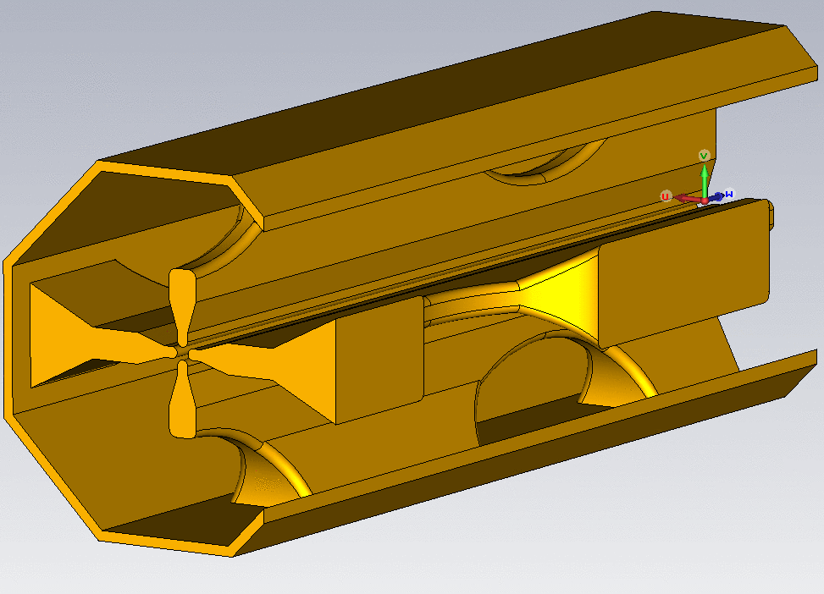
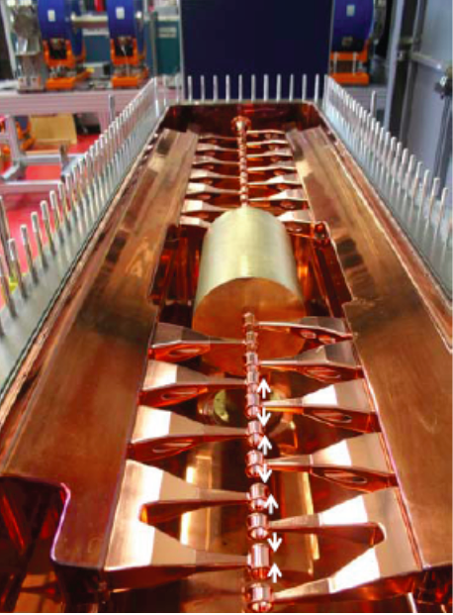
Warm RF Components
RFQ Segment
IH Structure
Frequency | 115 MHz
Total length | 3.6 m
Voltage | 85 kV
Average radius | 7 mm
Number of segments | 4
Input energy | 25 KeV
Output energy | 500 keV/u

Slide 9
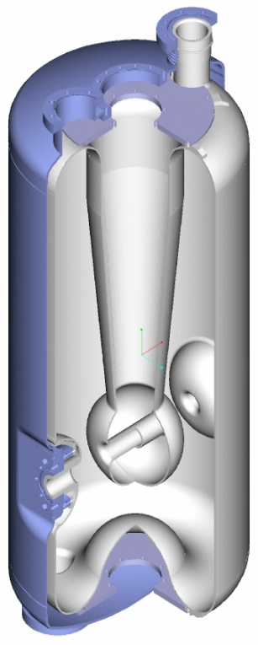
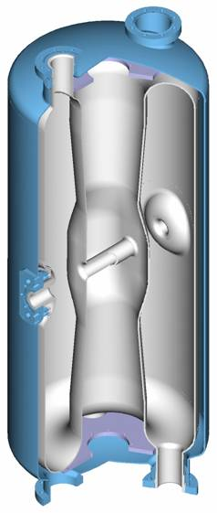
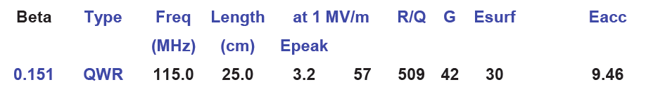
Superconducting Cavities
P. Ostroumov, ANL
QWR HWR

Slide 10
Superconducting Ion Linac
Superconducting linac provides superior flexibility to maximize energies for multiple charge ion beams (from H⁻ to ²⁰⁸Pb⁶⁷⁺).
  SC linac can provide 100 MeV/u for lead ions.
  In the same SC linac, an H⁻ beam can reach 280 MeV, which is high enough to suppress space-charge in the booster (space-charge is most severe for the lowest mass-to-charge ratio, i.e. H⁻)
  Single 2-gap SC cavity can provide significantly higher (factor of ~ 10) voltage per cavity compared to room temperature cavities. High-Q (power ~ voltage²) ⇨ much higher peak fields available with SC cavities.
P. Ostroumov, ANL

Slide 11
Voltage Gain per SC Cavity – Final Energies
²⁰⁸Pb⁶⁷⁺
H⁻
P. Ostroumov, ANL

Slide 12
Ion Source/Linac – Space-Charge Issues
The space-charge effects are quite significant in the injection beam-lines from the ion sources.
  Emittance after both ABPIS and EBIS are not simple ellipses, beam collimation is required before transferring ions into the linac.
Following the RFQ there are no significant space-charge effects
  If EBIS is used for ion beam generation (peak current ~5 mA) one needs to compensate space charge defocussing with standard rms beam envelope matching technique.

Slide 13
Booster (8 GeV, γ_{t} = 10)
Ring circumference: 273 m
(≈ 2200/8)
E_{kin} = 285 MeV – 7.062 GeV
Injection: multi-turn 6D painting
  0.22-0.25 ms long pulses ~180 turns
  Proton single pulse charge stripping at 285 MeV
  Ion 28-pulse drag-and-cool stacking at ~100 MeV/u
  Ion energies scaled by mas-to-charge ratio to preserve magnetic rigidity
Crossing angle:
75 deg.
injection
RF cavity
extraction
70
7
A. Bogacz
BETA_X&Y[m]
DISP_X&Y[m]
0
-7
0
BETA_X
BETA_Y
DISP_X
DISP_Y
272.306
Inj. Arc (255⁰)
Straight
Arc (255⁰)
Straight (RF + extraction)
13

Slide 14
Booster Lattice (8 GeV, γ_{t} = 10)
70
7
A. Bogacz
BETA_X&Y[m]
DISP_X&Y[m]
0
-7
0
BETA_X
BETA_Y
DISP_X
DISP_Y
272.306
Arc Bends:
L_{b} = 120 cm
B = 2.73 Tesla
bend ang. = 7.08 deg.
Sagitta =1.8 cm
Straight Quads:
L_{q} = 40 cm
G_{F} = 12.57 Tesla/m
G_{D} = -24.52 Tesla/m
G_{F} = 12.57 Tesla/m
Arc Quadrupoles:
L_{q} = 40 cm
G = 12-58 Tesla/m
Lattice configured with super-ferric magnets
14

Slide 15
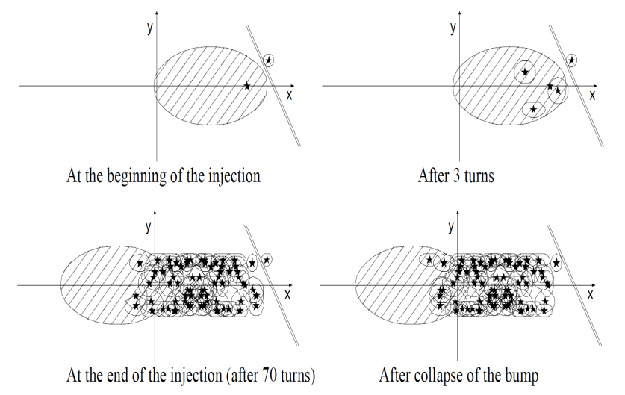
Ion Injection – Transverse Phase-space Painting
30
Doublet straight injection optics
5
separation of the injection orbit bump (12σ)
BETA_X&Y[m]
DISP_X&Y[m]
0
-5
31.8
BETA_X
BETA_Y
DISP_X
DISP_Y
55
B. Erdelyi, NIU

Slide 16
Acceleration − Low Frequency RF Cavities
Booster |  |  |  |  |  | H⁺ |  |  | ²⁰⁸Pb⁶⁷⁺
Circumference |  | 273 | m |  | Energy | 0.28 | − | 8 | 0.112 | − | 3.2 | GeV
Harmonic Number |  | 1 |  |  | RF Frequency Range | 0.817 | − | 1.274 | 0.578 | − | 1.25 | MHz
Gaps per Cavity |  | 2 |  |  | Ramping Time |  |  | 0.396 |  |  | 0.56 | sec
Cavity Number |  | 1 |  |  | Vgap |  |  | 8.0 |  |  | 5.75 | kV
Cavity Length |  | 2.2 | m |  | Beam Power |  |  | 8.0 |  |  | 1.85 | kW
Total Cavity Length |  | 2.2 | m |  | Power Loss per Cavity |  |  | 41.2 |  |  | 41.2 | kW
Ferrite Toroid Inner Radius |  | 0.25 | m |  | Syn. Phase |  |  | 30.0
Ferrite Toroid Outer Radius |  | 0.5 | m
Ferrite Stack Length |  | 1 | m |  | Acceleration time |  |  | 120 |  |  | 144 | msec
Maximum Vgap |  | 10 | kV |  | Cooling time |  |  | 16 |  |  | 55 | msec
S. Wang
16

Slide 17
Booster − Space-Charge Issues
Incoherent space-charge tune shift at injection (285 MeV):
  Present baseline: ΔQ_{sc} = 0.1 (for 0.2 Amp coasting beam)
  Consider more aggressive scenario … ΔQ_{sc} ≥ 0.3
Structure resonance crossing and stop-band corrections
  Significant fraction of particles in the beam can move cross third-integer and quarter-integer resonance lines.
  Properly placed quadrupoles and sextupoles could be used to correct the stop-band width of those resonances to minimize the amplitude growth and hence the beam loss.
Halo generation ⇨ beam collimation required
I. Hofmann
GSI
G. Franchetti
FAIR

Slide 18
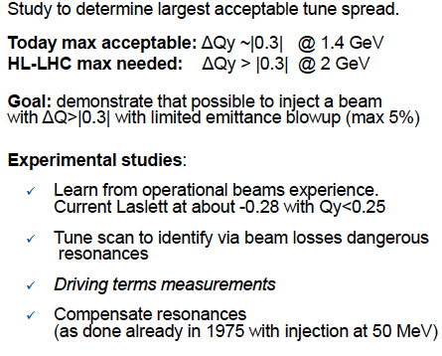
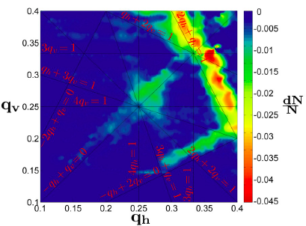


Large Space-Charge Tune Shift Operation
PS Booster at CERN
tune scan
S. Gilardoni CERN

Slide 19
Tune Diagram – Space-charge Footprint?
Table 1 Dipole, multipoles in units of 10⁻⁴, reference radius at 1.5 cm
9
Q_{y}
Q_{x/y} = 9.87 / 8.85
P. McIntyre
Texas A&M
8.5
9.5
2
3
4
5
Q_{x}
10
Nominal current 15kA (I_{scale}=1)
Table 2 Quad multipoles, reference radius 3 cm
70
Tracking for 1.2×10⁵ turns
7
BETA_X&Y[m]
DISP_X&Y[m]
0
-7
0
BETA_X
BETA_Y
DISP_X
DISP_Y
272.306

Slide 20
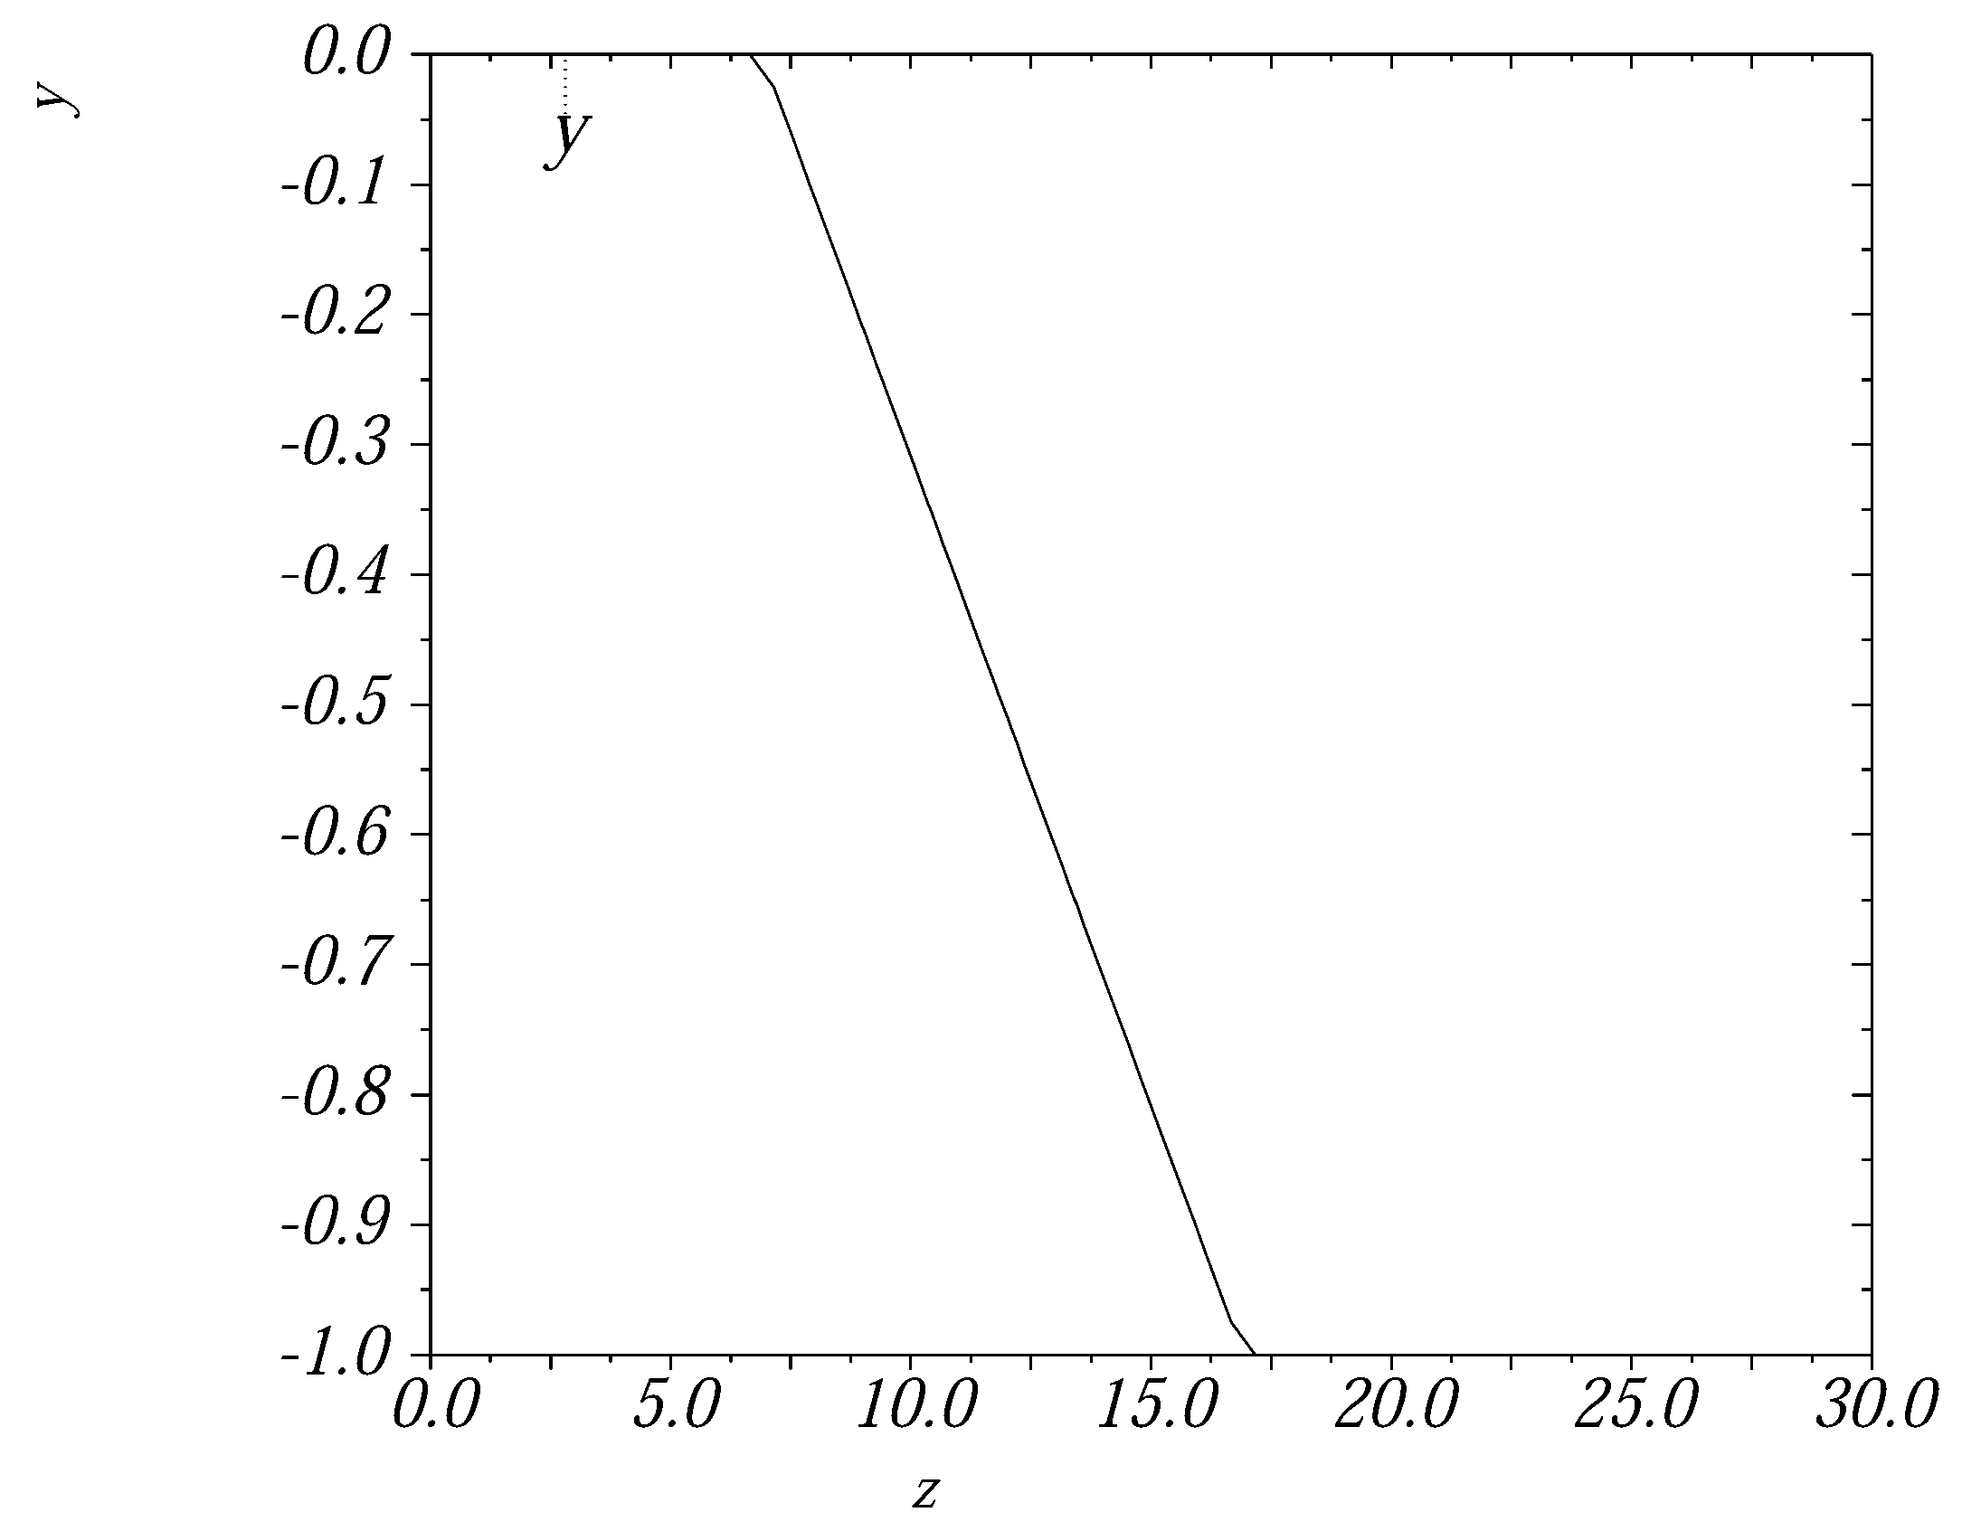
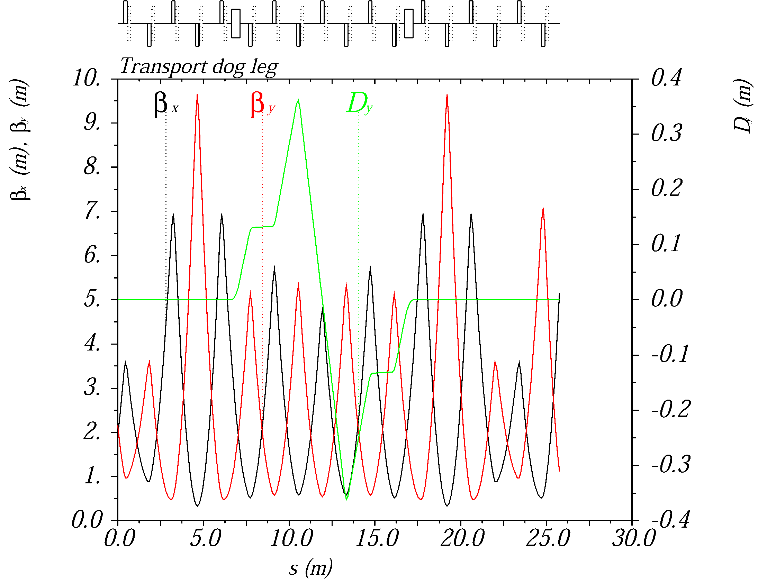
Linac-to-Booster Transfer Line
Booster injection scheme
  Combined longitudinal and transverse phase space painting
  Components: stripping foil, four-dipole booster orbit bumper system, magnetic and electrostatic septa
Two same-strength quadrupole families of opposite sign
  Eighteen 16 T/m 20/30 cm magnetic/physical length quadrupoles
  Each quadrupole surrounded by 30 cm long corrector and 15 cm long BPM
  Enough quadrupoles for matching to linac and booster as needed
Achromatic 1 m vertical step
  Two 0.5 T 50/78 cm magnetic/physical length dipoles
matching
vertical step
matching
ions
V. Morozov

Slide 21
Booster-to-Ion Ring Transfer Line
Lattice based on FODO (90⁰ )
50
6
BETA_X&Y[m]
  Enough independent quadrupoles (8) for betatron matching to Ion Ring
DISP_X&Y[m]
0
-6
0
BETA_X
BETA_Y
DISP_X
DISP_Y
83.8917
kicker
septum
127.5⁰ Arc
septum
kicker
Booster Extraction
Ion Ring
Injection
Kickers (2):
L[cm] 120
B[kG] 1.5 angle [mrad] 5
2
Coordinates X&Y[cm]
Horizontal Extraction: Kicker + Septum
Rise time [ns] Flat Top [ns] Fall time [ns]
300 300 300
-2
A. Bogacz
0
X
Y
5.5
21

Slide 22
Summary
The MEIC hadron injector complex design is well established
Present choice for Ion Sources:
  ABPIS for polarized protons and light ions
  EBIS for un-polarized heavy ions
SRF Linac based on FRIB (285 MeV protons and 100MeV/u lead)
8 GeV Booster design avoiding transition crossing (including transfer lines)
  Low momentum compaction Optics based on perturbed FODO lattice
  Lattice configured with super-ferric magnets (Texas A&M design)
  Injection: Combined longitudinal and transverse phase-space painting
  Extraction: Single kicker and magnetic septum
  Space-charge tune ‘footprint’ needs to be studied in the presence of multipoles
No clearly identified technical risks present
Proven, conservative technologies used throughout the scheme

Slide 23
Backup Slides

Slide 24
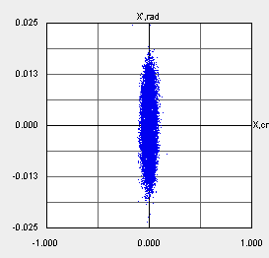
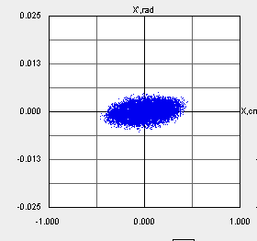
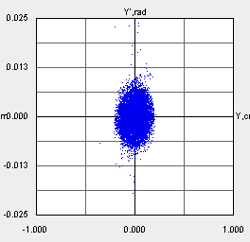
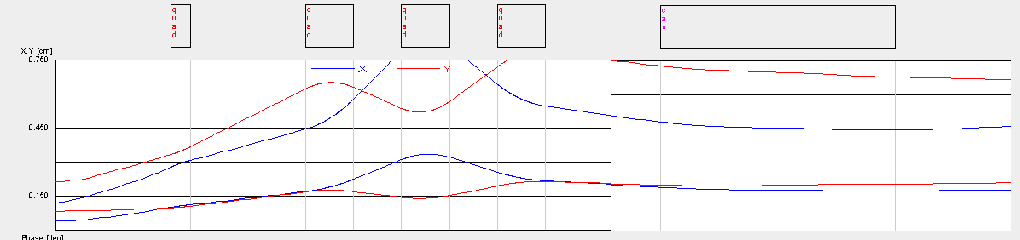
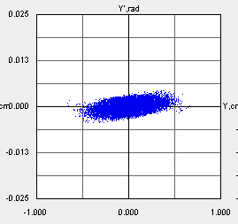
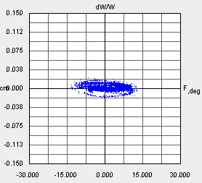
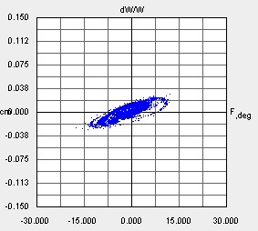
Medium Energy Beam Transport (MEBT)
x
x
x’
Q1
Q2
Q3
Q4
Buncher
x’
y
y
y’
L= 995 mm
y’
Δφ
Δφ
Space-charge defocusing significant - rms beam envelope matching required
ΔW/W
ΔW/W
Quadrupole Parameters
Buncher Parameters
 | Eff. Length (mm) | Gradient (T/m)
Q1 | 20.0 | 23.0
Q2 | 50.0 | -22.0
Q3 | 50.0 | 32.75
Q4 | 50.0 | -16.5
Cavity | Quarter Wave
Voltage | 0.8 MV
Frequency | 115 MHz
Length | 340 mm

Slide 25
Stripping energy
²⁰⁸Pb³⁰⁺ ➔ ²⁰⁸Pb⁶⁷⁺
P. Ostroumov, ANL

Slide 26
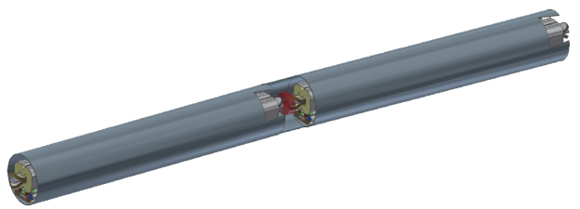
Arc Cell − Super-ferric Magnets
30
3
BETA_X&Y[m]
DISP_X&Y[m]
0
0
0
BETA_X
BETA_Y
DISP_X
DISP_Y
8.76306
Bend
Sextupole
Bend
Bend:
L_{b} = 120 cm (magnetic length)
Lead ends: 2×22 cm
B = 2.73 Tesla
bend ang. = 7.08 deg.
Sagitta =1.8 cm
Correctors
BPM
Quad
P. McIntyre
Texas A&M
Quadrupole:
L_{q} = 40 cm
G = 12-58 Tesla/m
Correctors (H/V): 10 cm
BPM can: 10 cm
Dual-dipole
Quad
Half-cell cryomodule
Magnet aperture radius:
6σ_{rms} = 42 mm
Sextupole:
L_{s} = 10 cm
S = 750 Tesla/m²
26

Slide 27
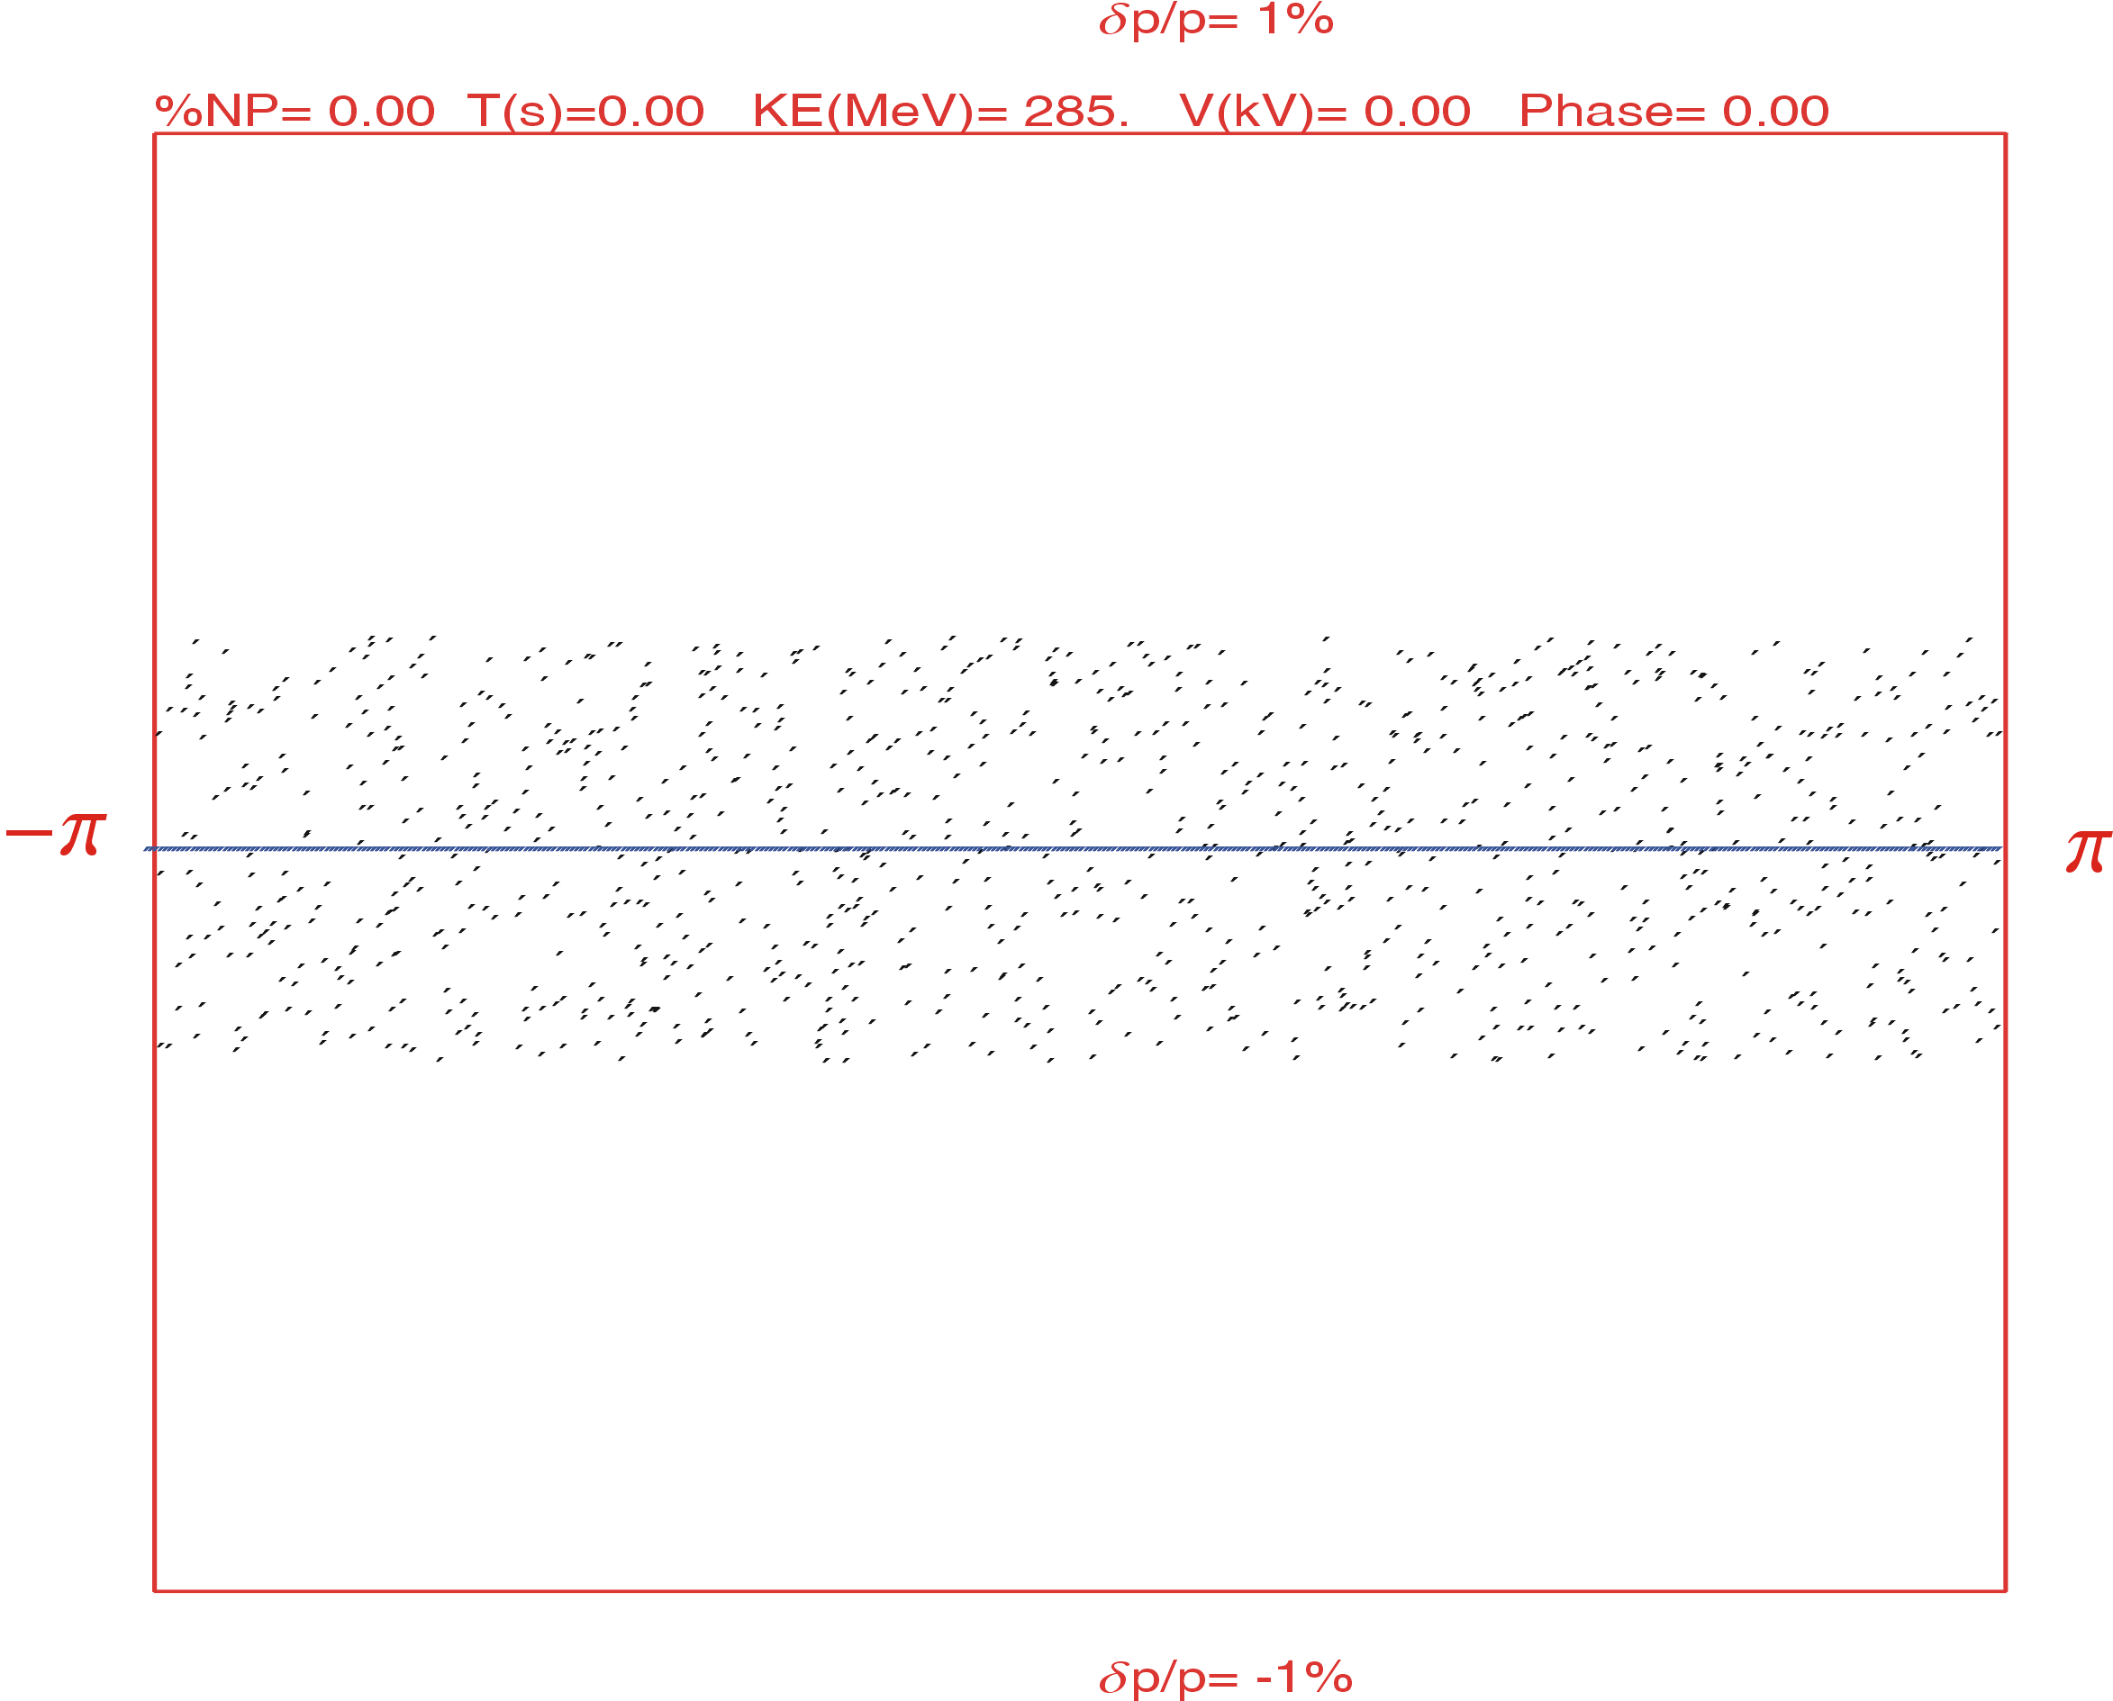
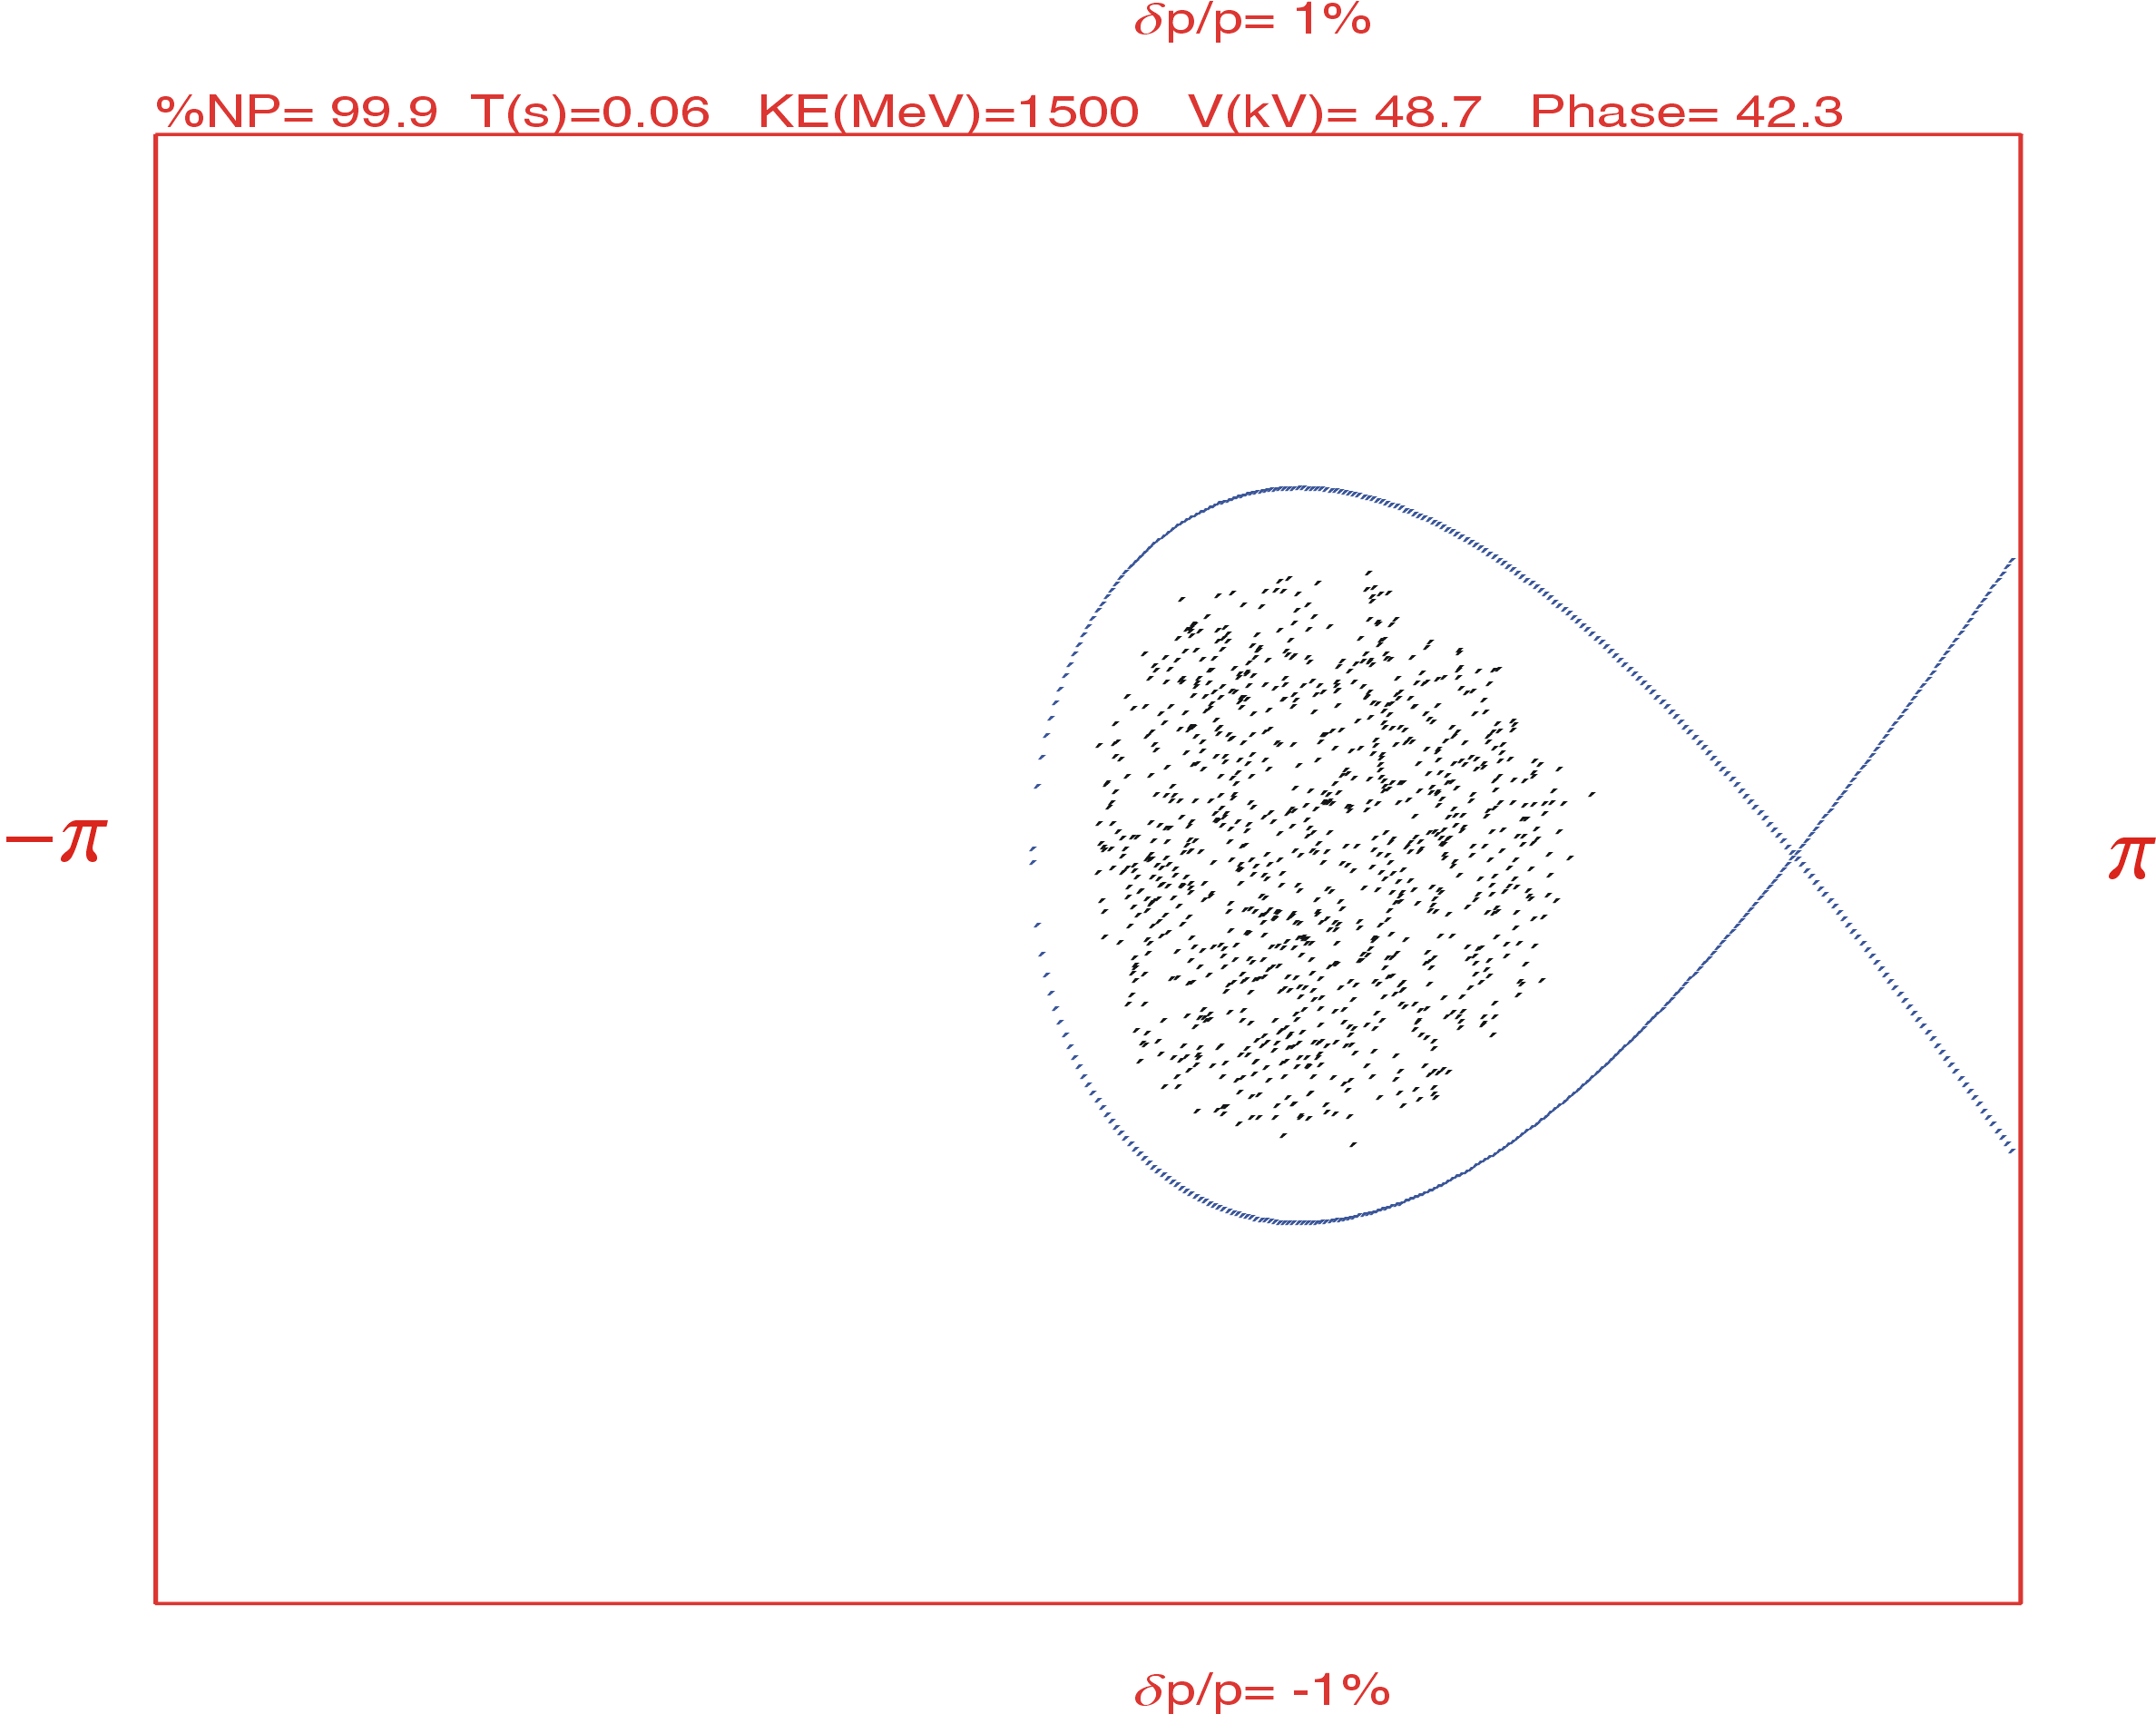
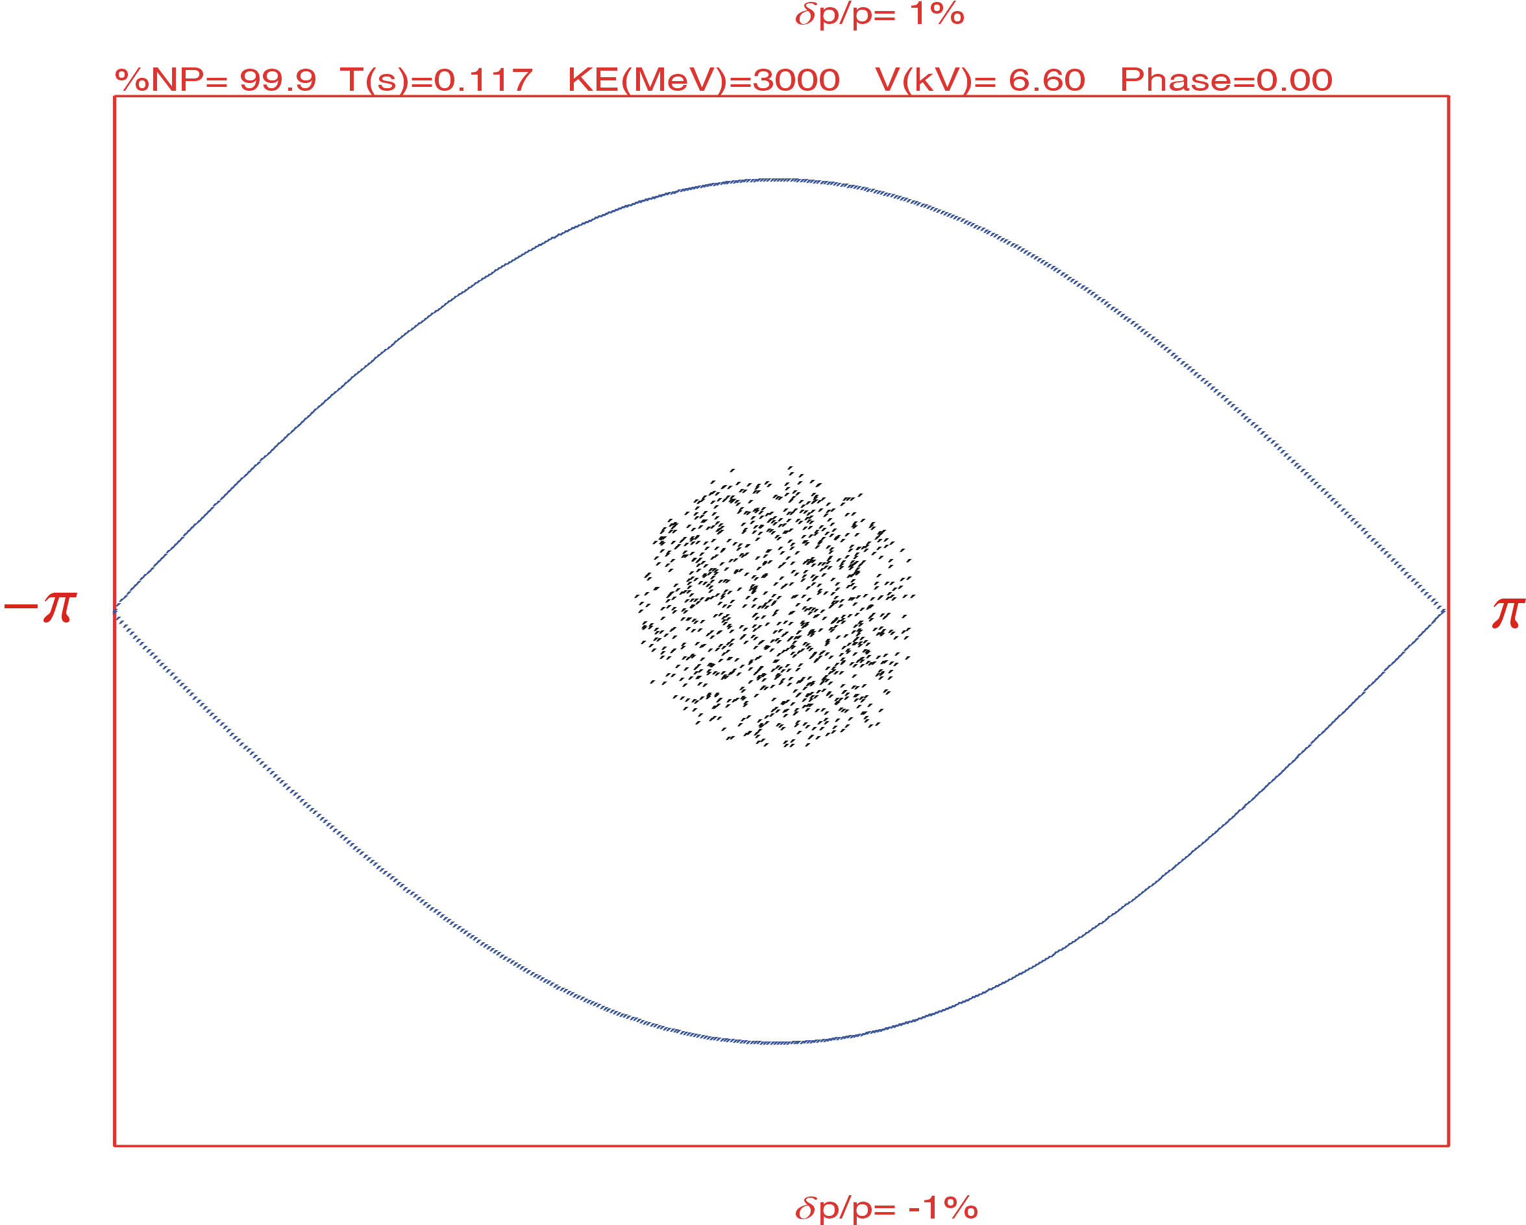
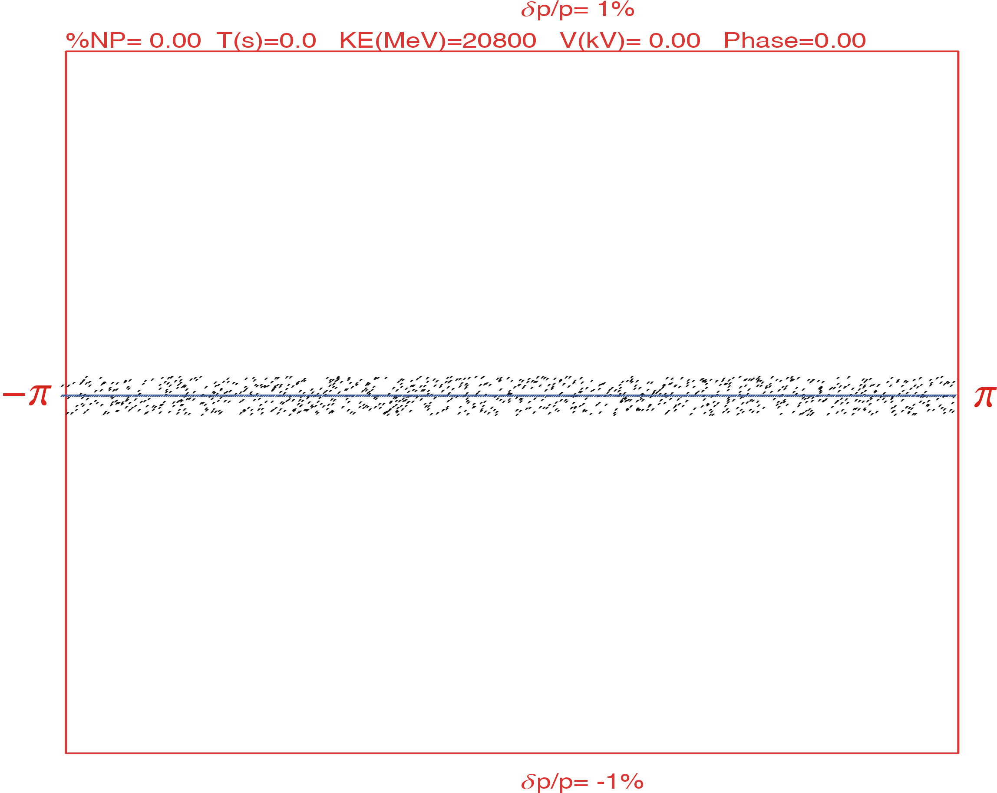
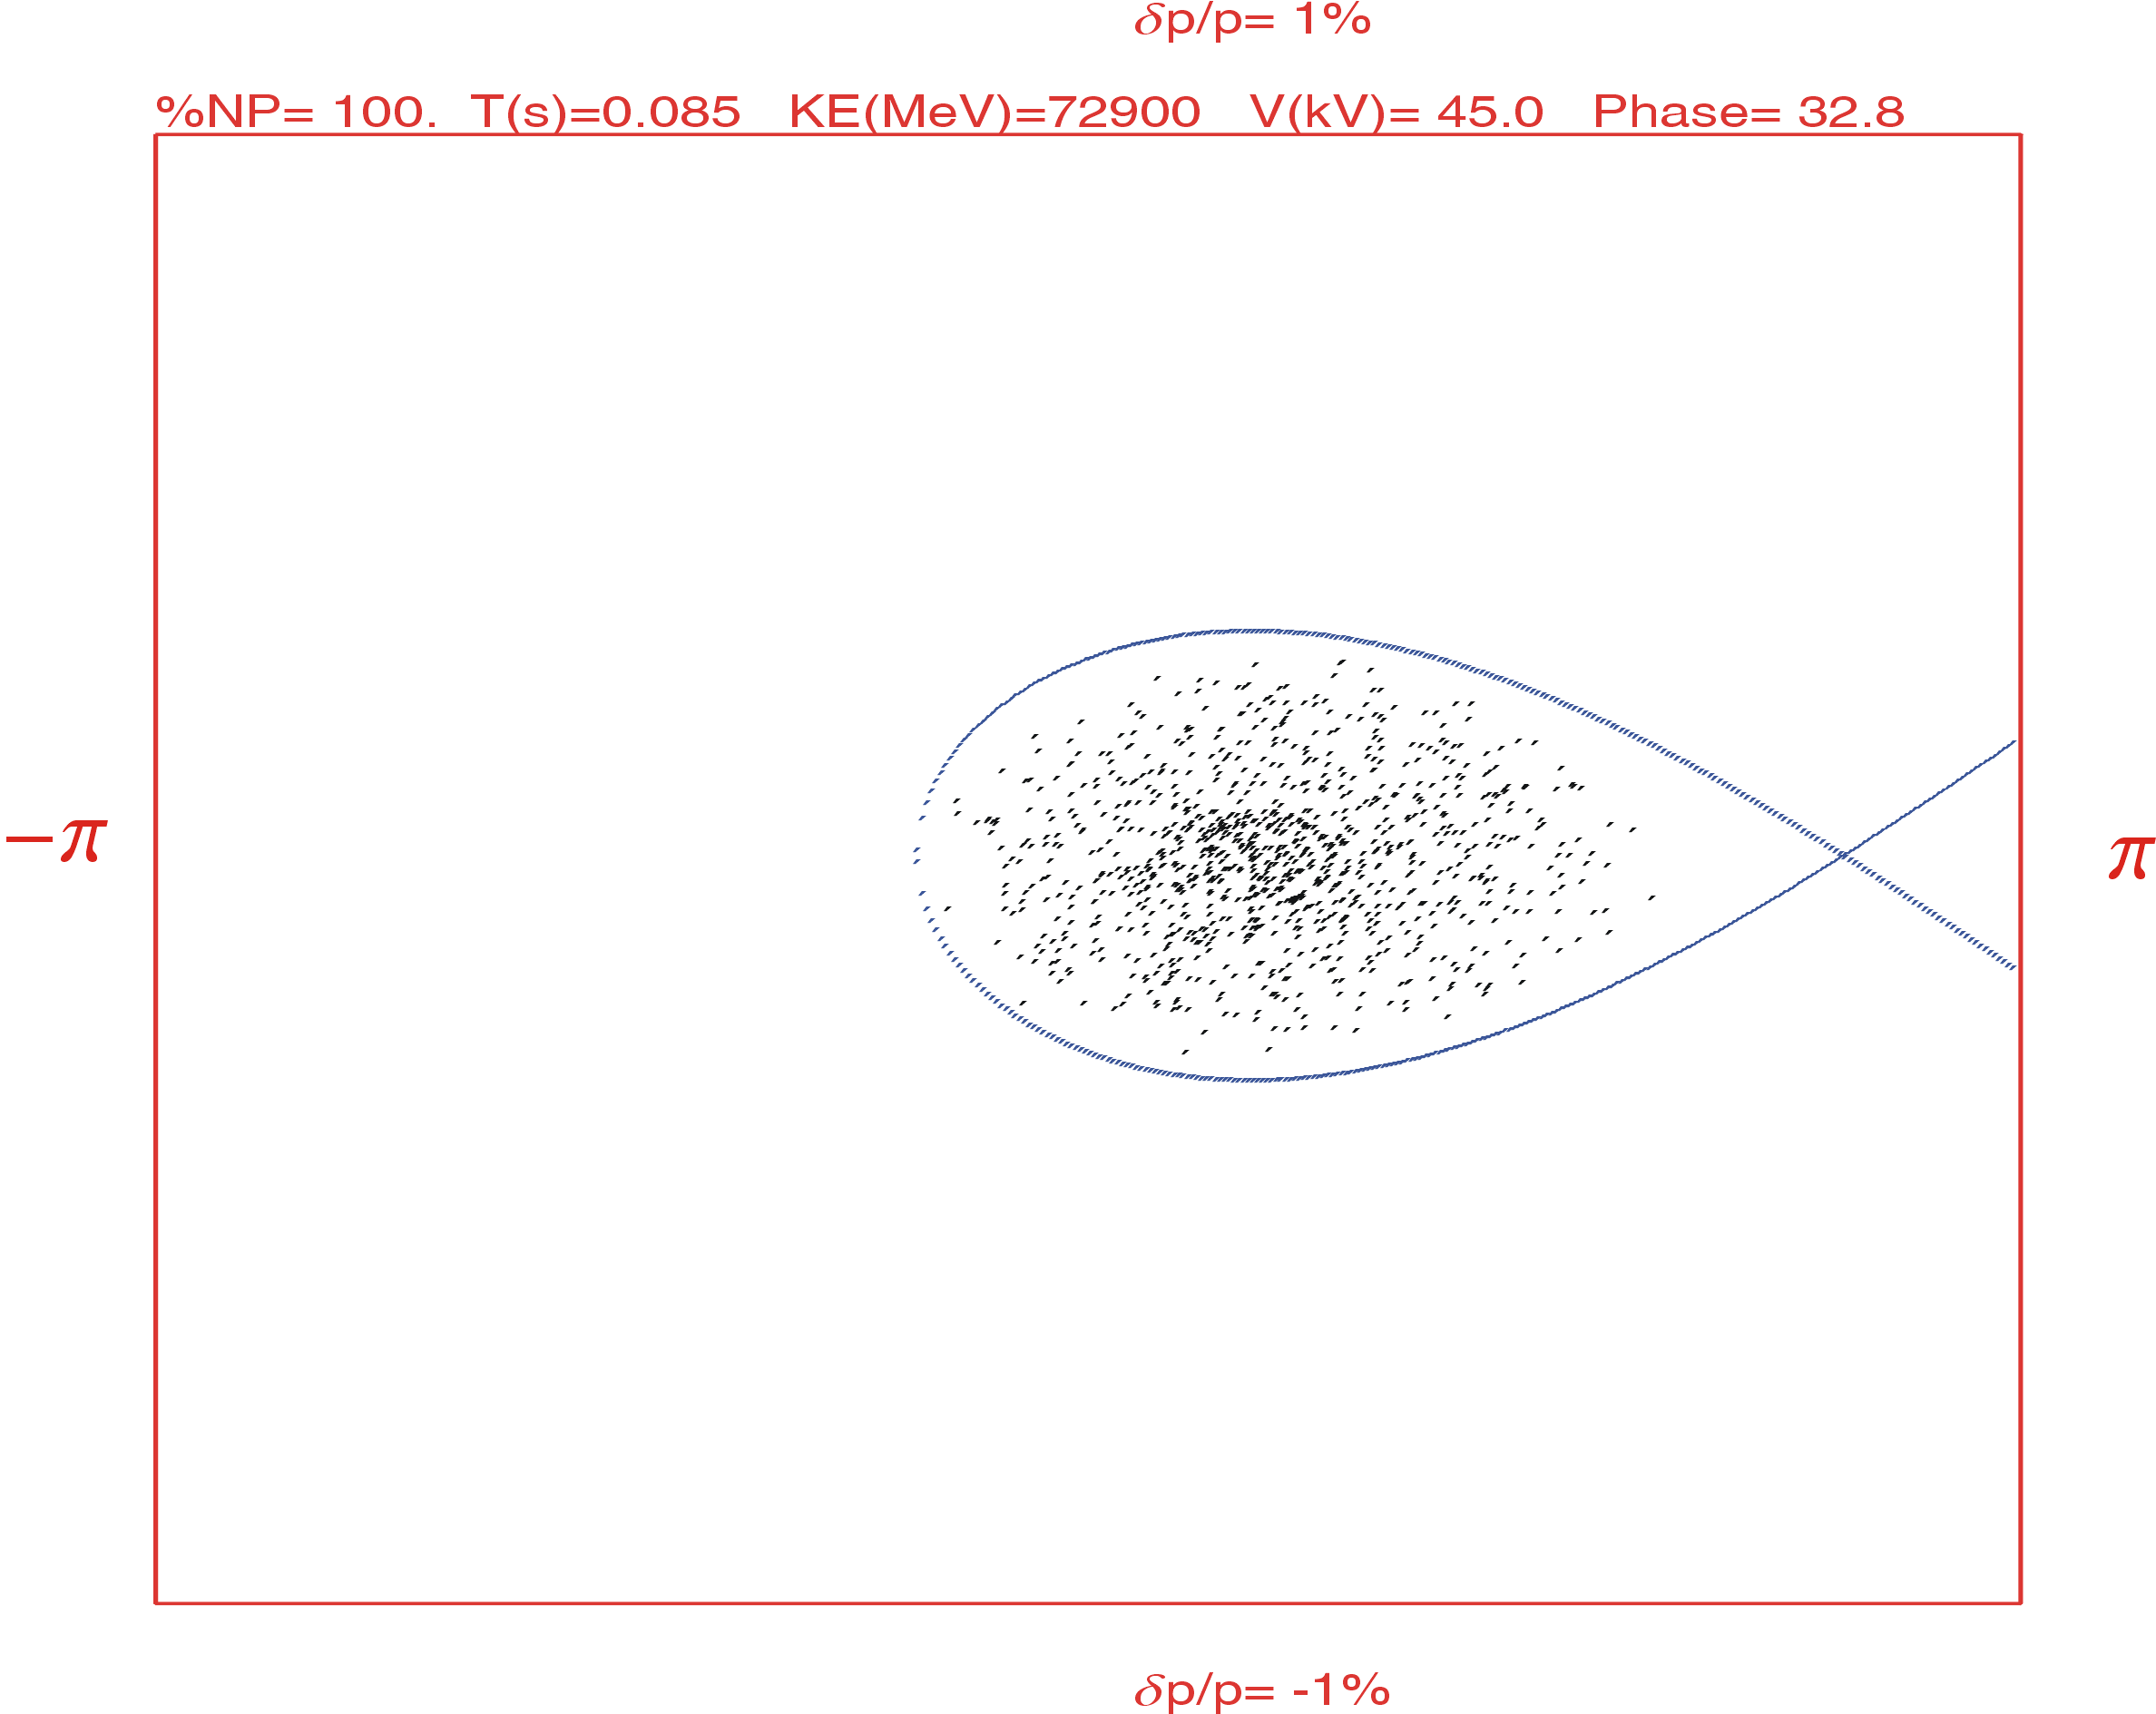
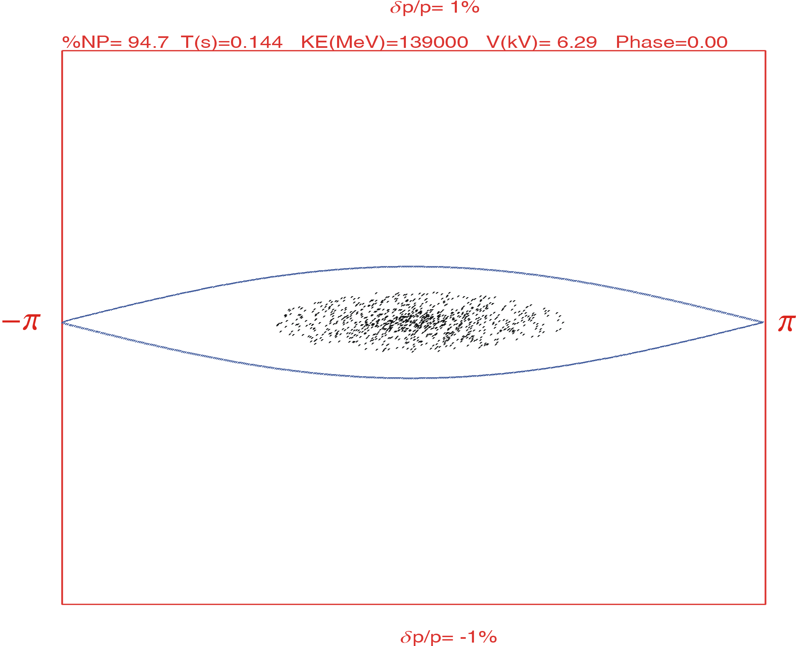
Adiabatic Capture and Acceleration (h =1)
 | H⁺ |  |  | ²⁰⁸Pb⁶⁷⁺
Energy | 0.28 | − | 8 | 0.112 | − | 3.2 | GeV
RF Frequency Range | 0.817 | − | 1.274 | 0.578 | − | 1.25 | MHz
Ramping Time |  |  | 0.396 |  |  | 0.56 | sec
protons
lead ions
B. Erdelyi, NIU

Slide 28
Booster-to-Ion Ring Transfer Line − Magnets
Lattice based on FODO (90⁰ )
50
6
BETA_X&Y[m]
DISP_X&Y[m]
0
-6
0
BETA_X
BETA_Y
DISP_X
DISP_Y
83.8917
kicker
septum
127.5⁰ Arc
septum
kicker
Booster Extraction
Ion Ring Injection
Arc Bends (28):
L_{b} = 120 cm
B = 1.89 Tesla
bend ang. = 4.9 deg.
sagitta = 1.3 cm
Magnetic Septa (2):
L_{b} = 150 cm
B = 1.5 Tesla
bend ang. = -4.9 deg.
Arc Quadrs (17):
L_{q} = 40 cm
G = 10-25 Tesla/m
Magnet aperture radius:
6σ_{rms} = 16 mm
A. Bogacz
28

Slide 29
Other Boosters − Tunes
  SNS Accumulator: 5.82 / 5.80
  SSC LEB: 11.65 / 11.60
  SPS: 1.82 / 2.72
  SPS Booster: 6.23 / 6.25
  J-PARC RCS: 6.45 / 6.42
  MEIC Booster: 9.87 / 8.85

