Slide 1
Expectations and Directions of MEIC Ion Injector Design Optimization
Yuhong Zhang
MEIC Collaboration Meeting Spring 2015
March 30 and 31, 2015

Slide 2
Motivation of Design Optimization
Large booster
collider ring
ion sources
SRF Linac
pre-booster
MEIC ion injector complex was designed more than 10 years ago
Back at that time, it had a very different goal for the colliding beams
1.5 GHz bunch repetition rate, 1 A nominal current, 5 mm RMS bunch length
Cost issue was not factored in
The ion injector design meets the requirement of formation of proton and ion beams for collisions
MEIC design has been evolved since then
Cost is the top driver now (presently, there is a $300M gap to the target)
476 MHz bunch repetition rate, 0.5 A nominal current, 1~2 cm RMS bunch length

Slide 3
1st Major Optimization of Ion Injector
8
3 to 25 GeV
25 to 100 GeV
Up to 3 GeV
8
Large booster
collider ring
ion sources
SRF Linac
pre-booster
Same circumference
Eliminating the large booster
Significant performance improvement
Much higher injection energy into the full size ring
(3 GeV into the large booster ring vs. 8 GeV into the collider ring)
Much small space charge tune-shift at injection (a factor of 5.3 reduction)
Allowing pre-cooling at the small booster ring (DC cooling more efficient)
One less ring in the main collider tunnel
No bypass of the large booster beam-line near detectors
More space for collider ring machine elements, and smaller tunnel cross section
Major cost reduction

Slide 4
Next Area of Optimization: Ion Linac
Ion sources
RFQ
QWR
QWR
HWR
4 cryos
IH
4 cryostats
2
10 cryostats
2 cryos
10 cryos
MEBT
Optimum stripping energy: 13 MeV/u
The present design is a warm/cold RF ion linac
285 MeV protons, or 100 MeV/u heavy ions
loaded cost: ~$300M
A SRF linac is best for high current, high intensity (high duty factor to CW) applications (such as SNS, FRIB)
Fact: some high duty applications also use a warm linac (CSNS, ESS)
Fact: MEIC ion linac is for low intensity, low duty operation
(up to10 Hz, 0.25 to 0.5 ms ➔ 0.25% to 0.5% duty factor)
Fact: all hadron colliders like Tevatron, eRHIC & LHC have warm linacs
Fact: 285 MeV is much higher than linacs for other hadron colliders (like
LHC); for heavy ions, 100 MeV/h is an order of magnitude higher

Slide 5
Expectation of Ion Linac Optimization
Cost driven optimization
Substantial cost reduction (>50%?)
Approaches
Significantly reducing the ion linac energy
Exploring feasibility to use a warm linac
Technical position
Should not affect the collider performance
It is OK to be “just good enough”
Does not need to include consideration of side programs
(that will use some components of the ion injector)

Slide 6
Approaches: High & Low Injection Energy
Lowering the injection energy into the booster
8
25 to 100 GeV
8
Very low energy
Up to 3 GeV
ion sources
Linac
collider ring
booster
Maintaining a high injection energy into the booster
8
25 to 100 GeV
Very low energy
Up to 3 GeV
8
Restore to high energy
ion sources
Linac
collider ring
booster
A compact accumulator/booster (Morozov CIS talk, Ostroumov talk)
A cyclotron (McIntyre talk)
An induction cell linac (S. Wang talk)

Slide 7
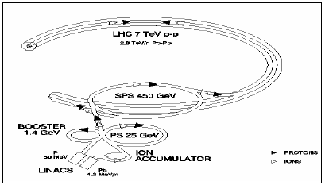
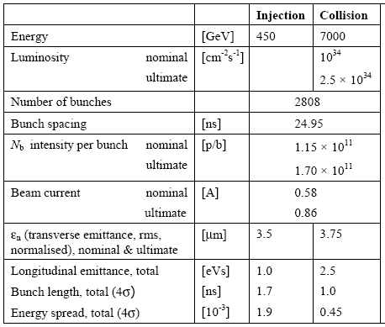
LHC Ion Injector Complex
Proton linac 50 MeV
ion linac
4.2 MeV/u Pb

Slide 8
What is the Bottom-line? Comparing with LHC
 | In the collider ring |  |  |  |  |  |  | In the booster ring
 | ppb | Bunch length | Bunch spacing | Emitt. | Linear dens. | Trans. Bright | Value intens. | Emitt @inj | Linear dens. | Trans. Bright. | Value intens.
 | N_{b} | σ_{s} | L_{b} | ε_{n} | N_{b}/σ_{s} | N_{b}/ε_{n} | N_{b}/ε_{n}σ_{s} | ε_{n} | N_{b}/L_{b} | N_{b}/ε_{n} | N_{b}/ε_{n}L_{b}
 | 10¹⁰ | cm | ns (m) | μm | 10¹²/m | 10¹⁶/m | 10¹⁸/m² | μm | 10¹⁰/m | 10¹⁶/m | 10¹⁶/m²
LHC | 11.5 (17) | 7.5 | 25 / 7.5 | 3.75 | 0.61 (2.3) | 3.1 (4.5) | 0.16 (0.24) | 3.5 | 1.5 (2.3) | 3.3 (4.9) | 0.43 (0.65)
MEIC | 0.66 | 1 | 2.1/0.63 | 1/0.5 | 0.26 | 0.93 | 0.53 | 3.5 | 1 | 0.19 | 0.3
Ratio | 17.6 (25.8) |  |  | 5.3 | 2.3 (3.4) | 3.3 (4.9) | 0.31 (0.46) | 1 | 1.5 (2.2) | 17.4 (25.8) | 1.5 (2.2)
It is clear that the MEIC parameters are less challenging than that of LHC.
LHC has a 50 MeV warm linac for protons and another low energy linac for heavy ions (4.2 MeV/n), then they should be good enough for MEIC
It has two small booster rings (PSB and LEIR), should we have them too?

Slide 9
Bottlenecks: Aperture & Space Charge at Injection
1st bottleneck: aperture, in the booster ring
Energy is very low at injection from the linac, geometric emittance is large, then the beam is very fat, requiring very large beam-stay-clear
2nd bottleneck: space charge, in the booster ring
After injection from the linac and accumulation, the beam is captured into a long bunch for acceleration
When the linac energy is decreased, the space charge becomes even more severe, it may limit the current (total charge) in the booster ring
3rd bottleneck: space charge, in the collider ring
After injection, the space charge tune-shift has a jump (due to the difference in ring circumferences)
Coasting beam
bunched beam

Slide 10
Injection Energy and Space Charge
Booster ring
Collider ring circumference | m | 2150
Stored protons | 10¹³ | 2.2
Booster ring circumference | m | 239
Stored protons | 10¹² | 2.5
Emittance | µm | 2.5
Charge intensity is limited by maximum allowed space charge tune-shift

Slide 11
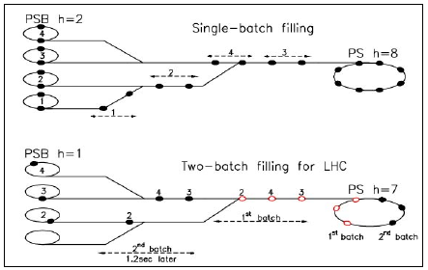
Overcome the Space Charge Bottleneck
LHC injection scheme from booster to PS ring: increase of number of injections
Protons stored in PSB is limited by space charge (and injection energy)
Old
A factor of 2 increase of intensity in PS ring
New

Slide 12
High Energy Injection: 1 Long Bunch x 9 Transfers
DC cooler
Accumulation
Coasting beam
Booster
(0.285 to 7.9 GeV)
collider ring
(8 to 100 GeV)
DC cooler
Capture/acceleration
Long bunch
BB cooler
Booster
(0.285 to 7.9 GeV)
DC cooler
DC cooler
DC cooling
Booster
(0.285 to 7.9 GeV)
Booster
(0.1 to 8 GeV)
Compression

Slide 13
Low Energy Injection: 1 Long Bunch x 3x9 Transfers
Reduce protons injected into the booster by a factor of 3 to mitigate the space charge tune-shift
After accelerating to the extraction energy (and possibly a DC cooling), compressing the beam to less than 1/3 of the booster circumference
This allows to transfer 24 bunches into the collider ring
DC cooler
BB cooler
collider ring
(8 to 100 GeV)
Booster
(0.1 to 8 GeV)

Slide 14
Beam Formation Cycle
Beam formation cycle
Eject the expanded beam from the collider ring, cycle the magnet
Injection from the ion linac to the booster
Ramp to 2 GeV (booster DC cooling energy)
DC electron cooling
Ramp to 7.9 GeV (booster ejection energy)
Inject the beam into the collider ring for stacking
The booster magnets cycle back for the next injection
Repeat step 1 to 6 for 8 to 24 times for stacking/filling the whole collider ring (number of injections depends on the linac energy)
Cooling during stacking in the collider ring
Ramp to the collision energy (20 to 100 GeV)
Coasting/rebunching (or bunch splitting) to the designed bunch repetition rate
Nominal formation time: 30 min
Cycle in the booster ring

Slide 15
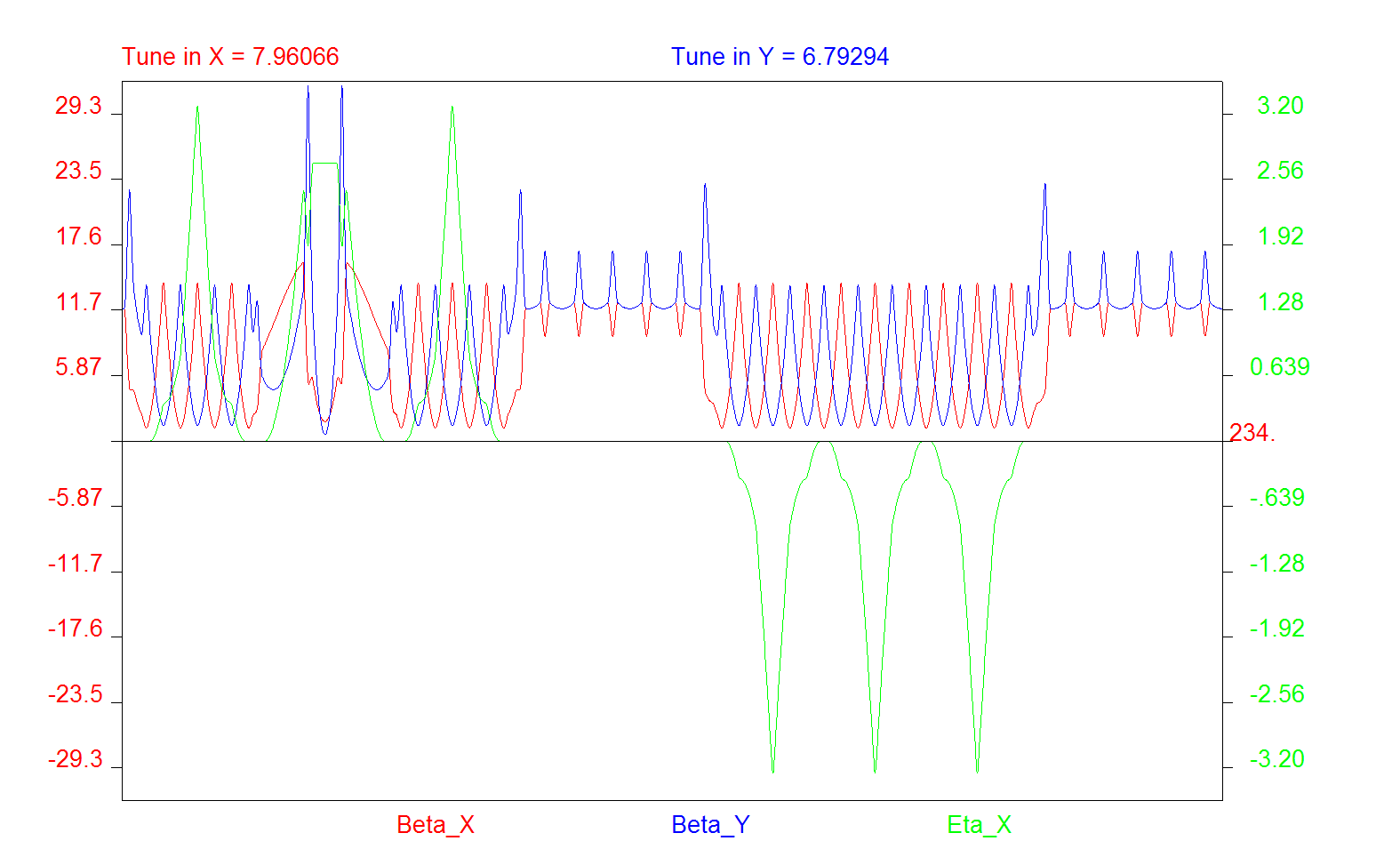
MEIC Booster Ring Optics
Nominal β value: ~14 m
Up to 3 GeV
Erdelyi
Nominal parameters
betatron: 14 m
Dispersion: 3 m
These magnets Need large aperture
70
7
Up to 7.9 GeV
Bogacz
BETA_X&Y[m]
Nominal β value: ~24 m
DISP_X&Y[m]
0
-7
0
BETA_X
BETA_Y
DISP_X
DISP_Y
272.306
Inj. arc (255⁰ ) 36 bends
Straight
Arc (255⁰) 36 bends
Straight

Slide 16
Physical Aperture of Magnets
MEIC Booster ring
Beam-stay-clear (6σ@ injection): ±5 cm
closed orbit allowance +1 cm
sagitta (with 1.2 m dipole): 1.8 cm
±6.4 cm
Norm. emittance 2,5 µm
Energy spread 0.001
Nominal betatron 14 m
Nominal dispersion 1 m
Booster ring optics design should include consideration of physical aperture

Slide 17
Choice of Booster Ring Ejection Energy
 | Kinetic energy | Magnet field | Ramp Range
 | GeV | T
Booster | 0.285 | 0.27 | 11.2
 | 7.9 | 3
Collider ring | 7.9 | 0.26 | 11.5
 | 100 | 3
Magnet ramp range
0.3 to 3 T typical for super-ferric
Ramp range > 10 is technical feasible, but requires more R&D and cost.
Space charge tune-shift limit in the booster and collider ring
 | Kinetic energy | Magnet field | Ramp range
 | GeV | T
Booster | 0.1 | 0.2 | 15.0
 | 5.8 | 3
Collider ring | 5.8 | 0.2 | 15.1
 | 100 | 3
 | Kinetic energy | Magnet field | Ramp Range
 | GeV | T
Booster | 0.05 | 0.17 | 17.9
 | 4.7 | 3
Collider ring | 4.7 | 0.17 | 18.2
 | 100 | 3

Slide 18
Towards 476 MHz Bunch Repetition Rate
The MEIC collider ring receives 9 to 63 long bunches from the booster ring (bunch length is 100 m to 40 m)
The colliding beam has a 476 MHz bunch repetition frequency ➔ 3418 bunches in the collider ring
The old scheme is first de-bunching (to a coasting beam) then re-bunching
There are serious problems
Longitudinal instability
Abort/cleaning gap
The alternative approach is bunching splitting (used in RHIC and LHC)
LHC scheme, in proton synchrotron (PS)
4 + 2 bunches injection in H=7, one empty bucket for a gap
1 to 3 split to 18 bunches in H=21, then 1 to 4 split to 72 bunches in H=84
Bunch spacing is 25 ns, gap is 320 ns ~ 96 m (now can be shorter)

Slide 19
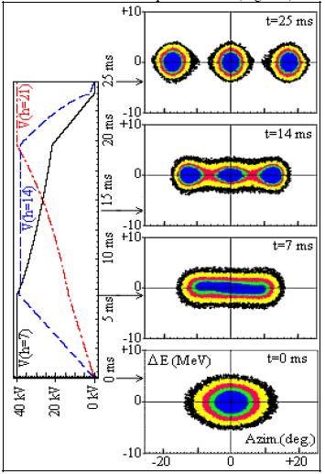
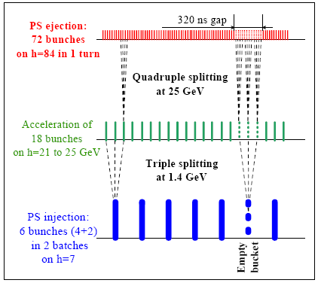
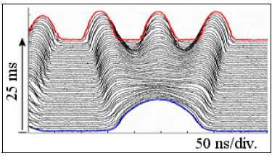
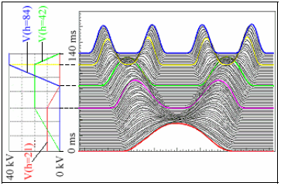
Bunch Splitting In LHC
1 to 3
1 to 3
1 to 4

Slide 20
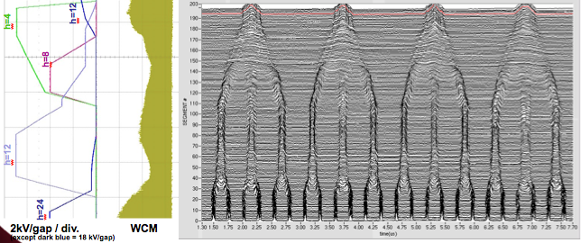
Bunch Merging in RHIC
Gold beam adiabatic bunch merging in the Brookhaven Booster. Time flows from bottom to top. Four RF harmonics (h=4, 8, 12, 24) are used to perform successive 2-to-1 and 3-to-1 bunch merges for a final effective 6-1 merge.

Slide 21
Bunch Splitting in MEIC
Linac energy (MeV) | Long bunches in the collider ring | Splitting | Short bunches in the collider ring | Collider Ring circumference (m)
285 | 9 | 1x10, 1x6, 1x6 | 3240 | 2041.2 + gap
100 | 27 | 1x5, 1x5, 1x5 | 3375 | 2126.3 + gap
50 | 63 | 1x3, 1x3, 1x6 1x5, 1x5, 1x2 | 3402 3150 | 2143.3 + gap 1984.5 + gap
Leaving a gap in the booster ring and in the collider ring
Missing long bunches since beam is always captured in some kind of RF buckets (similar to the PS case, 6 bunches in H-7 buckets)
Adjust the ratio of the booster and collider ring circumference
Barrier-bucket is another approach which deserves further studies

Slide 22
Formation of Heavy Ion Beams in MEIC
At low energy, it is challenge to accelerate protons and heavy ions efficiently using a common DTL type apparatus since ions have different flying time in drafting tubes due to different charge-mass ratio
For example, Lead ions has different charge states in a linac,
From source: ²⁰⁸Pb³⁰⁺, 208/30=6.93
After stripper: ²⁰⁸Pb⁶⁷⁺, 208/30=3.10
Stripping injection into collider: ²⁰⁸Pb⁸²⁺, 208/30=2.53
The standard approach is two linacs
Electron cooling is required for accumulation of heavy ions
Pre-cooling of heavy ions in the booster ring seems not necessary
APBIS
H- source
DC cooler
BB cooler
proton linac
EBIS
collider ring
(8 to 100 GeV)
booster
(0.285 to 8 GeV)
Heavy ion linac

Slide 23
Choosing Energy of MEIC Heavy Ion Linac
LHC
4.2 MeV/n for Pb, very low,
A compact accumulator-booster ring (LEIR)
MEIC
Presently a single booster design
Booster size is relatively large (~240 m, 1/9 of the collider ring)
The SRF linac has a stripper (²⁰⁸Pb³⁰⁺ to ²⁰⁸Pb⁶⁷⁺) @ 13 MeV/n, providing a good reference point (we prefer a high charge state)
As a preliminary conceptual study, we choose 25 MeV/n

Slide 24
Single (Low) Ion Linac Approach?
It is advantage in cost and operation to have a single linac
Ion sources
RFQ
QWR
QWR
HWR
4 cryos
IH
4 cryostats
2
10 cryostats
2 cryos
10 cryos
MEBT
stripping
?
p: 55 MeV
Pb: 13 MeV/u
p: 100 MeV
Pb: 25 MeV/u
A conceptual design of DTL
J. Guo talk
Section | RFQ | IH | CH1 | CH2 | CH3 (future upgrade)
Lowest Q/A particle to accelerate | Pb³⁰⁺ | Pb³⁰⁺ | Pb⁶⁴⁺ | H⁻ | H⁻
Exit E_{k} (MeV/u) | 1.4 | 10 | 40 | 60 | 100
Exit β | 0.055 | 0.145 | 0.283 | 0.341 | 0.428
Max V_{eff} (MV) | 10 | 60 | 98 | 20 | 40
Number of tanks |  | 4-5 | 4-5 | 1 | 2

Slide 25
Path Forward
Bottom-up: Evaluating different approaches and technologies
High & low injection energy
One linac vs. two linacs.
Accumulator/booster ring, cyclotron, induction cell line
Narrow to two most promising design concepts (one high and one low injection energy) for further technical analysis
Support cost impact analysis
Down selection for a new baseline

Slide 26
Acknowledgement
The MEIC accelerator design study group, particularly,
Alex Bogacz, Yaroslav Derbenev, Jiquan Guo, Fanglei Lin, Vasiliy Morozov, Fulvia Pilat, Robert Rimmer, Todd Satogata, Haipeng Wang, Shaoheng Wang, He Zhang (Jefferson Lab)
Peter Ostroumov (ANL)
Peter McIntyre (Texas A & M Univ.)

Slide 27
Backup Slides

Slide 28
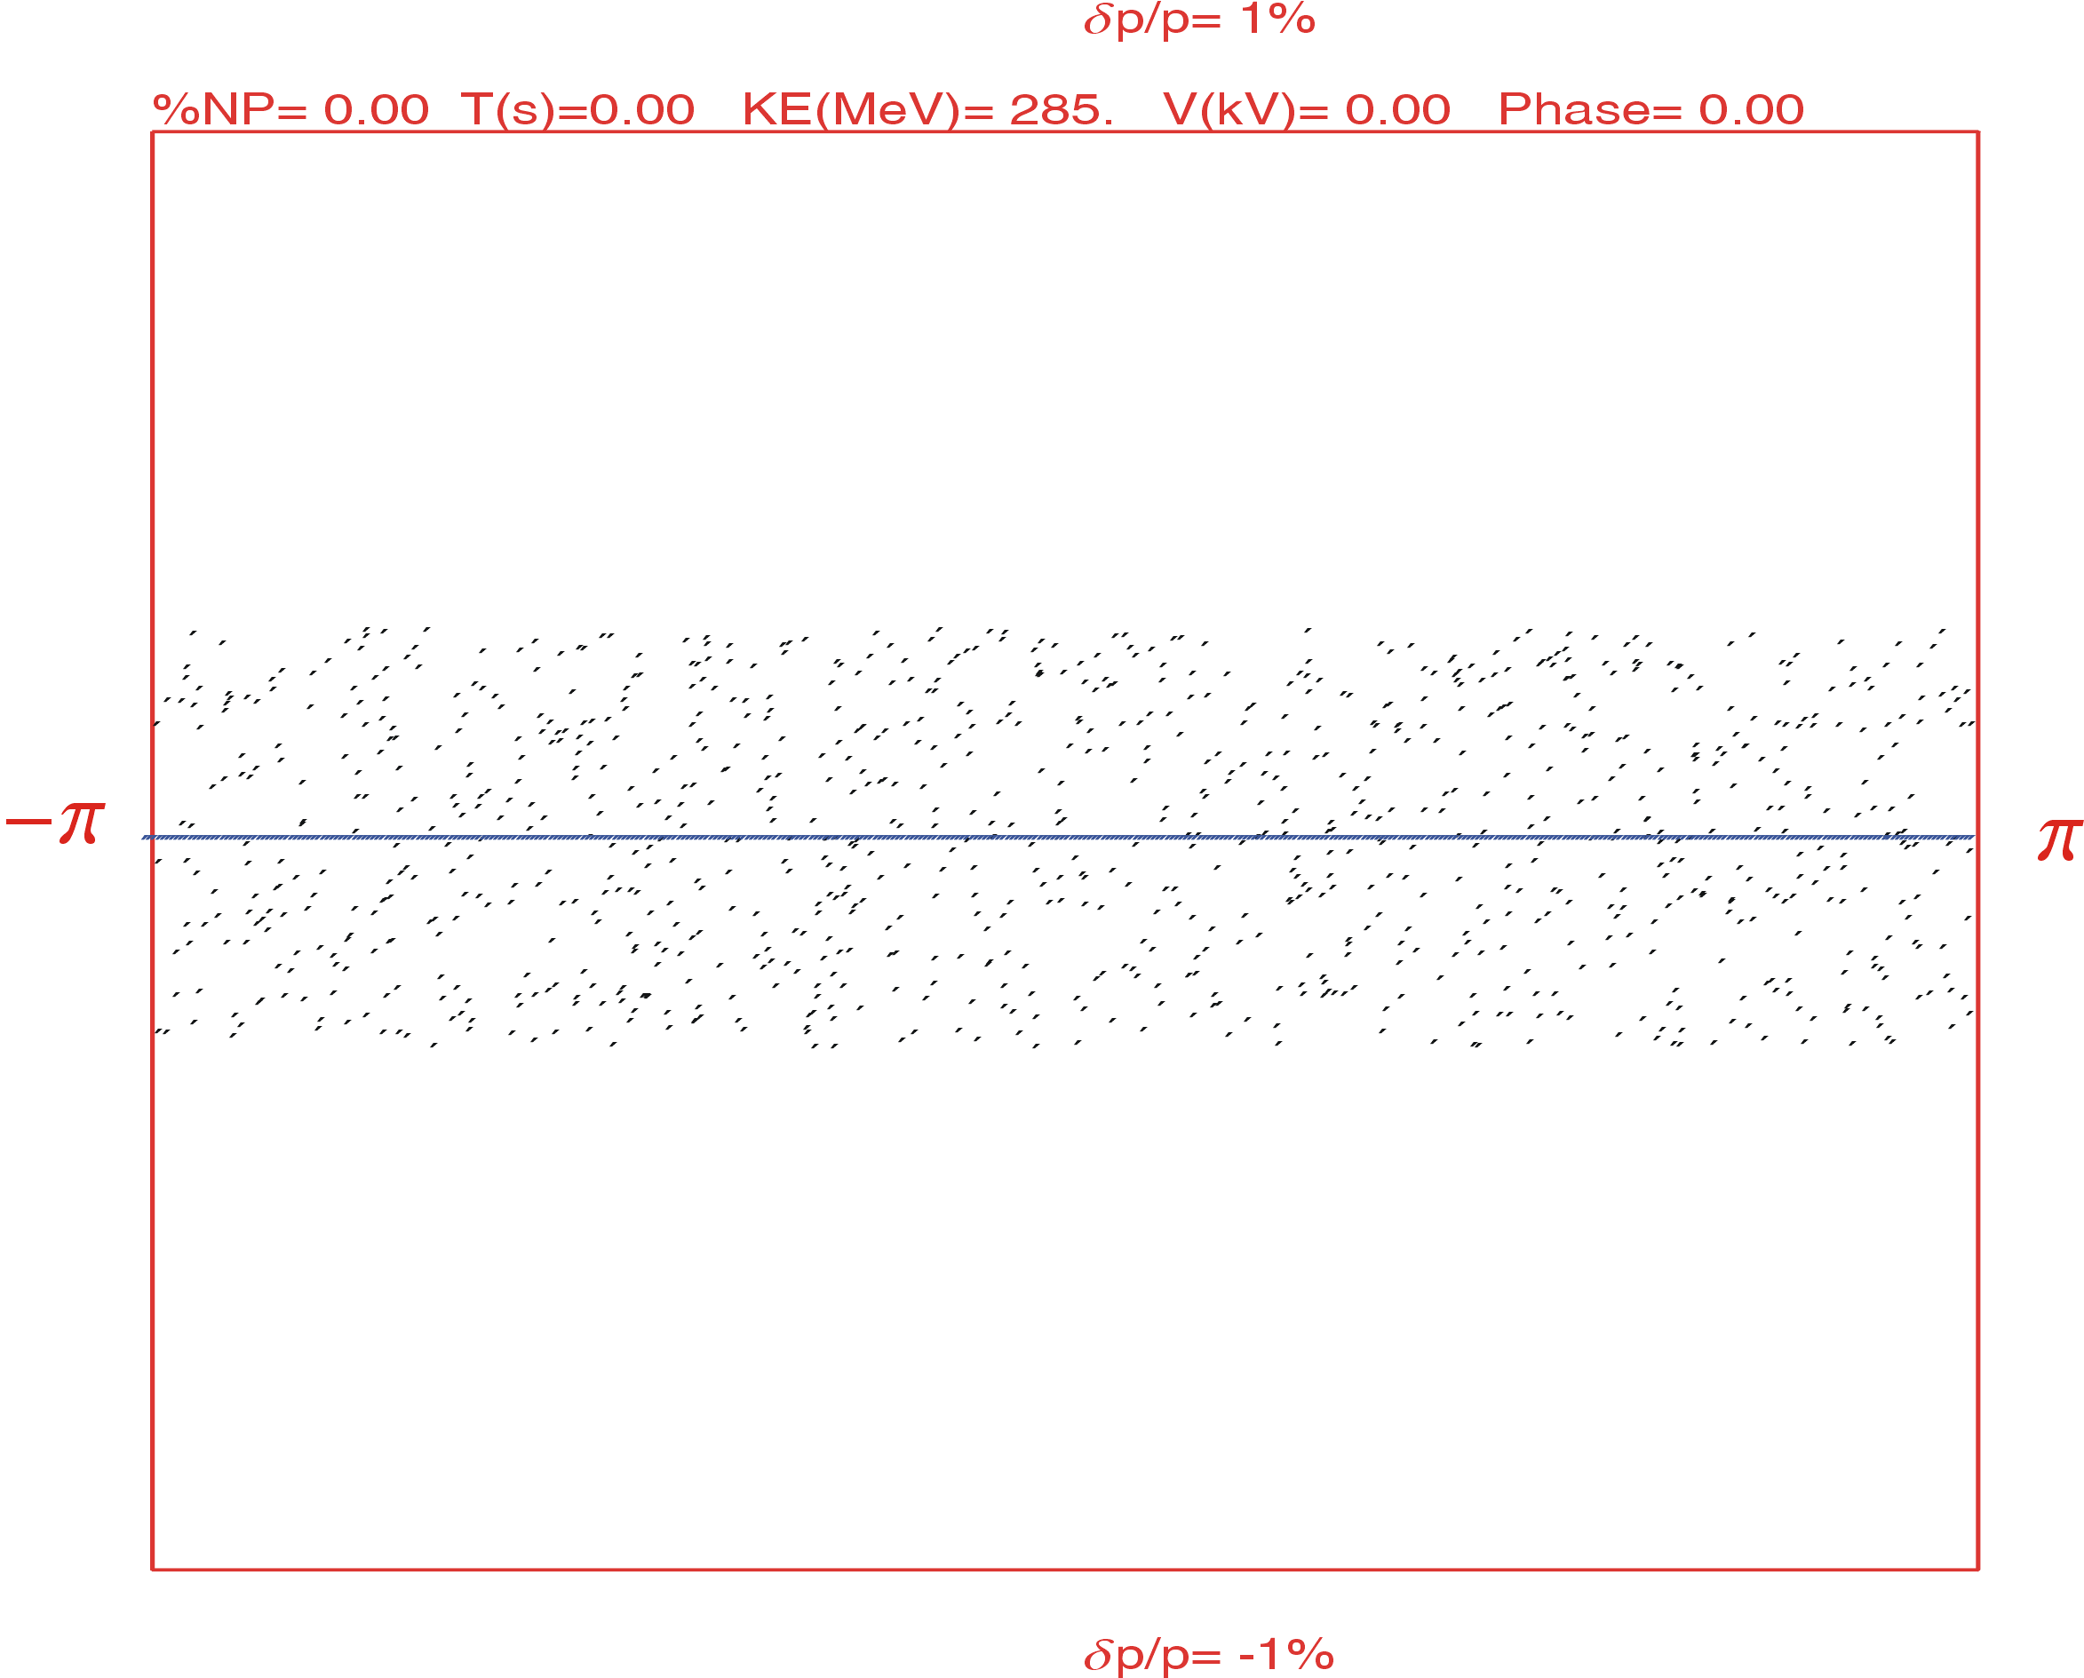
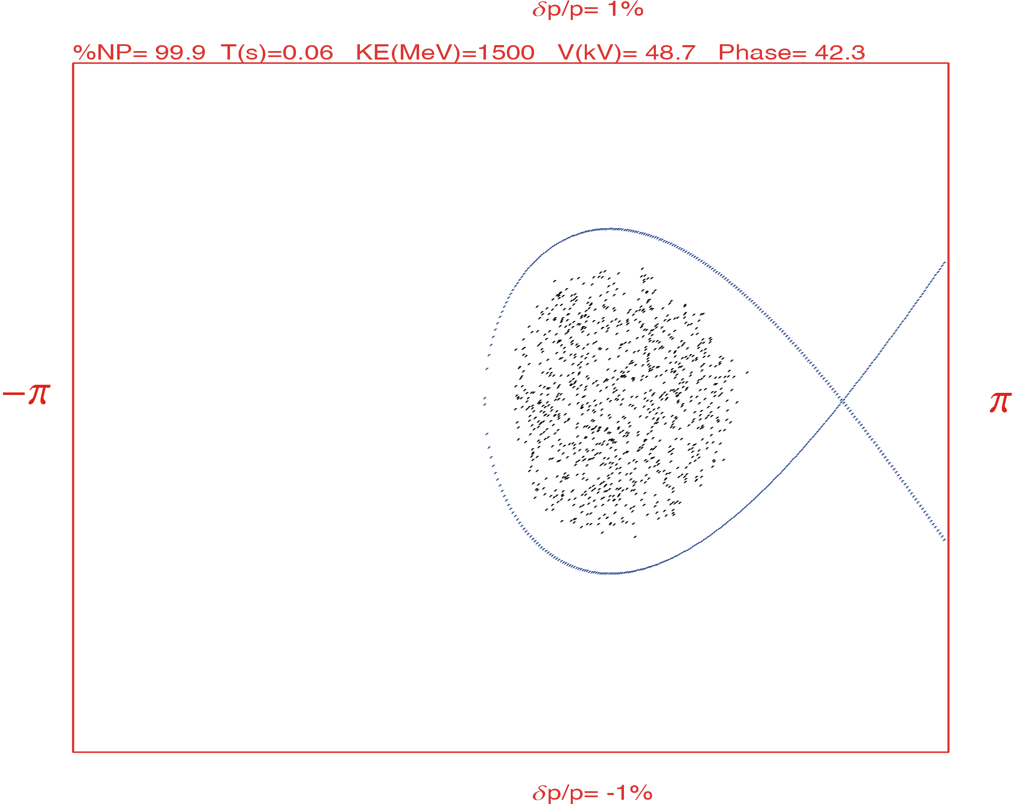
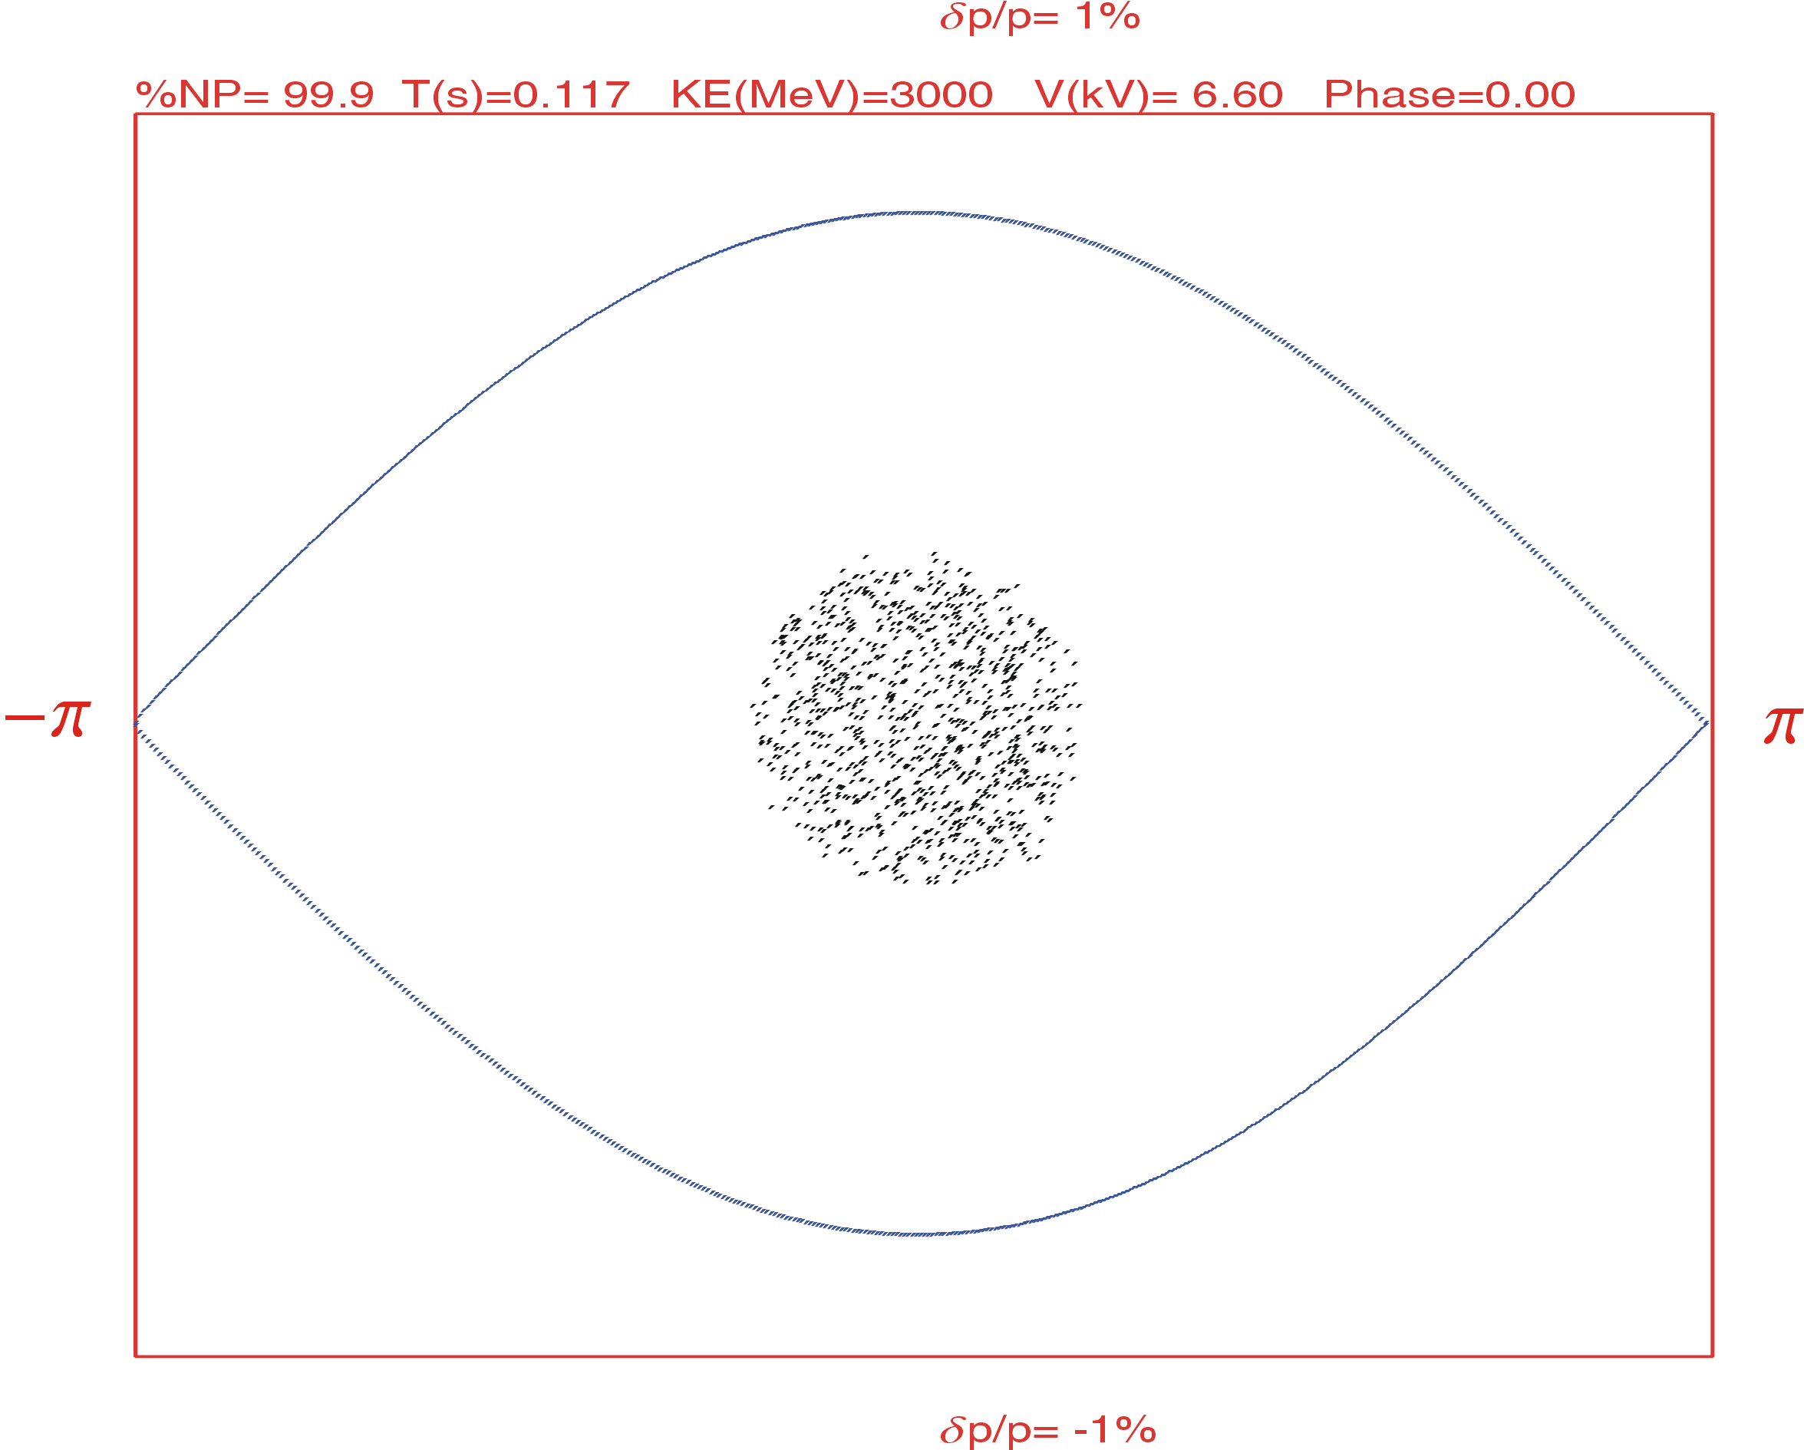
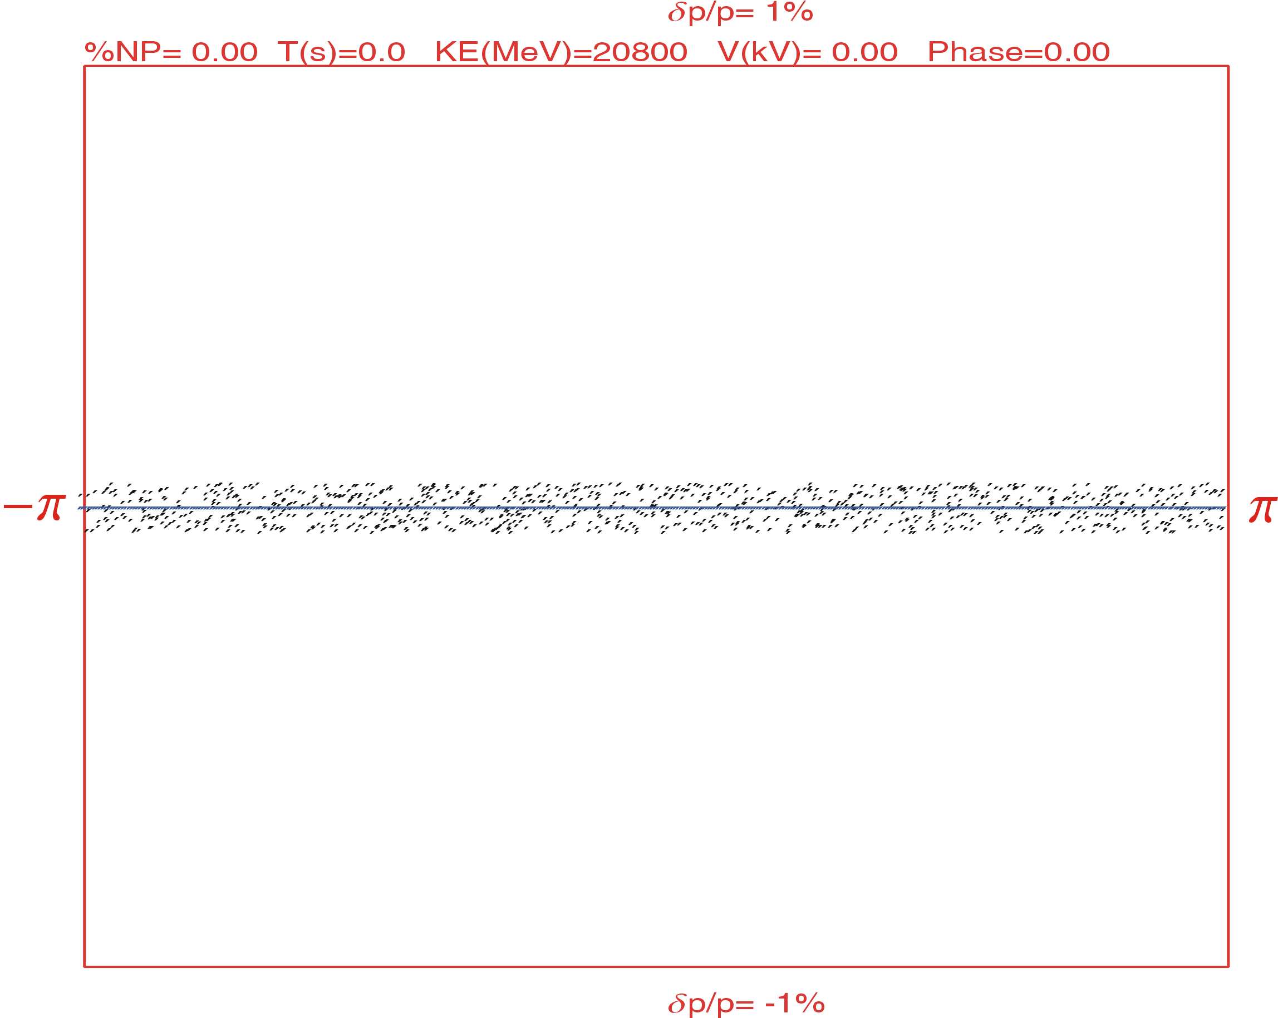
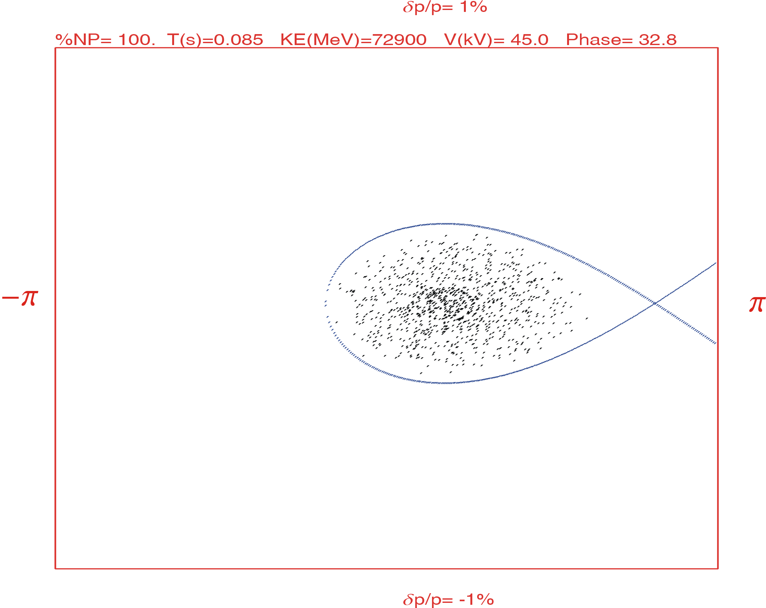
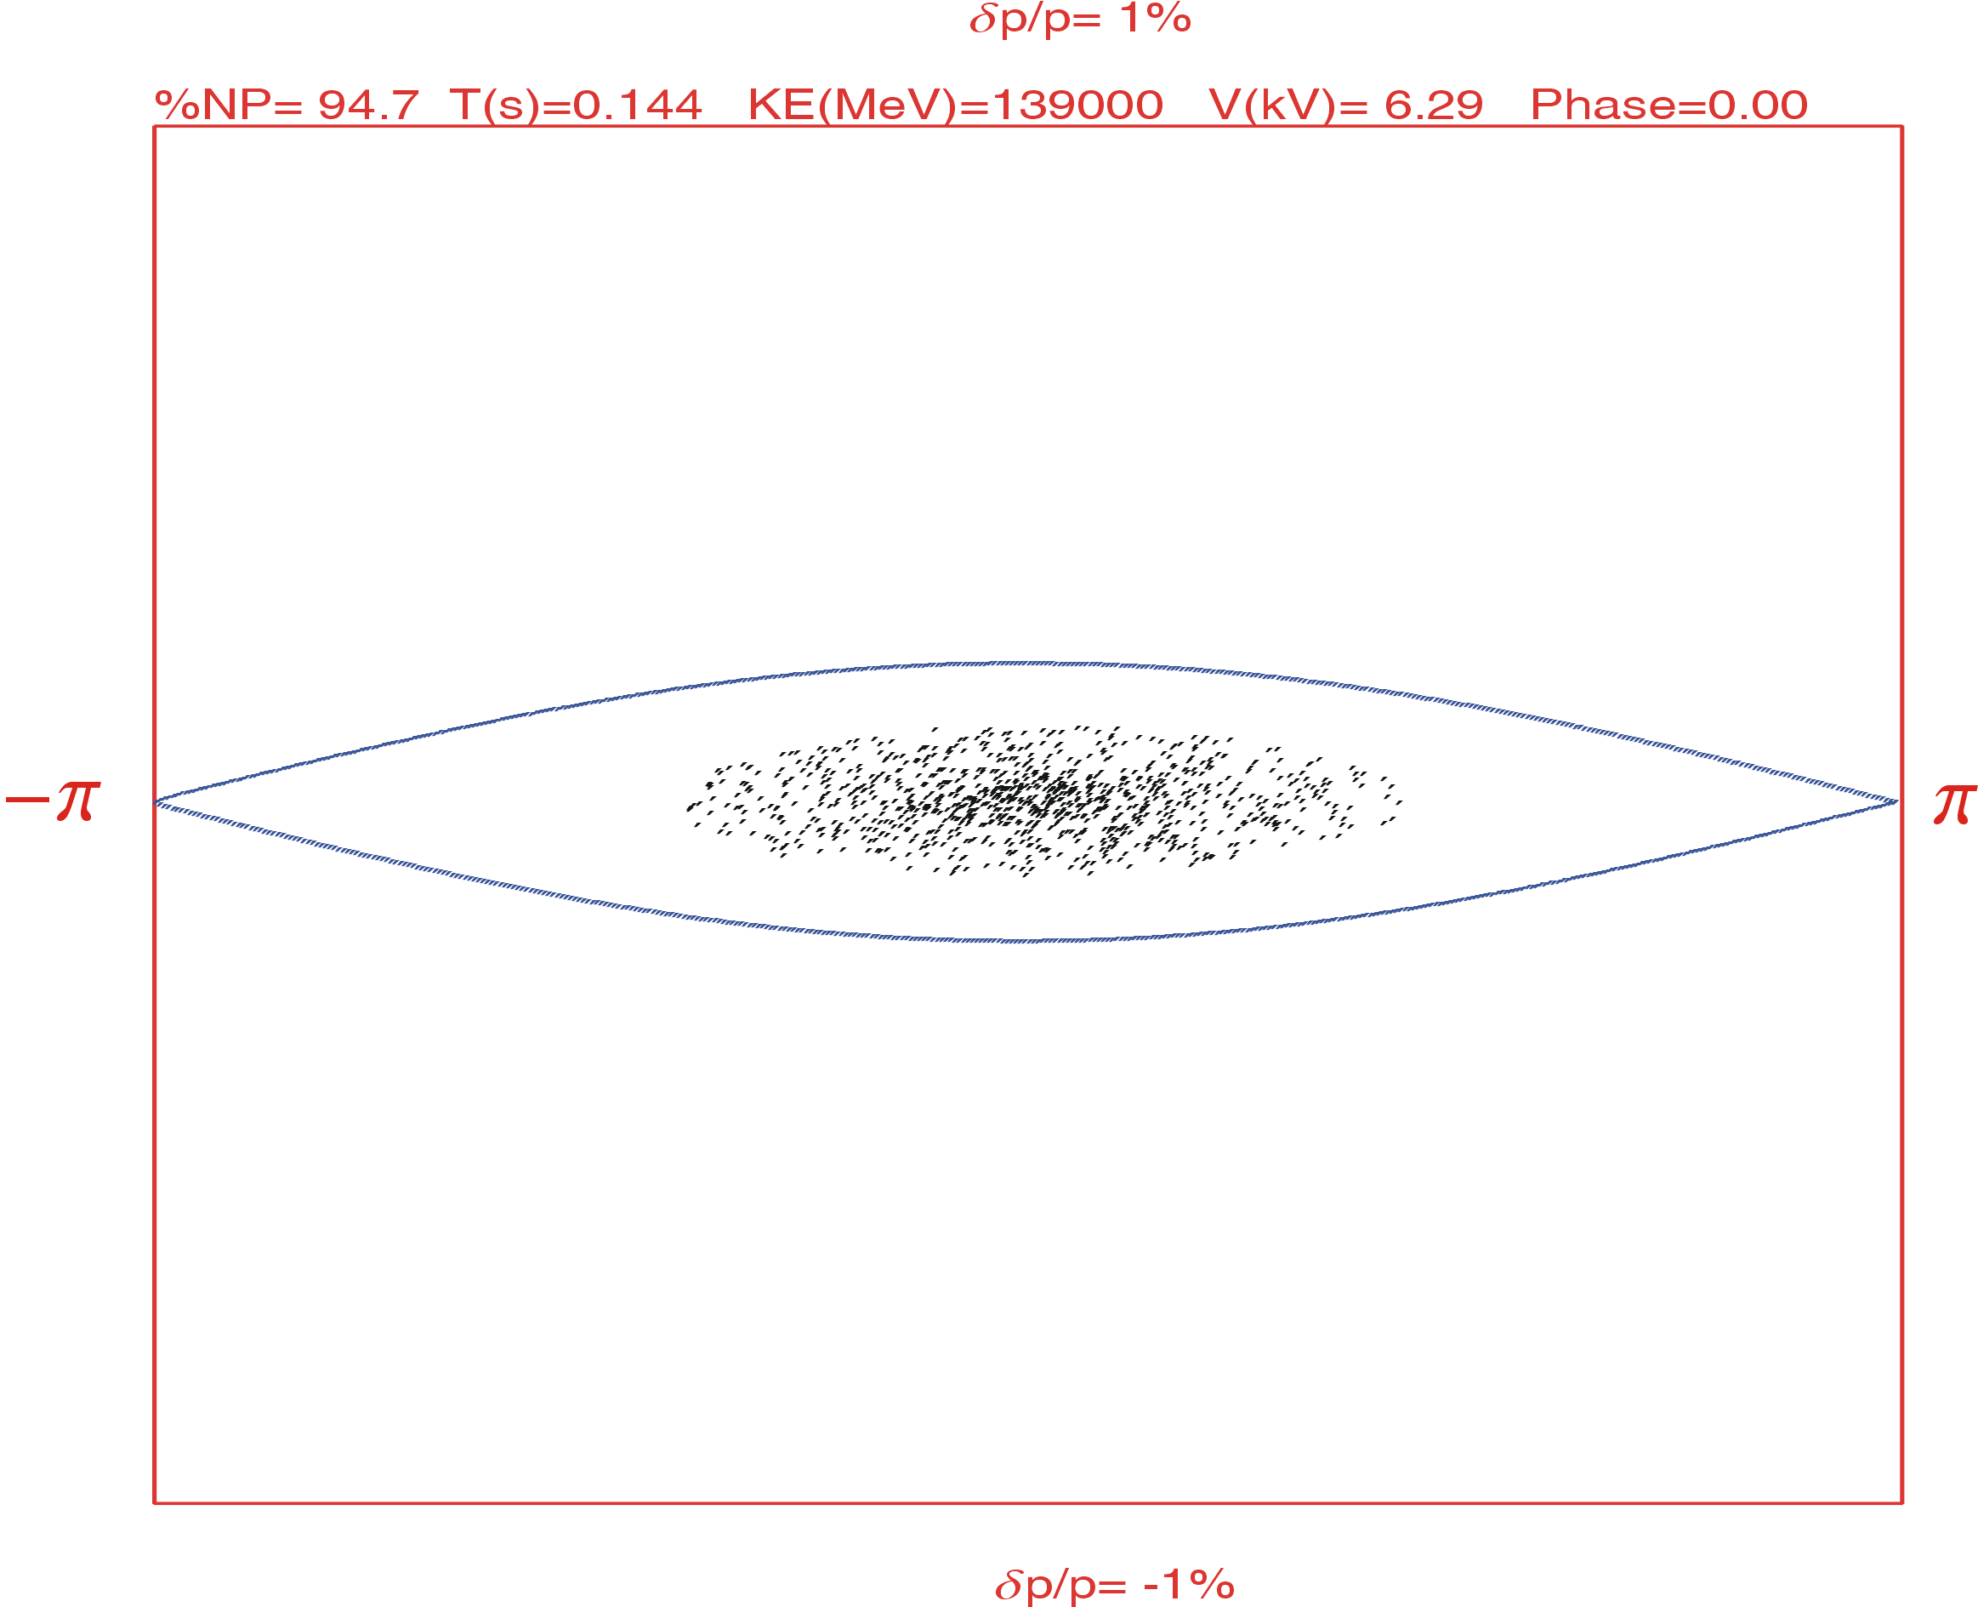
Longitudinal Dynamics in the Booster Ring
Proton
B. Erdelyi, P. Ostroumov
Lead ion

Slide 29
MEIC Proton Requirements
Collider ring
Circumference | m | 2154.28
Nominal current | A | 0.5
Bunch repetition rate | MHz | 476
Bunch spacing | m | 0.63
Number of bunches |  | 3418
Protons per bunch | 10⁹ | 6.56
Total protons in ring | 10¹³ | 2.24
Normalized emittance | mm mrad | 0.5 @ 30 GeV; 1 @ 100 GeV

Slide 30
Aperture and Beam-Stay-Clear
MEIC Collider ring
Beam-stay-clear (10σ@ injection): ±2 cm
closed orbit allowance +1 cm
dispersion of (±0.5% spread) ±1 cm
sagitta (with 4 m dipole length): 1.8 cm
±5 cm
Beam-stay-clear: ±4 cm
Nominal betatron function value: 24 m
Injection | MeV | 285 | 100 | 50
Max emittance | μm | 1.55 | 0.88 | 0.61
Nominal betatron function value: 14 m
Injection | MeV | 285 | 100 | 50
Max emittance | μm | 2.66 | 1.50 | 1.05
MEIC Booster ring
Beam-stay-clear (6σ@ injection): ±4 cm
closed orbit allowance +1 cm
dispersion of (±0.5% spread) ±1 cm
sagitta (with 1.2 m dipole): 1.8 cm
±6.4 cm
Beam-stay-clear: ±5 cm
Nominal betatron function value: 24 m
Injection | MeV | 285 | 100 | 50
Max emittance | μm | 2.42 | 1.37 | 0.96
Momentum spread and momentum acceptance is also an limiting issue in injection/accumulation
Nominal betatron function value: 14 m
Injection | MeV | 285 | 100 | 50
Max emittance | μm | 4.15 | 2.35 | 1.64

Slide 31
Proton Beam Formation Scheme (Part 1)
Linac energy | MeV | 285 |  |  | 100 | 50
Nominal current in the collider ring | A | 0.5 | 1 | 1.5 | 0.5 | 0.5
Booster circumference (1/9 of collider) | M | 239.4 | 239.4 | 239.4 | 239.4 | 239.4
Booster ring betatron value (nominal) | M | 14 | 14 | 14 | 14 | 14
Accumulation protons in booster | 10¹² | 2.5 | 2.5 | 2.5 | 0.83 | 0.356
Norm. emitt. of accumulated beam | μm | 2.66 | 2.66 | 2.66 | 1.49 | 1.04
RMS spot size in booster | mm | 6.7 | 6.7 | 6.7 | 6.6 | 6.6
beam-stay-clear (6 RMS spot) | mm | 40 | 40 | 40 | 39.8 | 39.8
Space charge tune-shift at coasting |  | 0.105 | 0.105 | 0.105 | 0.130 | 0.120
Capture (for acceleration) KE | MeV | 285 | 285 | 285 | 100 | 50
Harmonic number |  | 1 | 1 | 1 | 1 | 1
RF frequency | MHz | 0.80 | 0.80 | 0.80 | 0.54 | 0.39
sin(φ_{s}) and φ_{s} | /deg | 0.6/37° | 0.6/37° | 0.6/37° | 0.79/52° | 0.88/61°
Bucket (& fraction of circumference) | m | 171(0.71) | 171(0.71) | 171(0.71) | 180(0.75) | 185(0.77)
Protons in each bucket | 10¹² | 2.5 | 2.5 | 2.5 | 0.83 | 0.356
Space charge tune-shift after capture |  | 0.147 | 0.147 | 0.147 | 0.173 | 0.156

Slide 32
Proton Beam Formation Scheme (Part 2)
Linac energy | MeV | 285 |  |  | 100 | 50
Nominal current in the collider ring | A | 0.5 | 1 | 1.5 | 0.5 | 0.5
Booster ring circumference | m | 239.4 | 239.4 | 239.4 | 269.3 | 269.3
Booster betatron value (nominal) | m | 14 | 14 | 14 | 14 | 14
After 1st stage acceleration KE | GeV | 2 | 2 | 2 | 1.4 | 0.8
Harmonic number |  | 1 | 1 | 1 | 1 | 1
RF frequency | MHz | 1.19 | 1.19 | 1.19 | 1.15 | 1.05
sin(φ_{s}) and φ_{s} | /deg | 0.6/36.9° | 0.6/36.9° | 0.6/36.9° | 0.79/52.0° | 0.88/61.0°
Bucket (& fraction of circumference) | m / | 116(0.48) | 116(0.48) | 116(0.48) | 84(0.35) | 69(0.29)
Protons in each bucket | 10¹² | 2.49 | 2.49 | 2.49 | 0.83 | 0.356
Spot size & beam-stay-clear | mm | 3.5/21.2 | 3.5/21.2 | 3.5/21.2 | 3.0/18.1 | 3.1/18.3
Space charge tune-shift at coasting |  | 0.025 | 0.025 | 0.025 | 0.034 | 0.050
After DC cooling kinetic energy | GeV | 2 | 2 | 2 | 1.4 | 0.8
Normalized emittance | μm | 0.5 | 0.5 | 0.75 | 0.5 | 0.65
RMS spot size & beam-stay-clear | mm | 1.5 / 9.2 | 1.5 / 9.2 | 1.9 / 11.3 | 1.8 / 10.5 | 2.4 / 14.5
Space charge tune-shift |  | 0.135 | 0.135 | 0.09 | 0.101 | 0.08

Slide 33
Proton Beam Formation Scheme (Part 3)
Linac energy | MeV | 0.285 |  |  | 100 | 50
Nominal current in the collider ring | A | 0.5 | 1 | 1.5 | 0.5 | 0.5
Booster ring circumference | m | 239.4 | 239.4 | 239.4 | 269.3 | 269.3
Booster betatron value (nominal) | m | 14 | 14 | 14 | 14 | 14
After 2nd stage acceleration KE | GeV | 7.9 | 7.9 | 7.9 | 5.8 | 4.7
Harmonic number |  | 1 | 1 | 1 | 1 | 1
RF frequency | MHz | 1.25 | 1.25 | 1.25 | 1.24 | 1.23
sin(φ_{s}) and φ_{s} | /deg | 0.6/37° | 0.6/37° | 0.6/37° | 0.79/52° | 0.88/61°
Bucket & fraction of circumference | m / | 110/0.46 | 110/0.46 | 110/0.46 | 116/0.32 | 87/0.24
RMS spot size and beam-stay-clear | mm | 0.86 / 5.2 | 0.86 / 5.2 | 0.86 / 5.2 | 0.99 / 6.0 | 1.2 / 7.4
Space charge tune-shift |  | 0.015 | 0.015 | 0.01 | 0.012 | 0.008
Bunch compression KE | GeV | 7.9 | 7.9 | 7.9 | 5.8 | 4.7
Harmonic number |  | 1 | 1 | 1 | 1 | 1
RF frequency | MHz | 1.25 | 1.25 | 1.25 | 1.24 | 1.23
sin(φ_{s}) and φ_{s} | /deg | 0.4/23.6° | 0.65/40.5° | 0.83/55.6° | 0.85/58.2° | 0.96/73.7°
Bucket (& fraction of circumference) | m | 142(0.59) | 102(0.43) | 67(0.28) | 64.7(0.27) | 29.6(0.12)
Space charge tune-shift |  | 0.012 | 0.016 | 0.016 | 0.015 | 0.015

Slide 34
Proton Beam Formation Scheme (Part 4)
Linac energy | MeV | 0.285 |  |  | 100 | 50
Nominal current in collider ring | A | 0.5 | 1 | 1.5 | 0.5 | 0.5
Booster ring circumference | m | 239.4 | 239.4 | 239.4 | 239.4 | 239.4
Booster betatron value (nominal) | m | 14 | 14 | 14 | 14 | 14
Collider ring circumference | m | 2154 | 2154 | 2154 | 2154 | 2154
Injected into collider ring, KE | GeV | 7.9 | 7.9 | 7.9 | 5.8 | 4.7
Injections from the booster |  | 9 | 9x2 | 9x3 | 9x3 | 9x7
Harmonic number |  | 9 | 9x2 | 9x3 | 9x3 | 9x7
Sum of bucket size | m | 993 | 1686 | 1741 | 1748 | 1861
Fraction of circumference |  | 0.46 | 0.78 | 0.81 | 0.81 | 0.86
Protons in the collider ring | 10¹² | 2.5x9 =22.43 | 2.5x9x2 =44.86 | 2.5x9x3 =67.28 | 0.83x9x3 =22.43 | 0.36x9x7 =22.43
Space charge tune-shift |  | 0.105 | 0.145 | 0.148 | 0.132 | 0.137
DC cooling at a lower energy (2, 1 and 0.8 GeV KE)
When number of protons in the booster is reduced, the space charge tune-shift is also lowered, then the energy at which the DC cooling is performed can also be lowered
Less protons and lower energy lead to high cooling efficiency

Slide 35
Lead Ion Beam Formation Scheme (Part 1)
Linac energy | MeV/n | 100 | 25
Nominal current in the collider ring | A | 0.5 | 0.5
Booster circumference (1/9 of collider ring) | m | 239.4 | 239.4
Booster ring betatron value (nominal) | m | 14 | 14
Accumulation lead (²⁰⁸Pb⁶⁷⁺) in booster | 10¹⁰ | 1.5 | 0.356
Normalized emittance of accumulated beam | μm | 1.47 | 1.00
RMS spot size in booster | mm | 6.6 | 7.7
beam-stay-clear (6 RMS spot) | mm | 39.8 | 46.3
Space charge tune-shift at coasting |  | 0.052 | 0.034
Capture (for acceleration) kinetic energy | MeV | 100 | 25
Harmonic number |  | 1 | 1
RF frequency | MHz | 0.54 | 0.28
sin(φ_{s}) and φ_{s} | /deg | 0.83 / 55.6° | 0.96 / 73.7°
Bucket (& fraction of circumference) | m | 162 (0.68) | 128 (0.54)
Space charge tune-shift after capture |  | 0.077 | 0.063

Slide 36
Lead Ion Beam Formation Scheme (Part 2)
Linac energy | MeV/n | 100 | 25
Nominal current in the collider ring | A | 0.5 | 0.5
Booster ring circumference | m | 269.3 | 269.3
Booster betatron value (nominal) | m | 14 | 14
After acceleration kinetic energy | GeV | 2.04 | 1.09
Harmonic number |  | 1 | 1
RF frequency | MHz | 1.19 | 1.11
sin(φ_{s}) and φ_{s} | /deg | 0.83 / 55.6° | 0.96 / 73.7°
Bucket (& fraction of circumference) | m / | 73.1 (0.31) | 32.9 (0.14)
Spot size & beam-stay-clear | mm | 2.6 / 15.7 | 2.7 / 16.1
Space charge tune-shift at coasting |  | 0.009 | 0.014
Bunch compression kinetic energy | GeV | 2.04 | 1.09
sin(φ_{s}) and φ_{s} | /deg | 0.7 / 44.4° | 0.2 / 11.5°
Bucket (& fraction of circumference) | m / | 98.1 (0.41) | 20.5 (0.09)
Space charge tune-shift |  | 0.007 | 0.023

Slide 37
Lead Ion Beam Formation Scheme (Part 3)
Linac energy | MeV/n | 100 | 50
Nominal current in collider ring | A | 0.5 | 0.5
Booster ring circumference | m | 239.4 | 239.4
Booster betatron value (nominal) | m | 14 | 14
Collider ring circumference | m | 2154 | 2154
Injected into collider ring, Kinetic energy | GeV/u | 2.04 | 1.09
Injections from the booster |  | 9x2 | 9x10
Harmonic number |  | 9x2 | 9x10
Sum of bucket size | m | 1766 | 1848
Fraction of circumference |  | 0.82 | 0.86
Protons in the collider ring | 10¹⁰ | 1.5x9x3 =27.35 | 0.356x9x10 =27.35
Space charge tune-shift |  | 0.062 | 0.206
Assuming no pre-cooling in the booster ring
Beam splitting scheme: 1x6 and 1x6 ➔ 90x6x6=3240 bunches ➔ 2041 m + gap

Slide 38
Possible Reasons Why Linac4 is so Expensive?
The goal of the Linac4 project is to build a 160 MeV H− linear accelerator replacing Linac2 as injector to the PS Booster (PSB). The new linac is expected to increase the beam brightness out of the PSB by a factor of 2, making possible an upgrade of the LHC injectors for higher intensity and eventually an increase of the LHC luminosity.
Furthermore, Linac4 is designed for possible operation at high-duty cycle (5%), if required by future high-intensity programs (SPL).
Linac4 will be located in an underground tunnel connected to the Linac4-PSB transfer line. A surface building will house RF equipment, power supplies, electronics and other infrastructure.
Ion species | H-
Output energy | 160 MeV
Bunch frequency | 352.2 MHz
Max. rep. rate | 2 Hz
Beam pulse Length | 400 microsec
Chopping scheme | 222/133 transmitted bunches/empty buckets
Mean pulse current | 40 mA
Beam power | 5.1 kW
N. particles per pulse | 1.0 ·10¹⁴
N. particles per bunch | 1.14 ·10⁹
Beam transverse emittance | 0.4 pmm mrad (rms)

Slide 39
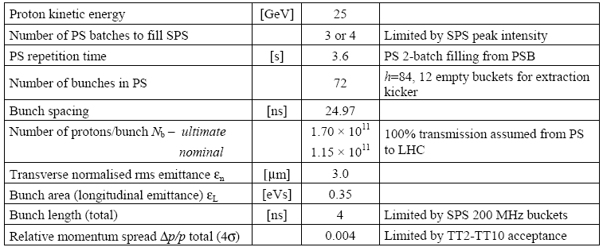
SPS Parameters for LHC Operation

