Slide 1
DTL Option for MEIC Ion Injection
Jiquan Guo, Haipeng Wang
Jlab
3/30/2015

Slide 2
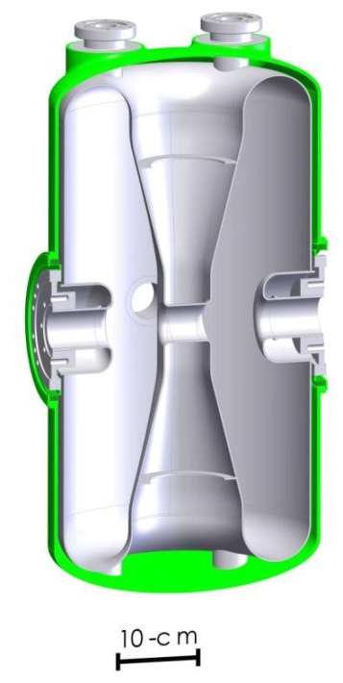
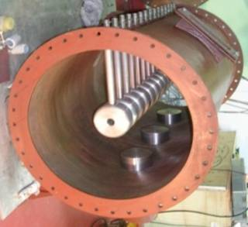
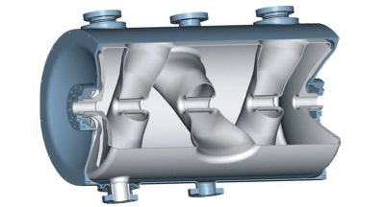
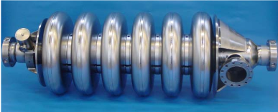
Hardron Linac: Typical Layout
~0.1MeV
0.5-5MeV
5-200MeV
80-300MeV
>300MeV
Source
RFQ
Alveraz/IH/CH/CC DTL
SRF spoke or QWR/HWR
SRF elliptical cavities
Alveraz DTL
IH-DTL
CH-DTL
SRF CH-DTL
SRF HWR
SRF Spoke
Elliptical (medium β)

Slide 3
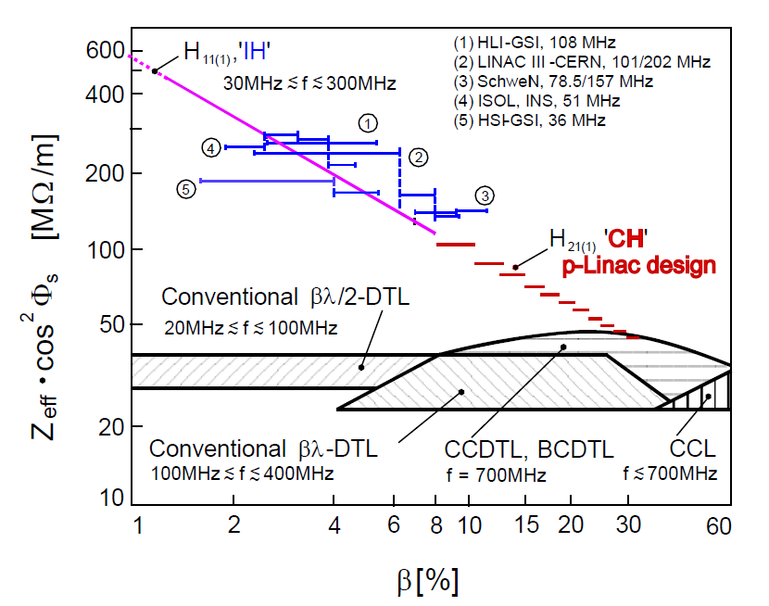
DTL Efficiency
G. Clemente, CARE-Note-2007-001-HIPPI
IH-DTLs are proven up to 8-10MeV/u
FAIR 70MeV proton linac CH-DTL is under commissioning, a heavy ion version of CH-DTL for up to 22MeV/u U³⁸⁺ has been proposed
Other DTLs like CC-DTL work at higher energy.
DTL (Drift Tube Linac) is a multi-gap accelerator structure with very high R/Q/L at low β. Efficiency drops as β goes higher, especially for IH/CH structures
Phase of different gaps are synced by the particle’s drift time. The structures have fixed (or very narrow) β profile.
Will get same E_{k}/u for different particles; have to lower V_{gap} for lighter particles to match the β profile, but also result in higher current capability.
Typical SRF QWR has Z_{eff} in the order of 10¹¹Ω, 3~4 order of magnitude better

Slide 4
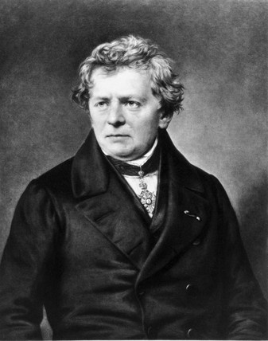
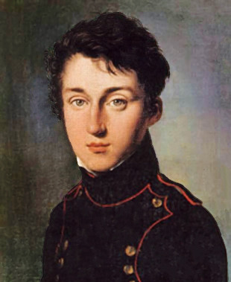
RF cavities: warm vs SRF
Ohm takes SRF
Carnot favors warm
Warm: Need multi-MW level RF power – major cost driver
SRF: Need to pump out both dynamic and static heat load at 0.1-0.3% efficiency
Warm RF can take the advantage of pulsed operation: increases efficiency with higher in-pulse beam loading, no Ohmic loss when pulse is off, reduces RF source cost and wall plug power

Slide 5
Technology choice
SRF single/double gap
Warm multi-gap
CW operation Low duty cycle pulsed
Low beam current High current
High β Low β
Particles w/ same E_{k}/q Particles w/ same E_{k}/u
SRF multi-gap cavity is also an option for 0.1<β<0.5 CW operation.
Warm DTL allows focusing magnets inside or very close to the tanks, which is crucial for β<0.1 heavy ion acceleration.
Z_{eff} /L for warm single/double gap structure is a little bit low, and the available RF sources with very low duty cycle in the frequency range of 0.1-0.4GHz cost too much per W_{avg}.

Slide 6
RF cavities: warm vs SRF, example 1, β~0.2
Warm CH-DTL (Use Z_{eff} of Tank 5 of FAIR p-linac, 325MHz, β=0.22-0.25) | SRF QWR (115MHz, 2 cavities)
L=1.52m, V_{eff}=4MV (scaled from 6MV) | L in cryomodule~1.6m, V_{eff}=4MV
Z_{eff} cos²Φ=82MΩ | R/Q=509Ω, G=42Ω, Φ=20°, R_{s}=65nΩ , Z_{eff} cos²Φ=2.9×10¹¹ Ω
P_{cu,peak}=195kW | P_{Nb}=28W, P_{static}=28W, P_{cryo}=17kW
I_{b}=50mA with 0.3ms pulse width, 5Hz, 0.15% beam duty cycle, RF pulse width 0.5ms | I_{b}=2.5mA with 6ms pulse width, 5Hz, 3% beam duty cycle
P_{RF FWD,peak} ~ 440kW (assume 10% reflection with beam loading) | P_{RF FWD} = 15kW (30% reflection due to microphonics etc.)
P_{RF FWD, avg}= 1.1kW
Wall plug power ~3kW | Wall plug power ~50kW

Slide 7
RF cavities: warm vs SRF, example 2, β~0.4
CC-DTL (Module 4 of CERN linac 4 CC-DTL, 352MHz, β=0.38-0.40, 80MeV/u) | SRF HWR (230MHz, 3 cavities)
L=2.6m, V_{eff}=8MV | L in cryomodule~2.4m, V_{eff} scale to 8MV
Z_{eff} cos²Φ=100MΩ | R/Q=250Ω, G=65Ω, Φ=20°, R_{s}=65nΩ, Z_{eff} cos²Φ=2.2×10¹¹ Ω
P_{cu,peak}=640kW | P_{Nb}=97W, P_{static}=33W, P_{cryo}=43kW
RF pulse width 1ms 25Hz, I_{b}=50mA with 0.8ms pulse width, 2% beam duty cycle | CW RF, CW beam 1mA
P_{RF FWD,peak} ~ 1150kW (assume 10% reflection with beam loading) | P_{RF FWD, cw} = 12kW (30% reflection due to microphonics etc.)
P_{RF FWD, avg}= 29kW
Wall plug power ~70kW | Wall plug power ~70kW

Slide 8
MEIC Booster Ring Injection Requirements
E_{k}/u: 30-50MeV for Pb^{64+#,} 50-100MeV for H⁻
Ion source pulse width: up to 0.5ms
Ion source current: up to 150mA for non-polarized H⁻, 4mA for polarized H⁻, as low as 0.1mA for Li³⁺
Rep-rate: 5 Hz nominal, depends on the ramping/cooling cycle in the booster ring
Only need to inject once in every 3-8hr, ~10µC of charged particles per injection. Each injection should take <=0.5hr. With ~1mA pulsed current, the total linac beam duration will be 10-1000ms, depending on the beam loss factor, so the overall duty factor is 10⁻⁴-10⁻⁶. Duty factor during injection should be ~0.1% or less.
Most of the parameters appear to prefer warm DTL, unless a side program is considered, or the required energy changes significantly.
Need to carefully examine the cost and performance of both technologies, with the consideration of the newest development in ion source and booster ring
# Pb charge state depends on stripping energy, which will be chosen to minimize total accelerating voltage, depending on the final particle energy. Here assumes a stripping energy of ~10MeV/u

Slide 9
A conceptual design of the DTL
Ion sources
Stripper
RFQ
IH
CH1
CH2
CH3
MEBT
Section | RFQ | IH | CH1 | CH2 | CH3 (future upgrade)
Lowest Q/A particle to accelerate | Pb³⁰⁺ | Pb³⁰⁺ | Pb⁶⁴⁺ | H⁻ | H⁻
Exit E_{k} (MeV/u) | 1.4 | 10 | 40 | 60 | 100
Exit β | 0.055 | 0.145 | 0.283 | 0.341 | 0.428
Max V_{eff} (MV) | 10 | 60 | 98 | 20 | 40
RF source (available for now) | 108/162/176MHz tetrode, <=400kW peak/tank, |  | 325 or 352MHz Klystron, 2.8MW peak/tank, <5kW average, may upgrade to magnetron
Number of tanks |  | 4-5 | 4-5 | 1 | 2
Total peak RF power (~0.1% duty factor): <20MW for 40MeV Pb/60MeV H⁻, ~25MW for 100MeV H⁻. RF system wall-plug power during injection will be ~100kW, depending on duty factor. Average wall plug power will be in 10s of kW, dominated by idle power of the tubes.
Estimated direct cost for HPRF sources and modulators: ~$10M
Capable for >20mA peak current, 0.2-0.5ms pulse width, 5Hz

Slide 10
Compared to the truncated baseline SRF linac
Ion sources
Stripper
RFQ
IH
QWR1
QWR2
HWR
MEBT
Section | RFQ | IH | QWR1 | QWR2 | HWR
Lowest Q/A particle to accelerate | Pb³⁰⁺ | Pb³⁰⁺ | Pb³⁰⁺ | Pb⁶⁴⁺ | Pb⁶⁴⁺
Exit Pb E_{k} (MeV/u) | 1.4 | 4.8 | 10 | 17 | 30
Exit H E_{k} (MeV/u) | 1.4 | 4.8 | 35 | 55 | 95
Max V_{eff} (MV) | 10 | 25 | 35 | 23 | 42
RF source | 115MHz tetrode, <=400kW peak/tank, |  | 115MHz CW, 6-8kW/cav |  | 230MHz CW, ~10kW/cav
Number of cavities/tanks |  | 3 | 20 | 15 | 15
RF power: ~2MW pulsed + ~400kW CW for 30MeV Pb/95MeV H⁻, ~1MW wall plug during injection, >100kW average wall-plug power
Estimated direct cost for HPRF sources and modulators: ~$6M
4K Heat load: ~275W, needs ~100kW wall plug power to cool
Capable for 2mA peak current, 0.2-0.5ms pulse width, 5Hz

Slide 11
Summary
The requirements of MEIC injection, especially the pulsed beam time structure, made warm DTL an very attractive option
Some limitations exist for DTL structures, like fixed β profile, and degraded efficiency at higher energy, but won’t eliminate DTL’s advantage.
Further design and cost estimate for warm linac option is needed for final decision.

