Slide 1

Enhancing Simulation Capability for Electron Cooling in MEIC project
He Zhang
MEIC Collaboration Workshop, 03/31/2015

Slide 2
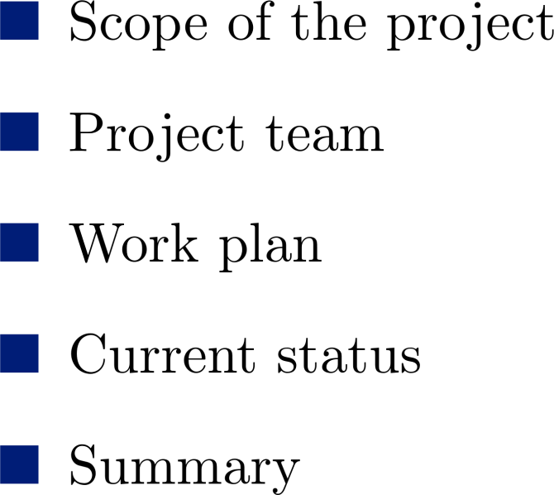
Outline

Slide 3
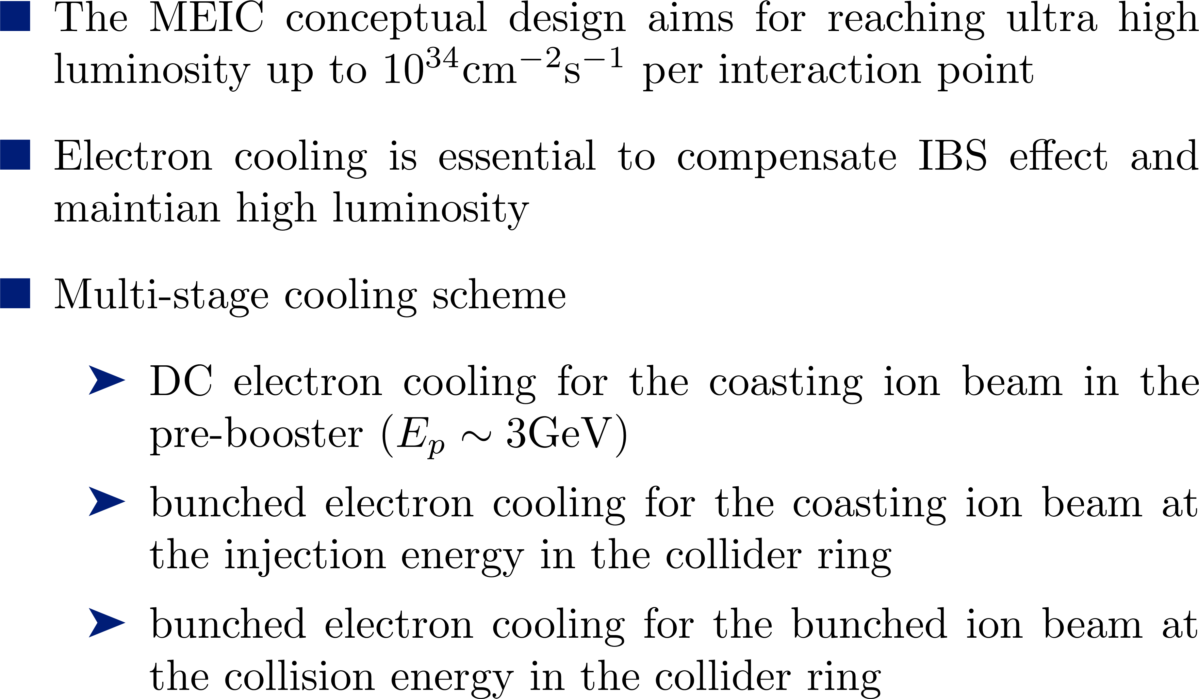
MEIC Cooling Scheme

Slide 4

Cooling Simulation Using BETACOOL
MEIC Cooling Simulation | BETACOOL | Limitations
DC Cooling | 1. RMS method (single particle model, Monte Carlo) 2. Model beam method
Bunched electron cooling for coasting ion beam | 1. RMS method (single particle) | Gaussian distribution for the ion bunch Overestimation of the friction force
Bunched electron cooling for bunched ion beam | 1. RMS method (single particle model, Monte Carlo) 2. Model beam method
Electron bunch evolution during cooling |  | 1. Electron bunch profile does NOT change during cooling
BETACOOL is a serial program.

Slide 5
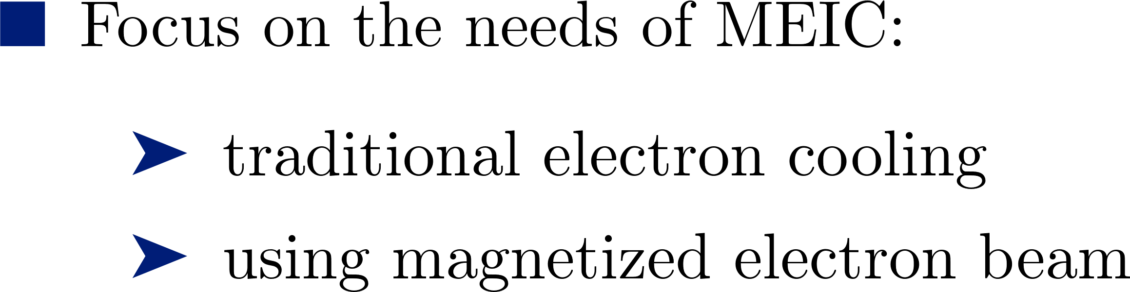
Goals of This Project
IBS | Martini model Core-tail model | Follow BETACOOL
Friction Force | Parkhomchuk formula | Follow BETACOOL
DC Cooling | RMS method Model beam method | Follow BETACOOL
Bunched Cooling | RMS method Model beam method | Improve BETACOOL model

Slide 6
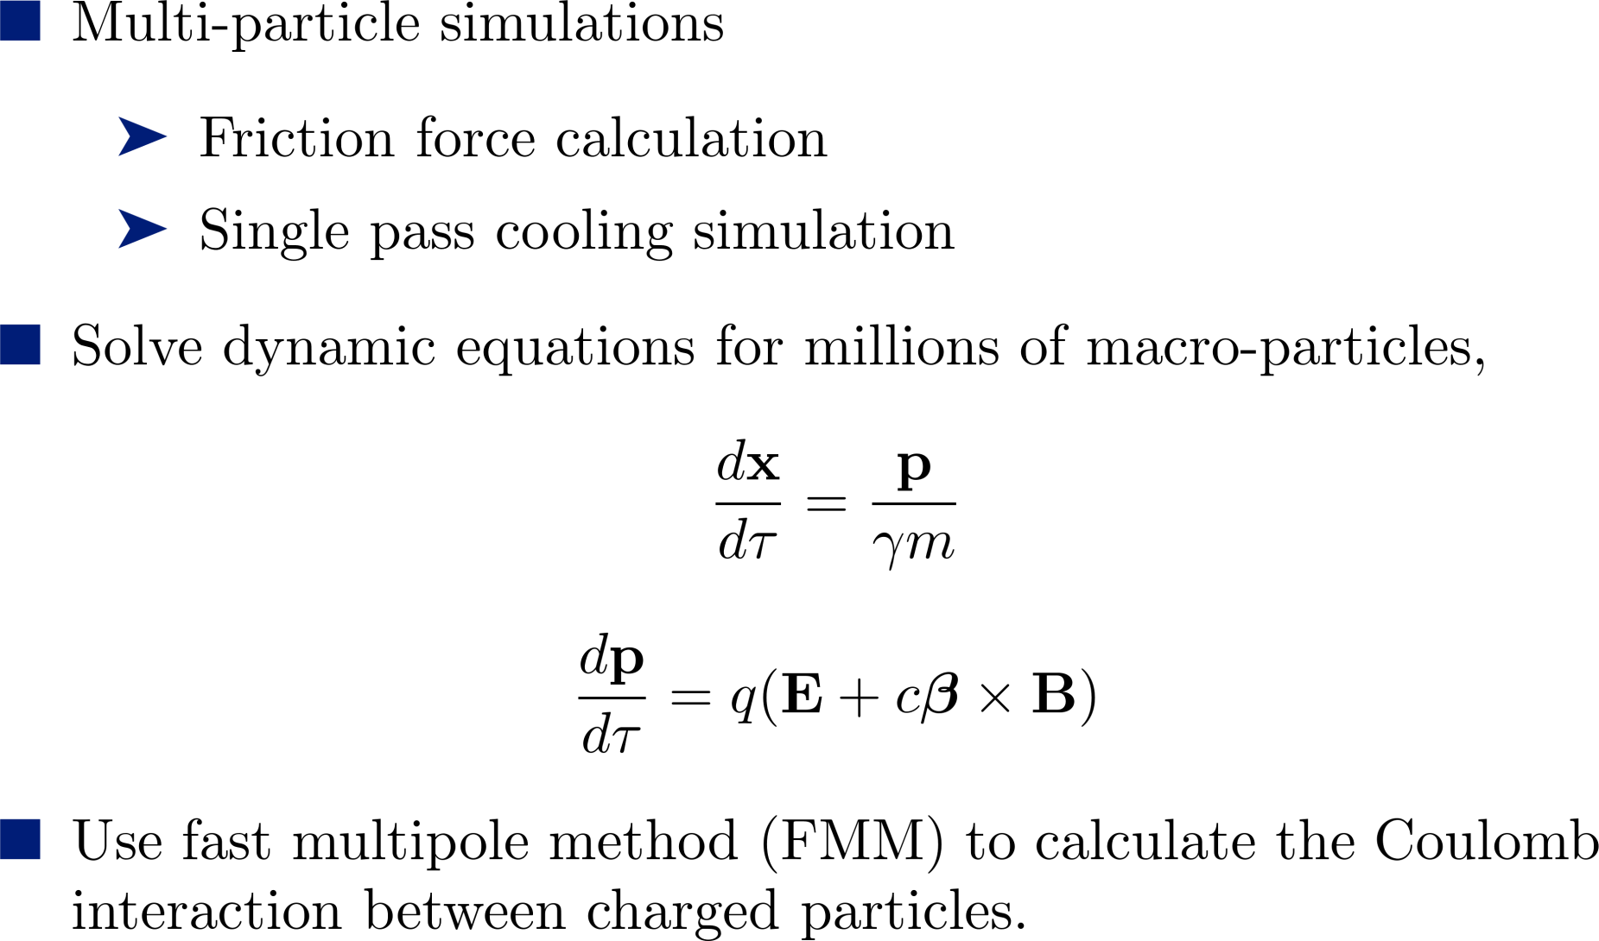
Goals of This Project

Slide 7
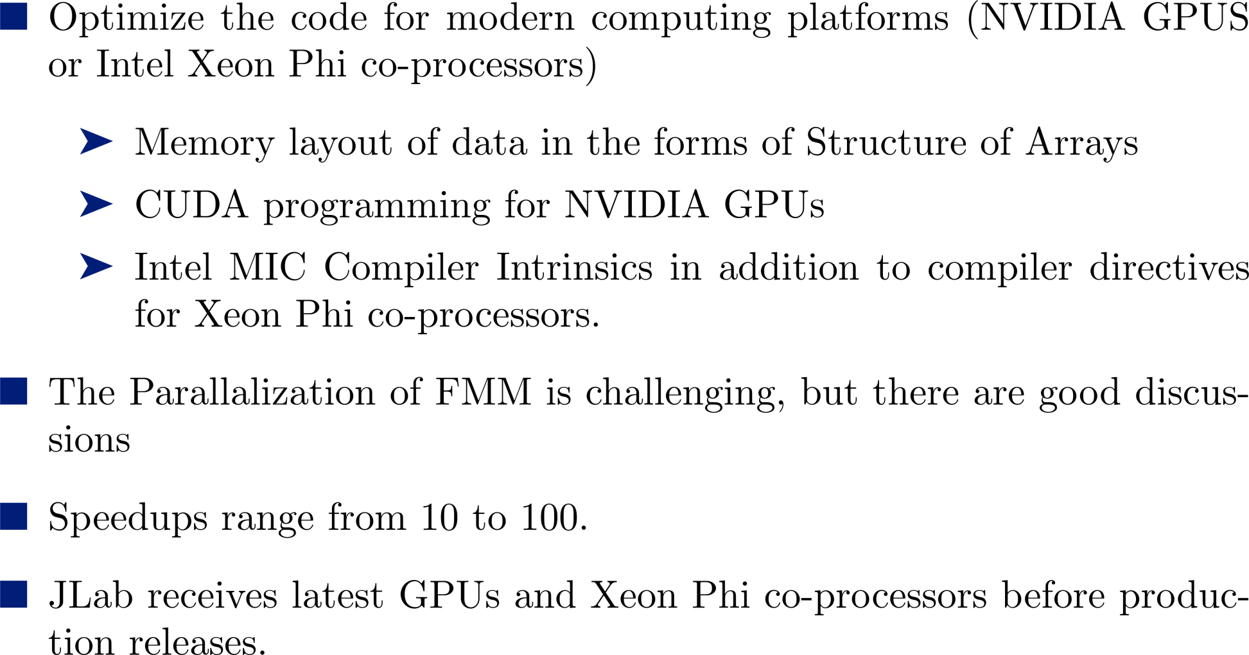
High Efficiency Parallel Program

Slide 8
Team
Name | Organization | Responsibility | Time (/year)
He Zhang | Staff Scientist, JLab | Electron cooling code development | 6 months
He Huang (River) | Visiting Scientist, ODU | FMM code development | <7 months
Rui Li | Staff Scientist, JLab | Support of physics | 1 months
Jie Chen | Staff Scientist, JLab | Support of high performance computation | 1 months
Li-shi Luo | Professor, ODU | Support of Algorithm design & optimization | < 1 months

Slide 9
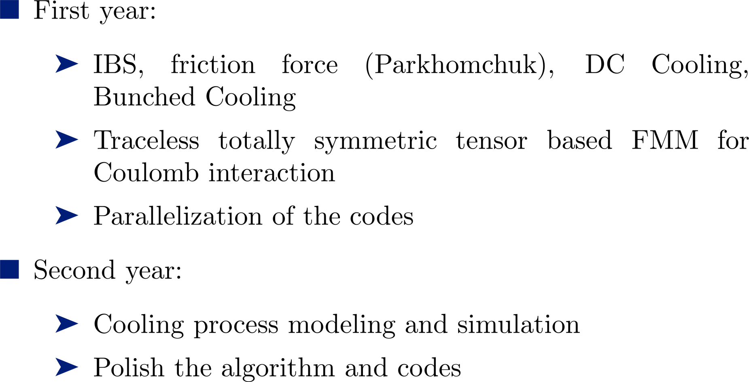
Work plan

Slide 10
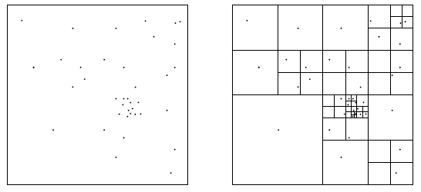
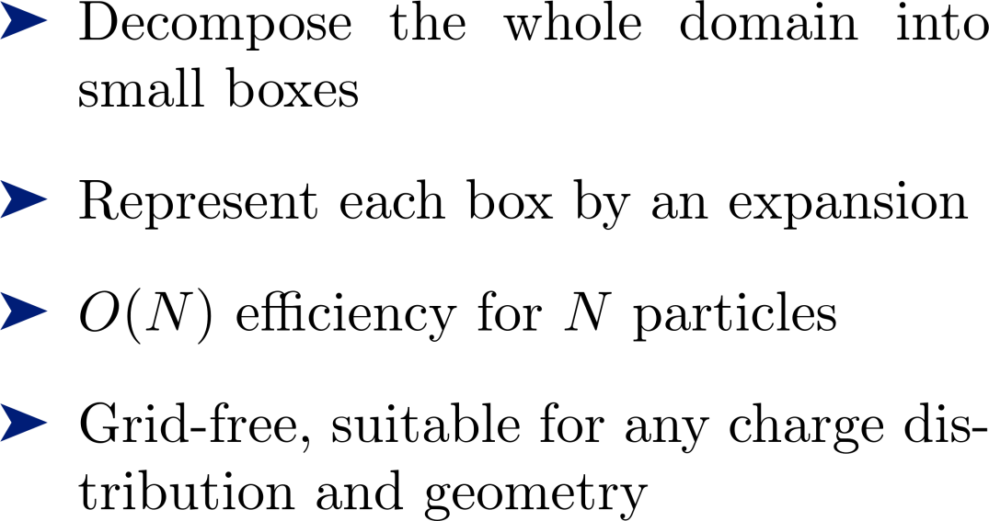
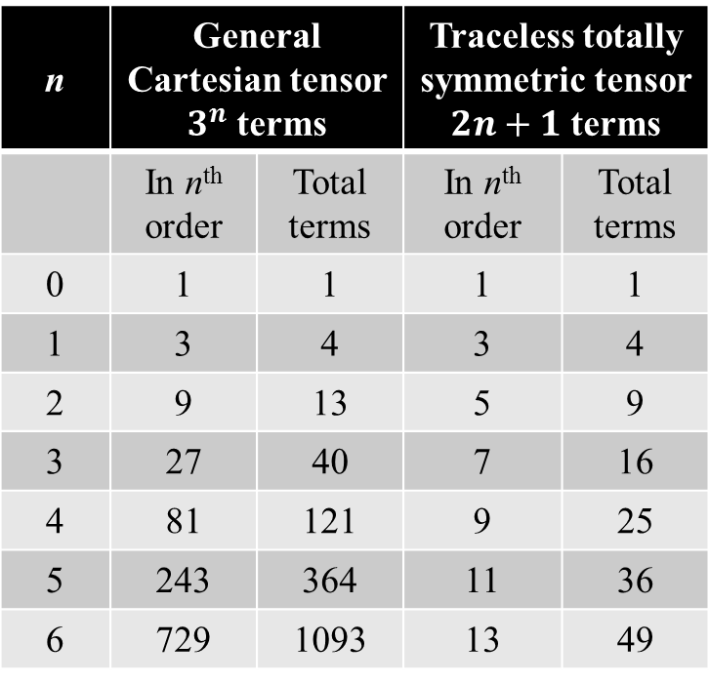
Current Status
n | General Cartesian tensor $3^{n}$ terms |  | Traceless totally symmetric tensor $2n+1$ terms
 | In n^{th} order | Total terms | In n^{th} order | Total terms
0 | 1 | 1 | 1 | 1
1 | 3 | 4 | 3 | 4
2 | 9 | 13 | 5 | 9
3 | 27 | 40 | 7 | 16
4 | 81 | 121 | 9 | 25
5 | 243 | 364 | 11 | 36
6 | 729 | 1093 | 13 | 49

Slide 11
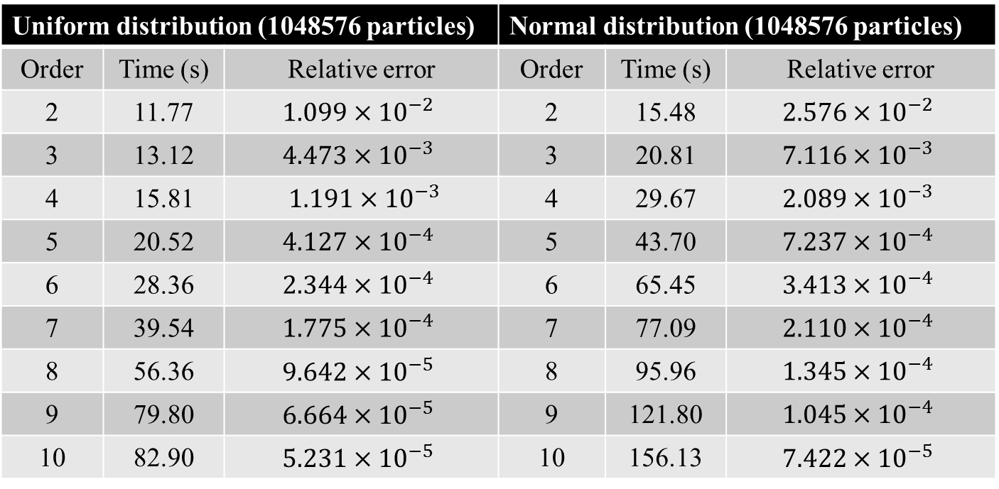
Current Status
Uniform distribution (1048576 particles) |  |  | Normal distribution (1048576 particles)
Order | Time (s) | Relative error | Order | Time (s) | Relative error
2 | 11.77 | $$1.099×{10}^{−2}$$ | 2 | 15.48 | $$2.576×{10}^{−2}$$
3 | 13.12 | $$4.473×{10}^{−3}$$ | 3 | 20.81 | $$7.116×{10}^{−3}$$
4 | 15.81 | $1.191×{10}^{−3}$ | 4 | 29.67 | $$2.089×{10}^{−3}$$
5 | 20.52 | $$4.127×{10}^{−4}$$ | 5 | 43.70 | $$7.237×{10}^{−4}$$
6 | 28.36 | $$2.344×{10}^{−4}$$ | 6 | 65.45 | $$3.413×{10}^{−4}$$
7 | 39.54 | $$1.775×{10}^{−4}$$ | 7 | 77.09 | $$2.110×{10}^{−4}$$
8 | 56.36 | $$9.642×{10}^{−5}$$ | 8 | 95.96 | $$1.345×{10}^{−4}$$
9 | 79.80 | $$6.664×{10}^{−5}$$ | 9 | 121.80 | $$1.045×{10}^{−4}$$
10 | 82.90 | $$5.231×{10}^{−5}$$ | 10 | 156.13 | $$7.422×{10}^{−5}$$

Slide 12
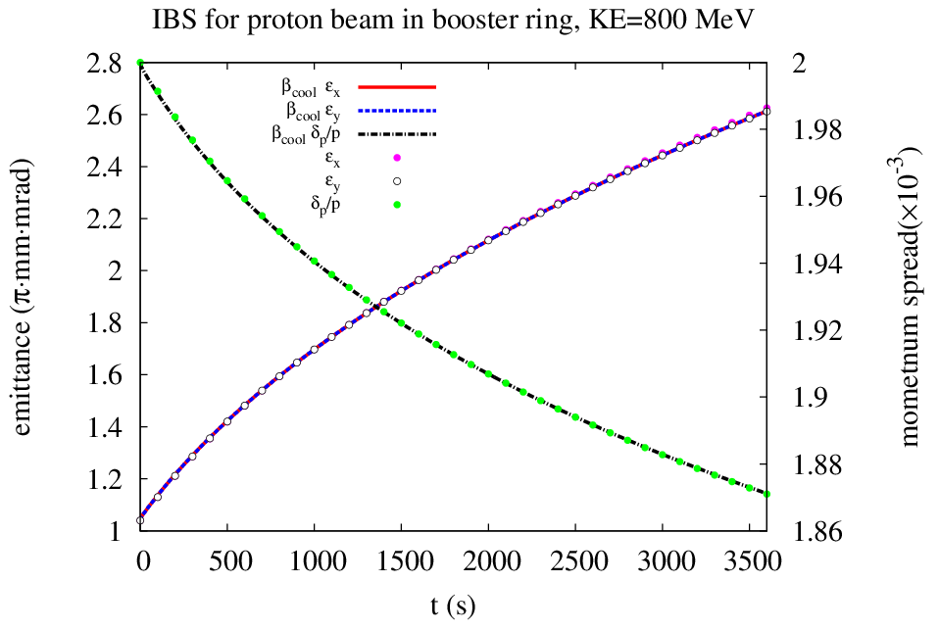
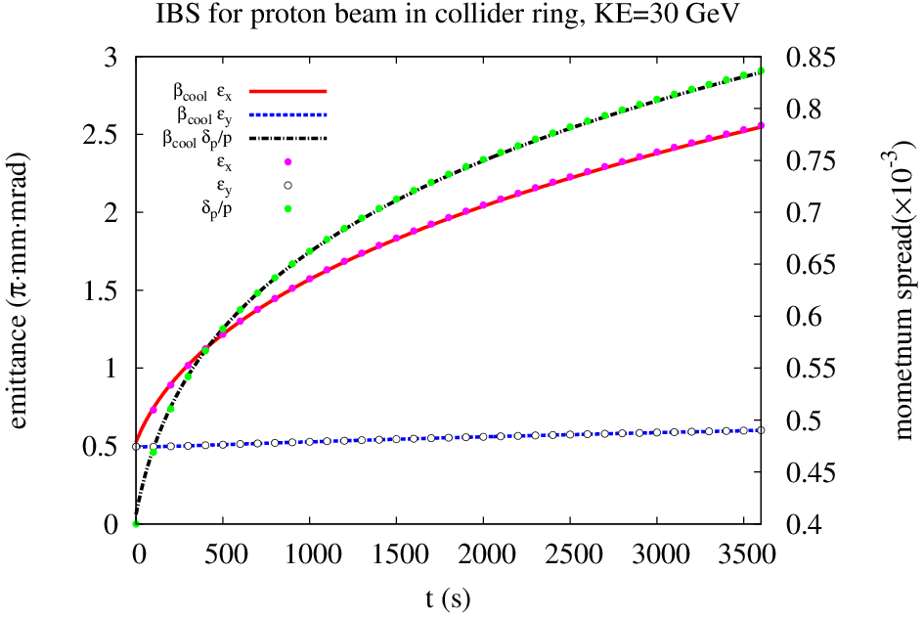
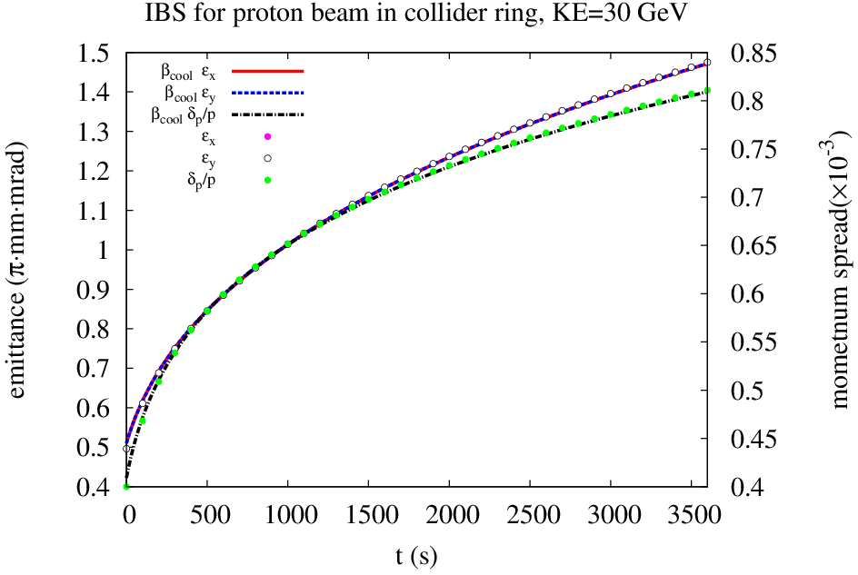
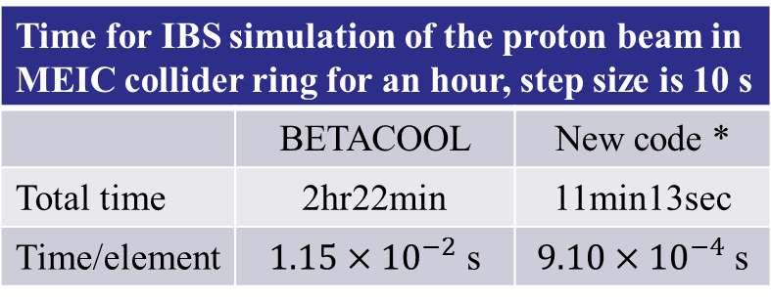
Current Status
Time for IBS simulation of the proton beam in MEIC collider ring for an hour, step size is 10 s
 | BETACOOL | New code *
Total time | 2hr22min | 11min13sec
Time/element | $1.15×{10}^{−2}$ s | $9.10×{10}^{−4}$ s
* Hasn’t been parallelized.

Slide 13
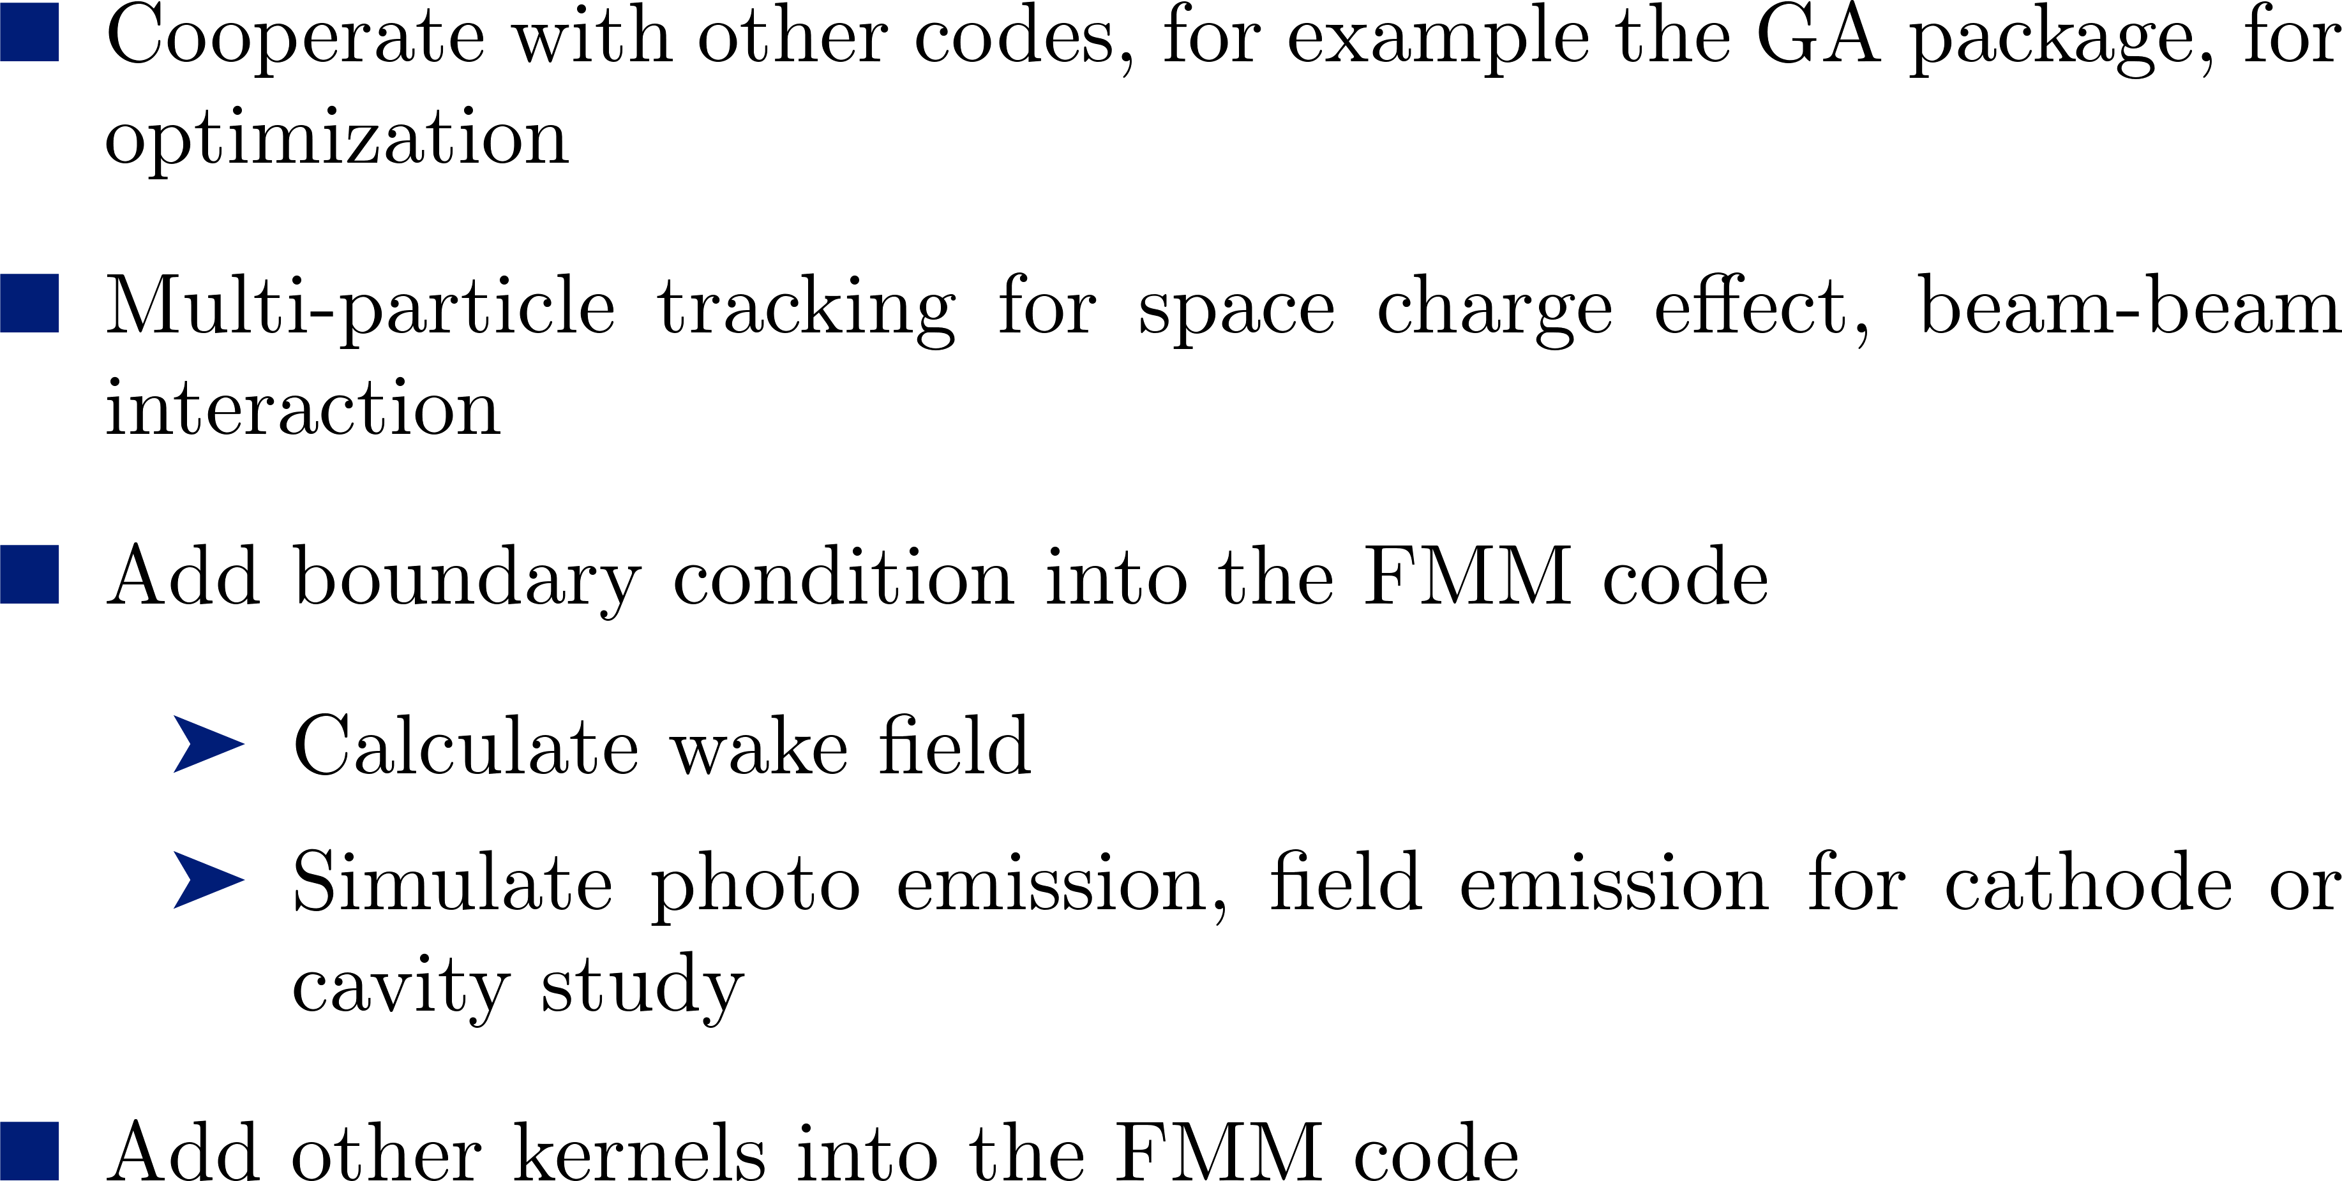
A Little Bit Out of the Scope

Slide 14
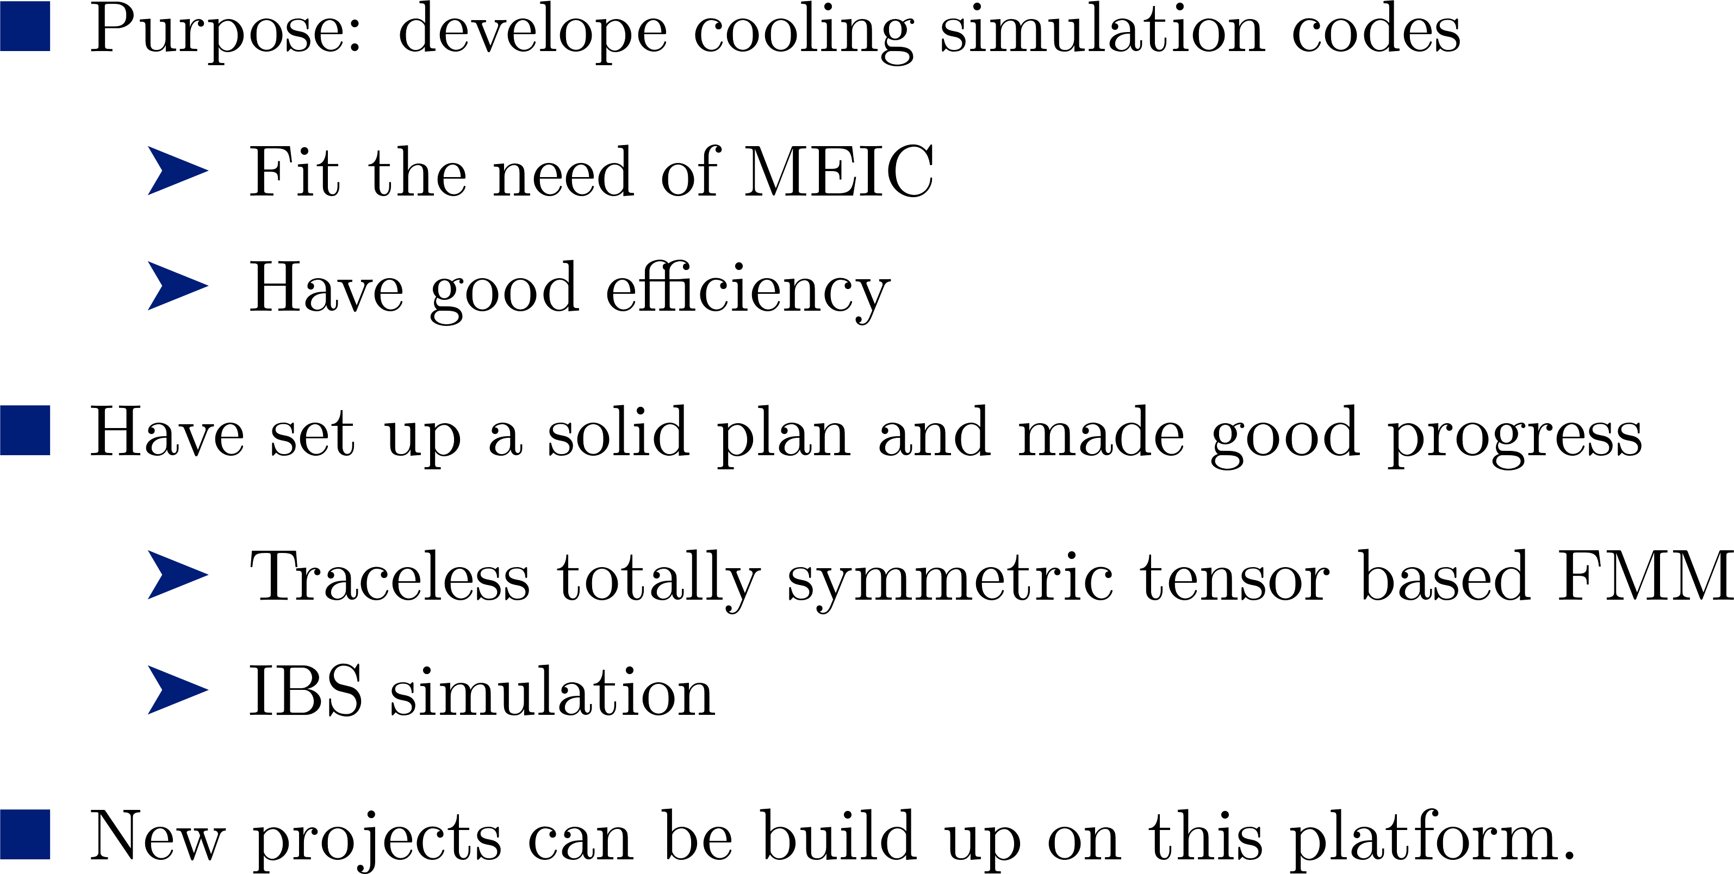
Summary

Slide 15


