Slide 1
C50-12 and C75-1 FY16 Budget for SRF Ops Scope
T. Reilly
31AUG2015

Slide 2
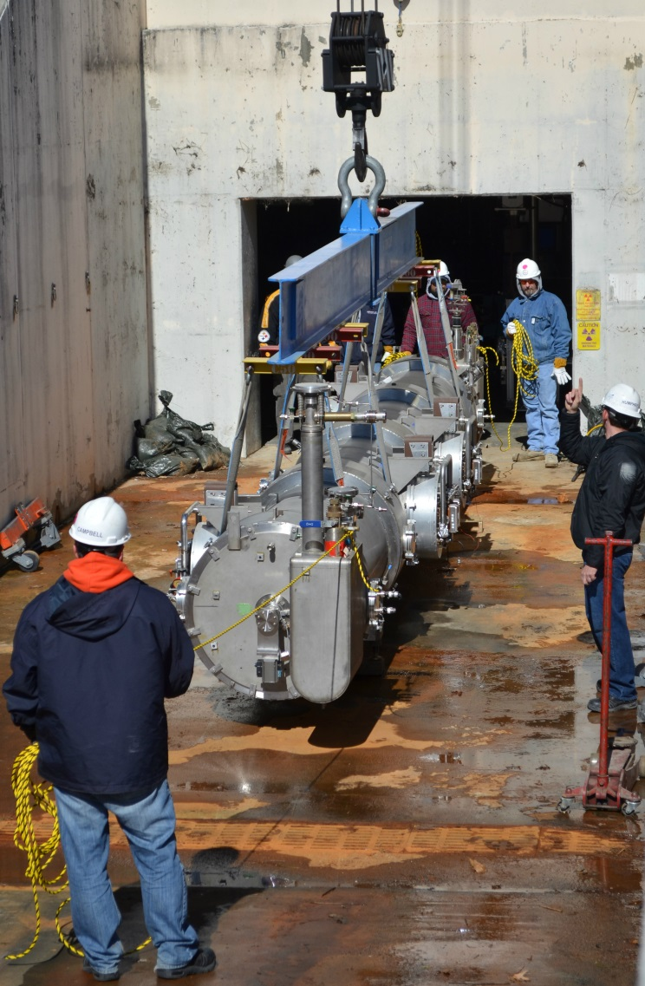
C50-12 Rebuild
General
Rebuild FEL02 (older C20)
Reuse most major components
Cavities, HOM loads, gate valves, etc.
  Cavities will receive light EP
  Cavity recipe is same as used for C50-11
Leverage Qo improvements as proven
FY15 Scope
Baseline test
Disassemble cryomodule
Buyout primary procurements
FY16 Scope
Qualify cavity pairs
Cryo unit assembly
Cryomodule assembly
Cryomodule acceptance test
Cryomodule install and commission

Slide 3
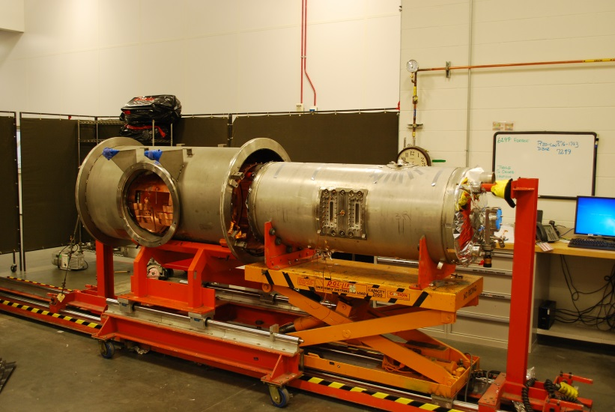
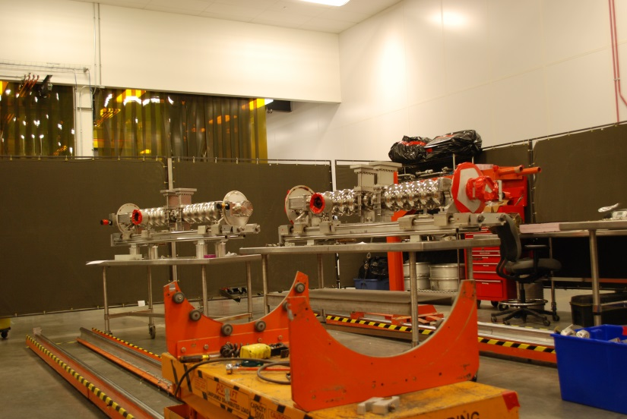
C50-12 Status
Cryomodule
Baseline test is done
Disassembly is done
HOM cans are built
Rotary feed-throughs are being worked
Helium vessels have been prep’d
All primary procurements have been made with exception of $10K
Cavity Pairs
One pair is completely disassembled
Second pair is partially disassembled
Dog legs and windows have been fabricated

Slide 4
FY16 C50-12 Plans
Scope | FY16 AWP Plan ($K) | FTE | Non-labor Direct Cost ($K)
Remove CM from Linac | $ - | 0.0 | $ -
Baseline test CM in Cave | $ - | 0.0 | $ -
Disassemble CM in Test Lab | $ - | 0.0 | $ -
Rework Cavity Pairs | $ 295 | 3.1 | $ 25
Windows and Dog Legs | $ 25 | 0.2 | $ 20
Assemble CM in Test Lab | $ 326 | 3.6 | $ 25
Conduct Acceptance Test in Cave | $ 45 | 0.4 | $ 10
Install and Commission in Linac | $ 35 | 0.3 | $ 5
Quality Control (Done by QA group) | $ 40 | 0.4 | $ -
Estimated total direct cost | $ 766 |  | $ 85
Approximate number of FTEs |  | 8.0

Slide 5
FY16 C75-1 Plans
SRF Operation only (no R&D)
Scope | Labor Estimate Direct Cost ($K) | FTE | Non-labor Direct Cost in ($K)
Remove CM from Linac | $ 15 | 0.15 | $ -
Baseline test CM in Cave | $ 45 | 0.4 | $ 10
Disassemble CM in Test Lab | $ 55 | 0.7 | $ -
Long Lead Procurements |  |  | $ 200
Estimated total direct cost | $ 115 |  | $ 210
 |  | 1.3

Slide 6
High Level SRF Production Plan
For Planning Only
DRAFT

Slide 7
Summary
C50-12
FY16 C50-12 scope is to complete the refurbishment, test, install and commission in late summer 2016
C50-12 AWP first draft are done
  $851K direct and 8 FTE
Does not include any R&D
C75-1
C75-1 SRF Operations scope is to remove from tunnel, baseline test, and disassemble. Suggest adding procurement of long lead items
C75-1 AWPS are not in place to populate.
FY16 Estimate: $115K labor, $210K non-labor both in direct $ and 1.3 FTE
Does not include any R&D

