Slide 1
0L04 Microphonics Test
R100 in SL vs 0L04 slot
0L04 trip investigation
Stepper vs detuning
He pressure ?
4 kHz instability vs control gain
T. Plawski

Slide 2
R100/C100- SL tunnel ( 2011)
Cavity # | R100 rms detuning [Hz] | C100 rms detuning [Hz]
1 | 1.9 | 1.6
2 | NA | 2.3
3 | NA | 4.4
4 | 4.6 | 4.3
5 | 6.7 | 6.7
6 | 4.4 | 6.1
7 | 4.8 | 1.6
8 | NA | 1.6

Slide 3
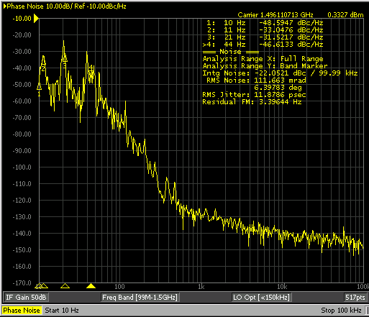
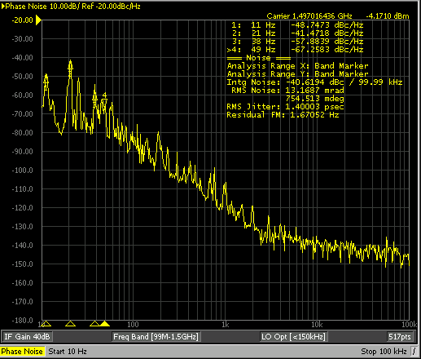
R100-SL (05/26/2011)
Tone mode
R100-Injector (10/17/2014)
GDR mode

Slide 4
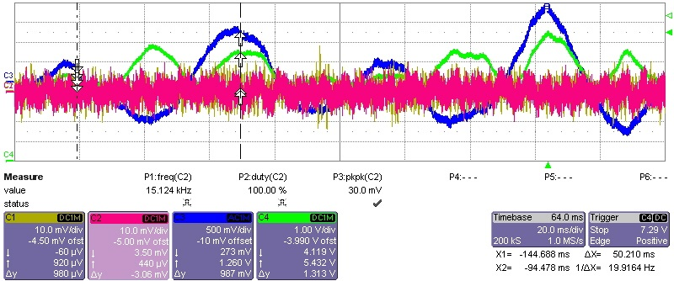
R100-Injector (10/17/2014)
Signals from accelerometer
Detuning 18°/div
Forward power
Typical detuning pattern ( every 10-20 minutes)
frequency ( mechanical modes) 11/21 Hz
detuning ~ 36 deg,
forward power rises 50 %

Slide 5
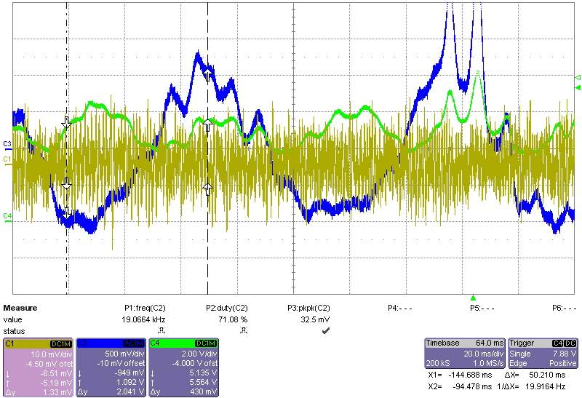
R100-Injector (10/17/2014)
Signal from
accelerometer
Detuning 18°/div
Forward power
Near trip event (1 hr - 3 hr)
frequency ( mechanical modes) 11/21 Hz
detuning ~ 47 deg,
forward power rises >100 %

Slide 6
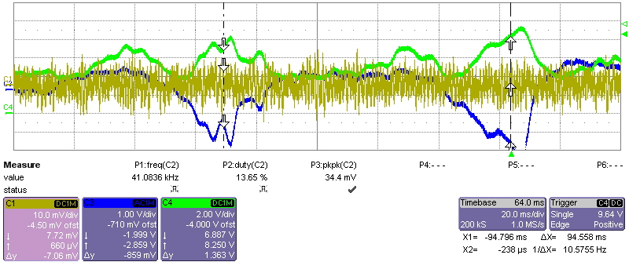
R100-Injector (10/17/2014)
Signal from
accelerometer
Detuning 18°/div
Forward power
Near trip event (1 hr - 3 hr)
frequency ( mechanical modes) 11/21 Hz
detuning ~ 50 deg,
forward power rises >130 %

Slide 7
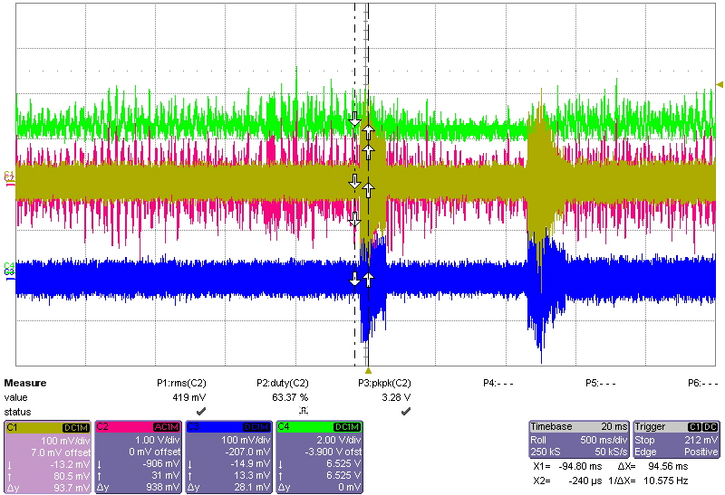
R100-Injector (10/23/2014)
Signal from
accelerometer
Detuning 18°/div
Forward power
Triggered on mechanical vibration
Accelerometer installed on the top of stepper motor – cav 7

Slide 8
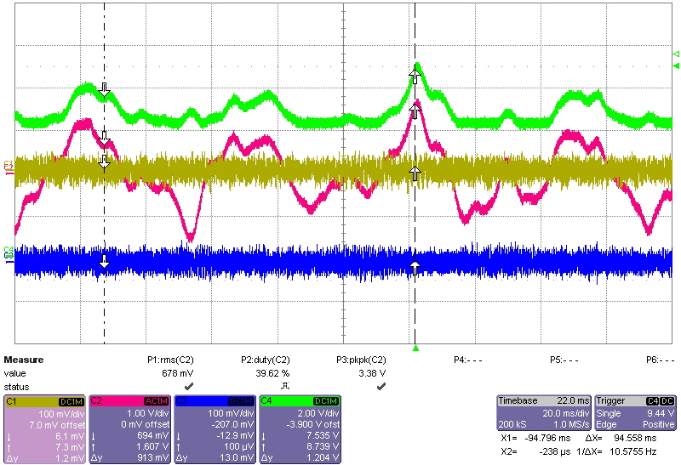
R100-Injector (10/24/2014)
Signal from
accelerometer
Detuning 18°/div
Forward power
Triggered on forward power

Slide 9
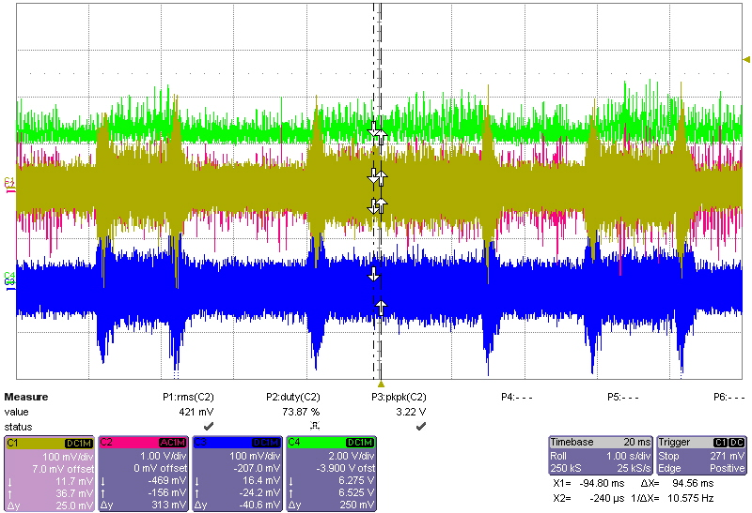
R100-Injector (10/24/2014)
Auto run
Signal from
accelerometer
Detuning 18°/div
Forward power

Slide 10
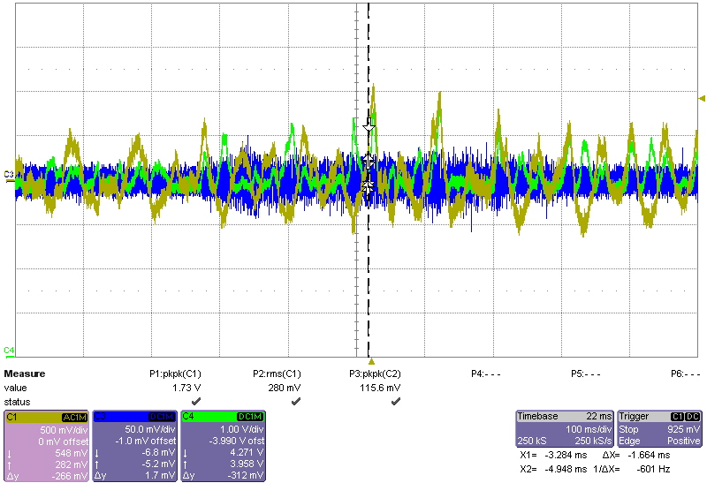
0L04 cav7 – accelerometer He U-tube (10/31/2014)
Detuning
Forward power
rms detuning 5 deg ( 2.5 Hz)
pk-pk detuning 31 deg (18 Hz)
!

Slide 11
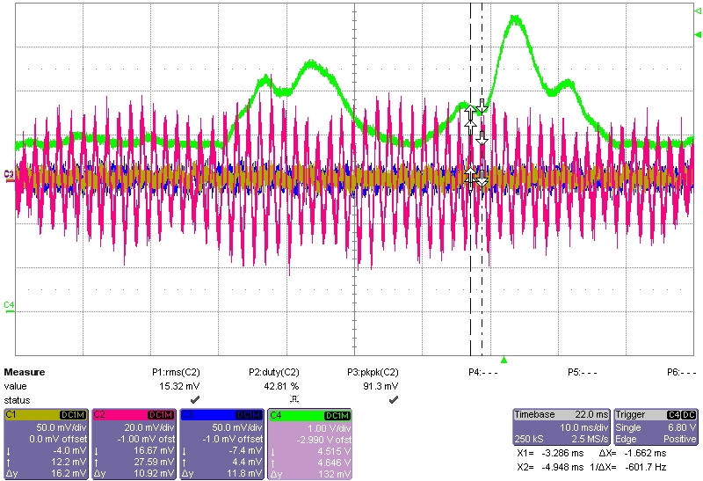
0L04 cav7 – accelerometer He U-tube (10/31/2014)
Signal from
accelerometer
Forward power
Forward power vs He tube accelerometer)

Slide 12
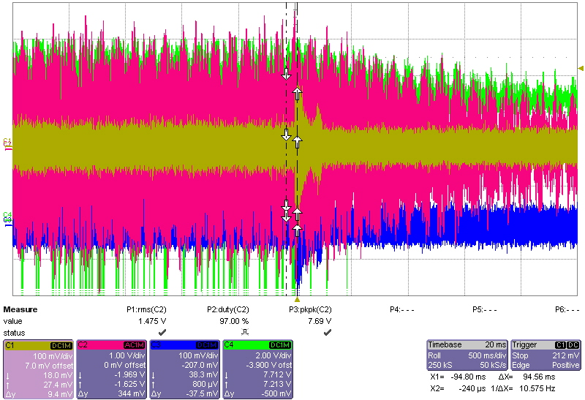
R100-Injector (10/24/2014)
Signal from
accelerometer
Detuning 18°/div
Forward power
4 kHz instabilities ( mitigate by gain change/reduction)

Slide 13
Conclusions
R100 in 0L04 slot acts similar to when in SL location
I did not find any particular source of mechanical vibration
Accelerometer measurements were not correlated with strong detuning events
Helium supply line may required more investigation (accelerometer positioning)
4 kHz instability known from linac LLRF systems has been measured and alleviated ( later, same procedure has been applied for all C100 LLRF)

