Slide 1
Development of Electron Cooling Simulation Program
He Zhang
Center for Advanced Studies of Accelerators (CASA), Jefferson Lab

Slide 2
Outline
IBS calculation
Friction force calculation
Electron cooling rate calculation
Special treatment for bunched electron cooling on coasting ion beam
Electron cooling dynamic simulation
Benchmark

Slide 3
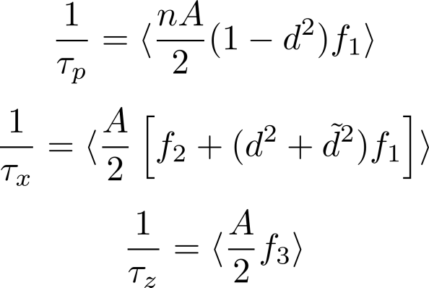
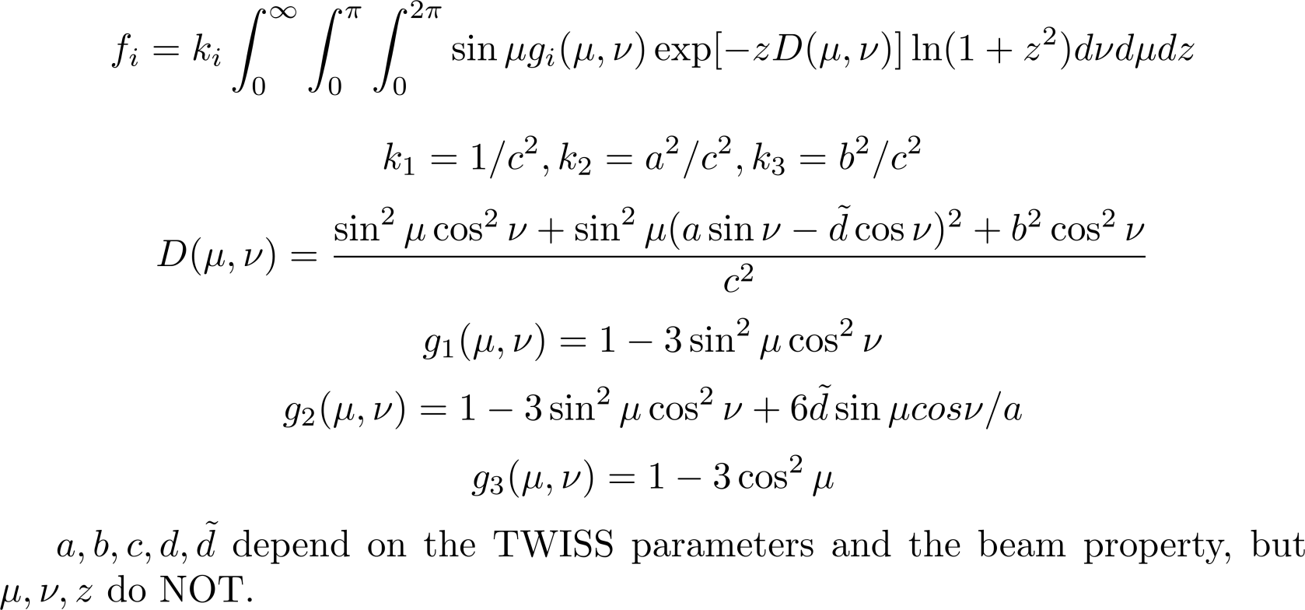
IBS Calculation
Martini model (No vertical dispersion, Transverse Gaussian distribution)

Slide 4
IBS Calculation
Efficient calculation of the IBS expansion rate using Martini model
Calculate $f_{i}$ and the rates for each element
Take average over the whole ring
In function $f_{i}$, $μ, ν, z$ are the sample points one selects to numerically calculate the integration. They do NOT depend on the TWISS parameters and the beam property.
Significant parts in $g_{1}, g_{2}, g_{3}, D\left(μ,ν\right),$ and $f_{i}$ only depend on $μ, ν$ and $z$. They have the same value for all the elements. So we only need to calculate them once.
It improves the efficiency of the program to avoid the redundant calculation.

Slide 5
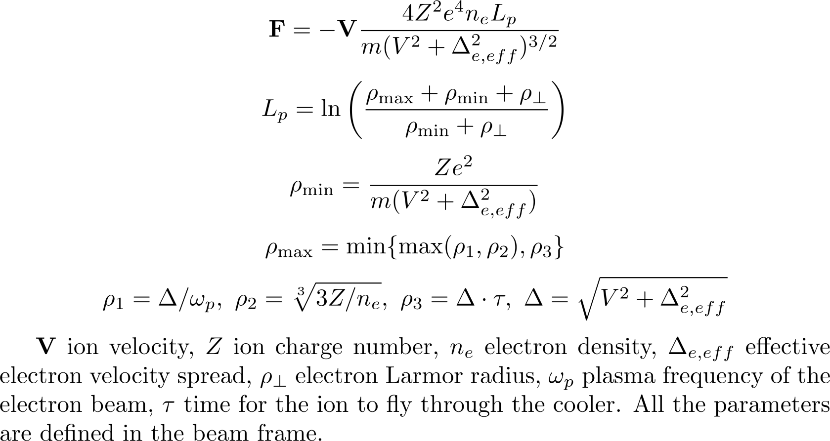
Friction Force Calculation
Friction force calculation for magnetized electron beam
Use Parkhomchuk formula for friction force in magnetized e⁻ beam

Slide 6
Cooling Rate Calculation
Single particle model: sample the ion beam with particles with the same emittance
Transversely:
longitudinally:

Slide 7
Cooling Rate Calculation
Single particle model: sample the ion beam with particles with the same emittance
Sample the ion beam (as in the previous page)
Calculate the electron charge density around each ion
Convert into beam frame
Calculate the friction force on each ion
Convert back to lab frame
Each ion feels a kick as $dp=F⋅dt$.
Calculate the new dynamic invariant $I$ and thus the emittance for each ion (as in the previous page) and take average on all of them.
$\frac{1}{τ}=\frac{ε_{new}}{ε_{old}}−1$

Slide 8
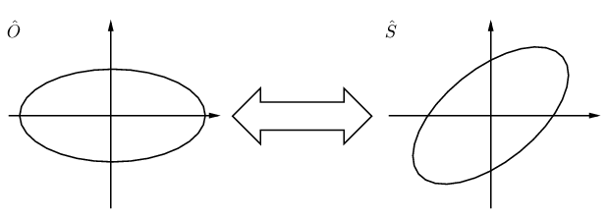
Cooling Rate Calculation
Monte Carlo model : sample the ion beam with particles of Gaussian distribution
Transversely:
From the TWISS parameters at the cooler ${\left(α,β,γ\right)}_{\hat{S}}$, derive ${\left(β,γ\right)}_{\hat{O}}$ with $α_{\hat{O}}=0$.
Generate random numbers $x_{β}$ and ${x′}_{β}$ of Gaussian distribution. $σ_{x_{β}}=\sqrt{εβ_{\hat{O}}}$ and $σ_{x_{β}^{′}}=\sqrt{\frac{ε}{β_{\hat{o}}}}$.
Transfer $x_{β}$ and ${x′}_{β}$ back to $\hat{S}$.
With dispersion: $x=x_{β}+Dδ$, $x^{′}=x_{ β}^{′}+D^{′}δ$
Longitudinally:
Gaussian random $δ$, $s−s_{0}=0$ for coasting beam
Gaussian random $δ$ and $s−s_{0}$ for bunched beam

Slide 9
Cooling Rate Calculation
Monte Carlo model : sample the ion beam with particles of Gaussian distribution
Sample the ions as described in the previous page
Calculate the electron charge density around each ion
Convert into beam frame
Calculate the friction force on each ion
Convert back to lab frame
Each ion feels a kick as $dp=F⋅dt$.
Emittace is calculated statistically as
$\frac{1}{τ}=\frac{ε_{new}}{ε_{old}}−1$

Slide 10
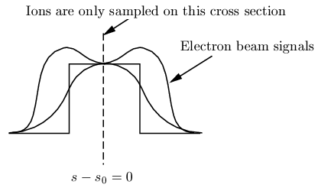
Special Treatment for Bunched to Coasting Cooling
How to sample the coasting beam in the longitudinal direction
Sample the ions in the center plate $s−s_{0}=0$ (Single particle model in BETACOOL)
Ions only see a piece of the
electron beam
Do not include the effect of the
profile of the electron beam
Sample the ions along the ring (MC model in BETACOOL)
Electron beam length << the circumference of the ring
Moderate number of ion samples,
e- bunch CANNOT catch any ion.
Too many ion samples means
a lot of redundant calculation.

Slide 11
Special Treatment for Bunched to Coasting Cooling
How to sample the coasting beam in the longitudinal direction
Only sample the ions that interact with one electron bunch
Calculate the cooling rate in the sampled region
Adjust the cooling rate w.r.t. the duty factor $D=L_{sample}/L_{distance}$
$\frac{1}{τ_{cool}}=\frac{1}{τ_{sample}}⋅D$
Random (uniform distribution) longitudinal position in the sample area.
Avoid redundant calculation
Take account the electron bunch profile

Slide 12
Special Treatment for Bunched to Coasting Cooling
We treat the bunched electron cooling as an average effect on the coasting ion beam. Is it valid?
If there is a particle that is always cooled in each circle, the longitudinal displacement of this particle during the cooling time is less than the cooler length:
$v\frac{dp}{p} T≤L_{cooler}$
velocity of the particle v - $3×{10}^{6}\sim 3×{10}^{8}$ m/s
cooling time T - $10 \sim 100$ s
cooler length L_{cooler} - $60$ m
momentum spread of the particle dp/p - $2×{10}^{−6}\sim 2×{10}^{−9}$
In practice, dp/p is about ${10}^{−5}\sim {10}^{−6}$.
Diffusion is much stronger than the weak bunching effect of electron cooling

Slide 13
Cooling Dynamic Simulation
RMS dynamic
In each time step
Sample the ions (single particle or Monte Carlo) w.r.t the given emittance
Calculate IBS rate $\frac{1}{τ_{IBS}}$
Calculate electron cooling rate $\frac{1}{τ_{ecool}}$
Total rate $\frac{1}{τ}=\frac{1}{τ_{IBS}}+\frac{1}{τ_{ecool}}$
$ε_{new}=ε_{old}⋅e^{dt/τ}$
Repeat till the end.
Ions are sampled at each time step, which means the Gaussian distribution is always assumed.

Slide 14
Cooling Dynamic Simulation
Model beam
Sample the ions (according to its initial distribution)
For each time step
Calculate the IBS effect, and apply the IBS kick on each particle as
$〈θ^{2}〉=\frac{ε}{β_{⊥}}\frac{dt}{τ_{IBS}}$, $Δθ=\sqrt{〈θ^{2}〉}⋅ξ$, Gaussian random number $ξ, σ_{ξ}=1$
Calculate the Friction force on each particle, and apply the kick as
$dp=F⋅dt$
Apply a random phase advance on each particle
Repeat the above step till the end
The ions are sampled only once at the beginning.
Can simulate the change of ion distribution during cooling.

Slide 15
Bunched to Coasting Cooling in Model Beam
Problem:
as discussed the bunched electron cooling is an average effect on the coasting ion beam. But in model beam dynamic simulation, each ion feels different friction force. Ions are not re-sampled, hence the cooling effect is not averaged.
Solution:
Sample the ions as groups. In each group, all the ions have the same transverse coordinate and momentum spread, but different longitudinal positions.
Calculate the average friction force on each group and apply the same kick to particles in the same group.
Apply the same IBS kick on the particles in the same group too.
Apply the same phase advance on the particles in the same group.

Slide 16
Benchmark
DC Cooling on coasting ion beam

Slide 17
Benchmark
Bunched Cooling on bunched ion beam

Slide 18
Benchmark
Bunched Cooling on coasting ion beam

